Slide 1
Request for
Snow Cover EDR Beta Maturity
DR # 7132
CCR # 474-CCR-13-0945
DRAT discussion: April 19, 2013
AERB presentation: April 24, 2013
Cryosphere Products Validation Team
Jeff Key, NOAA/NESDIS/STAR, Team Lead
Paul Meade, Cryosphere Products JAM

Slide 2
Outline
Snow Cover EDR Users
Beta EDR Maturity Definition
Summary of Snow Cover EDR
Snow Cover EDR requirements
History of Algorithm Changes/Updates
Beta Maturity Evaluation
Beta Justification Summary
Caveats of Operational Snow Cover EDR
Additional Supporting Documentation
Future Plans Toward Provisional Status
Conclusions

Slide 3
Snow Cover EDR Product Users
  U.S. Users
    NOHRSC - National Operational Hydrological Remote Sensing Center
    NSIDC, National Snow Ice Data Center
    NIC, National/Naval Ice Center
    OSPO, Office of Satellite and Product Operations
    STAR, Center for Satellite Applications and Research
    GSFC, NASA/Goddard Space Flight Center Hydrological Sciences Branch
    NWS, National Weather Service, including the Alaska Ice Desk
    CLASS, Comprehensive Large Array-data Stewardship System
  User Community
    Transportation
    Agriculture and Hydrology
    Emergency Management
    Operational Weather Prediction
    Climate Research
    DOD

Slide 4
Beta EDR Maturity Definition
Early release product.
Minimally validated.
May still contain significant errors.
Versioning not established until a baseline is determined.
Available to allow users to gain familiarity with data formats and parameters.
Product is not appropriate as the basis for quantitative scientific publication studies and applications.

Slide 5
VIIRS Snow Cover EDR
The VIIRS Snow Cover/Depth Environmental Data Record (EDR) products consist of a snow/no snow binary map and snow fraction in a horizontal cell.
The objective of the VIIRS retrieval is to achieve the performance specifications designed to meet the requirements stated in the JPSS L1RD Supplement.
The specifications apply under clear, daytime conditions only. Surface properties cannot be observed through cloud cover by a Visible/Infrared (VIS/IR) sensor.
The specification for the Snow Cover/Depth EDR places requirements on the VIIRS binary map product and the VIIRS snow fraction product.

Slide 6
Specification of the VIIRS Binary Map
Parameter | Specification Value
a. Binary Horizontal Cell Size,
1. Clear – daytime (Worst case) | 0.8 km
2. Clear – daytime (At nadir) | 0.4 km
3. Cloudy and/or nighttime | N/A
b. Horizontal Reporting Interval | Horizontal Cell Size
c. Snow Depth Range | > 0 cm (Any Thickness)
d. Horizontal Coverage | Land
e. Vertical Coverage | > 0 cm
f. Measurement Range | Snow / No snow
g. Probability of Correct Typing | 90%
h. Mapping Uncertainty | 1.5 km
RGB Image shows dense smoke (high absorption) in northwest, north central and central coastal portions of image.
6

Slide 7
Specification of the VIIRS Snow Fraction
Parameter | Specification Value
a. Horizontal Cell Size,
1. Clear – daytime (Worst case) | 1.6 km
2. Clear – daytime (At nadir) | 0.8 km
3. Cloudy and/or nighttime | N/A
b. Horizontal Reporting Interval | Horizontal Cell Size
c. Snow Depth Ranges | > 0 cm (Any Thickness)
d. Horizontal Coverage | Land
e. Vertical Coverage | > 0 cm
f. Measurement Range | 0 – 100% of HCS
g. Measurement Uncertainty | 10% of HCS (Snow/No Snow)
h. Mapping Uncertainty | 1.5 km
RGB Image shows dense smoke (high absorption) in northwest, north central and central coastal portions of image.
7

Slide 8
Summary of the Snow Cover EDR Algorithm Inputs
xDRs & IPs
Output EDRs & IPs
VIIRS 375m SDRs I1, I2, I3, I5
VIIRS 750m SDRs M15, M16
VIIRS 375m TC GEO
VIIRS 750m TC GEO
VIIRS Cloud Mask IP
VIIRS AOT IP
VIIRS COP IP
Snow Cover EDR Algorithm
VIIRS Snow Cover Binary Map EDR
VIIRS Snow Cover Fraction EDR
Auxiliary Data
VIIRS Snow Cover Tunable Parameter File
VIIRS Snow Cover Quality Tunable Parameter
Notes:
Ancillary
GFS forecast surface pressure, lapse rate, and air temperature (for topography corrected surface pressure)
Look-up tables
DEM for surface altitude
Infrared and Microwave OSS coefficients
Local Angle Correction
IR emissivity and reflectivity covariance
MW emissivity covariance
AVTP and AVMP and Ozone covariance

Slide 9
Snow Cover EDR Processing Flow
Load and check SDR Reflectance and Brightness Temperatures
VIIRS 375m SDRs I1, I2, I3, I5
VIIRS 750m SDRs M15, M16
VIIRS 375m TC GEO
VIIRS 750m TC GEO
VIIRS Cloud Mask IP
VIIRS AOT IP
VIIRS COP IP
Initial Pixel Quality Checks
Construct VIIRS Imagery Resolution Snow Binary Map
(NDSI based algorithm)
NDSI = (R_{0.64μm} – R_{1.61μm}) / (R_{0.64μm} + R_{1.61μm}) > 0.4
R_{0.865μm} > 0.11
T_{11.45μm} (TOA brightness temperature) < 281 K
For NDSI between 0.1 and 0.4 NDVI thresholds as a function of NDSI are used:
NDVI = (R_{0.865μm}-R_{0.64μm})/(R_{0.64mm}+R_{0.865μm})
ndvi_lower = a1 + a2*NDSI
ndvi_upper = b1 + b2*NDSI + b₃*NDVI²+ b₄*NDVI³ ( Klein et al., 1998)
Construct EDR Quality Flags
for Snow Binary Map and Snow Fraction Map
Snow
Write Snow Binary Map and Snow Fraction Map Products
Construct VIIRS Moderate Resolution Snow Fraction Map
2x2 aggregation of Snow Binary Map

Slide 10
Snow Cover EDR Algorithm
The VIIRS Snow Cover EDR algorithm is an adaptation of the heritage MODIS SnowMap algorithm (Hall et.al 2001) that classifies snow based upon the Normalized Difference Snow Index (NDSI) and additional reflectance, thermal and NDVI thresholds.
The EDR consists of two products: (1) snow binary map (375 m spatial resolution @nadir) and (2) a snow fraction map (750 m spatial resolution @nadir) that is derived from the binary map as a 2x2 aggregated snow fraction.
The VIIRS algorithm adaptations from that of the MODIS heritage are: (1) use of a TOA brightness temperature for thermal false snow screening instead of a surface temperature and (2) use of the VIIRS imagery resolution 0.645µm (I1) reflectance in the NDSI instead of the 0.555 µm reflectance used by the MODIS algorithm.

Slide 11
History of Algorithm changes/updates (1/2)
Date | Update/DR# | Reason | Completed
12-20-2010 | VIIRS Snow Cover EDR Look-up/DR4138 | Updated false snow thermal screening threshold. Previous threshold value was based on MODIS data. New threshold values has been derived from VIIRS F1 test program results | No indication that the work has been completed
03-31-2011 | Snow algorithm inconsistent with new requirements/DR4246 | Operational approach for snow fraction retrieval is inadequate | Not Completed
04-10-2013 (last update) | Snow EDR has fixed limit setting on solar zenith angle (SZA)/DR4895 | Need to remove the fixed limits on solar zenith angle and make the limits tunable | Not Completed
04-25-2012 | Alternative snow/ice grid needed to support algorithms/DR4700 | Need to modify the Snow/Ice GranToGrid algorithm to make use of the NOAA Global Multisensor Automated Snow/Ice Map | Not Completed

Slide 12
History of Algorithm changes/updates (2/2)
Date | Update/DR# | Reason | Completed
06-18-2012 | VIIRS-SNOW-COVER-QUAL LUT SZA Thresholds/DR4787 | Updates needed to solar zenith angle thresholds in the VIIRS-SNOW-COVER-QUAL LUT and to the seed data for the GridIP-VIIRS-Snow-Ice-Cover-Rolling-Tile dataset | Completed
04-12-2013 | Request for Beta Maturity Status for VIIRS Cryospheres EDRs and Ips/DR7132 | Approval requested for the Snow Cover EDR (a snow / no snow binary map product). | Not Completed

Slide 13
Beta Maturity Evaluation of the Binary Snow Cover Product

Slide 14
Beta Maturity Evaluation Approach, Binary Snow Cover (1/3)
Maturity evaluation approach:
  Visual analysis of the product, identification of obvious failures of the algorithm/product including
    Missed snow in the regions which are known to be always snow covered at the time of the year when observations were made
    Mapped snow in the regions which are known to be always snow-free at the given time of the year
  Comparison of VIIRS Snow Cover EDR with independent in situ and remote sensing-based information on the snow cover distribution including
    In situ snow cover observations
    IMS interactive snow cover analysis
    MODIS Terra/Aqua snow cover maps
    METOP AVHRR snow cover maps

Slide 15
Beta Maturity Evaluation Approach, Binary Snow Cover (2/3)
Details:
  Evaluation has been performed
    Globally for the visual analysis and when comparing with MODIS and AVHRR products
    Over Northern Hemisphere when comparing with IMS
    Over Continental US (CONUS) when comparing to station data
  Time period when comparison has been conducted
    Routine comparison since the beginning of the VIIRS snow product generation
    Maturity assessment is based on the VIIRS snow maps generated in the last four months period (December 2012-March 2013) when no major changes were introduced to the VIIRS cloud mask (VCM)
    VIIRS global snow data were acquired and processed on every third day

Slide 16
Beta Maturity Evaluation Approach, Binary Snow Cover (3/3)
More details:
  Preprocessing of VIIRS snow retrievals
    All daily granules have been processed to generate gridded daily global snow cover map
      1, 5 km and 10 km grid cells size
    Two cloud masks were tested, “conservative” and “relaxed”
      “relaxed” cloud mask included observations identified as “confidently cloudy” and “probably cloudy”
      “conservative cloud mask included observations identified as “confidently cloudy” , “probably cloudy” and “probably clear”

Slide 17
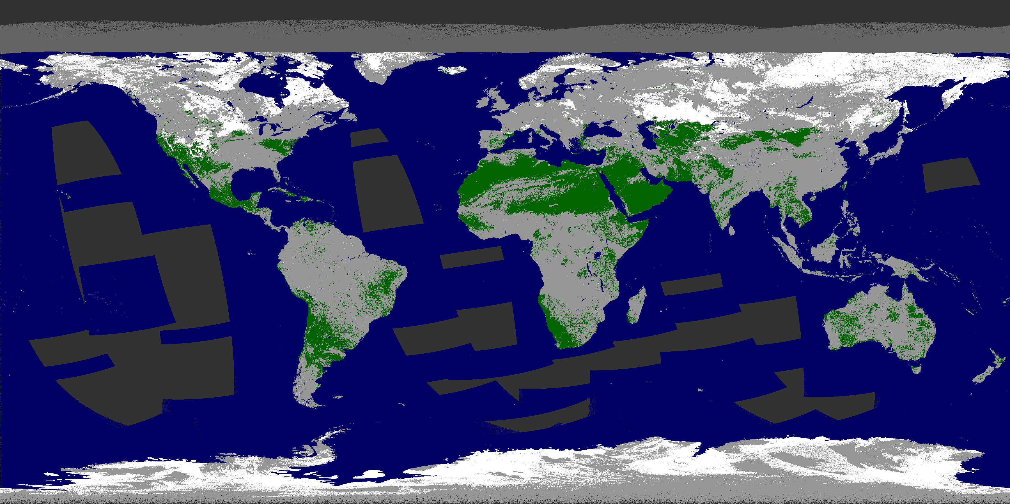
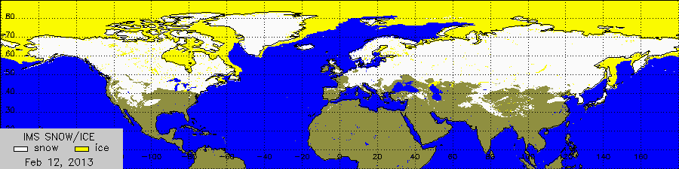
Beta Maturity Evaluation, Qualitative analysis of VIIRS binary snow maps
VIIRS snow map
Qualitative analysis of the VIIRS Binary Snow maps (which are part of the Snow Cover EDR) has shown that this product provides realistic characterization of the global-scale snow cover distribution.
In clear sky portions of the image snow mapped by VIIRS closely corresponds to the snow cover identified interactively by IMS analysts.
snow
land
cloud
No data
IMS Snow and Ice Chart
February 12, 2013

Slide 18
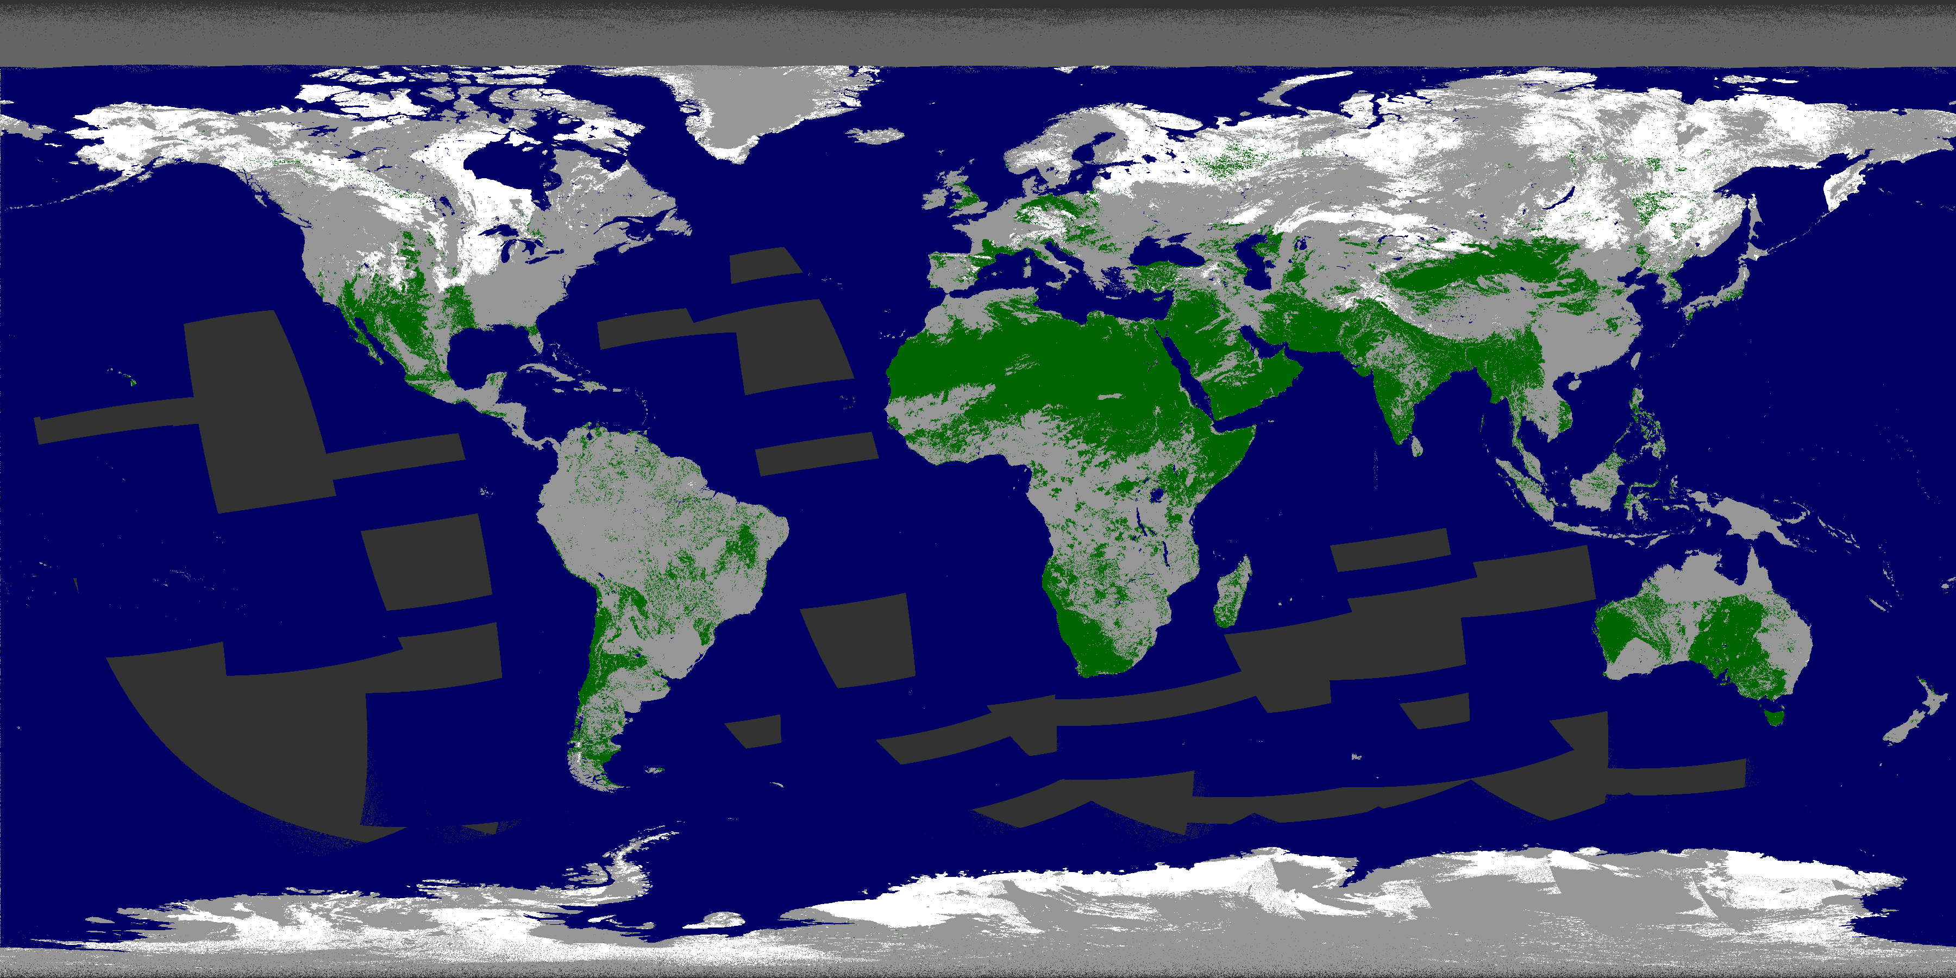
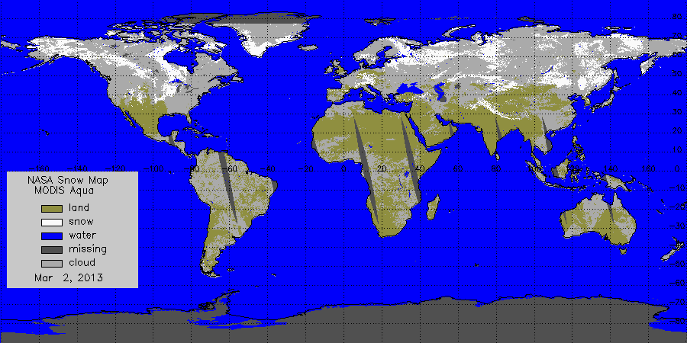
Beta Maturity Evaluation – VIIRS vs MODIS Binary Snow Map
NPP-Suomi VIIRS snow cover map
Visual analysis has shown that VIIRS binary snow maps compare well to MODIS Aqua snow maps. There are some differences in the cloud mask applied in the two products.
No severe overestimates or underestimates of the snow cover have been found in the VIIRS snow product.
MODIS Aqua snow cover map
March 2, 2013 (day 2013061)

Slide 19
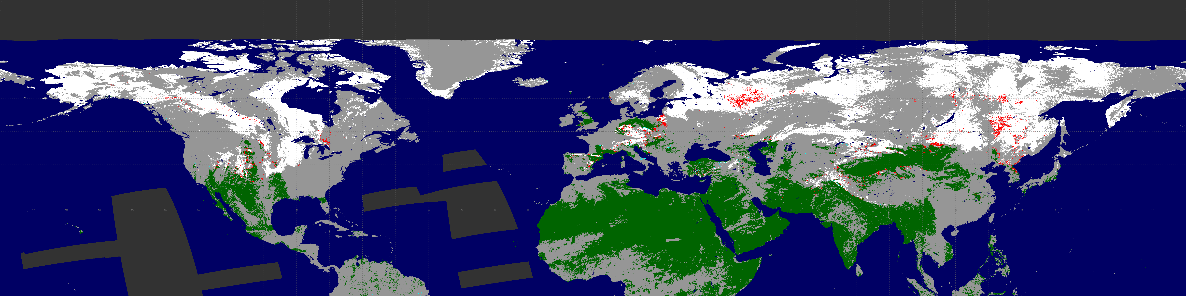
Beta Maturity Evaluation – VIIRS vs IMS Quantitative Comparison
To facilitate the analysis of the VIIRS binary snow product accuracy we have brought VIIRS and IMS snow maps to the same projection and generated an overlay of the two maps.
VIIRS binary snow cover with IMS overlaid (March 2, 2013)
White: VIIRS & IMS snow
Light Gray: VIIRS clouds
Green: VIIRS & IMS snow-free land
Dark gray: not processed, or no data
VIIRS snow map errors:
Omission (snow miss)
Commission (false snow)
The agreement between the two maps on the snow cover distribution calculated in cloud-clear portions of the VIIRS product over the Northern Hemisphere was 98.3%. Omission and commission errors comprised 1.6 and 0.1% respectively. Snow omissions occur mostly over densely forested areas.

Slide 20
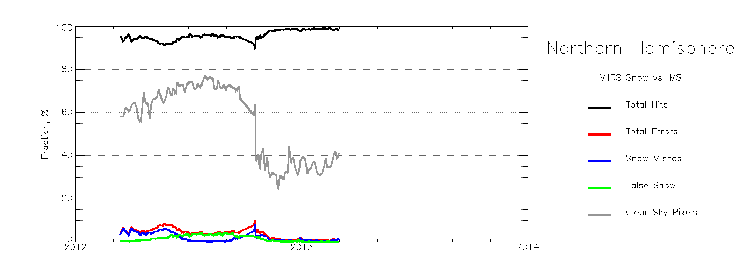
Beta Maturity Evaluation –
VIIRS Binary Snow vs IMS Time Series
Time series of estimates of correspondence between the VIIRS binary snow map and the IMS snow product
VIIRS binary snow map data aggregated within 4 km size grid cells
Each 4 km grid cell was then labeled according to the dominant category of pixels in it
Comparison was performed by matching the two products grid cell by grid cell
“Total hits” include snow-snow and land-land correct classifications
“Total errors” include VIIRS snow misses and VIIRS false snow identifications
The percent of Clear Sky Pixels in the VIIRS product is given for the 25-60⁰ N latitude band
A noticeable drop in the amount of available cloud-clear grid cells in the VIIRS product in October 2012 corresponds to substantial changes the cloud team introduced to the cloud algorithm. Since the end of 2013 the agreement between the two products over Northern Hemisphere remains above 98%.

Slide 21
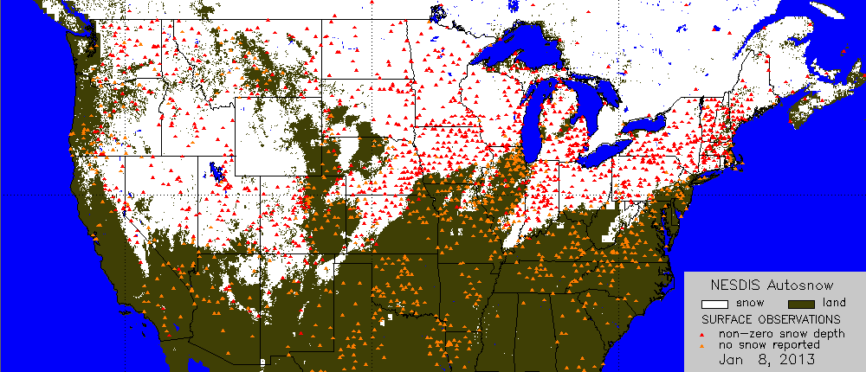
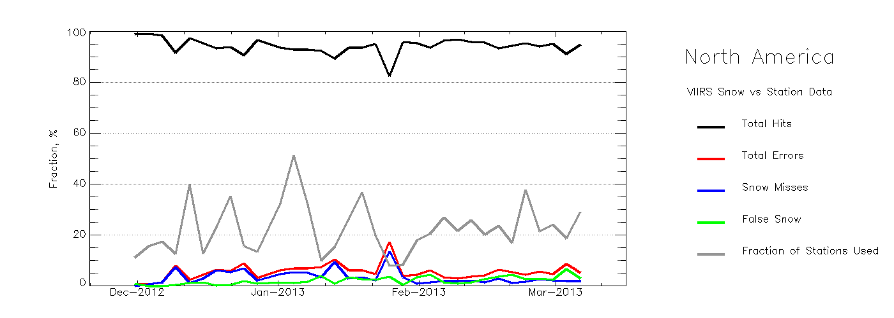
VIIRS Binary Snow Map vs In Situ Snow Observations
Daily statistics of correspondence between VIIRS snow and in situ data.
Location of US Coop Stations
“Total hits” include correct snow-snow and land-land classifications
“Total errors” include VIIRS snow misses and VIIRS false snow identifications
Observations from US Cooperative network stations over Continental US have been used. The number of daily VIIRS-in situ match ups ranges from 150 to 1030.
Except of one day disagreement between VIIRS daily snow retrievals and in situ data did not exceed 10%.

Slide 22
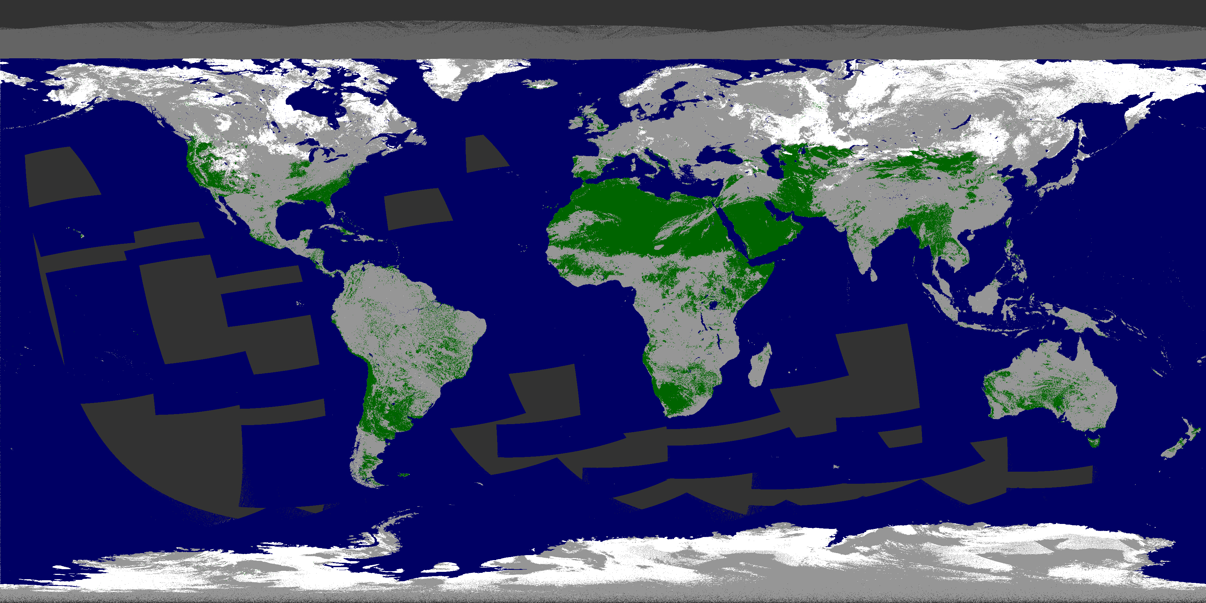
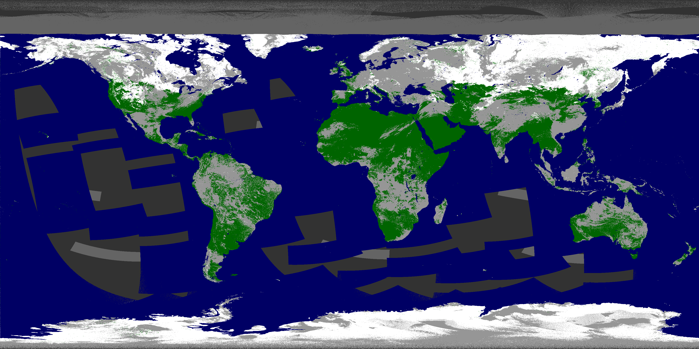
VIIRS Binary Snow Cover: Cloud Flag Issue (1/2)
VIIRS snow maps were produced with two cloud masks, “relaxed” and “conservative”. The “relaxed” cloud mask included “confidently cloudy” and “probably cloudy” categories. The “conservative ” cloud mask included “confidently cloudy”, “probably cloudy” and “probably clear” categories.
.
“Conservative” cloud mask used
“Relaxed” cloud mask used
White: snow
Light Gray: clouds
Green: snow-free land
Dark gray: not processed, or no data)
Maps with “conservative” cloud mask have noticeably more clouds than maps with the “relaxed” cloud mask

Slide 23
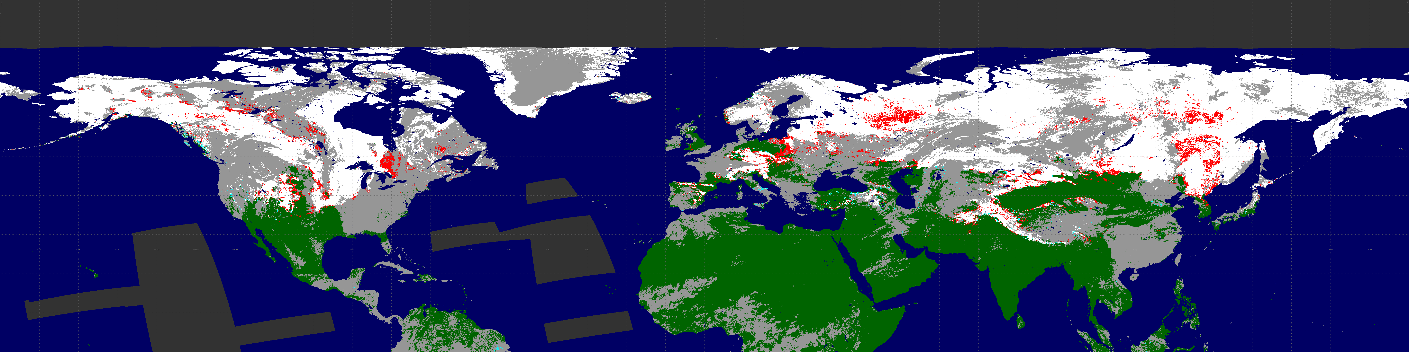
VIIRS Binary Snow Cover: Cloud Flag Issue (2/2)
VIIRS maps with different cloud masks were compared with the IMS product.
“Conservative” cloud mask used
White: VIIRS & IMS snow
Light Gray: VIIRS clouds
Green: VIIRS & IMS snow-free land
Dark gray: not processed, or no data
VIIRS snow map errors:
“Relaxed” cloud mask used
Omission (snow miss)
Commission (false snow)
The snow product with a “conservative” cloud mask tends to miss less snow as compared to the snow map with the “relaxed” cloud mask. Therefore at this time it is recommended to us the “conservative” cloud mask.

Slide 24
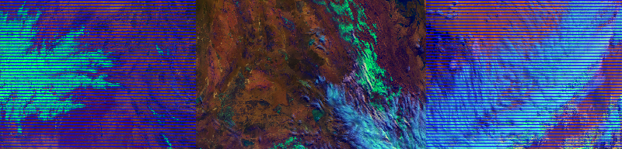
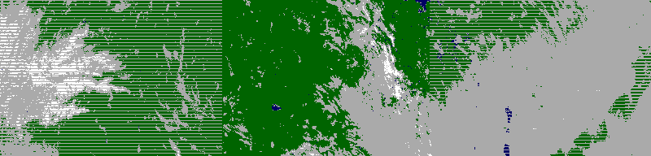
VIIRS Binary Snow Cover: Other Issues
The use of “conservative” cloud mask results in the cloud clear snow cover scenes frequently labeled as cloudy.
VIIRS RGB granule image
VIIRS granule snow product
snow
land
cloud
No data / not processed

Slide 25
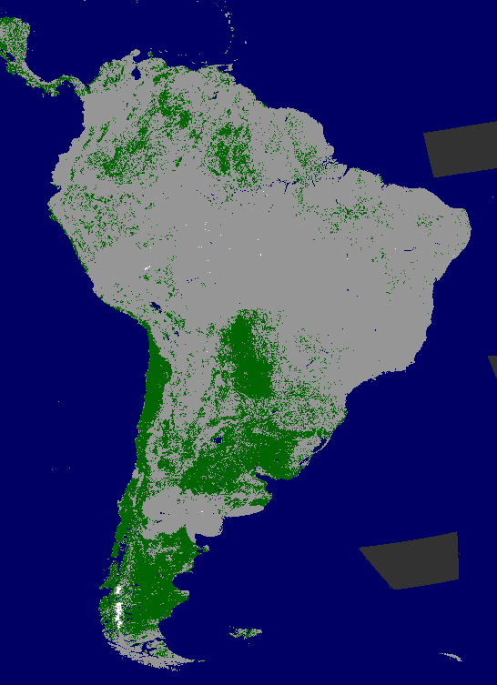
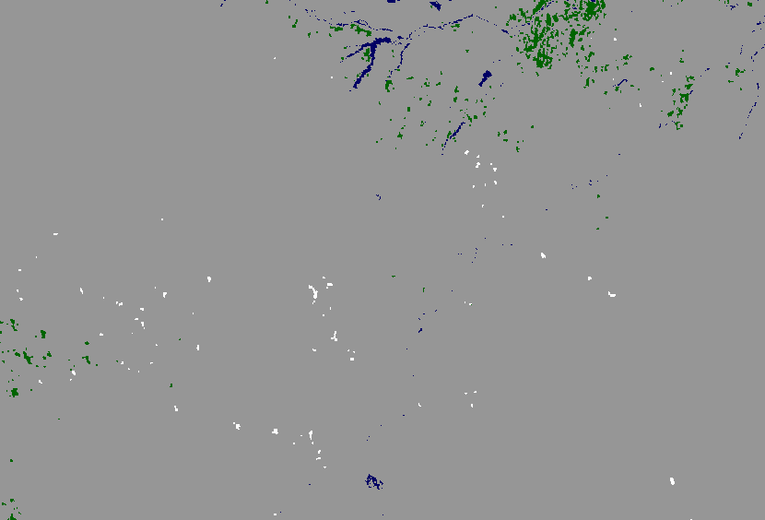
VIIRS Binary Snow Cover: Other Issues
Portion of VIIRS global gridded snow map over South America on Jan 13, 2013
Some clouds are missed by the VIIRS cloud mask (VCM). Missed clouds are most often interpreted as snow and thus may appear in the snow product as spurious snow.
The extent of spurious snow cover is small compared to the true snow. However these errors tend to accumulate in the VIIRS clear sky snow/ice composited images and affect other VIIRS products that rely on them (e.g., LST, NDVI, Albedo, etc)
snow
land
cloud

Slide 26
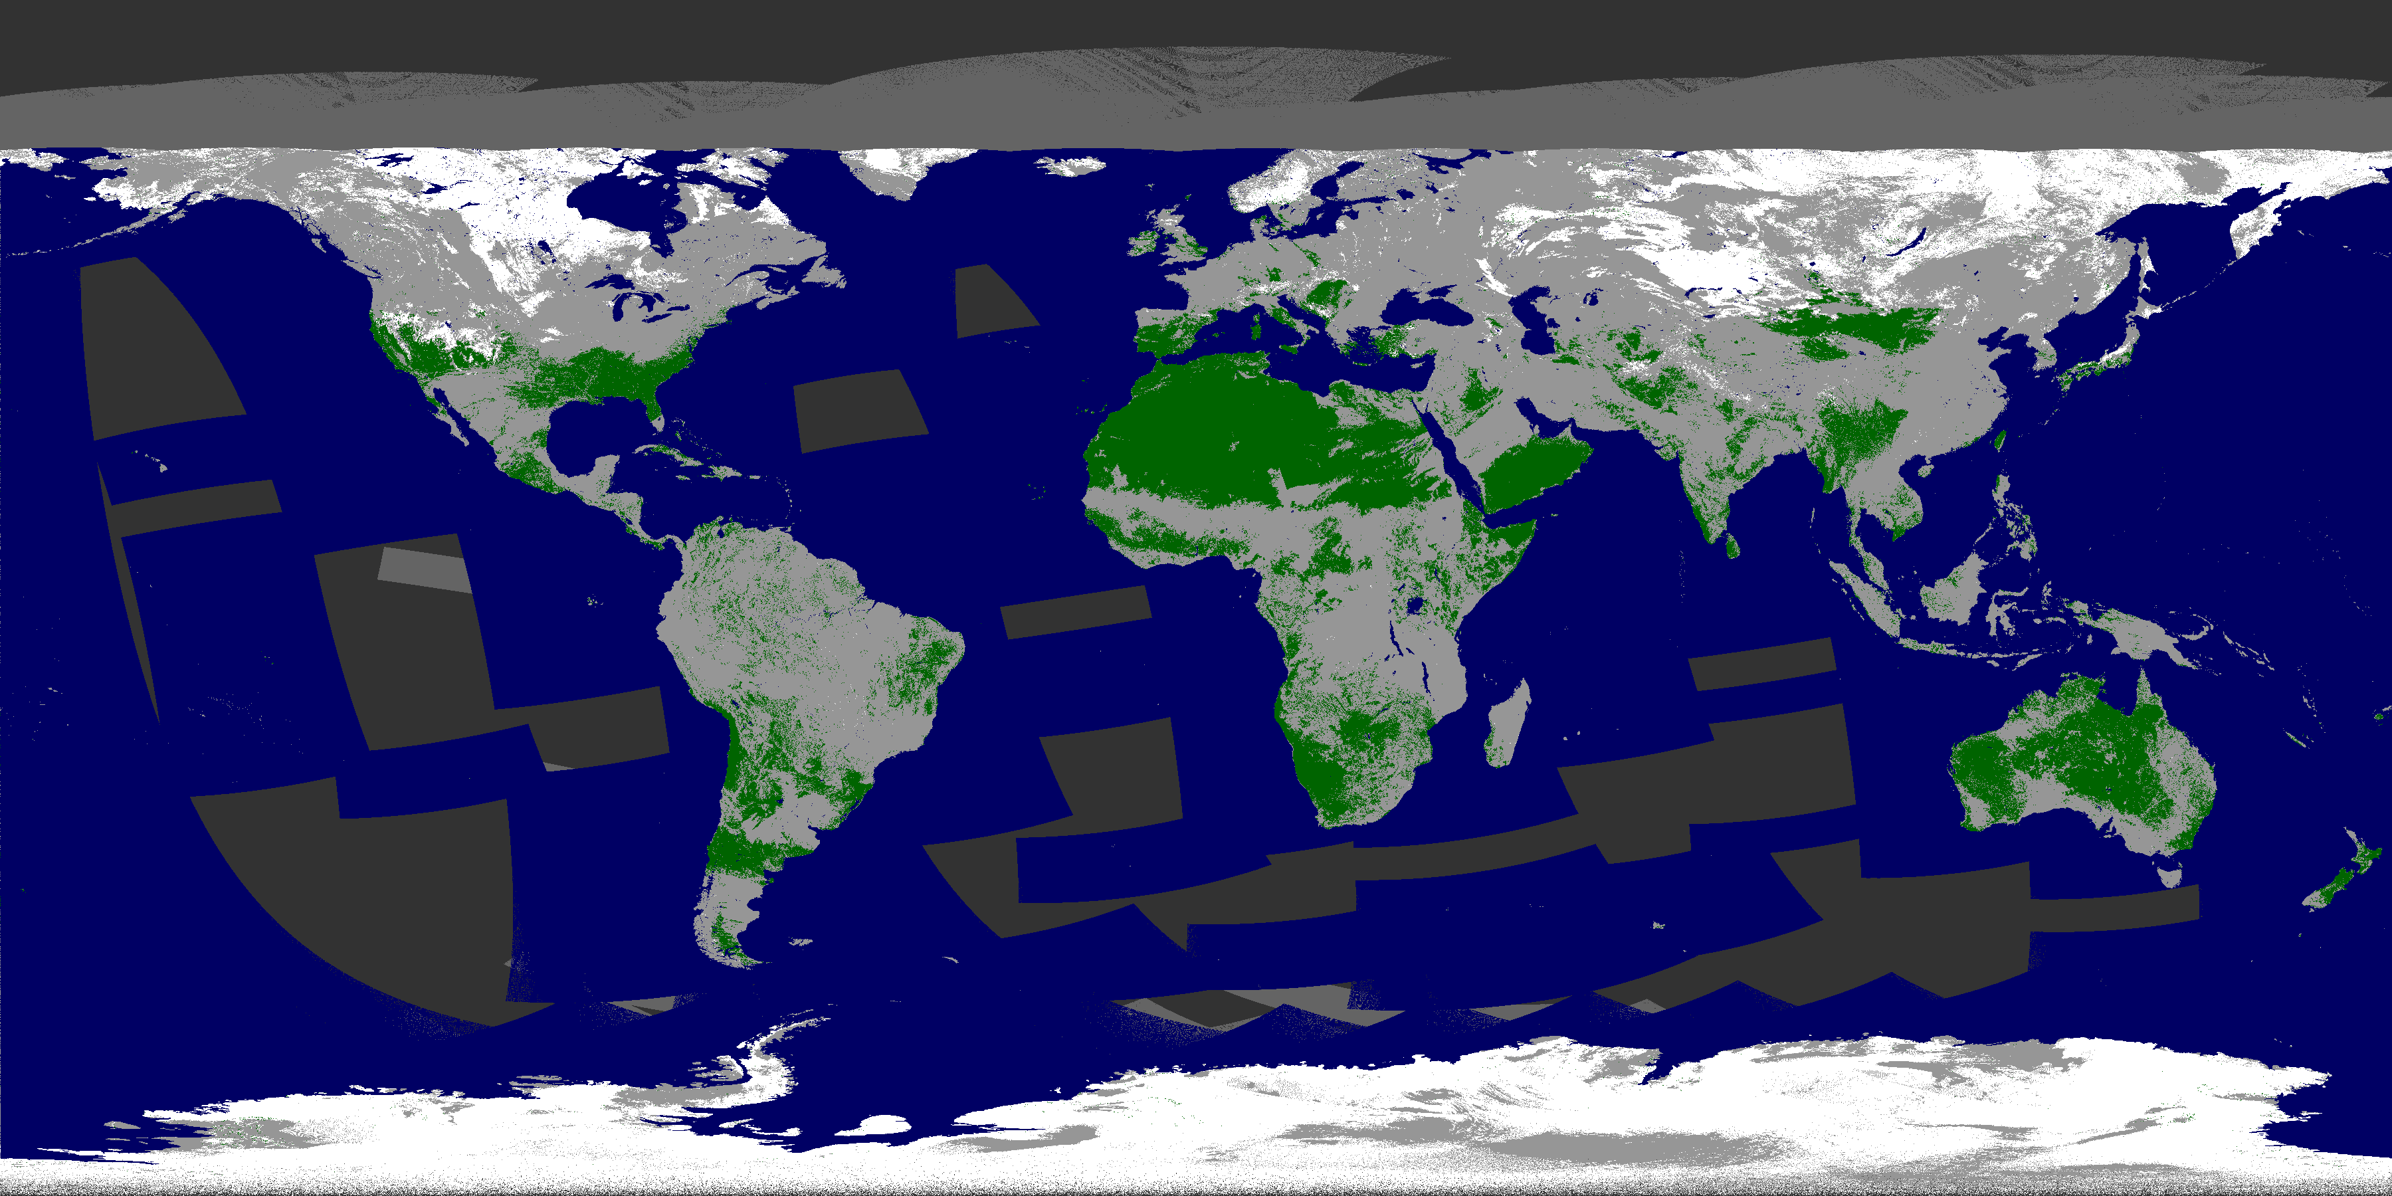
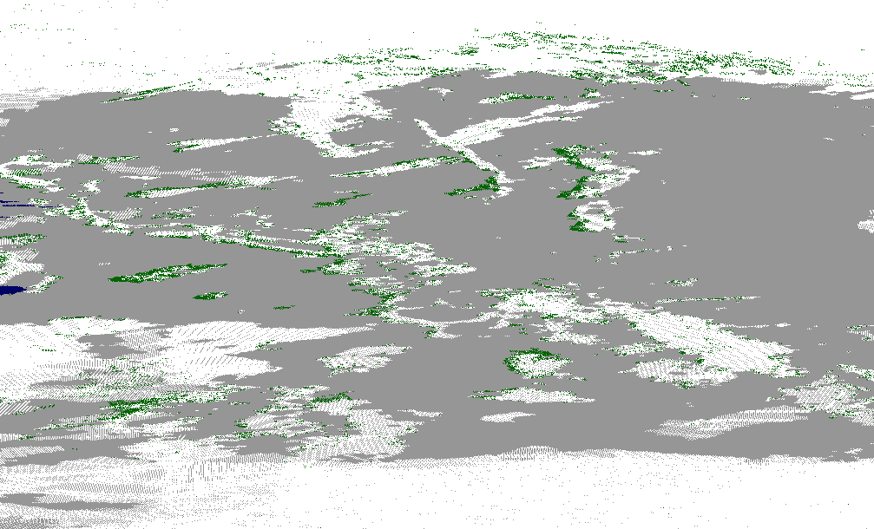
VIIRS Binary Snow Cover: Other Issues
VIIRS snow cover, January 31, 2013 (day 2013031)
Occasional failures to detect snow shadowed by clouds were noticed in the VIIRS snow product
snow
land
cloud

Slide 27
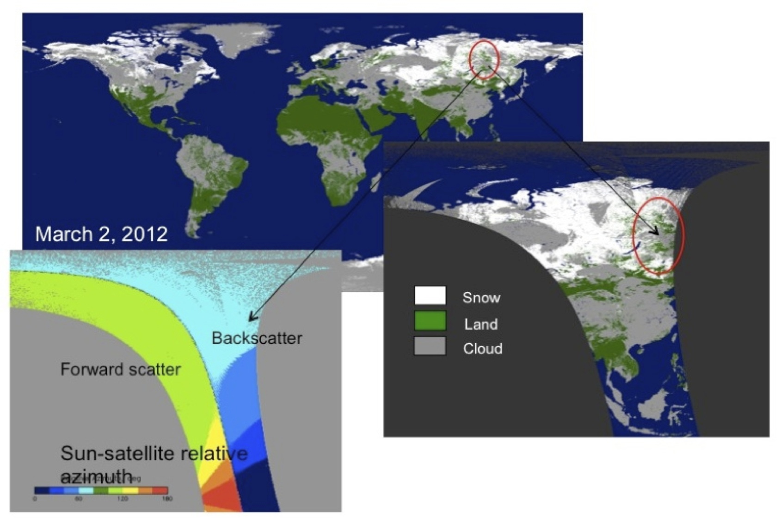
VIIRS Binary Snow Cover: Other Issues
Snow misses in the VIIRS snow product tend to occur more frequently when observations are made in the backscatter

Slide 28
Beta Justification Summary: Binary Snow Cover
Criteria: Early release product
  Snow Cover EDR performance is dependent on VIIRS SDR, VIIRS Cloud Mask IP and the Aerosol Optical Thickness IP
    VIIRS SDR Cal and Geo products reached provisional maturity in March, 2013.
    VIIRS Cloud Mask IP reached provisional maturity in February, 2013
    VIIRS Aerosol Optical Thickness reached beta maturity in September 2013
    VIIRS COP IP has reached beta maturity in March 2013
Criteria: Minimally validated
  Evaluation is based on a limited number of focus days (global comparisons for retrieval products)
    About 40 days during December 2012-March 2013 time period
    Earlier evaluation results are not valid because of significant modifications introduced to the cloud mask prior to this time period.

Slide 29
Beta Justification Summary: Binary Snow Cover (2/3)
Criteria: Available to allow users to gain familiarity with data formats and parameters
  Cryosphere Snow Cover EDR team has evaluated IDPS EDR products available from STAR Central Data Repository (SCDR). Same products are available at NOAA CLASS
    Users can access and read the products and the product compares reasonably with the heritage satellite snow map products
  Beta release will allow other users within the community to gain experience with the data formats and parameters.
    This is important to allow users to complement the validation activity.

Slide 30
Beta Justification Summary: Binary Snow Cover
Criteria: Product is not appropriate as the basis for quantitative scientific publication studies and applications
  The product has known flaws but is of sufficient quality to justify use by a broader community.
  The product may change considerably with the further expected changes to the VIIRS cloud mask.
  Most of the issues
    Missing and false snow may be linked to maturing, improving VIIRS Cloud Mask (VCM) and out of date (not daily updated) Grid-VIIRS-Snow-Ice-Cover-Rolling Tiles that affect performance.
  Comprehensive estimates of the VIIRS snow cover product will become possible once the VIIRS cloud mask algorithm is finalized and allowed to run unchanged for a period of several months. The decision on the provisional status of the product will be made when these estimate are made.

Slide 31
Future Plans and Issues:
Binary Snow Cover Product
Several changes/modifications to the Binary Snow Map algorithm are considered
  Spatial-based filter to identify potentially spurious snow
  Climatology-based filter to identify “false snow”
  Changes to the algorithm threshold values to improve snow detection
    In the backscatter
    Over forested areas
Detailed performance characterization requires:
  Comprehensive evaluation of the product stratified by the season of the year, climatic/geographic zone and surface cover type
  A more detailed analysis of the algorithm and product performance at local scales
Further validation of the VIIRS Binary Snow Map product with the most recent cloud mask is needed before the decision on the provisional maturity of the product can be made

Slide 32
Conclusion: Binary Snow Cover Product
The VIIRS Binary Snow Cover Product (which is part of the VIIRS Snow Cover EDR) has met the beta maturity stage based on the definitions and the evidence shown
  It exceeds the definition of beta in most cases
  The product performance is close to meeting requirements at this time.
Issues have been uncovered during validation of the VIIRS Binary Snow Cover Product and solutions are being evaluated.
  Identified problems are mostly related to failures of the VIIRS cloud mask algorithm and product
  If the accuracy of the cloud mask does not change as the result of latest improvements, modifications to the VIIRS Binary Snow Map algorithm should be introduced to at least partially compensate for the cloud mask errors

Slide 33
Beta Maturity Evaluation of the
Fractional Snow Cover Product

Slide 34
Binary Snow Product vs Snow Fraction
“Snow cover is the fraction of a given area of the earth’s horizontal surface that is masked by snow. In addition, a binary snow/no-snow mask will be produced.” JPSS Level 1 Requirements, SUPPLEMENT – Final, Version: 2.3 11/02/2012
Different requirements
  Imagery vs moderate resolution
  Binary classification vs continuous range from 0 to 1
Different physical meaning and approaches to retrievals
  Absence / presence vs relative coverage
Different presentation
  Thematic maps vs fraction maps
Different validation
  Probability of correct classification vs uncertainty
Notes:
Ancillary
GFS forecast surface pressure, lapse rate, and air temperature (for topography corrected surface pressure)
Look-up tables
DEM for surface altitude
Infrared and Microwave OSS coefficients
Local Angle Correction
IR emissivity and reflectivity covariance
MW emissivity covariance
AVTP and AVMP and Ozone covariance

Slide 35
History of Algorithm Evolution
1998-1999 Multiple Endmember Spectral Mixture Analysis (MESMA) developed, implemented, tested and evaluated
Inclusion of BRDF correction factor
2004 Development of modeled Snow Reflectance LUT
2005 Optional processing of snow cover fraction from the binary mask using 2x2 aggregation of the imagery resolution snow binary map incorporated
2007a MESMA “algorithm for computing snow fraction has been developed but is not being implemented operationally “
2007b “2x2 binary map aggregation based snow fraction will be implemented operationally for NPP in place of MESMA”
2010 Sections related to the MESMA snow fraction algorithm eliminated
Notes:
Ancillary
GFS forecast surface pressure, lapse rate, and air temperature (for topography corrected surface pressure)
Look-up tables
DEM for surface altitude
Infrared and Microwave OSS coefficients
Local Angle Correction
IR emissivity and reflectivity covariance
MW emissivity covariance
AVTP and AVMP and Ozone covariance

Slide 36
Snow Fraction
The snow fraction algorithm has undergone significant
development since the Critical Design Review (CDR).
Snow fraction computed using 2x2 aggregation of the binary snow mask, results in reporting of snow fraction in 25% increments.
The performance of snow fraction is determined by the performance of the snow binary map since the snow fraction is based on a 2x2 aggregation of the snow binary map pixels.
The snow fraction algorithm will produce an error estimate for each pixel.
Notes:
Ancillary
GFS forecast surface pressure, lapse rate, and air temperature (for topography corrected surface pressure)
Look-up tables
DEM for surface altitude
Infrared and Microwave OSS coefficients
Local Angle Correction
IR emissivity and reflectivity covariance
MW emissivity covariance
AVTP and AVMP and Ozone covariance

Slide 37
Beta Maturity Evaluation Approach
Daily global calculations of snow fraction aggregated within grid cells of different scales (from 1 km to 0.3°) were used to identify the areas of significant errors.
Calculated results of fractional snow cover products were compared locally with VIIRS false color imagery presenting ground truth to explore the commission and omission errors in calculations and determine possible reasons of the errors.
The comparisons of calculations with ground truth were made at the highest possible resolution at pixel scale for 5 min granule in the natural satellite coordinates with X axis corresponding to scan line and Y axis parallel to satellite motion.
The calculations with modified approach were repeated for individual days to assess the influence of corrections and averaged for a month to consider a systematic picture of changes in the results of calculations
Notes:
Ancillary
GFS forecast surface pressure, lapse rate, and air temperature (for topography corrected surface pressure)
Look-up tables
DEM for surface altitude
Infrared and Microwave OSS coefficients
Local Angle Correction
IR emissivity and reflectivity covariance
MW emissivity covariance
AVTP and AVMP and Ozone covariance

Slide 38
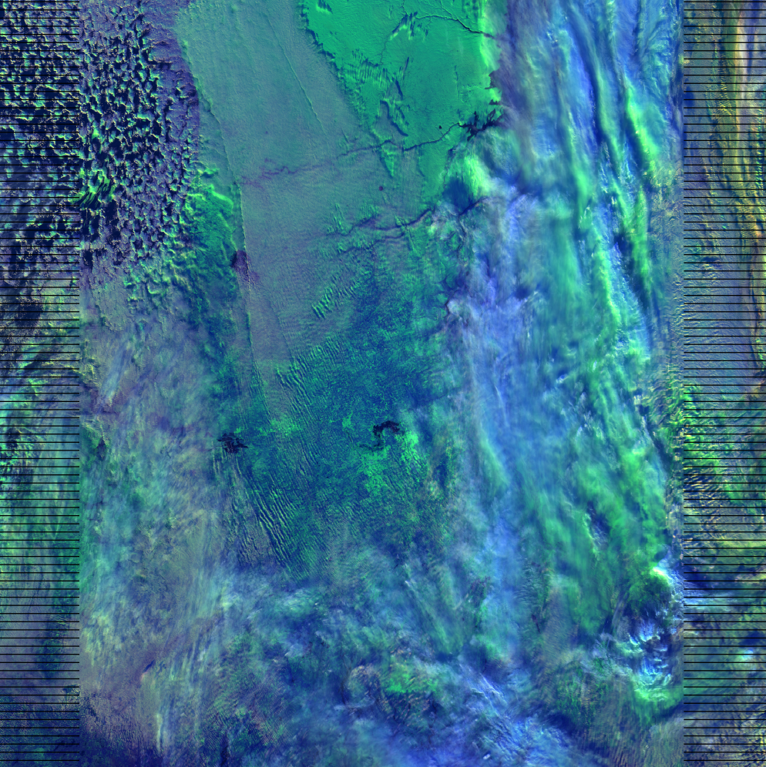

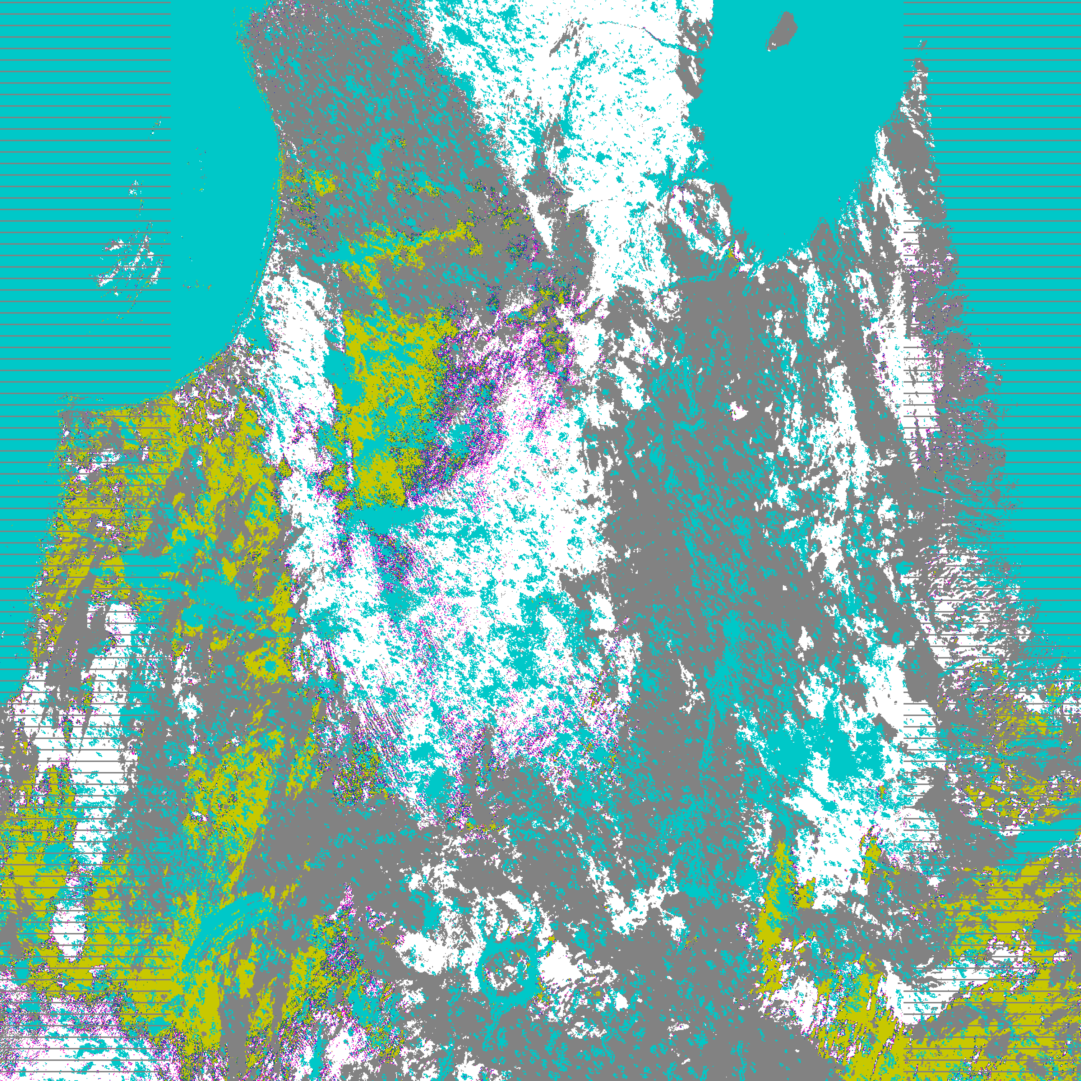
Example of Omission Errors Due to Missing Clouds (yellow zone within white snow cover)
100%
75%
50%
25%
Non-
Snow
Water
Clouds
Boreal forest
False color image Snow thematic map
Notes:
Ancillary
GFS forecast surface pressure, lapse rate, and air temperature (for topography corrected surface pressure)
Look-up tables
DEM for surface altitude
Infrared and Microwave OSS coefficients
Local Angle Correction
IR emissivity and reflectivity covariance
MW emissivity covariance
AVTP and AVMP and Ozone covariance

Slide 39
Current Status of Snow Cover Processing
The following improvements have been implemented for calculations:
New updated cloud mask is used
Snow retrieved only for “confidently clear” pixels
Speckle-like false snow in low latitudes is removed by applying double filtering (Minimum number of observations and snow fraction above 0.1)
The following results are obtained:
Daily global calculations provide a systematic picture of Snow Cover distributions without significant commission and omission errors
The areas of lower snow fraction are associated with the influence of boreal forest mostly in Europe and Asia and to much less degree in Eastern and Western Canada
Notes:
Ancillary
GFS forecast surface pressure, lapse rate, and air temperature (for topography corrected surface pressure)
Look-up tables
DEM for surface altitude
Infrared and Microwave OSS coefficients
Local Angle Correction
IR emissivity and reflectivity covariance
MW emissivity covariance
AVTP and AVMP and Ozone covariance

Slide 40
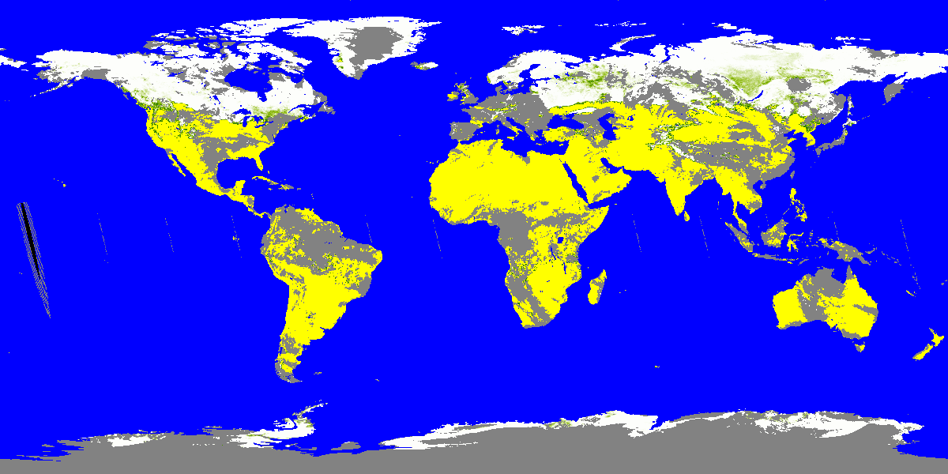

Snow Cover on March 29 and 30, 2013
(calculations illustrate consistency)
Notes:
Ancillary
GFS forecast surface pressure, lapse rate, and air temperature (for topography corrected surface pressure)
Look-up tables
DEM for surface altitude
Infrared and Microwave OSS coefficients
Local Angle Correction
IR emissivity and reflectivity covariance
MW emissivity covariance
AVTP and AVMP and Ozone covariance

Slide 41
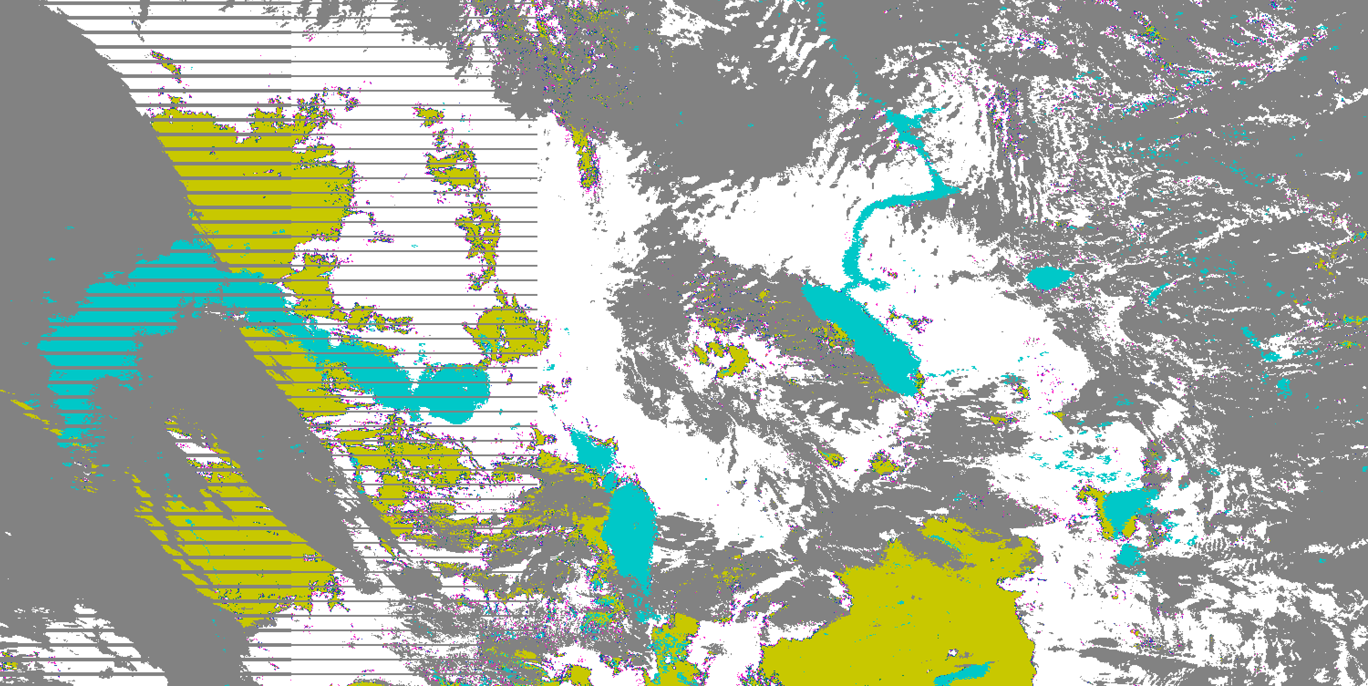
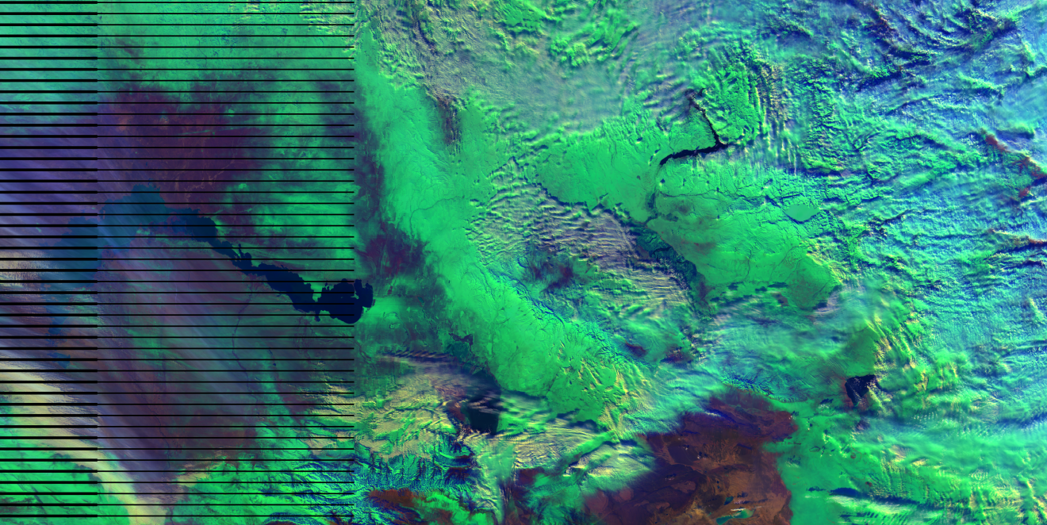
Satisfactory Retrieval of Snow Line
(border between snow and non-snow)
The locations of snow free (yellowish) regions in the thematic map (top) closely correspond to the areas without snow easily distinguishable in the false color image (bottom)
Notes:
Ancillary
GFS forecast surface pressure, lapse rate, and air temperature (for topography corrected surface pressure)
Look-up tables
DEM for surface altitude
Infrared and Microwave OSS coefficients
Local Angle Correction
IR emissivity and reflectivity covariance
MW emissivity covariance
AVTP and AVMP and Ozone covariance

Slide 42
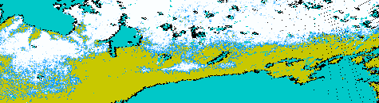
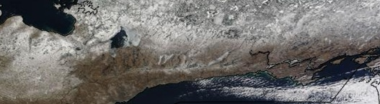
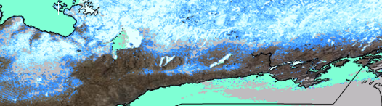
Transition Zones from Snow Covered Regions to Snow Free Areas are Very Narrow
VIIRS
fraction
Image
MODIS
fraction
Notes:
Ancillary
GFS forecast surface pressure, lapse rate, and air temperature (for topography corrected surface pressure)
Look-up tables
DEM for surface altitude
Infrared and Microwave OSS coefficients
Local Angle Correction
IR emissivity and reflectivity covariance
MW emissivity covariance
AVTP and AVMP and Ozone covariance

Slide 43
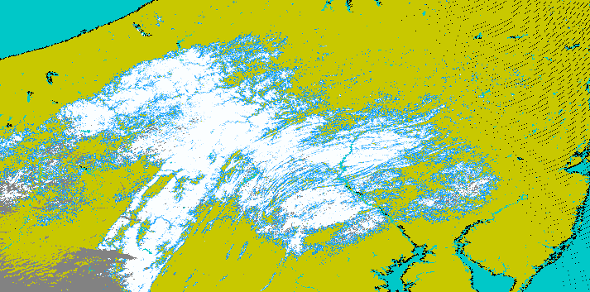
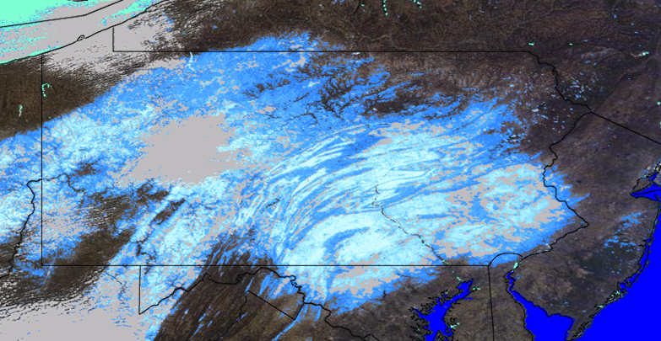
Loosing Details of Fraction Distributions within the Snow Zone
VIIRS
fraction
MODIS fraction
Notes:
Ancillary
GFS forecast surface pressure, lapse rate, and air temperature (for topography corrected surface pressure)
Look-up tables
DEM for surface altitude
Infrared and Microwave OSS coefficients
Local Angle Correction
IR emissivity and reflectivity covariance
MW emissivity covariance
AVTP and AVMP and Ozone covariance

Slide 44
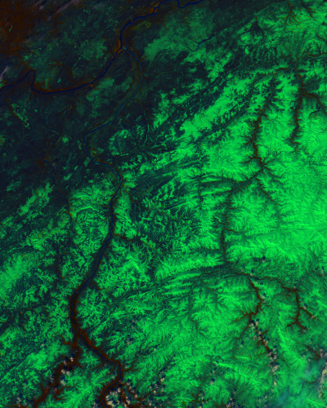
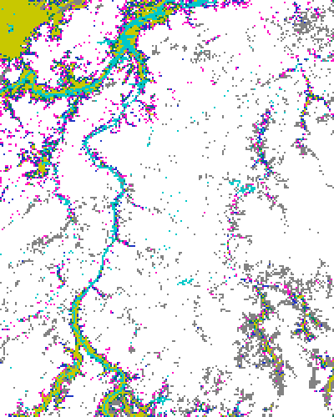
Missing Snow Structure in VIIRS
Fractional Snow Product
M
100%
75%
50%
25%
Non-
Snow
Water
Clouds
False color image VIIRS snow fraction
Notes:
Ancillary
GFS forecast surface pressure, lapse rate, and air temperature (for topography corrected surface pressure)
Look-up tables
DEM for surface altitude
Infrared and Microwave OSS coefficients
Local Angle Correction
IR emissivity and reflectivity covariance
MW emissivity covariance
AVTP and AVMP and Ozone covariance

Slide 45
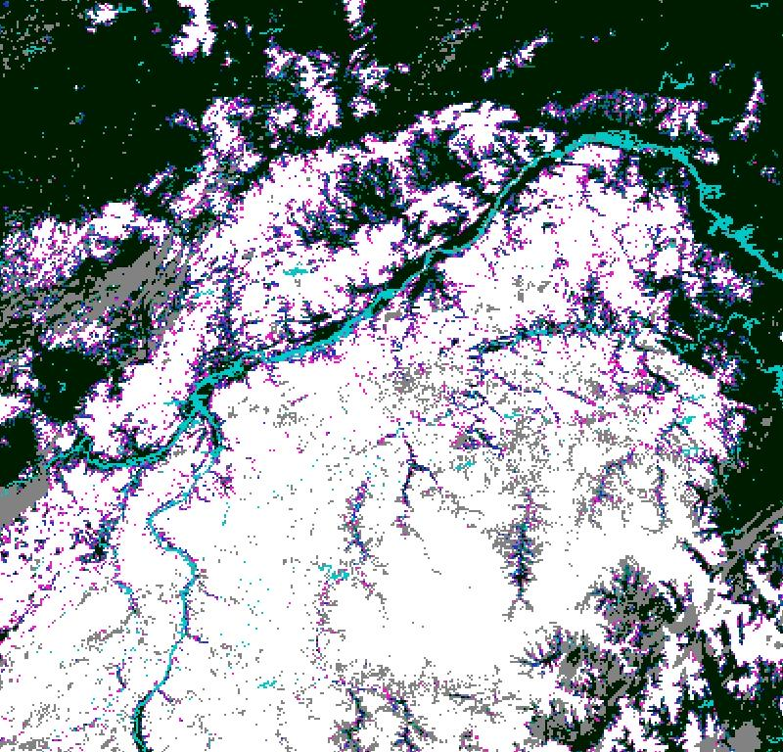
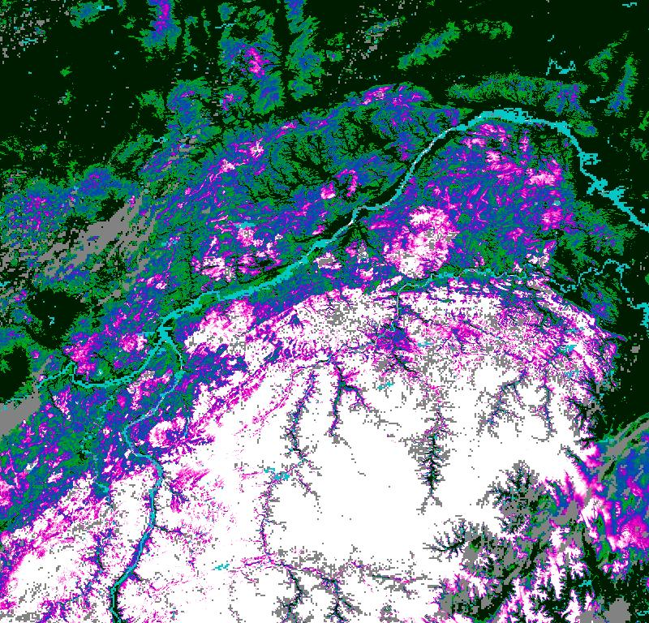

Comparison of Snow Fractions
VIIRS Product
Simple simulation
0% 100%
Notes:
Ancillary
GFS forecast surface pressure, lapse rate, and air temperature (for topography corrected surface pressure)
Look-up tables
DEM for surface altitude
Infrared and Microwave OSS coefficients
Local Angle Correction
IR emissivity and reflectivity covariance
MW emissivity covariance
AVTP and AVMP and Ozone covariance

Slide 46
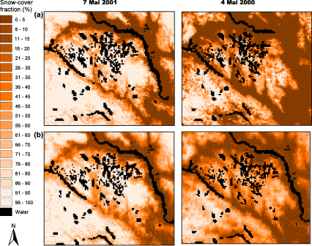
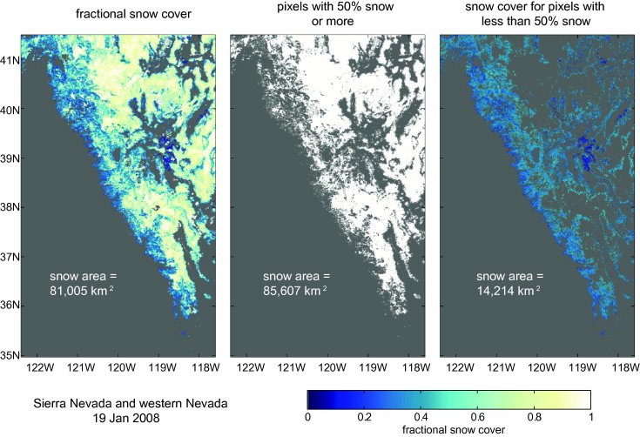
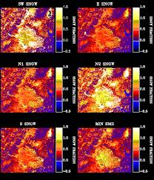
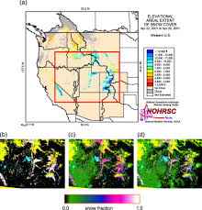
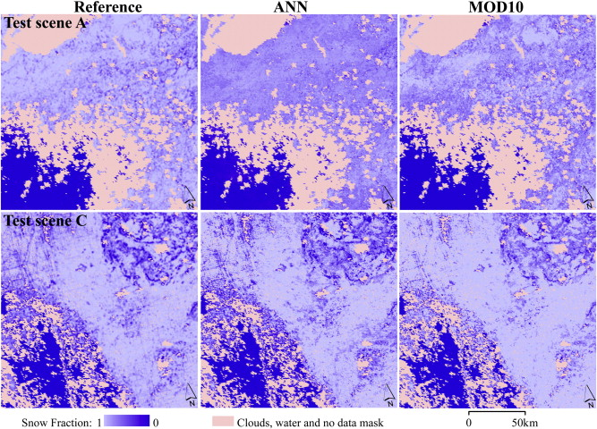
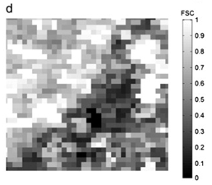
Typical View of Snow Fractions
Notes:
Ancillary
GFS forecast surface pressure, lapse rate, and air temperature (for topography corrected surface pressure)
Look-up tables
DEM for surface altitude
Infrared and Microwave OSS coefficients
Local Angle Correction
IR emissivity and reflectivity covariance
MW emissivity covariance
AVTP and AVMP and Ozone covariance

Slide 47
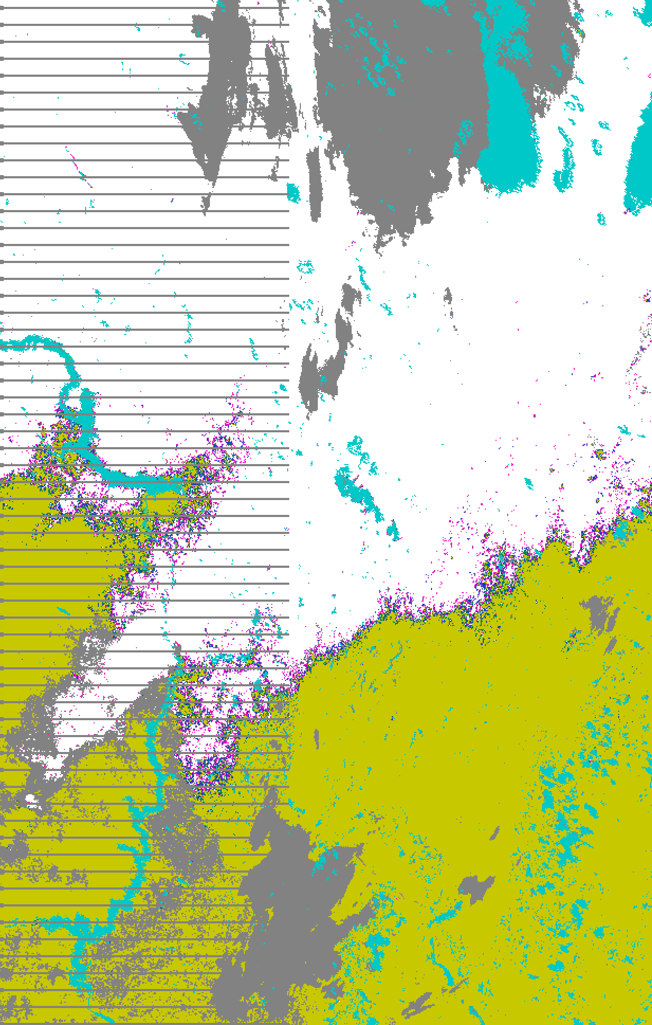
VIIRS Snow Fraction Product (in a center)
Differs from Similar Existing Products
Notes:
Ancillary
GFS forecast surface pressure, lapse rate, and air temperature (for topography corrected surface pressure)
Look-up tables
DEM for surface altitude
Infrared and Microwave OSS coefficients
Local Angle Correction
IR emissivity and reflectivity covariance
MW emissivity covariance
AVTP and AVMP and Ozone covariance

Slide 48
Beta Maturity Justification
Early release product
Snow Cover EDR is dependent on VIIRS SDR, VIIRS Cloud Mask IP, and Geolocation, each meeting maturity requirements
Minimally validated
Fractional snow cover product is validated:
globally for each day at 5 km grid cells in months representative for four seasons
globally averaged for months at 5 km grid cells
locally at pixel resolution for numerous 5 min granules
May still contain significant errors
Fractional Snow Cover product is of questionable utility:
Does not correspond to existing scientific conception
Differs significantly from other similar existing products
Does not correspond to its name & purpose replacing typical smooth changes in snow fraction by sharp jump from 0 to 1
Does not represent the variability of snow fraction within snow zones
It is likely that it will not (ever) meet requirements
Notes:
Ancillary
GFS forecast surface pressure, lapse rate, and air temperature (for topography corrected surface pressure)
Look-up tables
DEM for surface altitude
Infrared and Microwave OSS coefficients
Local Angle Correction
IR emissivity and reflectivity covariance
MW emissivity covariance
AVTP and AVMP and Ozone covariance

Slide 49
Beta Maturity Justification (2/3)
Versioning not established until Beta establishes the baseline for this product
It is considered unnecessary to establish the baseline for this product as the product requires changes in approach and realization
Available to allow users to gain familiarity
Cryosphere team has evaluated IDPS EDR products available from CLASS
  Users can access and read the products and the product compares reasonably with the heritage satellite snow map products
Beta release will allow other users within the community to gain experience with the data formats and parameters.
  This is important to allow users to complement the validation activity.
Notes:
Ancillary
GFS forecast surface pressure, lapse rate, and air temperature (for topography corrected surface pressure)
Look-up tables
DEM for surface altitude
Infrared and Microwave OSS coefficients
Local Angle Correction
IR emissivity and reflectivity covariance
MW emissivity covariance
AVTP and AVMP and Ozone covariance

Slide 50
Beta Maturity Justification (3/3)
Product is not appropriate as the basis for quantitative scientific publications studies and applications
Identified known deficiencies in fractional snow product require corrective actions to implement an alternative approach.
Notes:
Ancillary
GFS forecast surface pressure, lapse rate, and air temperature (for topography corrected surface pressure)
Look-up tables
DEM for surface altitude
Infrared and Microwave OSS coefficients
Local Angle Correction
IR emissivity and reflectivity covariance
MW emissivity covariance
AVTP and AVMP and Ozone covariance

Slide 51
Potential Solution: MESMA
Multiple Endmember Spectral Mixture Analysis (MESMA) uses the reflectances in nine VIIRS moderate resolution reflectance bands to retrieve snow fraction.
An objective of any spectral mixture analysis is the definition of subpixel proportions of spectral endmembers that may be related to mappable surface constituents.
Spectral mixture analysis “unmixes” the mixed pixel, determining the fractions of each spectral endmember that combine to produce the mixed pixel’s spectral signature.
The approach is to model the signature from each pixel as a combination of two components: a modeled snow reflectance spectrum and a modeled non-snow reflectance spectrum.
The approach is based on the assumption that the non-snow endmember spectrum for each pixel can be estimated from non-snow surface BRDF that will be obtained from the VIIRS Gridded Surface Albedo IP.
Notes:
Ancillary
GFS forecast surface pressure, lapse rate, and air temperature (for topography corrected surface pressure)
Look-up tables
DEM for surface altitude
Infrared and Microwave OSS coefficients
Local Angle Correction
IR emissivity and reflectivity covariance
MW emissivity covariance
AVTP and AVMP and Ozone covariance

Slide 52
MESMA Performance Analysis (1999)
Snow Fraction Measurement Uncertainty:
Stratified Performance for Typical Case
Scan Angle | Snow Fraction (Truth)
 | 0.0– 0.25 | 0.25 – 0.5 | 0.5 – 0.75 | 0.75 – 1.0
Nadir | .070 | .072 | .076 | .081
Edge-of-Scan | .077 | .079 | .089 | .102
Notes:
Ancillary
GFS forecast surface pressure, lapse rate, and air temperature (for topography corrected surface pressure)
Look-up tables
DEM for surface altitude
Infrared and Microwave OSS coefficients
Local Angle Correction
IR emissivity and reflectivity covariance
MW emissivity covariance
AVTP and AVMP and Ozone covariance

Slide 53
Benefit and Opportunity to Restore MESMA
(exceptional circumstances)
MESMA was a part of all NPOESS algorithm and code developments for more than 10 years and delivered to IDPS
The approach was considered, approved, and recommended to retrieve snow fraction at many meetings at all levels
The code is still a part of a relatively recent version of software
MESMA is currently a standard approach to such kind of tasks
Existing experience of applying MESMA to retrieve snow fraction clearly demonstrates the advantages of the approach considered as one of the best for snow remote sensing
There is no need for a lengthy process of approving a new approach since it has been already approved
It is possible to start validation of the algorithm immediately
Notes:
Ancillary
GFS forecast surface pressure, lapse rate, and air temperature (for topography corrected surface pressure)
Look-up tables
DEM for surface altitude
Infrared and Microwave OSS coefficients
Local Angle Correction
IR emissivity and reflectivity covariance
MW emissivity covariance
AVTP and AVMP and Ozone covariance

Slide 54
Additional Supporting Documentation
TIM Meetings and Presentations
  Relevant TIM presentations:
  Conference presentations:
  Romanov P., Appel I. (2012) Mapping Snow Cover with Suomi NPP VIIRS, EUMETSAT Conference, Gdansk, Poland, September 2012.
  Romanov P., Appel I. (2012) Snow cover products from Suomi NPP VIIRS: Current status and potential improvements, IGARSS, Munich, Germany, July 2012.
  Romanov P., Appel I. (2012) Mapping Snow Cover with Suomi NPP VIIRS, NOAA 2012 Satellite Science Week. Meeting. Summary Report. April 30 – May 4, 2012. Kansas City, Missouri.
List reports
  Weekly, monthly, quarterly Progress Reports are posted at ftp://ftp.star.nesdis.noaa.gov/pub/smcd/emb/promanov/VIIRS_SNOW

Slide 55
Snow Cover Fraction: Conclusions (1/2)
The VIIRS Snow Cover Fraction (which is part of the VIIRS Snow Cover EDR) has met the beta maturity stage based on the beta criteria.
The current algorithm for estimating Snow Cover Fraction has significant limitations and is of questionable utility. The method does not correspond to other fractional snow cover products and to current scientific conceptions of fractional snow cover.
The proposed approach cannot be “fixed”; the nature of the product makes it (arguably) not useful.
The NASA snow team has reached these same conclusion.
Notes:
Ancillary
GFS forecast surface pressure, lapse rate, and air temperature (for topography corrected surface pressure)
Look-up tables
DEM for surface altitude
Infrared and Microwave OSS coefficients
Local Angle Correction
IR emissivity and reflectivity covariance
MW emissivity covariance
AVTP and AVMP and Ozone covariance

Slide 56
Snow Cover Fraction: Conclusions (2/2)
Acceptable approaches to snow cover retrieval should take the advantage of using available spectral VIIRS information at moderate resolution.
One of possible options to be considered – MESMA (one of the best for Snow Cover remote sensing) that was a part of all NPOESS algorithm and code developments for more than 10 years and successfully delivered to IDPS.
While validation and evaluation of this product will continue, it is possible that is will not be recommended for Provisional maturity status.
Notes:
Ancillary
GFS forecast surface pressure, lapse rate, and air temperature (for topography corrected surface pressure)
Look-up tables
DEM for surface altitude
Infrared and Microwave OSS coefficients
Local Angle Correction
IR emissivity and reflectivity covariance
MW emissivity covariance
AVTP and AVMP and Ozone covariance

