Slide 1
Validated Stage 1 Science Maturity Readiness Review for
Snow Cover Fraction
Presented by Igor Appel
Cryosphere Products Validation Team
September 4, 2014

Slide 2
Outline (recommended)
Algorithm Cal/Val Team Members
Product Requirements
Evaluation of algorithm performance to specification requirements
  Evaluation of the effect of required algorithm inputs
  Quality flag analysis/validation
  Error Budget
Documentation
Identification of Processing Environment
Users & User Feedback
Conclusion
Path Forward

Slide 3
Cryosphere Team Membership
EDR | Name | Organization
Lead | Jeff Key | NESDIS/STAR
Co-Lead | Pablo Clemente-Colón | NESDIS/STAR and NIC
Wisconsin:
Ice | Yinghui Liu | CIMSS/U. Wisconsin
Ice | Xuanji Wang | CIMSS/U. Wisconsin
Ice | Rich Dworak | CIMSS/U. Wisconsin
Maryland:
Snow | Peter Romanov | CREST/CCNY
Snow | Igor Appel | IMSG
Colorado:
Ice | Mark Tschudi | U. Colorado
Ice | Dan Baldwin | U. Colorado
Other:
All | Paul Meade | DPE
3

Slide 4
VIIRS Snow Cover Product Users
  U.S. Users
    NSIDC - National Snow Ice Data Center
    NIC - National/Naval Ice Center
    OSPO - Office of Satellite and Product Operations
    NOHRSC - National Operational Hydrological Remote Sensing Center
    STAR - Center for Satellite Applications and Research
    CLASS - Comprehensive Large Array-data Stewardship System
    NWS including Alaska
  User Community
    Agriculture
    Hydrology
    Numerical Weather Prediction
    Transportation
    Emergency Management
    DOD

Slide 5
VIIRS Snow Cover EDR
The VIIRS Snow Cover/Depth Environmental Data Record (EDR) product consist of two products
  Snow/no snow binary map
  Snow fraction in a horizontal cell
The objective of the VIIRS retrieval is to achieve the performance specifications designed to meet the requirements stated in the NPOESS System Specification.
The specifications apply under clear-sky, daytime conditions only. Surface properties cannot be observed through cloud cover by a Visible/Infrared (VIS/IR) sensor.
The specification for the NPOESS Snow Cover/Depth EDR places requirements on the VIIRS binary map product and the VIIRS snow fraction product.

Slide 6
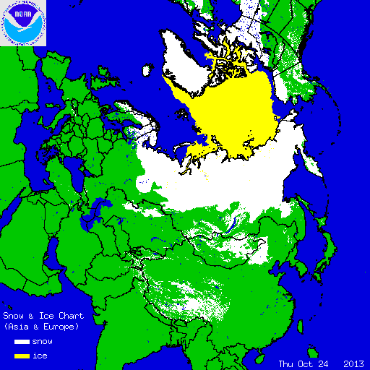
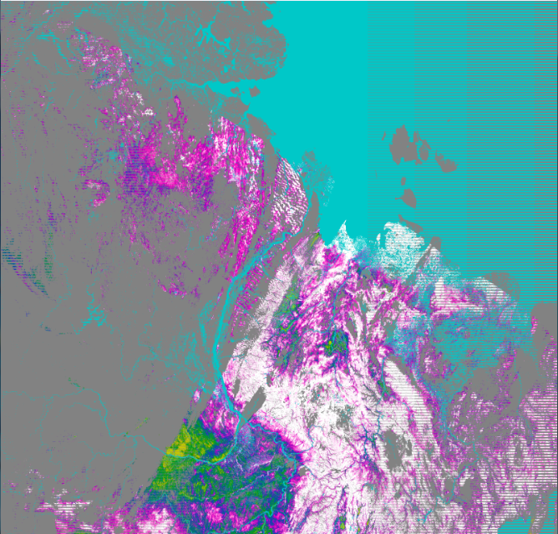

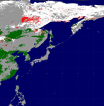

Snow Fraction on 10/24/13 (03:20)
IMS Snow Chart
Missing Snow Corresponds to Low Fraction
IMS Snow Chart
Missing Snow in Binary retrieval

Slide 7
Specification of the VIIRS Snow Fraction
Parameter | Specification Value
a. Horizontal Cell Size,
1. Clear – daytime (Worst case) | 1.6 km
2. Clear – daytime (At nadir) | 0.8 km
3. Cloudy and/or nighttime | N/A
b. Horizontal Reporting Interval | Horizontal Cell Size
c. Snow Depth Ranges | > 0 cm (Any Thickness)
d. Horizontal Coverage | Land
e. Vertical Coverage | > 0 cm
f. Measurement Range | 0 – 100% of HCS
g. Measurement Uncertainty | 10% of HCS (Snow/No Snow)
h. Mapping Uncertainty | 1.5 km
RGB Image shows dense smoke (high absorption) in northwest, north central and central coastal portions of image.
7

Slide 8
Requirements to Snow Fraction Retrieval
(Uncertainty)
Initially, the U.S. Government (USG) threshold requirements formulated by DoD and DOC in the Integrated Operational Requirements Document (IORD) included 10% measurement uncertainty under clear conditions for 1.3 km horizontal cell size.
The threshold requirements needed for Improved Freshwater Resource Management consider snow information for North America as Mission Critical data with measurement accuracy 10% and horizontal resolution 0.5 km.
It is logical that the requirement to measurement uncertainty for Fractional Snow Cover remained unchanged in the latest version of the Level 1 Requirements, Supplement.

Slide 9
NPOESS Snow Fraction Retrieval
Originally, an application of the Multiple Endmember Spectral Mixture Analysis (MESMA) was developed for VIIRS to retrieve snow fraction.
The spectral mixture analysis defines subpixel proportions of spectral endmembers related to mappable surface constituents.
It “unmixes” the mixed pixel, determining the fractions of each spectral endmember combined to produce the mixed pixel’s spectral signature.
The performance analysis indicated that the measurement uncertainty requirement can be achieved, except for scenes with forest canopy.

Slide 10
Transformation of NPOESS Algorithm
In the current version of the VIIRS processing system, the MESMA was (temporarily?) replaced by the aggregation of the Binary Snow within 2x2 pixel blocks.
According to one source, Snow Fraction computed based on a 2x2 aggregation of the binary map replaced the originally proposed Multiple End Member Spectral Mixture Analysis (MESMA) approach due to uncertainty in the effort required to understand complex behavior in the initial results.
Snow fraction computed based on a 2x2 aggregation of the binary map is not a valid approach and provides no additional information beyond that already provided by the Snow Binary Map.

Slide 11
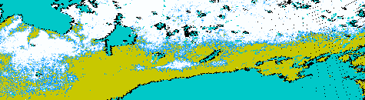
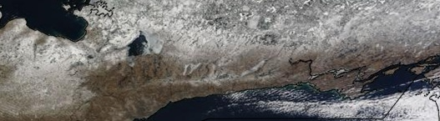
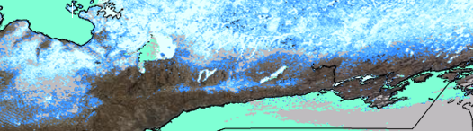
Transition Zones from Snow Covered Regions to Snow Free Areas are Very Narrow
VIIRS
fraction
Image
MODIS
fraction
In 2x2 snow fraction (top) snow to no snow transition regions are unrealistically narrow compared to the MODIS based snow fractions

Slide 12
SNPP Validation Stages Maturity Definition
Validated Stage 1:
  Using a limited set of samples, the algorithm output is shown to meet the threshold performance attributes identified in the JPSS Level 1 Requirements Supplement with the exception of the S-NPP Performance Exclusions
Validated Stage 2:
  Using a moderate set of samples, the algorithm output is shown to meet the threshold performance attributes identified in the JPSS Level 1 Requirements Supplement with the exception of the S-NPP Performance Exclusions
Validated Stage 3:
  Using a large set of samples representing global conditions over four seasons, the algorithm output is shown to meet the threshold performance attributes identified in the JPSS Level 1 Requirements Supplement with the exception of the S-NPP Performance Exclusions
Notes:
JK: You changed the slide with the Val 1 definition to include Provisional. However, Lihang provided a new slide for everybody to use, one that has the definitions for all three validated stages.

Slide 13
Discrepancy Report 4246
Title: Snow algorithm inconsistent with … requirements
Submitter: Neal Baker
Program Officer Monitor: Paul Meade
Description: … a 10% (uncertainty) value cannot be achieved. We will have to investigate sub pixel snow algorithms.
Secondary comment of 20130416: … this algorithm … is of little value to a user and it really deserves to be delete and replaced by an alternate algorithm
Secondary comment of 20131029: … Program Office Monitor set to … Cryosphere EDR JAM to begin work looking at substitute fractional snow cover algorithms, per recommendation of Mitch Goldberg and Jim Gleason during data product Beta Maturity AERB and direction of Cryo Cal/Val Lead Jeff Key

Slide 14
Algorithm Recommendations
Recommendations for IDPS algorithms:
Product | Through Aug 31 | NPP after Aug 31 | JPSS
Binary Snow Cover | 1 | 1 | 1 or 3
Fractional Snow Cover | 2 | 2 | 2
  NPOESS algorithm has evolved into the NOAA-endorsed JPSS algorithm and any needed improvements should continue.
  NPOESS (or evolved) algorithm will not meet requirements or effort is too large, replace with NOAA-endorsed JPSS algorithm
  NOAA-endorsed algorithm should be used even if NPOESS (or evolved) algorithm meets performance because of legacy, enterprise, blended products, and other considerations.
Notes:
For 2 or 3, present the alternative algorithm methodology description, algorithm performance against the level 2 supplement specification and any user assessments.

Slide 15
Alternative Snow Fraction Algorithms for VIIRS
Multispectral, multi-endmember linear unmixture (MODSCAG, GOESRSCAG, MESMA – Painter, 2009)
Most comprehensive approach, uses observations in all reflective spectral bands
Derives the fraction of each surface type within IFOV including snow
- Spectral properties of all global land cover types to be accurately characterized (reflectance &BRDF)
- Inversion procedure may be unstable (spectrally similar end-members possible)
Demonstrated application in occasional local-scale studies (mostly mountain regions)
NDSI-based, Salomonson & Appel (2004) modified by G. Riggs for VIIRS
Assumes linear relationship between NDSI and snow fraction. End-members are static.
Extremely easy to implement and take specific local conditions into considerations.
Serious performance issues over forested areas revealed (MODIS snow team has been notified)
Implemented operationally with MODIS global data
Single band reflectance-based, linear unmixture, Romanov et al (2003)
Assumes linear relationship between the TOA visible reflectance and snow fraction
Needs TOA visible reflectance and BRDF of snow and snow-free land surface
Easier to implement than the multispectral multi-endmember version of the algorithm
Used routinely with GOES Imager data over North America since 2003 and with METOP AVHRR over the globe since 2013

Slide 16
Snow Fraction Algorithms
Two approaches/algorithms to estimate snow fraction from satellite data:
NDSI-based, following Salomonson & Appel (2004) as reported by G. Riggs
SnowFraction = -0.01 + 1.45 * NDSI
where NDSI = (R₁ - R₃ ) / (R₁ +R₃ ), and R₁ and R₃ are correspondingly VIIRS-observed reflectances in bands I1 and I3. This is equivalent to a linear mixture algorithm with two end-members representing snow-free land surface and complete snow cover. It has been demonstrated that taking variability of snow and non-snow properties into account increases the quality of snow fraction retrieval. The techniques of geometric optics is used to develop asymptotic analytical equation describing snow bidirectional reflectance with high accuracy and clear physical interpretation applicable to retrieve snow properties. Algorithm has been developed for MODIS and currently used for VIIRS data.
Reflectance-based, modified from Romanov et al (2003)
SnowFraction=(R-R_{land})/(R_{snow}-R_{land})
Linear mixture algorithm with two end-members representing snow-free land and fully snow-masked land surface based on VIIRS-observed reflectance in the visible band I1 (R). End-member reflectances R_{land} and R_{snow} are determined empirically. The angular anisotropy of the end-memebr reflectance is parameterized with a simple kernel-driven model. Algorithm was first developed for and used with GOES Imager data. A new version of the algorithm with modified parameterization of R_{land} and R_{snow} was applied to NPP VIIRS data. See a more detailed description of the algorithm in a separate document.

Slide 17
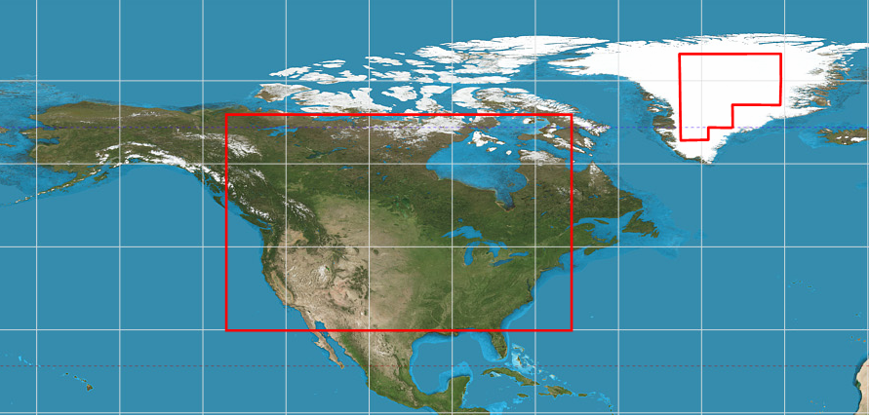
BRDF model for Reflectance-based algorithm
Used to determine snow BRDF
Used to determine snow-free land BRDF
Proposed BRDF model:
R_{snow, land} = C₀ + Σ _{i=1,7} C_{i} F_{i,}
Kernel functions (F_{i}) and kernel loads (C_{i})
Kernel Functions | Kernel Loads | Kernel Load Values
 |  | Snow-free land | Snow
1. | C₀ | 19.02 | 63.45
Cos (θ_{sol}) | C₁ | 9.699 | 89.90
Cos (θ_{sat}) | C₂ | -9.944 | -16.33
Cos (θ_{sol}) Cos (θ_{sat}) | C₃ | 13.16 | 61.81
Cos² (θ_{sol}) | C₄ | -36.30 | -140.9
Cos² (θ_{sat}) | C₅ | -6.289 | -5.114
Cos⁴ (θ_{sol}) | C₆ | 20.18 | 51.62
Cos⁴ (θ_{sat}) | C₇ | 5.419 | -2.623

Slide 18
Correcting Reflectance for Angular Anisotropy
Snow Reflectance
Snow Reflectance
Observed
Model
Land Reflectance
Land Reflectance
Snow Reflectance
BRDF model helps to reduce the effect of changing observation geometry on the end-member reflectance
Normalized
(0⁰ VZA, 60⁰ SZA)
Land Reflectance

Slide 19
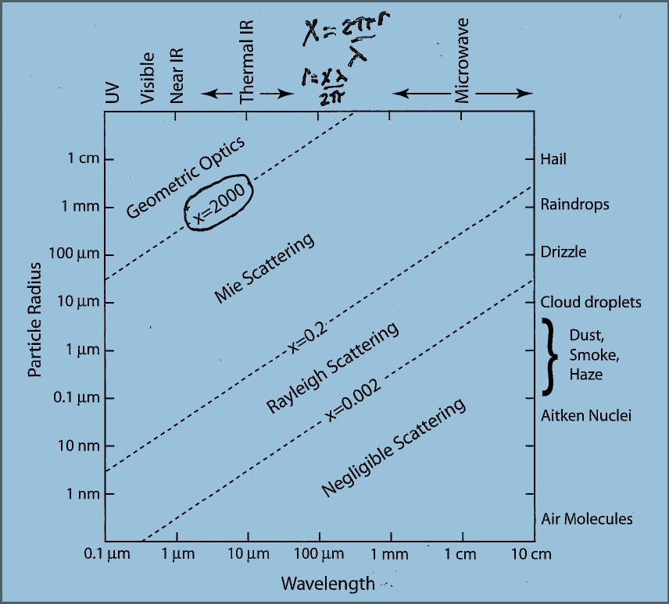
Analytical model of snow BRDF
where R₀ is taken from precalculated LUT approximated by an analytical function
Geometric optics instead of Mie calculations because Mie size parameter > 2000 for snow
K₀ – the escape function approximated as
(λ) - fraction of absorbed energy
Applied asymptotic analytical equation provides simple and highly accurate solution allowing clear physical explanation and interpretation

Slide 20
Estimate of Model Accuracy

Slide 21
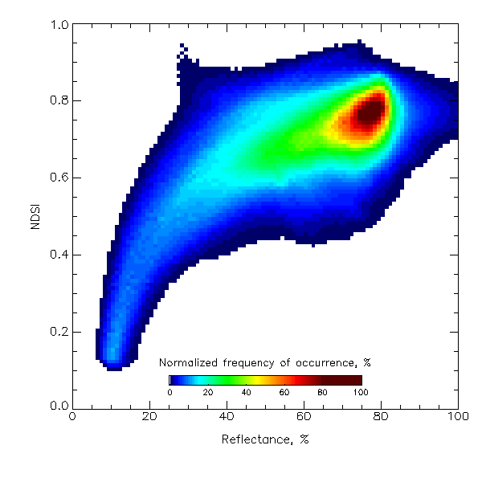
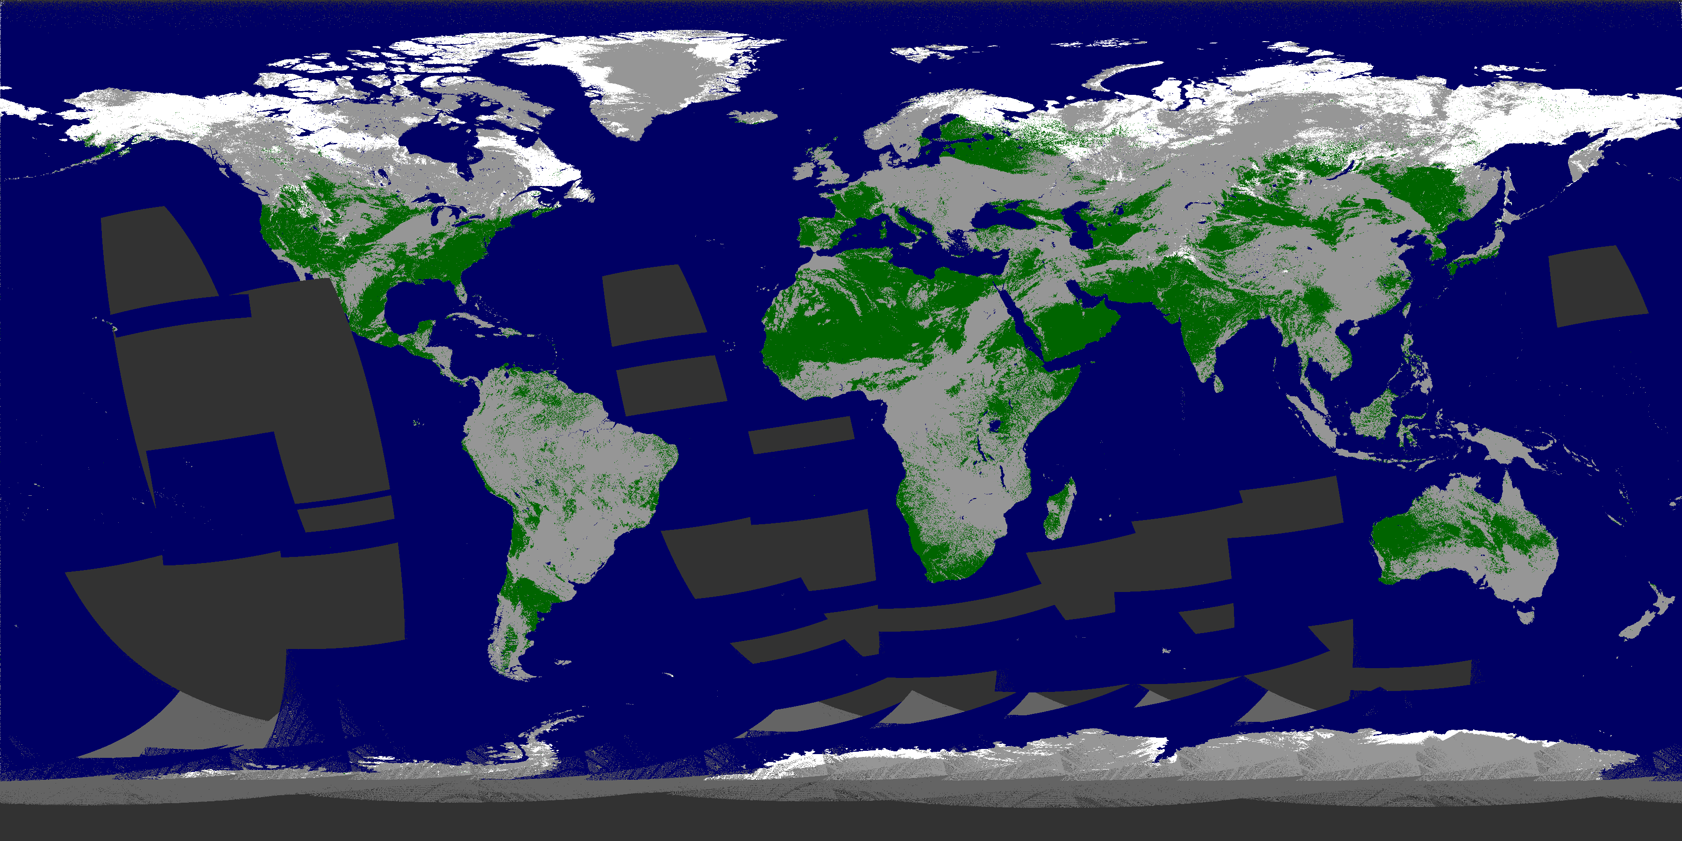
NDSI vs Visible Reflectance
NDSI vs Visible Reflectance
VIIRS snow map , April 9, 2014
On the whole, the increase in NDSI corresponds to the increase in the visible reflectance, though the relationship between those parameters is clearly non-linear
Scatter plot of VIIRS visible (band 1) reflectance and NDSI for “snow pixels”

Slide 22
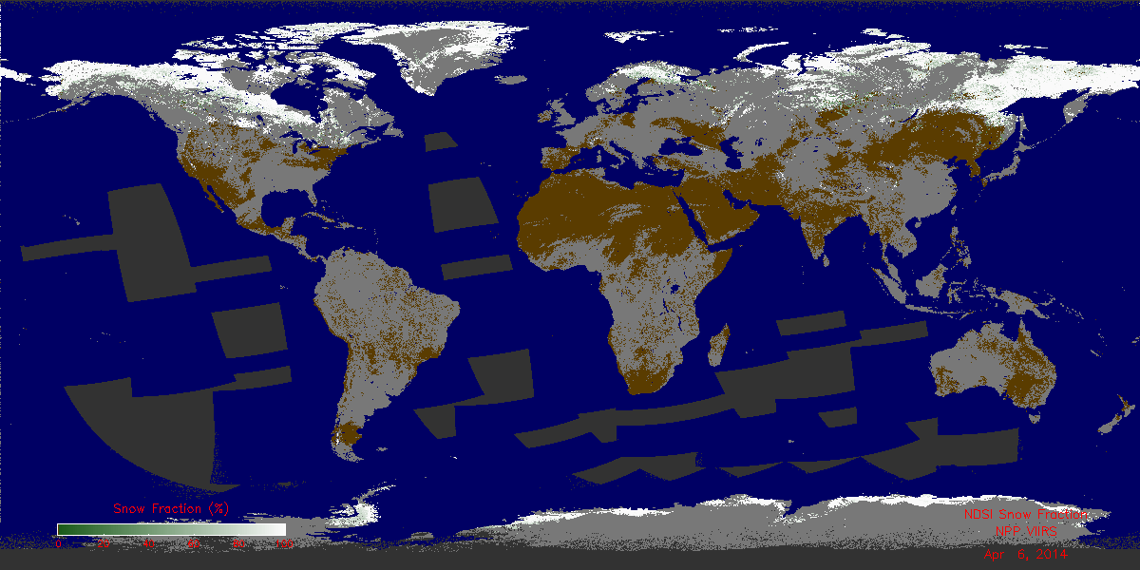

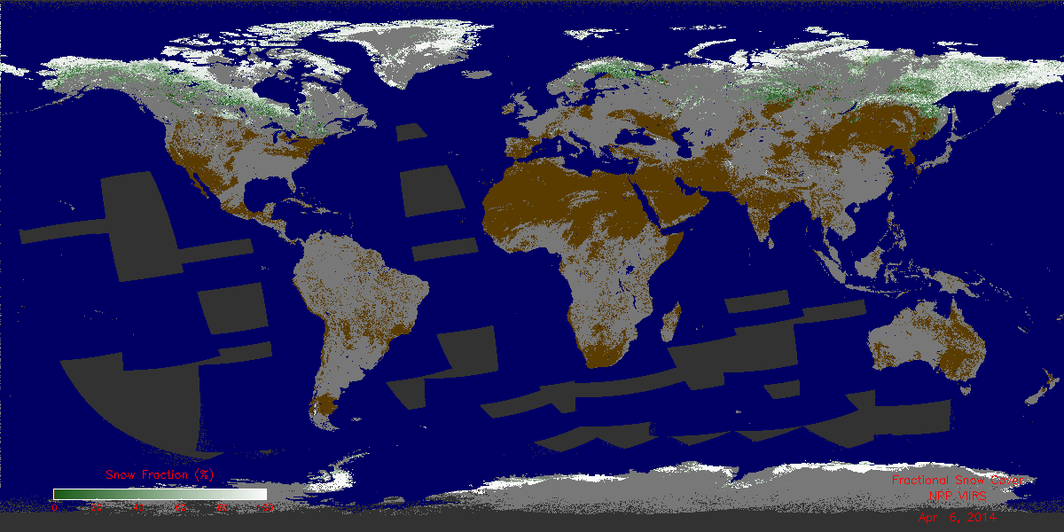
Global Snow Cover Fraction Maps
Since January 2014 VIIRS global gridded snow fraction maps have been derived on a daily basis, see http://www.star.nesdis.noaa.gov/smcd/emb/snow/viirs/viirs-snow-fraction.html.
NDSI-based
Reflectance-based
Clouds are shown in gray, snow-free land surface is brown.

Slide 23
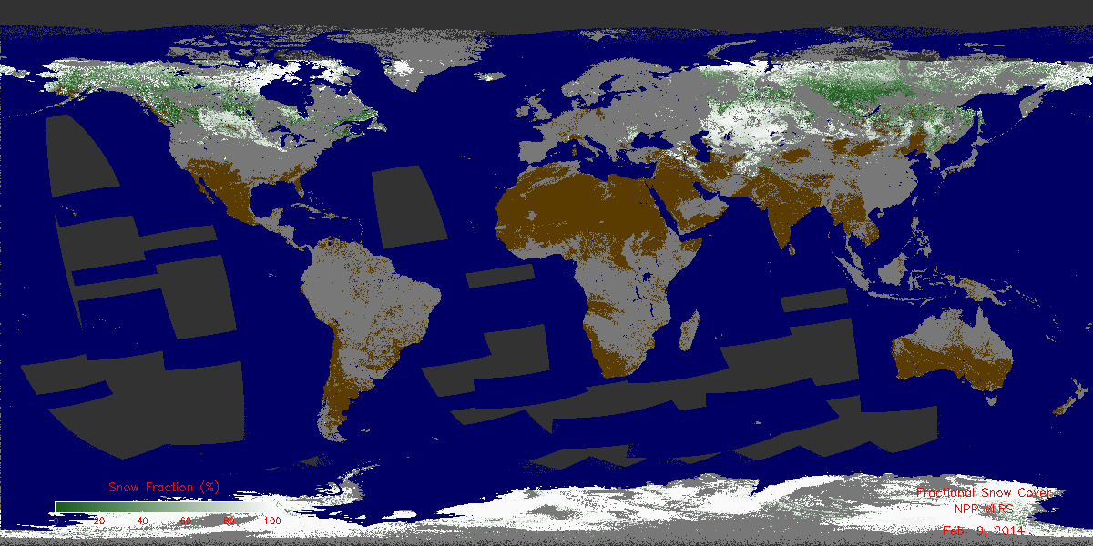
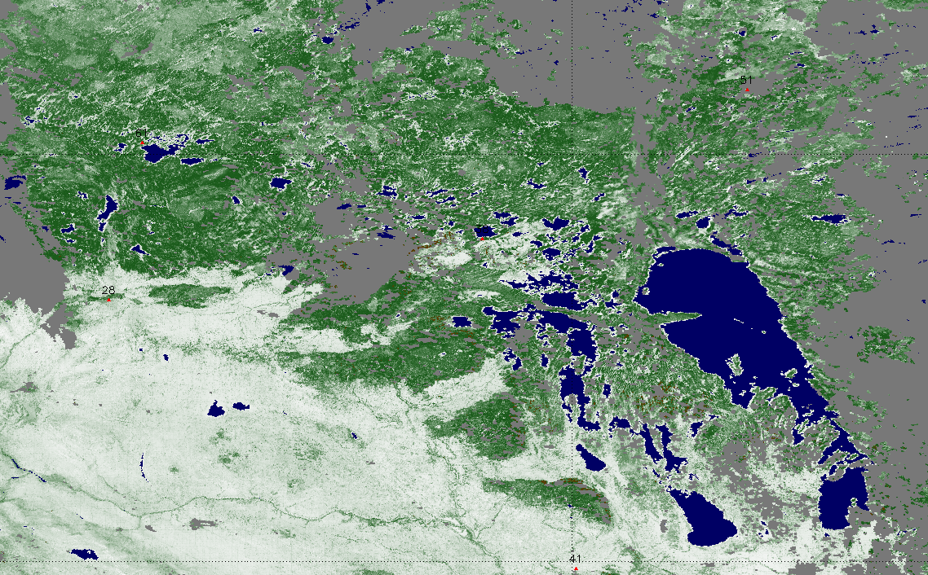
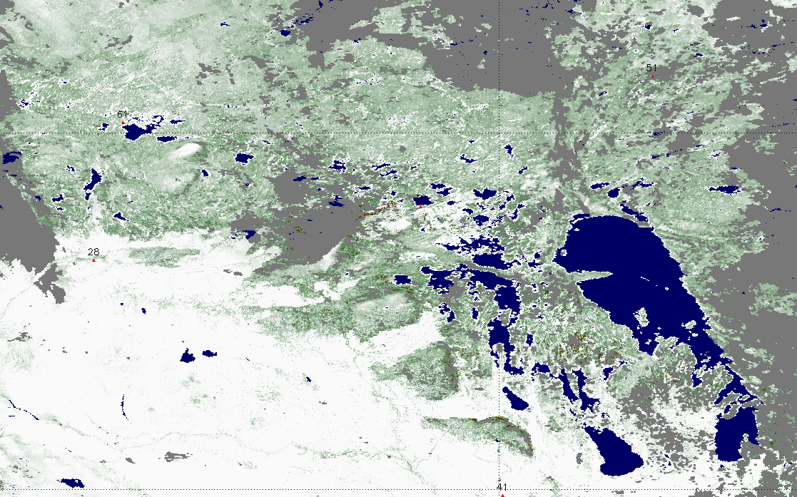
Difference between Snow fraction Maps
There is obvious similarity in the snow fraction patterns in the two products on the regional scale. However NDSI-based snow fraction is much larger in the forest
Reflectance-based snow fraction
Clouds are shown in gray
NDSI-based snow fraction

Slide 24
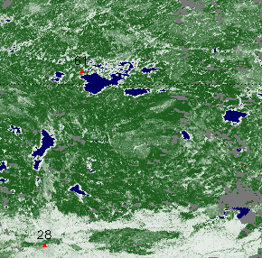
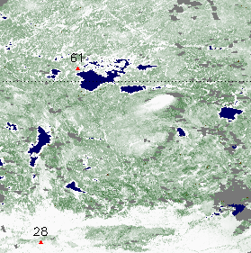
Difference between Snow fraction Maps
There are noticeable differences in the two snow fraction products at the local scale
Reflectance-based
NDSI-based

Slide 25
Role of Changes in Endmembers
The quality of snow cover information provided by remote sensing varies from region to region as well as from day to day depending on
- snow and background surface types
- the geometry of satellite observations
- the state of the atmosphere
Observed changes in pixel reflectances should not be ascribed exclusively to variable fraction, because they depends also on local variability in spectral signatures of the endmembers
Allowing for local variability in spectral signatures of endmembers within a scene is a key requirement to snow algorithms

Slide 26
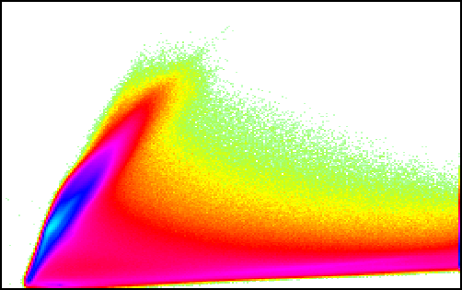
Variability of snow & non-snow reflectances
(within a scene)
The simplest case of a two-dimensional histogram presenting the joint probability densities for Landsat band 2 (X axis) corresponding to VIIRS band M5 (0.64 µm) and Landsat 5 (Y axis) corresponding to VIIRS band M10 (1.61µm) illustrates significant variability in reflections characterizing snow and non-snow endmembers.
Non-snow
endmembers
Shortwave IR reflectance
Mixed pixels
Snow endmembers
Visible reflectance

Slide 27
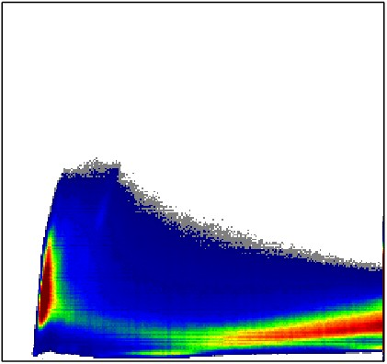
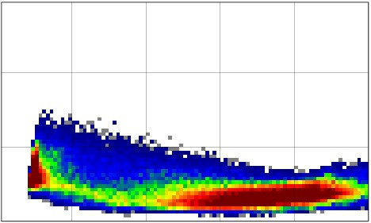
Variability of snow & non-snow reflectances
(within the same scene)
Shortwave IR reflectance
Shortwave IR reflectance
Visible reflectance
Visible reflectance
High resolution observations Moderate resolution observations

Slide 28
Evaluation of NDSI-based and Reflectance-based Snow Fraction Retrievals
FRACTIONAL SNOW DISCUSSION of 07/08/2014
Overall Summary: There are three algorithms:
Spectral unmixture (aka MODSCAG, GOESRSCAG, Painter algorithm),
NDSI-based, and
c) Single band approach (aka Romanov).
Overall agreement that an enterprise algorithm approach is a good idea, but need to assess and compare the results of the three algorithms in order to make a recommendation on which to implement.
“No independent observations of snow fraction are available, direct validation can not be performed” (Romanov)

Slide 29
Alternative algorithm for sub-pixel snow fraction retrieval
Different points of view were formulated during discussions regarding possible alternatives.
Selection needs to be based on the quality of results that need to meet existing requirements (10% uncertainty).
NDSI-based (Solomonson/Appel, Hall/Riggs)
  Linearly relates snow fraction to NDSI (Normalized Difference Snow Index)
  Easy to implement, routinely applied to MODIS
NASA’s fractional snow cover product is based on the NDSI approach. Their estimates show that VIIRS could provide better snow fraction at finer resolution. Accuracy estimates for VIIRS snow fraction using the NDSI algorithm are at about 85-98% depending on viewing conditions, surface and snow cover (George Riggs).

Slide 30
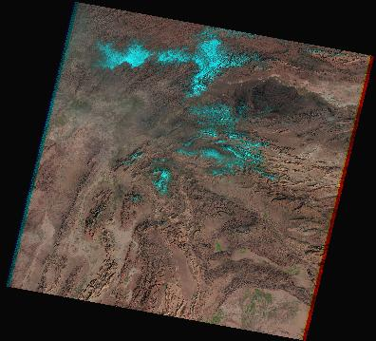
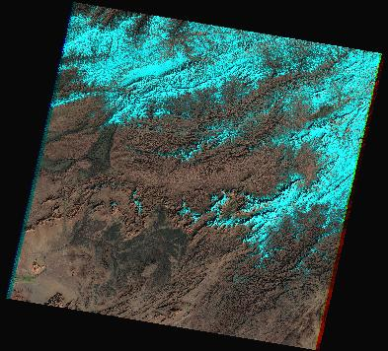
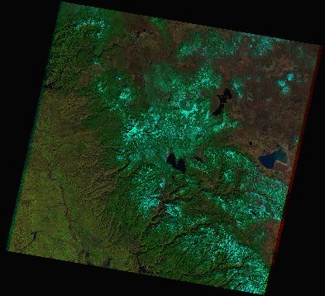
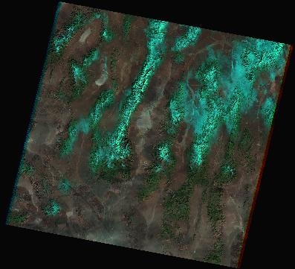
False color Landsat images
Images combining false colors – blue for visible, green for near infrared, and red for short-wave infrared – clearly identify snow (cyan), vegetation (green) and bare ground (brown-redish)
Snow looks very similar in all scenes despite variability of its reflectance

Slide 31


False color Landsat pixels in spectral space
The same false color pixels are presented in the spectral space defined by visible (X axis) and short-wave infrared (Y axis) reflectances
High visible and low short-wave reflectances correspond to snow
Low visible and high short-wave reflectances correspond to non-snow
This is the basis of using NDSI to distinguish snow from non-snow
non-snow
non-snow
Shortwave IR reflectance
Shortwave IR reflectance
snow
snow
vegetation
Visible reflectance
Visible reflectance

Slide 32
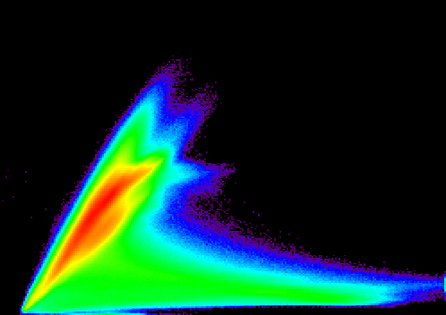
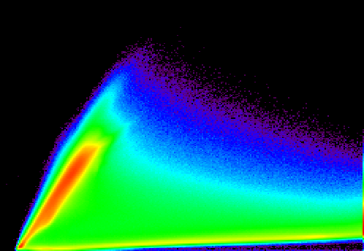
Two dimensional histograms in spectral space
The probability density functions illustrate very typical concentration of snow and non-snow pixels along straight lines characterizing the most probable reflectances of snow and non- snow
Allowing for the features of spectral signatures enhances the retrieval
Shortwave IR reflectance
Shortwave IR reflectance
non-snow
non-snow
snow
snow
Visible reflectance
Visible reflectance

Slide 33
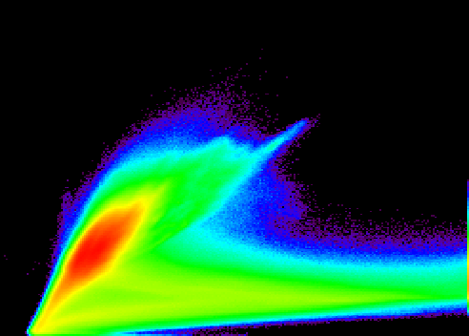
1-band Snow fraction retrieval
Most Landsat pixels could be classified as pure snow or non-snow The algorithm assigns intermediate fractions to those pure pixels – radically underestimates fraction of snow and retrieves snow in non-snow areas (for moderate and high resolution information)
0%
50%
100%
Shortwave IR reflectance
1-band snow fraction retrieval
non-snow
1-band endmembers
snow
-nonsnow
snow
Visible reflectance

Slide 34
NDSI - based retrieval
The NDSI based retrieval fundamentally differs from a 1-band approach. The results of using NDSI (depicted in red color) provide snow fraction using the relationship between reflectances that corresponds to observations.
0%
NDSI snow fraction retrieval
Shortwave IR reflectance
50%
100%
Visible reflectance
Notes:
JK: I’m not sure what this is showing and what it has to do with the single-band approach. Label the axes.

Slide 35
Quantitative estimate of NDSI regression for VIIRS
Landsat scenes selected to validate VIIRS snow products
Date | Path | Row | Sun elevation | Latitude | Longitude | Region
33 | 123 | 32 | 28 | 40 N | 117 E | E China
33 | 139 | 29 | 24 | 45 N | 93 E | W China
33 | 139 | 30 | 25 | 43 N | 93 E | W China
33 | 139 | 31 | 27 | 42 N | 92 E | W China
34 | 41 | 33 | 29 | 39 N | 117 W | Nevada
34 | 41 | 34 | 30 | 37 N | 118 W | Nevada
34 | 146 | 29 | 25 | 45 N | 83 E | W China
35 | 137 | 29 | 25 | 45 N | 96 E | Mongolia
35 | 137 | 30 | 26 | 43 N | 96 E | W China
35 | 153 | 39 | 36 | 30 N | 67 E | Afghanistan
36 | 128 | 30 | 26 | 43 N | 110 E | Mongolia
37 | 30 | 28 | 24 | 46 N | 98 W | N Dakota
39 | 44 | 27 | 24 | 47 N | 119 W | Washington
39 | 44 | 31 | 28 | 42 N | 121 W | Washington
40 | 156 | 35 | 33 | 36 N | 64 E | Afghanistan
40 | 156 | 37 | 35 | 33 N | 64 E | Afghanistan

Slide 36
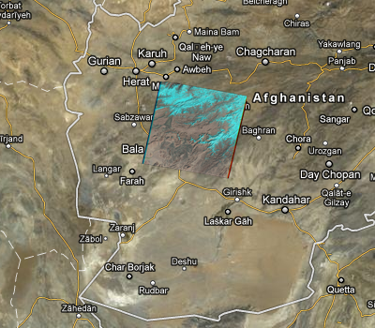
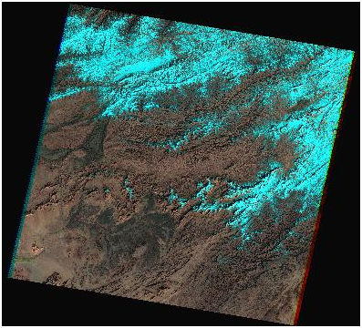
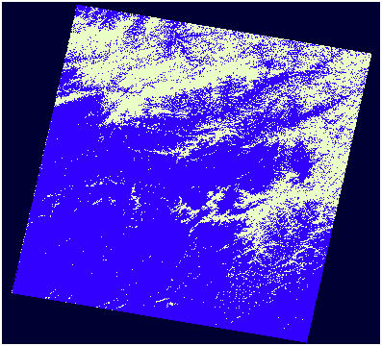
Quantitative estimate of NDSI regression for VIIRS
Location of Landsat scene false color image pixel classification
on 02/09 (path - 156, row – 37)

Slide 37
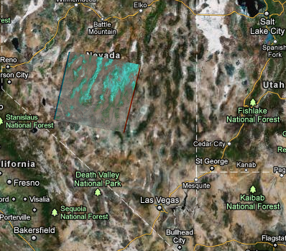
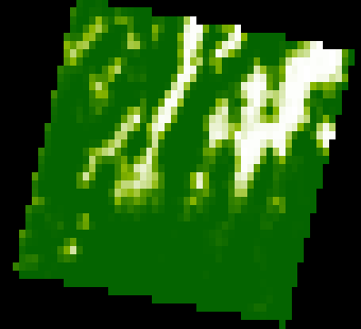
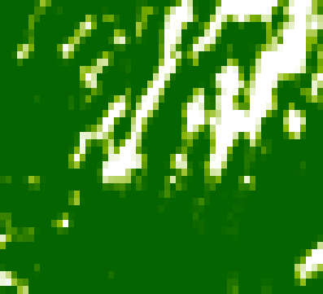
Quantitative estimate of NDSI regression for VIIRS
Location of Landsat scene true and VIIRS fraction
on 02/03 (path - 41, row – 33)
0 0 1
snow fraction palette

Slide 38
Quantitative estimate of NDSI based snow fraction for VIIRS
Statistics characterize high quality of regression on ground truth
Date | Path | Row | Corr. Coeff. | Inter-cept | Slope | Mean true | Mean VIIRS | Location
33 | 123 | 32 | 0.87 | -0.09 | 1.02 | 0.20 | 0.11 | Beijing
33 | 139 | 29 | 0.95 | -0.03 | 0.97 | 0.40 | 0.36 | Altay
33 | 139 | 30 | 0.95 | -0.07 | 1.06 | 0.61 | 0.57 | Xinjiang 1
33 | 139 | 31 | 0.97 | -0.01 | 1.00 | 0.20 | 0.19 | Xinjiang 2
34 | 41 | 33 | 0.98 | -0.01 | 0.92 | 0.20 | 0.18 | Nevada
34 | 41 | 34 | 0.96 | -0.01 | 1.02 | 0.07 | 0.06 | Sierra
34 | 146 | 29 | 0.94 | -0.03 | 1.06 | 0.68 | 0.68 | Tian Shan
35 | 137 | 29 | 0.95 | -0.03 | 1.00 | 0.52 | 0.49 | W Mongolia
35 | 137 | 30 | 0.96 | 0.01 | 0.94 | 0.35 | 0.34 | Gobi
35 | 153 | 39 | 0.78 | -0.01 | 0.65 | 0.05 | 0.02 | Pakistan
36 | 128 | 30 | 0.90 | 0.08 | 0.93 | 0.92 | 0.94 | S Mongolia
37 | 30 | 28 | 0.94 | 0.24 | 0.78 | 0.80 | 0.87 | Dakotas
39 | 44 | 27 | 0.95 | -0.01 | 1.04 | 0.19 | 0.18 | Spokane
39 | 44 | 31 | 0.91 | 0.03 | 1.07 | 0.22 | 0.26 | Oregon
40 | 156 | 35 | 0.96 | -0.01 | 1.06 | 0.09 | 0.09 | N Afghanistan
40 | 156 | 37 | 0.94 | -0.05 | 1.18 | 0.27 | 0.26 | C Afghanistan

Slide 39
Summary of quantitative estimate of
NDSI regression approach
average regression coefficient is 93% despite a couple of low magnitudes
average intercept of linear regression line is less than 1% (negative)
average slope of linear regression line is 0.98
average bias of data is less than 1%
average standard deviation is 10%
Because the standard deviation varies between 4% for snow coverage close to 0% and 100% to 14% for snow coverage in the range 40% - 60%, the uncertainty for entire areas covered by snow will be certainly less than 10% (the requirement) even before any modification/enhancement.

Slide 40
Additional Supporting Documentation
Publications and Presentations.
  Key, J. R., R. Mahoney, Y. Liu, P. Romanov, M. Tschudi, I. Appel, J. Maslanik, D. Baldwin, X. Wang, and P. Meade, 2013, Snow and ice products from Suomi NPP VIIRS, J. Geophys. Res. Atmos., 118, doi:10.1002/2013JD020459.
  Appel I. (2011) Improvement of the NPP VIIRS fractional snow cover EDR for creation of a climate data records using MODIS and VIIRS. Remote Sensing and Geoinformation, 182 -190.
  Romanov P., Appel I. (2012) Mapping Snow Cover with Suomi NPP VIIRS, EUMETSAT Conference, Gdansk, Poland, September 2012.
  Romanov P., Appel I. (2012) Snow cover products from Suomi NPP VIIRS: Current status and potential improvements, IGARSS, Munich, Germany, July 2012.
  Romanov P., Appel I. (2012) Mapping Snow Cover with Suomi NPP VIIRS, NOAA 2012 Satellite Science Week. Meeting. Summary Report. April 30 – May 4, 2012. Kansas City, Missouri.
  Appel. I. (2012) Improved VIIRS Snow Cover Information for Terrestrial Water Cycle Applications. AGU Chapman Conference on Remote Sensing of Terrestrial Water Cycle, Kona, Hawaii, February 2012.
  Appel. I. (2012) Validation and Potential Improvements of the NPP Fractional Snow Cover Product Using High Resolution Satellite Observations. 32nd EARSeL Symposium and 36th General Assembly, Mykonos, Greece, May 2012.
  Appel I. (2013) Remote Sensing Information for Snow Monitoring. Third International Symposium on the Arctic Research, Tokyo, Japan, January 2013.
Appel I. (2014) The Influence of Uncertainty in Cloud Masking on the Quality of VIIRS Snow Products. Land product Validation and Evolution Workshop, Rome.
Appel I. (2014) The Influence of Observation Geometry on the Quality of VIIRS Snow Products. 7th EARSeL LISSIG Workshop, Bern
Appel I. (2014) Retrieval and Validation of VIIRS Snow Cover Information for Terrestrial Water Cycle Applications in Remote Sensing of the Terrestrial Water Cycle, edited by Venkataraman Lakshmi, AGU, Washington, D. C. and Wiley, Hoboken, N. J.

Slide 41
Conclusions
VIIRS observations give the opportunity of daily snow fraction mapping at 375 m (or at least 800 m) at nadir, that is adequate for most applications
A number of needed enhancements to algorithms are foreseen to improve the accuracy of snow retrievals to meet requirement to the uncertainty of the VIIRS snow fraction
The optimal approach to improve moderate resolution remote sensing information on snow fraction will allow for the variability of snow and non-snow properties within a scene-specific snow algorithm

Slide 42
Path Forward
To meet the product accuracy requirements the current VIIRS Fractional Snow Cover Algorithm has to be replaced by a more advanced algorithm estimating the sub-pixel snow cover fraction
Recommendation: Implement the NDSI-based algorithm in the IDPS.
Longer-range plan: Improve, test and implement the spectral unmixing algorithm.

Slide 43
Possible Approach to Replace Algorithm
To begin doing the following
Implement a simple algorithm making some enhancements to improve the retrieval quality
Consider potential use of other algorithm advantages
Make the emphasis on the comparative quantitative estimate of fractional snow product quality for global coverage
In the case if further improvements are needed
It is very reasonable to assume that the uncertainty requirements could be met only if specific local conditions are taken into consideration
Estimate applicability of scene specific approaches to modify the algorithms

Slide 44
Long-Range Plans, Milestones
 | Suomi NPP | JPSS J1
FY15 | Implement, test, and deliver new fractional snow cover algorithm Continued validation of snow products Recommendations on snow/ice gridding | JPSS Risk Reduction Projects: Consider applicability of GOES-R algorithms for VIIRS products Minor algorithm improvements
FY16 | Algorithm maintenance and minor improvements | Hold algorithm preliminary design reviews Define enhanced validation plan
FY17 | Long-term validation of VIIRS snow products | Hold algorithm critical design reviews Begin transitioning to JPSS Redefine products if needed
FY18 | Long-term validation of VIIRS snow products | J1 launch Beta maturity status

