Slide 1


STAR Algorithm and Data Products (ADP)
Provisional Maturity Review
Suomi NPP Surface Type EDR Products
X. Zhan, C. Huang, R. Zhang, K. Song,
M. Friedl, D. Sulla-Menashe
Y. Tang, M. Tsidulko, R. Mahoney, A. Sei, D. Cumpton
Presented by X. Zhan
09/10/2014

Slide 2
Presentation Outline
Overview of Surface Type EDR
Development of 1st VIIRS QST IP
1st VIIRS QST IP compared with MODIS products
Summary and future plan

Slide 3
VIIRS Surface Type EDR Team
Xiwu Zhan (NOAA/NESDIS/STAR)
  Surface Type EDR team lead, User outreach
Chengquan Huang (UMD/Geography)
  Algorithm development lead
Rui Zhang/Kuan Song (UMD/Geography)
  Algorithm development
  QST Product generation
  User readiness
Mark Friedl (Boston University)
  Cal/Val lead
Damien Sulla-Menashe (Boston University)
  Ground truth data development
  Product validation
  MODIS land cover products as QST IP seed

Slide 4
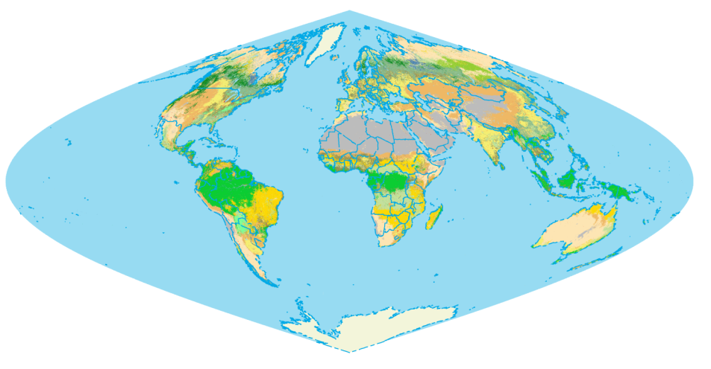
User Needs for Surface Type Products
Essential Climate Variable
  Modeling studies (Primary user: NCEP land team led by M. Ek)
    Land surface parameterization for GCMs
    Biogeochemical cycles
    Hydrological processes
  Carbon and ecosystem studies
    Carbon stock, fluxes
    Biodiversity
Feed to other VIIRS products
  BRDF/Albedo
  Land surface temperature (LST)
Surface type change monitoring
  Snow cover
  Burned area (TBD)
  Flooding/deforestation/etc (TBD)

Slide 5
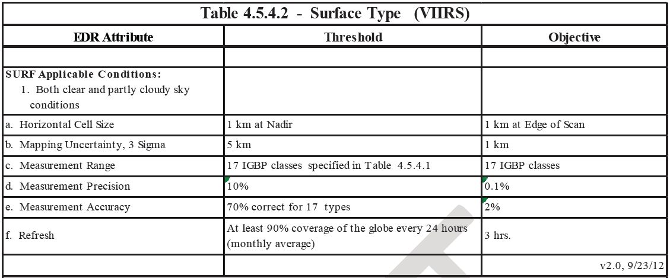
L1RD Requirements
*
*
* Current IDP product was designed to meet heritage NPOESS requirements. Beta evaluation is done against those heritage requirements. Precision and accuracy numbers are to be corrected in the JPSS L1RD.

Slide 6
Existing Global Surface Type Products
Product | Sensor | Resolution | Data range | Classification method | Accuracy | Source
GlobCover | MERIS | 300 m | 2005 | Classification and labeling | 73% | Defourny et al., 2007
MODIS LC-Collection 5 | MODIS | 500 m | 2005 | Decision tree | 74.8% | Friedl et al., 2010
MODIS LC-Collection 4 | MODIS | 1 km | 2001 | Decision tree | ~75% | Friedl et al, 2002
DISCover | AVHRR | 1 km | 1992.4-1993.3 | Clustering and labeling | 66.9% | Scepan, 1999
UMD-1km | AVHRR | 1 km | 1992.4-1993.3 | Decision tree | 69% (training) | Hansen et al., 2000
GLC2000 | SPOT-VEGE TATION | 1 km | 1999.11-2000.12 | Regional experts | 68.6% | Mayaux et al., 2006

Slide 7
Overview of VIIRS Surface Type EDR
Describes surface condition at time of each VIIRS overpass
Produced for every VIIRS swath/granule
  Same geometry as any VIIRS 750m granule
Two major components
  Gridded Quarterly Surface Type (QST) IP
    Remapped to the swath/granule space for each VIIRS acquisition
    Requires one full year of VIIRS data
    Just developed, subject of this review
  Includes flags to indicate snow and fire based on
    Active fire Application Related Product (ARP)
    Snow EDR
Vegetation Fraction is included, but will be replaced by NDR GVF

Slide 8
History of ST EDR Related DRs
Date | DR # | Reason | Status
11/18/2011 | 4452 | ST rename vegetation fraction | NDE provides separate GVF product in future
11/18/2011 | 4458 | C5 Decision tree replacement | UMD to upgrade QST IP algorithm with SVM in future
11/18/2011 | 4459 | QST IP goes to annual | To be approved in future
05/22/2012 | 4707 | Update QST IP seed data | Completed with MODIS C5 LC
09/12/2012 | 4900 | Remove new QST IP Seed fill values | Completed with update MODIS C5 LC
01/14/2013 | 7002 | ST EDR Beta review | Completed, with a focus on ST EDR
03/2013 | 7090 | ST EDR update for use of snow rolling tile | Approved, DPE implemented
09/2013 | 7329 | ST EDR controller cores without optional input VCM | Changed VCM to required input
10/2013 | 7549 | ST EDR Vegetation Fraction fill value | Changed to produce VF only for clear sky without aerosol impact
01/2014 | 7522 | Update IDPS with new VIIRS QST-IP/QST-LWM (CCR 1700) | Test data from Mx8.4 indicates installation of the new QST-IP/QST-LWM tiles successful

Slide 9
Current Status of Surface Type EDR
Provisional maturity science review done in Jan 2014:
  1st VIIRS QST IP (gridded) based on pure VIIRS 2012 data was generated;
  Preliminary quality check indicates reasonable quality
Improvements since beta review:
  Change snow fraction from 0.75 to 0.5 in aggregating Snow EDR from 375m to 750m before being copied to Surface Type EDR
  Use rolling tile snow products when VIIRS Snow EDR not available
  Vegetation fraction fill value issues addressed
  Mx8.4 test data indicated that new VIIRS QST-IP/QST-LWM has been correctly installed in IDPS

Slide 10
What to look for in this review
Development of VIIRS QST IP
  VIIRS data processing
    Gridding
    Compositing
    Annual metrics generation
  Training data collection
  Classification
QST IP assessment
  Comparison with MODIS Collection5
  Mx8.4 test data evaluation
Next steps

Slide 11
VIIRS QST IP Overview
Global surface type product
  Gridded, 1km
  17 IGBP surface type classes
  Required typing accuracy ~70%
  Generated quarterly to reflect recent changes
    Based on gridded surface reflectance products (IDPS version still being evaluated)
    Use decision tree (C5.0) classifier
    Requires training data

Slide 12
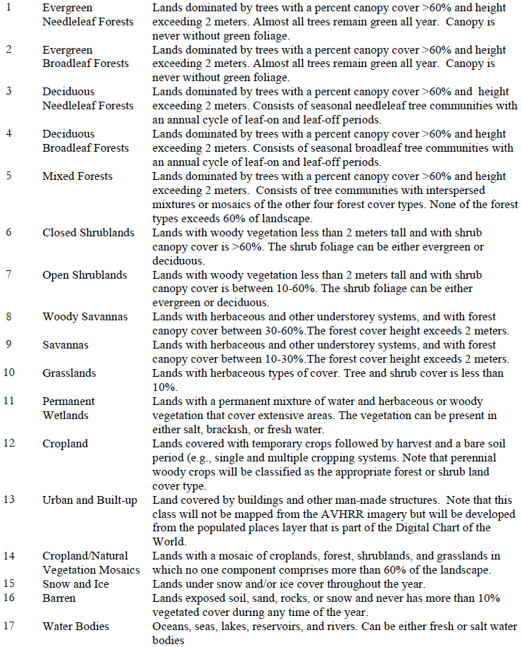
Surface Types in QST IP
Classes separated by a threshold value more likely to be confused:
Closed vs open shrublands
Forest vs woody savanna vs savanna
Cropland vs cropland/natural vegetation mosaics

Slide 13
Data Flow of QST IP Algorithm
VIIRS surface reflectance data (swath)
Gridding
Gridded surface reflectance data
Compositing
Global composites (daily)
Compositing

Slide 14
Overview of QST IP Algorithm and Product Assessment Approaches
VIIRS surface reflectance data (swath)
Gridding
Training sample
Validation data
Gridded surface reflectance data
Compositing
Decision tree
Support vector machines (SVM)
Global composites (daily)
VIIRS QST IP product
Compositing
Global composites (32-day)
Other surface type products
Metrics generation
Annual metrics (global)

Slide 15
Gridding, Compositing, Annual Metrics (GCAM) Overview
VIIRS surface reflectance data (swath)
Required before classification
  Remove cloud/shadow
  Annual metrics globally more consistent
Should be done by IDPS, but gridded data not available until recently
  processed in-house at UMD
  Improvements possible
    Composites comparable to or better than MODIS composites
Gridding
Gridded surface reflectance data
Compositing
Global composites (daily)
Compositing
Global composites (32-day)
Metrics generation
Annual metrics (global)

Slide 16
Gridding
Done in house at UMD
  No gridded data from IDPS until late 2012
  Solution provided by Land PEATE
    MODIS like VIIRS data (5-minutes aggregation)
    Gridding tool
  Fully automated downloading and gridding scripts
  All 2012 VIIRS data required by QST IP processed
    ~880,000 files (80,000 granules x 11 bands), totaling ~150 TB
    > 30,000 CPU hours

Slide 17
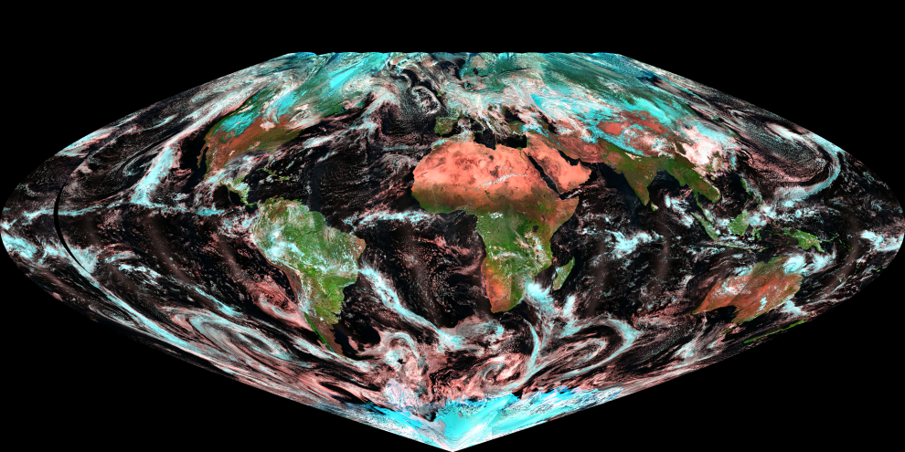
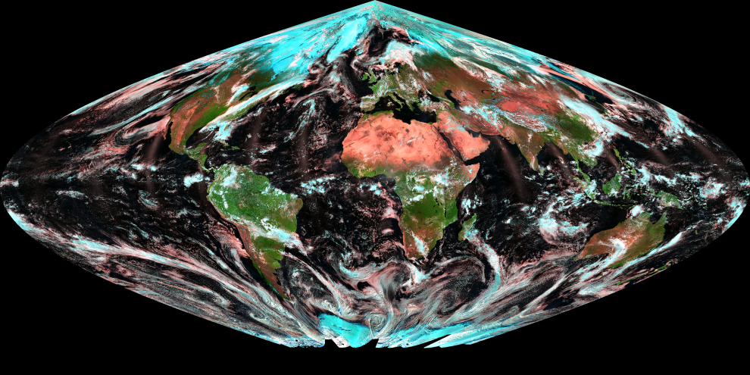
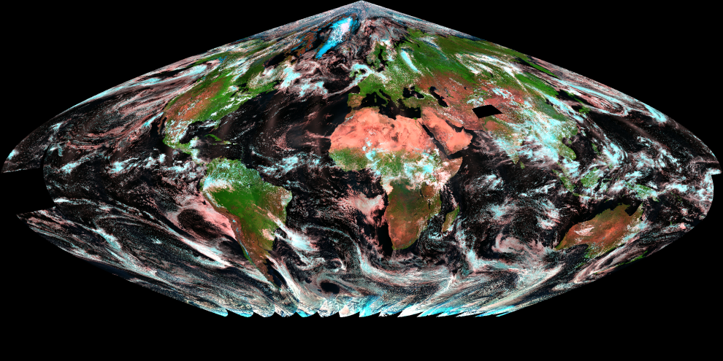
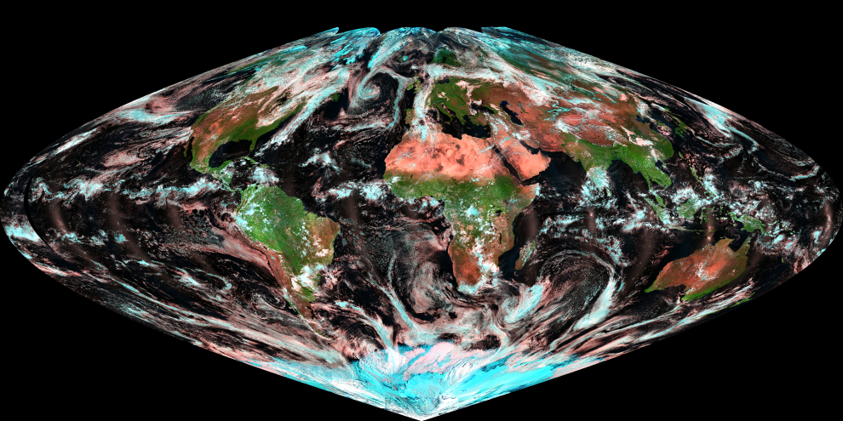
Global Mosaics of Gridded Daily Data
2012-021
2012-112
2012-200
2012-295

Slide 18
Compositing
Required for reducing cloud/shadow contamination
MODIS algorithm: “best” quality
  Requires good quality flags and cloud mask
Surface Type ATBD algorithm: Controlled View Angle Max NDVI
  Max NDVI has many known issues
    Tends to choose off-nadir view observations
    Cloud selected over water
    Problematic over non-vegetated areas
  Improved Max NDVI
    Compositing priority: vegetated > soil > water > snow > cloud

Slide 19
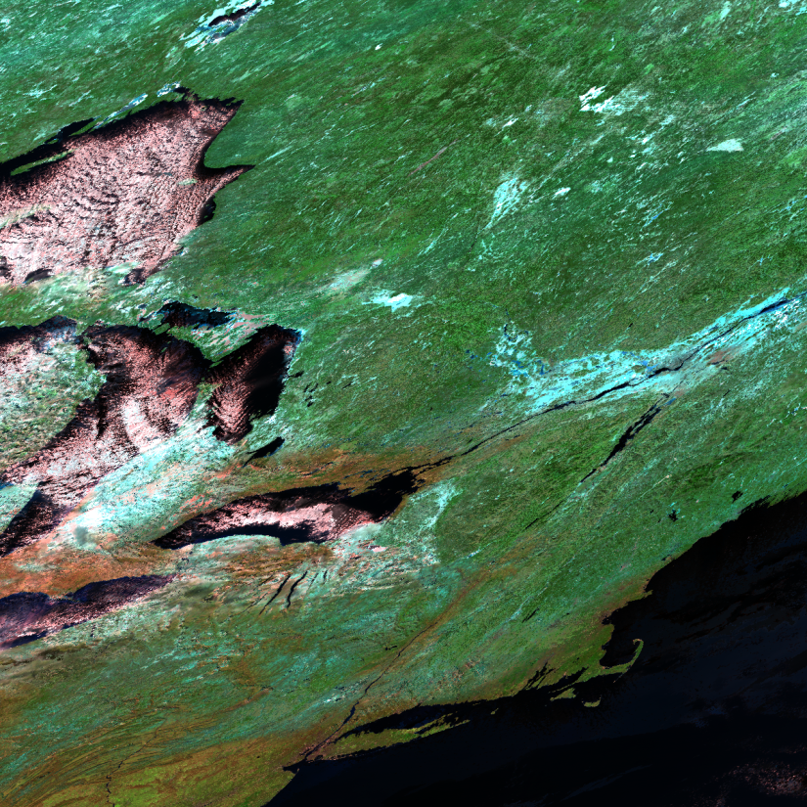
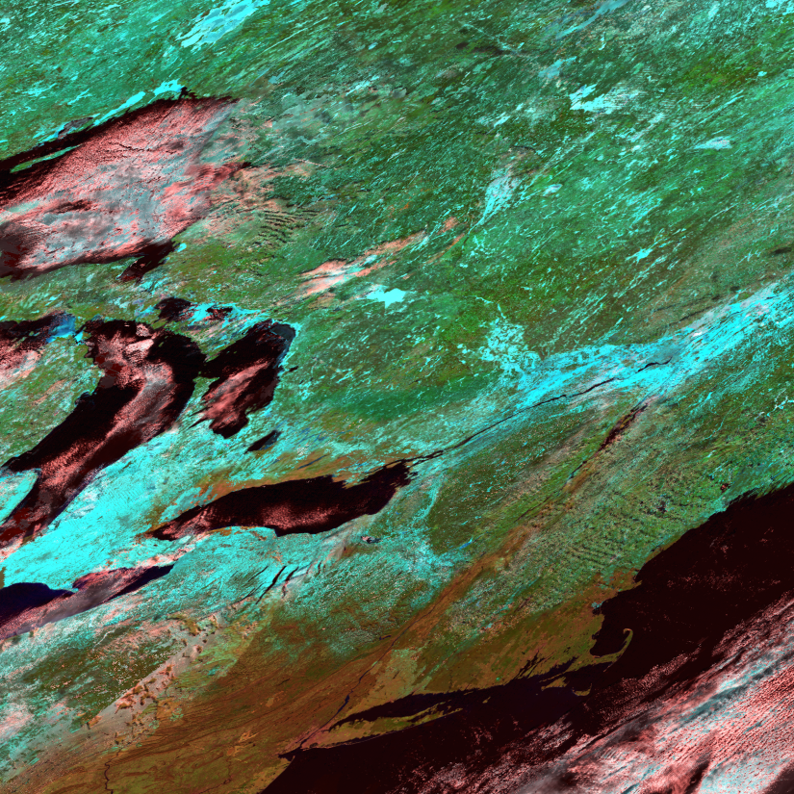
VIIRS Composites Comparable with Standard MODIS Composites (MOD09A1)
MODIS tile H12v04 (New York to Great lakes), 8-day (2012/193-200)
Better composites over water
VIIRS, M11-7-5
MODIS, B7-2-1

Slide 20
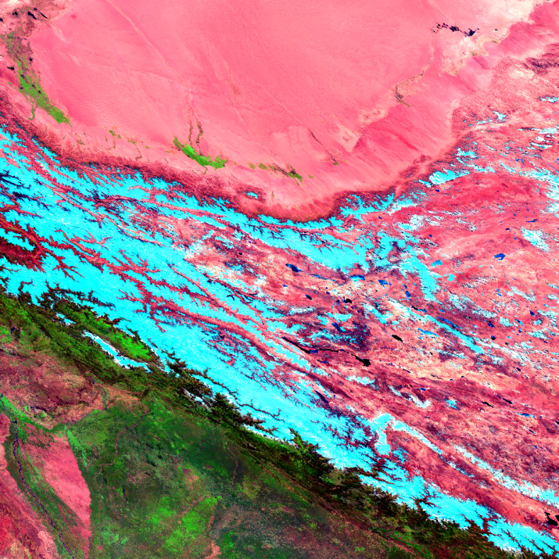
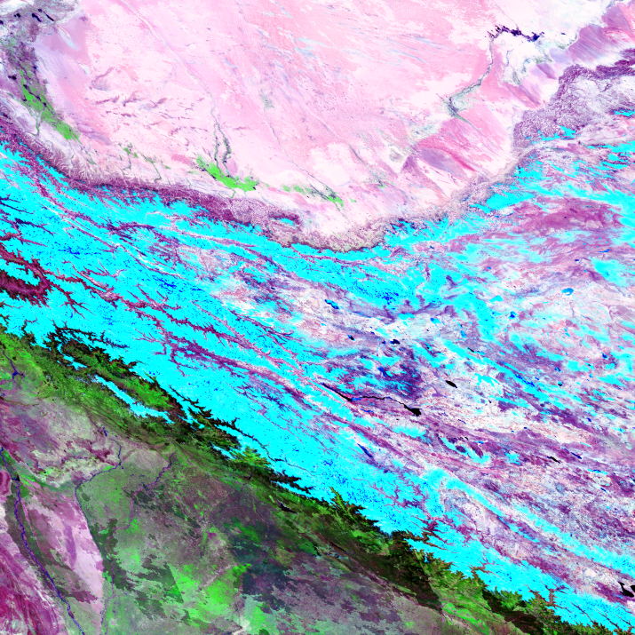
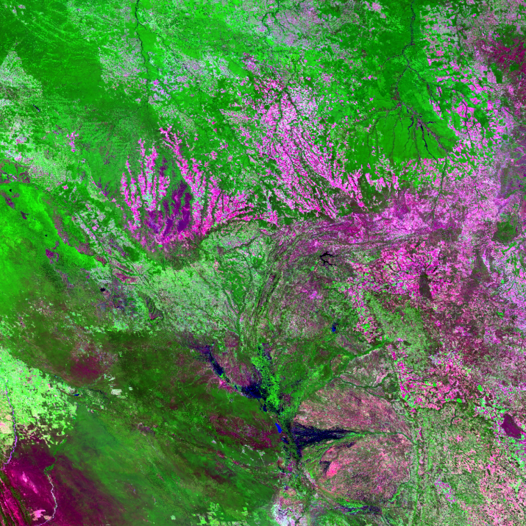
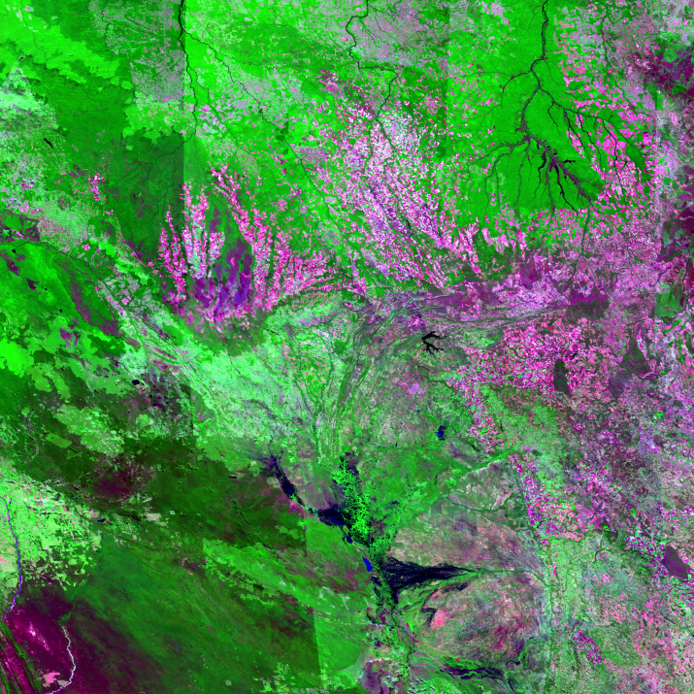
More Comparison with MODIS Composites
H12v04 (western China)
2012/193-200
Less snow pixels selected
H12v10 (Brazil, Arc of Deforestation)
2012/193-200
Less artifacts (swath boundary)
VIIRS, M11-7-5
MODIS, B7-2-1

Slide 21



Cloud Reduction through Compositing
Daily (2012/200)
32-day (2012/193-224)
8-day (2012/193-200)

Slide 22




Global Mosaics of 32-day Composites
2012/1-32
2012/97-128
2012/193-224
2012/289-320

Slide 23
Use of Annual Metrics
Based on metrics developed by Hansen et al for AVHRR land cover and MODIS VCF
  Further cloud removal in the 32-day composites
  Normalize differences between the northern and southern hemisphere
  Better reflect vegetation phenology and other surface characteristics
    Some metrics could be sensitive to residual clouds in the 32-day composites

Slide 24

Annual Metrics from VIIRS
– 2012 Median NDVI

Slide 25


VIIRS 2012 Growth Season NDVI Variation
0 0.8

Slide 26

Median of the Three Warmest 32-day Composites
(M11, M7, M5 in RGB)

Slide 27

Late Spring (97-128) 32-day Composite

Slide 28
Annual Metrics (76 Total) Used
NDVI Metrics:
  Second maximum monthly NDVI in a year
  Minimum NDVI value in the highest 7 monthly NDVIs
  Median NDVI in the highest 7 monthly NDVIs
  Range of NDVI in the highest 7 monthly NDVIs
  Median NDVI in the 5 warmest months
  NDVI of the warmest month
Reflectance Metrics (VIIRS M bands 3-8, 10, 11, 15):
  Second maximum reflectance, during the 7 greenest in the year
  Minimum reflectance, during the 7 greenest months
  Median reflectance of the 7 greenest months
  Range of reflectance, among the 7 greenest months
  Median reflectance of the 5 warmest months
  Reflectance of the month with the second highest NDVI in the year
  Reflectance of the warmest month

Slide 29
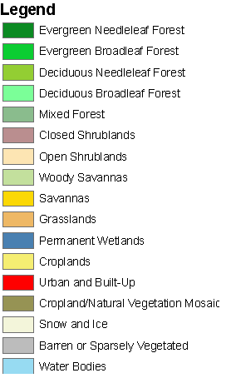
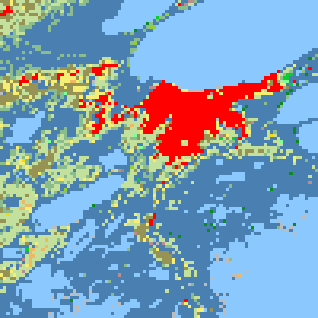

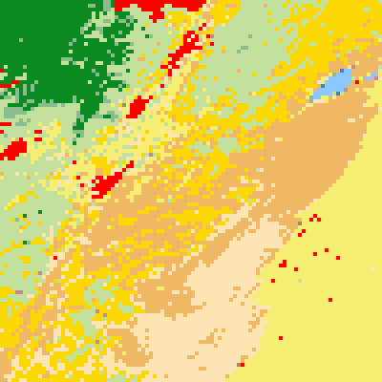

Training Data Distribution
Class | Training Points
1 | 518
2 | 937
3 | 190
4 | 738
5 | 673
6 | 204
7 | 1114
8 | 854
9 | 697
10 | 1398
11 | 1179
12 | 3739
13 14 | 579
15 | 314
16 | 674
Land Cover in Louisiana Training pixels
These training points were provided by Boston University, in 500m resolution. They were majority-sampled into 1000m resolution for VIIRS classification
Land Cover in CA Training pixels

Slide 30
Classification Algorithm – Decision Tree
X > a?
Easy-to-understand decision rules
Improved accuracy through ensemble (boosting)
Robust for global applications
  Base algorithm for several existing global surface type products (Hansen et al., 2000; Friedl et al., 2002; 2010)
  Specified in ATBD
N
Y

Slide 31
Decisions Made Based on Information Theory
  For each variable, try all possible ways to split the training samples
  For each split, calculate the following:
  The selected split maximizes the Gain_Ratio
    Different DT algorithms may use different criteria
  Applied recursively

Slide 32
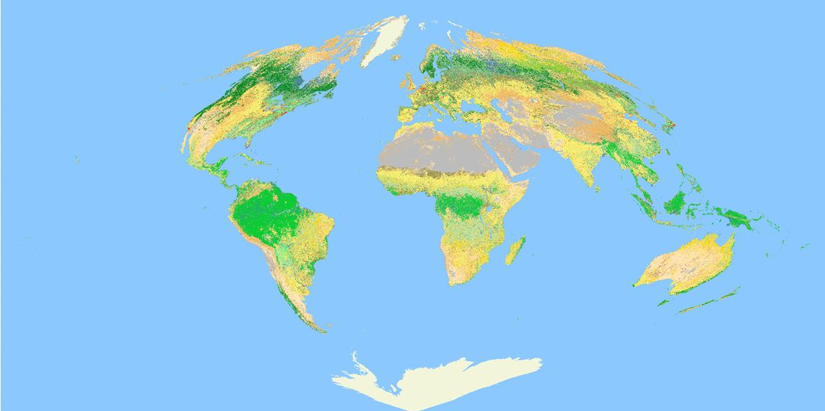
First VIIRS QST IP from 2012 VIIRS Data

Slide 33
Comparison with MODIS Land Cover Products
MODIS Collection 4 (C4) land cover product
  Derived using annual MODIS data
  Decision tree
  Reported accuracy: ~75%
  Initial seed in IDPS
MODIS Collection 5 (C5) product
  Derived using multi-year MODIS data
  Decision tree
  Post-classification process
  Use class prior probability
  Reported accuracy: 74.8%
  Currently used as seed in IDPS

Slide 34


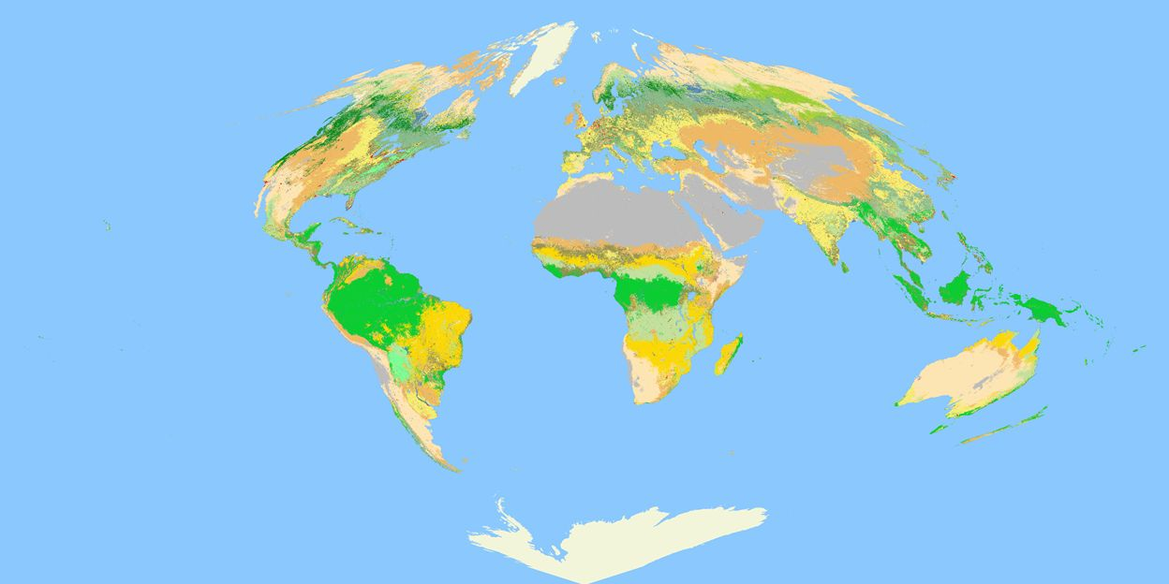
Comparison with MODIS C4/C5 LC
VIIRS QST IP
MODIS C4 LC
MODIS C5 LC

Slide 35
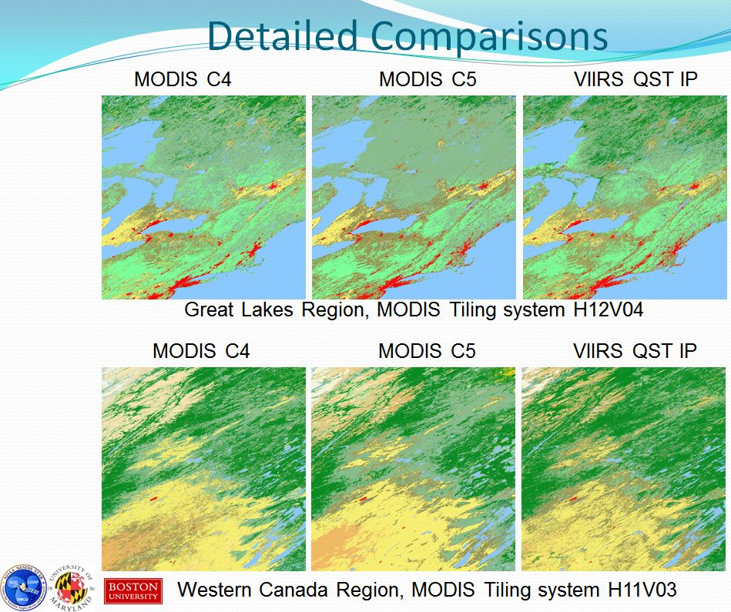
Detailed Comparisons

Slide 36
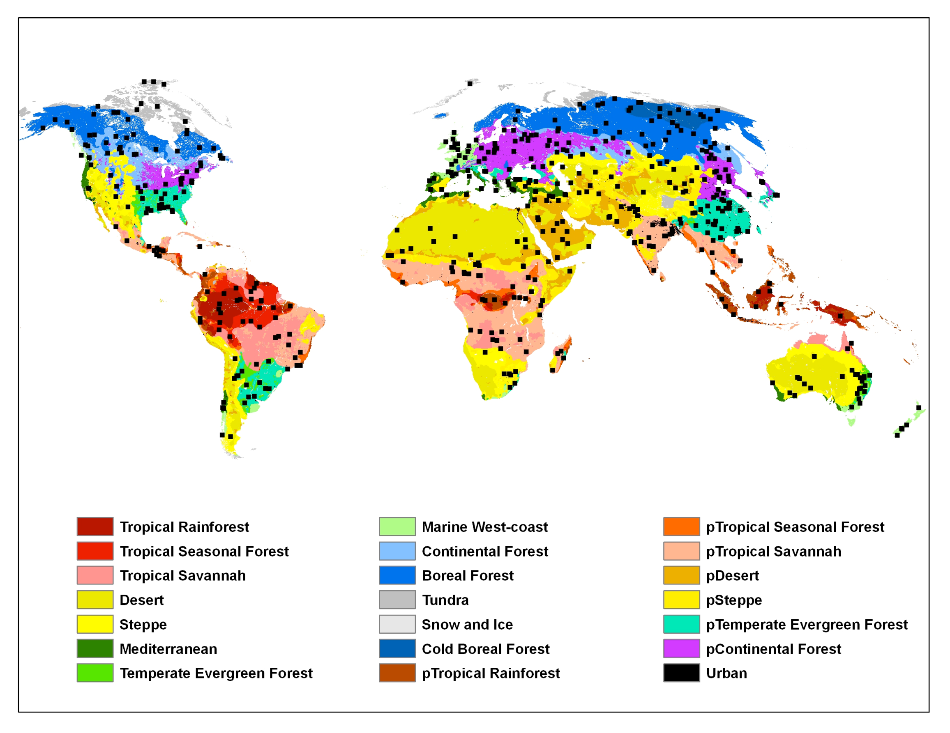
Validation Sample Design
Each sample block (black squares) contains between 10 and 35 1-km VIIRS pixels.
Notes:
The independent global validation dataset was based on a stratified random sample of 500 blocks. The strata used were based on an intersection between Koppen climate zones and population density. Proportionally more samples were allocated to heterogeneous and more heavily populated regions.

Slide 37
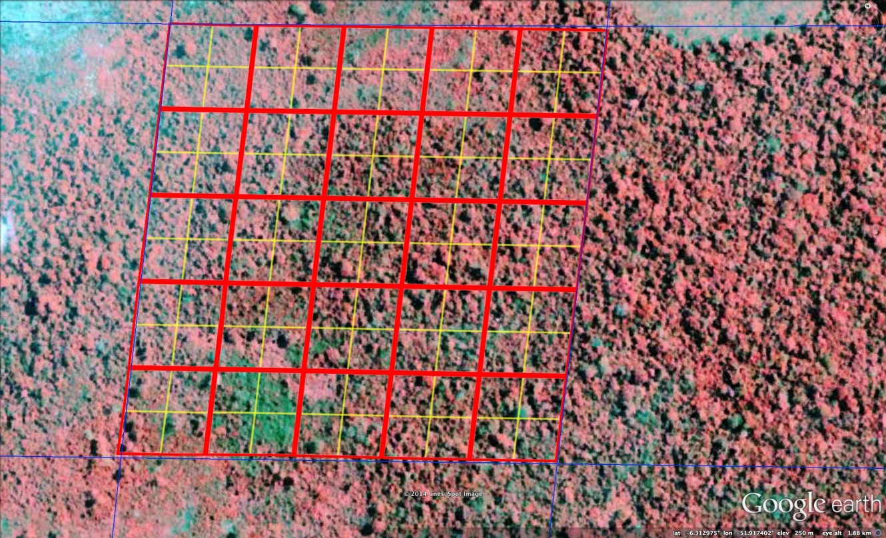
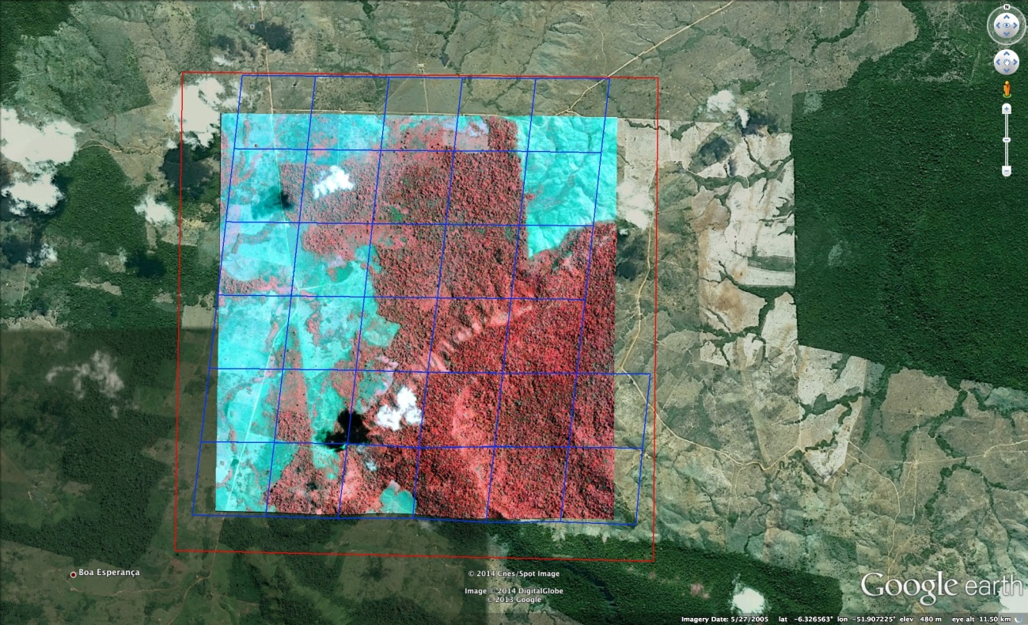
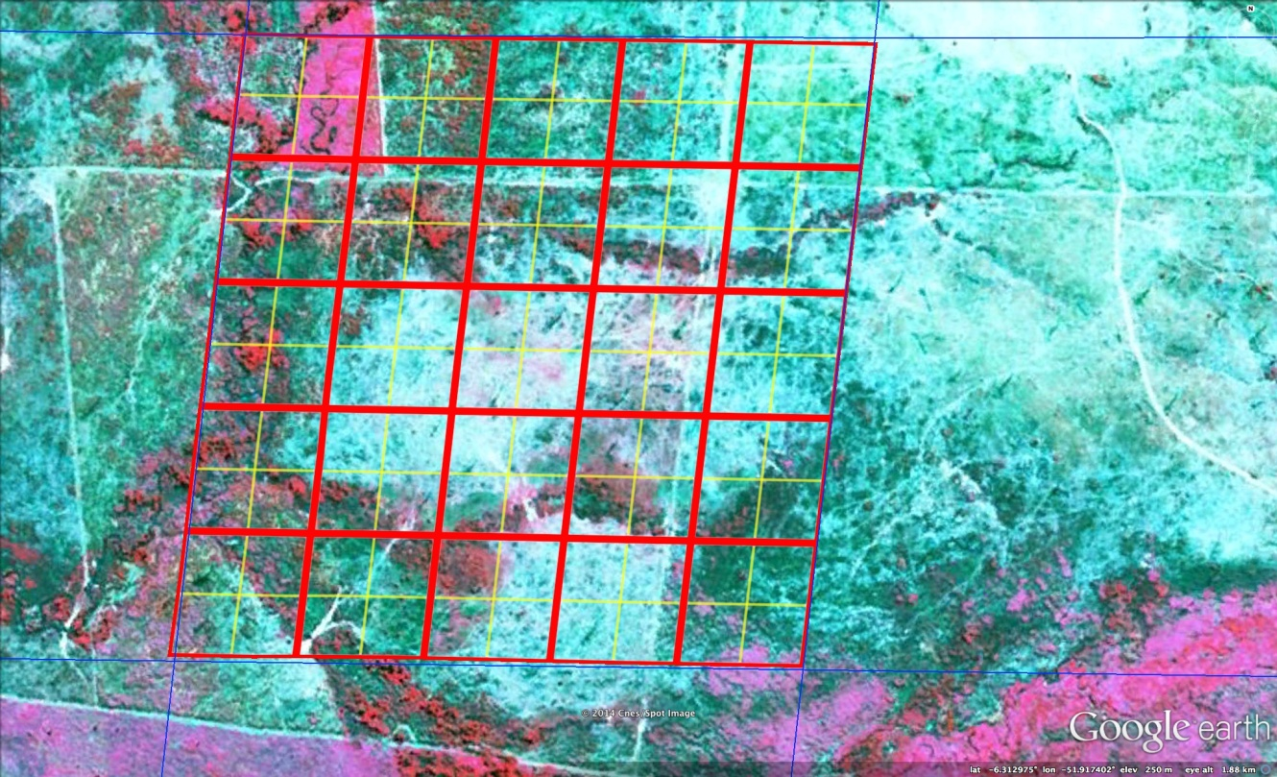
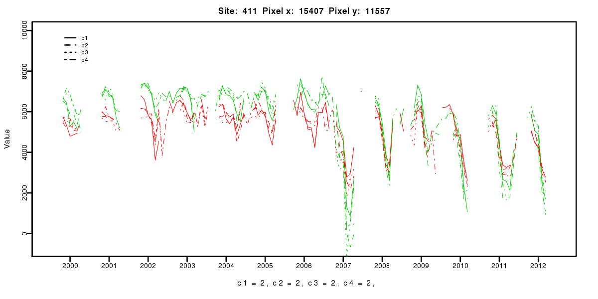
Illustration of Validation Interpretation Protocol
2004
Sample VIIRS pixel for two different years 2007 and 2011.
Full validation block in GoogleEarthTM with sample pixel highlighted in red.
Change (deforestation) identified from MODIS time series as occurring for sample pixel (right) in 2007.
2011
Notes:
Each validation block contains between 10-35 VIIRS 1km pixels. This is an example of our validation tool built in Google Earth. For each pixel here we provide a IGBP class valid for the 2010-2014 period and the presence of any land cover change that might make that label invalid.

Slide 38
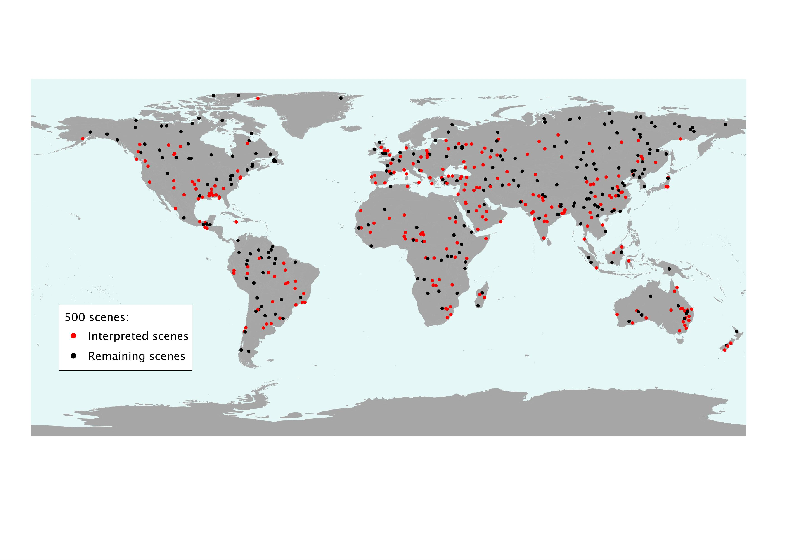
Interpretation Status for 500 blocks
We have completed 260 of the 500 sample blocks (red points).
Notes:
We have interpreted a little more than half of the 500 blocks. We have also completed 104 out of a subsample of 121 priority scenes representing about 20% of the 500 blocks. There is a lack of available imagery at high latitudes making interpretation of those sites very difficult. We have an agreement with our partners at NASA-NGA to collect those data over the upcoming summer months.

Slide 39
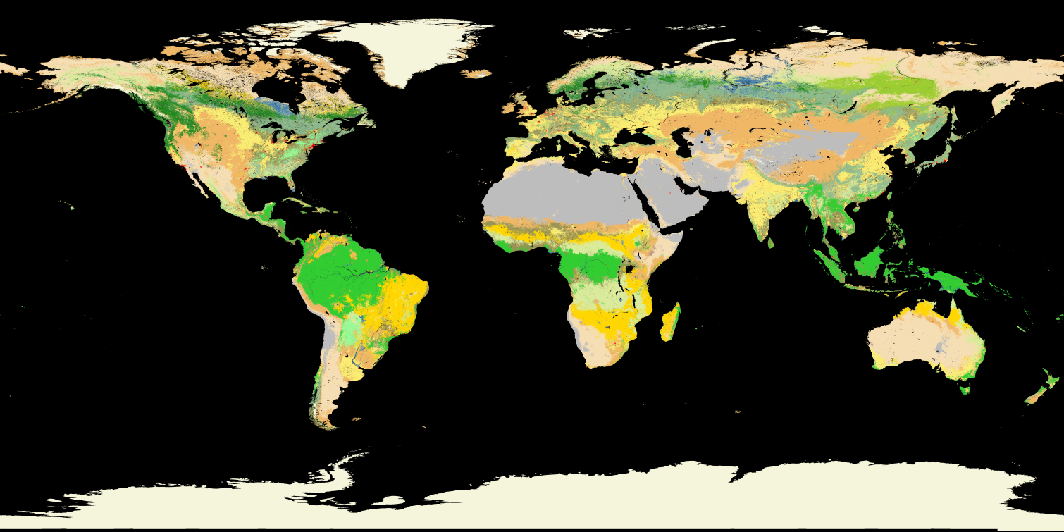
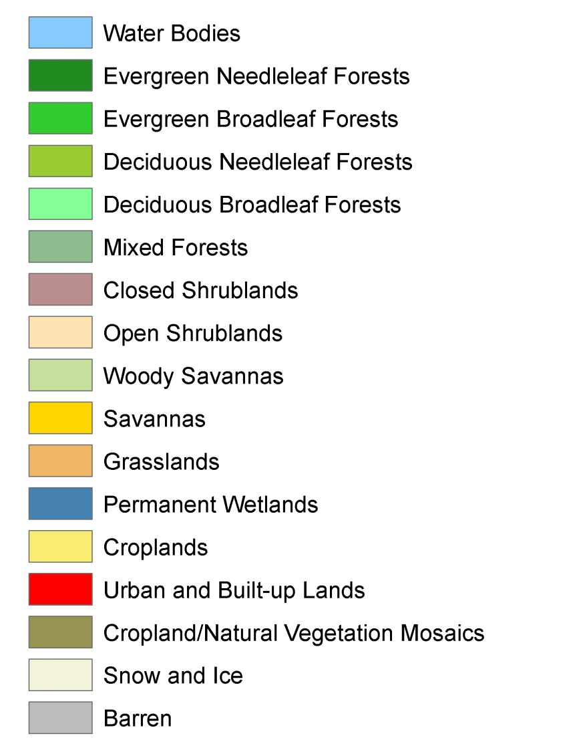
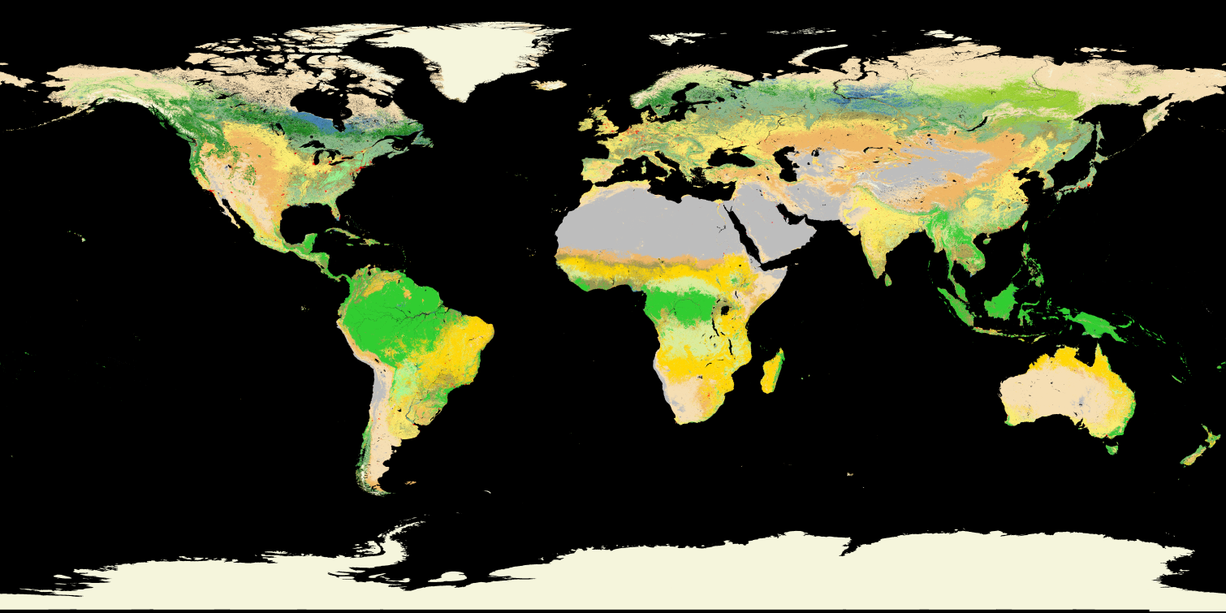
MODIS Seed
IGBP Legend
VIIRS
Notes:
Overall patterns are very similar. VIIRS has less grassland often replacing those areas with open shrublands. VIIRS has more agriculture in some areas but less in others especially tropics – Africa/India.

Slide 40
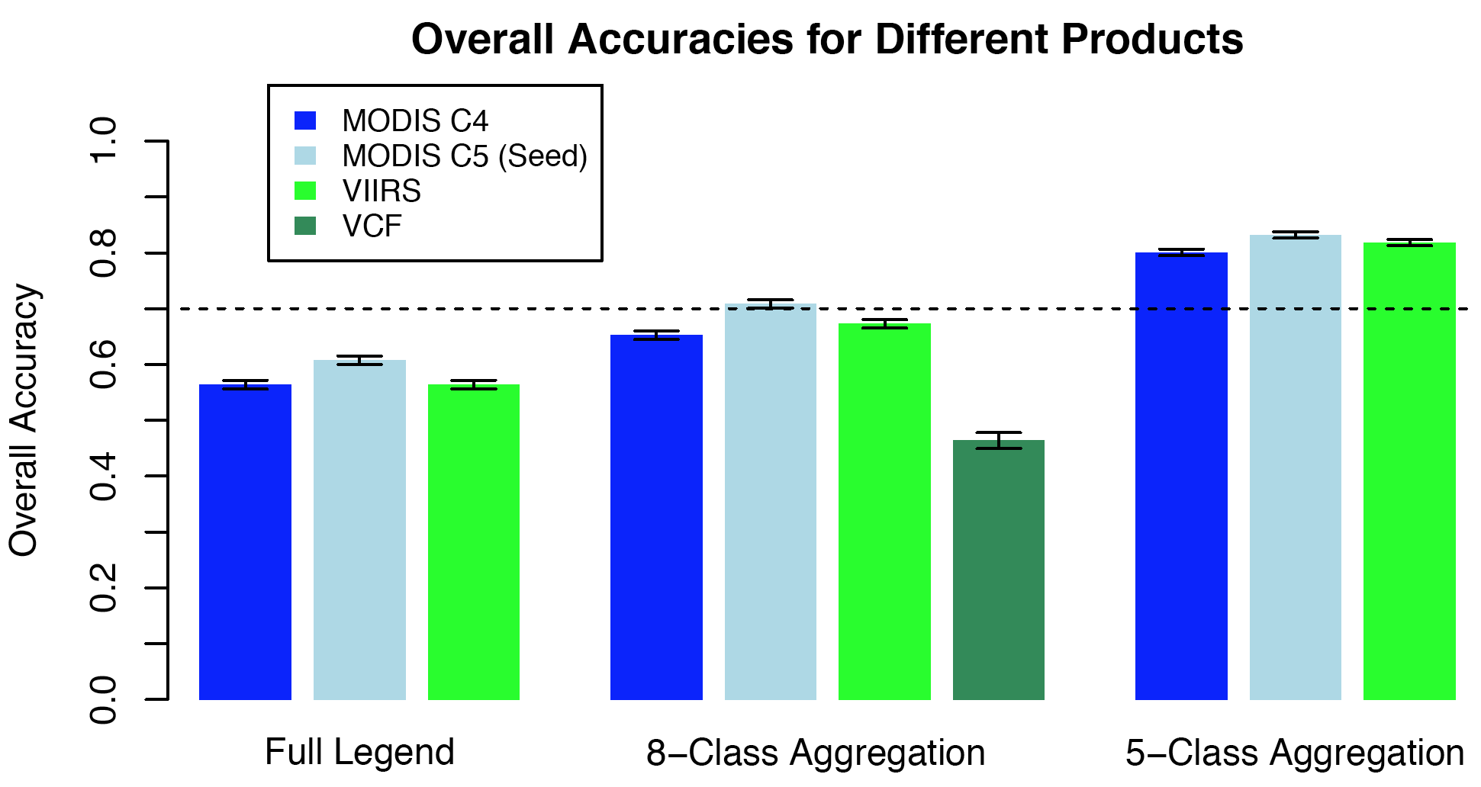
70% Accuracy Threshold
There is more variance in overall accuracies across aggregation levels than between maps.

Slide 41
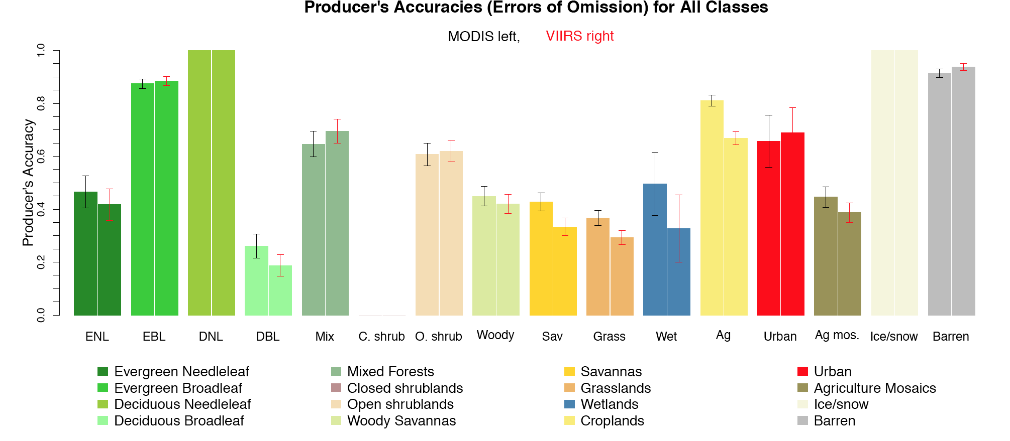
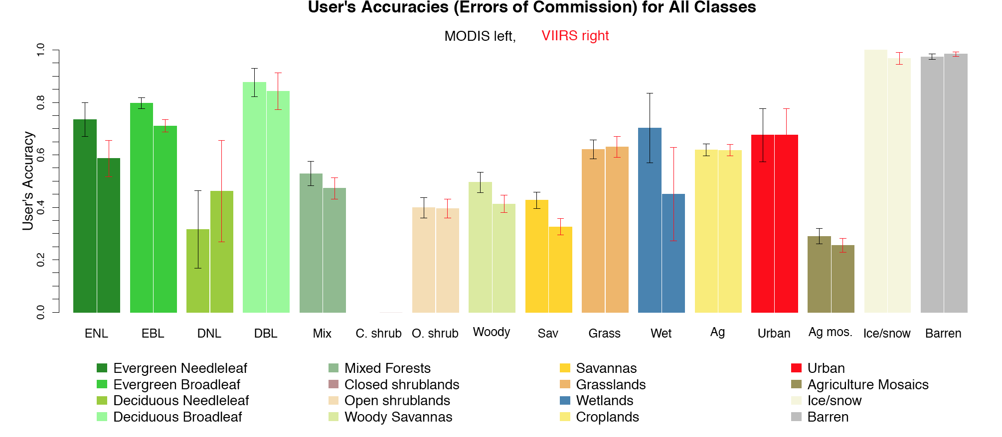

Slide 42
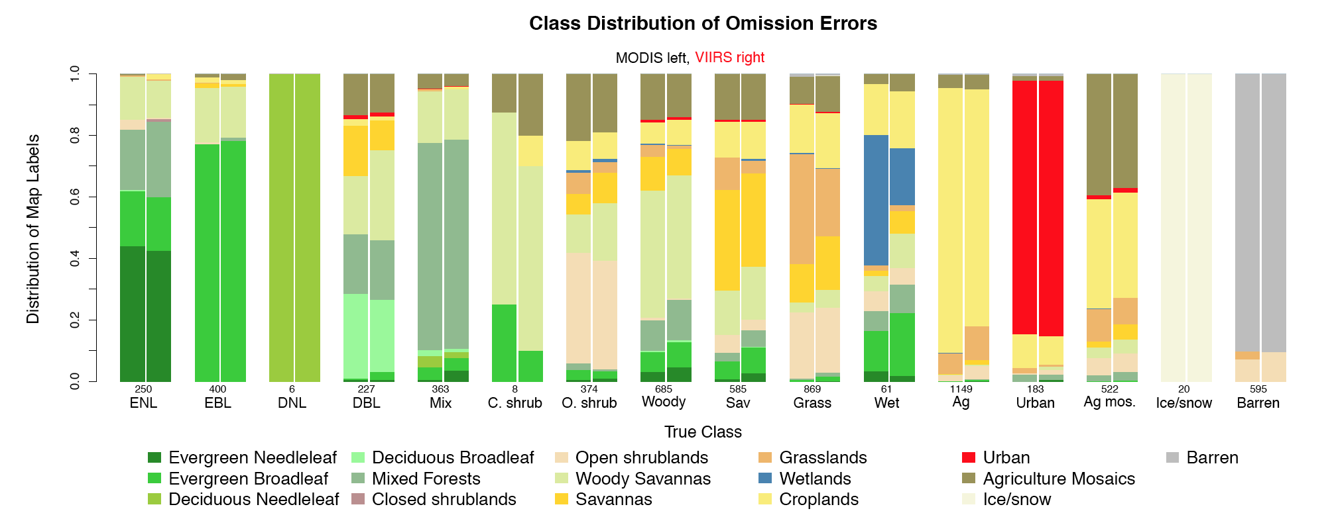
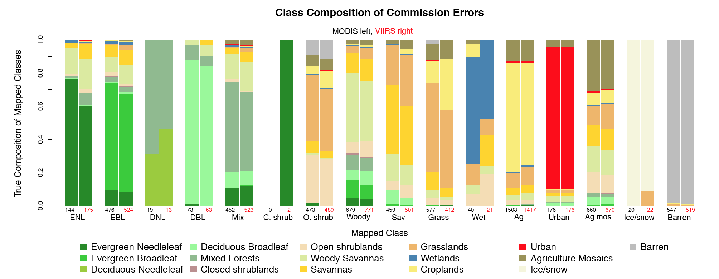

Slide 43
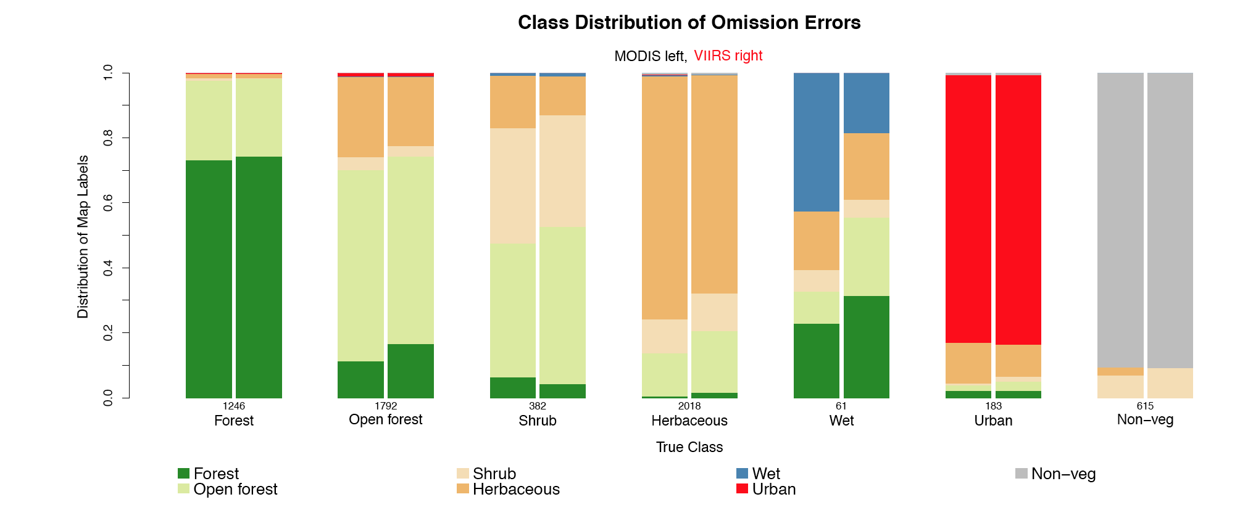
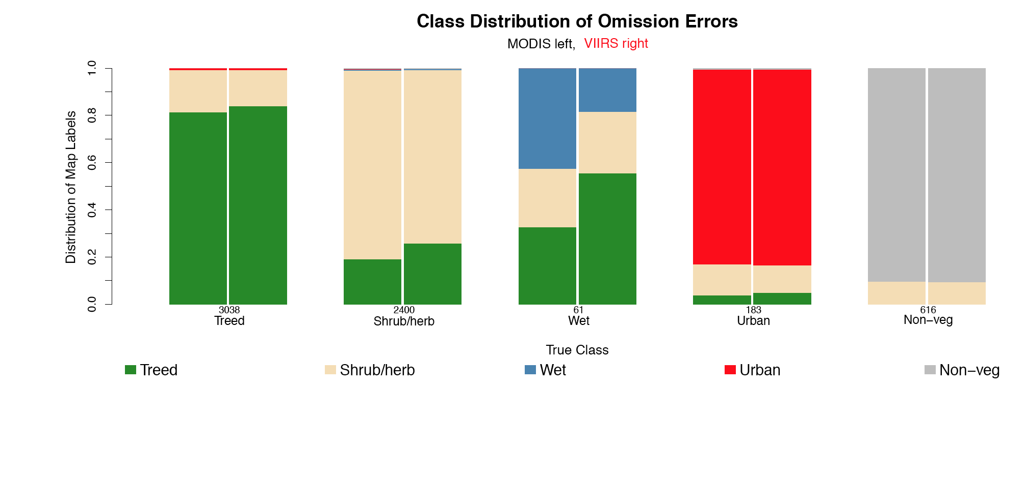
Notes:
At different aggregation levels we see smaller error rates because accuracies are dominated by intra-class confusion.

Slide 44
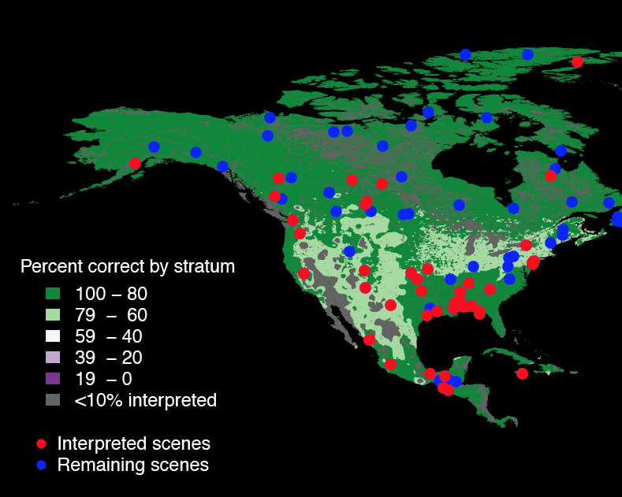
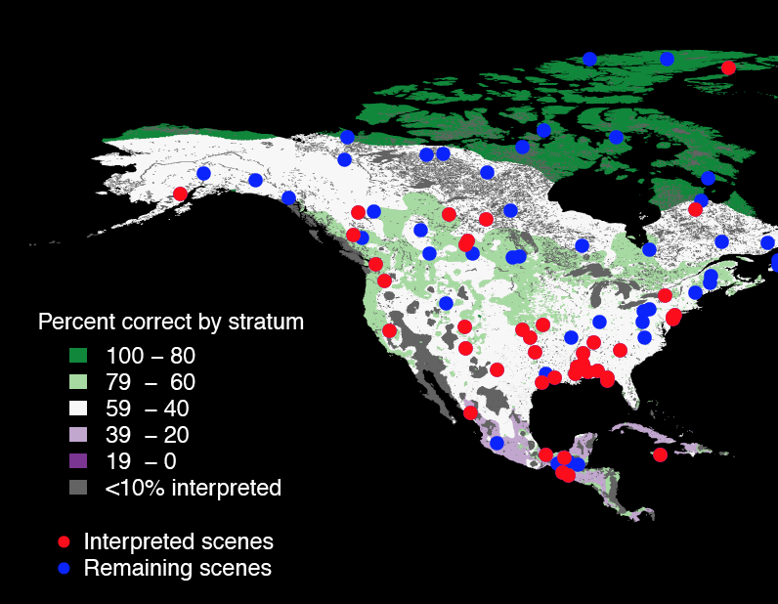
North America – Accuracies by Stratum
Five Class Legend
Full Legend

Slide 45
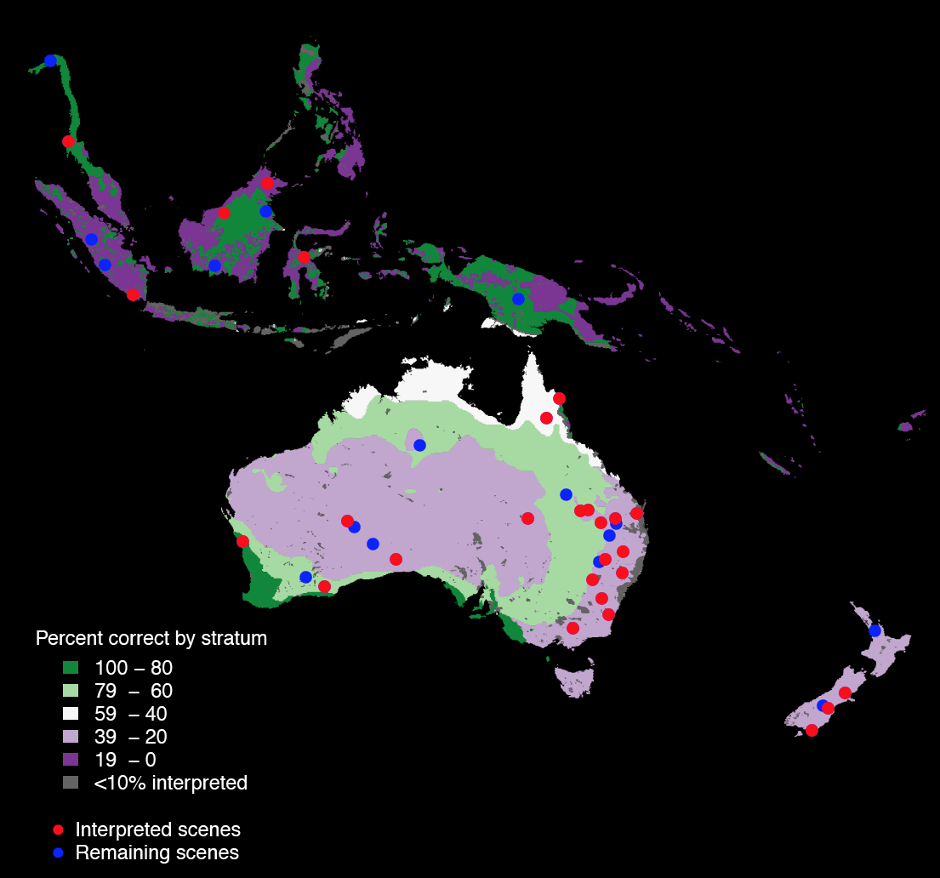
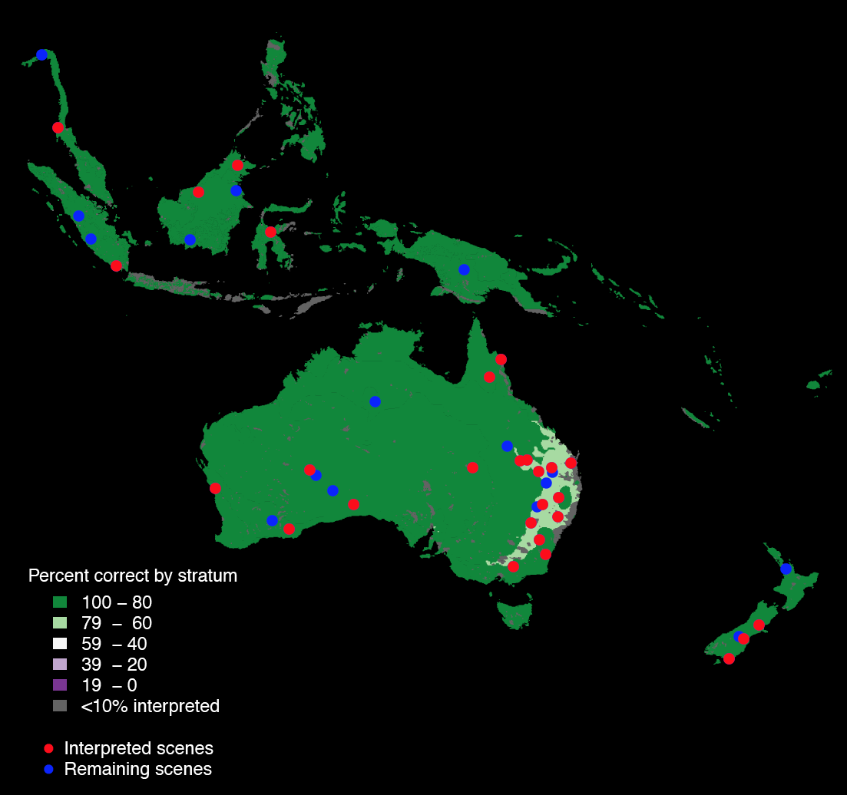
Australia – Accuracies by Stratum
Full Legend
Five Class Legend

Slide 46
MODIS Seed
IGBP Legend
VIIRS

Slide 47
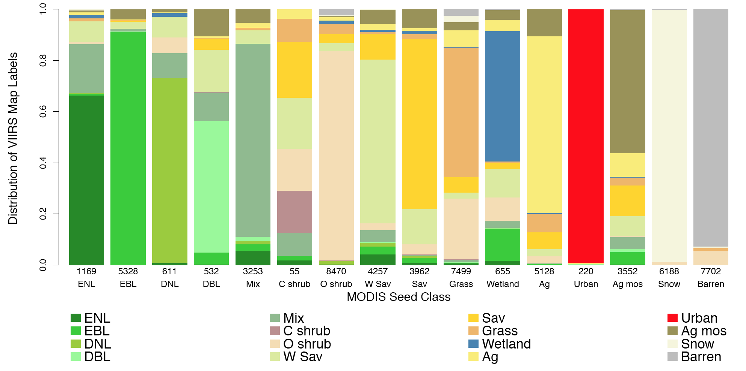
Qualitative Comparison of the Two Maps
Class confusion between the MODIS Seed and the VIIRS map is assessed from a random sample of ~60,000 1km land pixels. Total percent agreement is 76%.
Notes:
Plot shows the errors of omission for mapped classes of VIIRS relative to the MODIS seed.

Slide 48
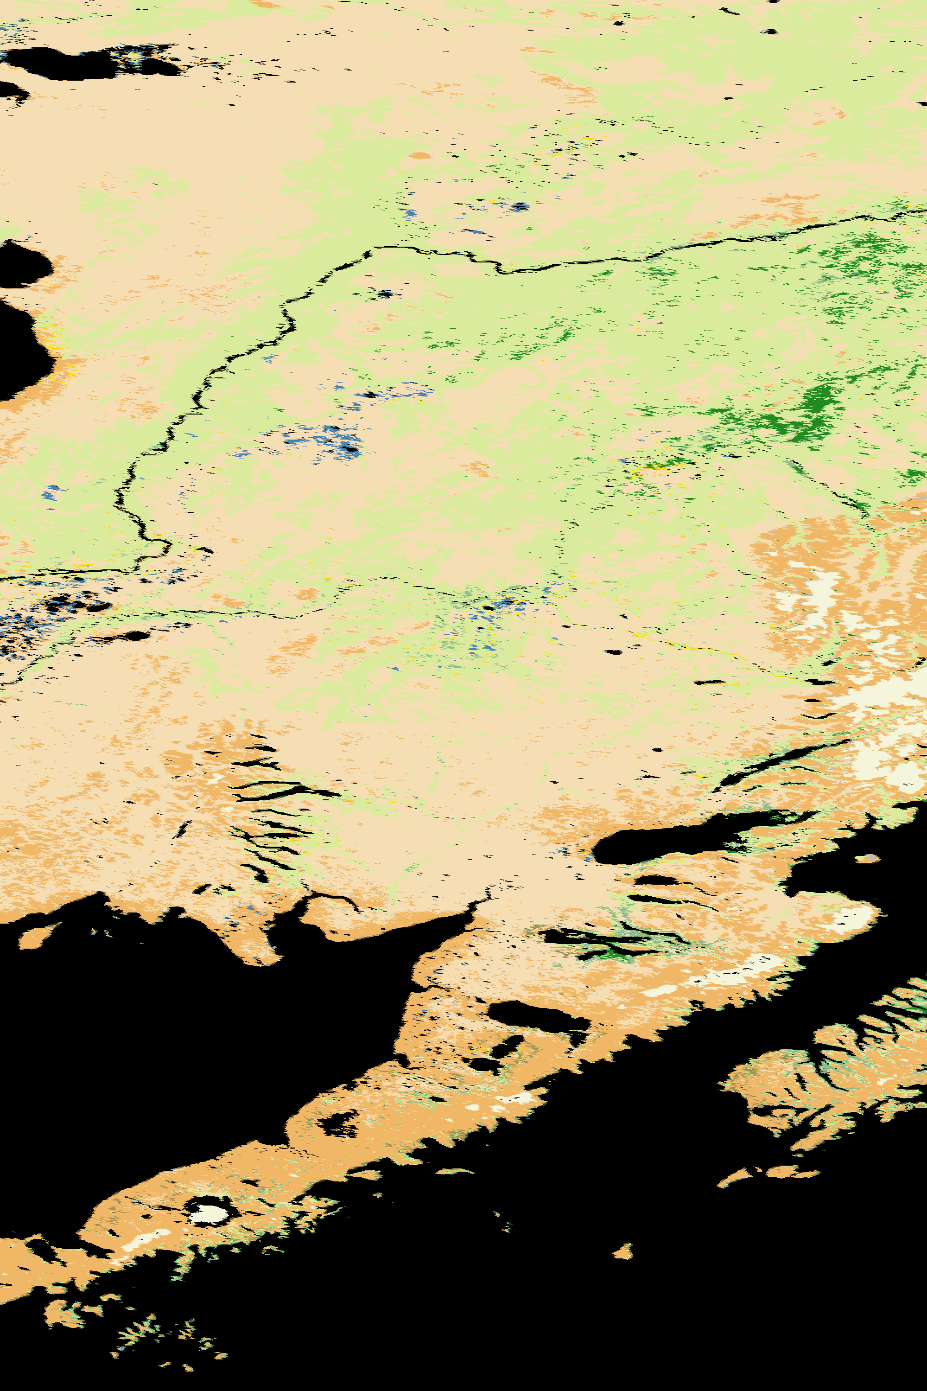
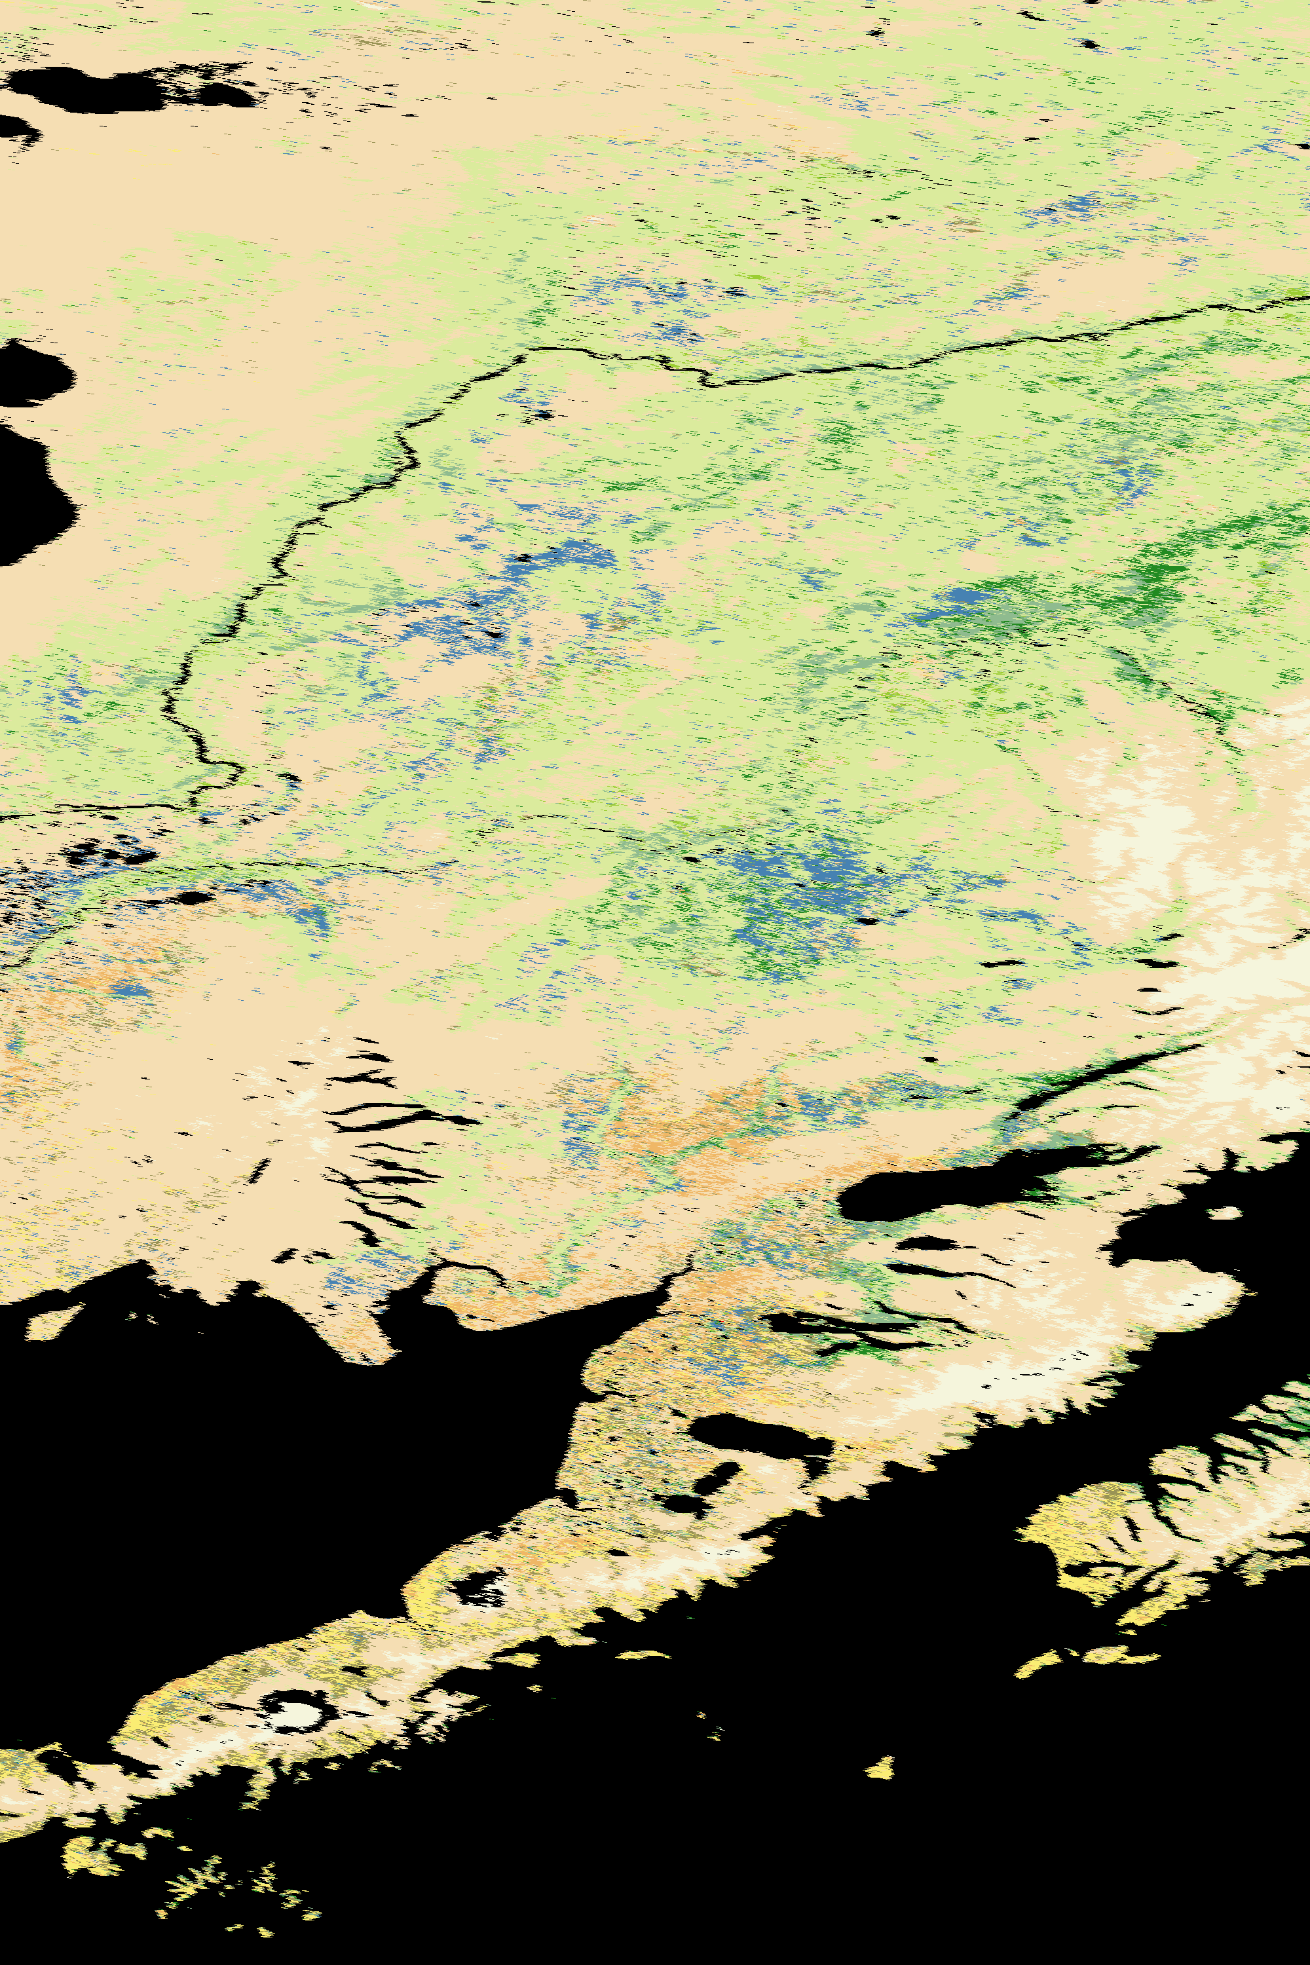
Alaska, USA
MODIS Seed
VIIRS
Notes:
Agriculture and ag/mosaic appearing on Aleutian peninsula and Kodiak island.

Slide 49
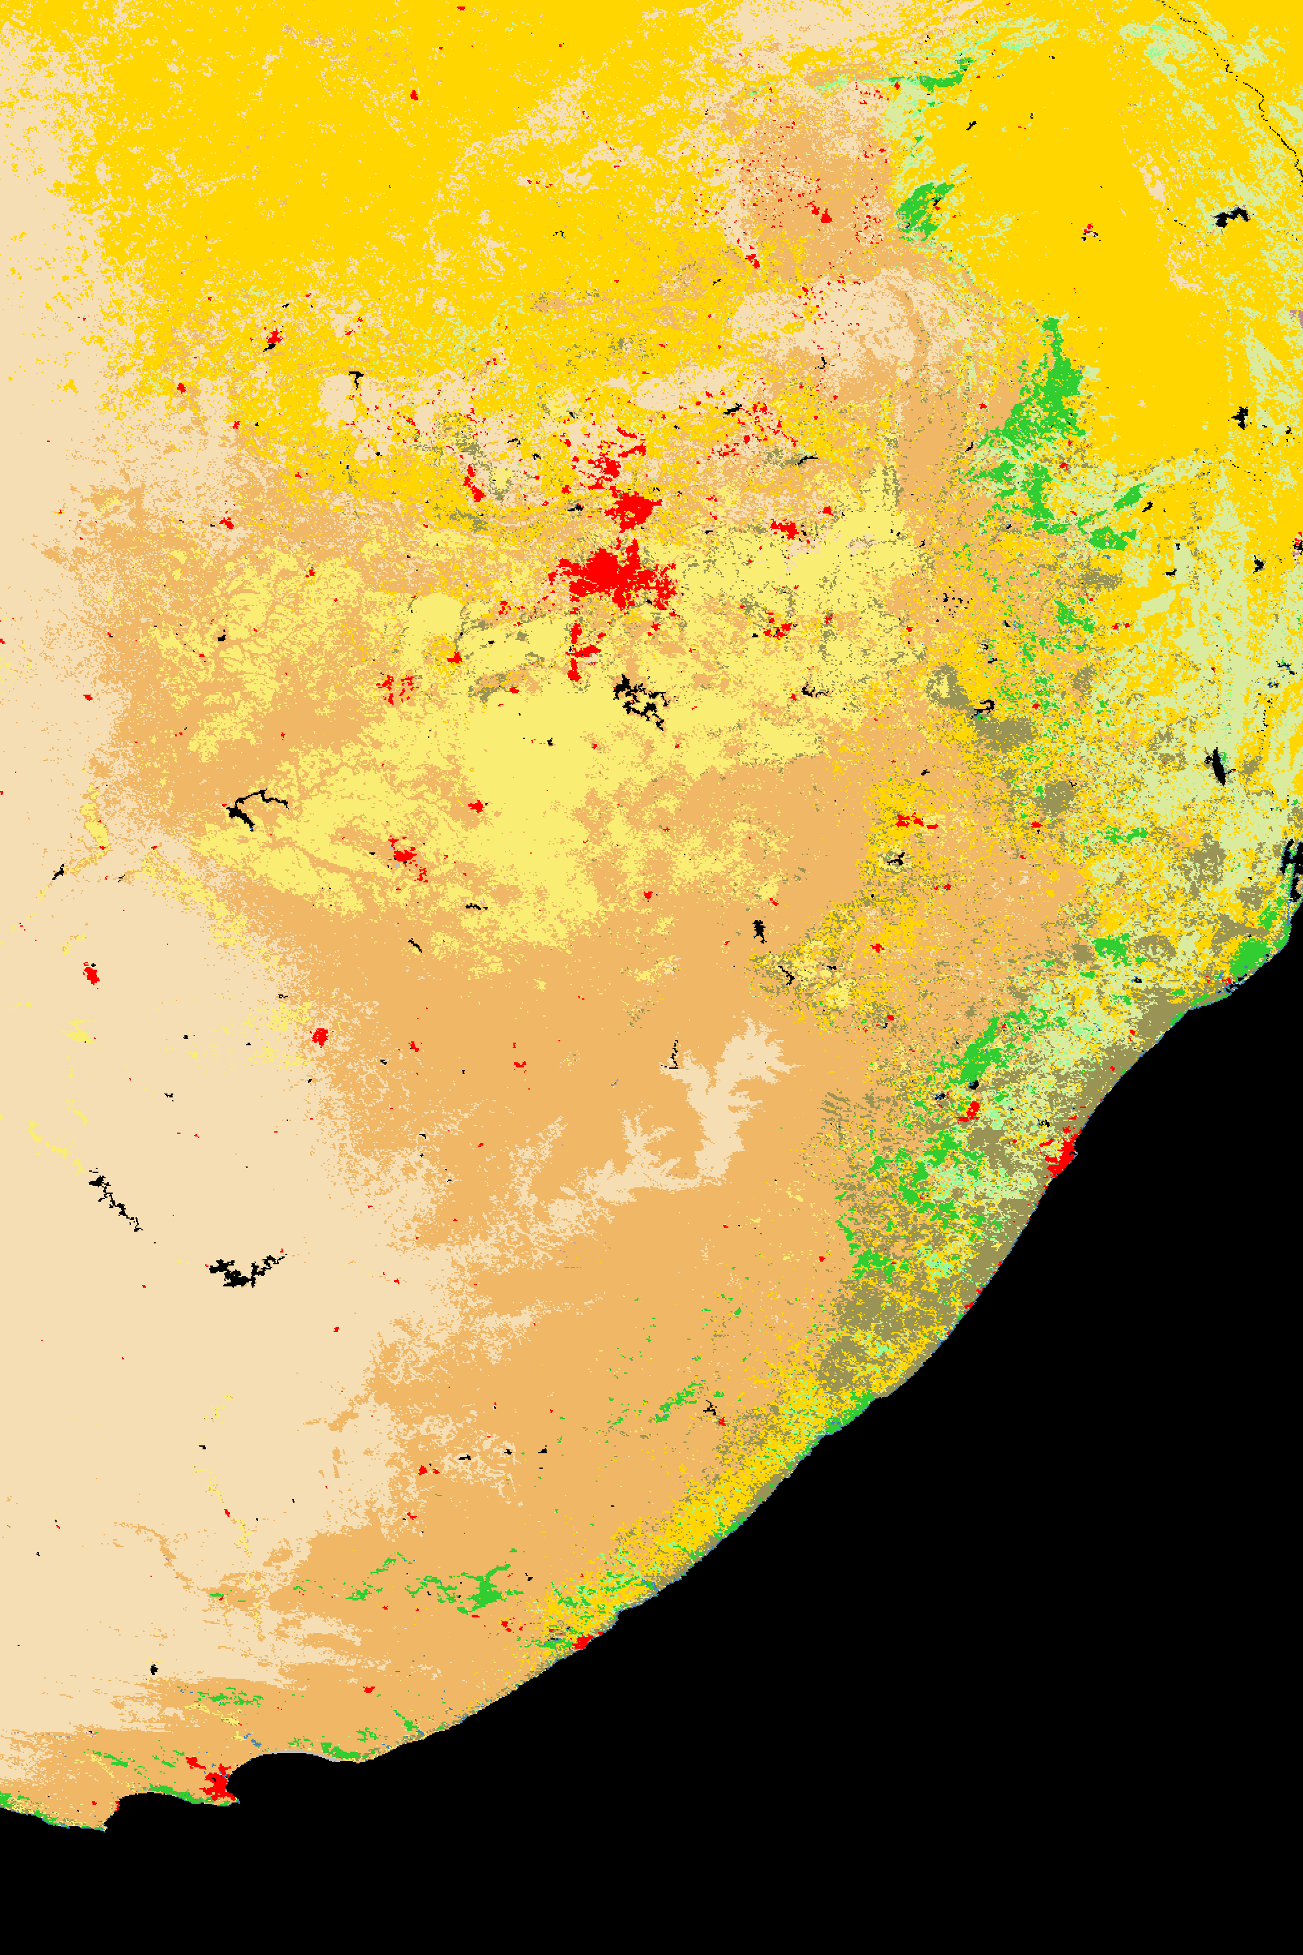
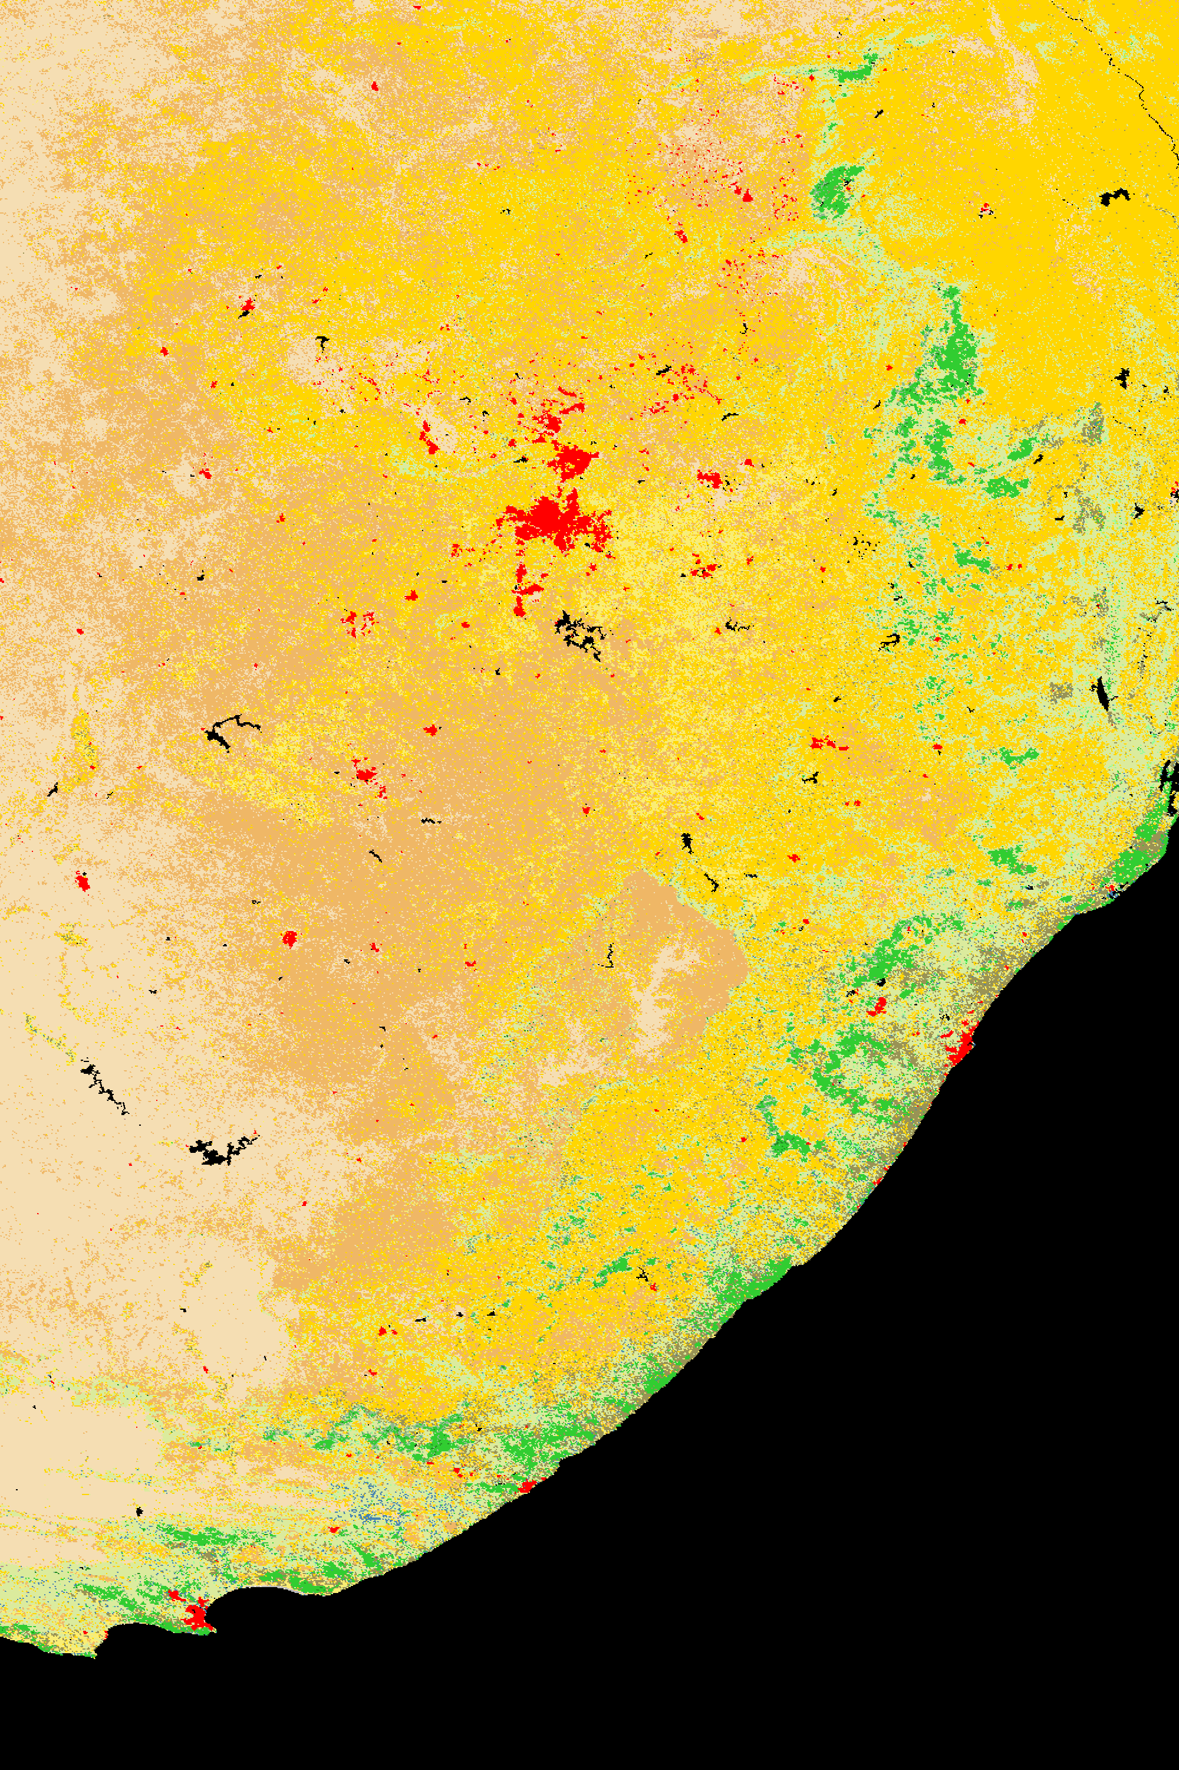
Johannesburg – South Africa
MODIS Seed
VIIRS
Notes:
Omission of one of the largest wheat/corn production centers in Africa

Slide 50
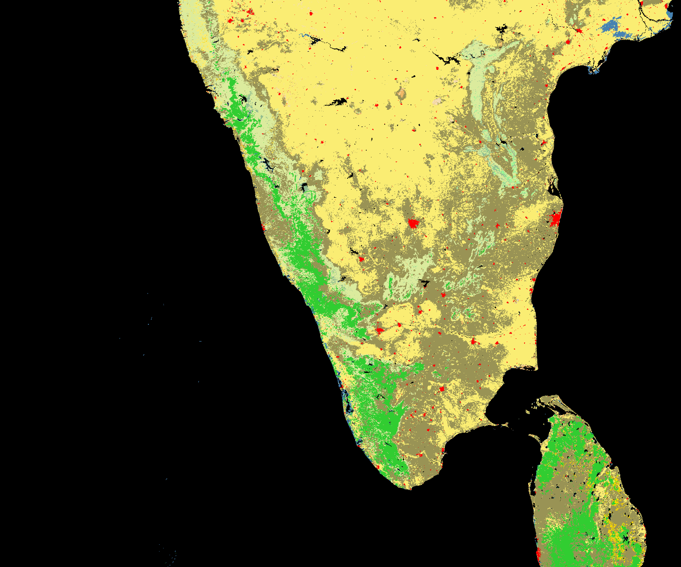
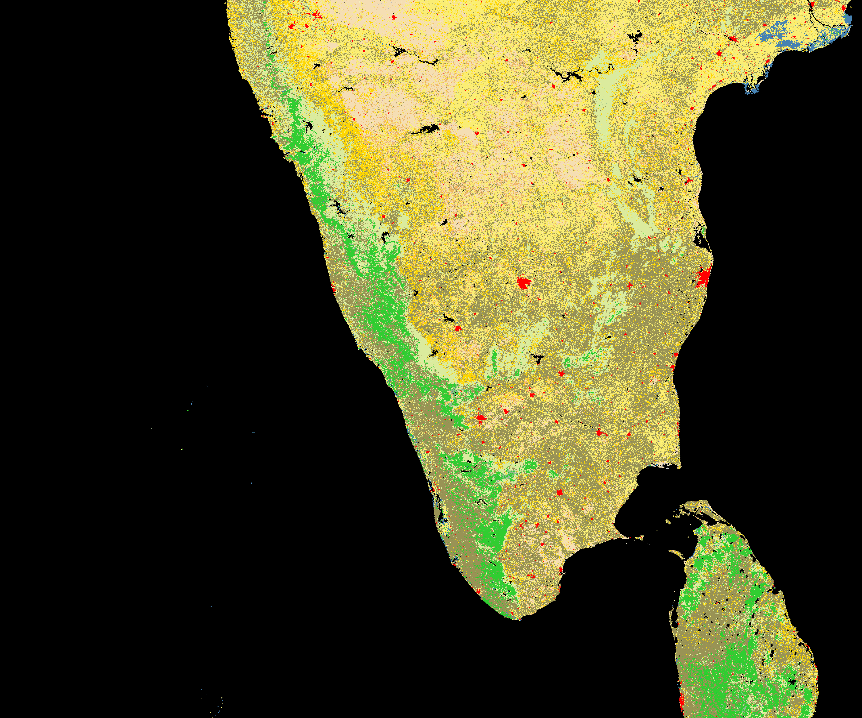
Southern India and Sri Lanka
MODIS Seed
VIIRS
Notes:
MODIS might overestimate agriculture in region but not by much.

Slide 51
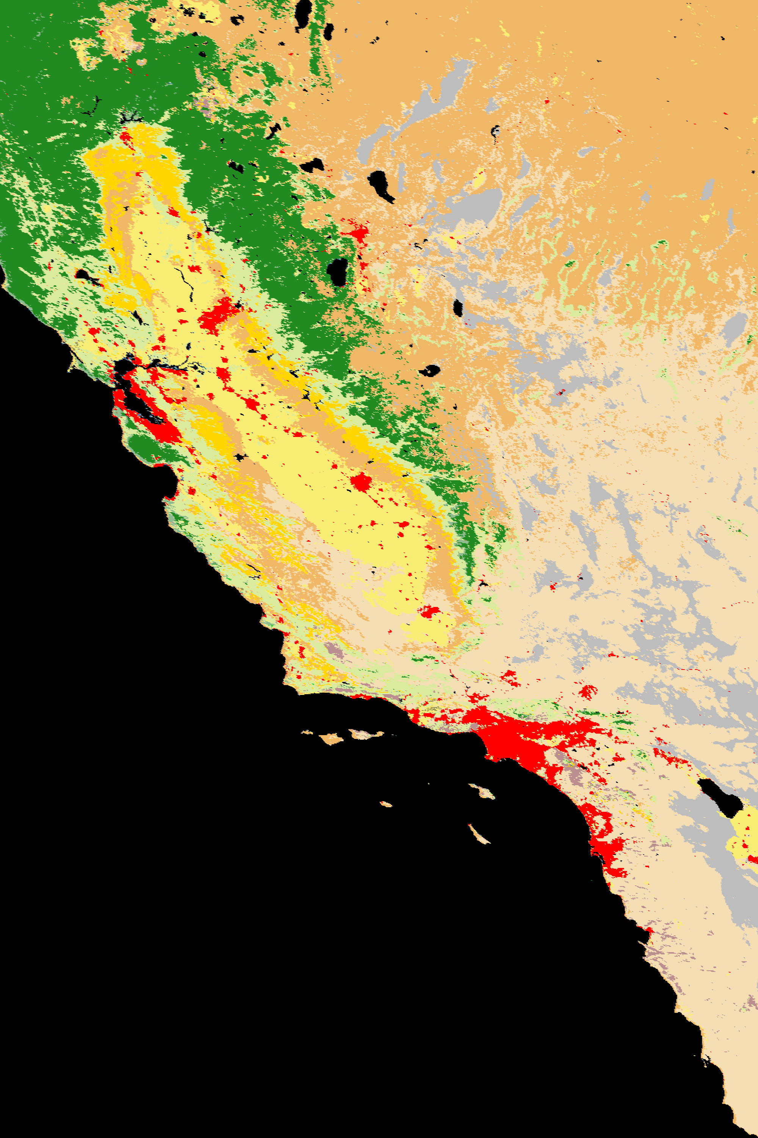
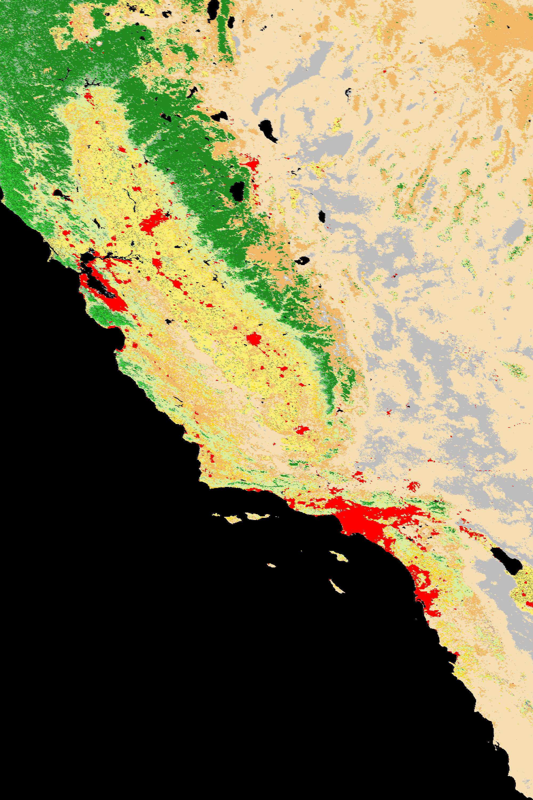
Southwestern USA
MODIS Seed
VIIRS
Notes:
Differences in grassland/open shrubland. Also differences in central California agriculture region and in the foothills of the Sierras. VIIRS has some speckle of evergreen broadleaf forests north of San Francisco.

Slide 52
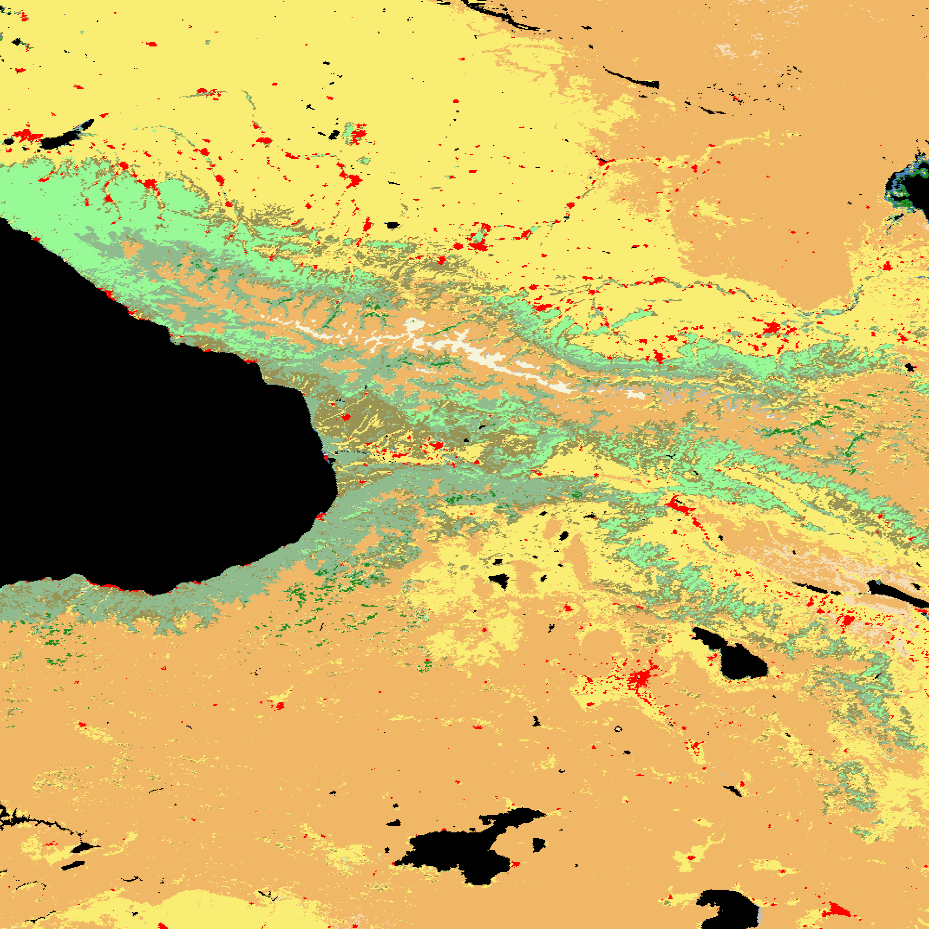

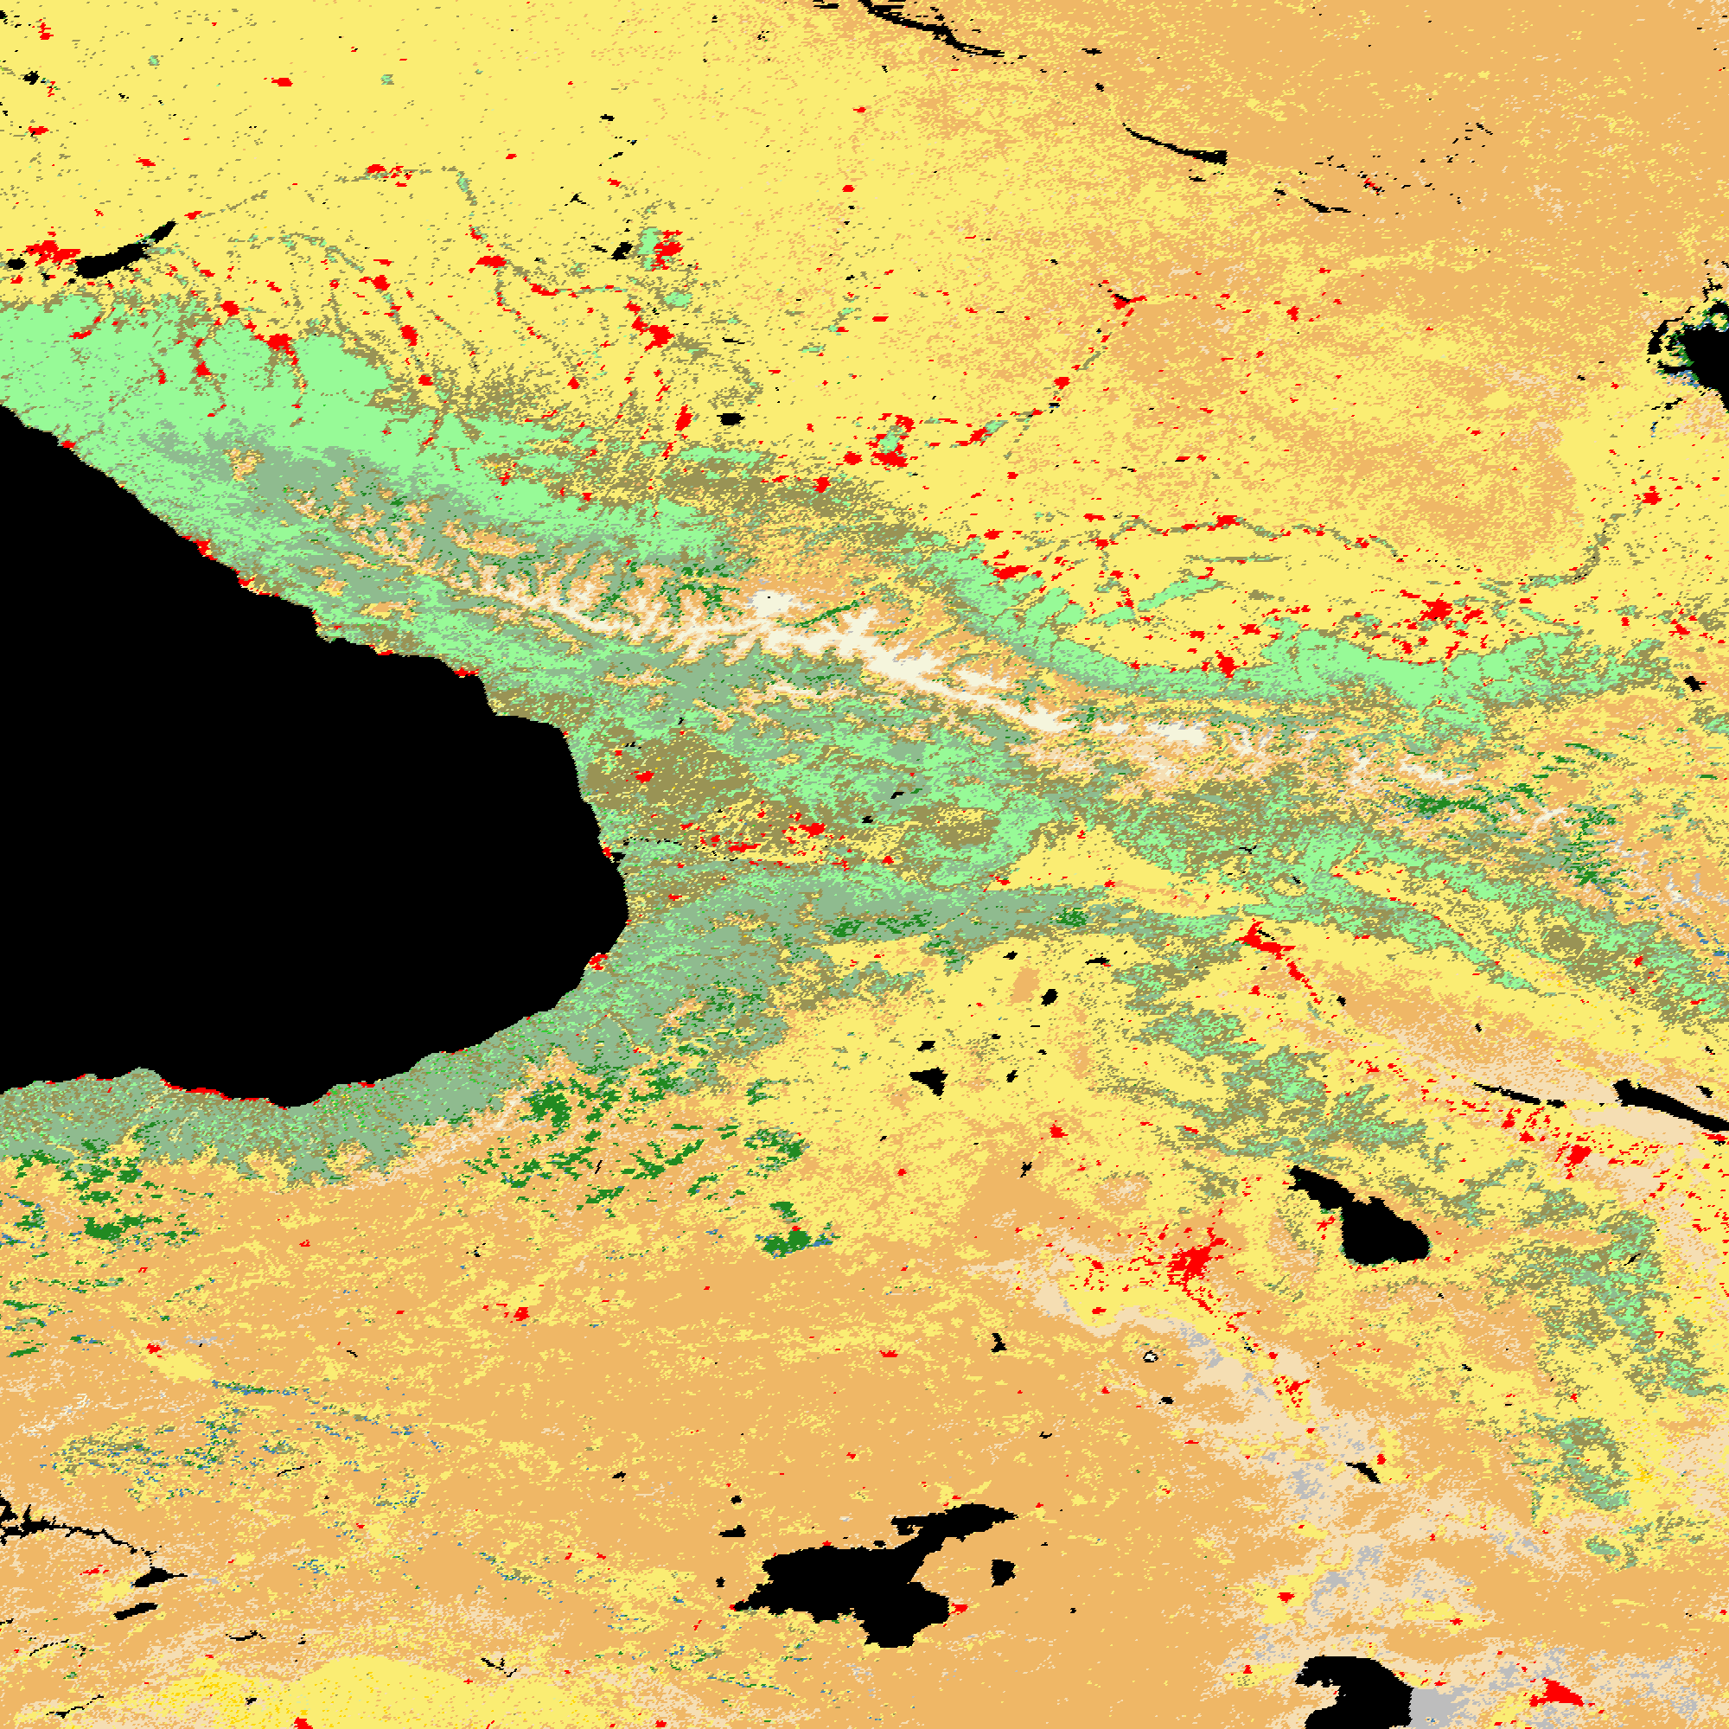
Caucasus Mountains - Russia
MODIS Seed
VIIRS
Notes:
Very similar maps – VIIRS has more snow/ice, open shrublands, and agriculture in place of graasslands.

Slide 53



Northeastern USA
MODIS Seed
VIIRS
Notes:
No noted differences except clearer depiction of forest types in VIIRS – more broadleaf decid and more evergreen needleleaf.

Slide 54


Beijing - China
MODIS Seed
VIIRS
Notes:
No real differences except closed shrubland versus forest NW of Bejing.

Slide 55
Recap from Assessment
The new VIIRS QST map compares favorably to the MODIS QST Seed.
Most of the class confusion and uncertainty in either map can be explained by spectrally similar or poorly defined IGBP classes.
With some modest improvements, the accuracy of the VIIRS QST map will exceed that of the MODIS Seed.

Slide 56
CCR1700 Surface Type EDR Test Results
Visual Comparisons among Surface type EDR in CCR 1700 test data, IDPS QST-IP data (CCR 692), and UMD delivered QST-IP data suggest that the new VIIRS based QST-IP has been indeed successfully implemented in the new CCR 1700 test data.

Slide 57



North America
UMD Delivered QST-IP
ST EDR in CCR 1700
IDPS QST-IP (CCR692)

Slide 58



South America
UMD Delivered QST-IP
ST EDR in CCR 1700
IDPS QST-IP (CCR692)

Slide 59



Europe
UMD Delivered QST-IP
ST EDR in CCR 1700
IDPS QST-IP (CCR692)

Slide 60



Asia
UMD Delivered QST-IP
ST EDR in CCR 1700
IDPS QST-IP (CCR692)

Slide 61
Surface Type Provisional Status Summary
ST EDR
  Operational algorithm (IDPS) validated
  Issues identified and addressed
  Further improvements possible with
    Improvements to Fire, Snow, and other VIIRS products
    Updates to QST IP
    Timely detection of major land cover change processes: flooding, burn scar, large scale deforestation

Slide 62
Surface Type Provisional Status Summary
QST IP
  In-house implementation of ATBD algorithms successful
    Gridding/compositing/annual metrics (GCAM)
    Classification
  Newly collected training data
    Original training data were of limited use (error, out of date, undesirable distribution)
    New data from BU
    Additional data collected by UMD
  First QST IP produced using 2012 VIIRS data
    Quality likely close to MODIS land cover products

Slide 63
Provisional Consideration and Future Plan
Gridding/compositing/annual metrics (GCAM) huge job
  Better done on systems with lots of CPU, bandwidth, and storage space
  Compositing and annual metrics have room to improve
    Especially over sparsely or non-vegetated surfaces
Better cloud removal
  Residual clouds apparent in some areas
  Usefulness of some metrics questionable
  Better compositing algorithm can help (e.g., use QA flags/cloud masks)
  Use multi-year data
    2-years VIIRS data already exist
    Can add MODIS data

Slide 64
Provisional Consideration and Future Plan
Training data improvement
  More representative
  Timely update of changes
Classification algorithm improvements
  SVM generally more accurate than DT
  Post-classification improvements (e.g., BU’s approach of incorporating class probability in MODIS C5)

Slide 65
Provisional Consideration and Future Plan
Take advantage of additional bands
  375m imagery bands allow better estimation of subpixel cover
  DNB useful urban
More comprehensive assessment
  Better use of freely available high resolution data (e.g. Google Earth, Landsat)

