Slide 1
Support Material for OMPS SDR to Beta Maturity Decision Performance compared to Pre-launch
Compilation of results from
JPSS and NPP OMPS Teams

Slide 2
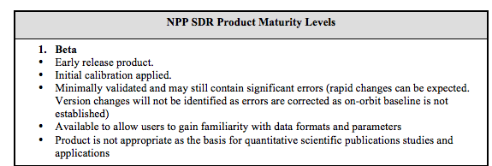
Data Product Beta Maturity Definition

Slide 3
Outline
Dark Current
Hot Pixels
Non-linearity
Solar Spectra
Signal-to-Noise
Stray Light
Wavelength Scale
South Atlantic Anomaly – charged particle effects
Geolocation Registration
Detector Temperature

Slide 4
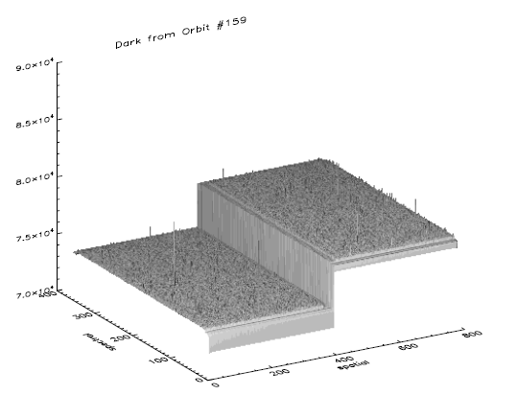
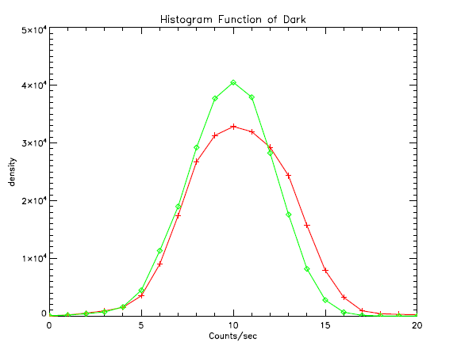
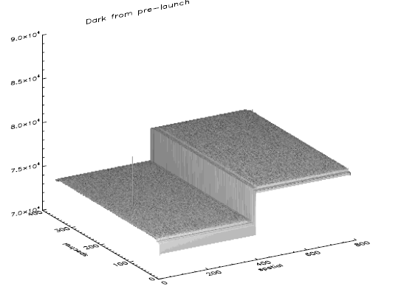
Dark Transition from Ground to Orbit
On-orbit
Raw dark image for orbit
Exposure time of 1247.1 second
The number of coadds is 100
A few potential hot pixels are observed.
Histogram function
On-orbit
Prelaunch
Gaussian distribution
Bin index
Prelaunch
Raw dark image for prelaunch
Exposure time of 1247.1 second
The number of coadds is 100
Only one hot pixel is identified
Notes:
Provided by C. Pan

Slide 5
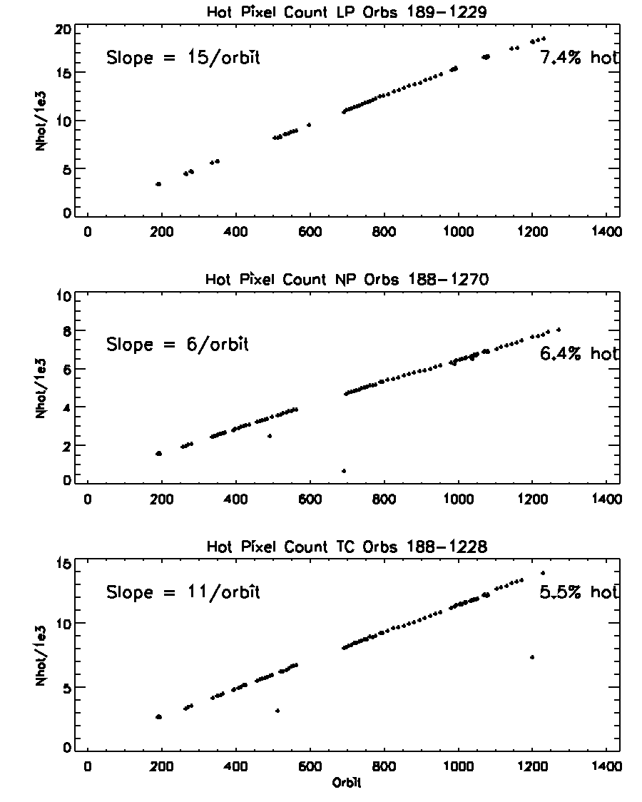
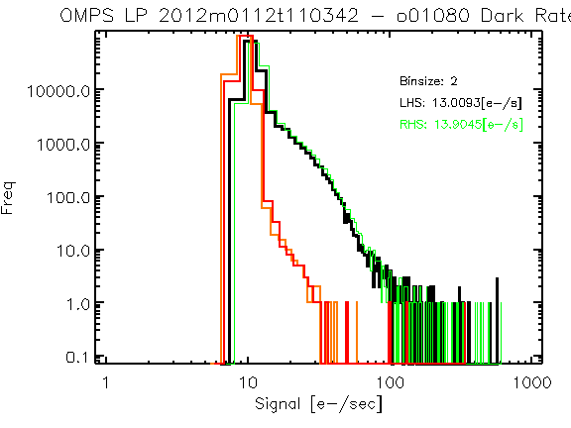
Hot pixels increasing as expected
Hot pixel defined as 8σ above pre-launch distribution
Pre-launch
Orbit 1080
Notes:
Provided by G. Jaross

Slide 6
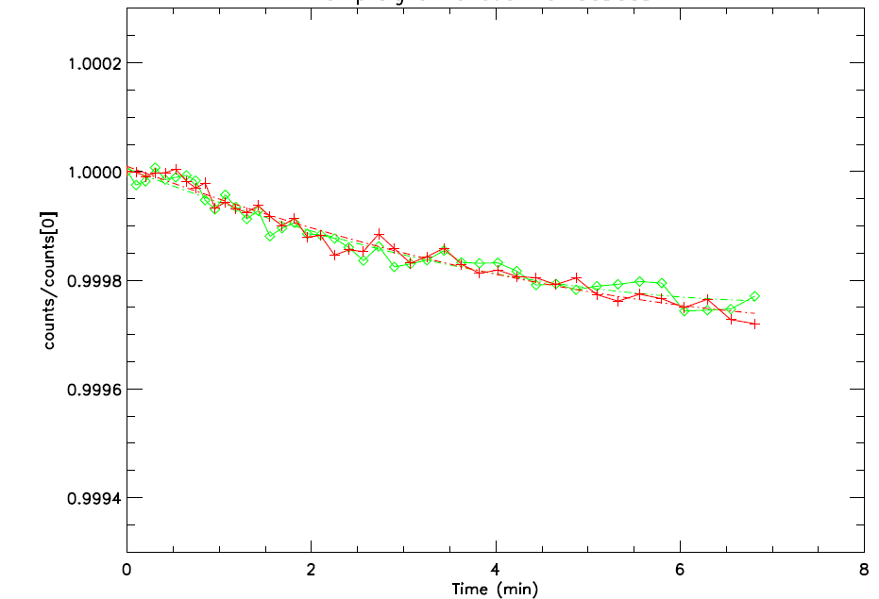
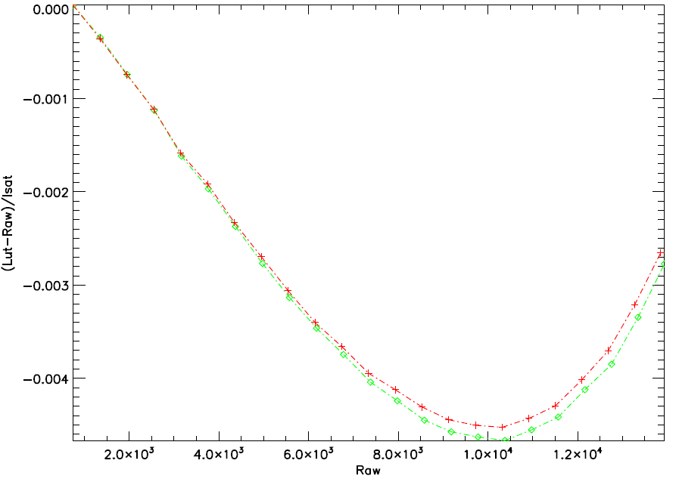
Linearity Performance Transition from Ground to Orbit
LED signal drifts
System nonlinearity
On-orbit
Prelaunch
On-orbit
Prelaunch
Observed OMPS TC LED drifts over time
meets the system requirement of < 1% per minute
Sensor nonlinearity is compliant with the specification of < 2%
Notes:
Provide by C. Pan

Slide 7
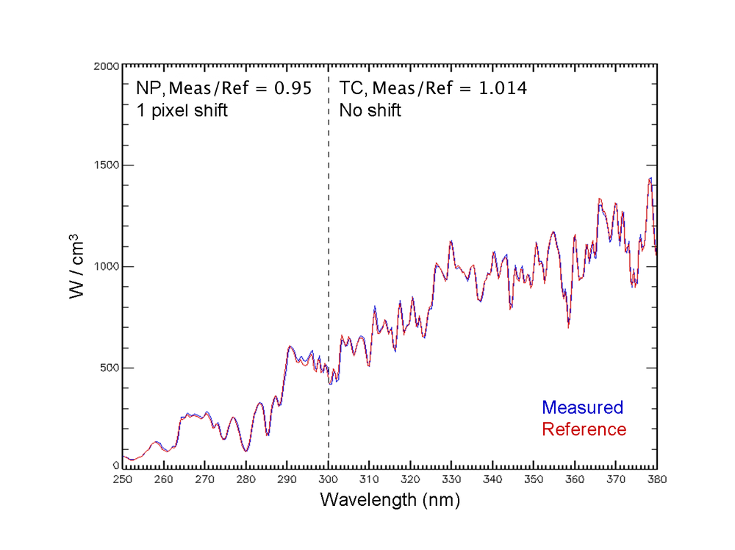
Spectral Calibration Transition from Ground to Orbit
Notes:
Provided by C. Seftor

Slide 8
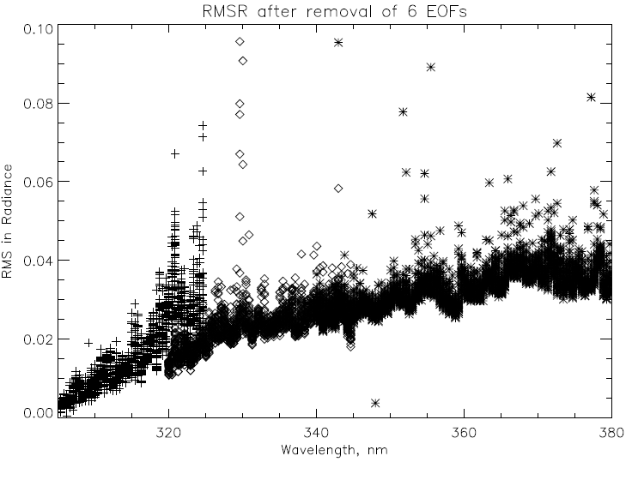
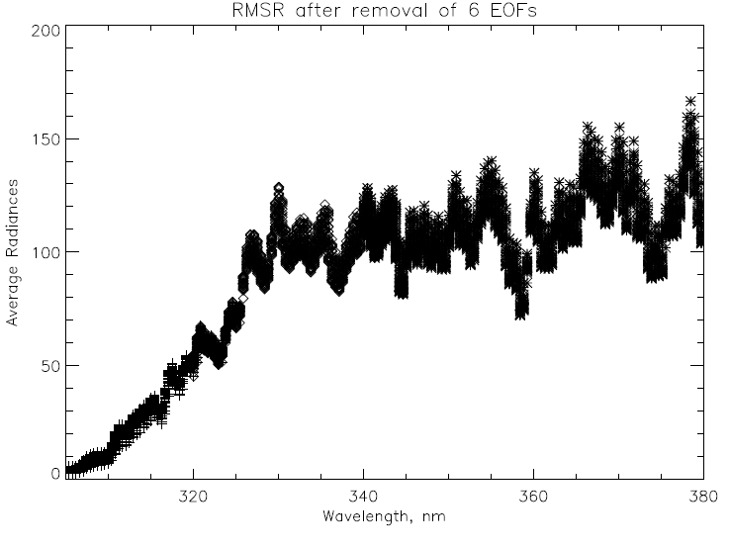
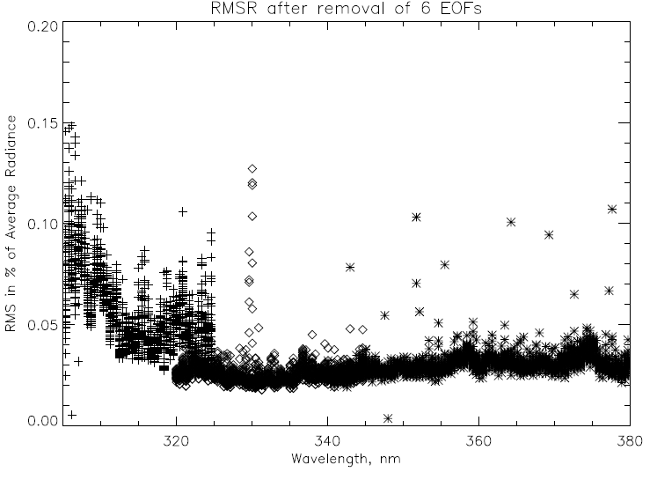
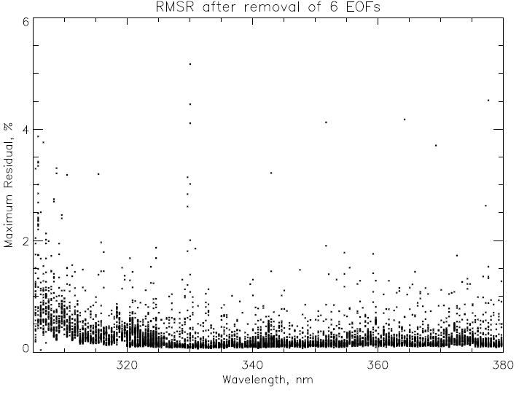
EOF/SNR analysis for six orbits (~1800 scans) OMPS NM on 1/28/2012 using three wavelength ranges (305-325, 320-345, 340-380) for 35 CT
Average Radiances
Maximum Residuals.
Spikes could be filtered.
0.1 is equivalent to SNR of 1000.
Notes:
All 35 cross-track positions. Top left shows noise in radiance units. Spikes not removed.
Provided by L. Flynn

Slide 9
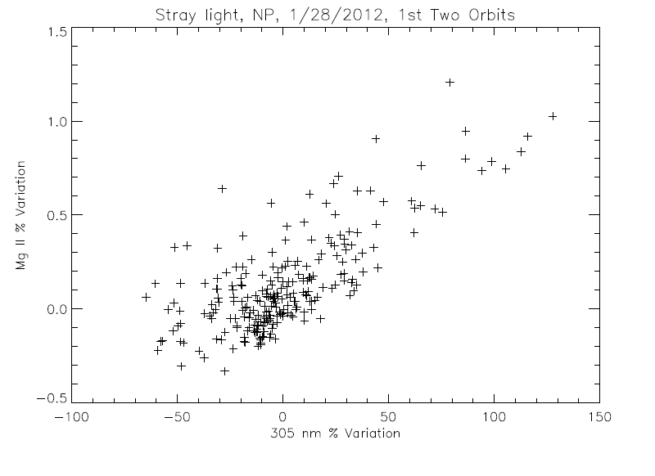
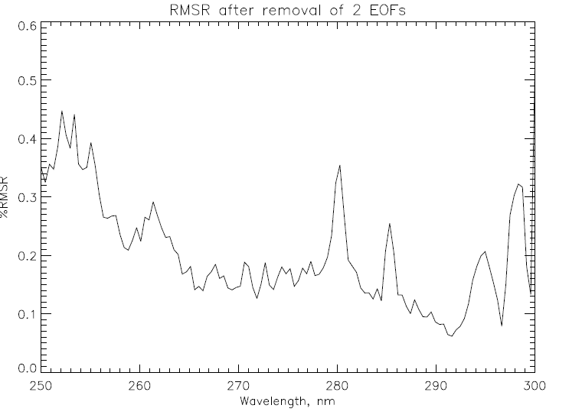
Stray Light and SNR for OMPS NP
The scatter plot on the left compares simple three-wavelength Mg II core-to-wing ratio variations (280 nm to the average of 277 nm and 282 nm) with longer wavelength variations at 305 nm. The core average is ~0.4 of wings, so this -0.5% to 1.5% variation represents (1.0/0.4 – 1 =) 1.5 times the wing variations.
The RMSR estimates on the right were done on clean data for 230 spectra. A spectral screen detected and removed one deviant value on average from each of the 120-wavelength spectra. The removal of the second EOF pattern was somewhat arbitrary as it and the third EOF may be stray light patterns. The EOF used a 6th order polynomial for normalization.
Notes:
Provided by L. Flynn

Slide 10
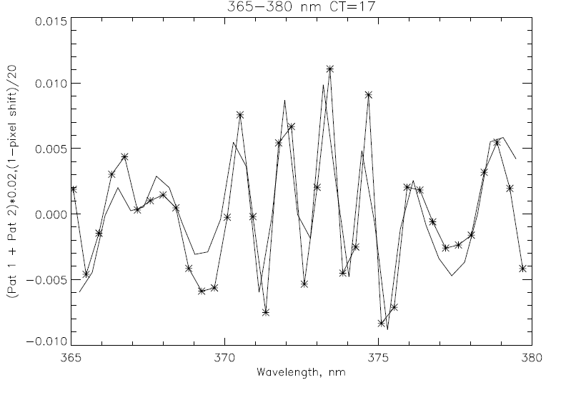
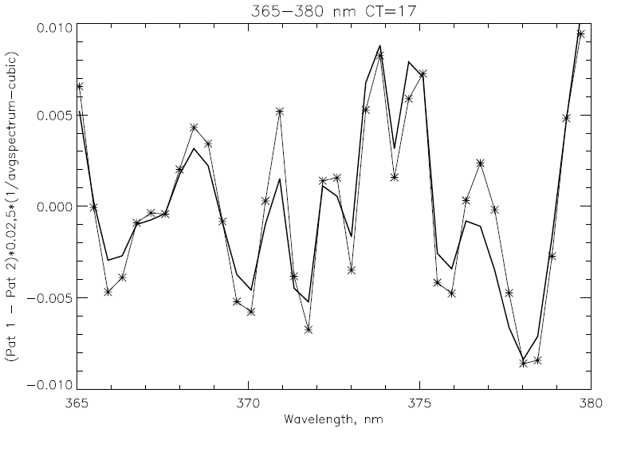
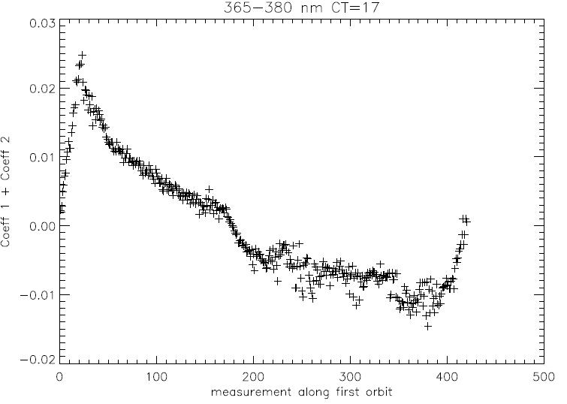
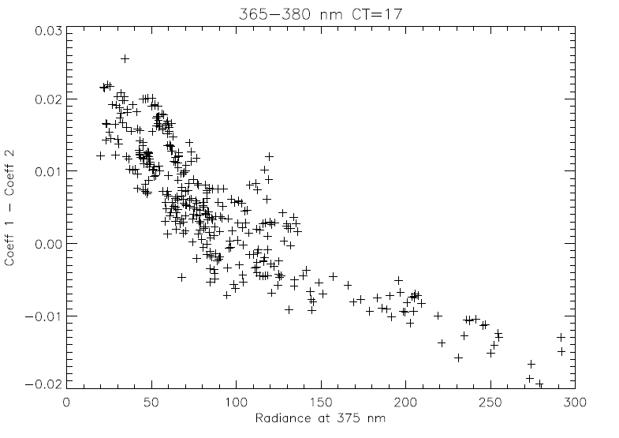
Wavelength Shift and Ring Effect/Stray Light
* EOF pattern
–– 0.02-nm shift
* EOF pattern
–– ∝ (1/Avg-poly)
EOF analysis 365 to 380 nm for parts of six orbits on 1/28/2012. The first two patterns contain 90% of the variability after removing a 3rd order polynomial from Rad/AvgRad. They are combinations of a Wavelength Scale Shift and Ring Effect/Stray Light. Given the radiance levels, a 0.01 in the figures at the top equates to approximately 1% variation.
Notes:
Provided by L. Flynn

Slide 11
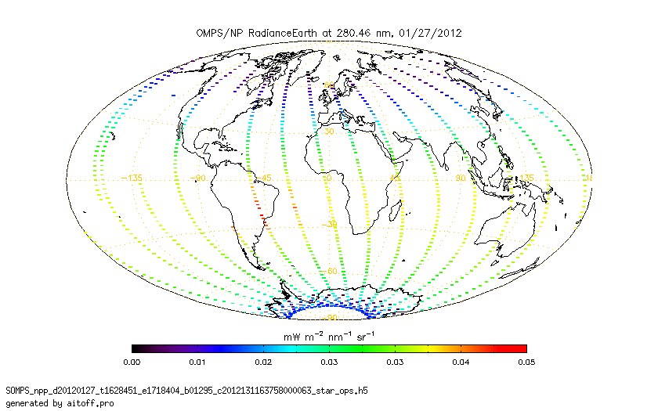
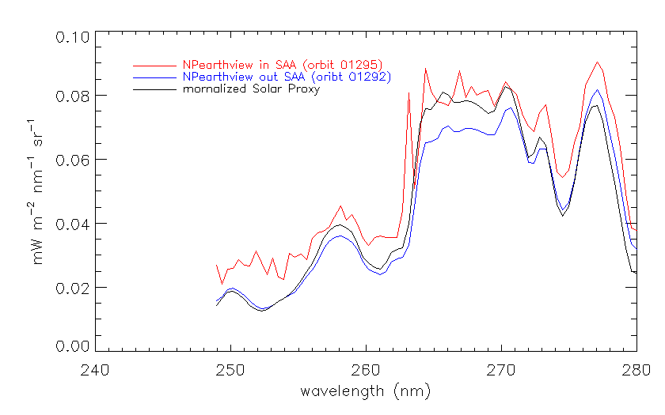
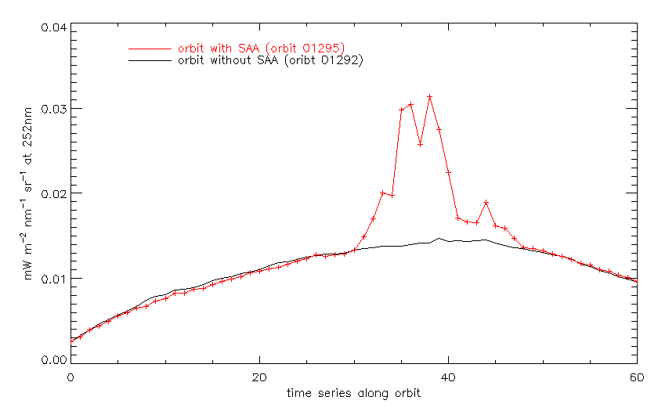
SAA Effects on NP
The noise/spikes show the expected increases when an orbital path falls with within the SAA but return to normal levels after passing through it.
Figure: J. Niu, NOAA/STAR (ERT)
Notes:
Provided by J. Niu

Slide 12
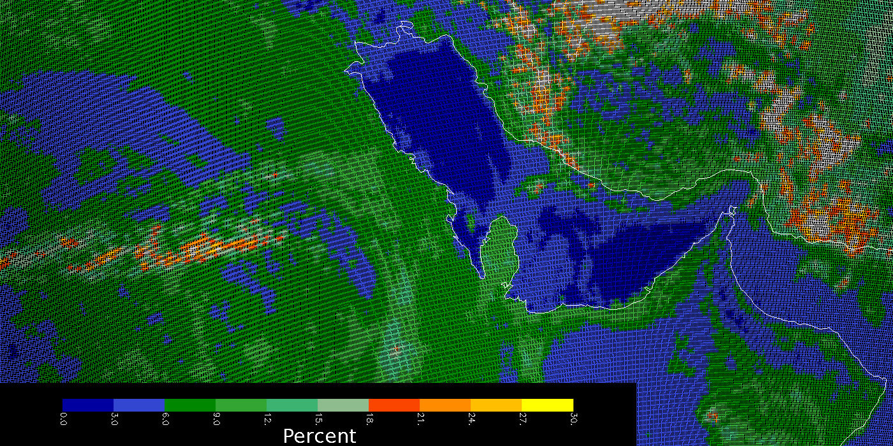
OMPS Geolocation
This image shows the effective reflectivity for the 380-nm Channel for part of an orbit of small Field-of-View (5 KM X 10 KM at Nadir) made by the OMPS Nadir Mapper in a special diagnostic mode. The Qatar peninsula sticking into the Persian Gulf in the middle of the picture lies along the nadir view of the orbital track and gives a preliminary assurance of the geolocation at better the 5 KM.
C. Seftor, NASA/GSFC (SSAI) 1/26-27/2012
Notes:
Provided by C. Seftor

Slide 13
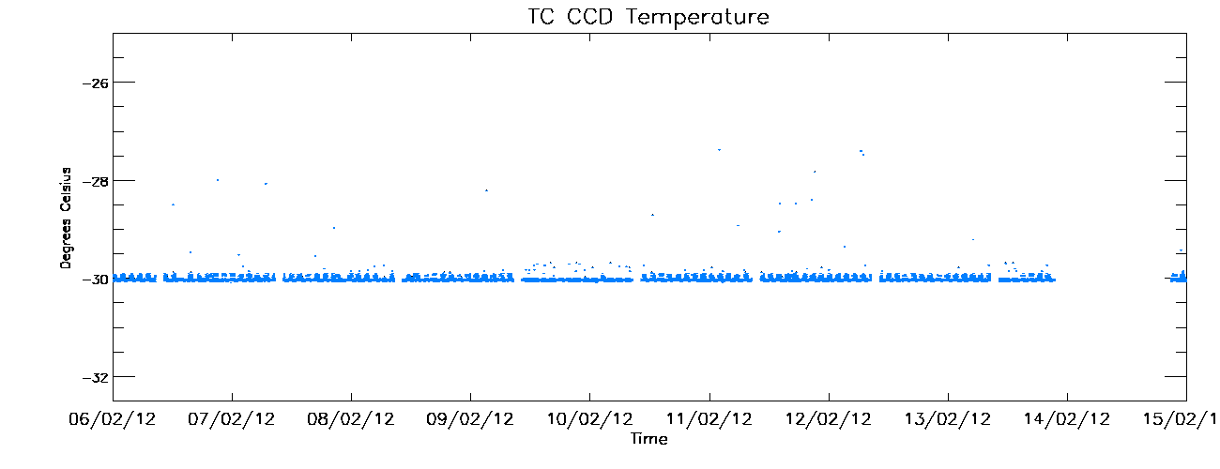
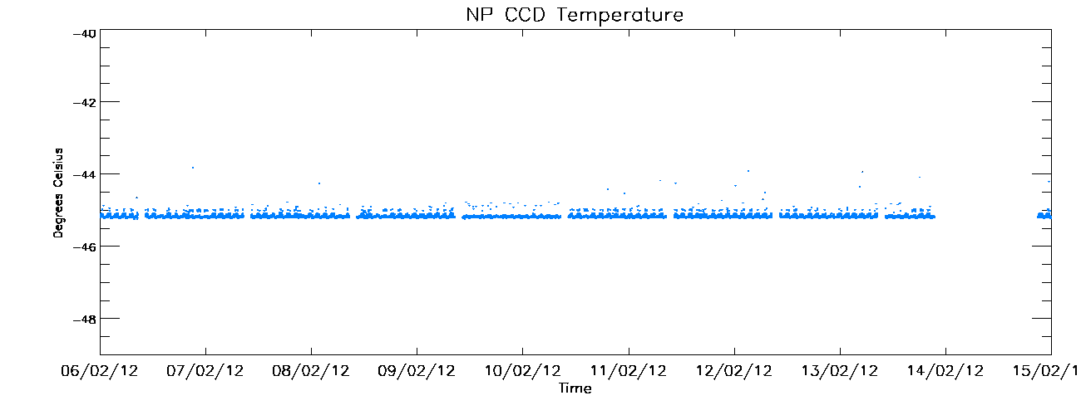
CCD Temperatures for the last ten days
Design temperature is -30∘C.
Deviations yet to be investigated.
Small intra-orbit cycle observed.
Design temperature is -45∘C.
Deviations yet to be investigated.
Small intra-orbit cycle observed.
Notes:
Provided by W. Yu

Slide 14
Backup Material

Slide 15
20120208 Update to OMPS Initial Performance Evaluation and First Images

Slide 16
Summary Bullets (Compiled by L. Flynn 2/8/2012)
OMPS NM SDRs
SNRs as expected (EOF and NN analysis)
Provide reasonable ozone and reflectivity (IDPS IP)
Geolocation is good at 5-KM level (Small FOV)
Intra-orbit Wavelength scale stability of 0.02-nm (EOF)
First Solar at 1% relative to laboratory
Solar is not in SDRs starting in February (Fill in ozone products)
Good Aerosol Index after NPP Science Team tweaking
OMPS NP SDRs
SNRs as expected (EOF and NN analysis)
No wavelength scale in product; all zeros – Fill in Profiles
Will need corrections/filtering in SAA as expected
Stray light is present (correlation of 280-nm variations with 305-nm variations gives 3%::50% response ratio)
First Solar at 5% relative to laboratory (possible 1-pixel offset in wavelength scale from expected)

Slide 17
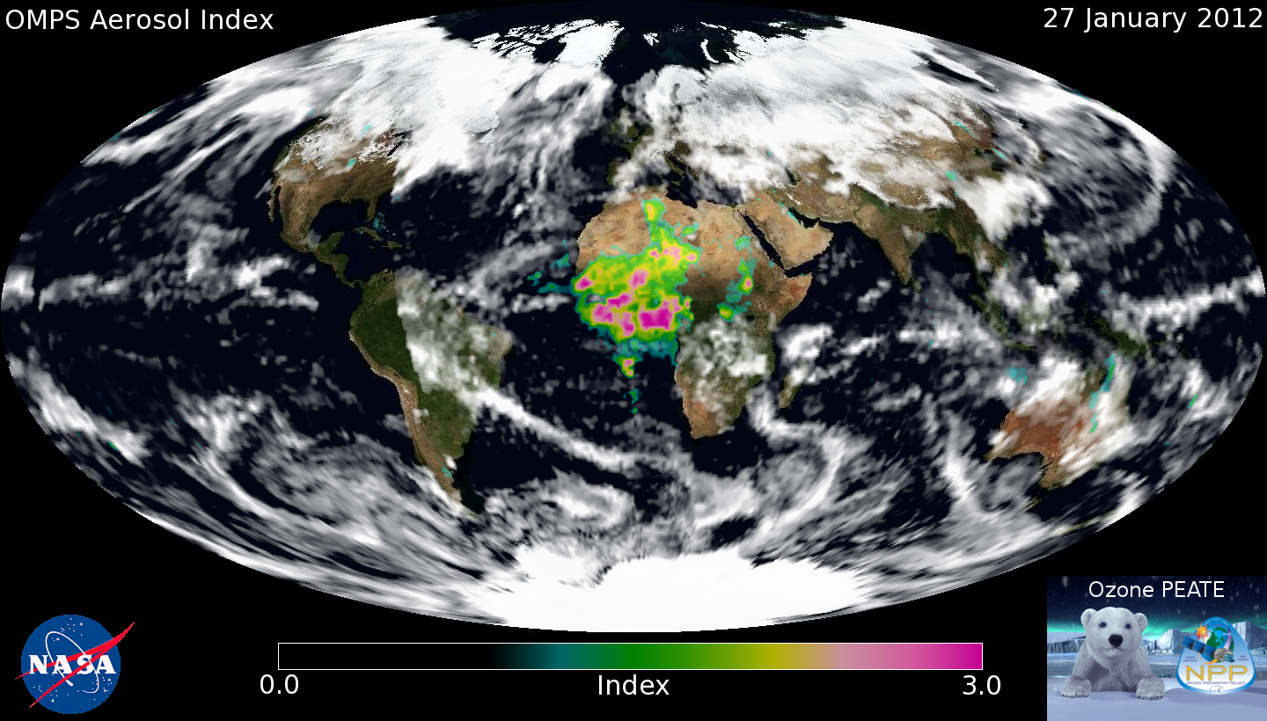
We've been working on a (very) preliminary set of soft calibration factors using the extremely limited amount of data we have so far. Using this calibration, we've generated the first daily aerosol index map from OMPS, which I'm attaching here. Sun glint has been screened out (for the most part), and clouds are represented by the OMPS reflectivity measurements. The MODIS Blue Marble image is being used for the background. Note the missing orbit over North / South America.
C. Seftor, NASA/GSFC (SSAI) 1/26-27/2012

Slide 18
Stray Light and SNR for OMPS NP
The scatter plot on the left compares simple three-wavelength Mg II core-to-wing ratio variations (280 nm to 277 and 282 nm) with longer wavelength variations at 305 nm. The core average is ~0.4 of wings, so this -0.5% to 1.5% variation represents (1.0/0.4 – 1 =) 1.5 times the wing variations.
The RMSR estimates on the right were done on clean data for 230 spectra. A spectral screen detected and removed one value on average from each of the 120-wavelength spectra. The removal of the second EOF pattern was somewhat arbitrary as it and the third EOF may be stray light patterns. The EOF used a 6th order polynomial for normalization.

Slide 19
EOF/SNR analysis for six orbits (~1800 scans) OMPS NM on 1/28/2012 using three wavelength ranges (305-325, 320-345, 340-380) for 35 CT
Notes:
All 35 cross-track positions. Top left shows noise in radiance units. Spikes not removed.

Slide 20
Wavelength Shift and Ring Effect/Stray Light
* EOF pattern
–– 0.02-nm shift
* EOF pattern
–– ∝ (1/Avg-poly)
EOF analysis 365 to 380 nm for parts of six orbits on 1/28/2012. The first two patterns contain 90% of the variability after removing a 3rd order polynomial from Rad/AvgRad. They are combinations of a Wavelength Scale Shift and Ring Effect/Stray Light. Given the radiance levels, a 0.01 in the figures at the top equates to approximately 1% variation.

Slide 21
20120202 OMPS Initial Performance Evaluation and First Images

Slide 22
Summary Bullets (Compiled by L. Flynn 2/2/2012)
OMPS NM SDRs
SNRs as expected (EOF and NN analysis)
Provide reasonable ozone and reflectivity (IDPS IP)
Geolocation is good at 5-KM level (Small FOV)
Intra-orbit Wavelength scale stability of 0.02-nm (EOF)
First Solar at 1% relative to laboratory
OMPS NP SDRs
SNRs as expected (EOF and NN analysis)
No wavelength scale in product; all zeros
Will need corrections/filtering in SAA as expected
Stray light is present (correlation of 280-nm variations with 305-nm variations gives 3%::50% response ratio)
First Solar at 5% relative to laboratory (possible 1-pixel offset in wavelength scale from expected)

Slide 23
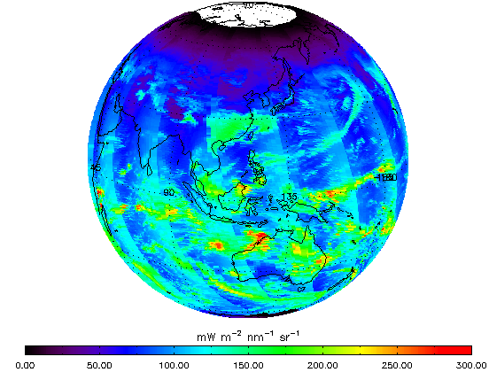
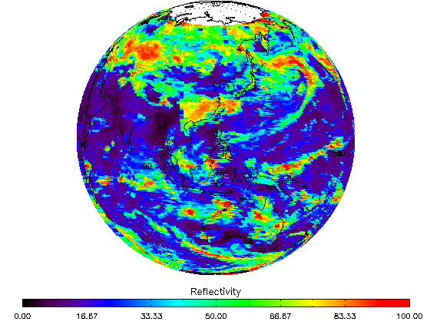
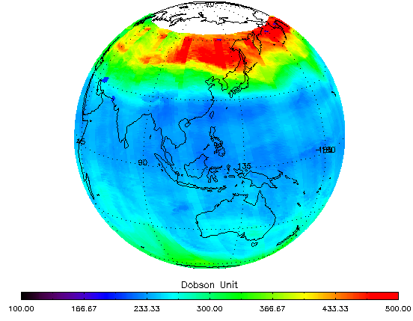
Figures: J. Niu, NOAA/STAR (ERT) 1/26-27/2012
← 331-nm Channel Radiances
for the first eight orbits of OMPS Nadir Mapper measurement (end of 1/26/2012 and start of 1/27/2012). This image shows the expected range of values and variations across the orbital track and with solar zenith angles at the times of the measurements. The white circle around the North Pole is the region of polar night during the Northern Hemisphere Winter. The OMPS needs scattered sunlight to make its measurements, so there are no data there.
Effective Reflectivity →
from the multiple triplet retrieval algorithm in IDPS for the same eight orbits. The quantity represents the UV reflectivity of the clouds and surface in each Field-of-View. Again, the range of values from bright clouds to dark open ocean scenes is as expected.
Total Ozone
from the multiple triplet retrieval algorithm in IDPS for the same eight orbits for the first pass ozone retrieval (IP product without CrIS or VIIRS information). The values show some cross track variations and are offset approximately 5% from another satellite ozone product. These uncertainty levels for preliminary products are consistent with the use of prelaunch calibration parameters and tables in the initial operational system.

Slide 24
OMPS Geolocation
This image shows the effective reflectivity for the 380-nm Channel for part of an orbit of small Field-of-View (5 KM X 10 KM at Nadir) made by the OMPS Nadir Mapper in a special diagnostic mode. The Qatar peninsula sticking into the Persian Gulf in the middle of the picture lies along the nadir view of the orbital track and gives a preliminary assurance of the geolocation at better the 5 KM.
C. Seftor, NASA/GSFC (SSAI) 1/26-27/2012

Slide 25
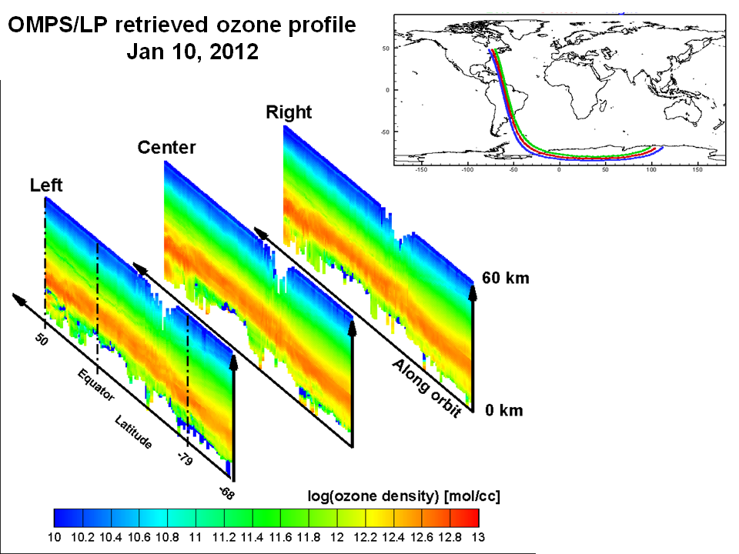
Figures: D. Rault, NASA LaRC
← OMPS Limb Profiler
These curtains represent the ozone profile in vertical slices through the atmosphere along the three paths shown above.
They demonstrate the ability of the research retrieval algorithm for the OMPS Limb Profiler in use at the NASA Ozone PEATE. The gaps at the top in the middle of the plots occur when the satellite encounters charged particles as it passes through the South Atlantic Anomaly; these are consistent with the modeled effects.
The profiles regularly extend down below 15 KM in altitude.
Notes:
Not to be outshined by Colin, I would also like to share this image of our first full-orbit retrieved ozone profiles from the OMPS Limb Profiler measurements. This image uses the PEATE processed RDRs as well as the SDR and EDR algorithms developed by the LP Science Teams. These retrievals of ozone profiles are presently being compared with MLS data to establish their quality and assess the potentials of the OMPS/LP to continue the 40-year ozone profiles record established by past NASA sensors such as SAM, SAGE, HALOE, HRDLS and MLS. These results are the fruit of team work involving NASA, SAIC (Philippe Xu) and SSAI (Tong Zhu, Nick Gorkavyi, Zhong Chen, Peter Hall, Jack Larsen) personnel. With this initial result, we can state that both the OMPS/LP sensor and the analysis team are ready for the mission. Thank you, Didier

Slide 26
OMPS Nadir Mapper and Nadir Profiler First Solar
Seftor NASA/GSFC SSAI

Slide 27
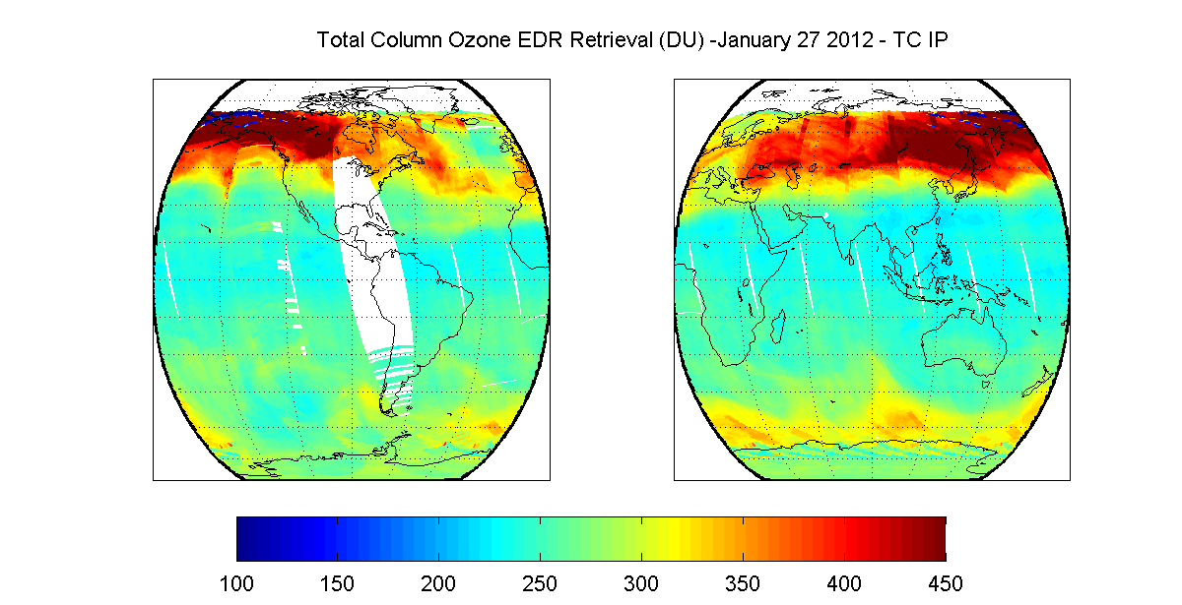
OMPS TC IP Retrieval – January 27, 2012
OMPS TC IP ozone values are plotted between 100 and 450 DU. Data as available on January 27. There are values outside of this range that need to be investigated. (M Novicki and B Sen, NGAS)

Slide 28
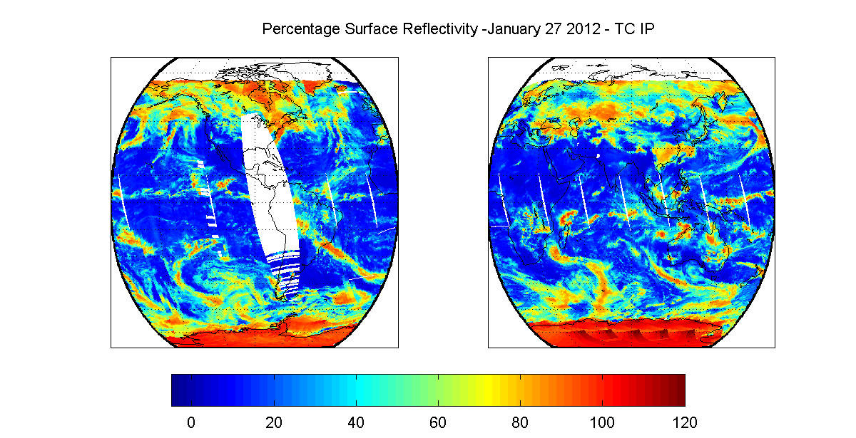
OMPS TC Surface Reflectivity – January 27, 2012
Surface reflectivity values between -5% and 120% are allowed by the OMPS TC EDR operational algorithm. Investigating ≈120% surface reflectivity values at high SZAs over Antarctic, southern Greenland and Hudson Bay. (M Novicki and B Sen, NGAS)

Slide 29
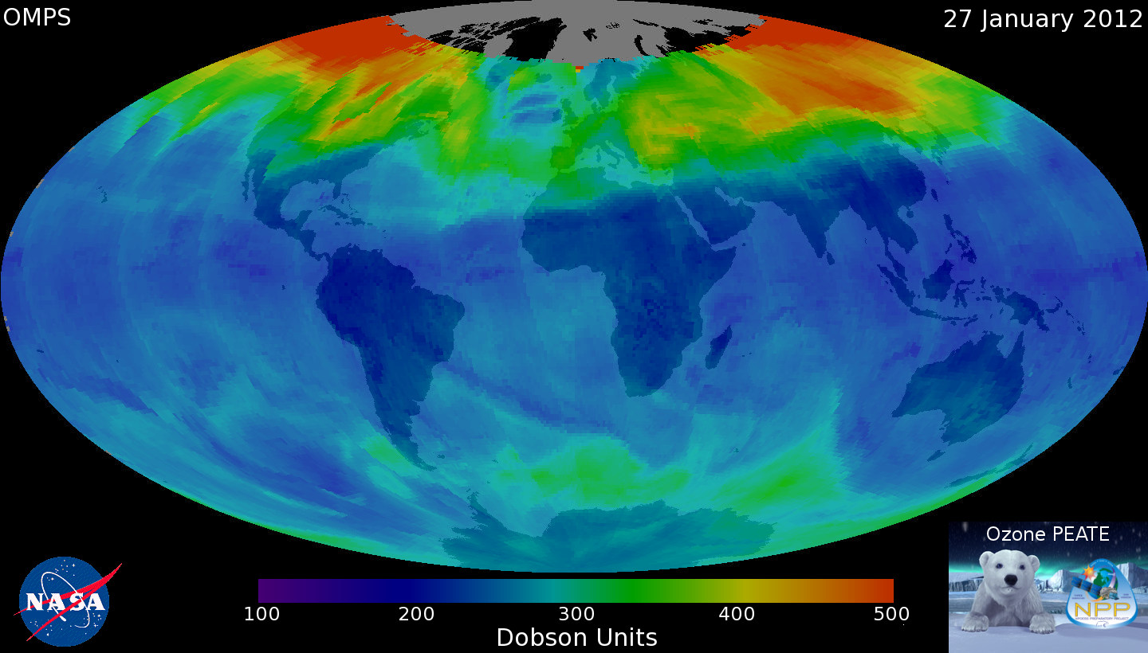
V8.6 Ozone Retrieval from NASA Ozone PEATE
Seftor NASA/GSFC SSAI

Slide 30
Backup

Slide 31
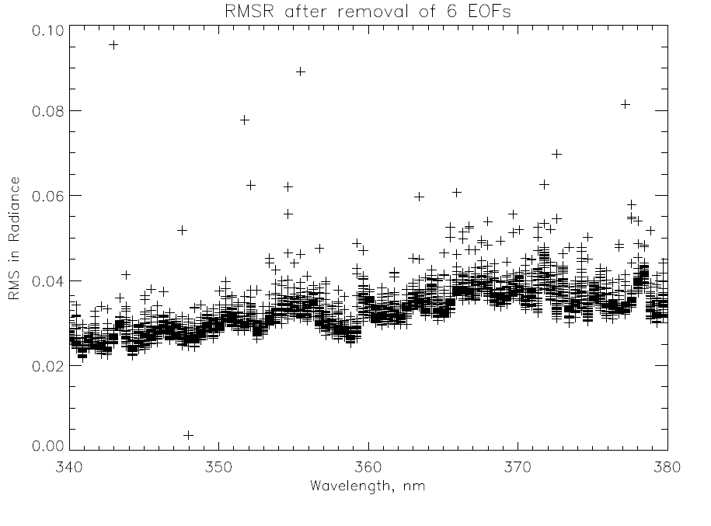
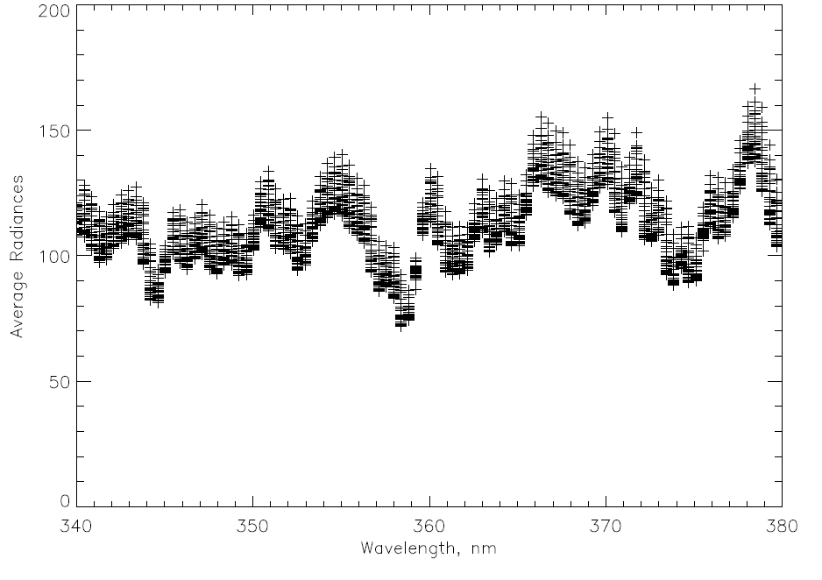
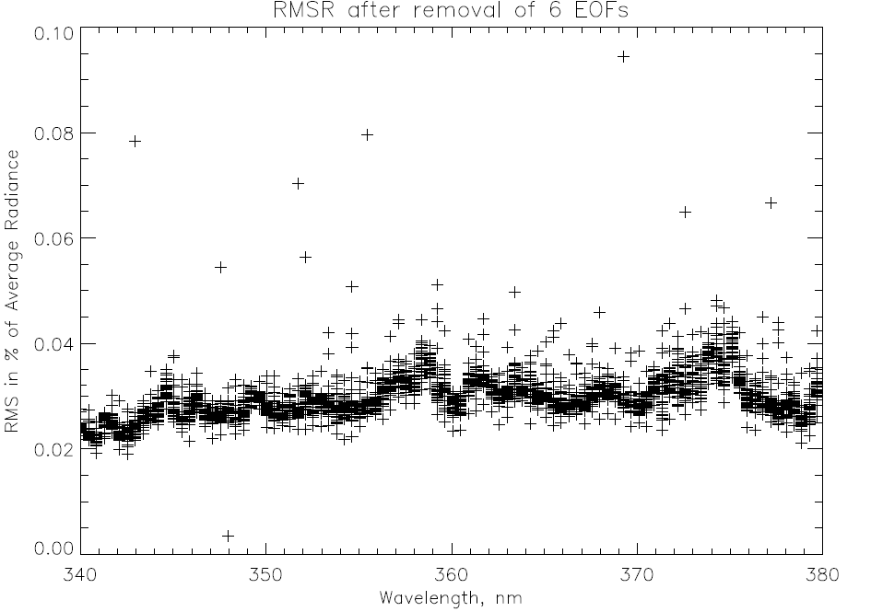
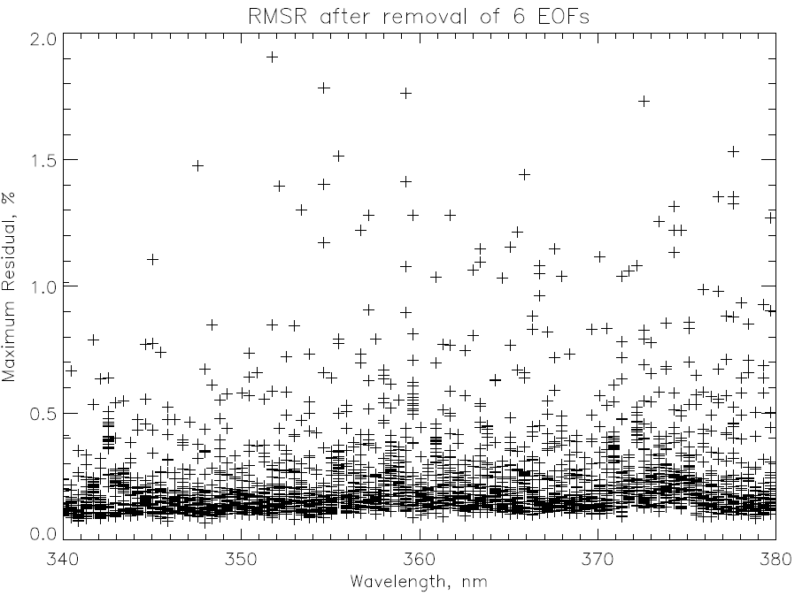
EOF/SNR analysis for six orbits OMPS NM on 1/28/2012

Slide 32
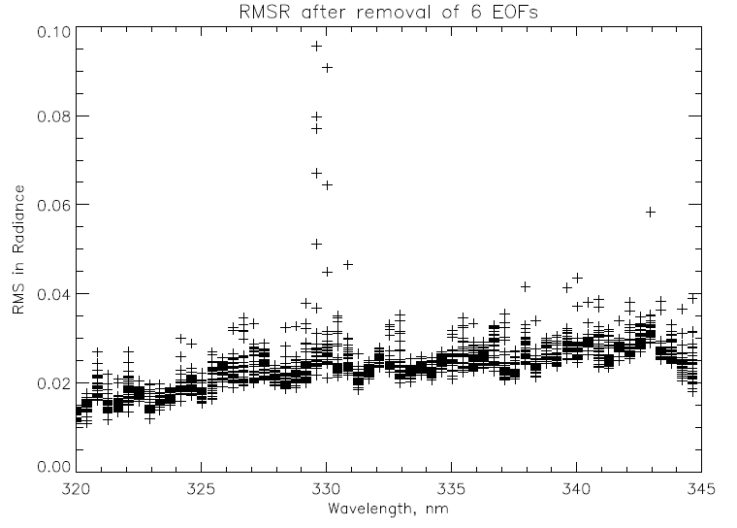
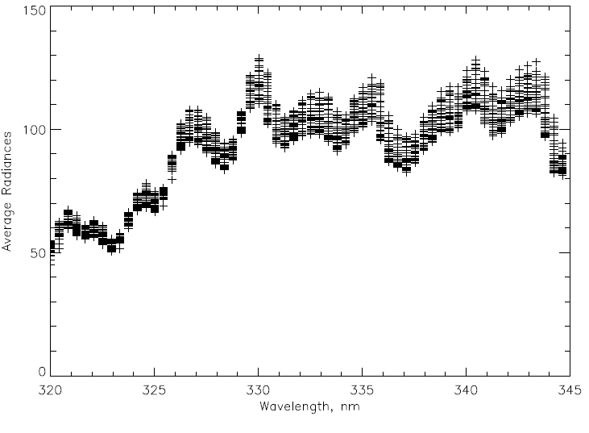
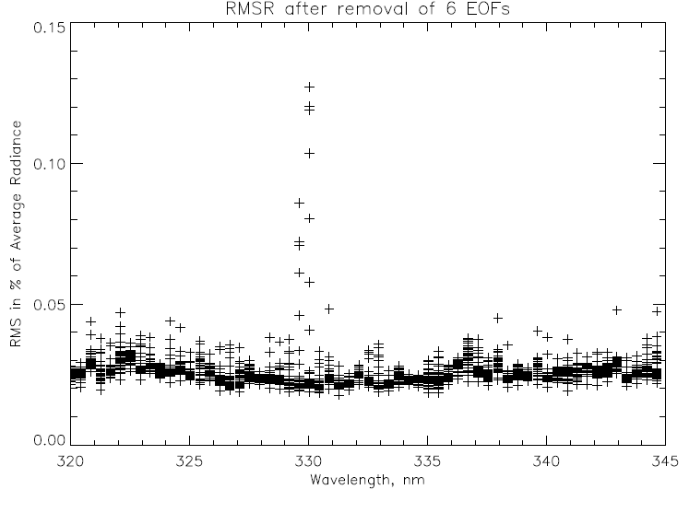
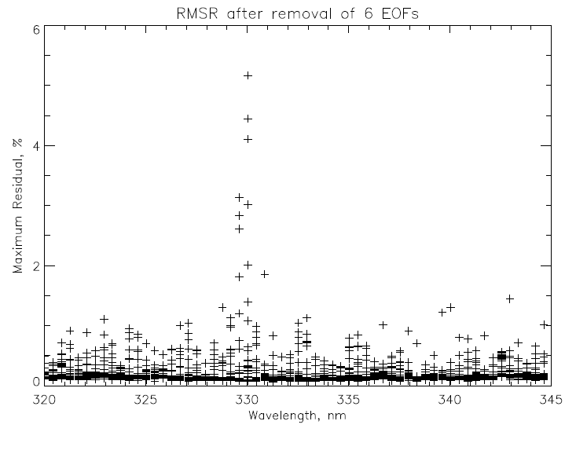
EOF/SNR analysis for six orbits OMPS NM on 1/28/2012

Slide 33
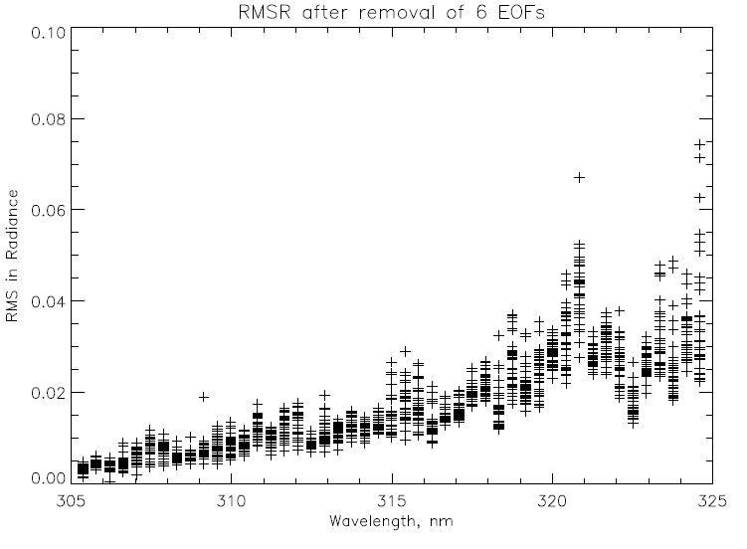
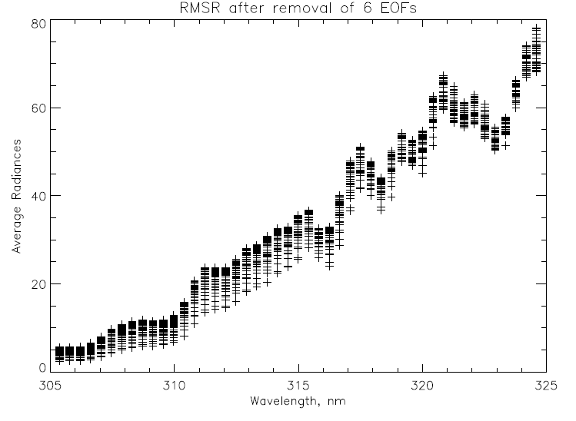
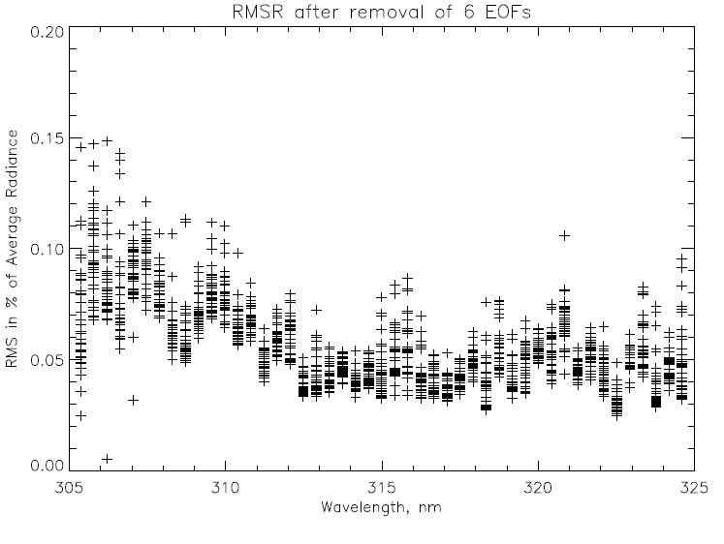
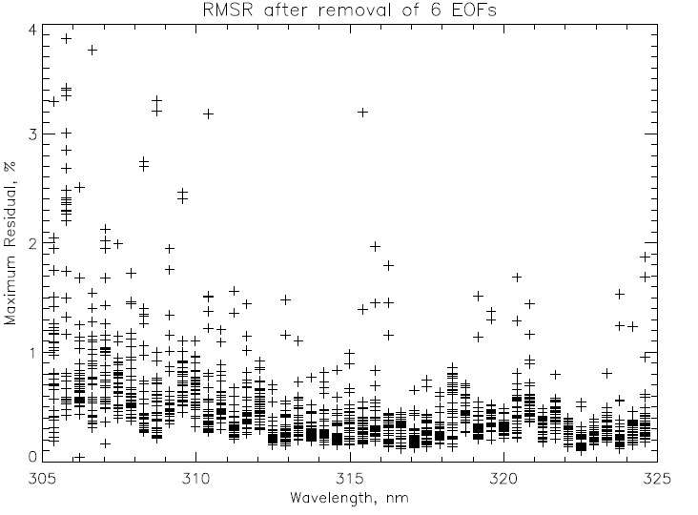
EOF/SNR analysis for six orbits OMPS NM on 1/28/2012

Slide 34
OMPS | RDR
OMPS | SDR - Ozone TC Cal/EV | Science team rewriting code to sever ties between SD and EV components of code, and that will not be done before Build Mx1.6 freeze date | DO + 1m Mar 12 | DO + 12m Feb 13 | DO + 15m May 13
OMPS | SDR - Ozone NP Cal/EV | No issues | DO + 1m Mar 12 | DO + 12m Feb 13 | DO + 15m May 13
OMPS | SDR - Ozone TC Geo | No issues | DO + 1m Mar 12 | DO + 3m May 12 | DO + 6m Aug 12
OMPS | SDR - Ozone NP Geo | No issues | DO + 1m Mar 12 | DO + 3m May 12 | DO + 6m Aug 12
OMPS | EDR - Ozone TC | Post-launch verification required; anticipate the need for post-launch adaptation of the TOMS-EP Version 8 algorithm to OMPS TC to satisfy JPSS L1RD accuracy and precision requirements | DO + 2m Apr 12 | DO + 6m Aug 12 | DO + 8m Oct 12 | DO + 10m Dec 12 | DO + 15m May 13
OMPS | EDR(IP) - Ozone NP | No heritage performance requirements; post-launch verification of operability required and anticipate the need for post-launch adaptation of the SBUV/2 Version 8 algorithm to OMPS NP to satisfy JPSS L1RD accuracy and precision requirements | DO + 2m Apr 12 | DO + 6m Aug 12 | DO + 8m Oct 12 | DO + 10m Dec 12 | DO + 15m May 13
OMPS | X-Sensor Mapping - VIIRS to OMPS | No issues
OMPS | X-Sensor Mapping - CrIMSS to OMPS | No issues
C
C
C
C
C
C
C
C
C
C
C
C
C
C
C
C
C
C
C
C
C
C
C
C
C
C
C
C
C
C
C
C
C
C
C
C
C
C
C
C
C
C
C
C
C
C
C
C
C
C
C
C
C
C
C
C

