Slide 1
OMPS Products Applications
Craig Long
NOAA/NWS/NCEP
Climate Prediction Center
SUOMI NPP SDR Product Review -- 23/24 October 2012 -- NCWCP Auditorium

Slide 2
What is OMPS
OMPS – Ozone Mapper Profiler Suite
Measures backscattered Ultraviolet and visible radiation
a nadir mapper that will map global ozone with about 50-km ground-resolution
a nadir profiler that will measure the vertical distribution of ozone in the stratosphere
a limb profiler that will measure ozone in the lower stratosphere and troposphere with high vertical resolution
Continues more than 30 years of operational ozone monitoring
Heritage
Profiler - SBUV(/2)
Mapper - TOMS, EPTOMS, OMI
Limb Profiler – Shuttle Ozone Limb Sounding Experiment/ Limb Ozone Retrieval Experiment (SOLSE/LORE)
Observations are used by ozone-assessment researchers and policy makers to track the health of the ozone layer.
SUOMI NPP SDR Product Review -- 23/24 October 2012 -- NCWCP Auditorium

Slide 3
Comparisons with Current Instruments
OMPS vs SBUV(/2)
250x250 km (max) vs 200x200 km scene area
~110 obs per orbit
8 km vs 7-10 km
OMPS vs TOMS/OMI
50x50 km (nadir) vs 50x50 km (TOMS) and 13x25 km (OMI)
Full Earth coverage
OMPS Limb Profile vs SBUV/2
3 km vs 7-10 km
60km down to cloud top
3 views x 200 km x 50 km scene area
SUOMI NPP SDR Product Review -- 23/24 October 2012 -- NCWCP Auditorium

Slide 4
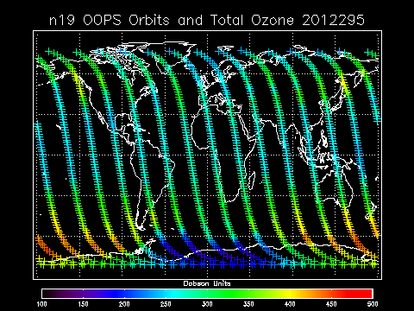
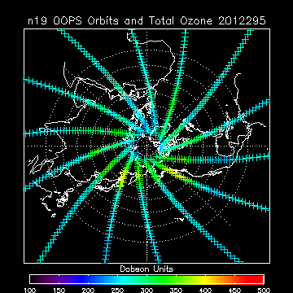
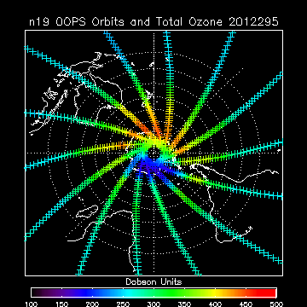
Nadir Profiler Data Coverage
SUOMI NPP SDR Product Review -- 23/24 October 2012 -- NCWCP Auditorium

Slide 5
Extension of Current Instruments
Current Profiler - SBUV/2
NOAA-16: launched 2000 – Originally a pm satellite. Now completely precessed a morning satellite
NOAA-17: Launched 2002 – AM satellite Eq crossing time is adverse for ozone monitoring
NOAA-18: Launched 2005 – PM satellite Eq crossing time is slipping to later times
NOAA-19: Launched 2009 – PM satellite Eq crossing time is near earliest.
Current Mapper – Aura OMI
Launched 2004
64 scan positions – only positions 1-27 usable
SUOMI NPP SDR Product Review -- 23/24 October 2012 -- NCWCP Auditorium

Slide 6
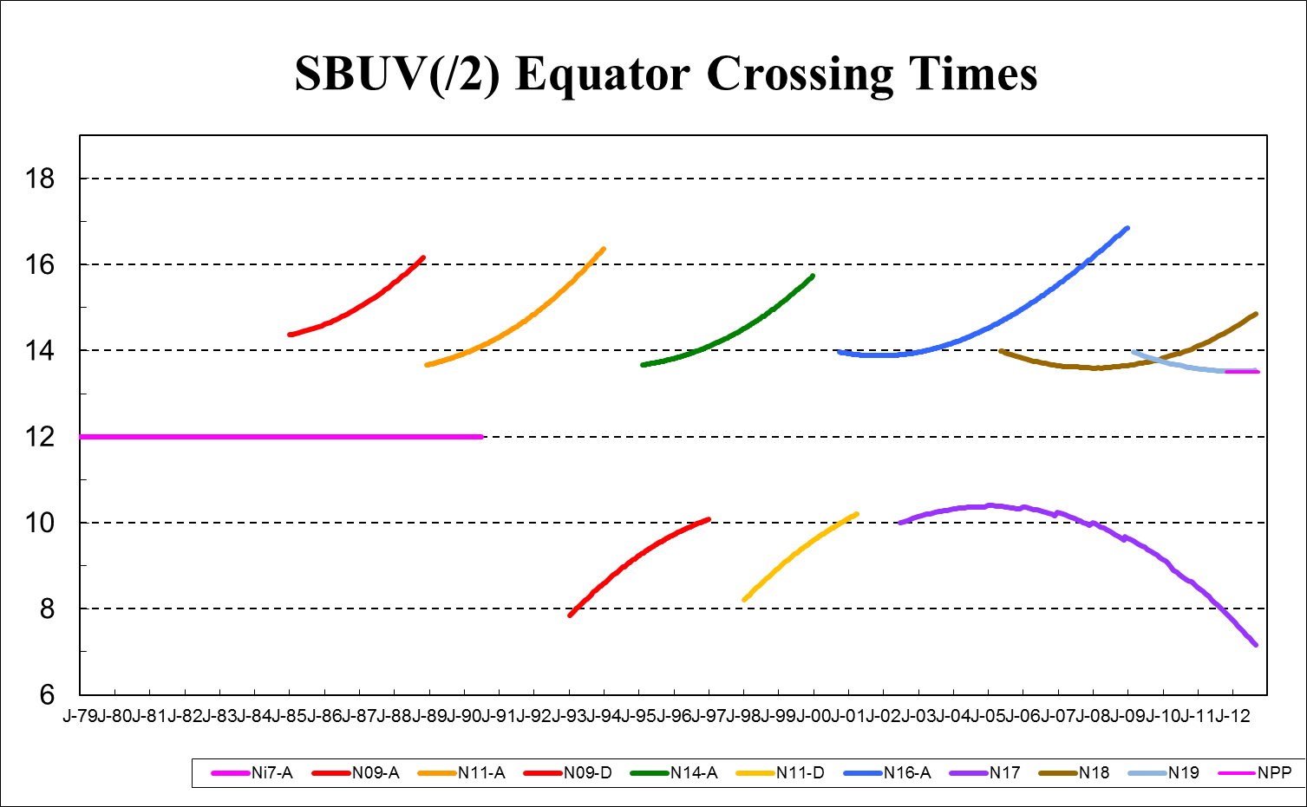
Extension of Current Instruments
SUOMI NPP SDR Product Review -- 23/24 October 2012 -- NCWCP Auditorium

Slide 7
How are Ozone Observations Used
Monitoring
Short term: daily monitoring of ozone hole
Long term: monitoring of trends (depletion/recovery)
Numerical Weather Models
Used for better retrieval of temperature information from IR channels
Needed for proper radiation computations
Forecasts used for UV Index and boundary conditions for Air Quality models.
Reanalyses
Use best available reprocessed ozone information
Used to validate or used as input for Climate-Chemistry Models
SUOMI NPP SDR Product Review -- 23/24 October 2012 -- NCWCP Auditorium

Slide 8
Analyses and Derived Products
SH ozone hole analysis
NH 2011 low ozone analysis
Ozone hole time series plot
Ozone anomalies time series
Global ozone time series trends
UV Index – US & Global
Air Quality forecasts, boundary conditions & stratospheric intrusions
SUOMI NPP SDR Product Review -- 23/24 October 2012 -- NCWCP Auditorium

Slide 9
Ozone Hole Monitoring
SUOMI NPP SDR Product Review -- 23/24 October 2012 -- NCWCP Auditorium

Slide 10
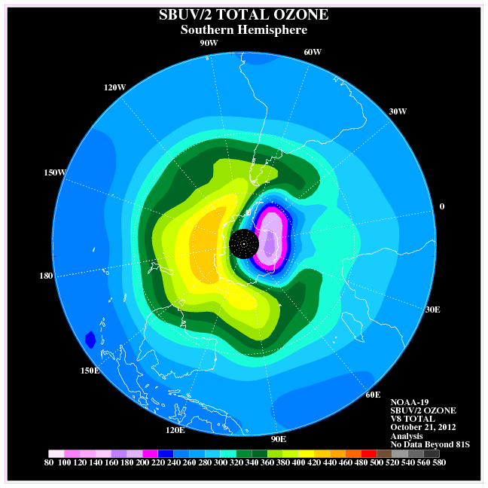
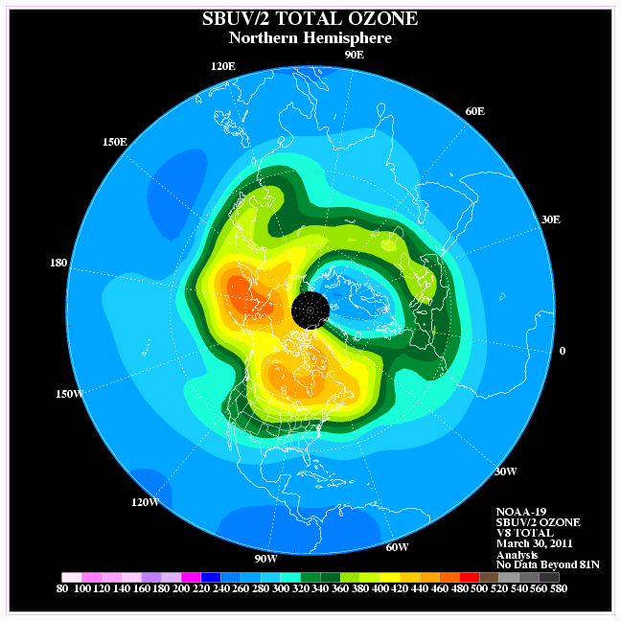
Ozone Hole Monitoring
Current SH Total Ozone Analysis from SBUV/2 obs
March 30, 2011 NH Total Ozone Analysis from SBUV/2 obs
SUOMI NPP SDR Product Review -- 23/24 October 2012 -- NCWCP Auditorium

Slide 11
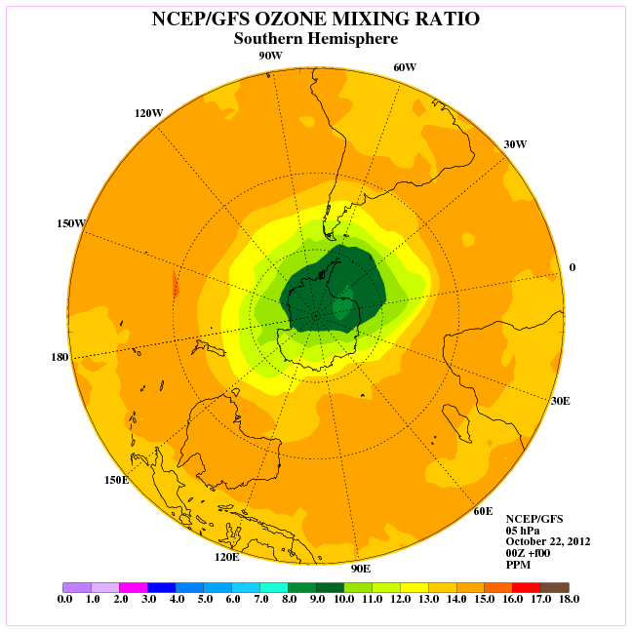
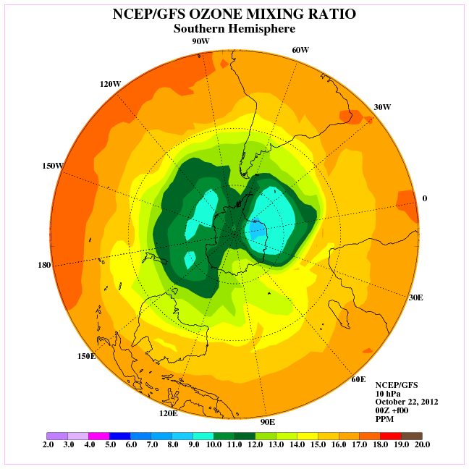
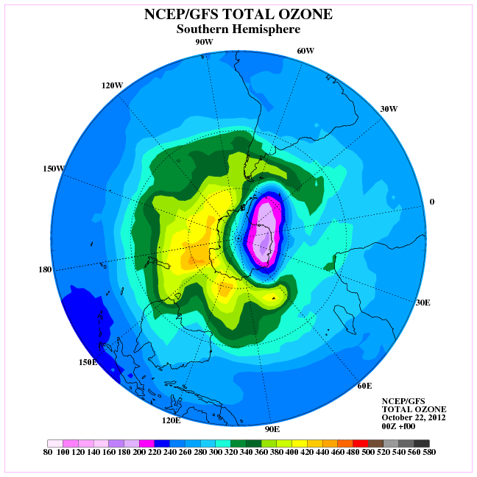
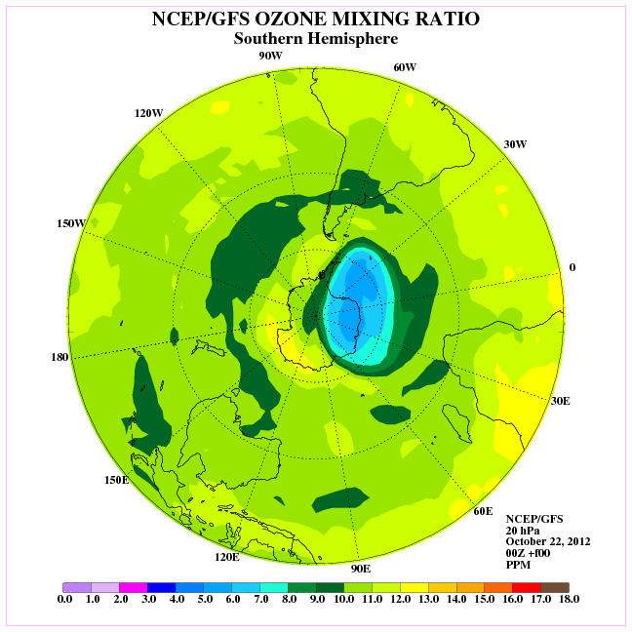
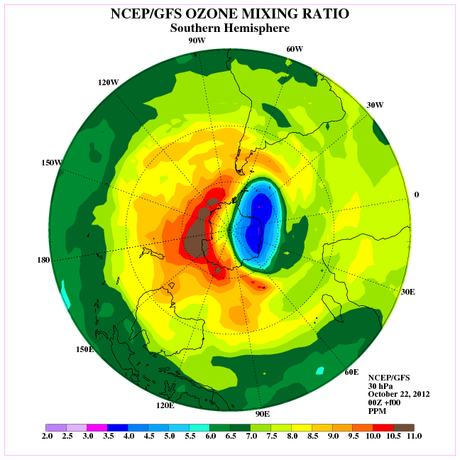
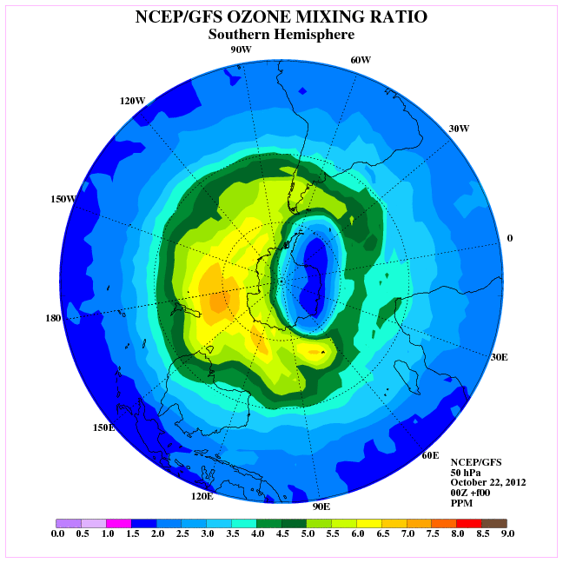
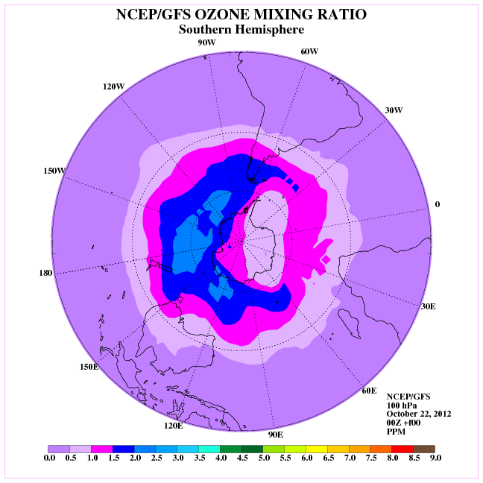
GFS Ozone Products
5 hPa
10 hPa
20 hPa
30 hPa
50 hPa
70 hPa
Current GFS Total and O3MR Ozone Analyses
SUOMI NPP SDR Product Review -- 23/24 October 2012 -- NCWCP Auditorium

Slide 12
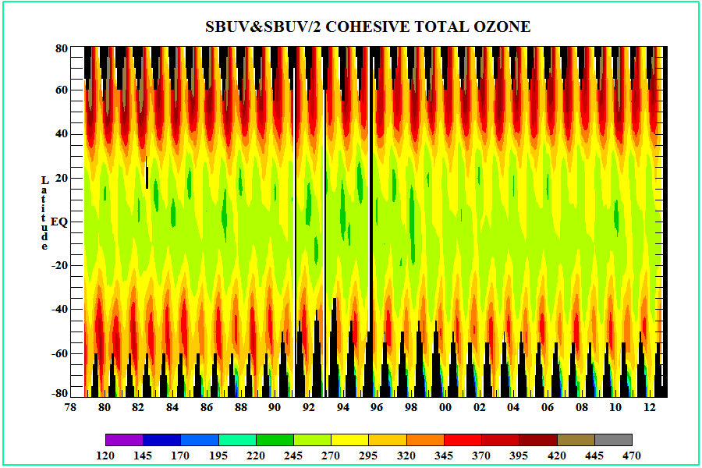
Long Term Monitoring
SUOMI NPP SDR Product Review -- 23/24 October 2012 -- NCWCP Auditorium

Slide 13
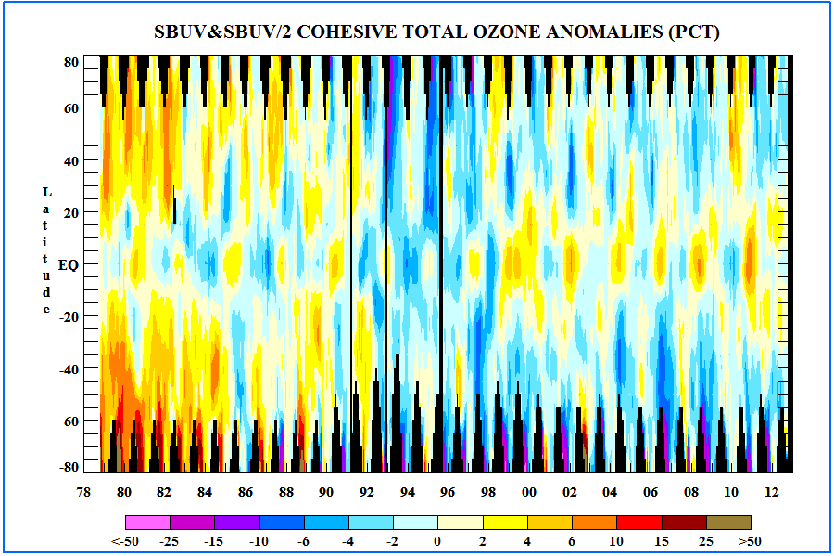
Ozone Anomalies
SUOMI NPP SDR Product Review -- 23/24 October 2012 -- NCWCP Auditorium

Slide 14
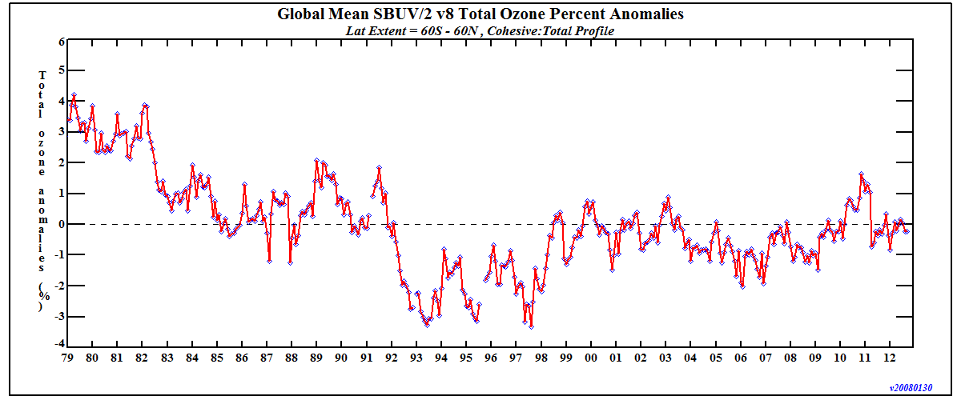
Ozone Trends
Statistical analysis of time series can be performed once atmospheric and solar oscillations and volcanic aerosols have been removed. Inflection point determined to be 1997.
SUOMI NPP SDR Product Review -- 23/24 October 2012 -- NCWCP Auditorium

Slide 15
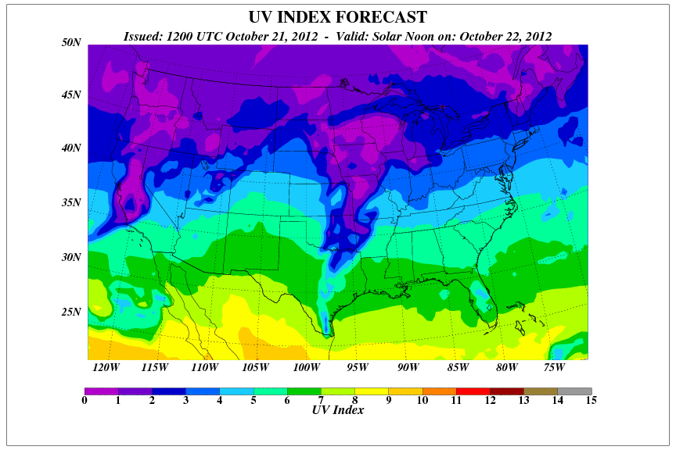
UV Index Forecasts
UV Index fcst utilizes:
Solar position
Elevation
Total ozone fcst
Albedo fcst
Cloud fcst
Aerosol fcst
SUOMI NPP SDR Product Review -- 23/24 October 2012 -- NCWCP Auditorium

Slide 16
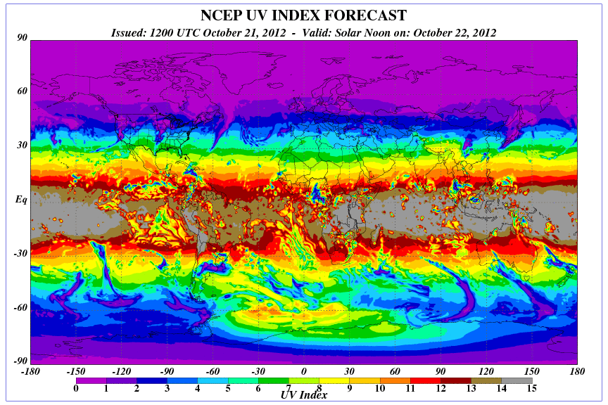
UV Index Forecasts
High UV Index due to Low Ozone values in ozone hole.
SUOMI NPP SDR Product Review -- 23/24 October 2012 -- NCWCP Auditorium

Slide 17
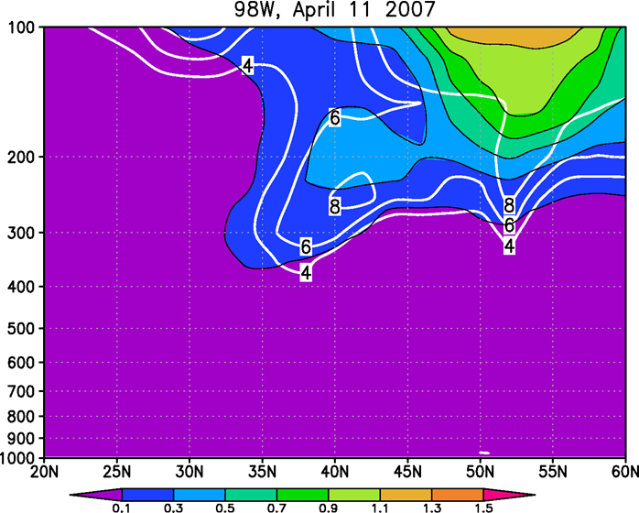
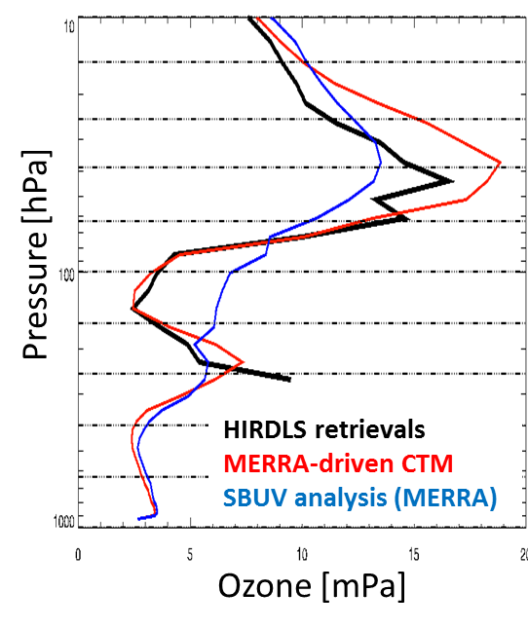
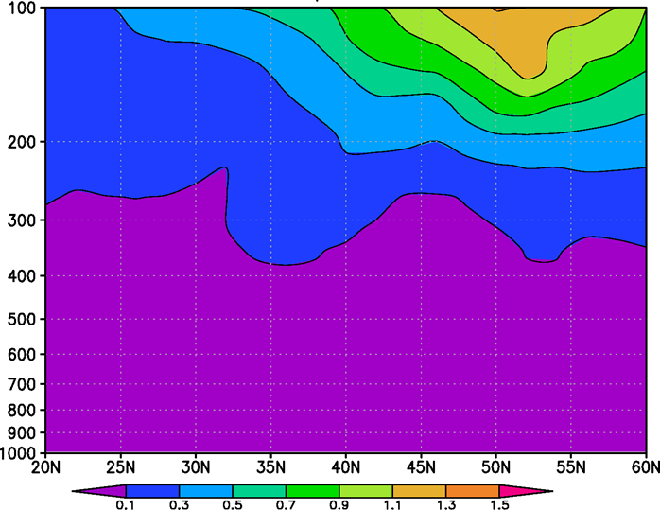
Benefits of Limb Sounder Higher Resolution
With High res obs
Higher vertical resolution obs than SBUV will enable air quality forecasters to monitor stratospheric intrusions.
SBUV/2 alone
SUOMI NPP SDR Product Review -- 23/24 October 2012 -- NCWCP Auditorium

Slide 18
Fini
SUOMI NPP SDR Product Review -- 23/24 October 2012 -- NCWCP Auditorium

