Slide 1
Evaluation of OMPS sensor and EV SDR performance
NASA’s OMPS Ozone Science Team
NASA Ozone Product Evaluation and Algorithm Test Element (PEATE)
JPSS OMPS Science Operations Center (SOC)
Conclusions:
Sensors are performing well
Calibrations are very good; no sign of degradation
Comparisons between IDPS & PEATE SDRs exhibit troubling differences
Differences have little effect on ozone, but cause us to question IDPS SDR
We recommend AGAINST Provisional status at this time

Slide 2
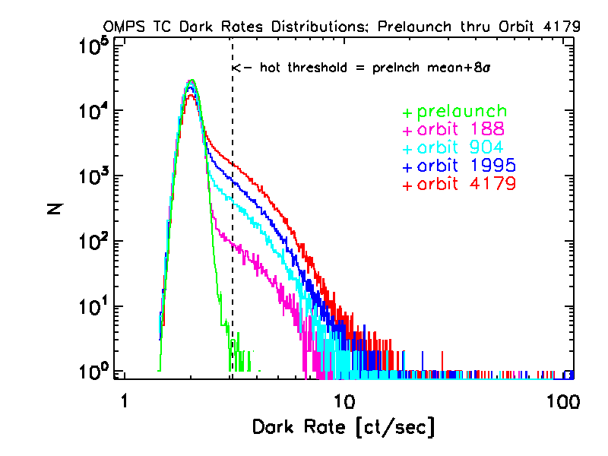
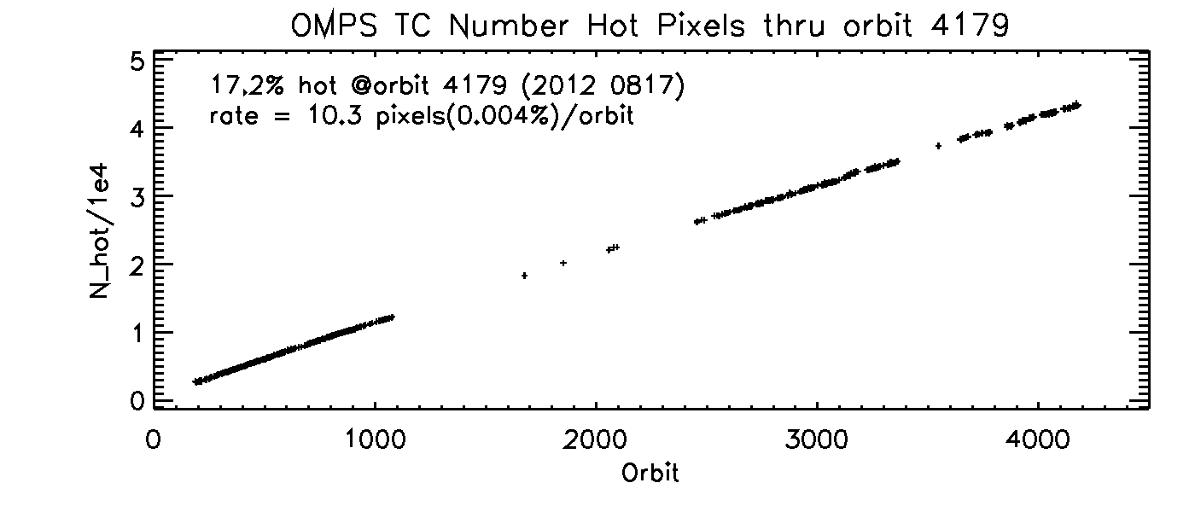
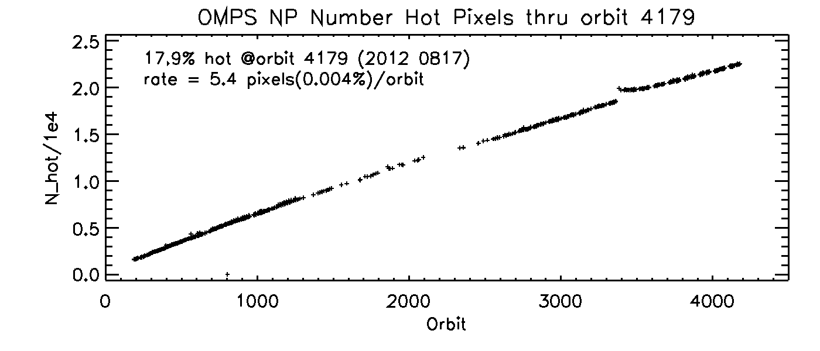
Increasing dark currents, as expected
Total Column
A “hot pixel” is any pixel with a statistically significant increase in dark current since launch
Nadir Profiler

Slide 3
Sensor linearity is stable
NP Linearity Measurement regression residuals
Orbits 230 - 1166
Knowledge spec. is ±0.2% over the full dynamic range
Q_{ideal} / 1000
Full well

Slide 4
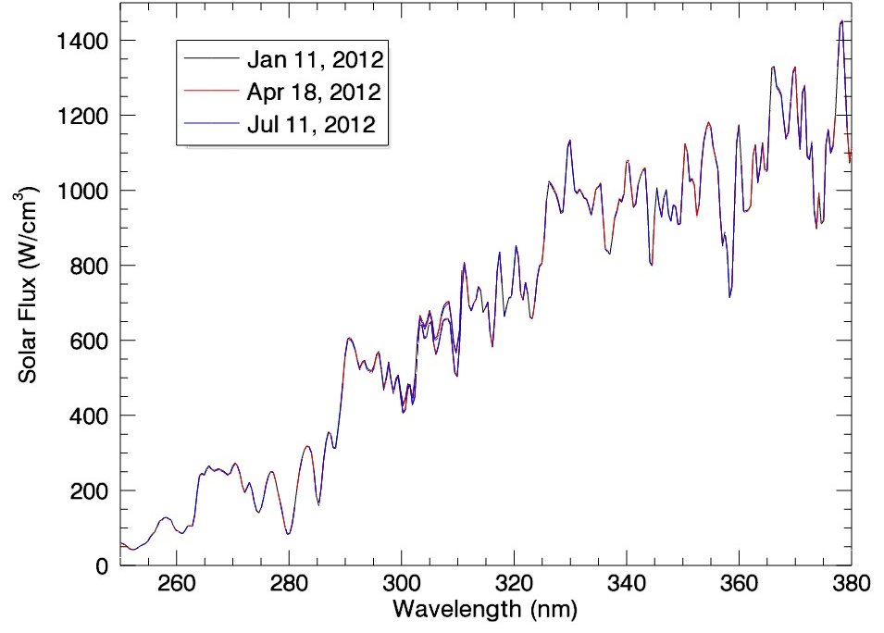
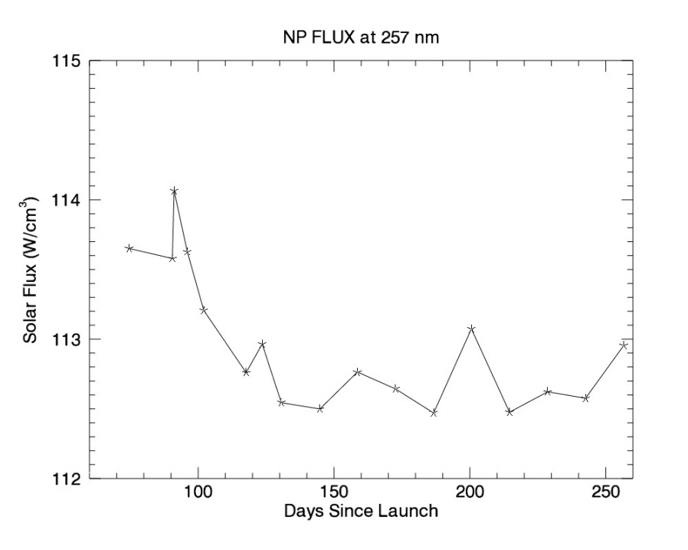
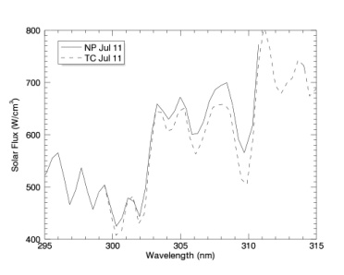
Solar measurements show no evidence of sensor change
Neither Nadir sensor has exhibited signs of degradation since first light measurements in January, 2012 except possibly at the very shortest wavelengths. Results also indicate that seasonally dependent sensor response corrections are very accurate.

Slide 5
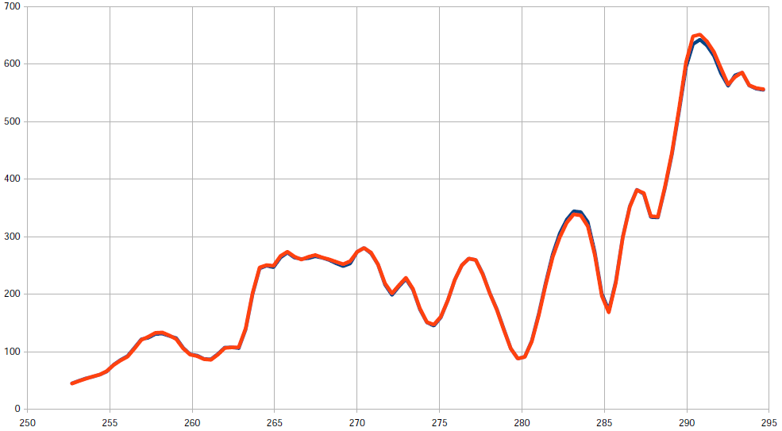
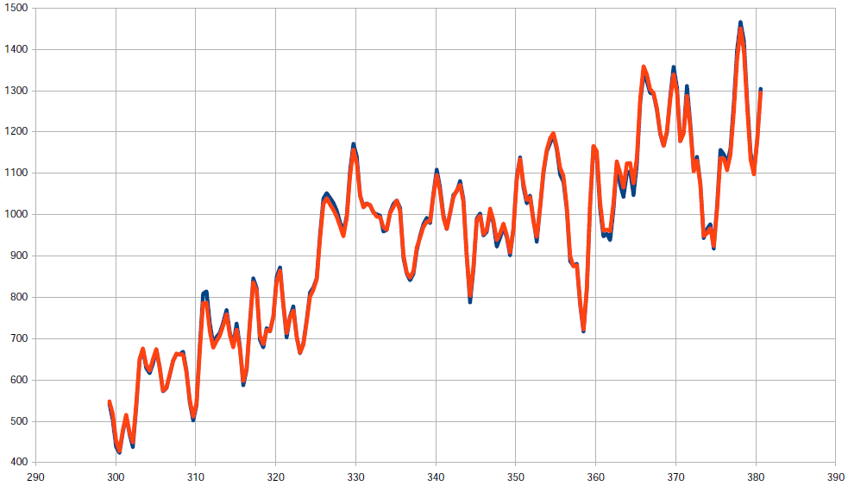
TC & NP wavelengths have been adjusted using measured solar spectra
OMPS NP Measured
Reference Spectrum
The wavelength registration is derived by comparison with a synthetic solar spectrum based on ATLAS SUSIM and Kitt Peak (also used for Aura/OMI).
Wavelength (nm)
Shift results suggest an accuracy of ~1/100 pixel.
OMPS TC Measured
Reference Spectrum
Wavelength (nm)

Slide 6
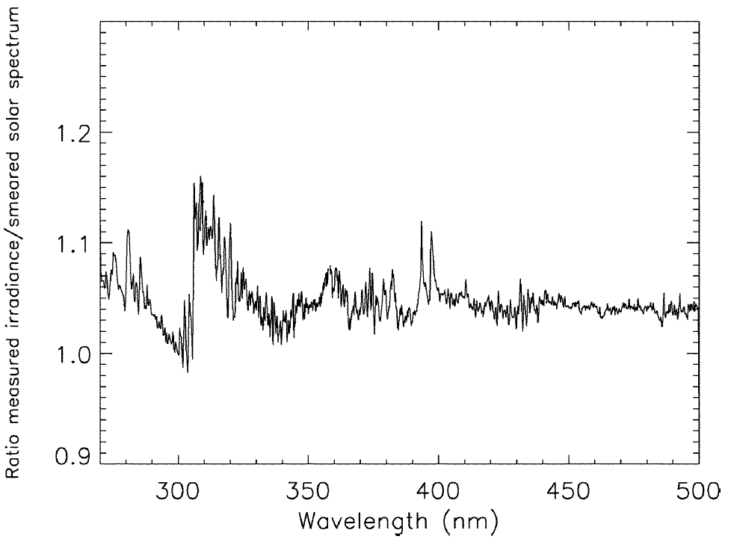
Solar spectra compare well with previous extraterrestrial measurements
OMPS Day 1 Solar Flux compared to synthetic spectrum after wavelength shift
OMI comparison to same synthetic spectrum

Slide 7
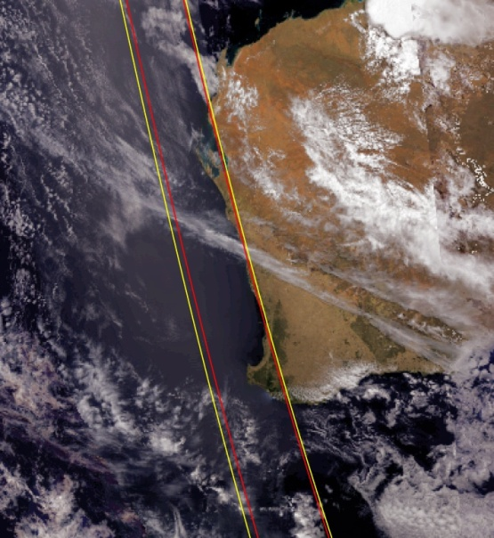
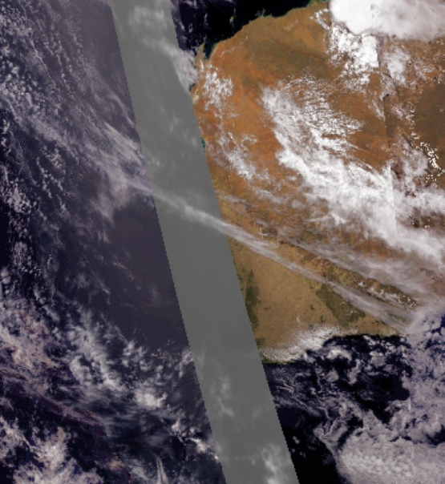
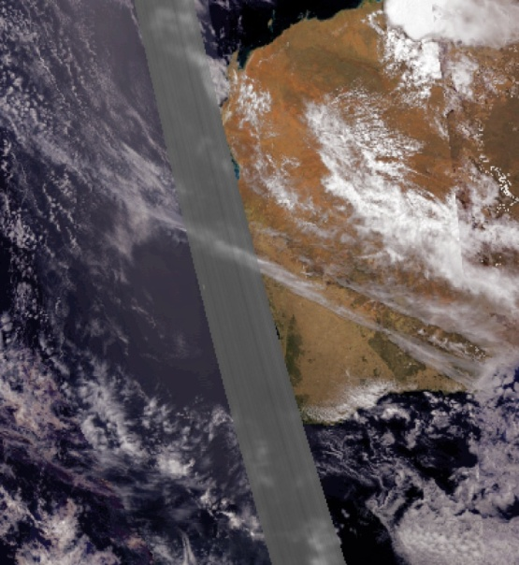
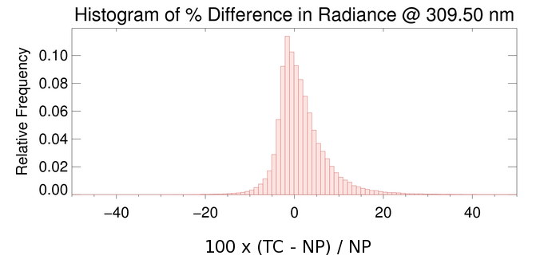
Colocation of TC & NP is reasonably good
OMPS Swath Coverage on VIIRS Image
(yellow=TC, red=NP)
Nadir Mapper (TC) TOA Refl.
310.70 nm Band (33)
Nadir Profiler (NP) TOA Refl.
310.73 nm Band (35)
OMPS EV_COLOC Orbit 1616 over Western Australia on 2/19/2012

Slide 8
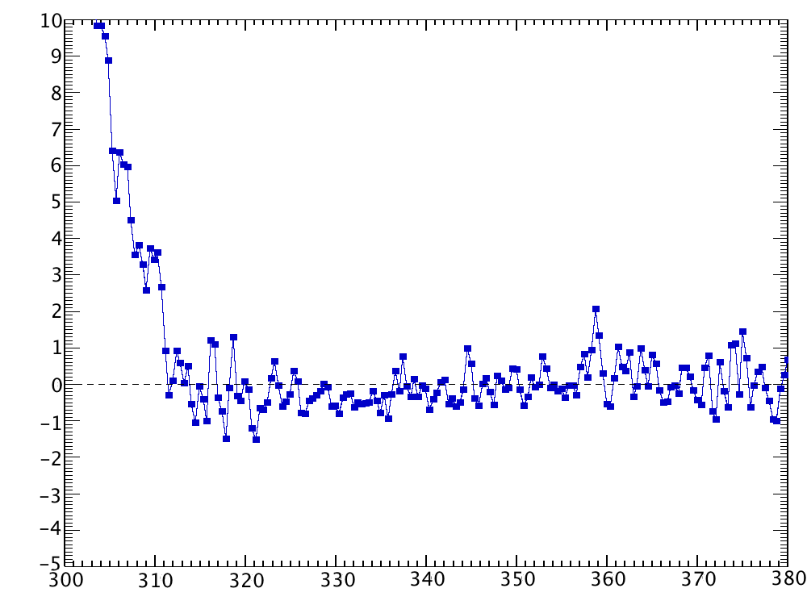
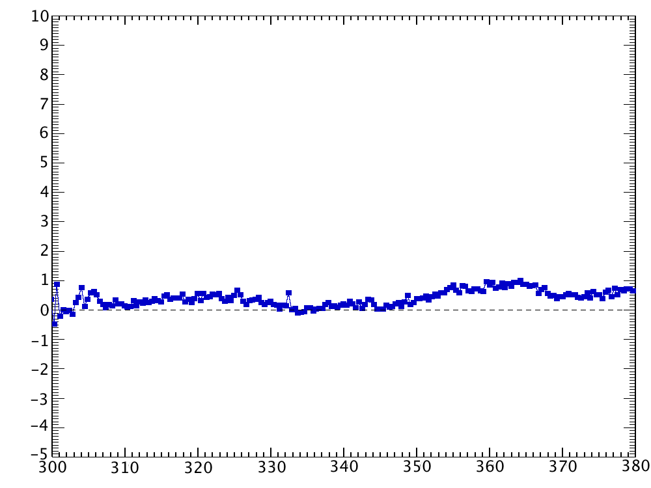
OMPS TC comparison with modeled TOA reflectances is quite good
Co-locate MLS temperature, ozone profiles to OMPS TC measurements
Reflectivity < 0.10
-10 < latitude < 10 degrees
June 2012
Calculate TOA reflectances (radiance / solar flux) from TC viewing conditions, MLS profiles using radiative transfer code (TOMRAD)
Compare measured OMPS TC reflectance with calculated reflectance
Agreement seen to within 1% for wavelengths > 312 nm
Stray light seen for wavelengths < 312 nm
Consistent with pre-launch sensor characterization
Stray light
Position 19 (nadir looking)
Percent reflectance difference (meas – calc)
Structure seen in spectrum
repeats in all swath positions,
taken out through dividing by
position 18 (Raman scattering)
Position 19 / Position 18
Wavelength (nm)

Slide 9
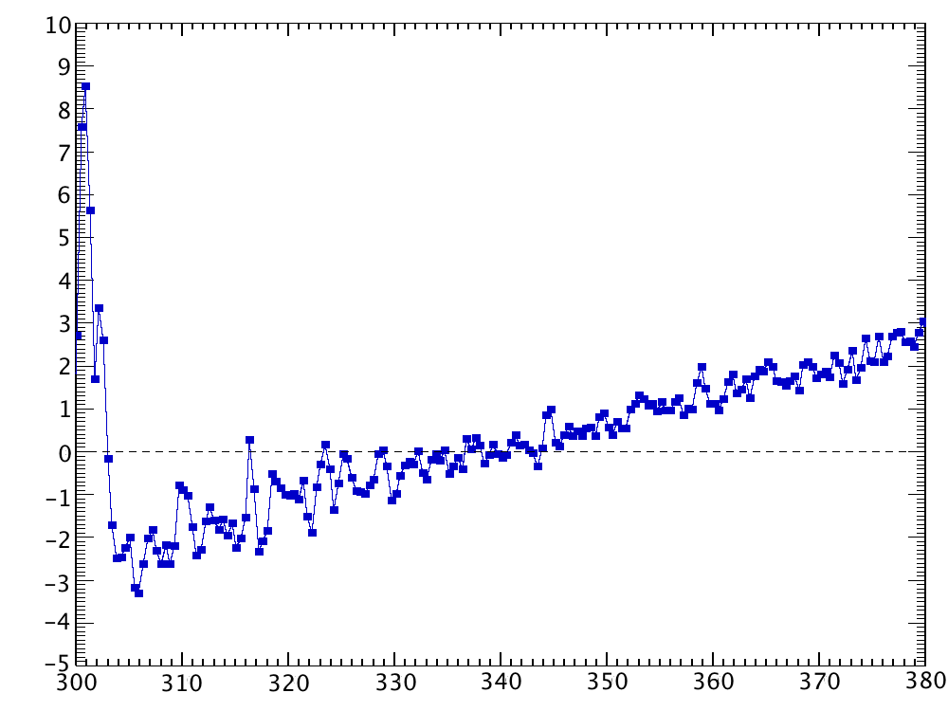
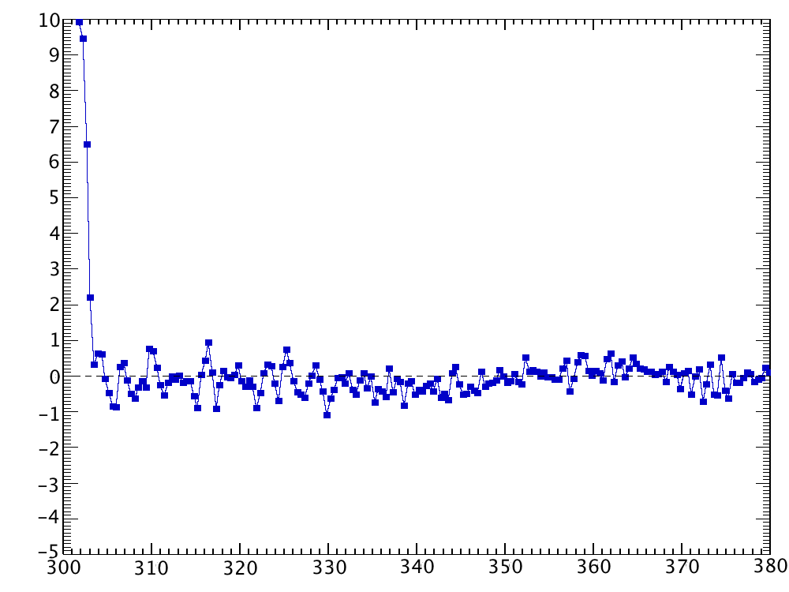
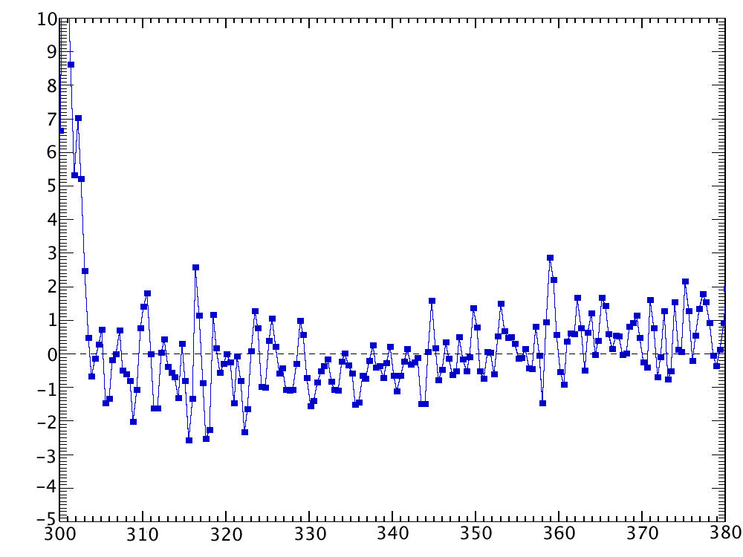
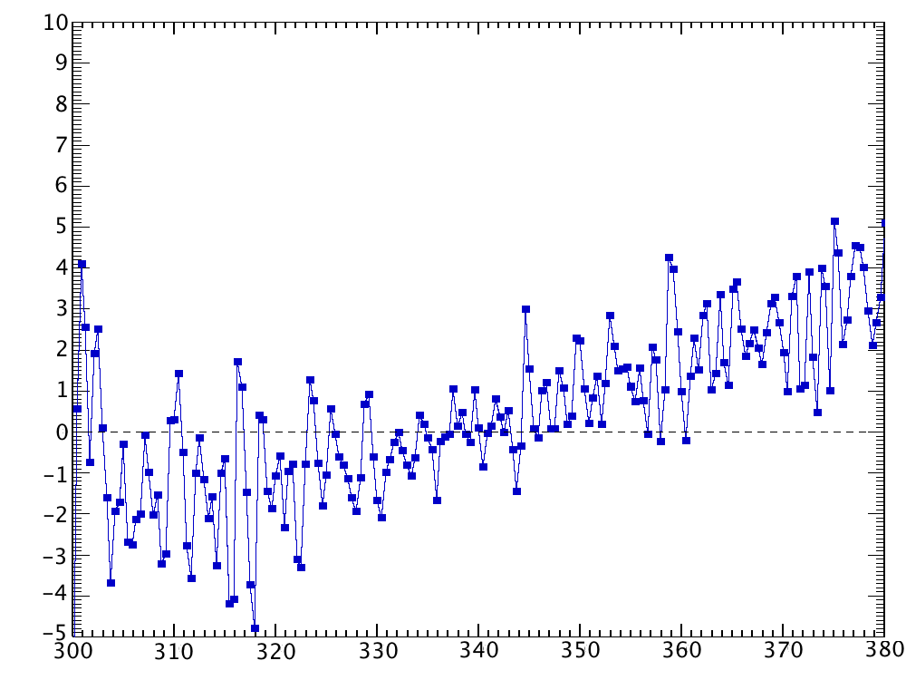
OMPS TC cross-track calibration is typical
Position 1 / Position 18
Position 4 / Position 18
Difference indicates inconsistency
with MLS ozone profile, will lead to
different total column ozone amounts
Problems at the far off-nadir positions lead to swath dependent ozone effects
Not unusual
Difference indicates
calibration issue
Percent NR difference (meas – calc)
Position 33 / Position 18
Position 36 / Position 18
Difference indicates inconsistency
with MLS ozone profile, will lead to
different total column ozone amounts
Difference indicates
calibration issue
Wavelength (nm)

Slide 10
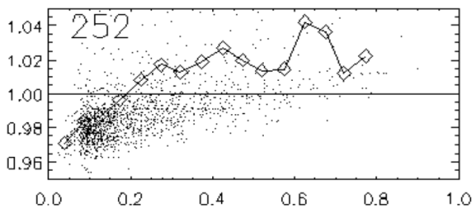
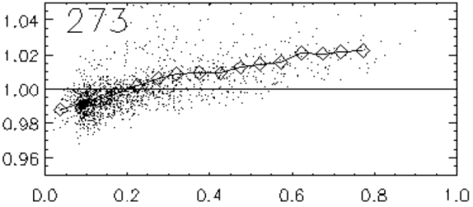
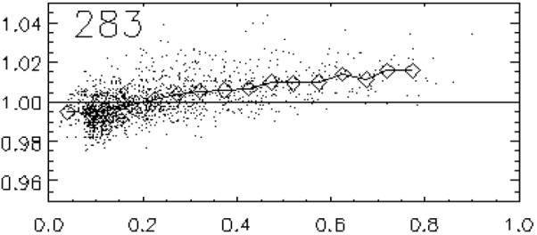
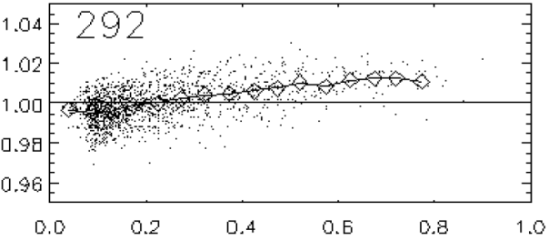
NP stray light appears “as expected”
Pre-launch stray light model applied to real data
Orb 2840
Model estimate
+
Measurement
+
Radiance / cos(SolZA)
+
+
+
+
SBUV2 technique for stray light evaluation applied to NP
Errors in 1 mb O₃ could be 5% or more
331 nm Reflectivity

Slide 11
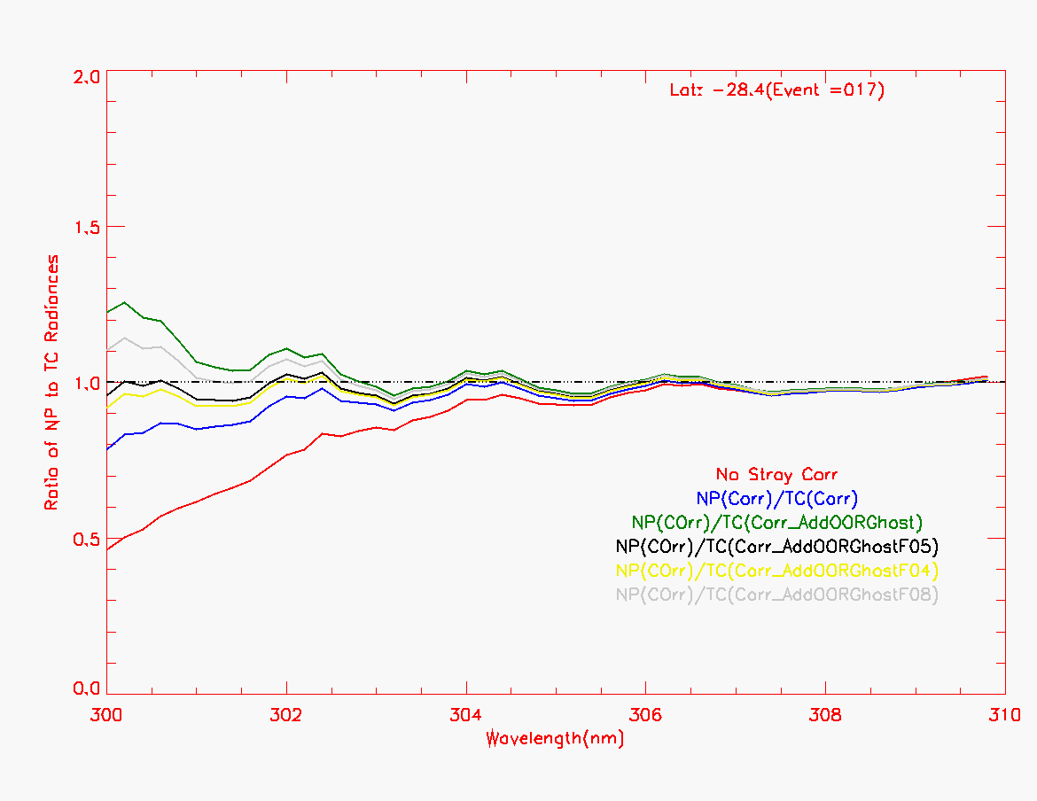
TC stray light can be corrected
NP / TC Radiance Ratio
Assume NP radiances contain no stray light in the overlap region (300 – 310 nm)
Use TC / NP comparison to tune ghost
Best result yields ±5% residual errors at 300 nm (except at high SolZA)
Orbit 2840
No Correction
Basic Correction
Basic Correction + various ghost models
TC Stray Light is partly caused by a ghost from 417 nm – not well characterized pre-launch

Slide 12
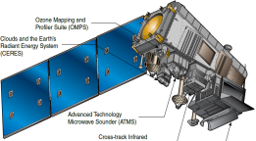
OMPS Operations
The OMPS SOC utilizes the NASA Cal. SDR product to maintain Flight and Ground calibrations
C3S
IDPS
OMPS RDRs
Fast Track & Diag. Flight Tables
NGAS
SD3E
Flight calibration operations were modified after launch to optimize measurements
LUTs
OMPS Science Operations Center
O₃ PEATE
NASA Cal. SDR
Analysis Results

Slide 13
OMPS SOC delivers Cal. tables
Table Description | Table Type | Delivery Status
TC & NP Day 1 Solar | LUT | Once (repeat is TBD)
TC & NP Wavelength | GND-PI | Monthly (ceased with Mx6.3)
TC & NP CF Earth | GND-PI | Monthly (ceased with Mx6.3)
TC & NP Dark Tables | GND-PI | In test
Diagnostic Flight Sample Tables | SCT | Frequently
Earth-view Flight Sample Tables | SCT | Once
Earth-view Ground Sample Tables | GND-PI | Once
Calibration Flight Sample Tables | SCT | Once
TC & NP Radiometric Coefficients | LUT | TBD
TC Stray Light Coefficients | LUT | In test
NP Stray Light Coefficients | LUT | Not planned
TC & NP Linearity (Flight & Ground) | SCT/GND-PI | Not planned
TC & NP Flat Field | SCT | Not planned

Slide 14
Flight calibrations modified after launch
EVNCAL – 1 orbit
Every week
Original
Modified
3orb Solar
Every 2nd week
TC Solar (1-4) | 12 images
NP Solar | 9 images
TC Solar (5-7) | 9 images
NP FF Lamp | 1 image
NP Linearity | 83 images
NP FF Dark | 1 image
NP Dark coadd | 1 image
TC FF Lamp | 1 image
TC Linearity | 83 images
TC FF Dark | 1 image
TC Dark coadd | 1 image
TC Solar (1,4,7) | 57 images
TC / NP Stor. Darks | 37 images
TC Solar 2 | 16 images
NP Solar | 16 images
TC Solar 6 | 16 images
TC / NP Open Darks | 37 images
TC Solar (1,3,5,7) | 54 images
TC / NP Closed Darks | 37 images
Orbit 1
Orbit 2
Orbit 3
EVLED_Closed – 1 orbit
Every 4th week
EV_4WK_DC – 1 orbit
Every 4th week
NP Lamp Warmup | 50 images
NP Linearity | 83 images
NP FF Lamp | 1 image
TC / NP Closed Darks | 5 images
TC Lamp Warmup | 50 images
TC Linearity | 83 images
TC FF Lamp | 1 image
TC / NP Closed Darks | 21 images
TC / NP Stor. Darks | 9 images

Slide 15
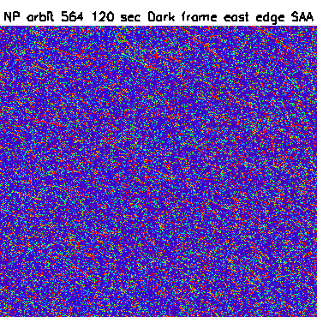
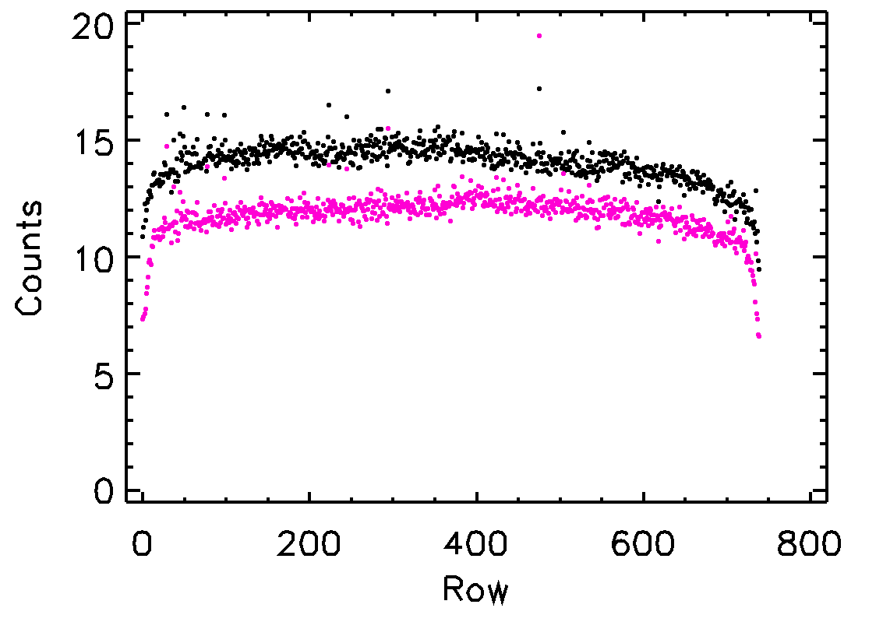
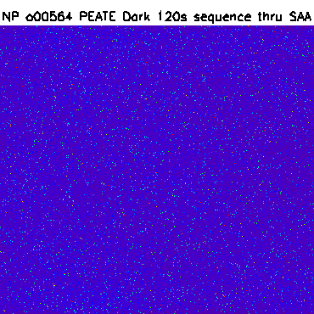
Updated dark calibration sequence
Original dark sequence was not optimized for transient removal
Before transient removal
Dark Correction for 7.5 sec TC Image
(row by row mean)
PEATE / SOC Darks
Original Cal. Darks
After transient removal
We do not currently understand this small dark current difference

Slide 16
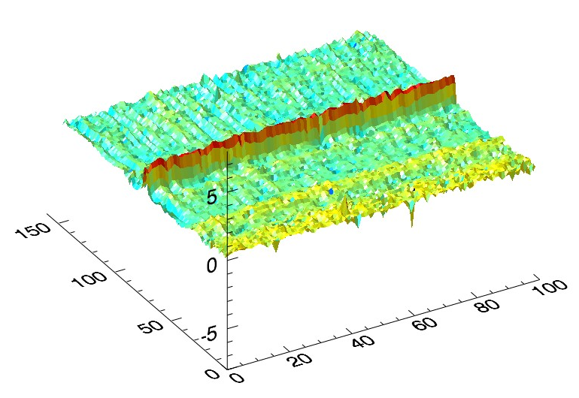
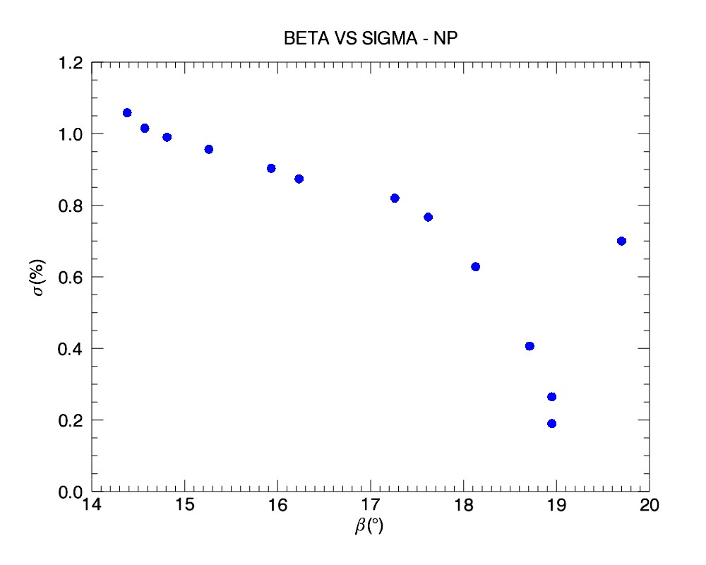
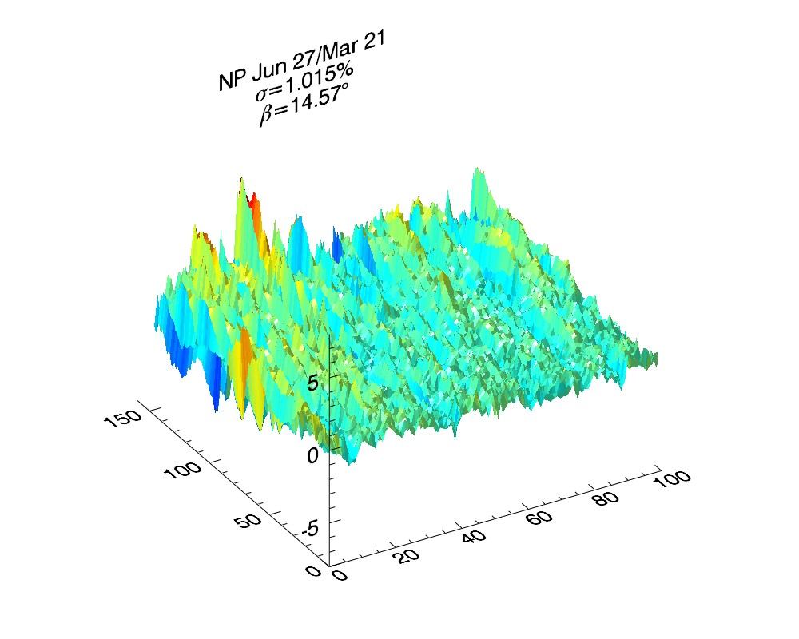
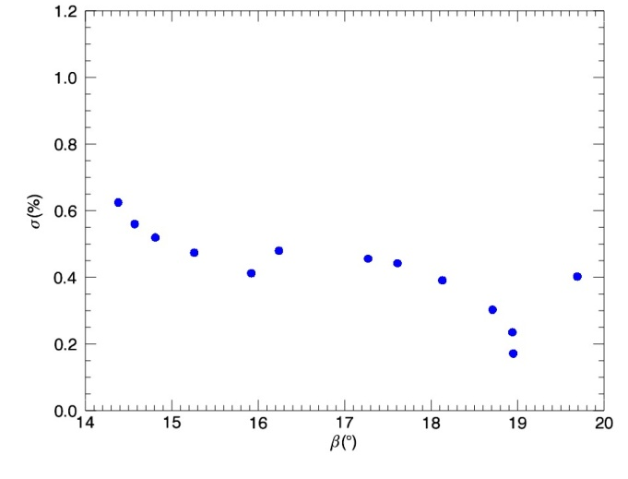
Solar noise driven by diffuser features
NP Working Diffuser ratio: Aug. 31 / Mar. 21
β=18.95° / β=18.95°
NP
σ of ratio to Mar. 21 (%)
NP Working Diffuser ratio: Jun. 27 / Mar. 21
β=14.57° / β=18.95°
Solar β Angle (degrees)
TC

Slide 17
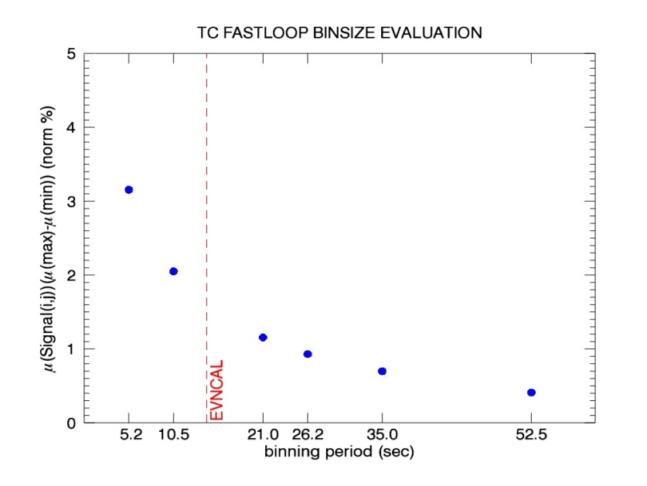
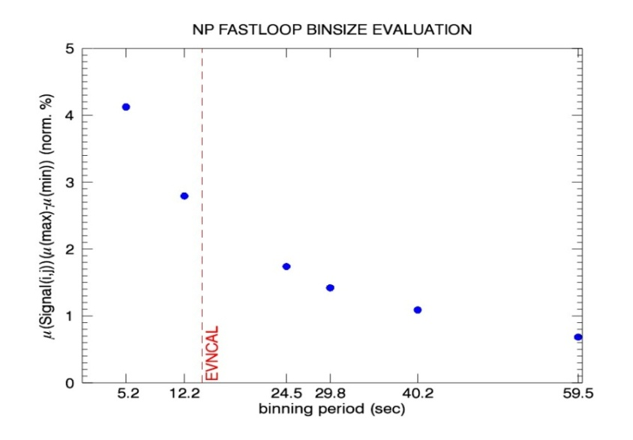
Special solar data resampled to study diffuser feature reduction
3-image running aggregation
Solar sequence lengthened to reduce noise from diffuser features
Original solar sequence
New solar sequence: ~ 80 sec
12-image running aggregation
Original solar sequence

Slide 18
NASA evaluation of IDPS OMPS SDR
What does the SDR do?
Radiance = [ Raw Counts – Bias – Smear – Dark – StrayLight ] x Cal. Consts.
OK
OK?
Problems
Not implemented
Problems
Smear, Dark, and StrayLight are small corrections, so radiance errors are small
Some problems have clear resolutions
For others the cause is still under investigation
EV SDR not understood well enough for Provisional
But …. we believe this evaluation is about establishing confidence in SDR

Slide 19
Transients in smear region not corrected
Derived Radiance (right side)
Smear is the only correction derived directly from Earth scene data
Smear Signal
These data are doors-closed, so radiances should be zero
Derived Radiance (left side)
Will result in significant radiance errors over entire swath (primarily in SAA)

Slide 20
Smear values (reported as used in SDR) don’t appear to be correct
PEATE SDR
Swath corresponding to
12 Oct 2012
5 hr, 52 min, 2.82 sec
smear
Bias Floor
Wavelength Index
Do not understand how
these values come about
given the existing co-add and binning
characteristics
IDPS SDR
smear
Wavelength Index

Slide 21
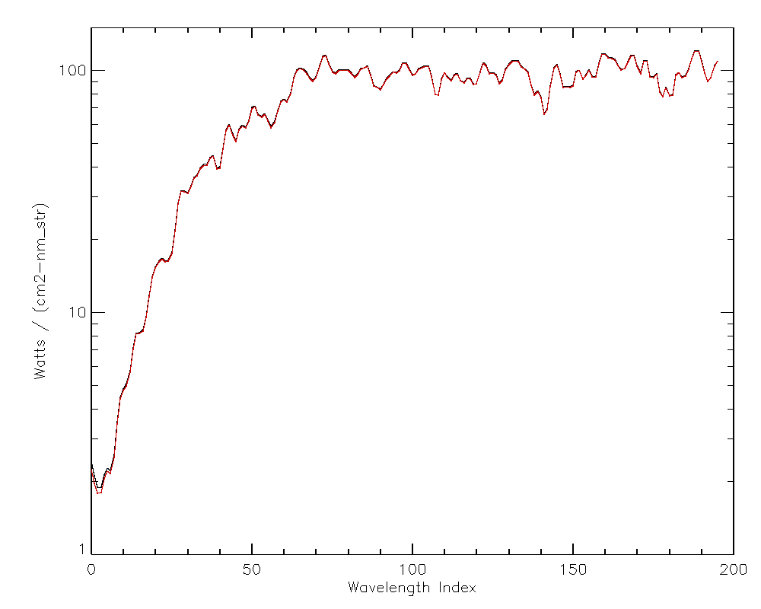
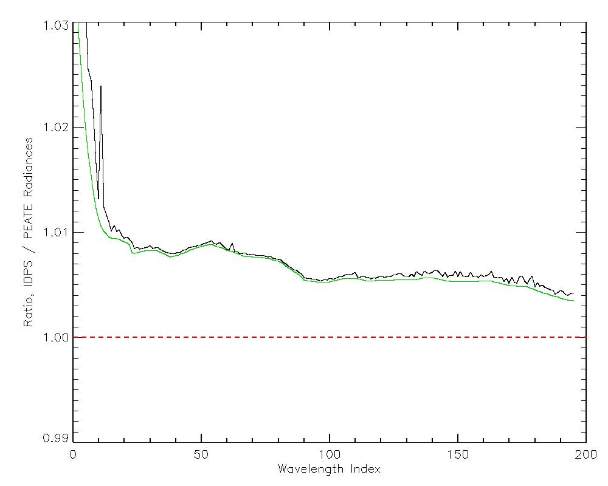
Calibration constants not appropriate for current stray light correction
IDPS SDR uses radiance conversion coefficients that already assume
that a stray light correction has already been applied to the radiances
No such correction has yet been applied
FOV 16
IDPS
PEATE
IDPS / PEATE
RadCoef SLcor / RadCoef NOcor

Slide 22
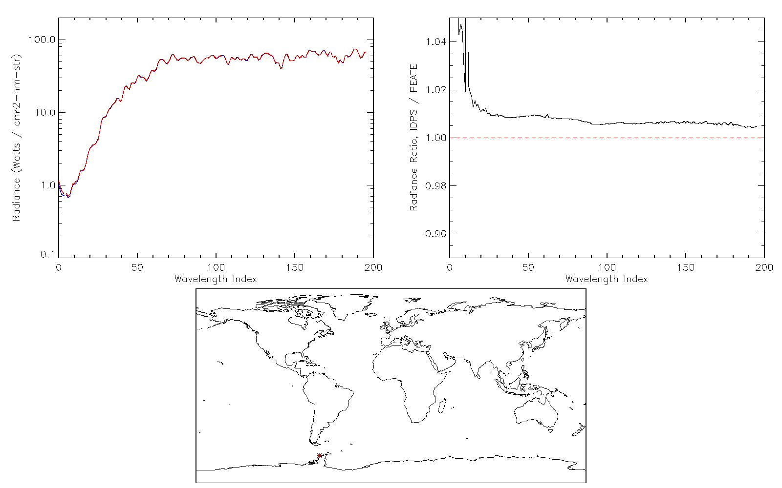
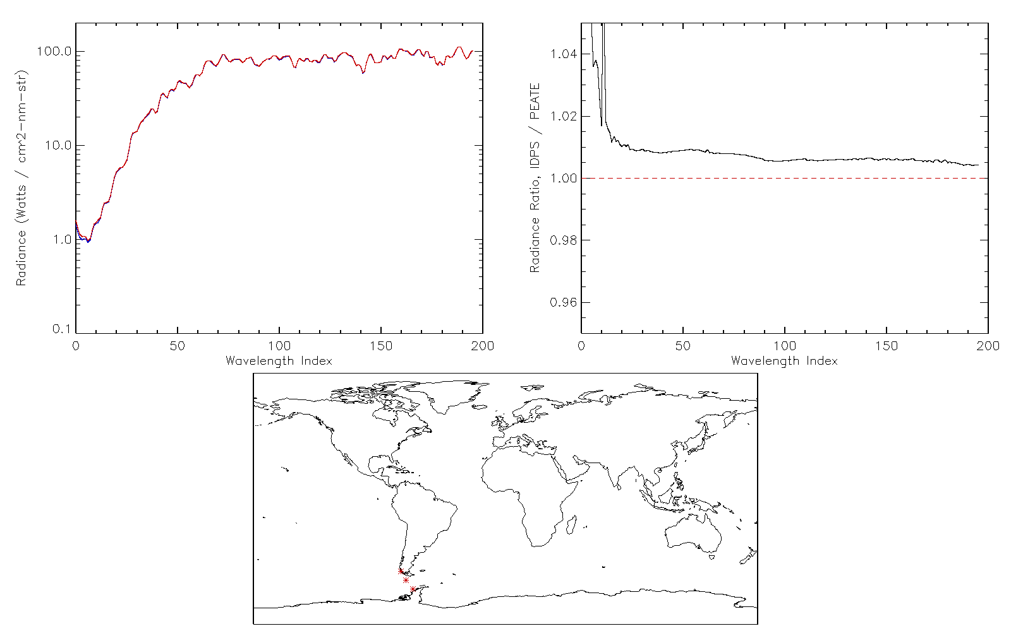
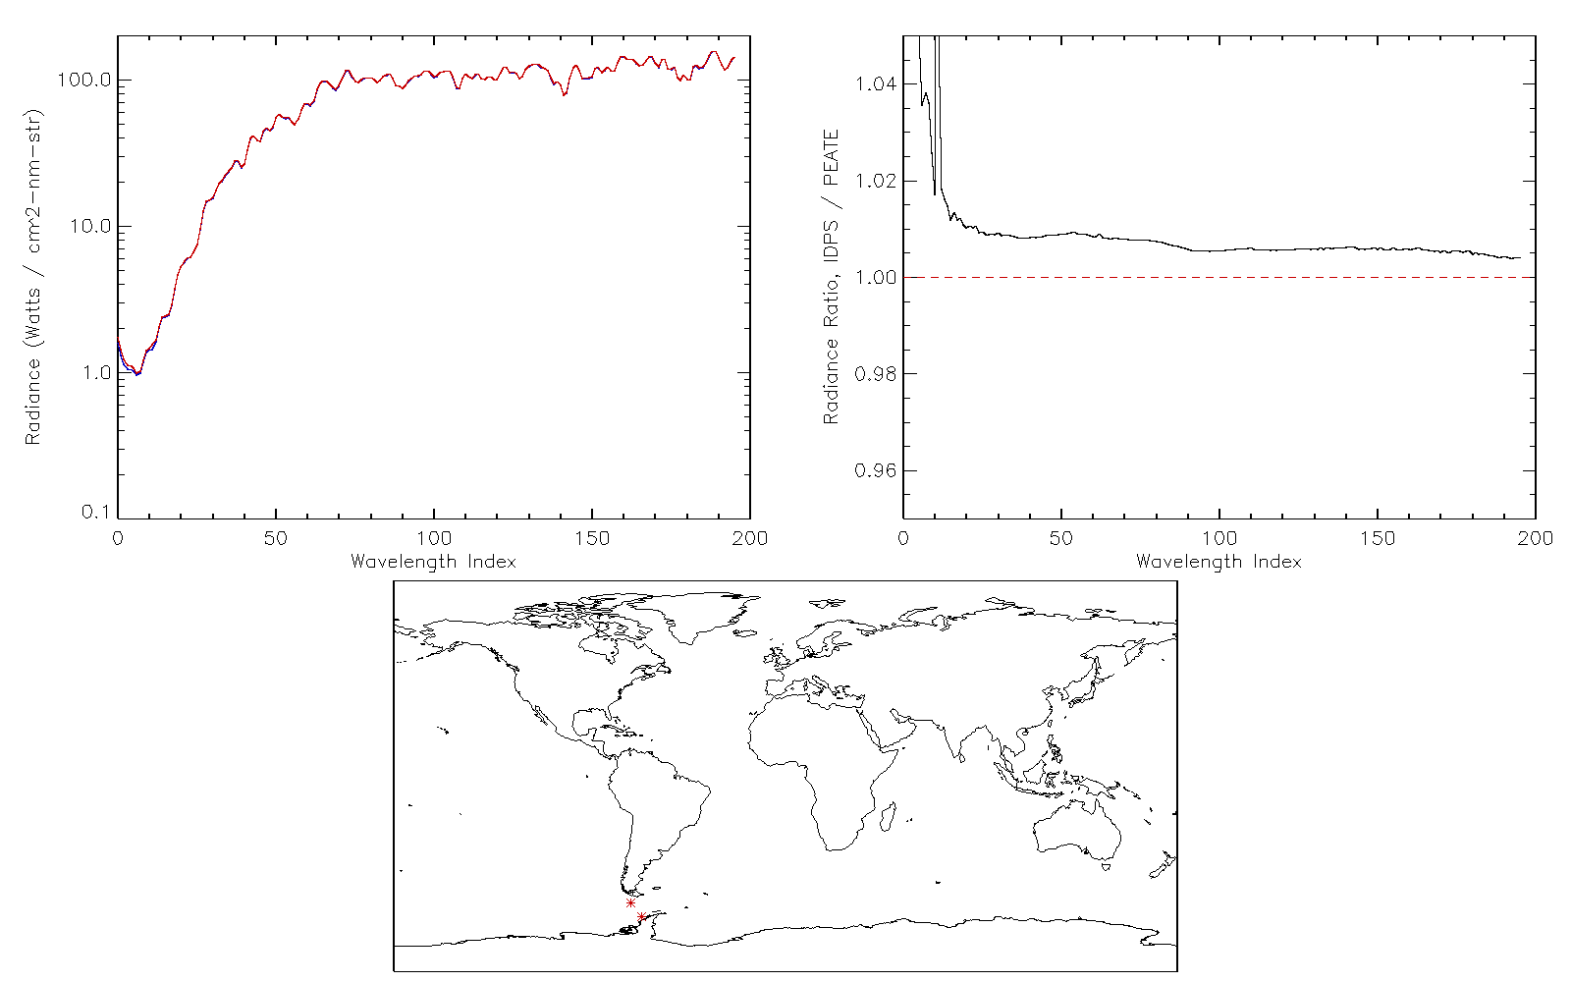
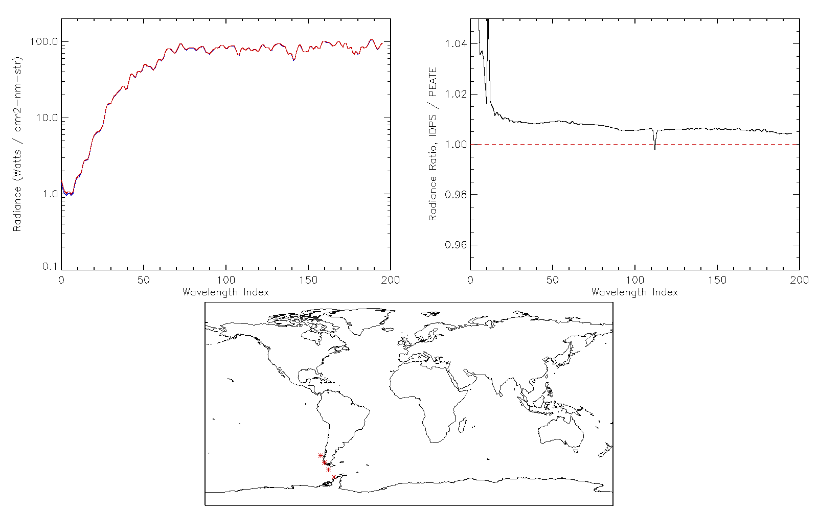
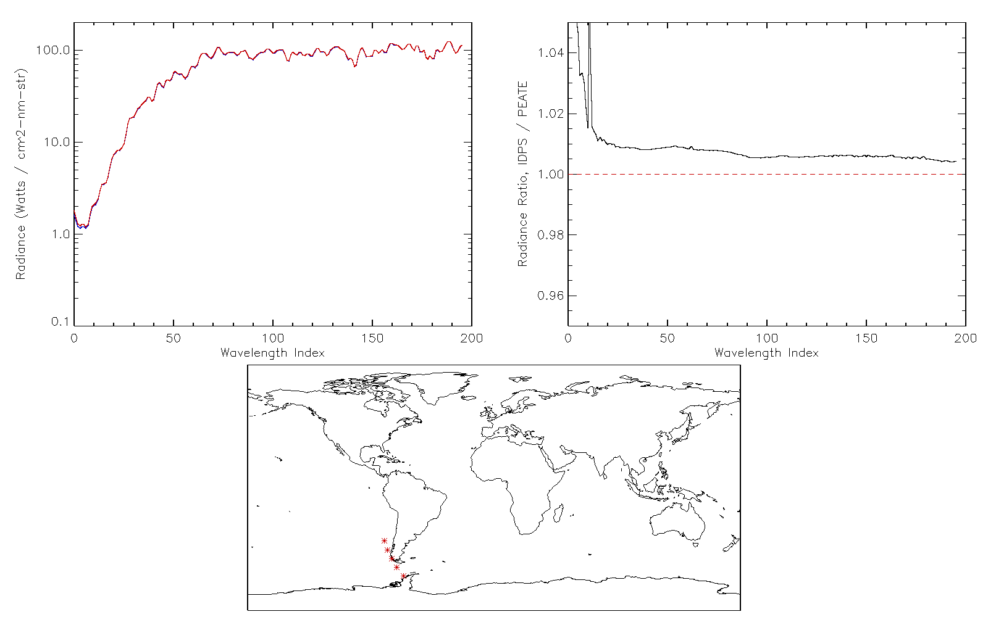
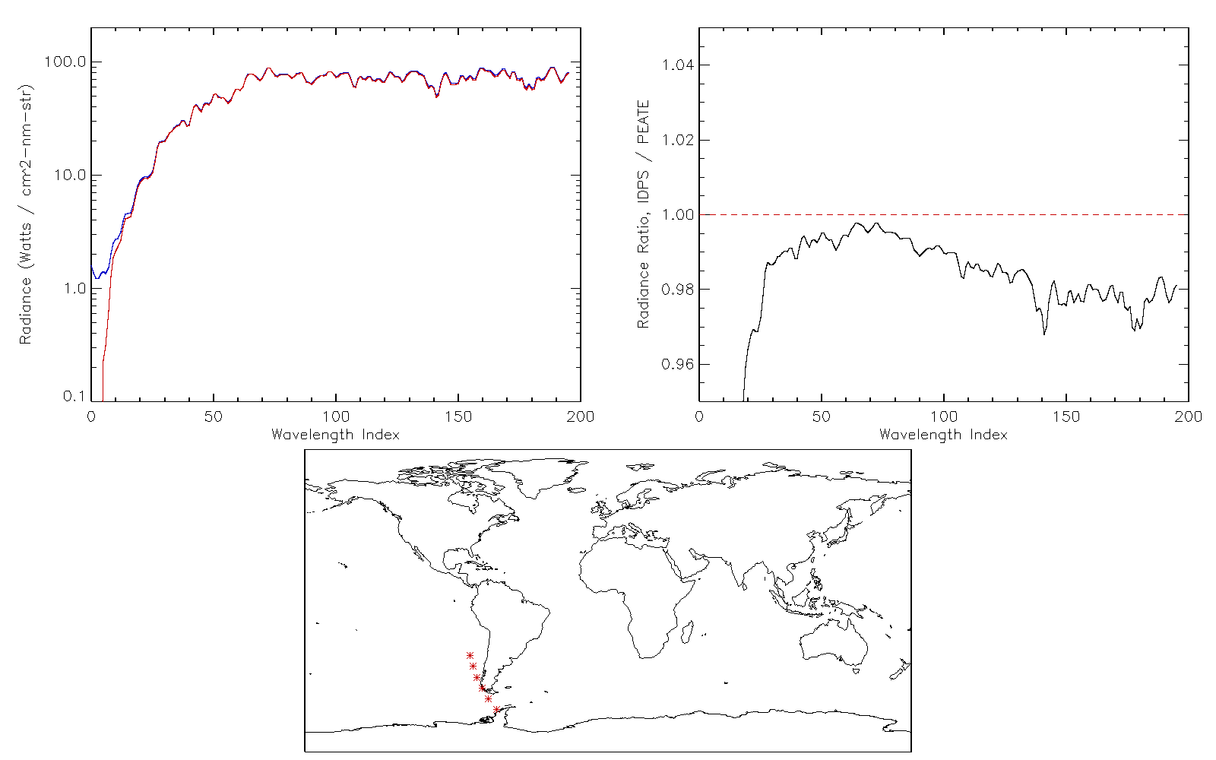
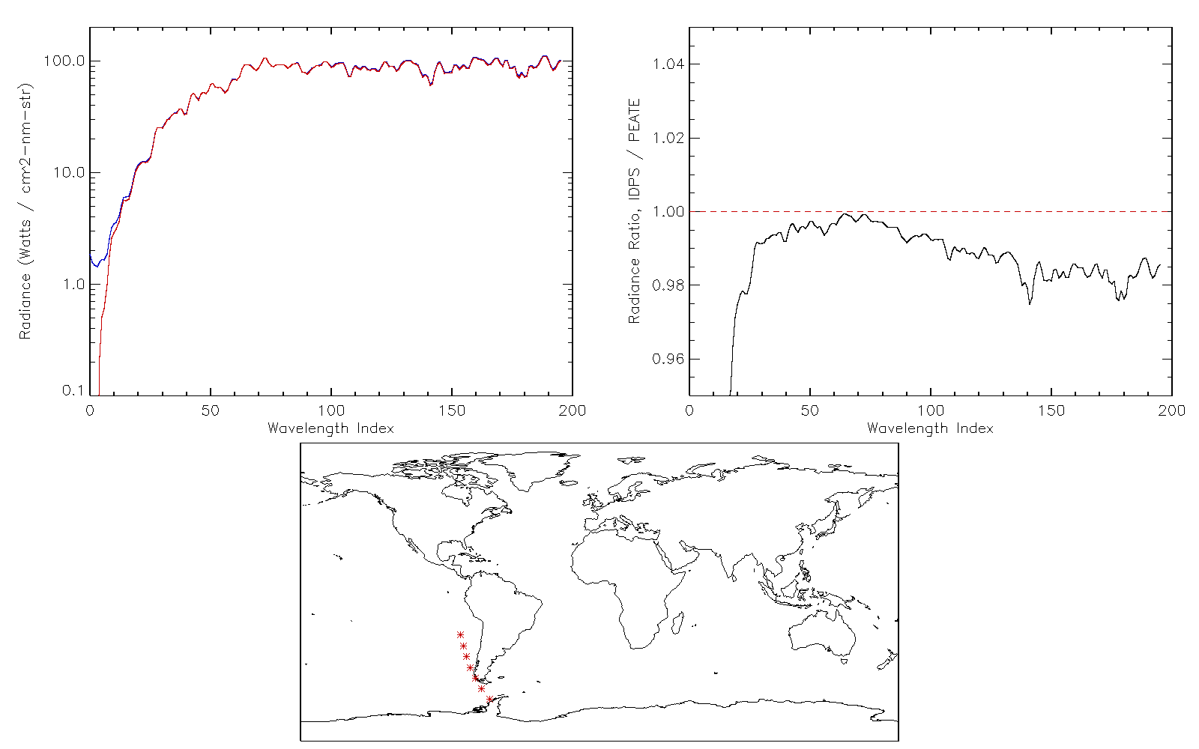
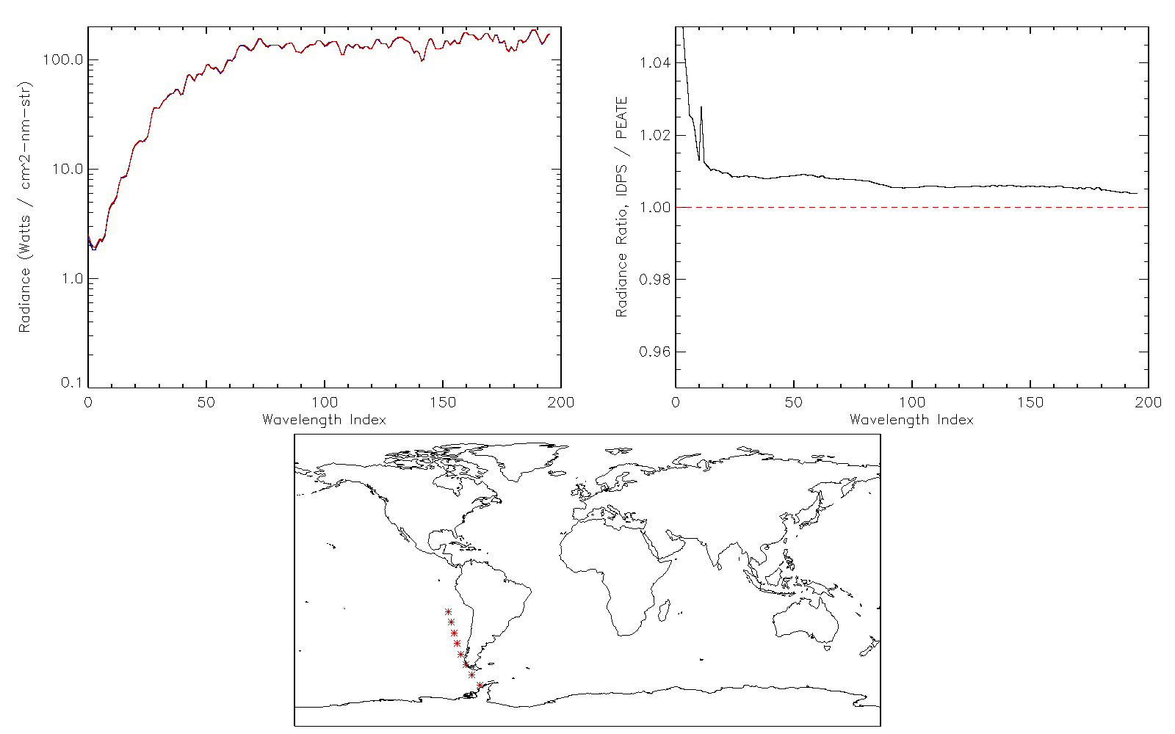
Code doesn’t properly deal with SAA corrections
IDPS
PEATE
Smear values used by SDR are all negative within the SAA
OMPS doesn’t produce negative numbers
SDR code currently uses a “special” Dark subtraction within the SAA

Slide 23
Special dark table generated to study interpretation by EV SDR code
SOC provided Darks GND-PI table
G-ADA SDR run DarkCurrentEarth
Test confirms that the EV SDR assigns darks to pixels the same way the SOC does when creating the Dark GND-PI table

Slide 24
Special test designed so that only dark counts show up in radiance output
Expected Darks in radiance output
Observed Darks in radiance output
We recently discovered that the test was ill-posed for testing darks. But these results are consistent with a smear problem.

Slide 25
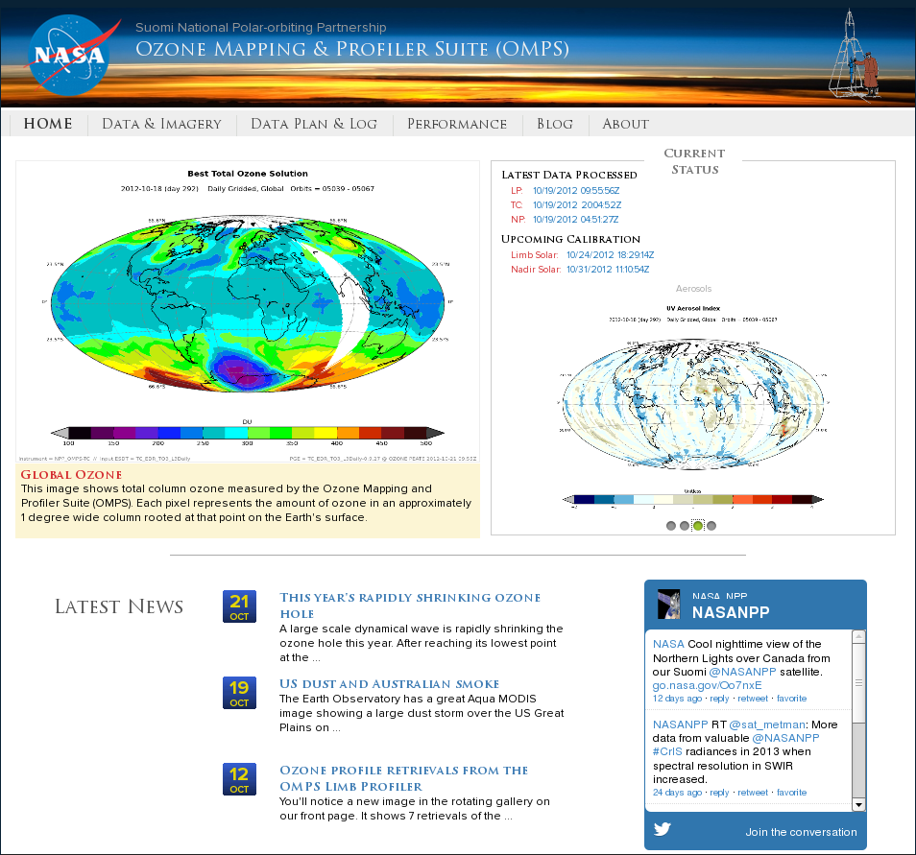
Shameless website plug
http://ozoneaq.gsfc.nasa.gov/omps

Slide 26
Backups

Slide 27
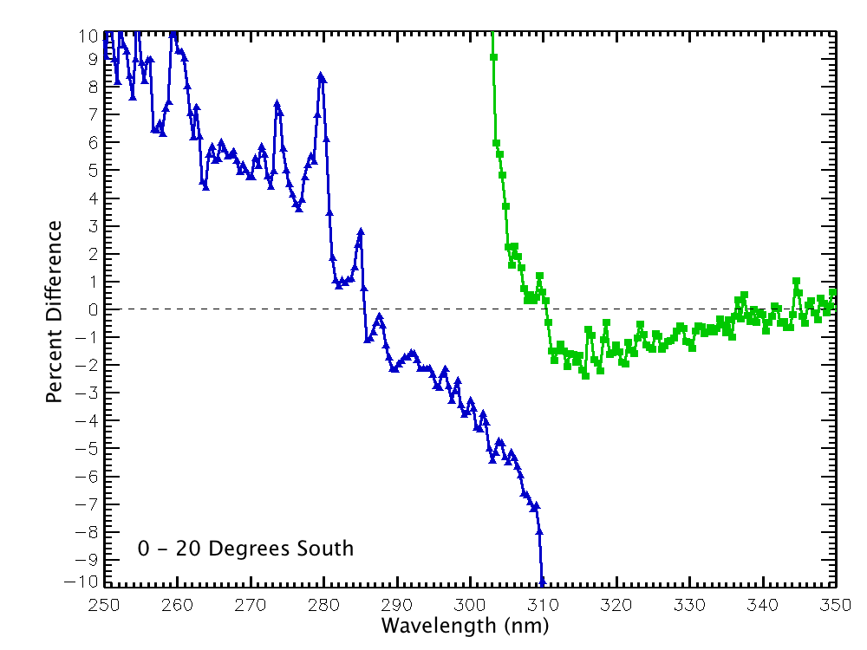
MLS Comparisons

Slide 28
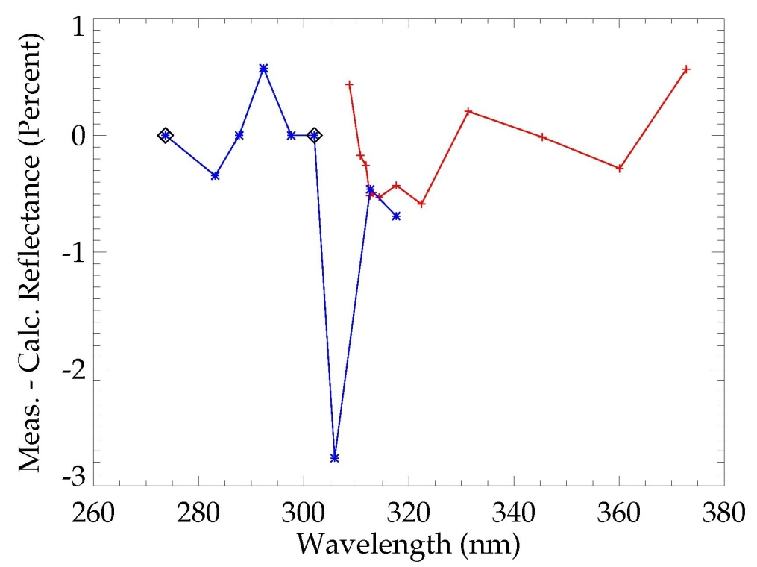
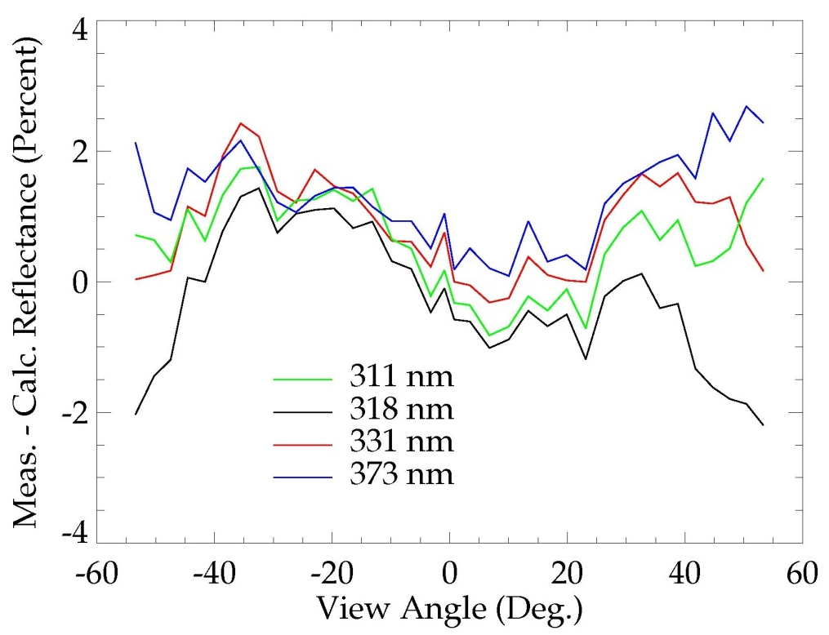
Calibration adjustments applied to PEATE products
Nadir Calibration Error
Mapper Cross-track Calibration
Reference wavelengths
Nadir Mapper
Nadir Profiler
Radiative transfer calculation error ?
The accuracy of the Nadir Mapper and Profiler calibration was assessed by comparing measurements with radiative transfer model calculations for top-of-the-atmosphere reflectance. These calculations are based on coincident ozone profile retrievals from the NOAA-18 SBUV2 instrument.

Slide 29
Radiance difference divided by Radiance coefficient
Expected Darks4
Observed Darks4
The left slide is same as that in previous slide but plotted with the same axis scales on the right

