Slide 1
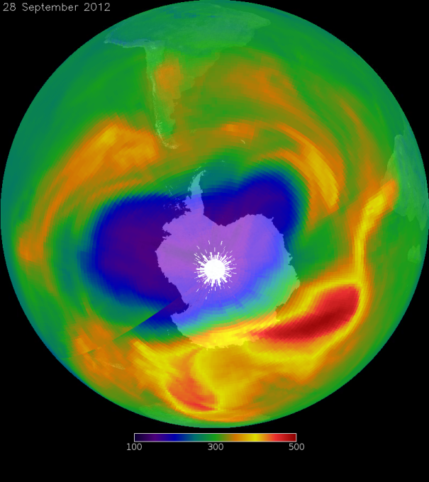
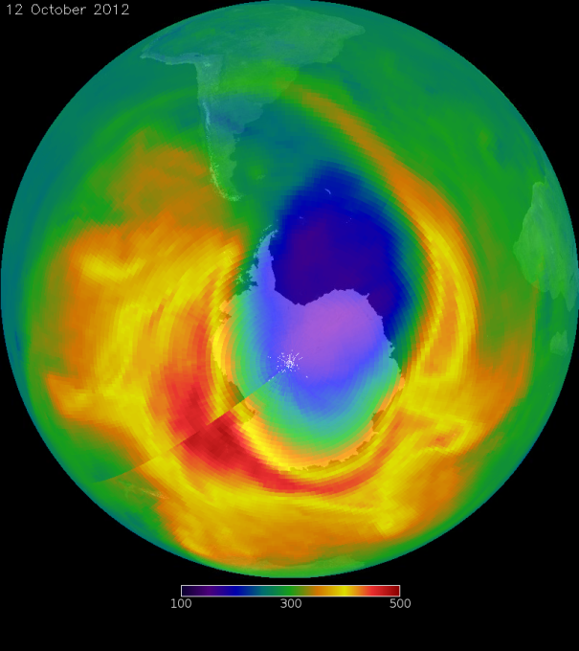
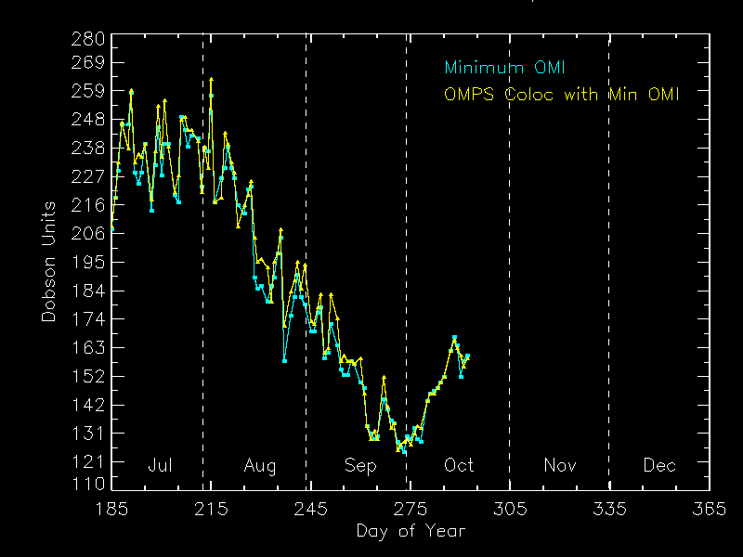
Ozone Hole 2012
Ozone ST & PEATE
28 Sep 2012
12 Oct 2012
100 300 500
Dobson Units
100 300 500
Dobson Units

Slide 2
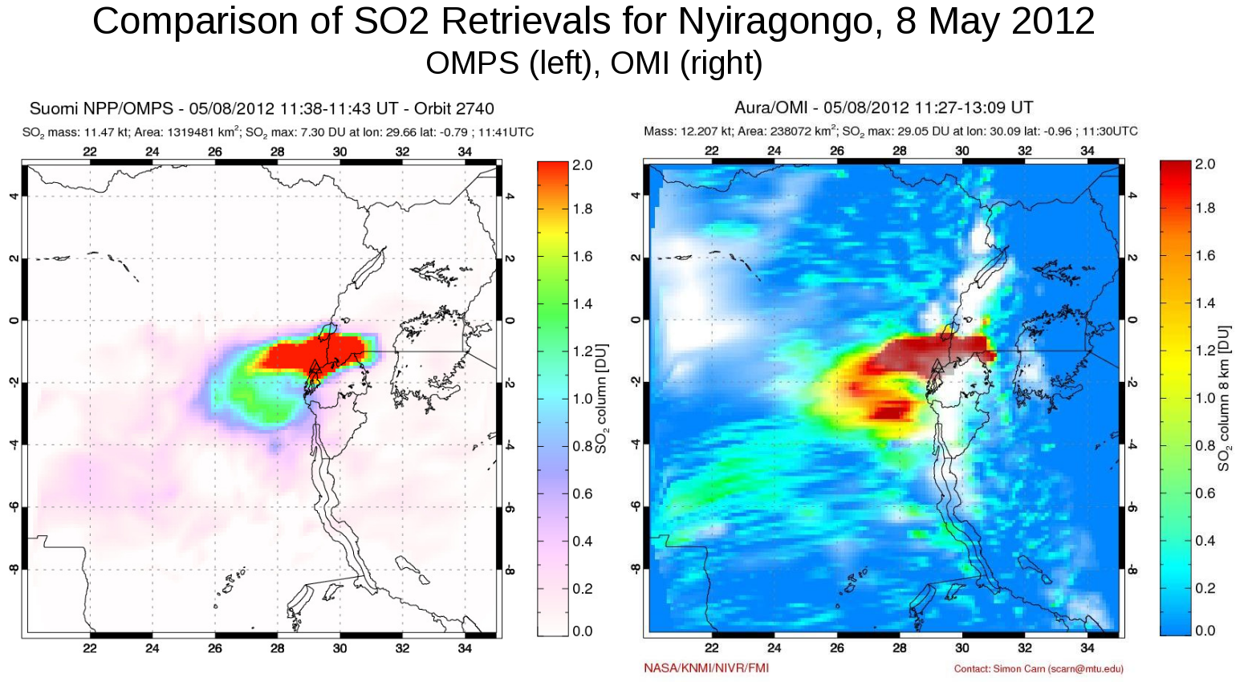
Volcanic Eruption
Ozone ST & PEATE

Slide 3
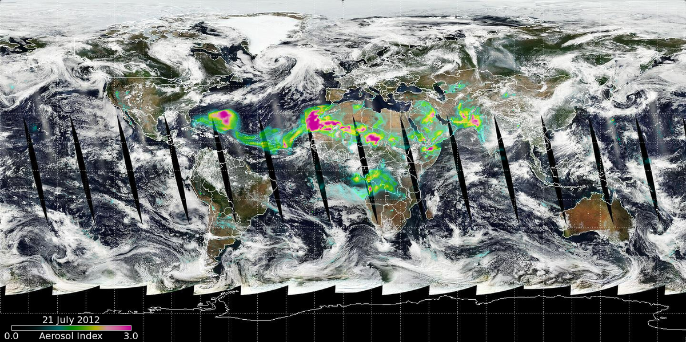
Short-term Prediction Research and Transition Center (SPoRT)
Ozone ST & PEATE

Slide 4
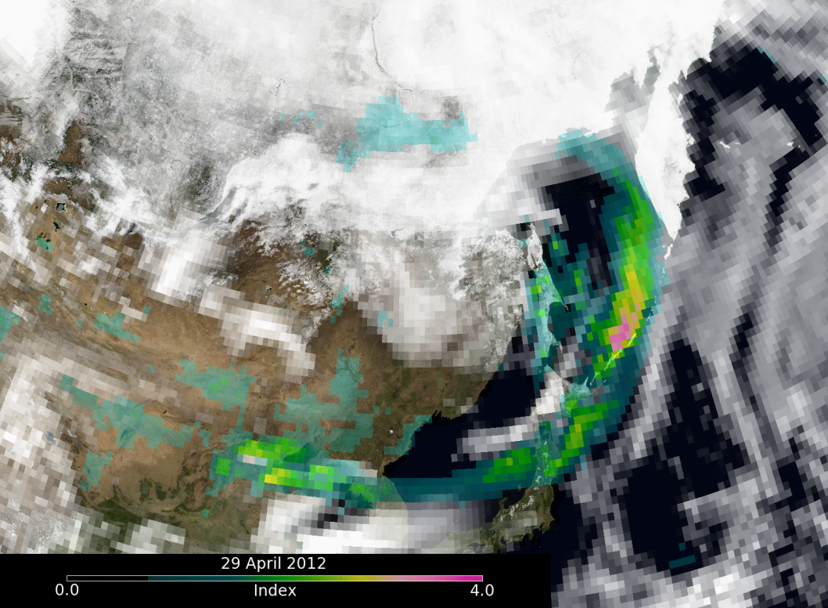
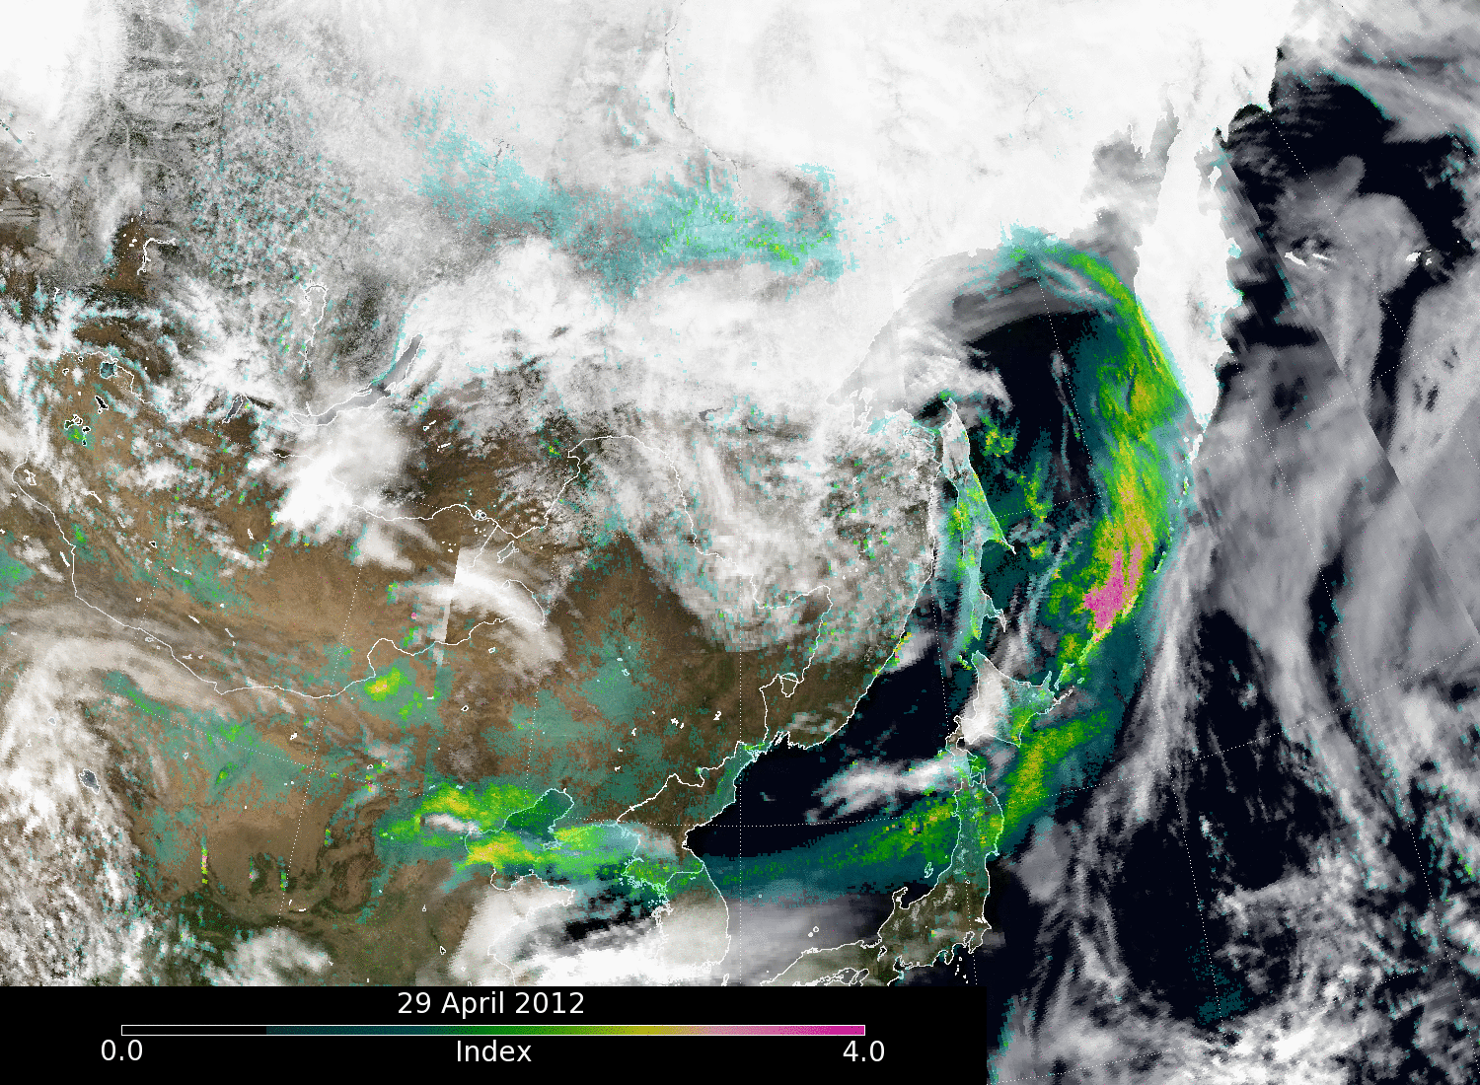
OMPS AI & Reflectivity over Blue Marble Asia – 29 April 2012
Ozone ST & PEATE
Nominal Resolution
High Resolution
1/28/13
4

Slide 5
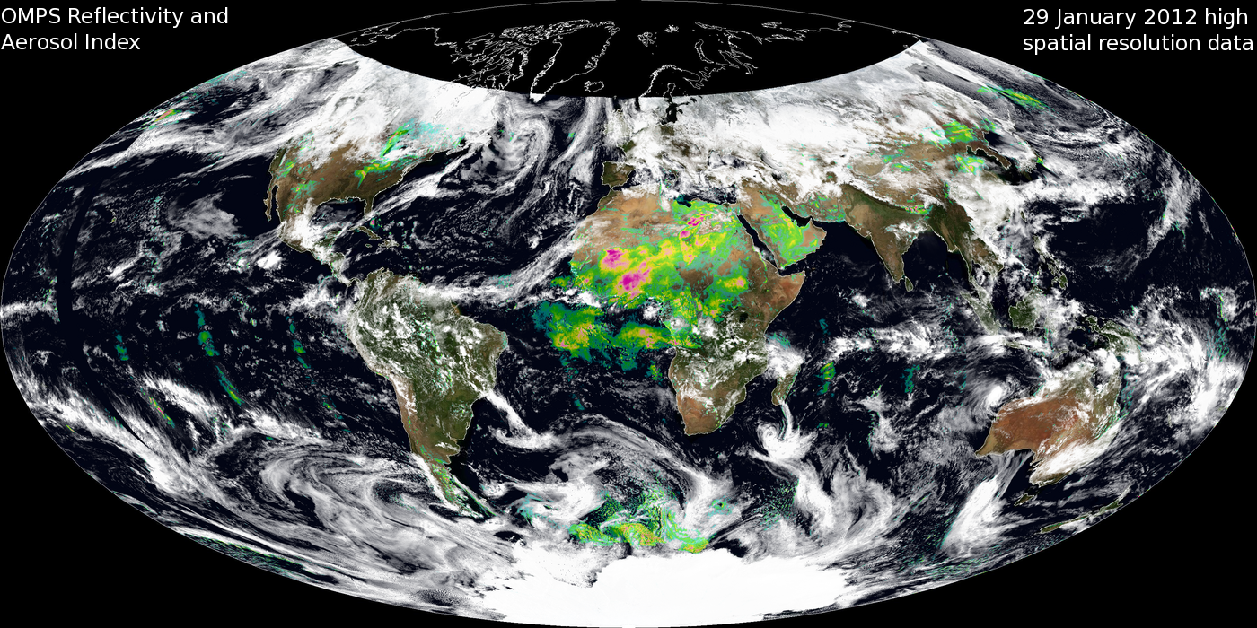
“Maximum” High Resolution
Ozone ST & PEATE

