Slide 1
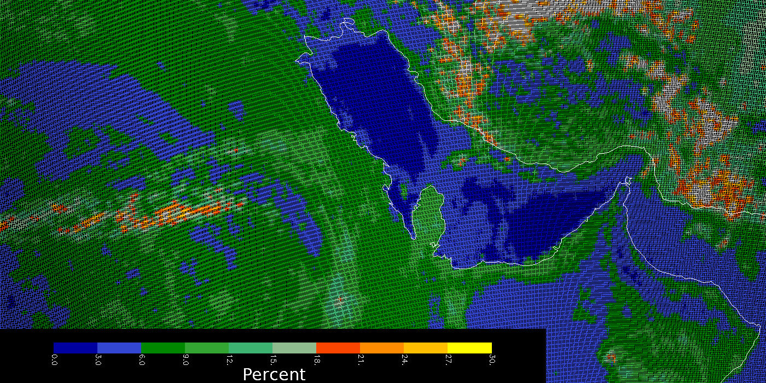
OMPS Geolocation
This image shows the effective reflectivity for the 380-nm Channel for part of an orbit of small Field-of-View (5 KM X 10 KM at Nadir) made by the OMPS Nadir Mapper in a special diagnostic mode. The Qatar peninsula sticking into the Persian Gulf in the middle of the picture lies along the nadir view of the orbital track and gives a preliminary assurance of the geolocation at better the 5 KM.
C. Seftor, NASA/GSFC (SSAI) 1/26-27/2012
Notes:
Figure provided by C. Seftor

Slide 2
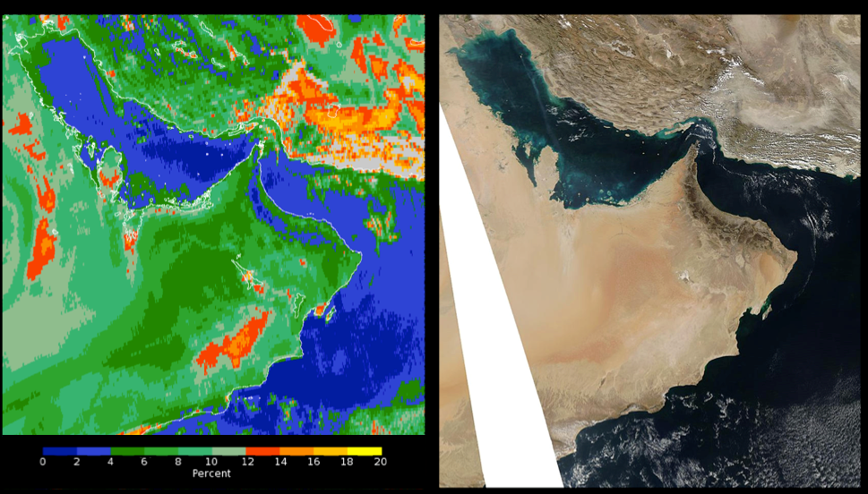
Less than 64 arcsec or 1/10 of a pixel.
Figure 1: High-Spatial-Resolution Geolocation Comparison. The image on the left shows a false color map of the OMPS effective reflectivity (from a single Ultraviolet channel at 380 nm) over the Arabian Peninsula region for January 30, 2012 when the instrument was making a special set of high-spatial-resolution measurements with 5×10 km² FOVs at nadir. The color scale intervals range from 0 to 2 % in dark blue to 18 to 20 % in yellow. The image on the right is an Aqua Moderate Resolution Imaging Spectroradiometer (MODIS) Red-Green-Blue image for the same day.

