Slide 1
Request for
CrIMSS EDR Beta Maturity
DR # 4850
CCR # 474-CCR-12-496
DRAT discussion: July 31, 2012
AERB presentation: Aug. 8, 2012
Christopher Barnet, CrIMSS EDR Validation and Algorithm Lead
Richard Cember, CrIMSS EDR JAM
Inputs from the CrIMSS EDR Validation Team

Slide 2
Outline
CrIMSS EDR Team
Users of CrIMSS EDR (1-slide)
Beta EDR Maturity Definition (1 slide)
Summary of CrIMSS EDR (4 slides)
CrIMSS EDR requirements (3 slides)
History of Algorithm Changes/Updates (1 slide)
Beta Maturity Evaluation (17 slides)
Beta Justification Summary (3 slides)
Caveats of Operational CrIMSS EDR (6 slides)
Additional supporting documentation (1 slide)
Future plans (1 slide)
Conclusions (1 slide)

Slide 3
Users of ATMS/CrIS SDRs and Sounding EDR Products
(and Point Of Contact)
U. S. Users:
  NCEP- National Centers for Environmental Prediction (Jim Jung/Dennis Keyser)
  GMAO- Global Modeling and Assimilation Office (Emily Liu)
  NRL – Naval Research Laboratory (Ben Ruston)
  FNMOC – Fleet Numerical Meteorology and Oceanography Center (Yiping Wang)
  STAR – Center for Satellite Applications and Research (Tony Reale, Murty Divakarla)
  CLASS - Comprehensive Large Array-data Stewardship System (John Bates)
  AWIPS-II – Advanced Weather Interactive Processing System (Brian Gockei)
Foreign Users:
  UK Met Office (Nigel Atkinson)
  JMA- Japan Meteorological Agency (Yoshiaki Takeuchi)
  ECMWF- European Center for Medium range Weather Forecasting (Tony McNally)
  DWD- Germany’s National Meteorological Service (Reinhold Hess)
  Meteo-France- France’s National Weather service (Lydie Lavanant)
  CMC- Canadian Meteorological Center (Louis Garand)
  EUMETSAT – Simon Elliott
Goto: outline, p.2

Slide 4
Beta EDR Maturity Definition
Early release product.
Minimally validated.
May still contain significant errors.
Versioning not established until a baseline is determined.
Available to allow users to gain familiarity with data formats and parameters.
Product is not appropriate as the basis for quantitative scientific publication studies and applications.
Goto: outline, p.2

Slide 5
Summary of the CrIMSS EDR (1/4)
The CrIMSS EDR algorithm utilizes all of the radiances from CrIS and ATMS within a CrIS field-of-regard (FOR) to produce a single sounding of the AVTP, AVMP
The FOR is derived from ~25 ATMS fields-of-view (FOV) that are optimally averaged along with an optimal spatial combination of the 9 CrIS FOVs (called cloud clearing) within a single interferogram sweep.
The AVPP product is derived from geopotential height computed from AVTP and AVMP.
The CrIMSS EDRs are heavily dependent on the upstream SDRs as well as empirically derived bias corrections with respect to the CrIMSS forward model (called the Optimal Spectral Sampling or OSS model).
As calibration of the CrIS or ATMS SDRs improves, so does the quality of the CrIMSS EDR.
Goto: outline, p.2

Slide 6
Summary of the CrIMSS EDR (2/4)
CrIS RDR
CrIS SDR
Apodization
CrIMSS EDR Processing Code
ATMS RDR
ATMS TDR
Remap SDR
ATMS SDR
GFS
Ancillary
Look-up Tables
CrIS Blackman-Harris apodized radiances and ATMS spatially convolved (i.e., Backus Gilbert) radiances are used to produce CrIMSS EDR products.
Configurable Parameters
Notes:
Ancillary
GFS forecast surface pressure, lapse rate, and air temperature (for topography corrected surface pressure)
Look-up tables
DEM for surface altitude
Infrared and Microwave OSS coefficients
Local Angle Correction
IR emissivity and reflectivity covariance
MW emissivity covariance
AVTP and AVMP and Ozone covariance

Slide 7
Summary of CrIMSS EDR (3/4)
Preprocessed CrIS, ATMS, GFS
Initialization
Preprocessing
ATMS R’s Available?
No
NWP First Guess
Next FOR
Yes
No
2-stage ATMS-only Retrieval
Yes
All FOV finished?
EDR Post Processing
42L AVTP, 22L AVMP
100L IP
No
CrIS R’s Available?
Quality Control
Yes
ATMS + CrIS retrieval
.or.
NWP + CrIS retrieval
Scene Classification
100L IP

Slide 8
Summary of CrIMSS EDR (4/4)
The CrIMSS EDR derives AVTP, AVMP, AVPP, O3-IP, surface temperature, surface emissivity simultaneously.
  AVTP reconstructed from 20 EOF’s, AVMP from 10 EOF’s
  Also 1 surface temperature, 5 MW EOF’s, 12 IR emissivity and reflectivity hingepoints, MW cloud top pressure and cloud liquid water path
    These products are not currently in HDF5 file(s)
  There is an inter-dependence within products
  Therefore, entire atmospheric state needs to be assessed in order to validate these products.
Assumption for EDR validation is that CrIS and ATMS SDRs are calibrated.
  Beta versions of SDR will be used to help algorithm and instrument assessments during EOC
  Assessment is “hierarchal” using NWP model(s) and operational RAOBs for global assessment and dedicated radiosondes for detailed site characterization.
  Characterization improves as more in-situ data is acquired.

Slide 9
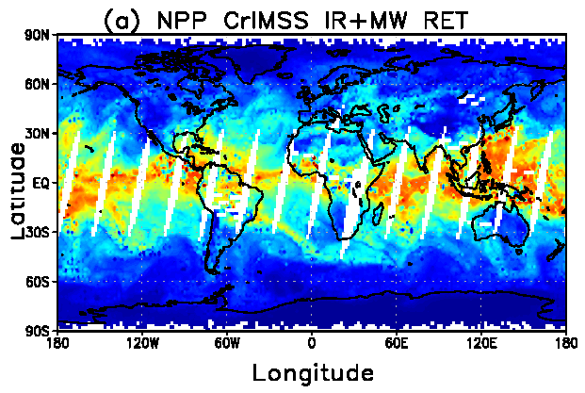
CrIMSS EDR Requirements (1/3)
Atmospheric Vertical Moisture Profile (AVMP).
Used for initialization of high-resolution NWP models, atmospheric stability, etc.
Lower tropospheric moisture layers are Key Performance Parameters (KPPs) .
Parameter (KPP in Blue) | IORD-II, JPSS-L1RD
AVMP Partly Cloudy, surface to 600 mb | Greater of 20% or 0.2 g/kg
AVMP Partly Cloudy, 600 to 300 mb | Greater of 35% or 0.1 g/kg
AVMP Partly Cloudy, 300 to 100 mb | Greater of 35% or 0.1 g/kg
AVMP Cloudy, surface to 600 mb | Greater of 20% of 0.2 g/kg
AVMP Cloudy, 600 mb to 300 mb | Greater of 40% or 0.1 g/kg
AVMP Cloudy, 300 mb to 100 mb | Greater of 40% or 0.1 g/kg
Example of AVMP (shown as total precipitable water) on May 15, 2012 from the CrIMSS off-line EDR
Results are from the coupled algorithm without QC
RGB Image shows dense smoke (high absorption) in northwest, north central and central coastal portions of image.
Goto: outline, p.2
9

Slide 10
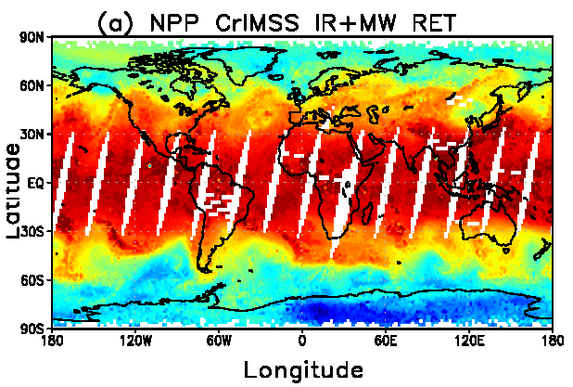
CrIMSS EDR Requirements (2/3)
Atmospheric Vertical Temperature Profile (AVTP).
Used for initialization of high-resolution NWP models, atmospheric stability, etc.
Lower tropospheric temperature are KPPs.
Parameter (KPP in Blue) | IORD-II, JPSS-L1RD
AVTP Partly Cloudy, surface - 300 mb | 1.6 K/1-km layer
AVTP Partly Cloudy, 300 to 30 mb | 1.5 K/3-km layer
AVTP Partly Cloudy, 30 mb to 1 mb | 1.5 K/5-km layer
AVTP Partly Cloudy, 1 mb to 0.5 mb | 3.5 K/5-km layer
AVTP Cloudy, surface to 700 mb | 2.5 K/1-km layer
AVTP Cloudy, 700 mb to 300 mb | 1.5 K/1-km layer
AVTP Cloudy, 300 mb to 30 mb | 1.5 K/3-km layer
AVTP Cloudy, 30 mb to 1 mb | 1.5 K/5-km layer
AVTP Cloudy, 1 mb to 0.05 mb | 3.5 K/5-km layer
Example of AVTP at 500 hPa on May 15, 2012 from the CrIMSS off-line EDR
Results are from the coupled algorithm without QC
RGB Image shows dense smoke (high absorption) in northwest, north central and central coastal portions of image.
10

Slide 11
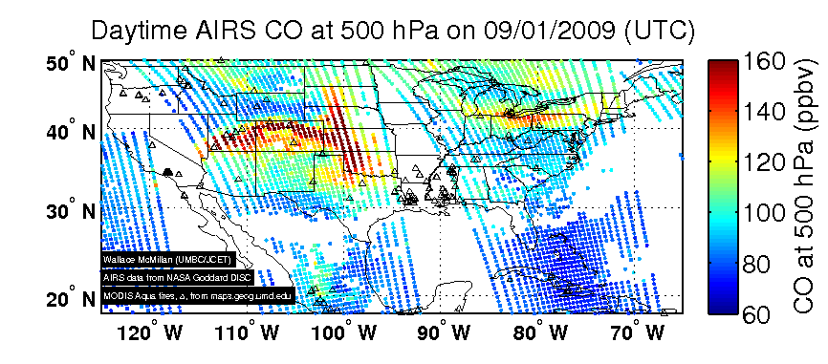
CrIMSS EDR Requirements (3/3)
Pressure product is a EDR derived product that requires validation.
  Derived from AVTP and AVMP
Ozone is an intermediate product (IP) used by the OMPS team.
  performance specification for CrIMSS
CO and CH4 are pre-planned product improvements(P³I, Not part of JPSS-funded cal/val program)
  SOAT has recommended full-resolution RDR’s for CrIS SW (and MW) bands to support the science community.
Example of AIRS carbon monoxide product: CO from California fires impacted Denver Colorado on Aug.30 and Oklahoma on Sep. 1, 2009
Image courtesy of Wallace McMillan, UMBC
RGB Image shows dense smoke (high absorption) in northwest, north central and central coastal portions of image.
Parameter (P³I in Blue) | IORD-II / JPSS-L1RD
Pressure Profile | 4 mb threshold, 2 mb goal
CH4 (methane) column | 1% ± 5% / 1% ± 4% (precison ± accuracy)
CO (carbon monoxide) column | 3% ± 5% / 35% ± 25% (precision ± accuracy)

Slide 12
History of Algorithm changes/updates
Date | Update/DR# | Reason | Completed
Nov. 2010 | 4068 & 4079 | Precip flag is out of date | In-work
Dec. 2010 | 4090 (same as 4045) | Derivatives w.r.t. emissivity | Cancelled
Feb. 2011 | 4207 & 4208 | Interpolation of AVTP/AVMP is incorrect, bottom layer missing | Have not confirmed that this is a real problem
Mar. 2011 | 4233 | Surface pressure has Gaussian Noise (for simulation) | Completed and closed
Mar. 2011 | 4234 | State.2 (increased spatial resol.) | Deferred to J1
Aug. 2011 | 4325 | ATMS bias correction | Proposed for Mx6.3
Aug. 2011 | 4334 | CrIS bias correction | Code complete (Mx5.0), LUT update proposed for Mx6.3
Aug. 2011 | 4335 | Updates of post-launch LUTs | OSS (both IR and MW) completed in Mx5.3, emissivity covariance LUT proposed for Mx6.3
Sep. 2011 | 4346 | Pressure inconsistencies at TOA | Closed
July 2012 | (to be submitted) | Code bug: non-LTE indexing | Causes rejection in daytime
Goto: outline, p.2

Slide 13
Beta Maturity Evaluation (1/19)
The graphic on the next page shows the various pathways of data that have been used to analyze the CrIMSS EDRs
Most of the analysis of the CrIMSS EDR has been done with the “Off-line” version of the IDPS
  This is our sand-box where we can make changes and run many granules (focus days, matchup-ups, etc.). Most validation is done with 100L IP’s.
  In Off-line version it is easy to add diagnostic printout and I/O.
  Results from this system will only be shown under the “caveats” section of this document.
  Once we have familiarity and functionality with ADL we will abandon use of the Off-line code (we are not proficient with ADL at this time and ADL is cumbersome to use to process large numbers of granules).
NGAS has used their science code to do similar evaluations
  Science code is the original source of the IDPS code.
  We have confirmed that the NGAS science-code and off-line code get the same answers
  Results from this system will not be shown in this document.
Beginning in mid-April, reasonable CrIMSS EDRs were also available on IDPS
  The evaluation of these EDRs is what is covered in this section.
Goto: outline, p.2

Slide 14
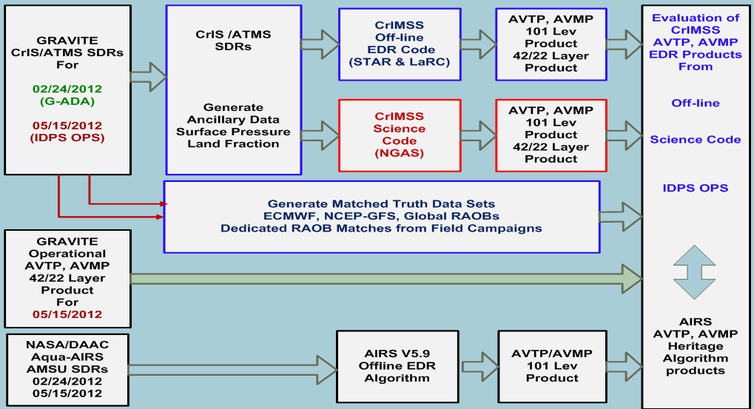
Beta Maturity Evaluation (2/19)
Graphic to illustrate CrIMSS EDR data pathways
(discussed on previous slide)

Slide 15
Beta Maturity Evaluation (3/19)
Focus days Comparison to other products
  ECMWF is used as a proxy for “truth”
    It is also used as a “transfer standard” for other retrieval systems such as AIRS and NUCAPS
  May 15th is the primary focus day because both ATMS and CrIS were calibrated and at the beta maturity level.
  Feb. 24th and 25th was also used
    NOTE: Feb. 25th is same orbit configuration as May 15th)
  We plan on collecting 4 focus days per year
    Focus day collections include Aqua, Metop SDRs and EDRs, ECMWF, GFS, etc.
Comparisons to GPS RO Products
  Large number of days were used in May, to get reasonable statistics.
Primary validation is dedicated radiosondes
  Very few radiosondes have been launched to date
    ~500 sondes were purchased by the JPSS project office and will be launched at 3 sites (Alaska, Oklahoma, Tropical Pacific) in support of provisional and stage.1 validation activities beginning in late July.
    20 radiosondes were launched by Aerospace Corp. from Hawaii in May.

Slide 16
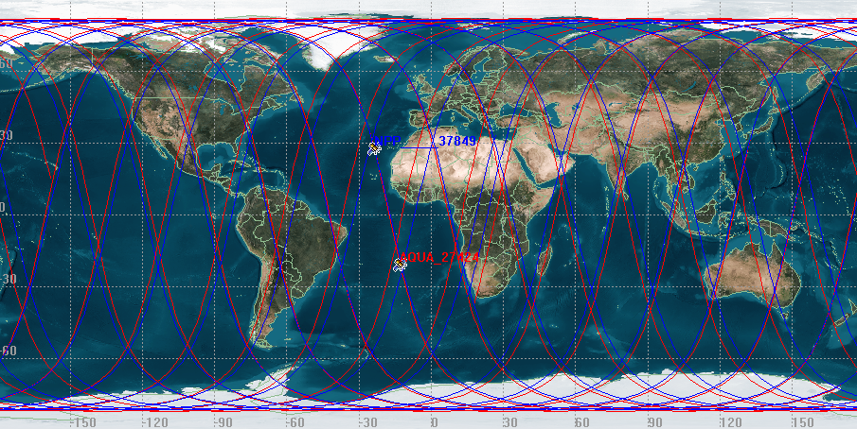
Beta Maturity Evaluation (4/19)
May 15 focus day was chosen because:
  It had very good overlap between NPP and Aqua satellites
  It was same the orbital configuration as the previous focus day (Feb. 25, 2012)
  Simultaneous nadir overpasses with Aqua occurred in many places:
  west coast of Africa
  East coast of S.America
  Northeast of Australia
  Many polar cases

Slide 17
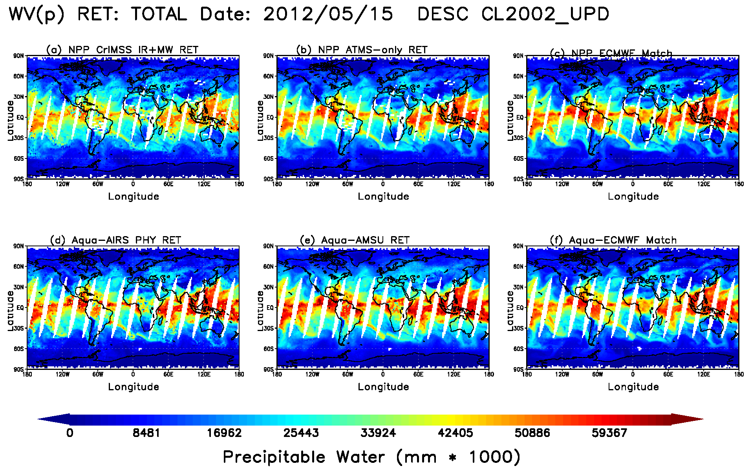
Beta Maturity Evaluation (5/19)
AVMP total precipitable water product for May 15, 2012
  CrIMSS IR+MW (upper left) and MW-only (upper middle)
  AIRS IR+MW (lower left) and AMSU-only (lower middle)
  Co-located ECMWF for CrIS (upper right) and AIRS (lower right)

Slide 18
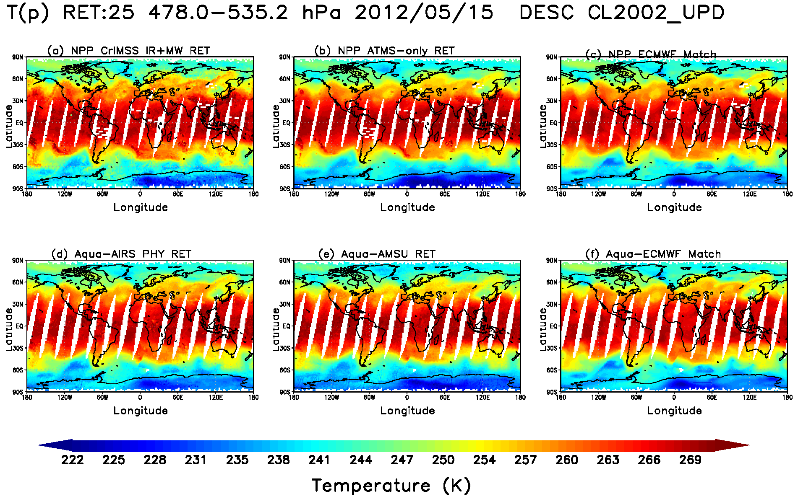
Beta Maturity Evaluation (6/19)
AVTP (850 hPa-surface) temperature product for May 15, 2012
  CrIMSS IR+MW (upper left) and MW-only (upper middle)
  AIRS IR+MW (lower left) and AMSU-only (lower middle)
  Co-located ECMWF for CrIS (upper right) and AIRS (lower right)

Slide 19
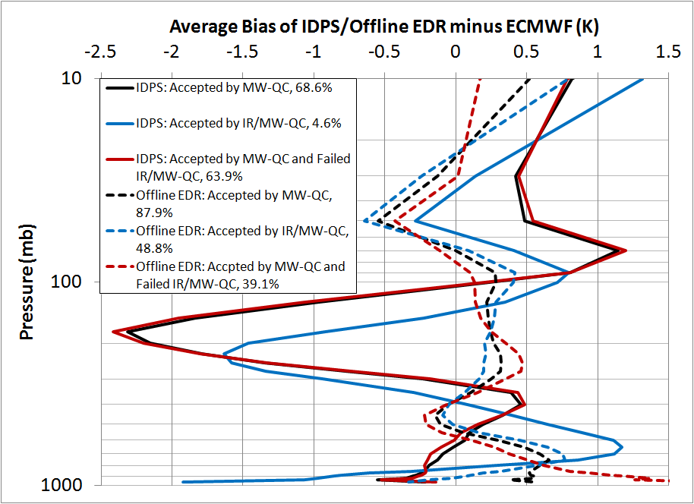
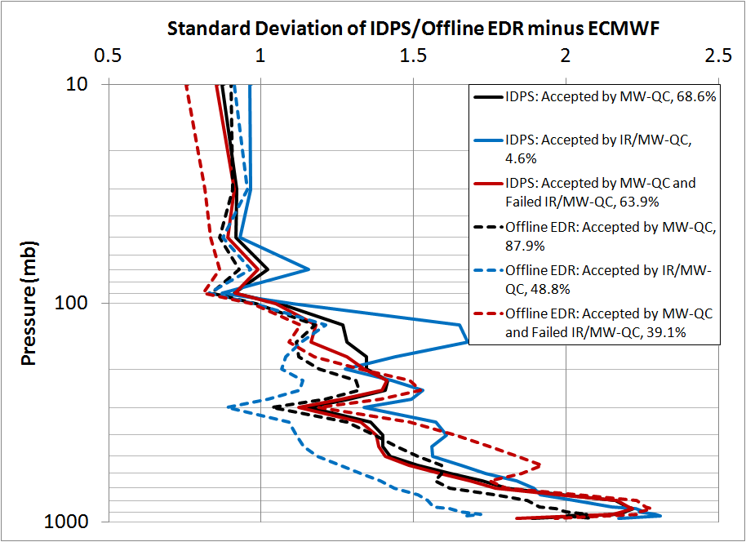
Beta Maturity Evaluation (7/19)
Global statistics for the May 15, 2012 focus day: CrIMSS 42 layer AVTP EDR from the IDPS (solid lines) with respect to ECMWF (closest forecast or analysis in space and time).
  IDPS yield is low due to sub-optimal noise estimates, radiance bias corrections, and emissivity covariance matrix
    MW-only yield (red lines) is 64.0%, IR+MW yield (blue) is 4.7%
  Off-line code with optimization (not implemented in IDPS at this time) improves both yield (39.2% MW + 48.9% IR) and performance (dashed lines).

Slide 20
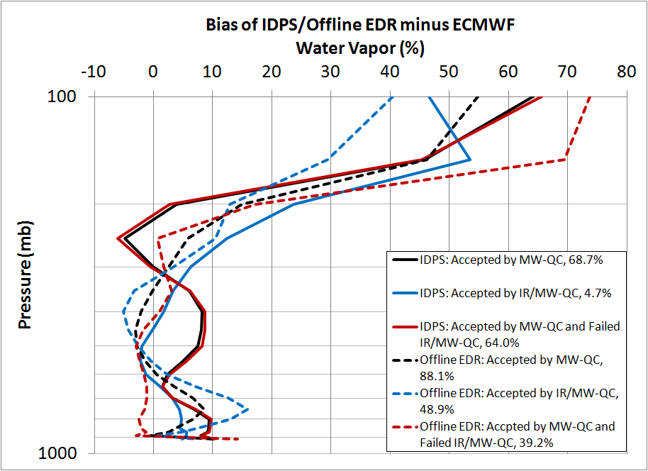
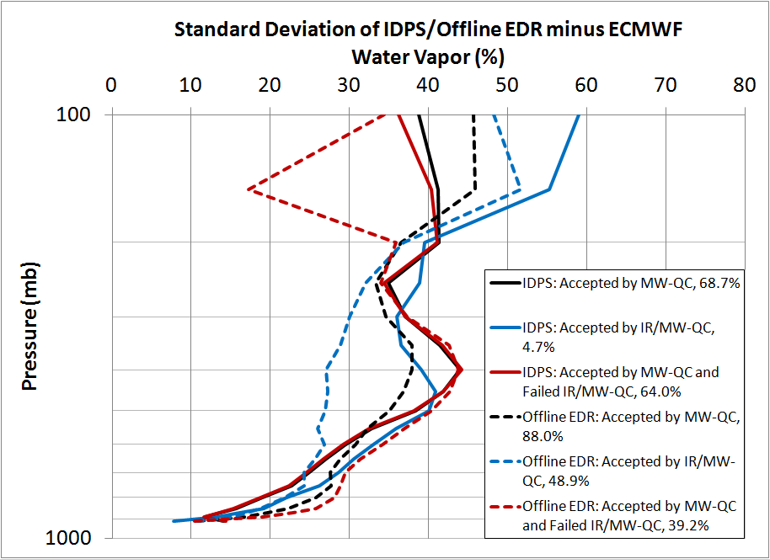
Beta Maturity Evaluation (8/19)
Global statistics for the May 15, 2012 focus day: CrIMSS 22 layer AVMP EDR from the IDPS (solid lines) with respect to ECMWF (closest forecast or analysis in space and time).
  IDPS yield is low due to sub-optimal noise estimates, radiance bias corrections, and emissivity covariance matrix
    MW-only yield (red lines) is 64.0%, IR+MW yield (blue) is 4.7%
  Off-line code with optimization (not implemented in IDPS at this time) improves both yield (39.2% MW + 48.9% IR) and performance (dashed lines).

Slide 21
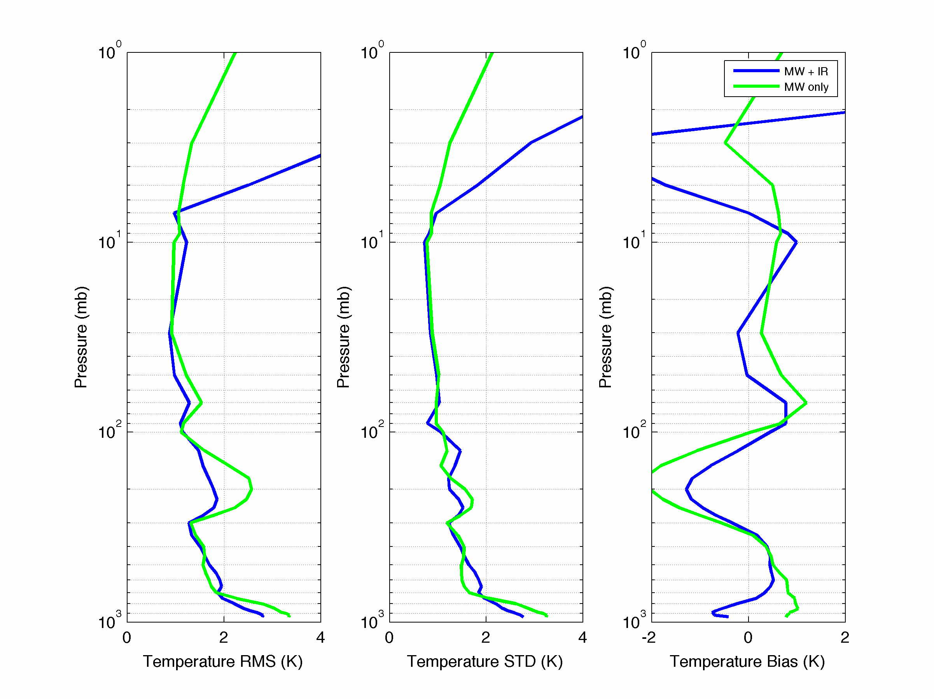
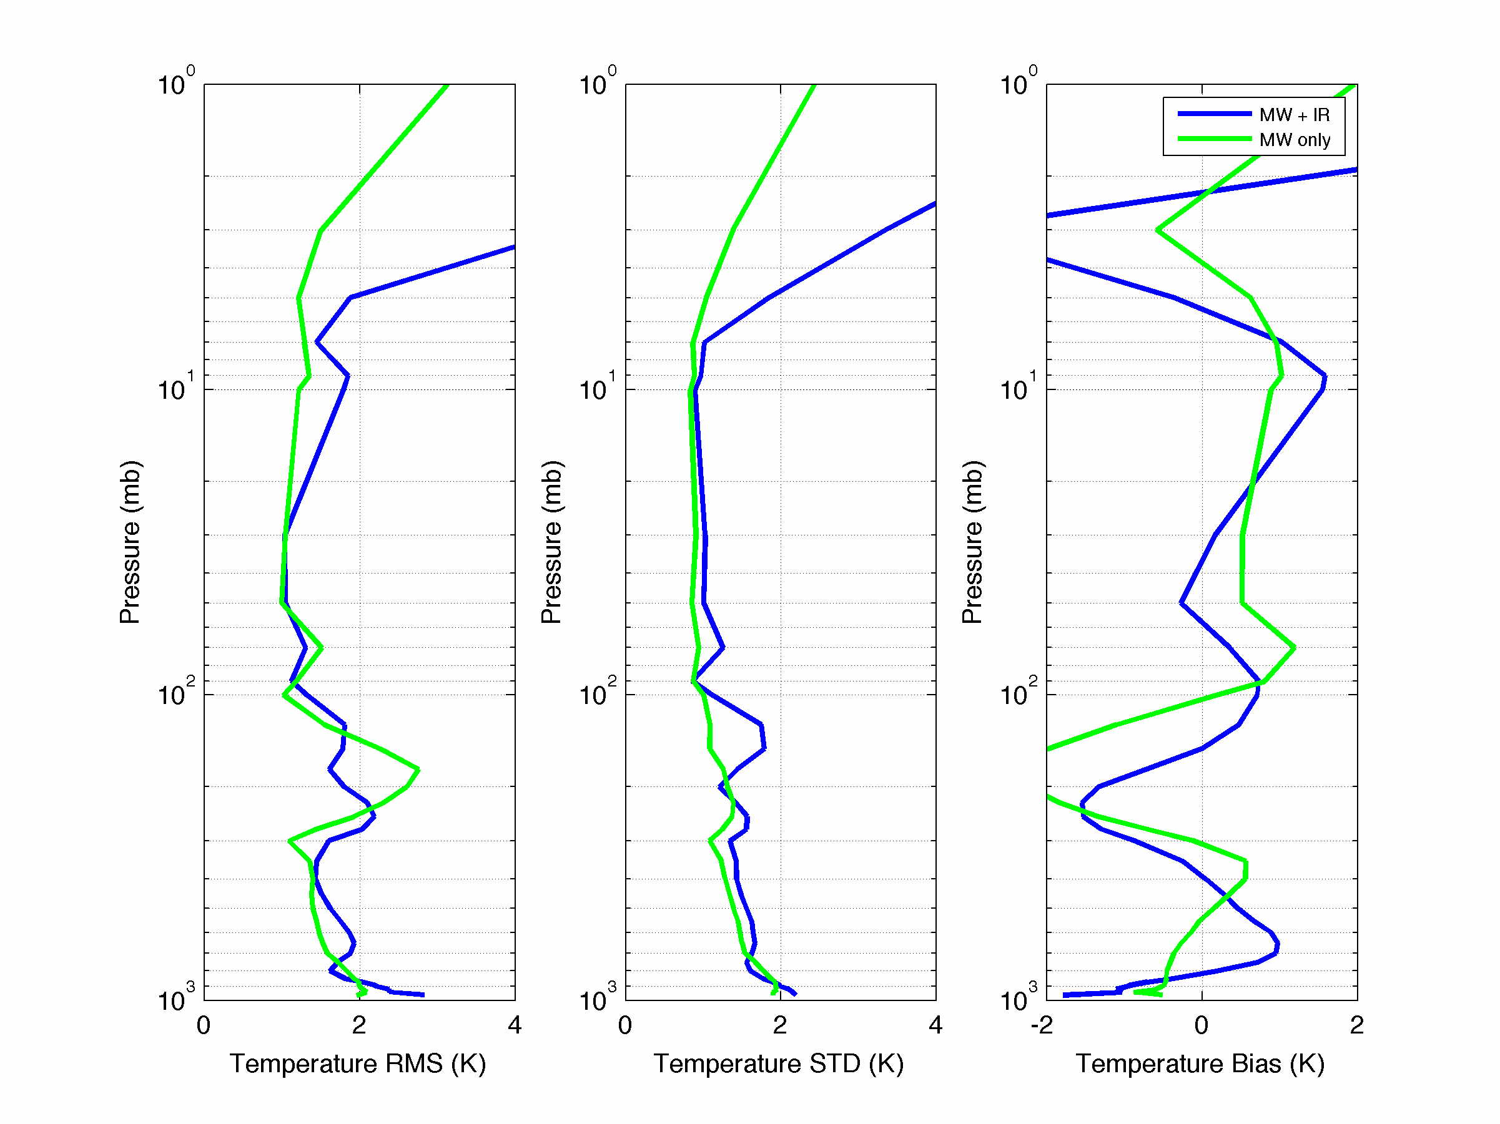
Beta Maturity Evaluation (9/19)
CrIMSS Off-line AVTP (slides courtesy of Xu Liu, NASA/LaRC)
  100 level IP product was converted to 42 EDR AVTP layers
  In this case, IR+MW acceptance is equal to the IDPS QC
  The MW-only QC is the same, but this plot includes all the accepted MW-only retrievals (including the cases accepted by the IR retrieval).
Land Cases (global)
4.7% yield for IR_MW
63.4% yield for MW-only
Ocean Cases (global)
7.0% yield for IR_MW
84.2% yield for MW-only

Slide 22
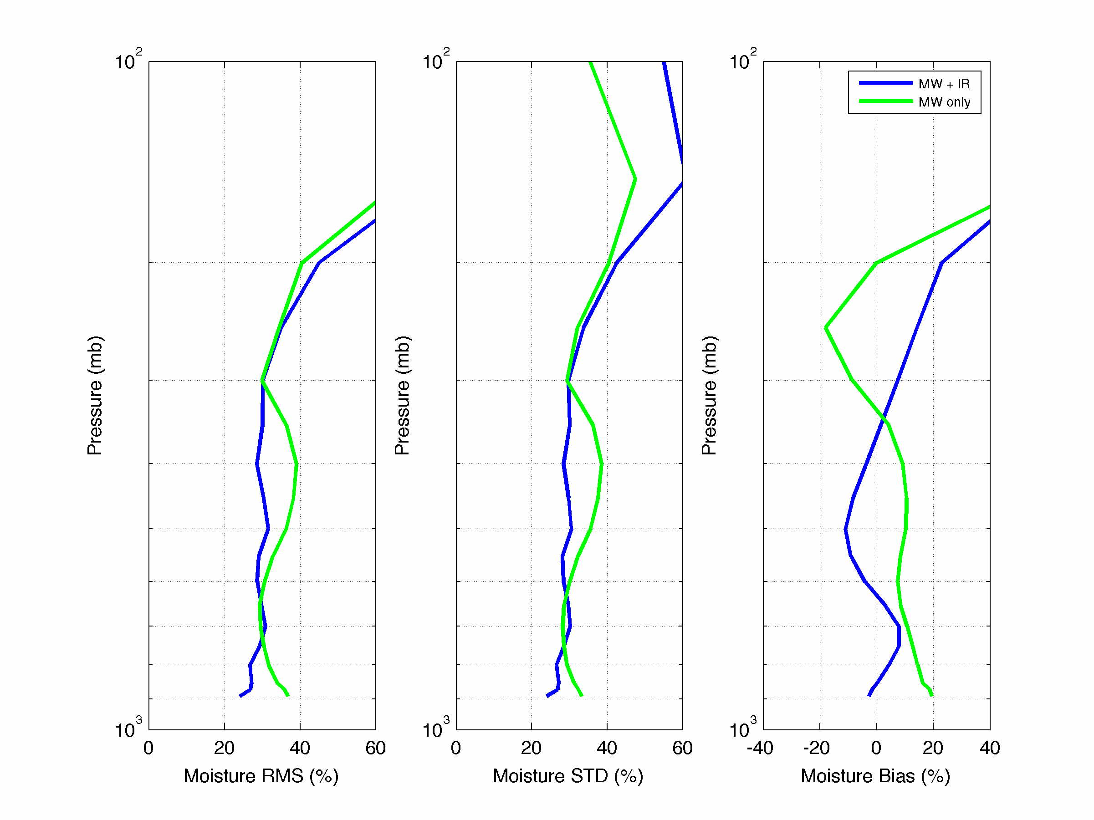
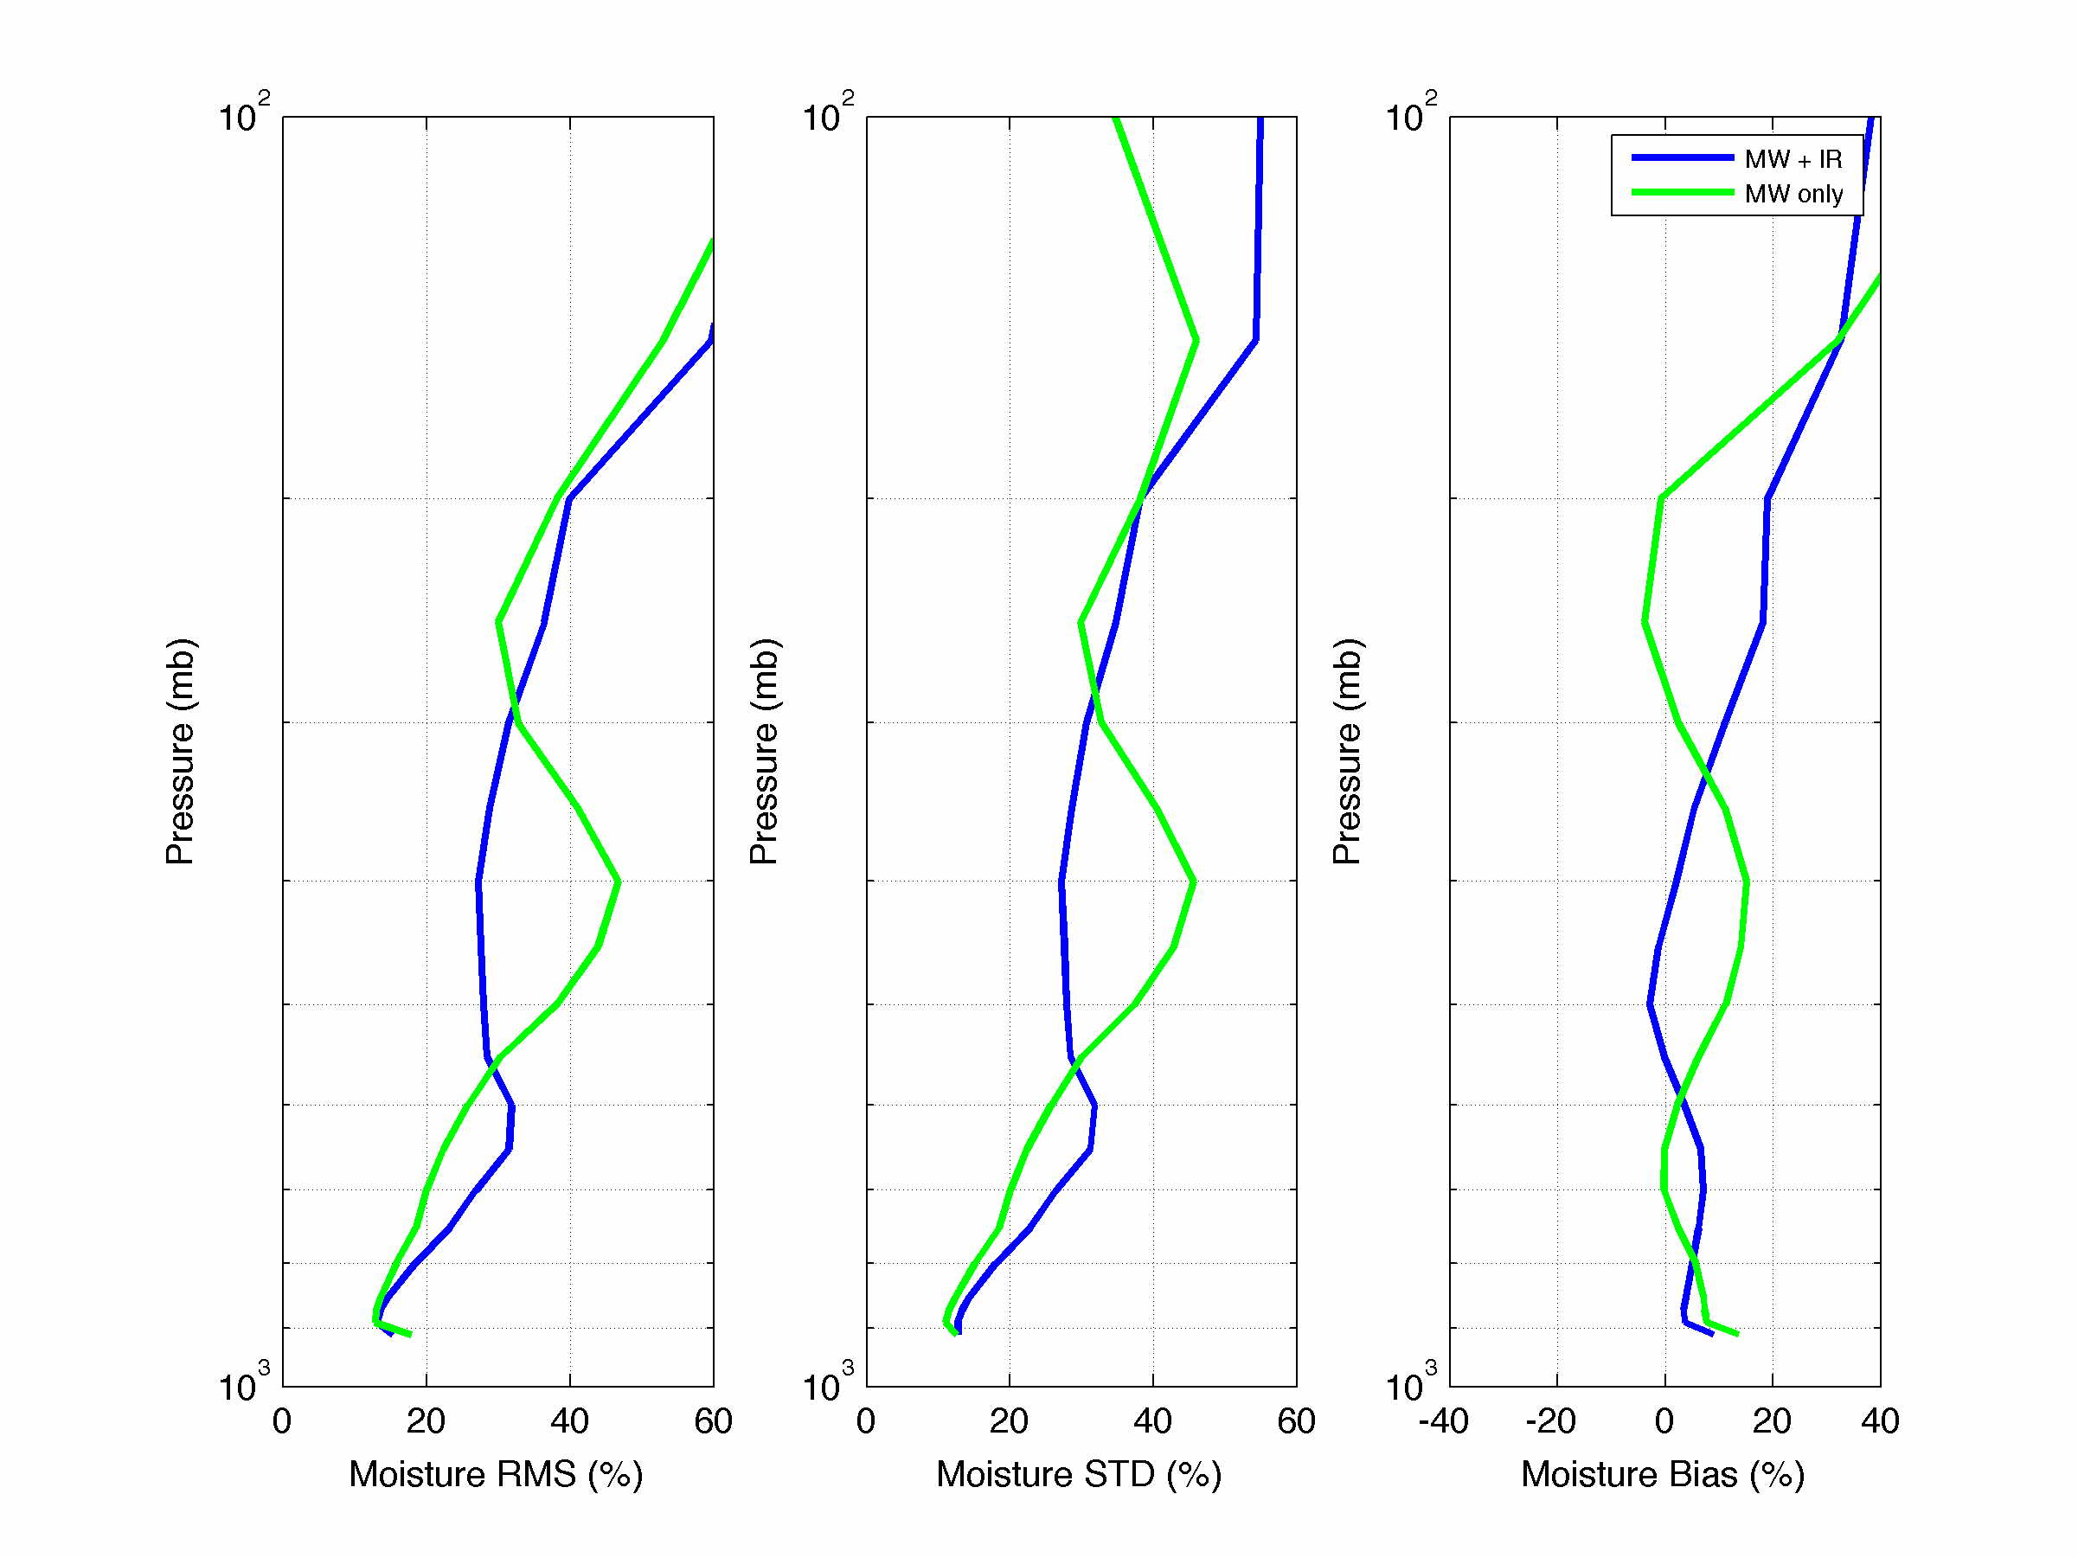
Beta Maturity Evaluation (10/19)
CrIMSS Off-line AVMP (slides courtesy of Xu Liu, NASA/LaRC)
  100 level IP product was converted to 22 EDR AVMP layers
  In this case, IR+MW acceptance is similar, but not exactly the IDPS QC
  The MW-only QC is the same, but this plot includes all the accepted MW-only retrievals (including the cases accepted by the IR retrieval).
Land Cases (global)
4.7% yield for IR_MW
63.4% yield for MW-only
Ocean Cases (global)
7.0% yield for IR_MW
84.2% yield for MW-only

Slide 23
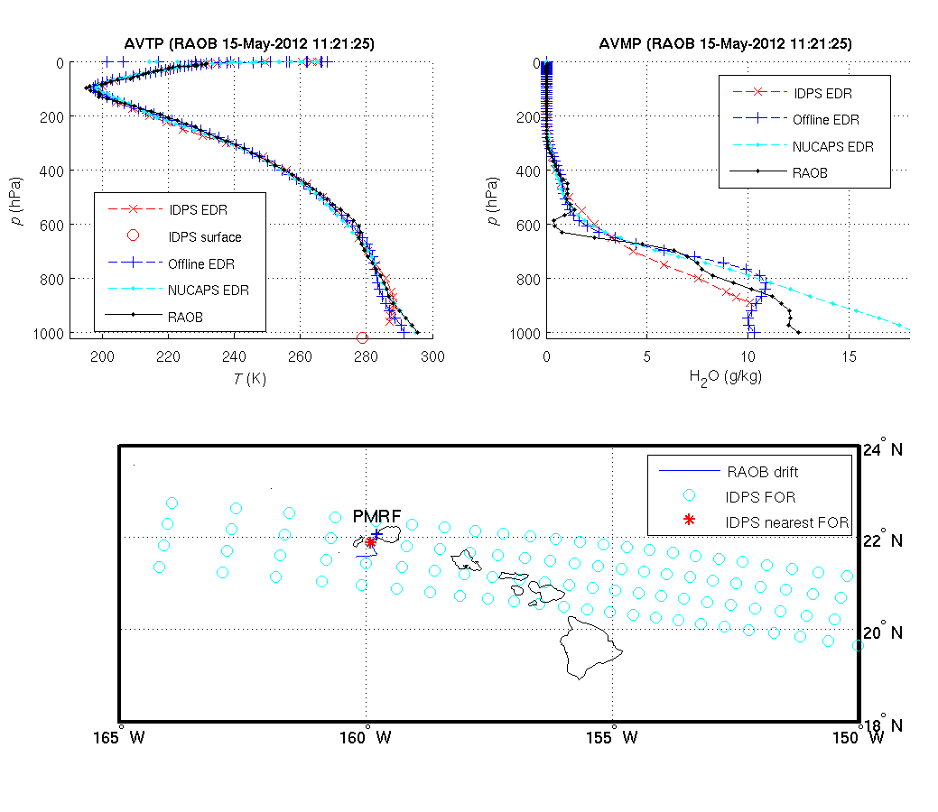
Beta Maturity Evaluation (11/19)
In May, Aerospace Corp. launched 20 sondes from Hawaii.
At right is one sonde (black), the Off-line optimized CrIMSS EDR result (blue), the IDPS EDR (red), and NUCAPS EDR (cyan) for ATVP (left) and AVMP (right)
While these results are preliminary, we are investigating the possibility that the EDR product, which is reported on coarse layers, is offset (DR4207/4208) .

Slide 24
Beta Maturity Evaluation (12/19)
Next Set of slides (courtesy of Bob Knuteson, Univ. of Wisconsin) show IDPS CrIMSS EDR products relative to co-located GPS sondes
  AIRS results are shown in top panels
  CrIMSS results are shown in bottom panels
GPS comparisons are only valid from ~300 hPa to 30 hPa
  In general, GPS results are an independent confirmation of what we have shown relative to ECMWF
  Statistics are similar to the heritage AIRS EDR products
    CrIMSS EDR has larger biases
      Because IDPS system does not have ATMS bias corrections)
    CrIMSS EDR has slightly larger standard deviation (SDV)
      IDPS code is not fully optimized

Slide 25
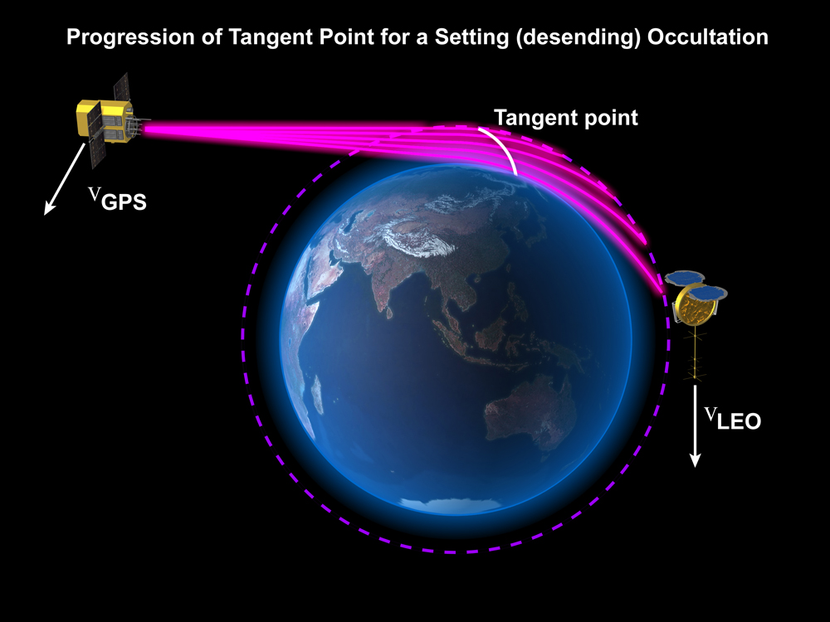
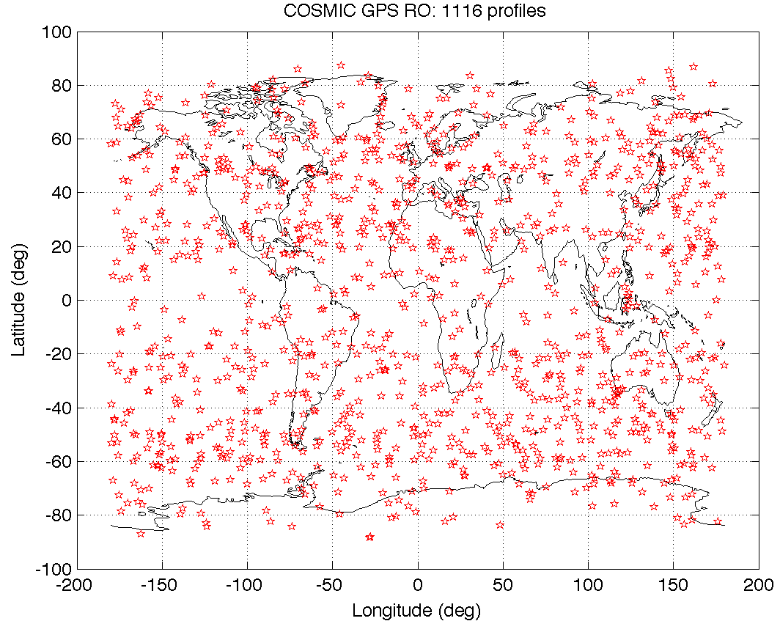
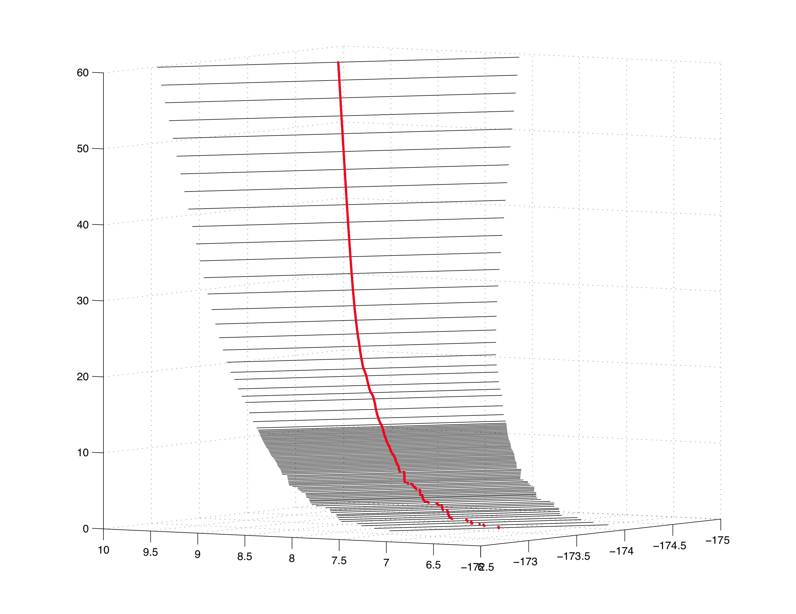
Beta Maturity Evaluation (13/19)
Matchups were found between COSMIC and CrIMSS retrievals of temperature (collocated and within 1 hour). The COSMIC data is used a common reference to compare CrIMSS and AIRS retrievals on a daily basis. The COSMIC dry temperature is valid in the range 30 – 300 mb.
http://www.cosmic.ucar.edu/launch/GPS_RO_cartoon.jpg
COSMIC Dry Temperature Profile
60
Altitude (km)
0
Latitude
Longitude
One Day of COSMIC Profiles

Slide 26
Beta Maturity Evaluation (14/19)
BIAS
RMS
STDEV
Global
90S - 90N
1-7 May 2012
(Day 122-128)
AIRS - COSMIC
BIAS
RMS
STDEV
CLASS
REDRO
Product
CrIMSS - COSMIC

Slide 27
Beta Maturity Evaluation (15/19)
BIAS
RMS
STDEV
Arctic
90N - 60N
1-7 May 2012
(Day 122-128)
AIRS - COSMIC
BIAS
RMS
STDEV
CLASS
REDRO
Product
CrIMSS - COSMIC

Slide 28
Beta Maturity Evaluation (16/19)
BIAS
RMS
STDEV
Northern Midlatitudes
60N - 30N
1-7 May 2012
(Day 122-128)
AIRS - COSMIC
BIAS
RMS
STDEV
CLASS
REDRO
Product
CrIMSS - COSMIC

Slide 29
Beta Maturity Evaluation (17/19)
BIAS
RMS
STDEV
Tropics
30N – 30S
1-7 May 2012
(Day 122-128)
AIRS - COSMIC
BIAS
RMS
STDEV
CLASS
REDRO
Product
CrIMSS - COSMIC

Slide 30
Beta Maturity Evaluation (18/19)
Southern Midlatitudes
30S – 60S
BIAS
RMS
STDEV
1-7 May 2012
(Day 122-128)
AIRS - COSMIC
BIAS
RMS
STDEV
CLASS
REDRO
Product
CrIMSS - COSMIC

Slide 31
Beta Maturity Evaluation (19/19)
BIAS
RMS
STDEV
Antarctica
60S – 90S
1-7 May 2012
(Day 122-128)
AIRS - COSMIC
BIAS
RMS
STDEV
CLASS
REDRO
Product
CrIMSS - COSMIC

Slide 32
Beta Justification Summary (1/3)
Criteria: Early release product
  CrIMSS EDR is dependent on ATMS and CrIS SDRs
    ATMS SDR reached beta maturity in Feb. 2012
      ATMS SDR does not have instrument bias corrections (side-lobe corrections) applied at this time
    CriS 1st light occurred on Jan. 20, approximated 42 days delay
    CrIS SDR reached beta maturity in Apr. 2012
  No post-launch changes have been made to the CrIMSS EDR
    Mx6.3 should have ATMS and CrIS bias corrections
    Mx7.0 should have changes to improve yield and quality of retrievals
Criteria: Minimally validated
  Majority of evaluation is based on three focus days (global comparisons for ECMWF and AIRS retrieval products).
    Nov. 11, 2011 focus day, ATMS was functioning
    Feb. 24, 2012 focus day, CrIS SDR still had major calibration issues
    May 15, 2012 focus day, both CrIS and ATMS were functioning well
  Some analysis has been done on other days
    comparisons to GPS on a number of days in May, 2012
    available dedicated radiosondes at specific locations
Goto: outline, p.2

Slide 33
Beta Justification Summary (2/3)
Criteria: Available to allow users to gain familiarity with data formats and parameters
  CrIMSS EDR team has evaluated IDPS EDR products available from CLASS
    Yield is low (both IR+MW and MW-only) and there are large biases
    Users can ignore MW-only QC and product compares reasonably with heritage products (from AIRS and IASI) for all non-precip cases
  CrIMSS EDR team has also evaluated an off-line, LINUx version of the IDPS code and made those outputs available to the cal-val team and NASA-funded researchers.
    Yield is significantly higher and performance is better when changes are implemented.
    Therefore, there does not appear to be any issues with the ATMS or CrIS radiances or the CrIMSS EDR algorithm.
  Beta release will allow other users within the community to gain experience with the data formats and parameters.
    This is important to allow users to complement the validation activity.

Slide 34
Beta Justification Summary (3/3)
Criteria: Product is not appropriate as the basis for quantitative scientific publication studies and applications
  The product has known flaws (see caveats slides later in this presentation), but these products are of sufficient quality to justify use by a broader community
  Most of the issues revolve around failed convergence
    Due to sub-optimal bias corrections and noise values
    Users can ignore or relax the quality flags and if they do, the products are comparable to other operational systems (Aqua/AIRS/AMSU and EUMETSAT/IASI/AMSU/MHS products)
  With the changes proposed for Mx6.3 (could be implemented in September timeframe) these products could be considered provisional.

Slide 35
Caveats for Operational CrIMSS EDR (1/6)
(these changes are proposed for MX6.3)
Does not have any bias correction for ATMS (DR4325)
  Causes scan angle dependent biases in AVMP and AVTP
  Causes low yield in coupled CrIS/ATMS retrieval
  Adding this bias correction to off-line code increased yield by ~6%.
Has a sub-optimal emissivity co-variance matrix (DR 4335)
  Causes poor KPP performance, especially in polar scenes
  In off-line code replacing this LUT increased yield by ~30%
Has pre-launch bias correction for CrIS (DR 4334)
  Based on IASI-proxy data, should be reasonable
Goto: outline, p.2

Slide 36
Caveats for Operational CrIMSS EDR (2/6)
(these changes will be proposed for Mx7.0)
Pre-launch values of CrIS and ATMS instrument noise LUTs is based on pre-launch, idealized performance
  Affects convergence and is causing low yields for both the microwave and coupled retrieval
  Modifying this in off-line code increased yield by ~25%
Scene stratification is not performing well
  Determination of “warm ocean” logic needs to be changed
Scene selection module is not performing well
  As a consequence of sub-optimal bias corrections and instrument noise estimates scenes are determined to be clear when they are cloudy.
  Causes poor convergence and rejection of the coupled retrieval and microwave retrieval, especially over polar regions.
  Fixed in off-line code by forcing cloud clearing for all cases.
Table on the next page summarizes the improvements of yield with respect to a number of changes discussed here.

Slide 37
Caveats for Operational EDR (3/6)
 | (1) | (2) | (3) | (4) | (5) | (6) | (7) | (8) | (9) | (10) |  | QC(1) | QC(4) | QC(5) | QC(1&4)
A1 |  |  |  |  |  |  |  |  |  |  |  | 44.45% | 9.57% | 53.41% | 6.87%
A2 | ✓ |  |  |  |  |  |  |  |  |  |  | 43.40% | 19.60% | 59.84% | 12.35%
A3 |  | ✓ |  |  |  |  |  |  |  |  |  | 55.40% | 23.70% | 83.92% | 17.09%
A4 |  |  | ✓ |  |  |  |  |  |  |  |  | 44.44% | 9.55% | 53.41% | 6.84%
A5 | ✓ | ✓ | ✓ |  |  |  |  |  |  |  |  | 51.93% | 44.12% | 87.14% | 30.26%
B1 | ✓ | ✓ | ✓ | ✓ |  |  |  |  |  |  |  | 75.25% | 47.33% | 87.14% | 46.00%
B2 | ✓ | ✓ | ✓ |  | ✓ |  |  |  |  |  |  | 51.93% | 44.12% | 87.14% | 30.26%
B3 | ✓ | ✓ | ✓ |  | ✓ | ✓ |  |  |  |  |  | 51.93% | 44.12% | 87.14% | 30.26%
B4 | ✓ | ✓ | ✓ |  |  |  | ✓ |  |  |  |  | 52.87% | 45.63% | 87.14% | 31.62%
B5 | ✓ | ✓ | ✓ | ✓ | ✓ | ✓ | ✓ |  |  |  |  | 75.97% | 48.59% | 87.14% | 47.30%
C1 | ✓ | ✓ | ✓ | ✓ | ✓ | ✓ | ✓ | ✓ |  |  |  | 77.10% | 50.28% | 90.34% | 49.14%
C2 | ✓ | ✓ | ✓ | ✓ | ✓ | ✓ | ✓ |  | ✓ |  |  | 76.71% | 50.09% | 89.06% | 48.76%
C3 | ✓ | ✓ | ✓ | ✓ | ✓ | ✓ | ✓ | ✓ | ✓ |  |  | 77.10% | 50.28% | 90.34% | 49.14%
C4 | ✓ | ✓ | ✓ | ✓ | ✓ | ✓ | ✓ |  |  | ✓ |  | 78.71% | 49.34% | 87.14% | 48.46%
C5 | ✓ | ✓ | ✓ | ✓ | ✓ | ✓ | ✓ | ✓ |  | ✓ |  | 80.29% | 50.83% | 90.34% | 50.10%
C6 | ✓ | ✓ | ✓ | ✓ | ✓ | ✓ | ✓ | ✓ | ✓ | ✓ |  | 80.29% | 50.83% | 90.34% | 50.10%
(1) | New Bias Files |  | (6) | calc_ir_noise: ozone-methane stdt*4
(2) | New Climatology LUT |  | (7) | set_irmw_invert: new ir noise calc.
(3) | readStdInputs reads Sol. Zen. Angle |  | (8) | calcCrimssProfiles: no stratification
(4) | calcCrimssProfiles: daytime noise*4 |  | (9) | setCovBack: warm ocean definition
(5) | calc_ir_noise: stdt error *2 |  | (10) | fovsel: forced cloud clearing

Slide 38
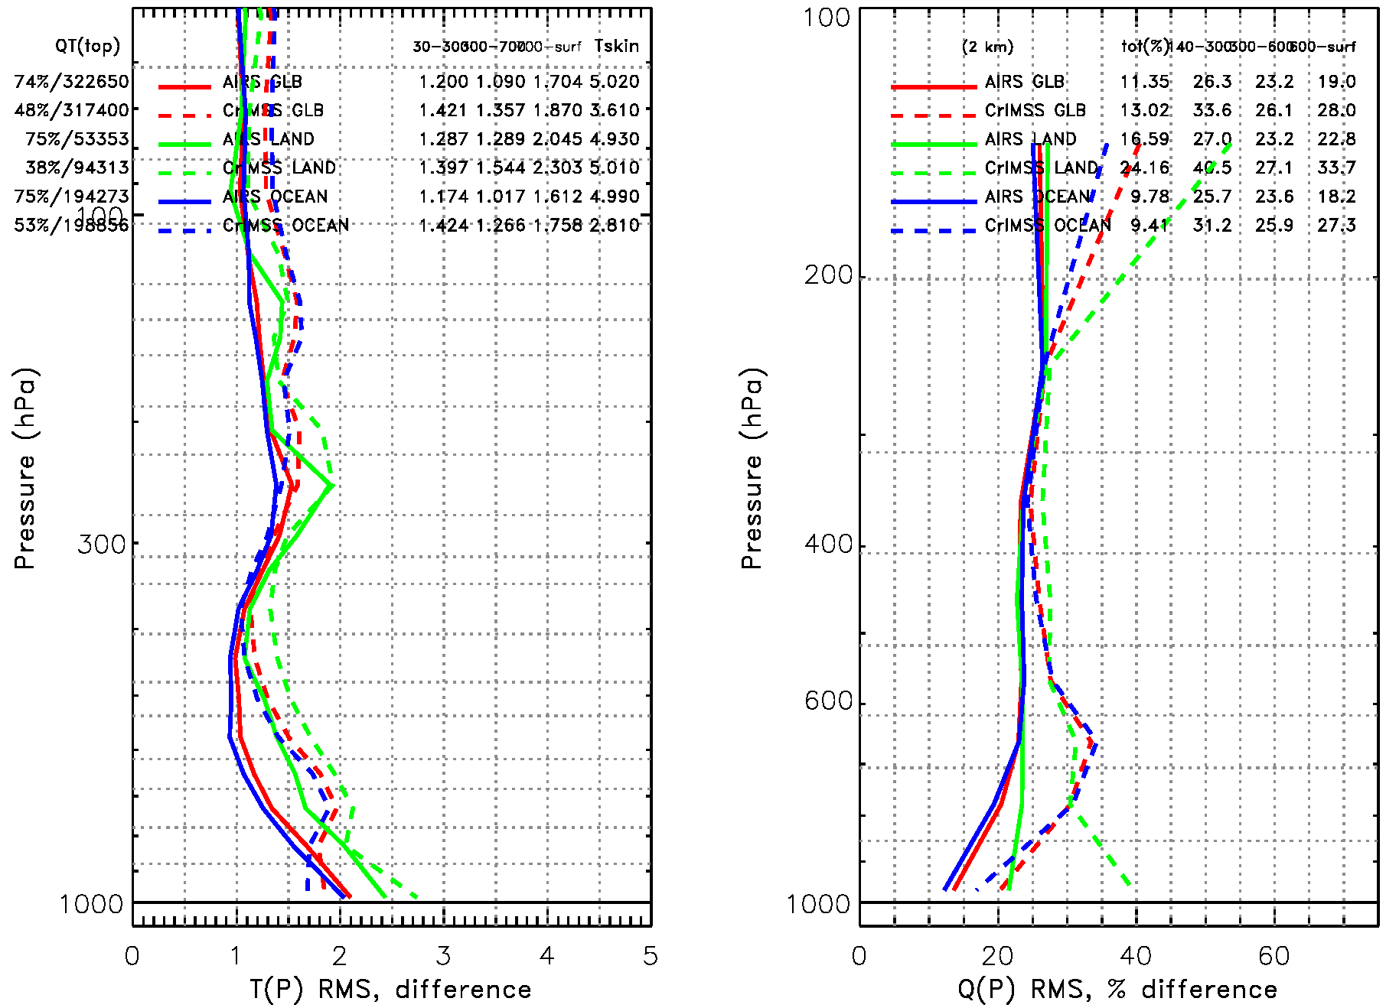
Caveats for Operational CrIMSS EDR (4/6)
Comparson of the IR+MW EDR w.r.t. ECMWF for May 15, 2012 -- if all the changes are installed (Off-line runs)
Global (red), land (green) and ocean (blue) statistics for the CrIMSS EDR (dashed) and heritage AIRS product (solid).
CrIMSS EDR has lower yield (38-53%) than AIRS (~75%) at this time
KPP performance is close to requirements (1.6K) for AVTP, but we still have work to do for AVMP (global is 28% vs. 20% requirement)
KPP
KPP
L1 Requirements
L1 Requirements

Slide 39
Caveats for Operational CrIMSS EDR (5/6)
(additional issues)
Daytime scenes have lower (~20%) yield than nighttime due to a software error in the indexing of channels affected by non-LTE
  Recently discovered bug and changes required are understood.
  The fix has not been implemented in any figures shown herein.
Precipitation flag is sub-optimal
  Precipitation flag is needed for excluding cases from the performance statistics.
  Current flag is using out of date algorithm and incorrect coefficients (AMSU coefficients used)
    Appears to be producing reasonable values, most of the time but does have high failure rate (both false positives and negatives).
  We will have a report on its performance in Sep. 2012 and implementation of code/coefficient changes in Jan. 2013

Slide 40
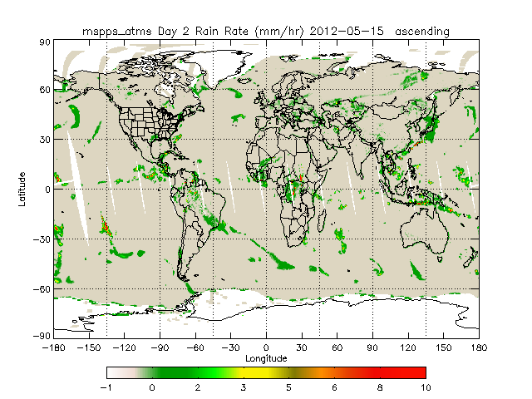
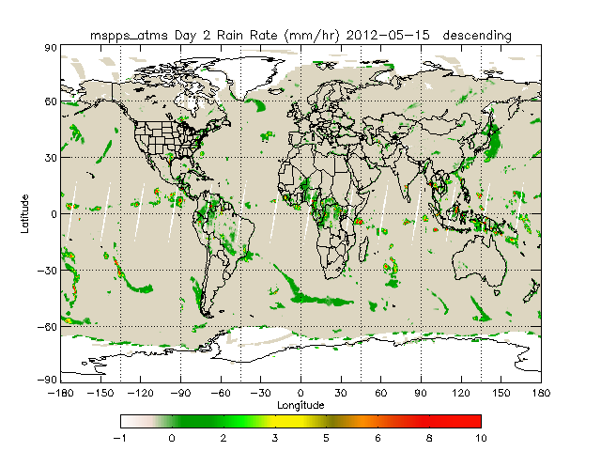
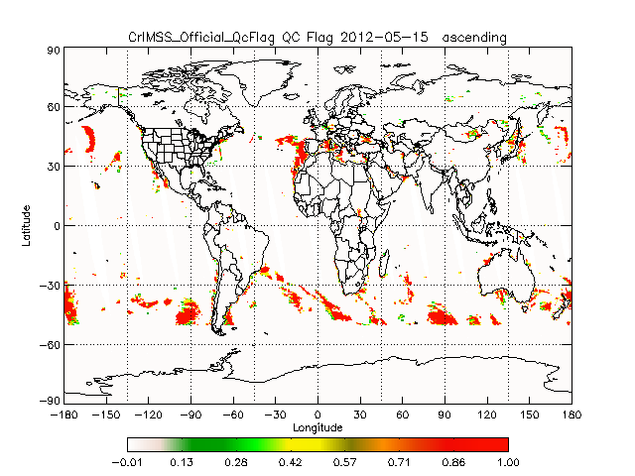
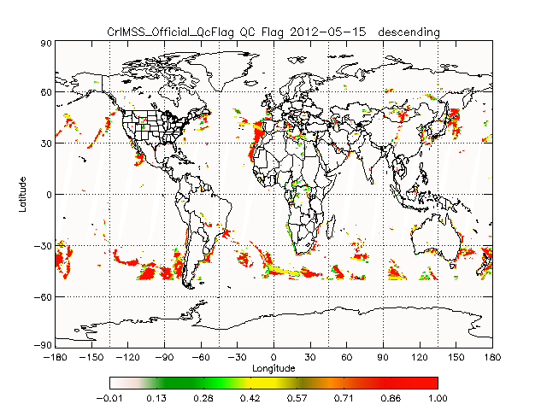
Caveats for Operational CrIMSS EDR (6/6)
(example of precip flag on 5/15
Ascending Orbit
Descending Orbit
MSPPS
CrIMSS EDR

Slide 41
Additional Supporting Documentation
Apr. 4, 2012 Presentation at CrIS beta review
(120404_crimssedr_barnet.pptx)
June 26, 2012 Telecon presentation
  Degui Gu, discussion of changes proposed for Mx6.3 (120626crimss_degui.pptx)
  Bob Kunteson, comparison to GPS (120626crimss_knuteson.ppts)
  Murty Divakarla, off-line EDR comparison to ECMWF (120626crimss_murty.ppt)
  Wenze Yang + Ralph Ferraro, Analysis of CrIMSS Rain Flah (120626crimss_yang.ppt)
Weekly reports
  Feb. 15, ATMS empirical bias correction and statistics of ATMS-only retrieval (120215adp_weekly_barnet.docx)
  Apr. 25, off-line global EDR statistics w.r.t. NUCAPS (120425adp_weekly_barnet.docx)
  May 29, off-line global EDR statistics w.r.t. AIRS (120530adp_weekly_barnet.docx)
  Jun 27, off-line global EDR statistics with proposed changes for Mx7.0 (120627adp_weekly_barnet.docx)
Goto: outline, p.2

Slide 42
Future Plans and Issues
We are working to get these changes into the IDPS
  The 45 day dry-run (7/31-9/12) and 90 day TPI testing (mid-Oct to mid-Jan) of IDPS will prevent upgrades of the IDPS EDR before provisional or stage.1 validation is scheduled for completion.
  Therefore, it is very likely that only the Off-line code will meet performance requirements until all changes can be implements (mid-2013 ??).
  Therefore, a high priority, near-term task is to confirm that off-line code can completely emulate the IDPS configuration.
Detailed performance characterization requires dedicated radiosondes
  We will continue the analysis with the 20 Aerospace radiosondes launched in May from Hawaii
  The ARM-CART radiosonde launches from North Slope of Alaska, Southern Great Plains, and Tropical Western Pacific are beginning now.
    Radiosondes will be launched for ~90 overpasses over the next 3 months
  We will also use radiosondes from the 2012 AEROSE Atlantic Cruise
    ~100 radiosondes and ~25 ozone sondes will be launched along an Atlantic Ocean path in Sep. 2012.
Radiosonde analysis will be part of the provisional maturity justification scheduled for the Nov/Dec 2012 timeframe.

Slide 43
Conclusion
CrIMSS EDR has met the beta stage based on the definitions and the evidence shown
  It exceeds the definition of beta in most cases
  Off-line EDR product performance is close to meeting requirements at this time (and continuing to improve).
Many issues have been uncovered during validation and solutions are being evaluated.
  Scan angle dependent biases and yield issues will be mitigated when DR 4325, 4334, 4335 is fully implemented (Mx6.3 ??)
  Low yield of products is due mostly to poor quality control and we have solutions working in the off-line code (hopefully implemented in Mx7.0)
Goto: outline, p.2

