Slide 1
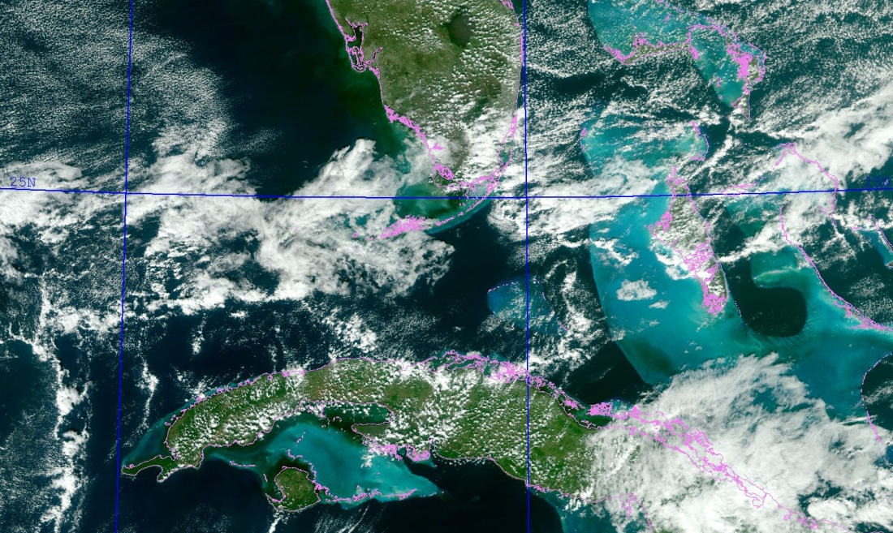
NRL-MRY VIIRS Demonstrations
Satellite Meteorological Applications Section
Naval Research Laboratory
Marine Meteorology Division, Monterey, CA
Jeff.Hawkins@nrlmry.navy.mil
Jeremy. Solbrig@nrlmry.navy.mil
March 1, 2007
VIIRS Imagery User Feedback
January 7, 2017
Notes:
The presentation is made possible due to the combined contributions of the following team members:
NRL- Naval Research Laboratory, Marine Meteorology Division, Monterey, CA (NRL-MRY):
Jeff Hawkins, Jeremy Solbrig, Arunas Kuciauskas, Mindy Surratt, Kim Richardson, Rich Bankert, and Tom Lee
SAIC: John Kent
CSU/CIRA: Steve Miller
VIIRS: AFWA IDPS/FNMOC, U. of Wisconsin (CIMSS), NOAA CLASS,
FNMOC: Jim Vermeulen, Jeff Tesmer, Yiping Wang, Paul McCrone
Met-9/7, MTSAT, SSM/I, SSMIS, AMSU
NRL-MRY: GOES-WEST/EAST (rooftop antennas)

Slide 2
NexSat Home Page
http://www.nrlmry.navy.mil/NEXSAT.html
Notes:
NexSat GUI includes a suite of rectangular domains from which the user can select to then view a suite of products for each area.
The user can sometimes drill down to smaller and higher resolution areas once the large domain is selected.
The product list is tailored for each domain and includes a suite of GEO/LEO products.
Note the “volcano” and “city zoom” icons in the lower left that lead the user to specific high resolution products geared to volcano monitoring and city views.
NRL- Naval Research Laboratory, Marine Meteorology Division, Monterey, CA (NRL-MRY):
Jeff Hawkins, Arunas Kuciauskas, Jeremy Solbrig, Mindy Surratt, Kim Richardson, Rich Bankert, and Tom Lee
SAIC: John Kent
CIRA: Steve Miller

Slide 3
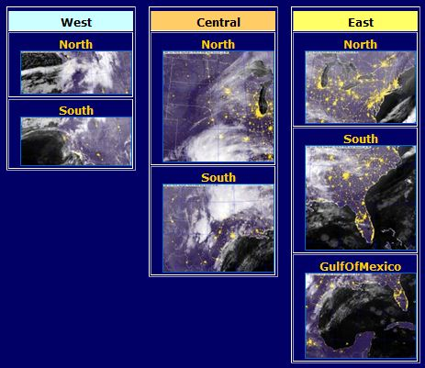
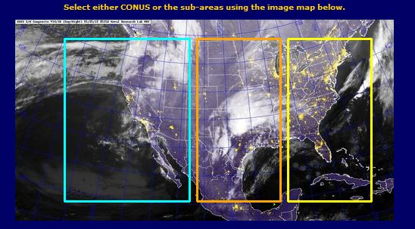
NexSat: CONUS Domain
Notes:
CONUS domain is separated into multiple smaller, higher resolution areas as viewed here and the product list on the left highlights the typical products available in each one.
NRL- Naval Research Laboratory, Marine Meteorology Division, Monterey, CA (NRL-MRY):
Jeff Hawkins, Arunas Kuciauskas, Jeremy Solbrig, Mindy Surratt, Kim Richardson, Rich Bankert, and Tom Lee
SAIC: John Kent
CIRA: Steve Miller

Slide 4
Catalog of NexSat Products
Standard Products
Visible (daytime)
Visible (night time)
Infrared
Water Vapor
True Color
Pseudo/GEO True Color
Rain Rates
Rain Totals 3, 6, 12, 24 hours 2, 3, 4, 5, 6, 7, 10, 12, 14 days
*Winds speed and direction low level middle level upper level
Cloud Products
Cloud layers (snow, low-middle, high)
CloudSat (cloud profile)
Cirrus cloud detection
Contrail detection
Low cloud detection (night)
Convective cloud top height
Cloud properties effective radius optical depth cloud top temperature cloud top height cloud type
Environmental Products
Aerosol amounts (optical depth)
Biomass (vegetation type)
Dust detection
Fire detection (hot spots)
Lightning detection
Snow cover (surface)
*NWP model overlays
Sea Level Pressure
500 mb Heights
sfc, 700 500 300 mb Winds
1000-500 mb Thickness
Surface Temperature
Jet Stream
* NAVGEM and COAMPS®
VIIRS products in orange
Notes:
Summary of products offered in NexSat, applying the visible, IR and microwave range
split into standard, cloud and value-added or environmental products
wide suite of model overlays as well from NRL NOGAPS and COAMPS output
NRL- Naval Research Laboratory, Marine Meteorology Division, Monterey, CA (NRL-MRY):
Jeff Hawkins, Jeremy Solbrig, Arunas Kuciauskas, Mindy Surratt, Kim Richardson, Rich Bankert, and Tom Lee
SAIC: John Kent

Slide 5
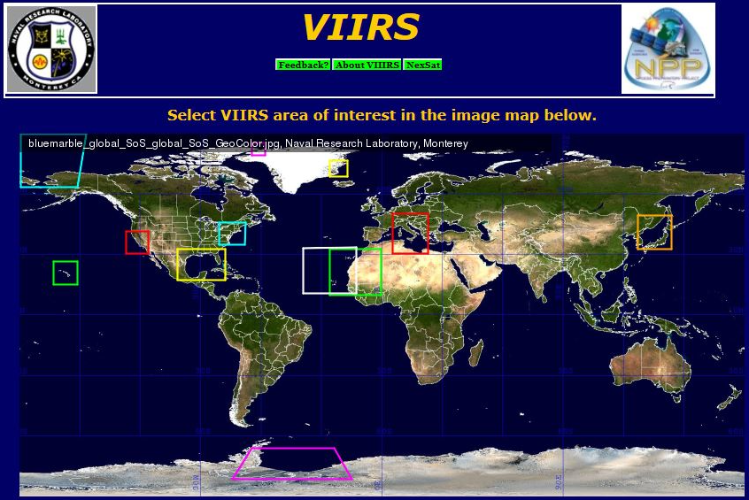
NRL VIIRS Cal/Val Web Page
http://www.nrlmry.navy.mil/VIIRS.html

Slide 6
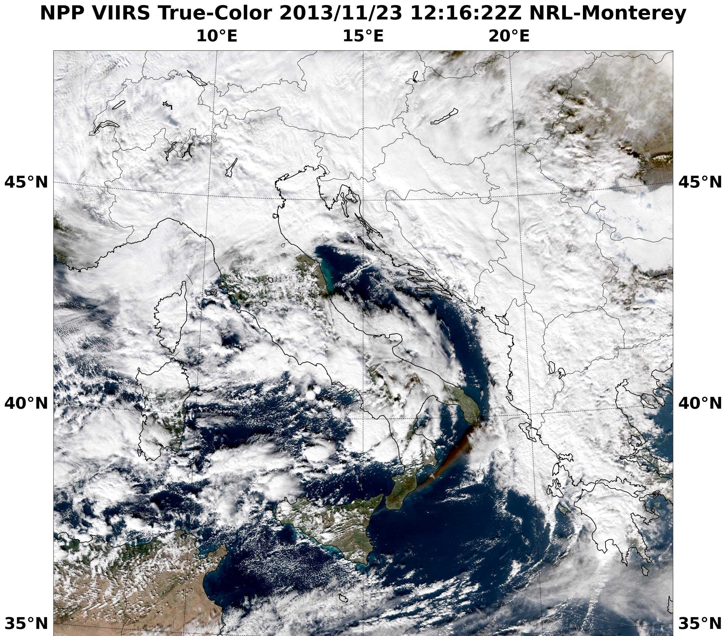
Monitoring Volcanic Plumes
Observing Aspects of Volcanic Ash
Mt. Etna Eruption
VIIRS products available to the Volcanic Ash Advisory Centers (VAAC)
Dark airborne ash plume being ingested into mesoscale low
Collaboration: Volcanic Ash Advisory Centers (VAAC)
Notes:
SNPP VIIRS true color image highlighting Mt. Etna’s dark volcanic plume as it moves to the NE and it entrained into a mesoscale low pressure system to the north.
Acknowledgments: Naval Research Laboratory, Marine Meteorology Division
Jeremy Solbrig, Arunas Kuciauskas, Kim Richardson, Rich Bankert, Jeff Hawkins, Mindy Surratt, Steve Miller (CIRA), and John Kent (SAIC)

Slide 7
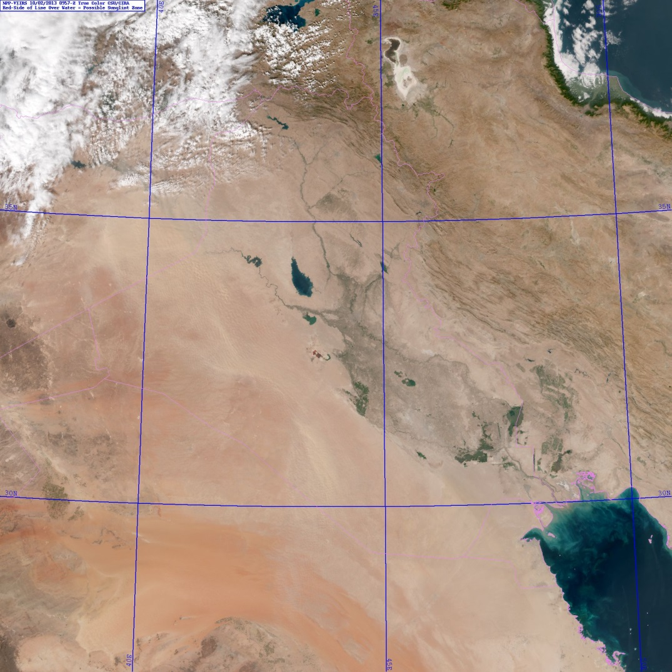
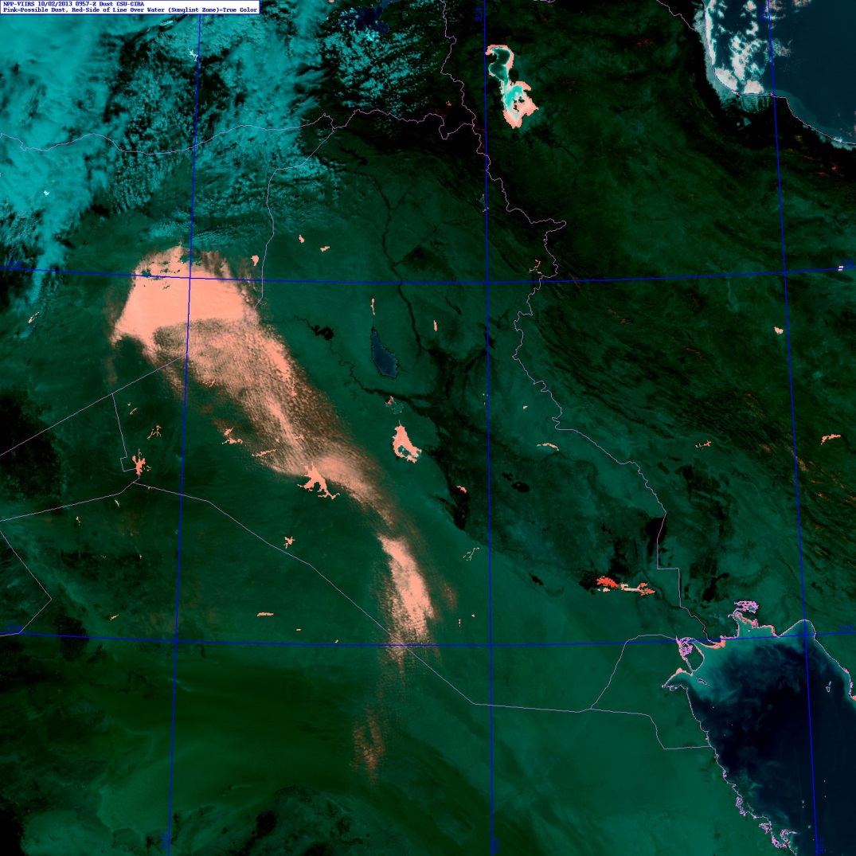
VIIRS Multi-Spectral Dust Enhancement
2 October 2013 0957 UTC
Dust
Storm
VIIRS provides a the required spectral suite of bands required to reproduce the MODIS
‘blue light absorption’ mineral dust enhancement algorithm of Miller(GRL; 2003).
Notes:
Operational relevance: dust storms occur worldwide and can change dramatically over timescales < 1 hr. Timely information is critical for making use of dust information in decision aids.
Acknowledgments: Data processed by Steve Miller (CIRA)

Slide 8
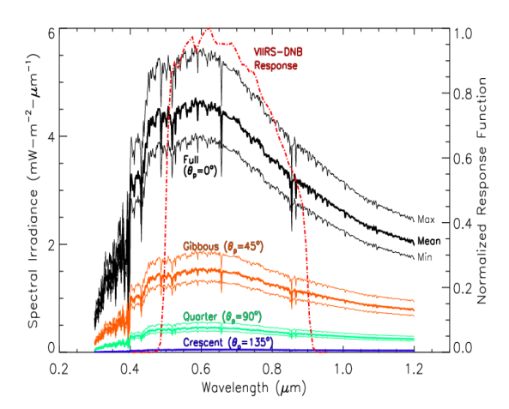
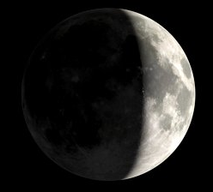
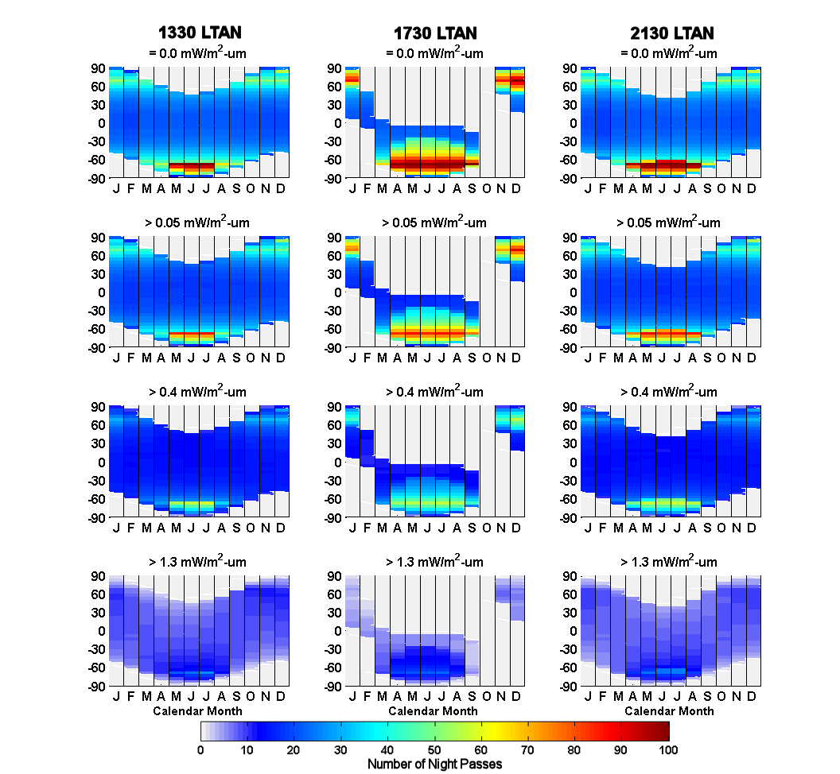
Tools for Quantitative Lunar Applications
from the VIIRS/DNB
A lunar irradiance prediction model to allow conversion from DNB radiance to reflectance units
R = πI↑ / [cos(θ_{m})E_{m}]
Enables quantitative applications from measurements of reflected moonlight
Miller and Turner, 2009. IEEE Trans. Geosci. Rem. Sens., 47(7), 2316-2329.
A lunar availability assessment for the VIIRS/DNB to determine when and where nighttime lunar applications are possible for NPP and other polar orbits.
~45% all nights at mid-latitudes offer sufficient levels of moonlight
Miller et al.. 2012. J. Atmos. Ocean. Tech., In Press.
Notes:
Method to convert SNPP VIIRS DNB radiances to reflectances.
Acknowledgments: Steve Miller (CIRA)

Slide 9
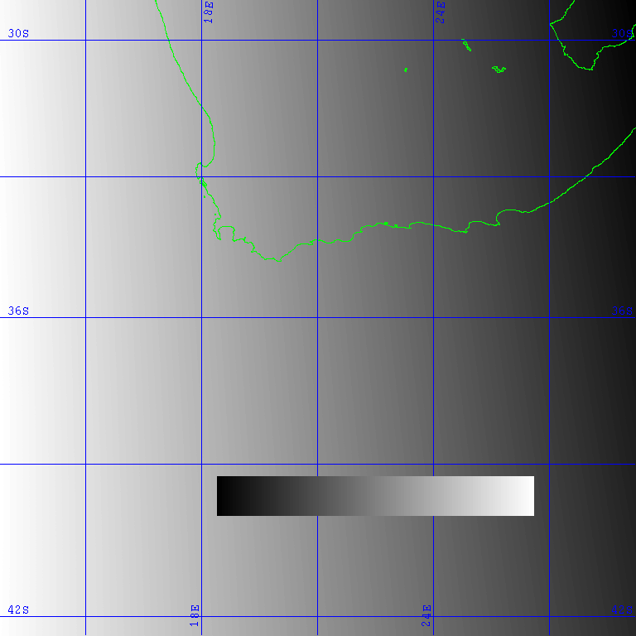
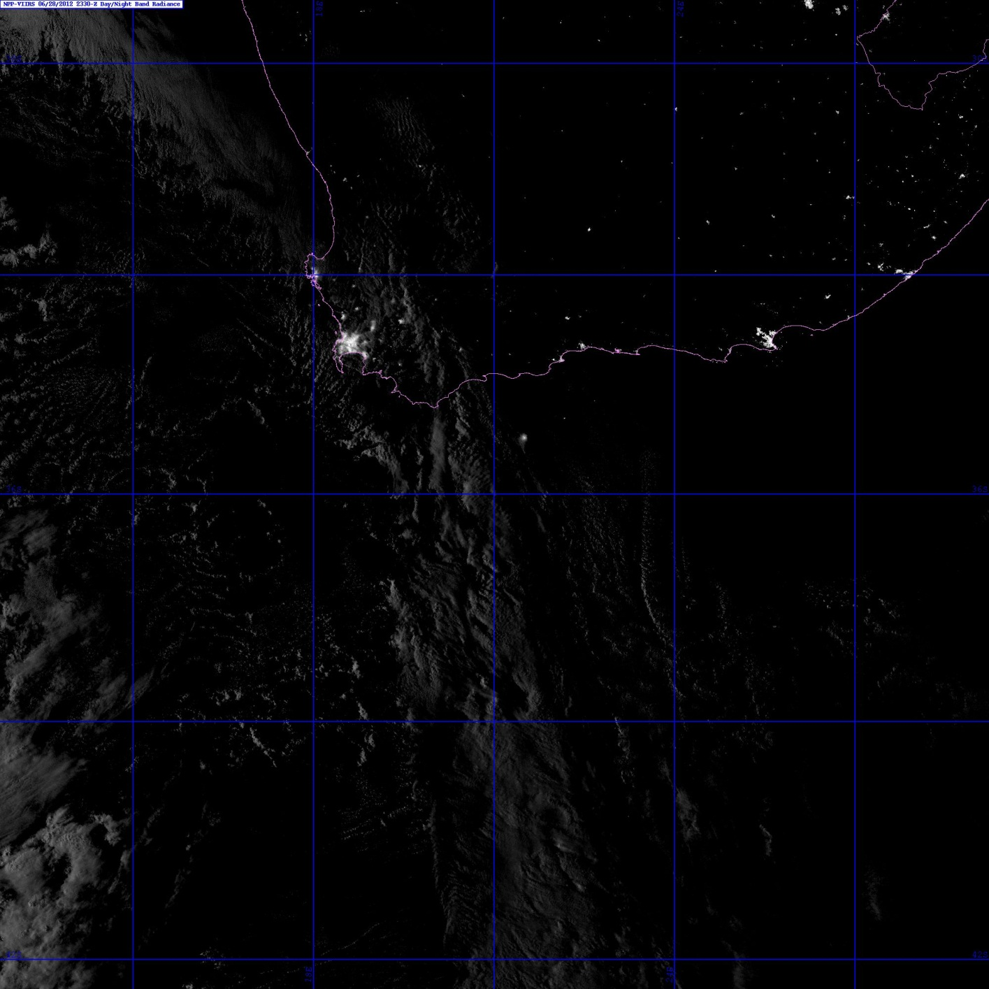
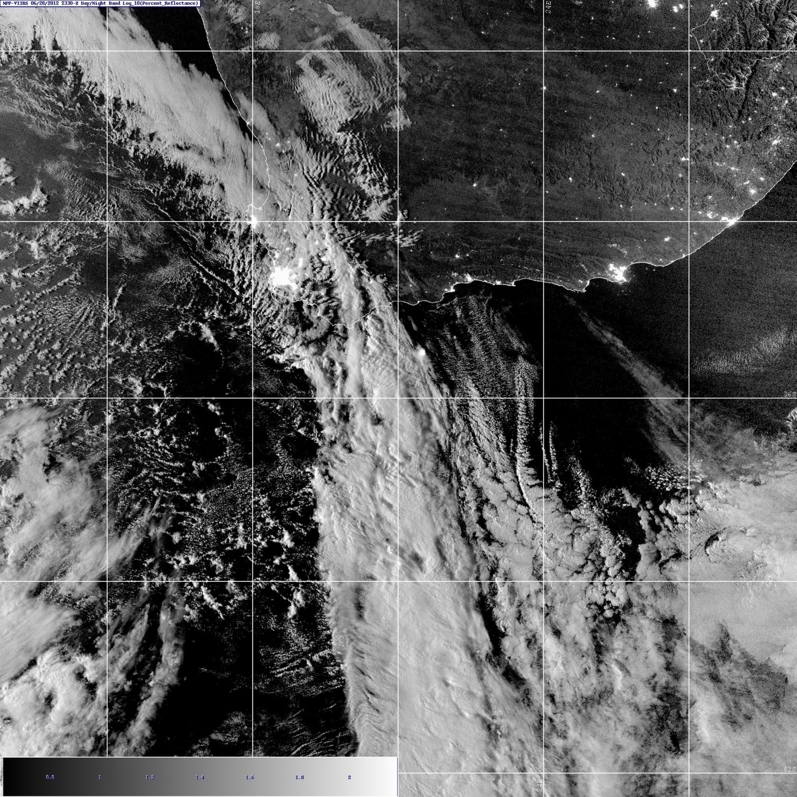
Reflectance Near ‘Lunar Terminator’
VIIRS DNB Radiance
The lunar model can be used to produce a form of near constant contrast (NCC) imagery.
Applicable to night-only (i.e., to lunar observations at different times in the lunar cycle, especially near lunar terminator.
Not applicable to the day/night terminator where solar signal is present.
(28 June 2012, South Africa, around first-quarter Moon) shown here… →
Moon is setting in the west at the time of the DNB nighttime overpass.
VIIRS DNB Reflectance
SOUTH
AFRICA
85 Lunar Zenith Angle 70
0 100
Notes:
Example of the difference between SNPP VIIRS DNB radiances and reflectances using the NRL-MRY lunar model. The reflectances provide a quantitative value that can then be used for both automated and manual use for multi-channel products and retrievals of night time cloud properties not feasible with radiance values.
Acknowledgments: Steve Miller (CIRA)

Slide 10
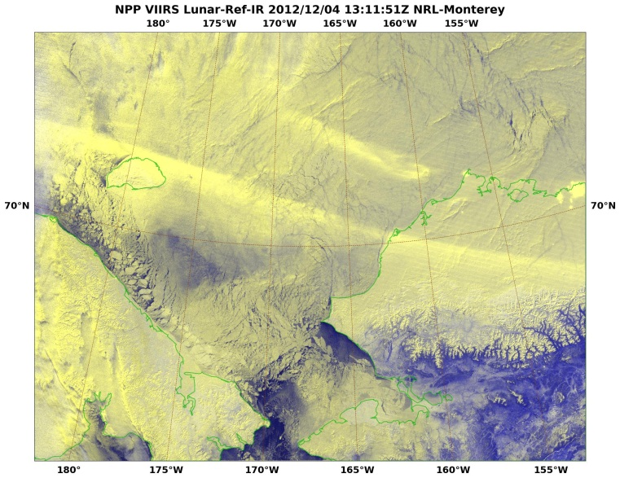
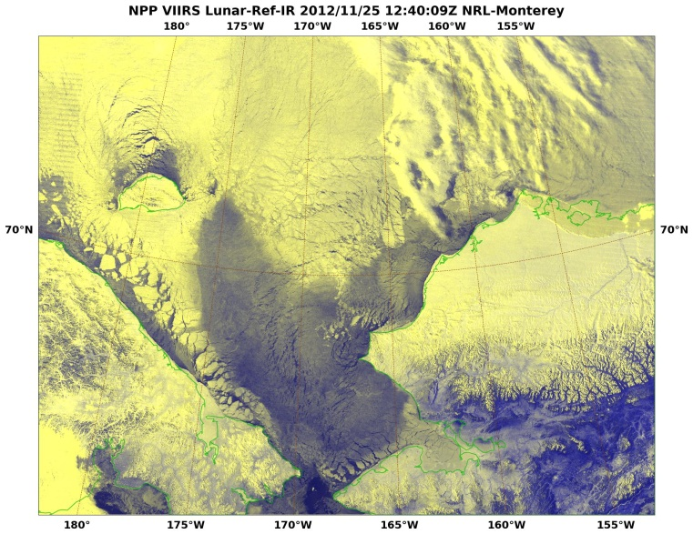
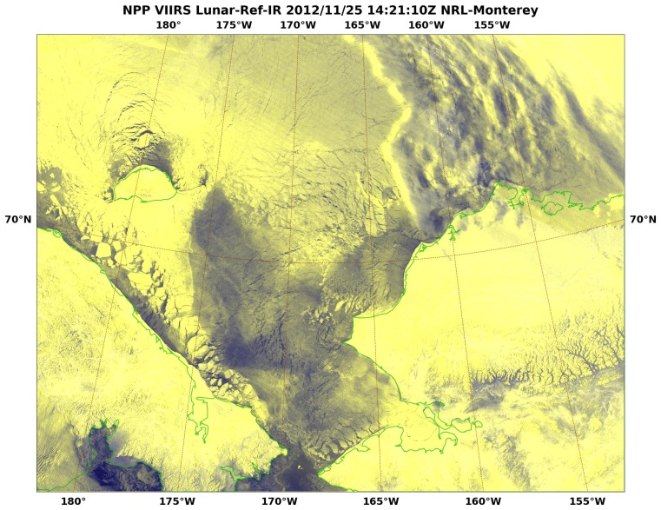
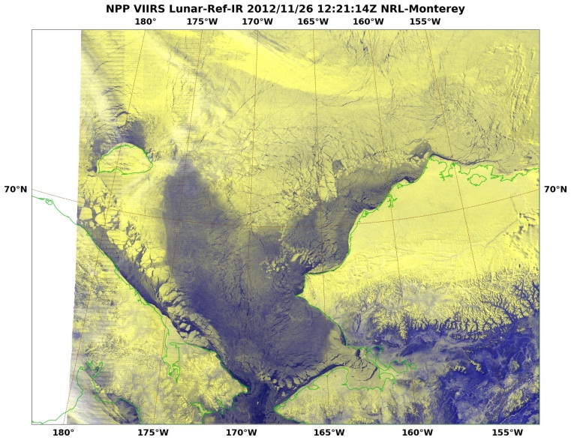
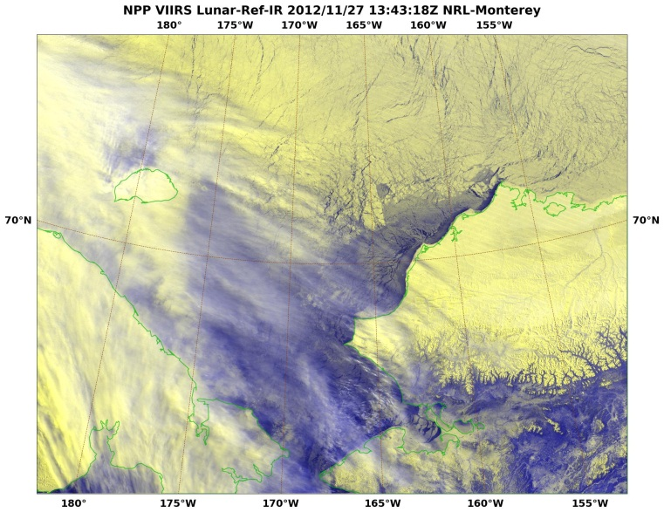
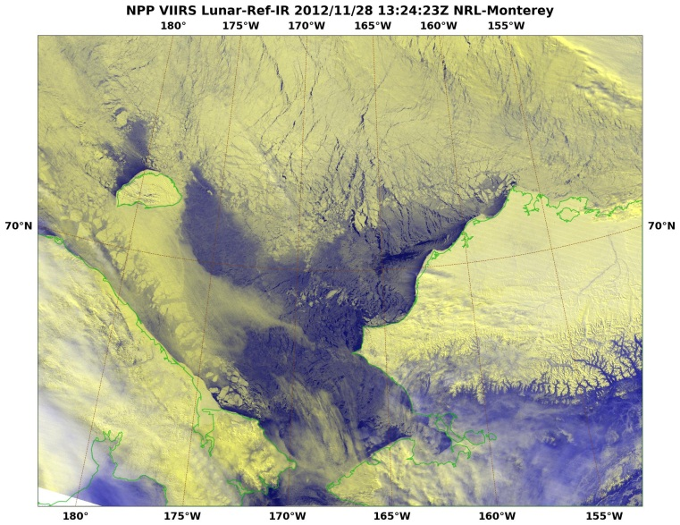
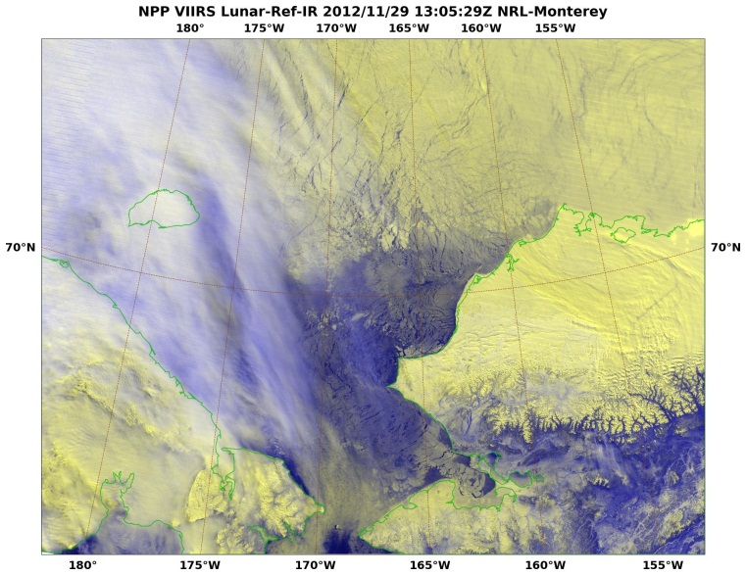
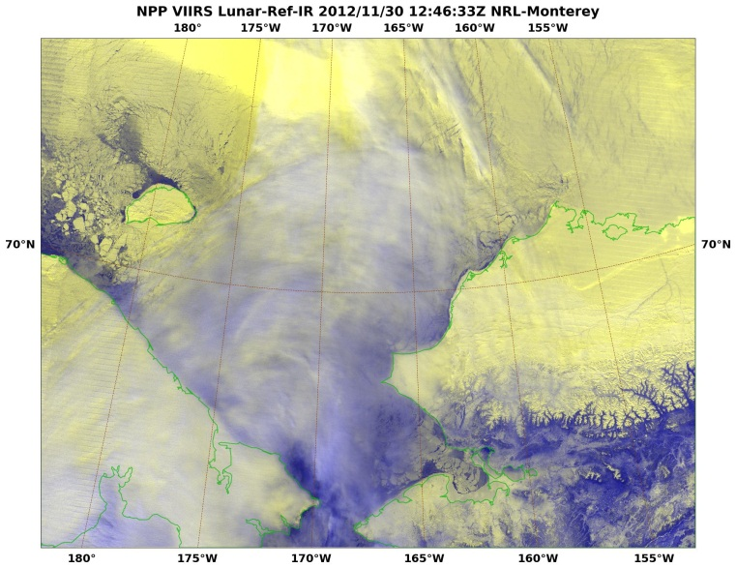
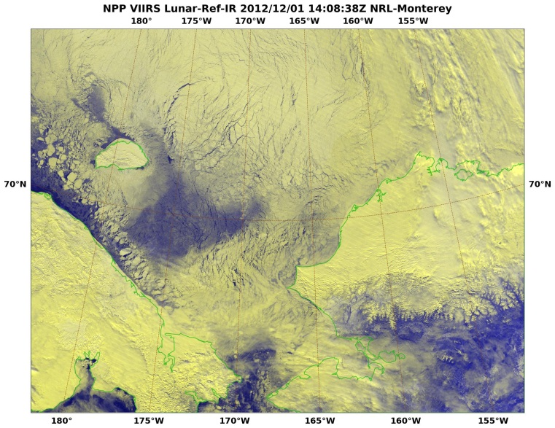
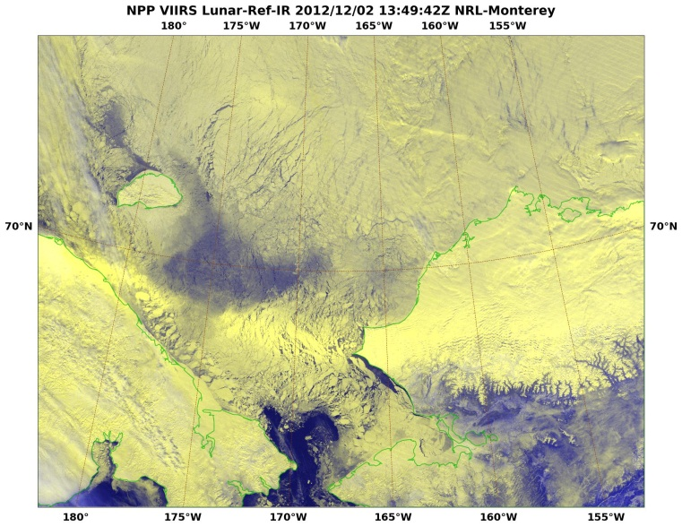
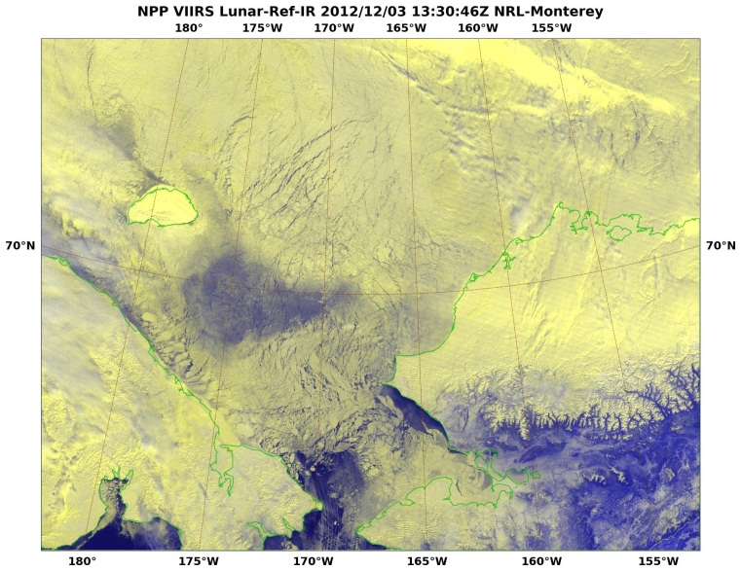
Nighttime Sea Ice Monitoring
DNB (low light visible) - Nighttime during Full Moon
11/27 – 12/04, Lunar cycle > 3/4
A r c t i c O c e a n
Chukchi
Sea
Alaska
10
Russia
Collaboration with National Ice Center: Suitland, MD
Notes:
VIIRS DNB+IR multi-spectral imagery animation (leveraging the multiple views/night at the high latitudes) in the Chukchi Sea area highlighting the ability to monitor sea ice motion and aurora phenomena.
Acknowledgments: Naval Research Laboratory, Marine Meteorology Division, Monterey, CA
Arunas Kuciauskas, Jeremy Solbrig, Mindy Surratt, Kim Richardson, Jeff Hawkins, Steve Miller (CIRA) and John Kent (SAIC)

Slide 11
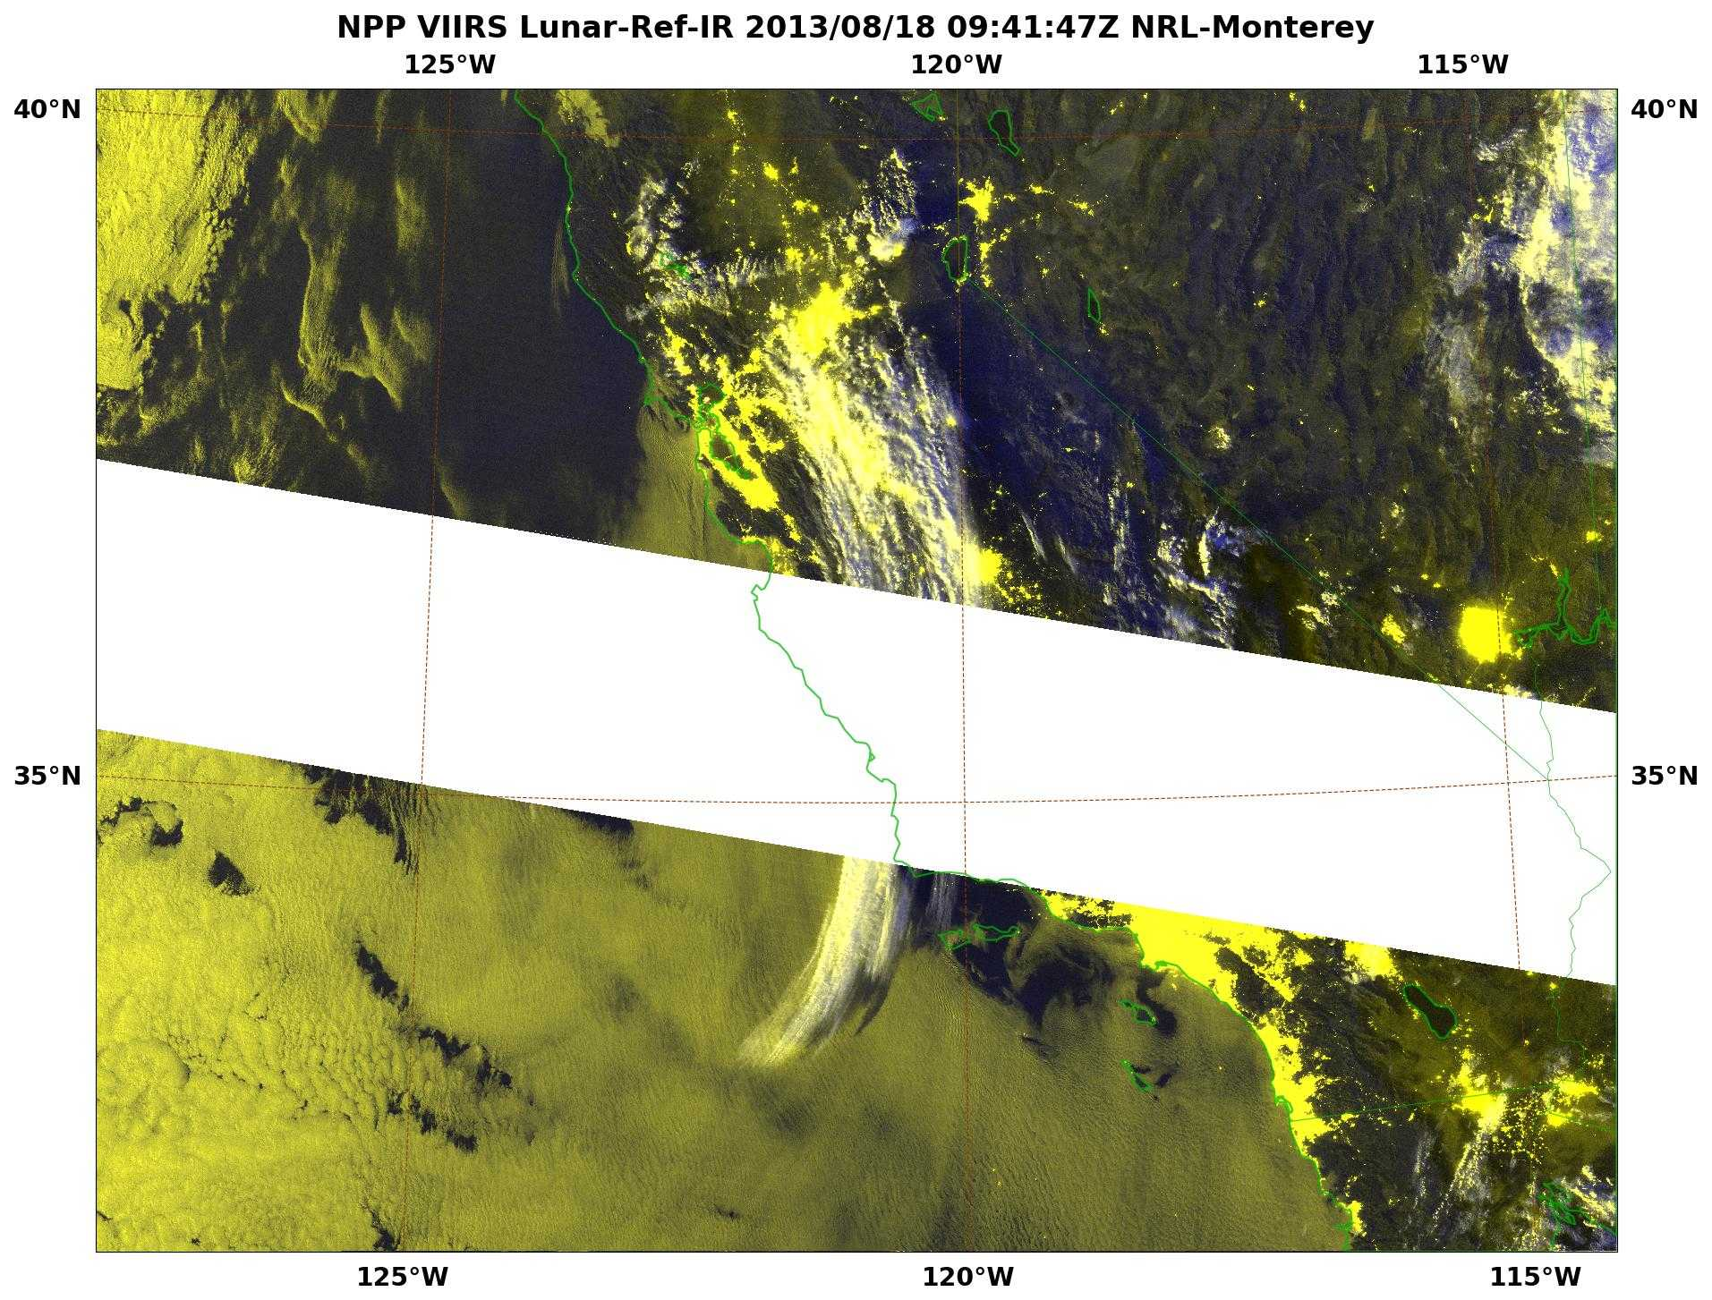
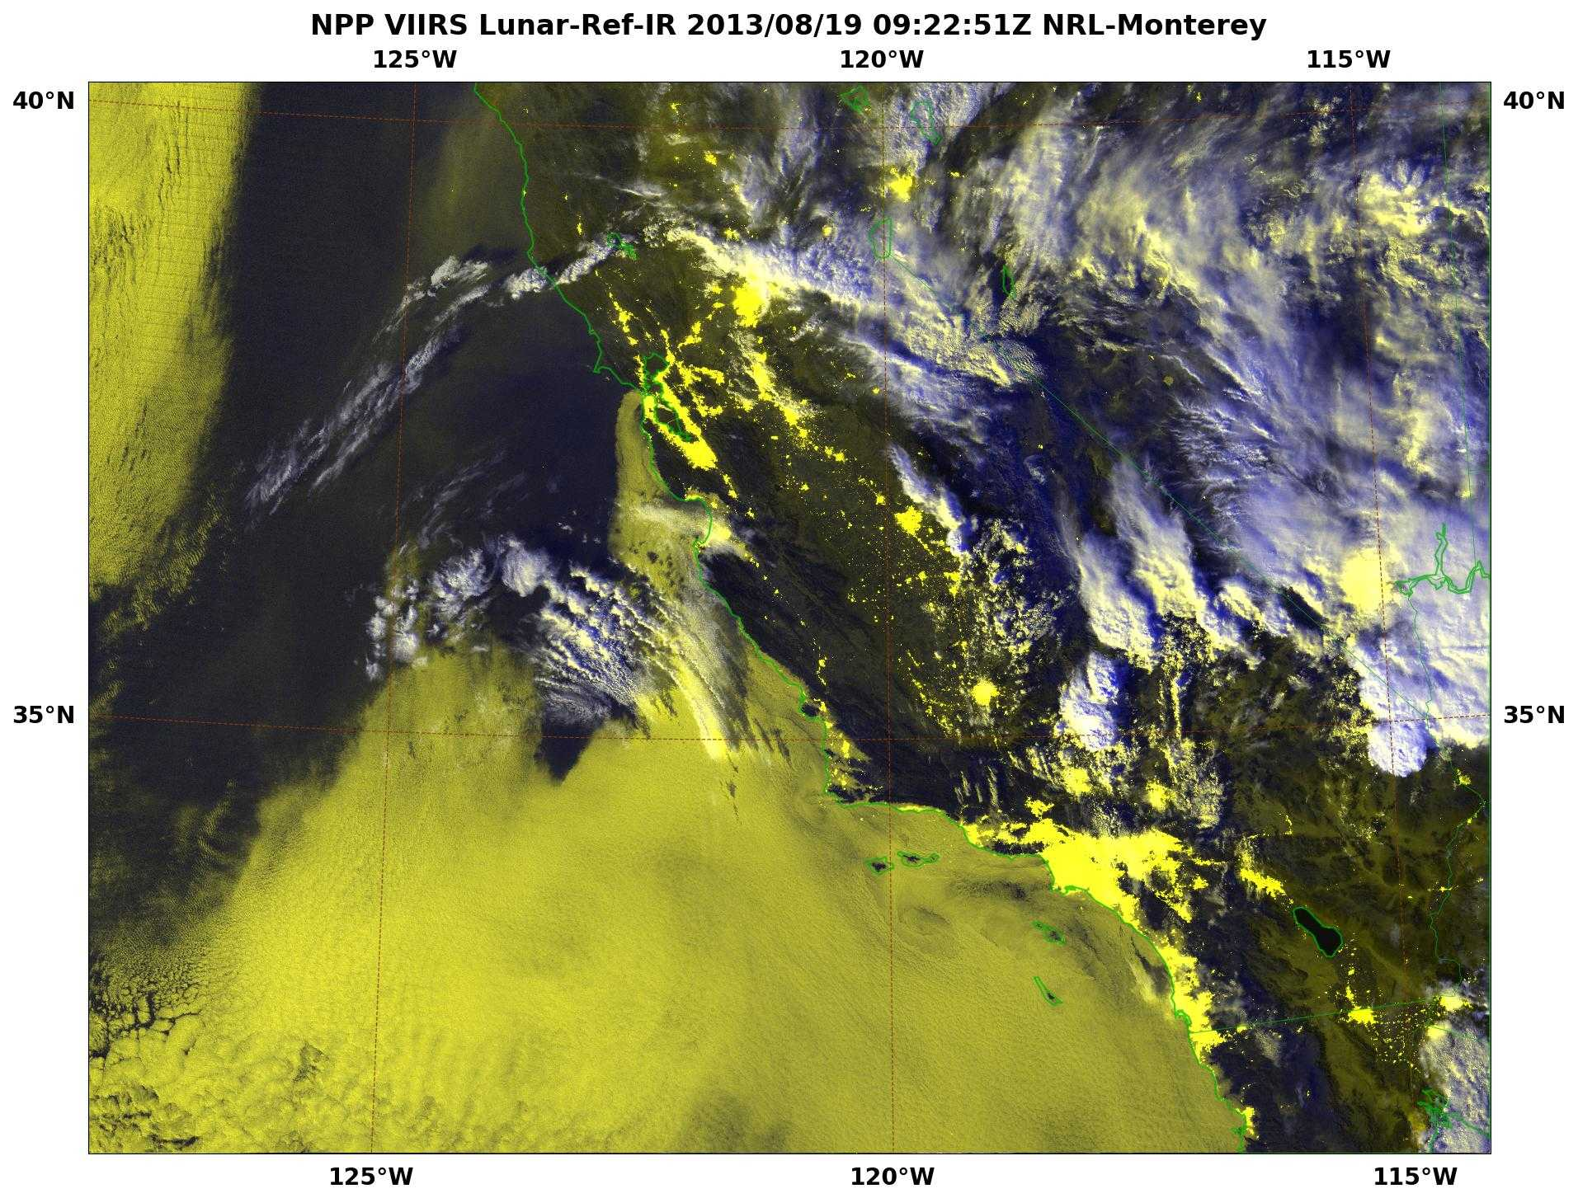
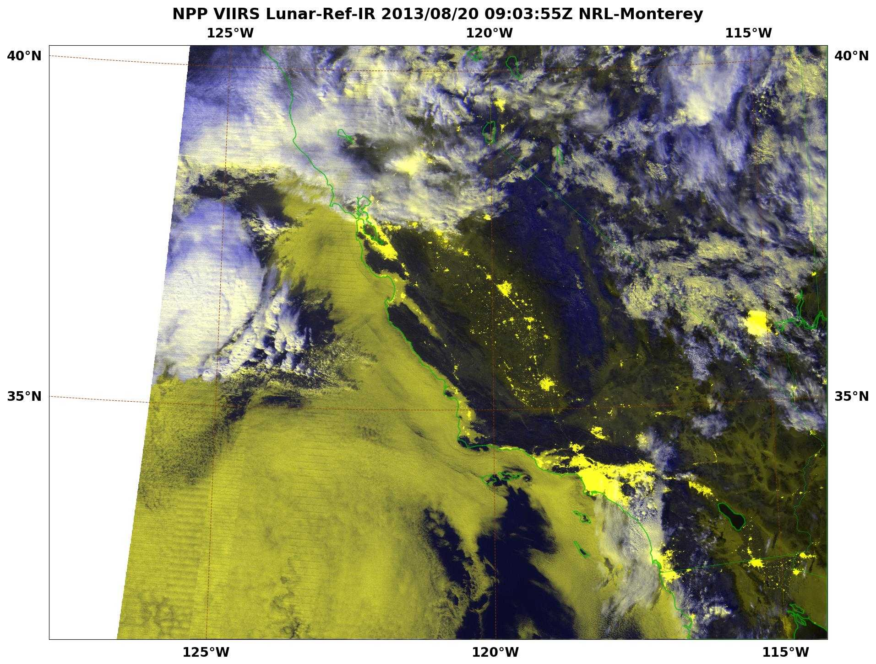
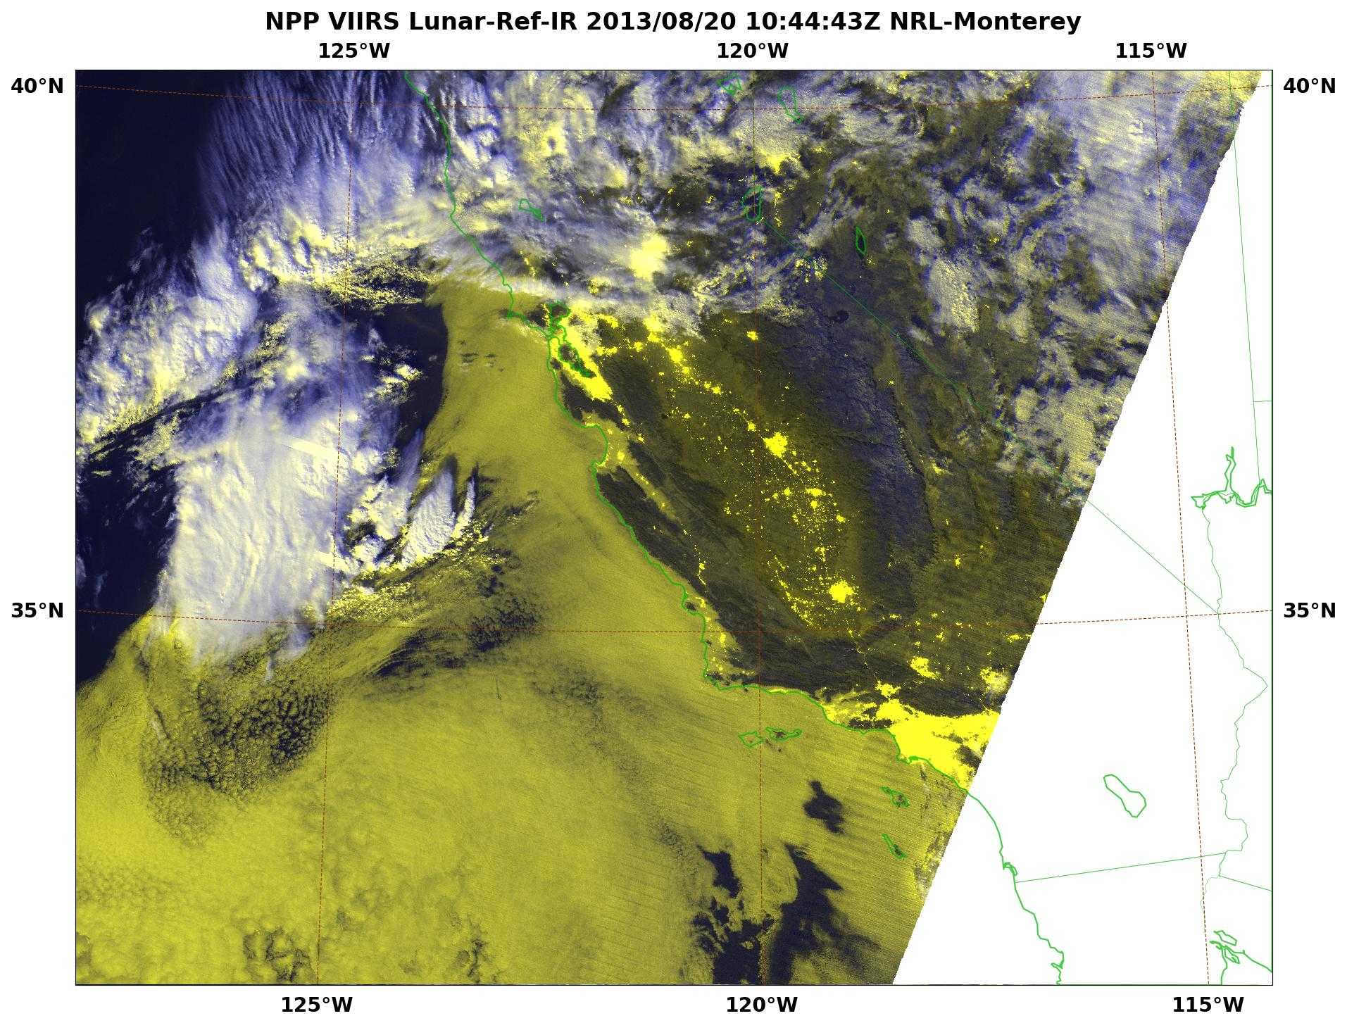
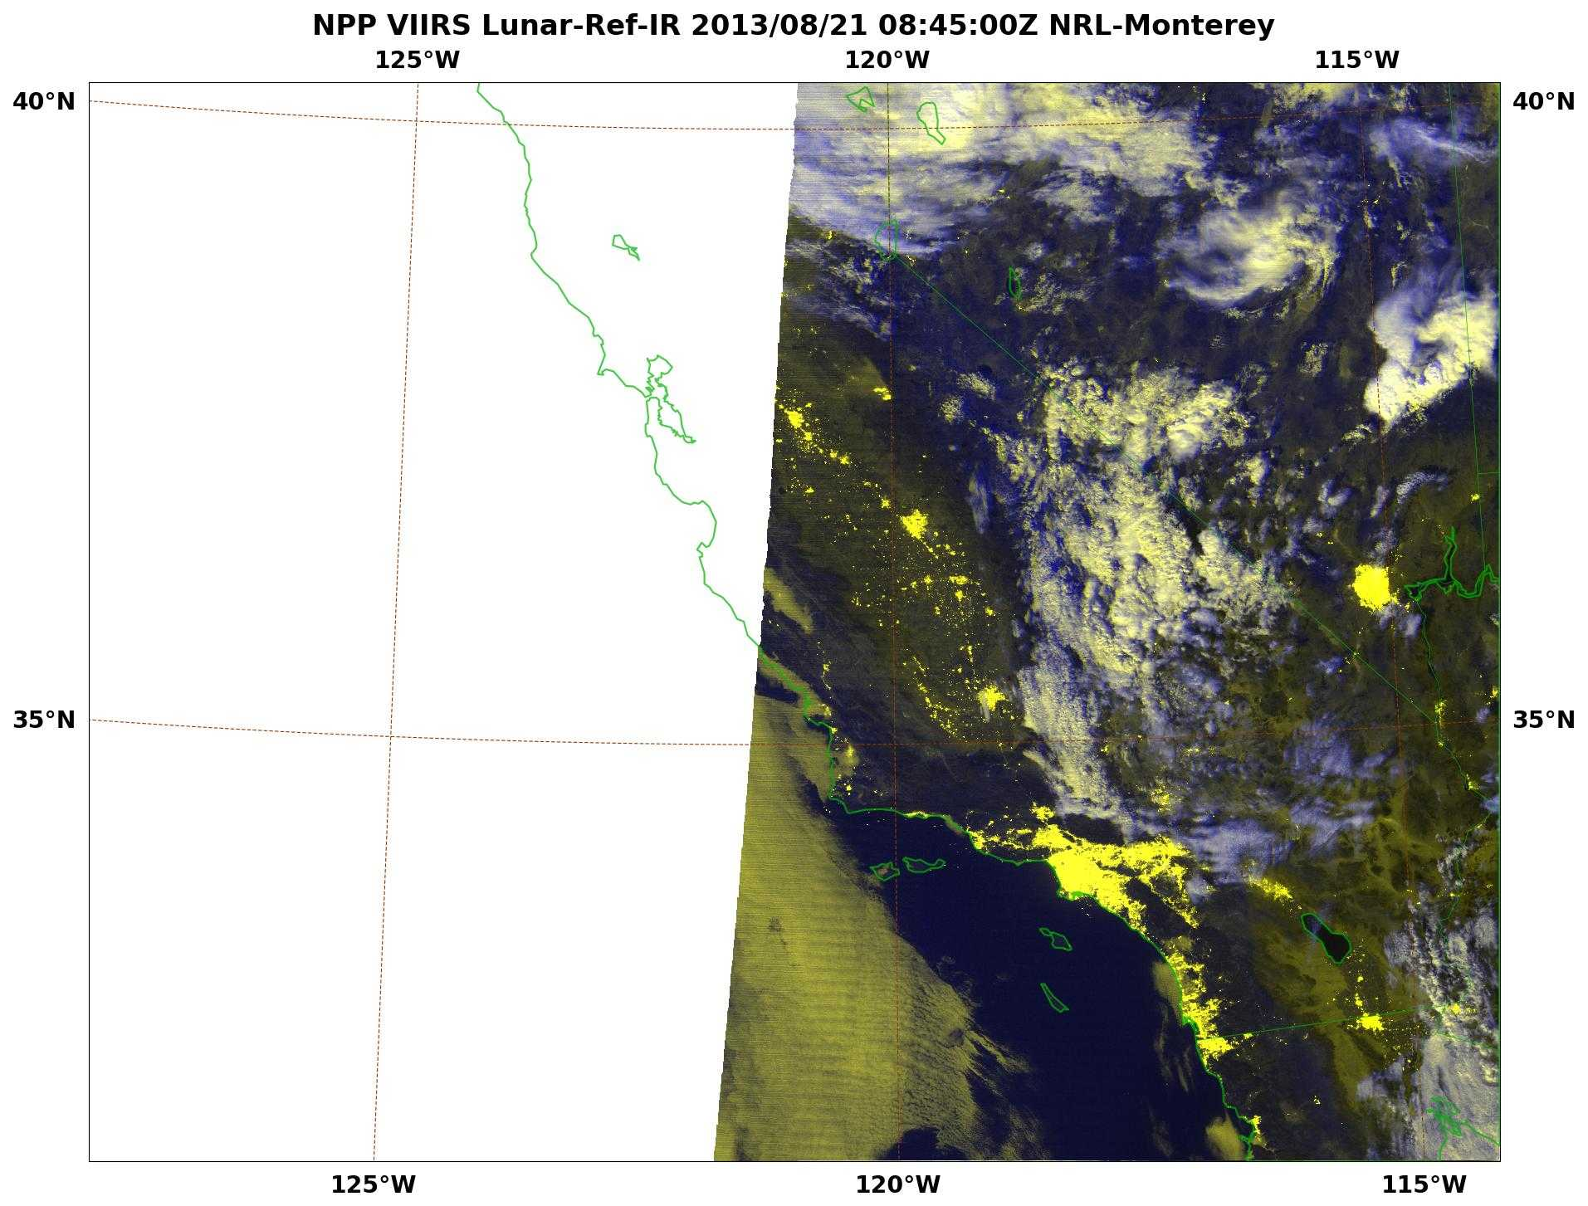
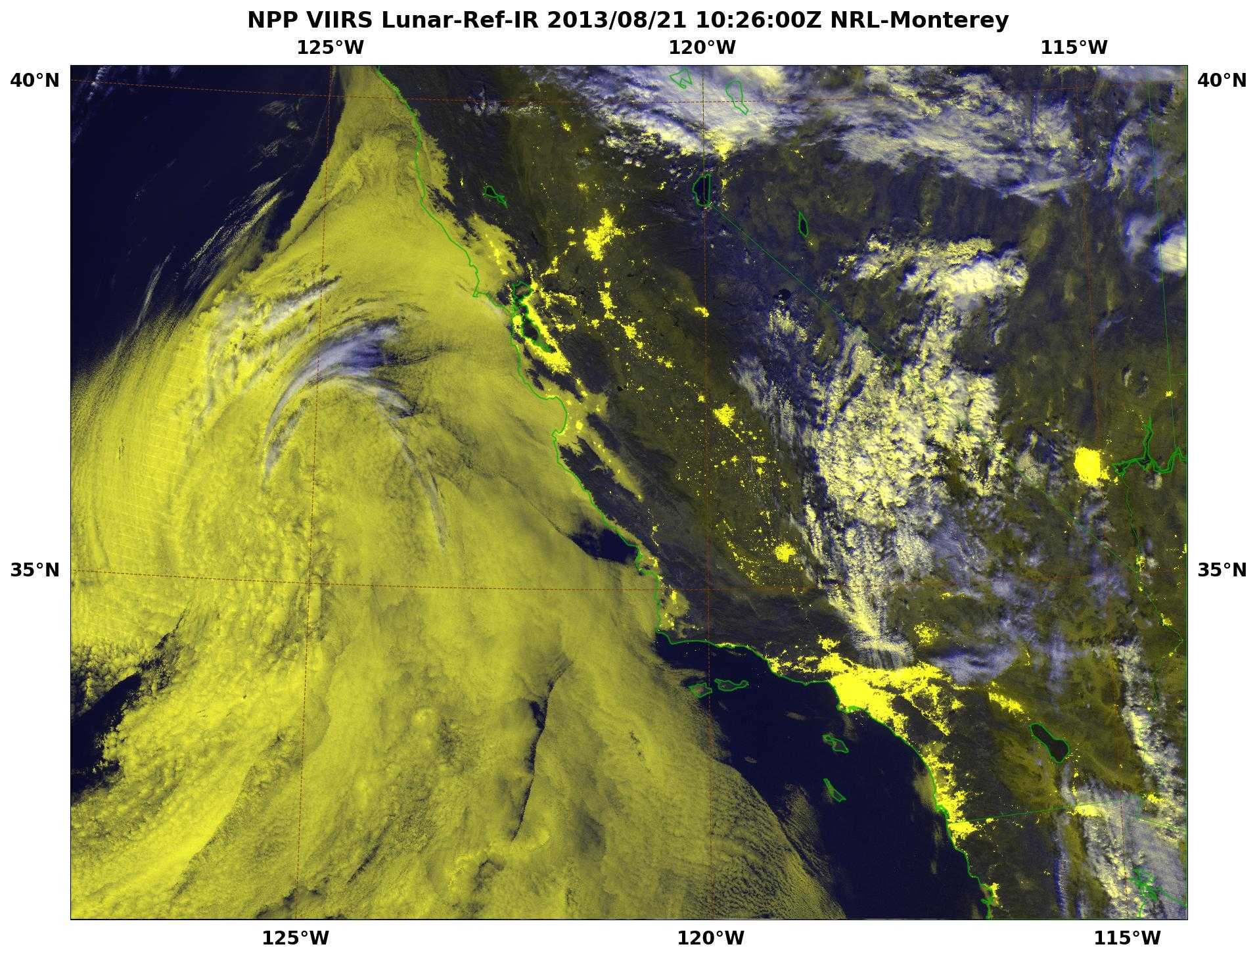
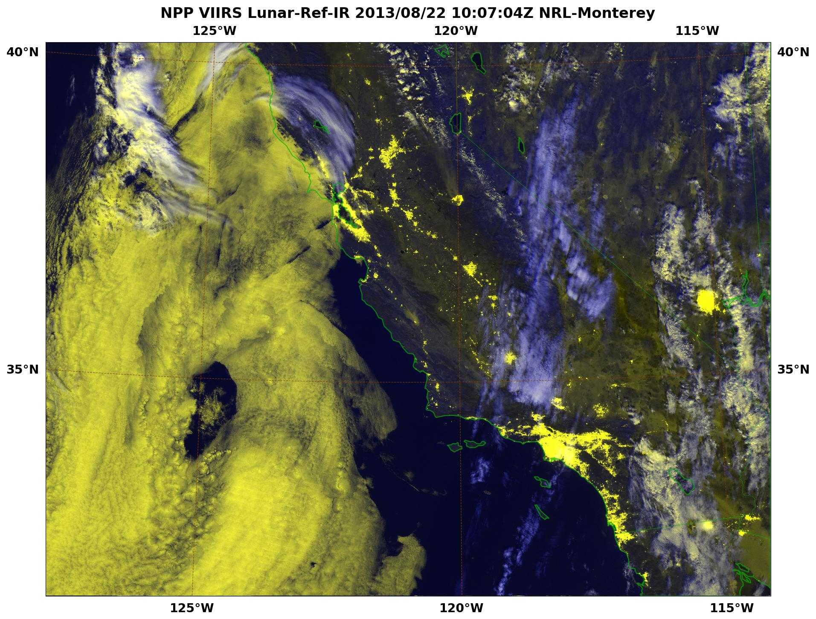
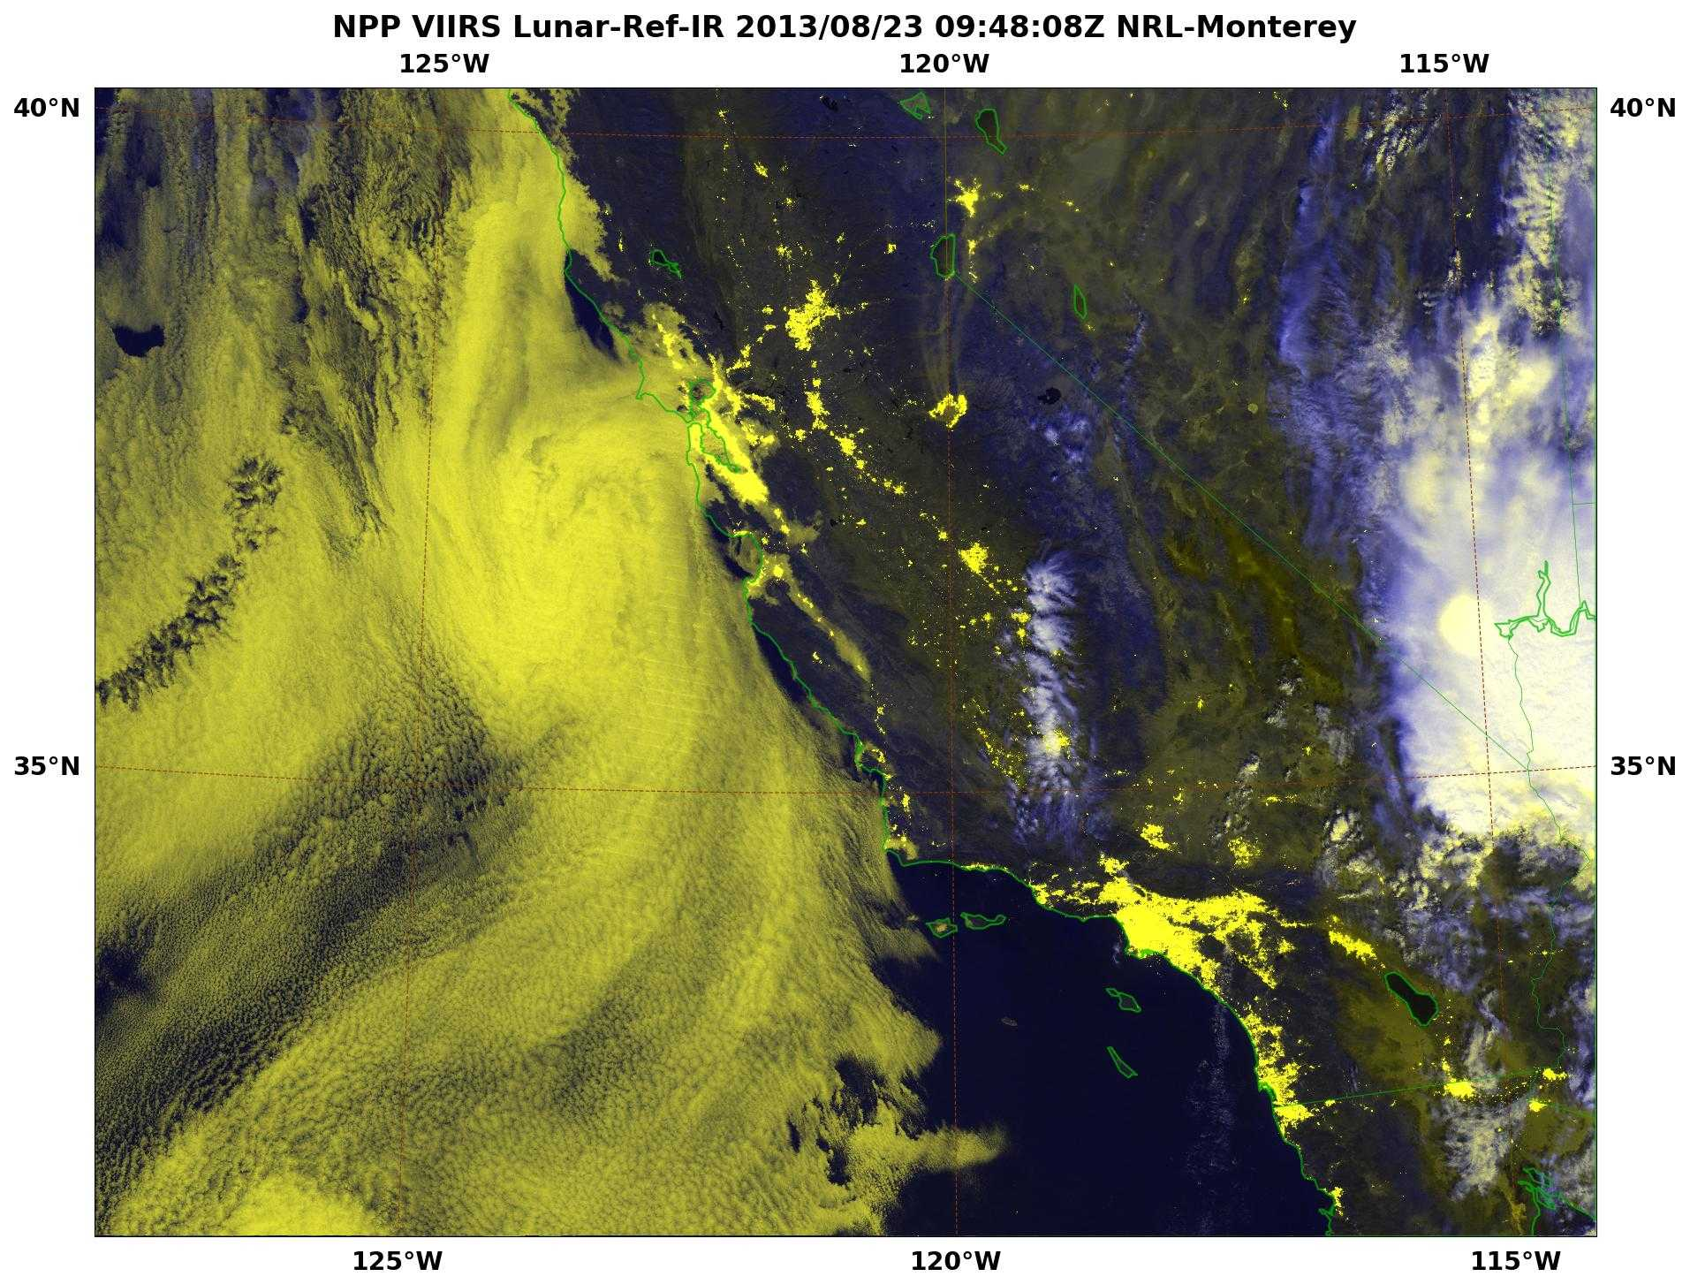
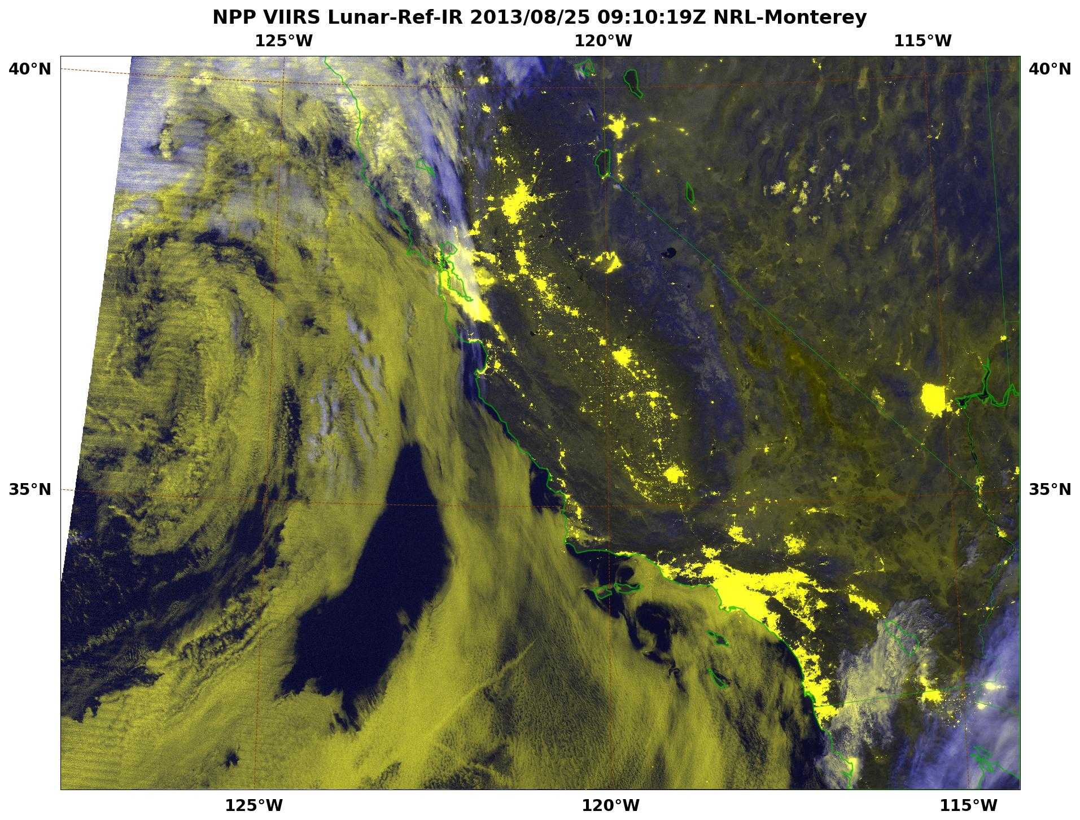
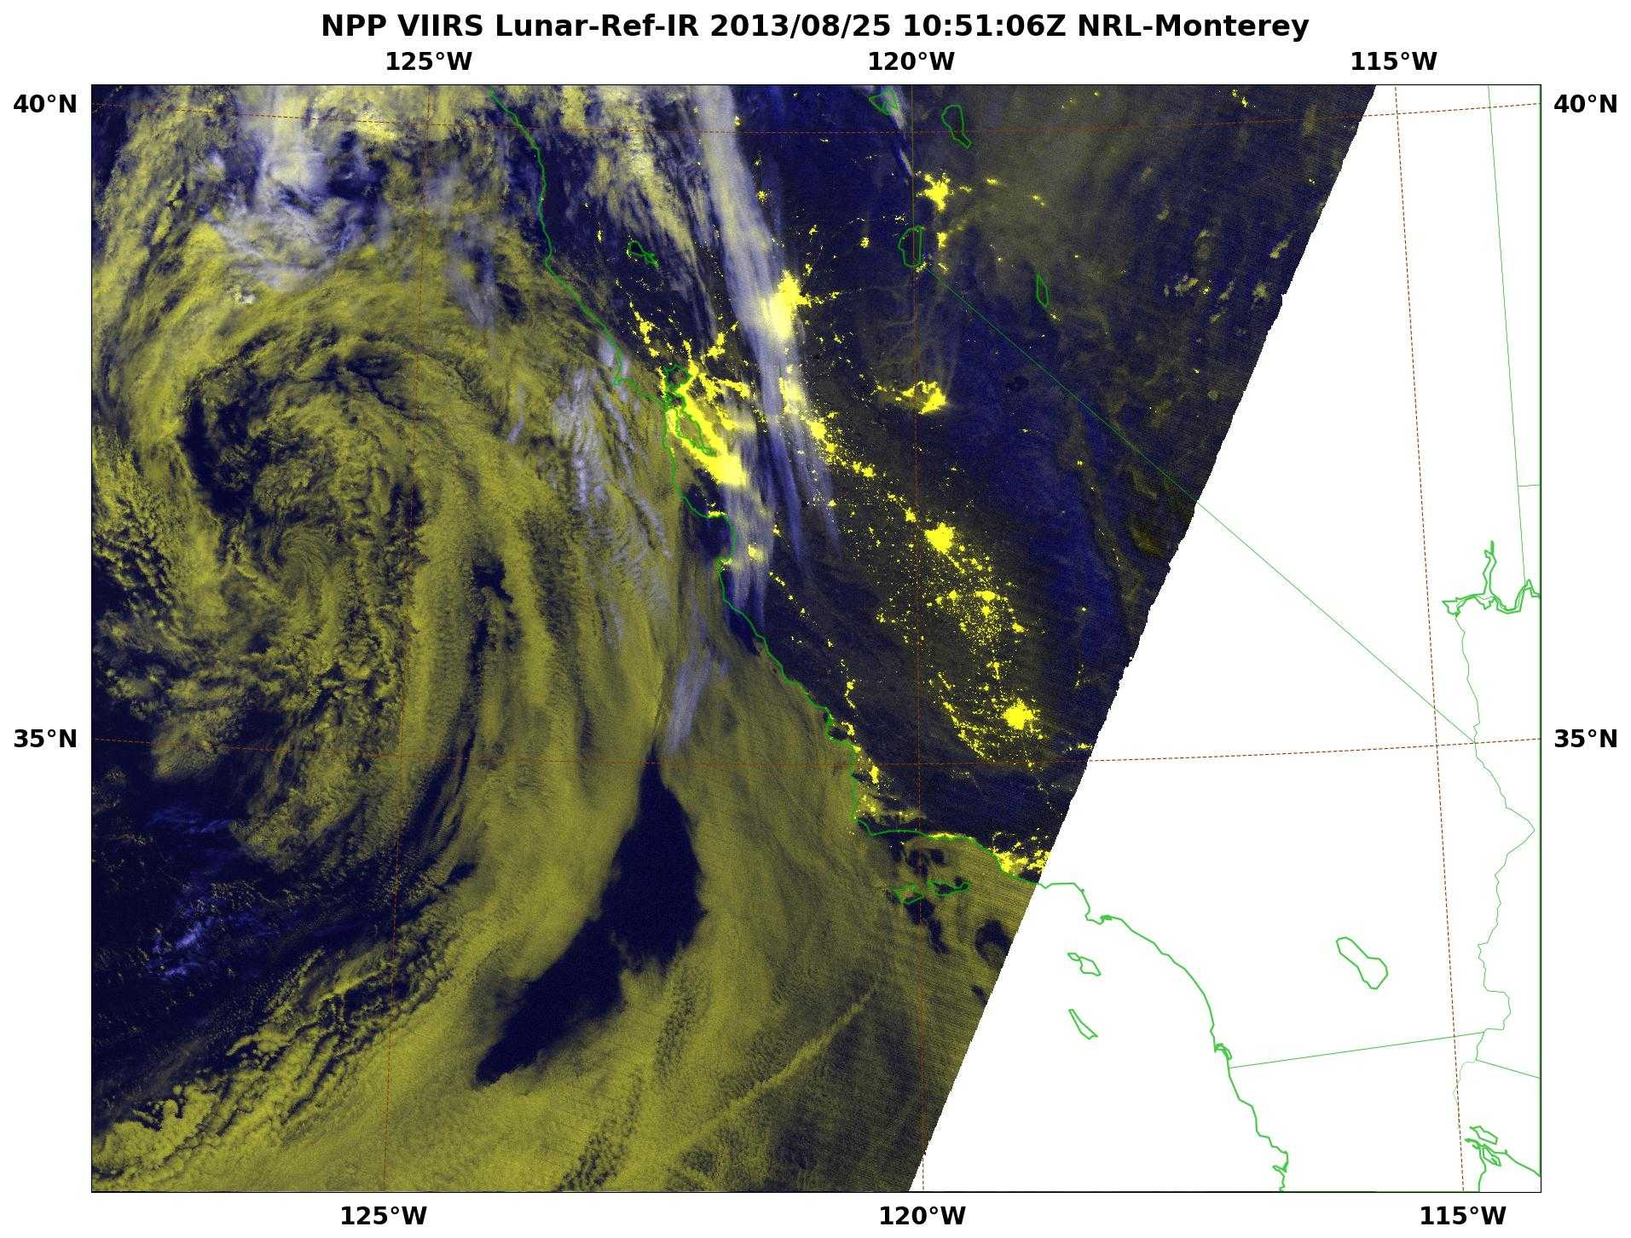
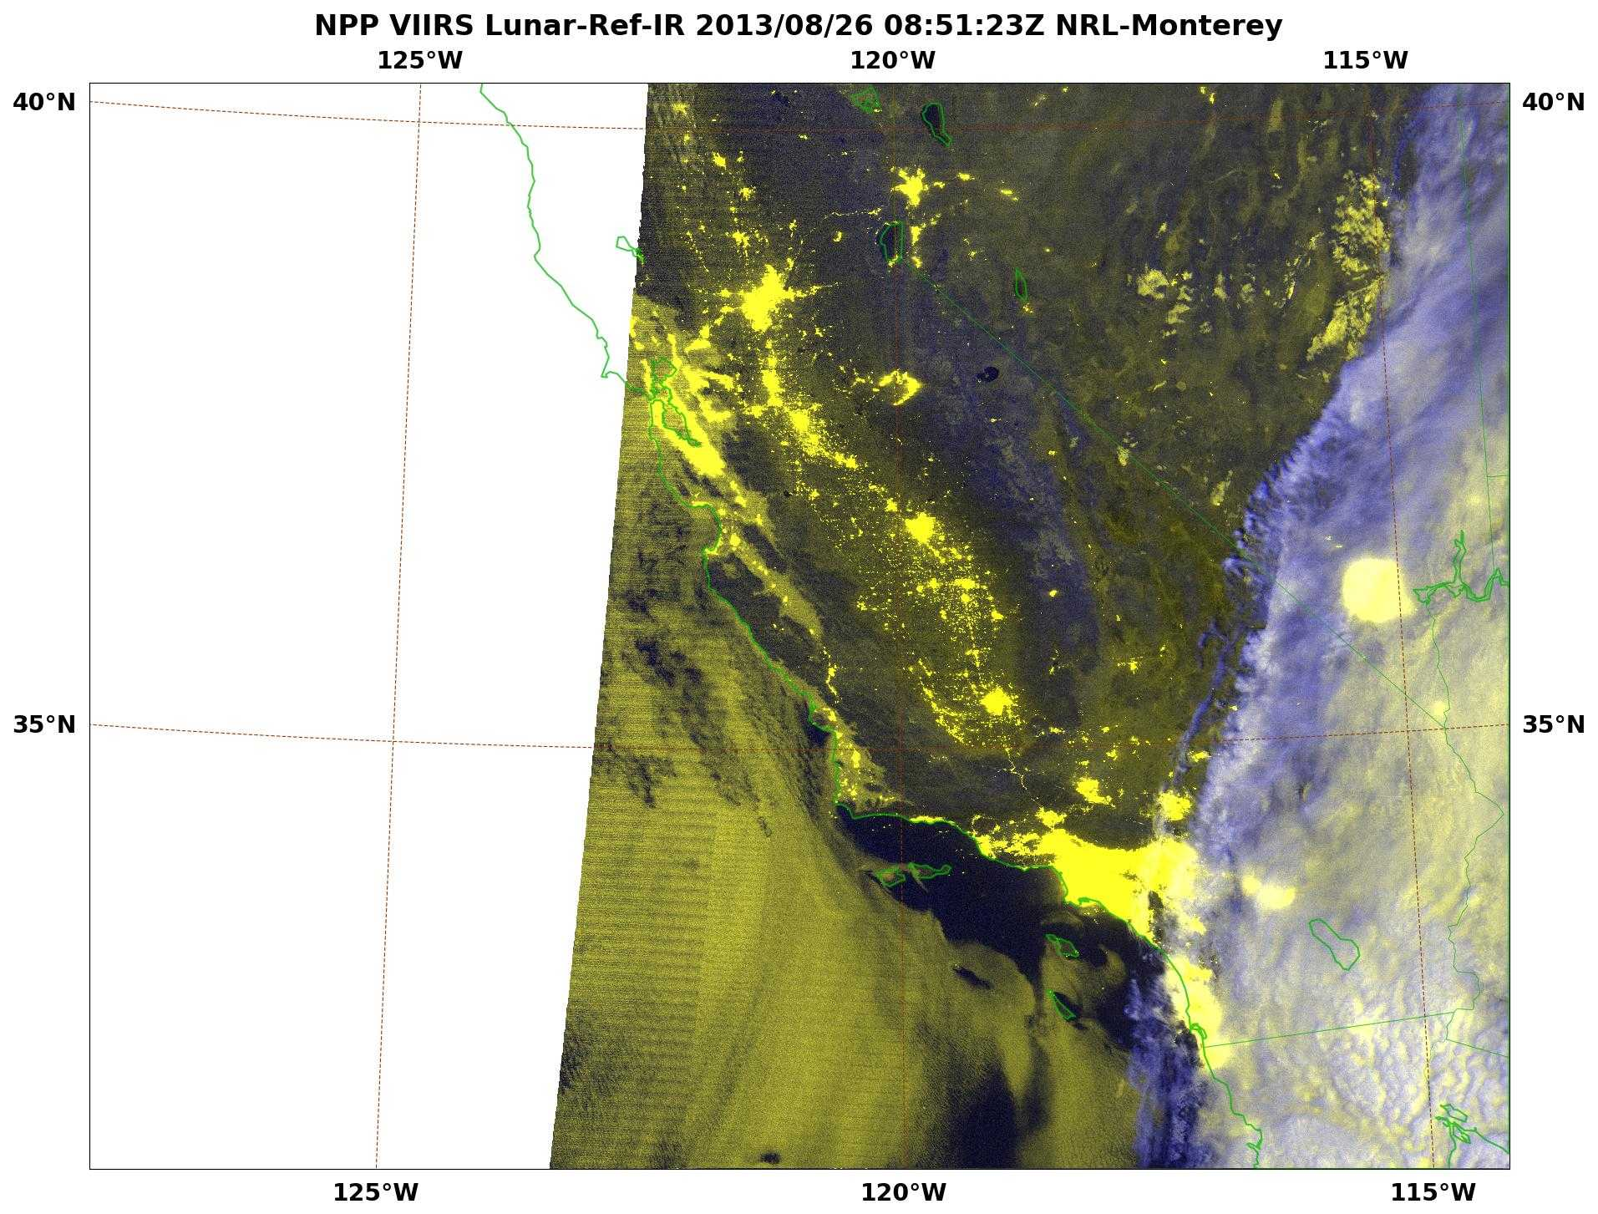
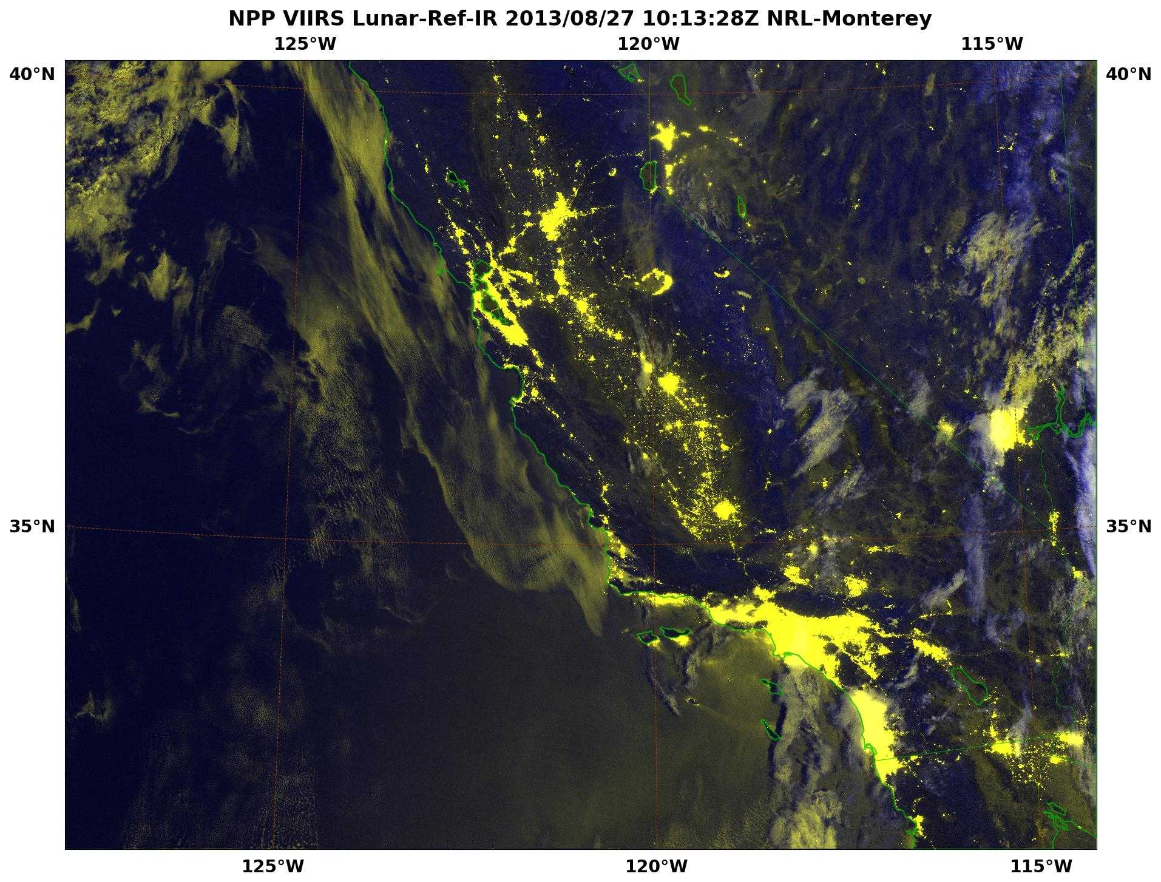
Tracking the Rim Fire at Night
VIIRS DNB + IR enhanced with Lunar Irradiance Model
18 – 27 August
Rim
Fire
Yosemite
Valley
Collaboration: Navy Aerosol Analysis & Prediction Team
Notes:
The S-NPP VIIRS DNB Imager allows for unprecedented views of hot spots illumination such as wildfires. This animation shows the dramatic increase in areal coverage since its onset.
Additionally, with lunar availability, smoke can be seen drifting northward from the source.
The Naval Research Laboratory in Monterey, CA (NRL-MRY) has been monitoring the massive Rim Fire that has entered the Yosemite National Forest. The following images Using products hosted on the NexSat and NRL-VIIRS webpages, the NexSat hosts VIIRS products. Many of the scenes for this presentation are obtained from products hosted within our west coast imagery.
Acknowledgements go out to the
Acknowledgments: Naval Research Laboratory, Marine Meteorology Division
Tom Lee, Jeremy Solbrig, Kim Richardson, Mindy Surratt, Arunas Kuciauskas, Rich Bankert, Jeff Hawkins, Steve Miller (CIRA), and John Kent (SAIC)
VIIRS data is provided by FNMOC via AFWA and CIMSS Peate via NOAA CLASS.

Slide 12
Comparing Nighttime Visible Products
23 Aug
DMSP-OLS 04:29Z
VIIRS-DNB 09:48Z
Notes:
Taking even the best selection of the DMSP OLS low light sensor still does not compare to the sharpness of the fire center and the associated smoke plume.
Acknowledgments: Naval Research Laboratory, Marine Meteorology Division
Tom Lee, Jeremy Solbrig, Kim Richardson, Mindy Surratt, Arunas Kuciauskas, Rich Bankert, Jeff Hawkins, Steve Miller (CIRA), and John Kent (SAIC)
VIIRS data is provided by FNMOC via AFWA and CIMSS Peate via NOAA CLASS.

Slide 13
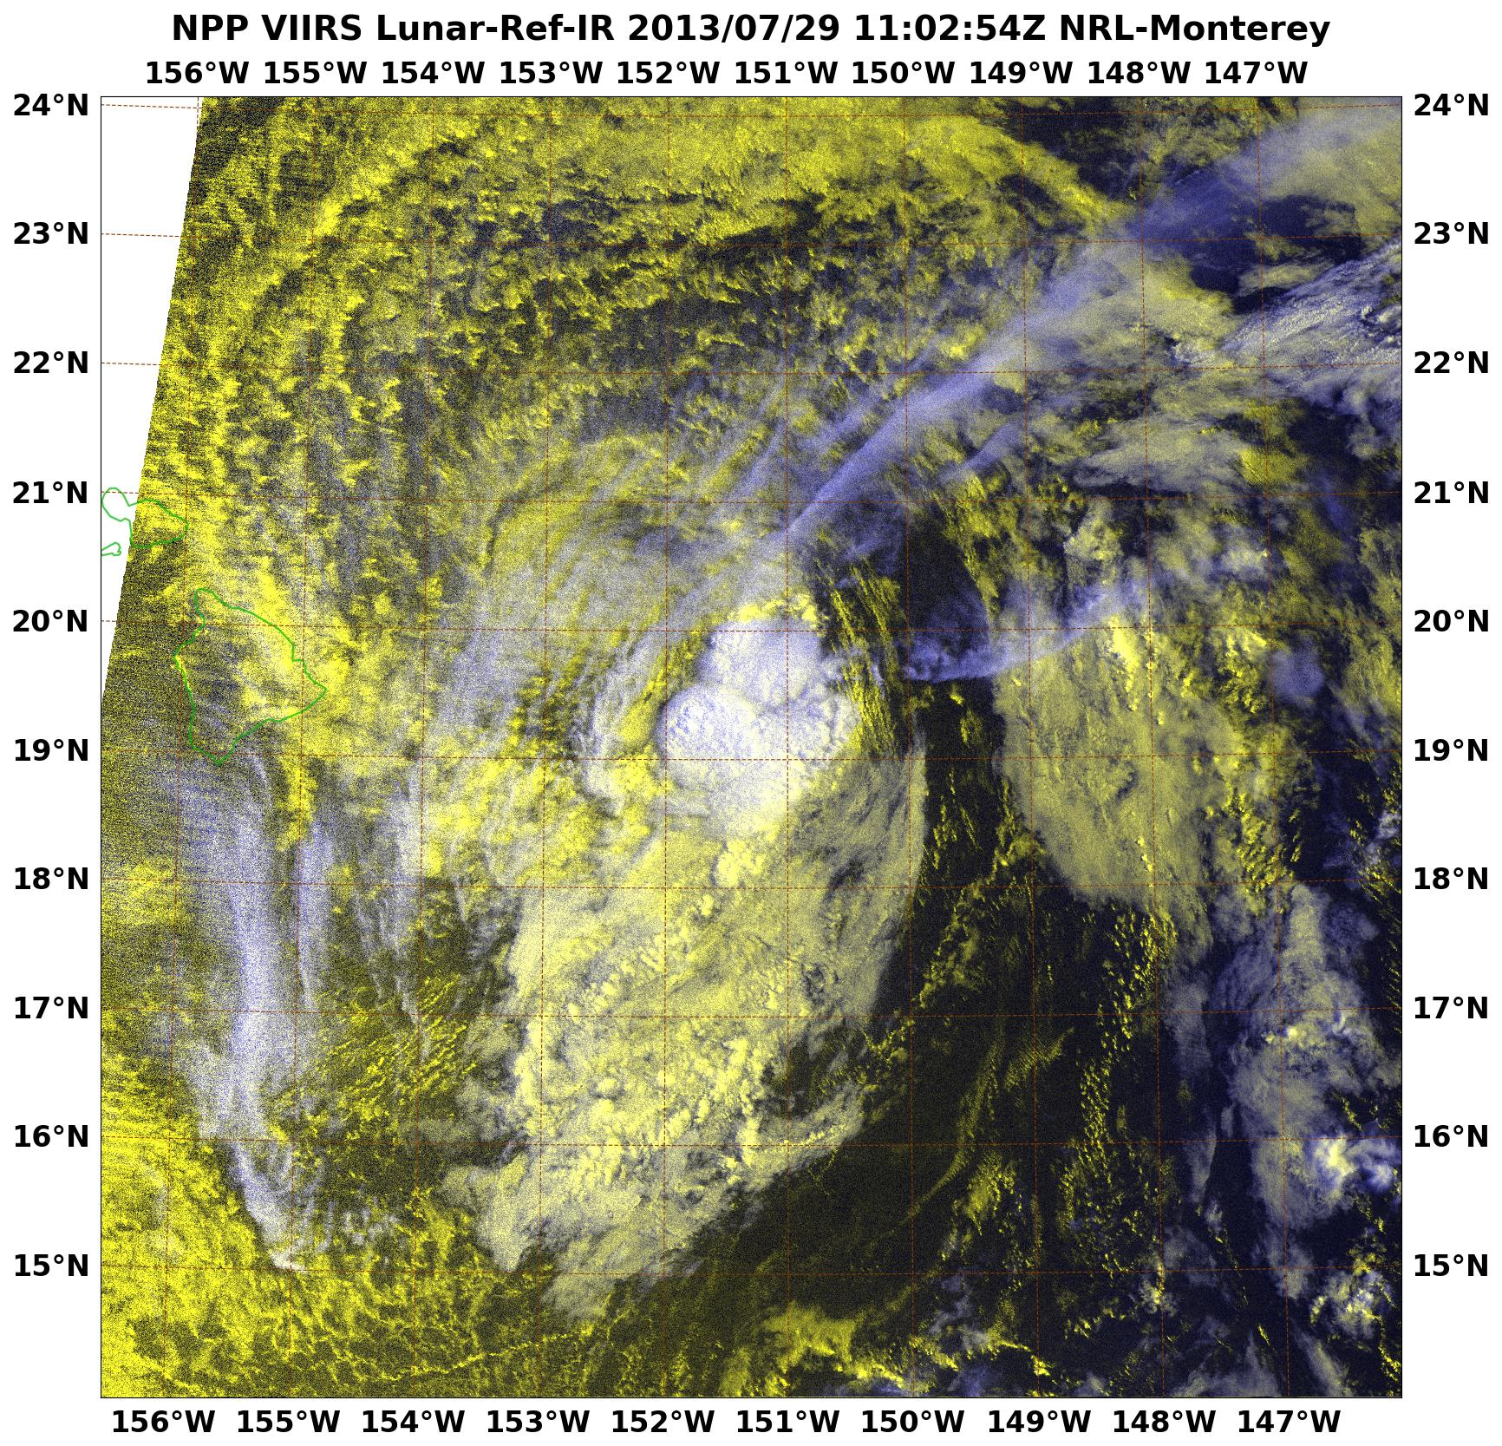
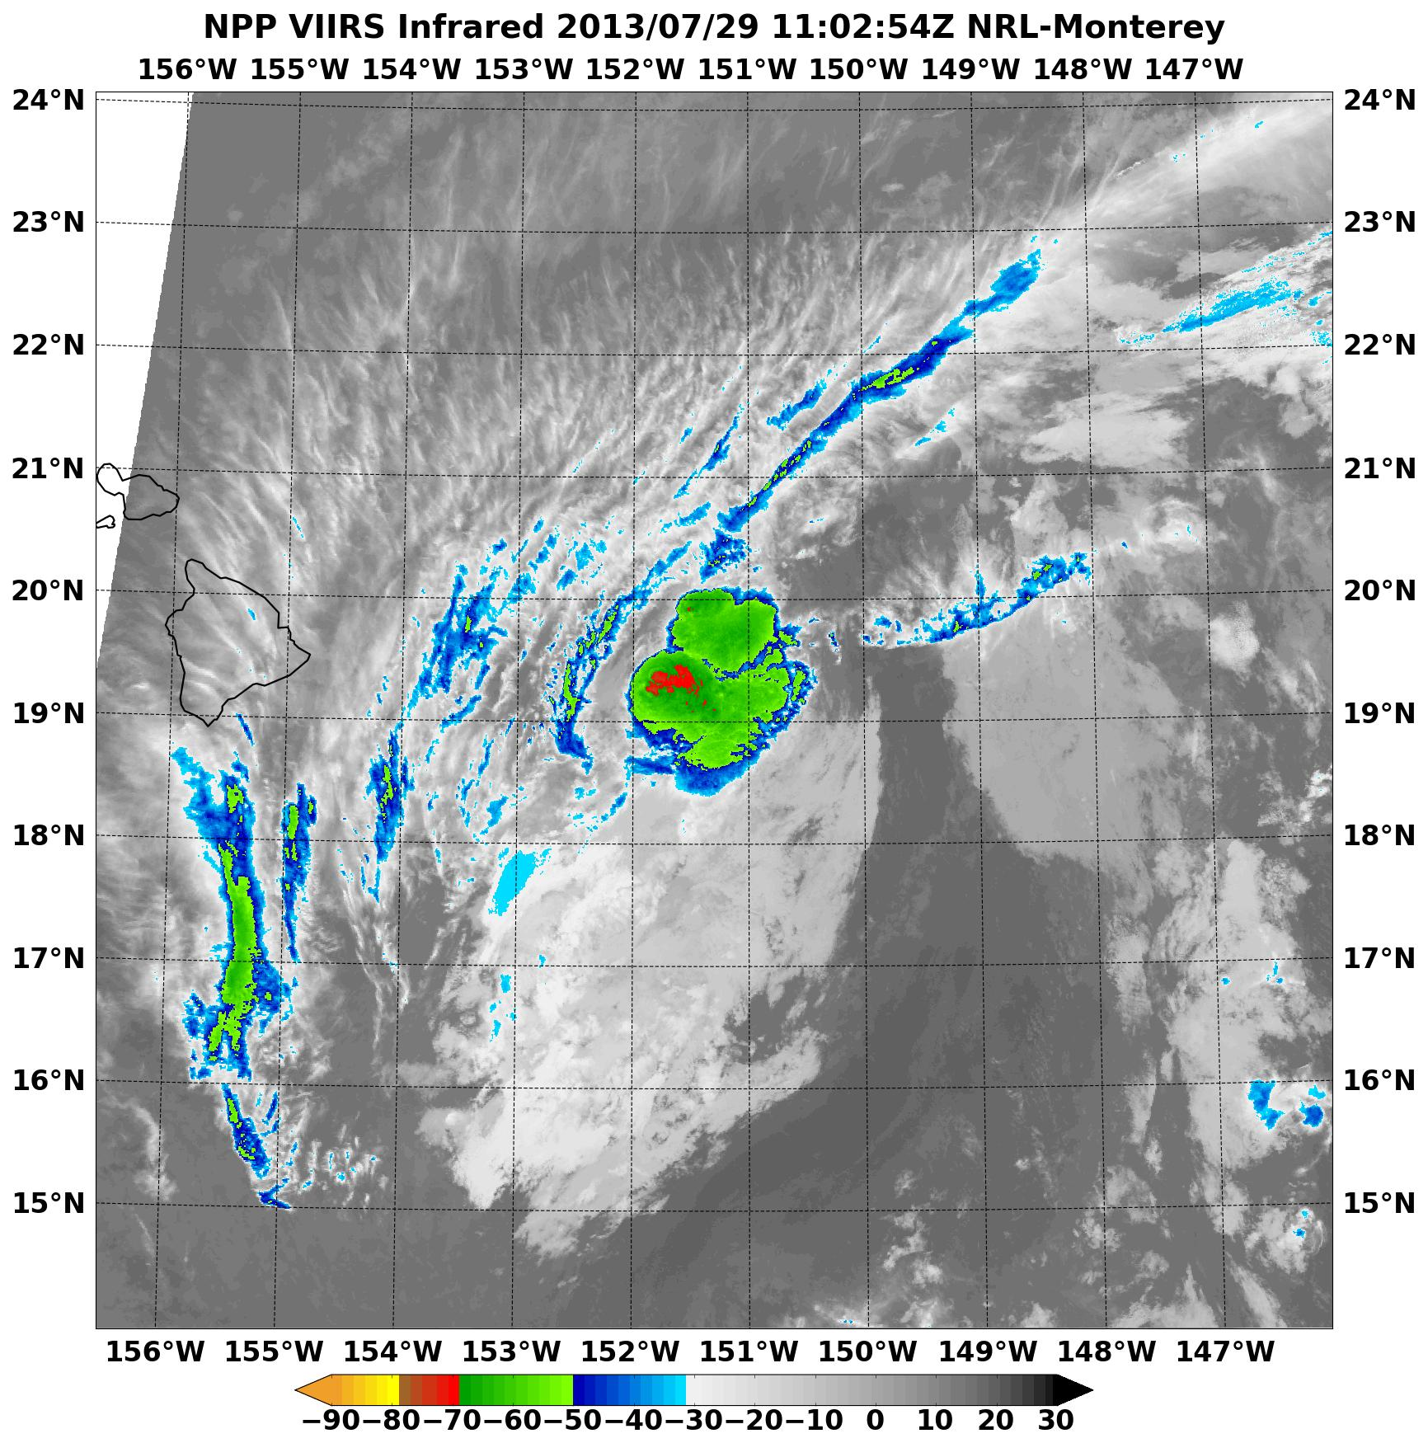
Nighttime TC Monitoring Via DNB
VIIRS DNB reflectance + IR reveals LLCC displaced ~60 nm from IR convection center
Maui
60 nm
Hawaii
CPHC Warning :
Relocated TS Flossie center fix well north
Landfall no longer on island of Hawaii
Revised track now impacts area along northern coasts
Collaboration: Joint Typhoon Warning Center
Notes:
Tropical Storm Flossie was relocated ~ 60 nm north on July 29, 2013 at 12Z due to VIIRS DNB imagery clearly revealing the low level circulation center (LLCC) had become separated from the IR convective center of mass (mid-upper level). Instead of heading towards the Big Island of Hawaii, Flossie was now headed further north along the northern edge of the Hawaiian islands and posed a much smaller threat since they would be on the southern (weaker) side of the slowly weakening storm.
Acknowledgments: Naval Research Laboratory, Marine Meteorology Division, Monterey, CA
Jeremy Solbrig, Mindy Surratt, Steve Miller, Kim Richardson, Jeff Hawkins, Buck Sampson, and John Kent

Slide 14
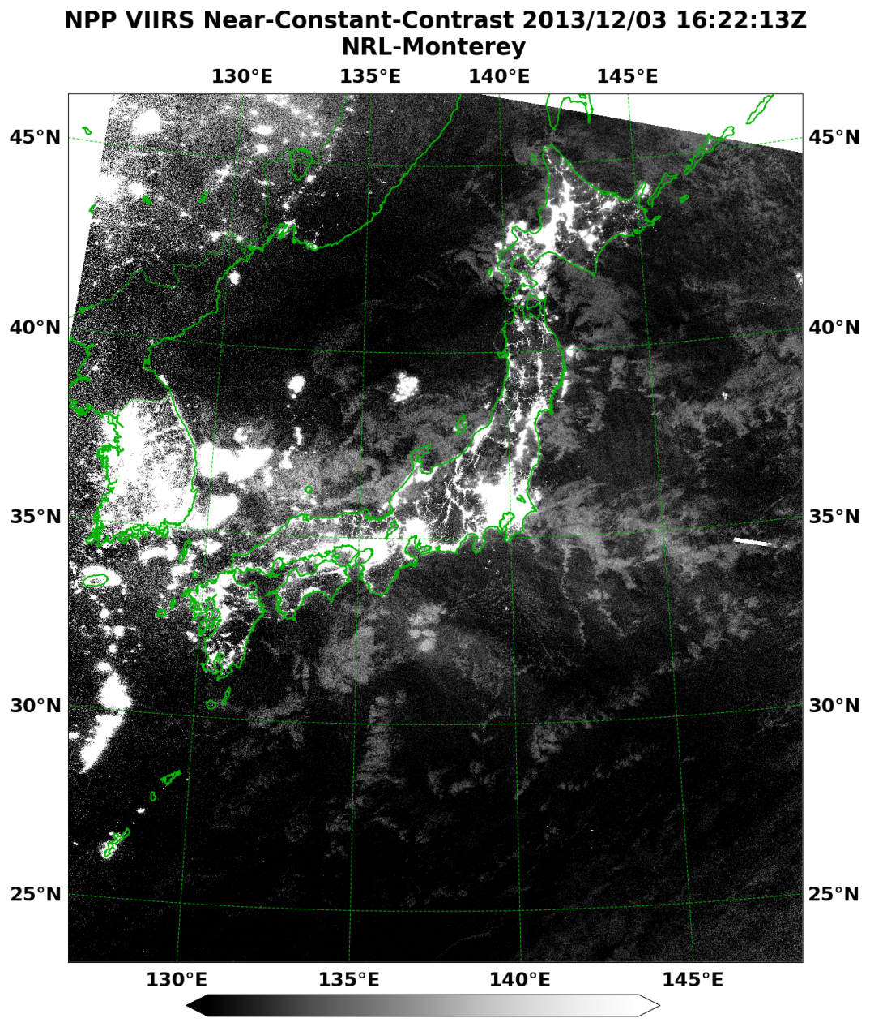
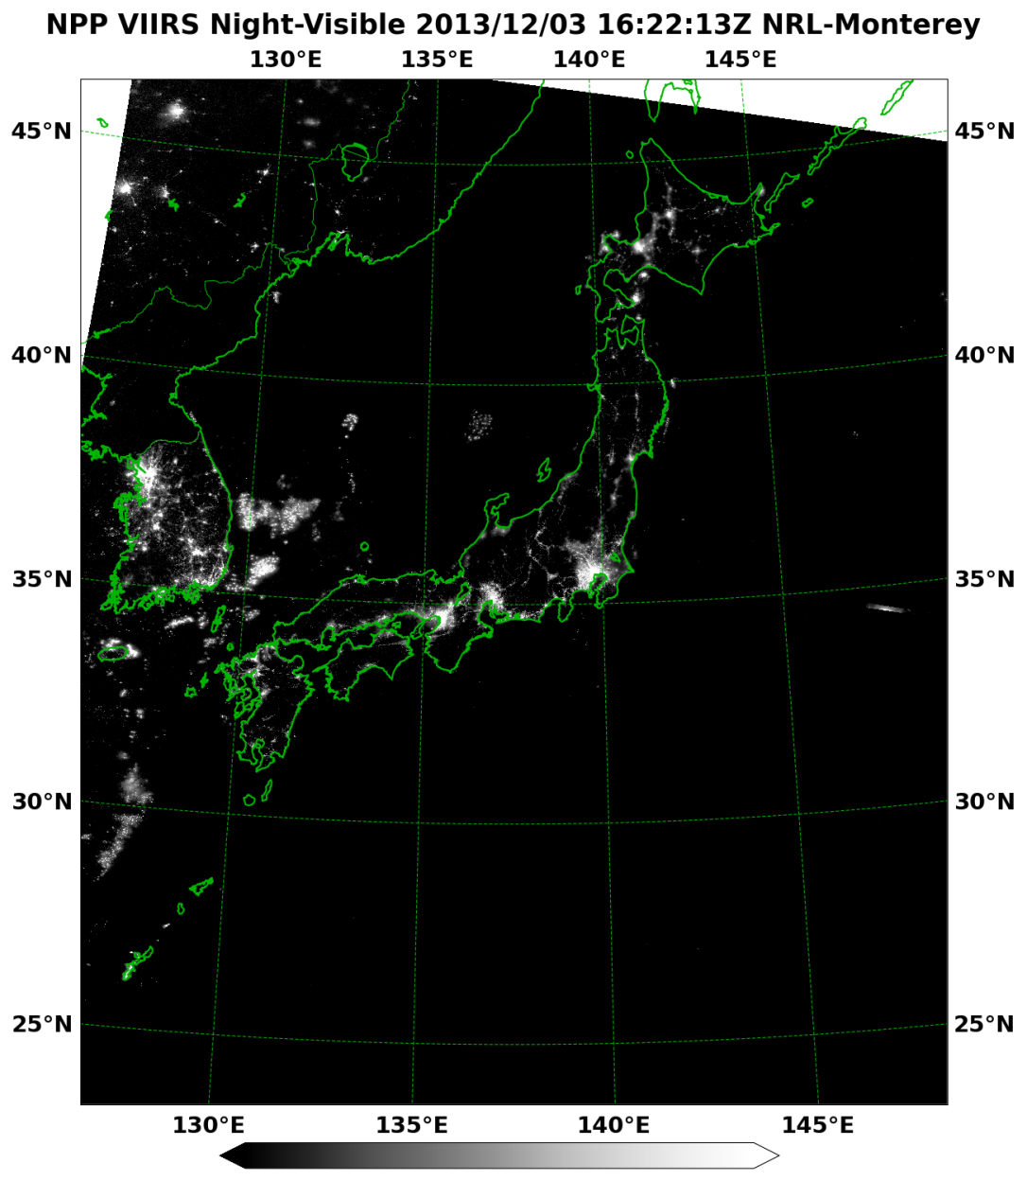
VIIRS Near Constant Contrast (NCC)
Contrast enhancement for cloud detection under faint illumination
Take advantage of highly variable air glow opportunities
Notes:
Example of near constant contrast (NCC) VIIRS DNB imagery in comparison with the corresponding DNB product. Note the ability to see some cloud structure due to the presence of air glow (no moon is up at this time).
NRL- Naval Research Laboratory, Marine Meteorology Division, Monterey, CA (NRL-MRY):
Jeremy Solbrig, Jeff Hawkins, Arunas Kuciauskas, Mindy Surratt, Kim Richardson, Rich Bankert, and Tom Lee
CSU/CIRA: Steve Miller

Slide 15
VIIRS Reflectances vs NCC
1. Better land surface details in the desert SW.
2. Improved cloud detail and contrast of clouds with land/ocean backgrounds.
3. Moonglint region--better illustration of the island wake calm waters (SE of
Catalina Island) for surface wind speed and direction inference.
4. Not only is it a nice image, but it's *quantitative* information which can be
translated into various physical properties like cloud optical depth.
Notes:
Note multiple enhancements of NRL lunar model reflectances versus the NCC product for a night time scene off CA coast.
NRL- Naval Research Laboratory, Marine Meteorology Division, Monterey, CA (NRL-MRY):
Jeremy Solbrig, Jeff Hawkins, Arunas Kuciauskas, Mindy Surratt, Kim Richardson, Rich Bankert, and Tom Lee
CSU/CIRA: Steve Miller

Slide 16
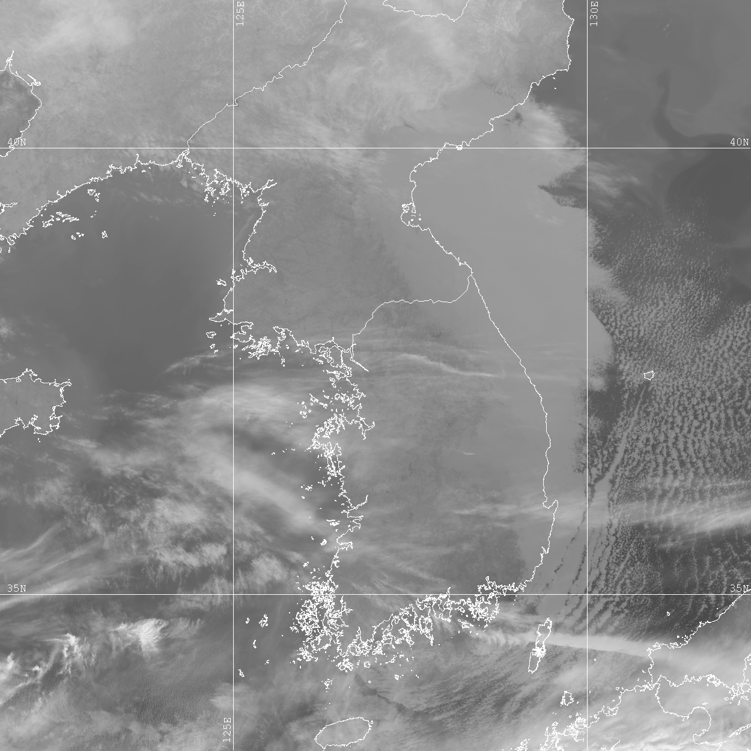
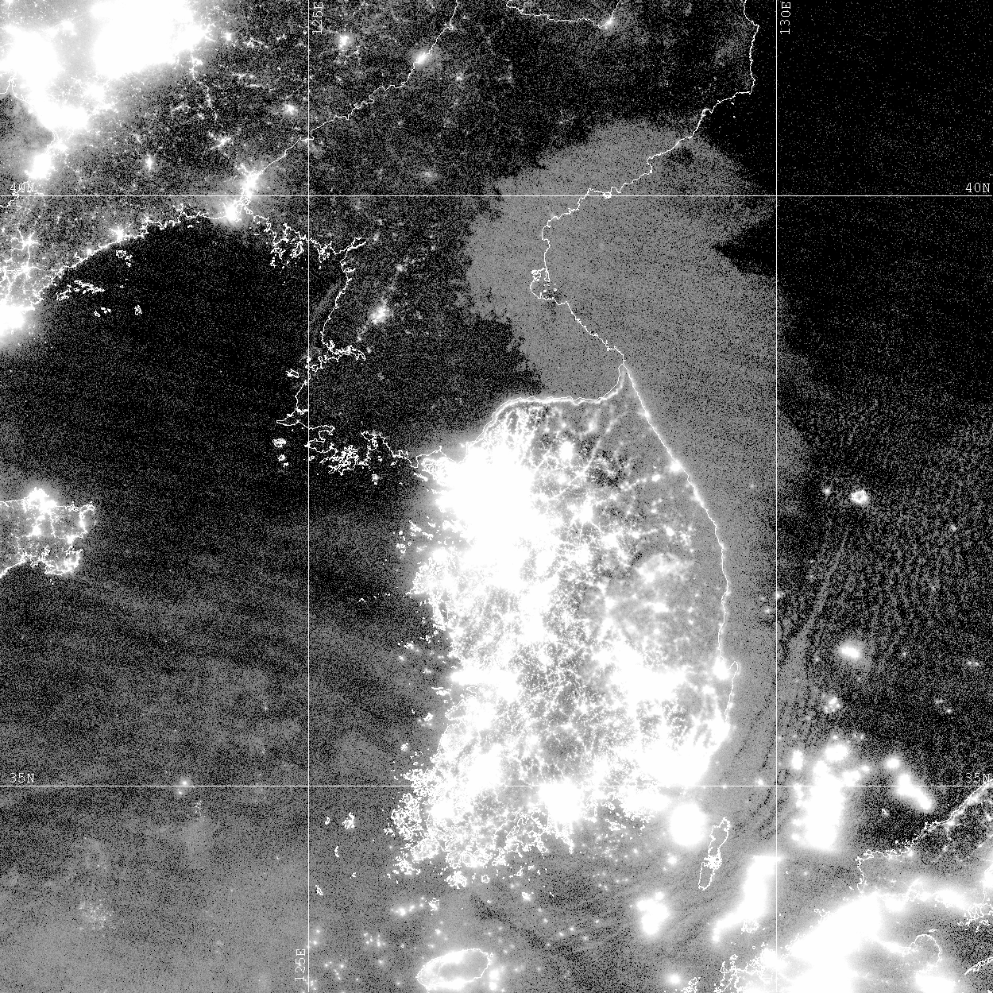
Low Clouds & Fog Detection
Feb 23, 2012
Low Cloud Deck
Boundary
Airglow provides sufficient illumination to “light up” low clouds
Korean
Peninsula
City lights
Fishing
boats
Day/Night Band
Thermal Infrared
Collaboration: Fleet Numerical & Meteorology Center
Notes:
Nighttime low clouds are frequently very difficult to discern over cold land surfaces due to the small thermal contrast between cloud top temperatures and land. However, using the SNPP VIIRS DNB data set and airglow illumination reflection off the tops of the low clouds, we can clearly detect the boundaries of low clouds over the Korean littoral zone (both land and water).
Acknowledgments: Naval Research Laboratory, Marine Meteorology Division, Monterey, CA
Jeremy Solbrig, Mindy Surratt, Steve Miller (CIRA), Kim Richardson, Jeff Hawkins, Arunas Kuciauskas, and John Kent (SAIC)

Slide 17
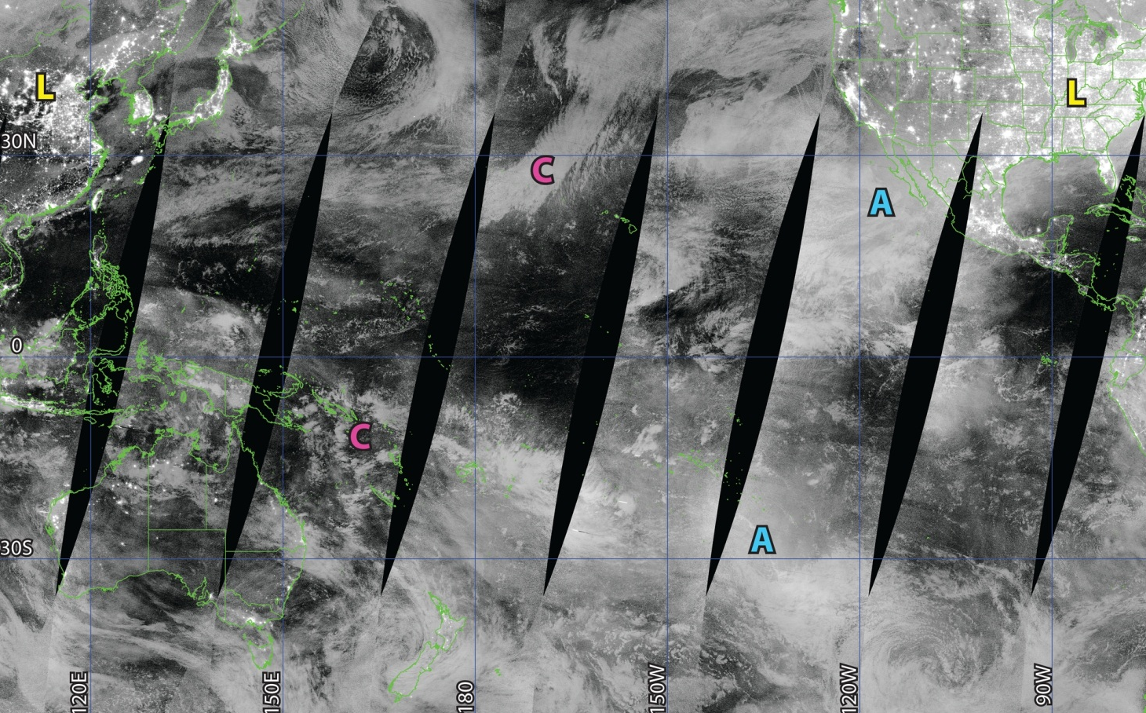
~1:30 AM Pacific: New Moon
Feb 22, 2012
Courtesy: S. Miller, CSU/CIRA
Notes:
Clouds over the Pacific Ocean are visible due to illumination not from the moon (moon is below the horizon), but due to night glow from the mesosphere.
Acknowledgments: Steve Miller (CIRA)

Slide 18
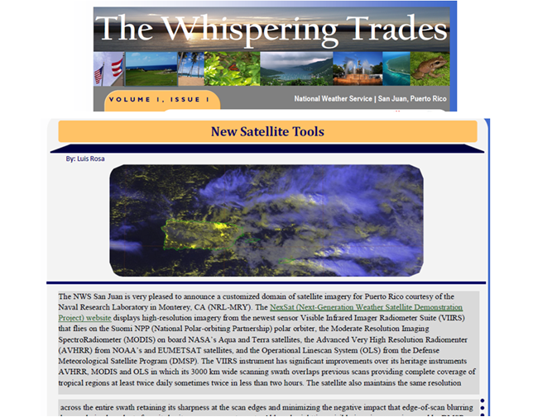
Outreach: Puerto Rico NWS Support
Collaboration: NWS Puerto Rico
Notes:
NexSat has added a Puerto Rico sector in an effort to make near real-time VIIRS products available to the Puerto Rico NWS office. The inherent advantages of VIIRS and increased temporal sampling (in addition to MODIS) of high resolution multi-channel imagery is used DAILY.
NRL- Monterey: Arunas Kuciauskas, Jeremy Solbrig, Mindy Surratt, Jeff Hawkins, Steve Miller (CIRA), Rich Bankert, Kim Richardson, John Kent (SAIC)
Naval Research Laboratory’s Marine Meteorology Division (Monterey, CA)

