Slide 1
Introduction to NCC in AWIPS VISIT Satellite Chat (18 Dec 2015)
Curtis Seaman, CIRA
Dan Lindsey, NOAA

Slide 2
What is NCC?
Near Constant Contrast (NCC) is a way to display VIIRS Day/Night Band (DNB) imagery in AWIPS
Converts DNB radiance to “pseudo-albedo” to provide visible imagery at night
CONS: not a true albedo like DNB Lunar Reflectance product; values vary throughout lunar cycle
PROS: Operationally supported by JPSS Program; provides some value even when there is no moonlight

Slide 3
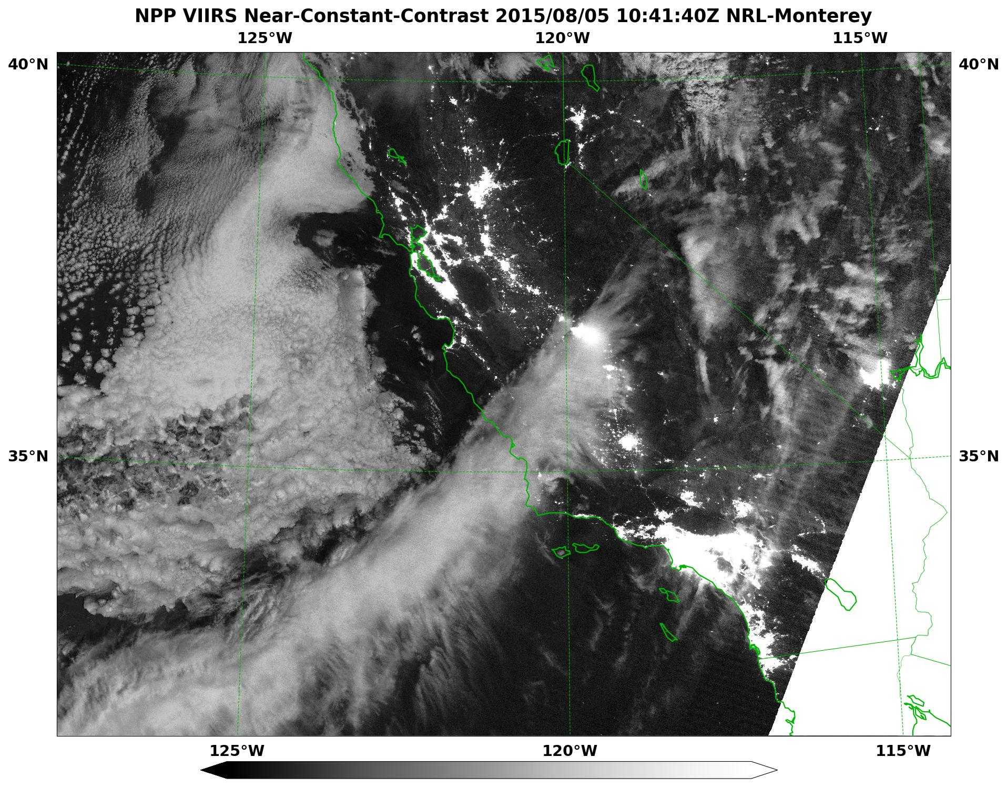
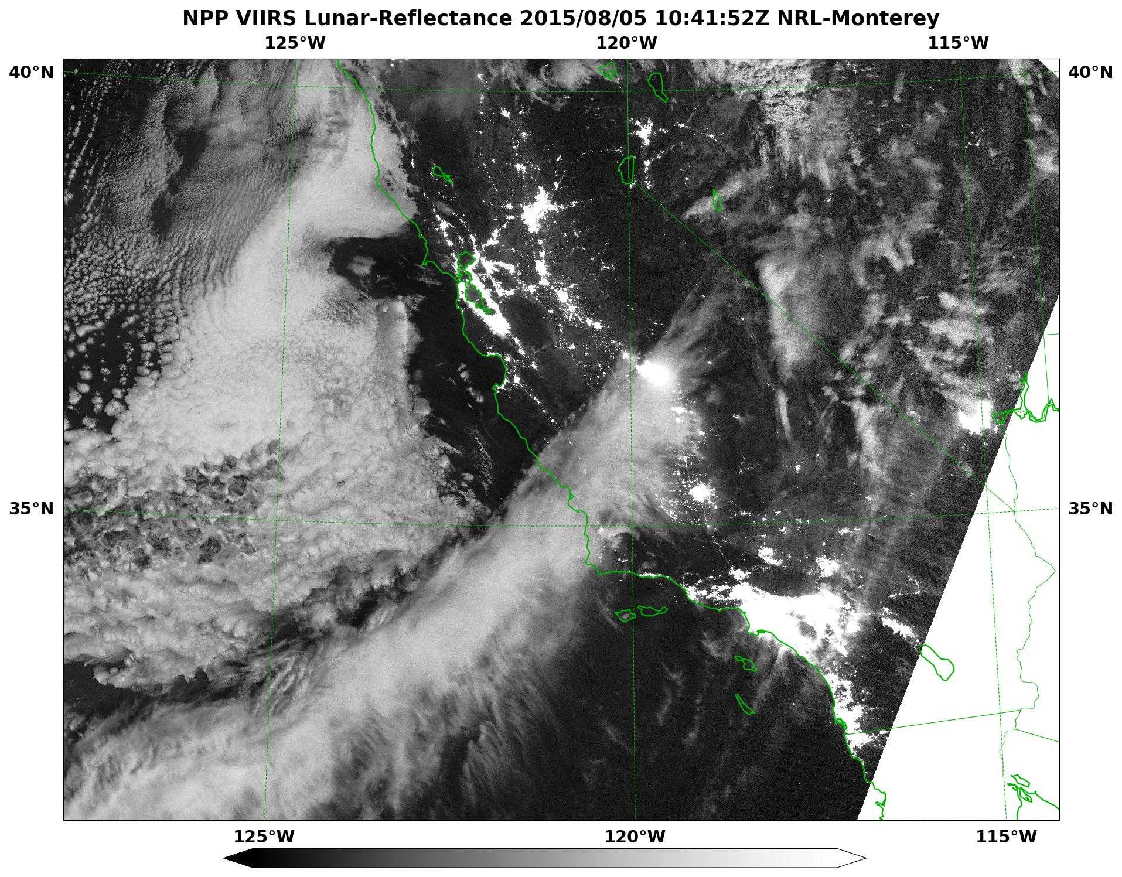
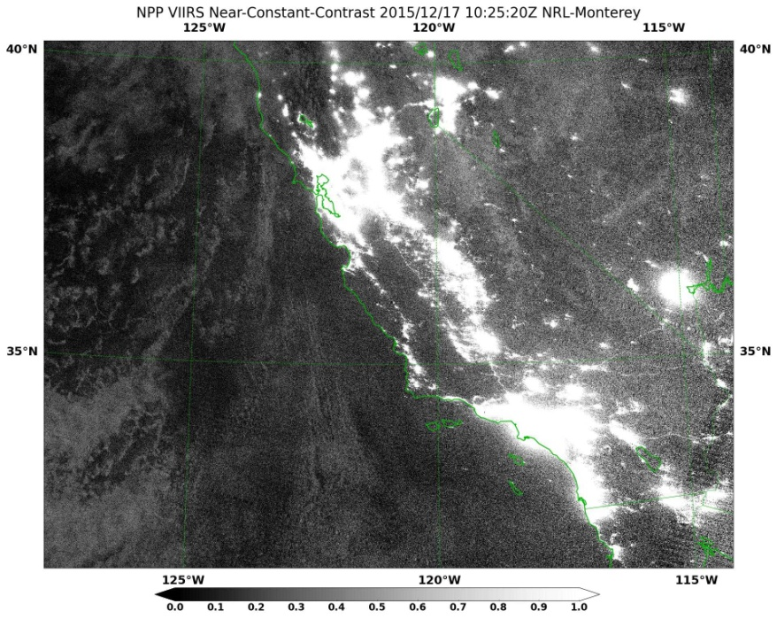
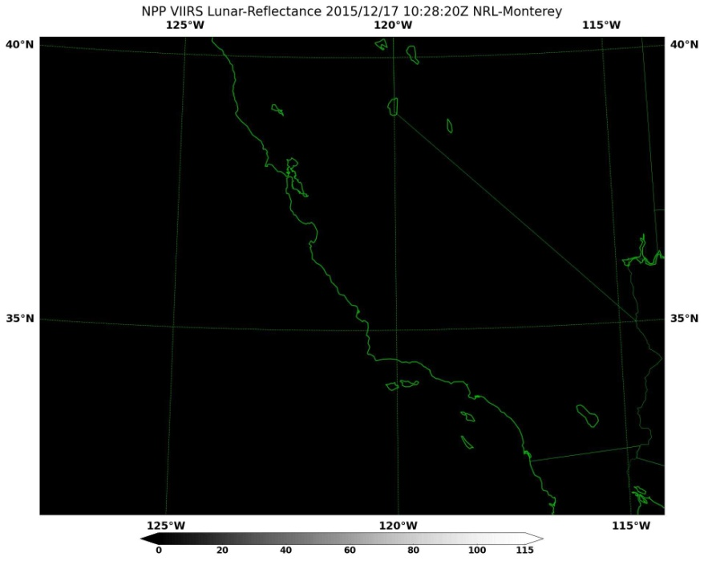
NCC vs DNB Lunar Reflectance
Moon above horizon
ü
Moon below horizon

Slide 4
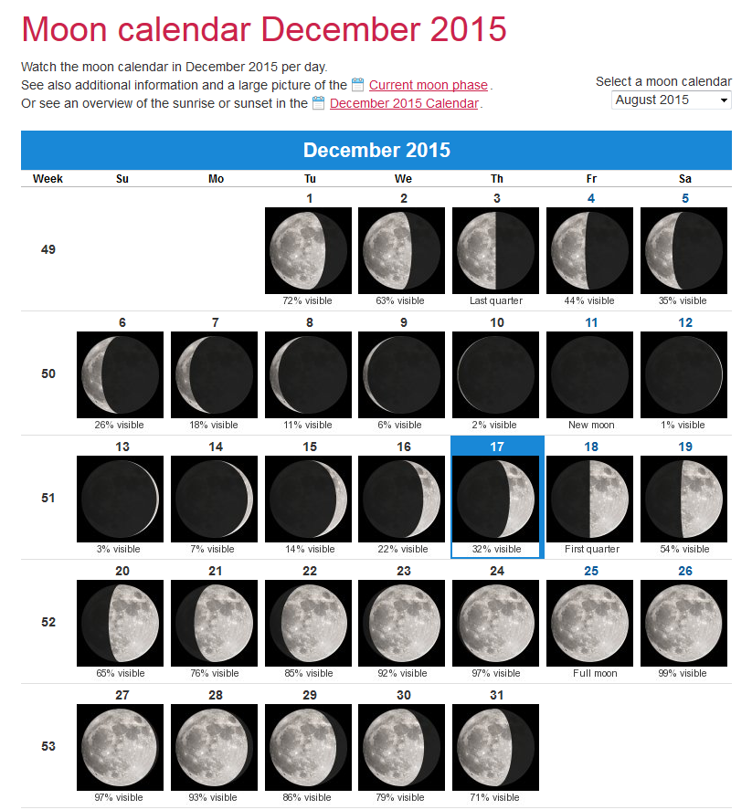
When the Moon Hits the VIIRS, Like a Big Piece of…
Great resource to find out about moon phase:
http://www.calendar-365.com/moon/moon-calendar.html
Moon below horizon from Last Quarter + 2 Days until First Quarter + 2 Days
Otherwise, there is moonlight and NCC quality improves
No Moonlight
Available

Slide 5
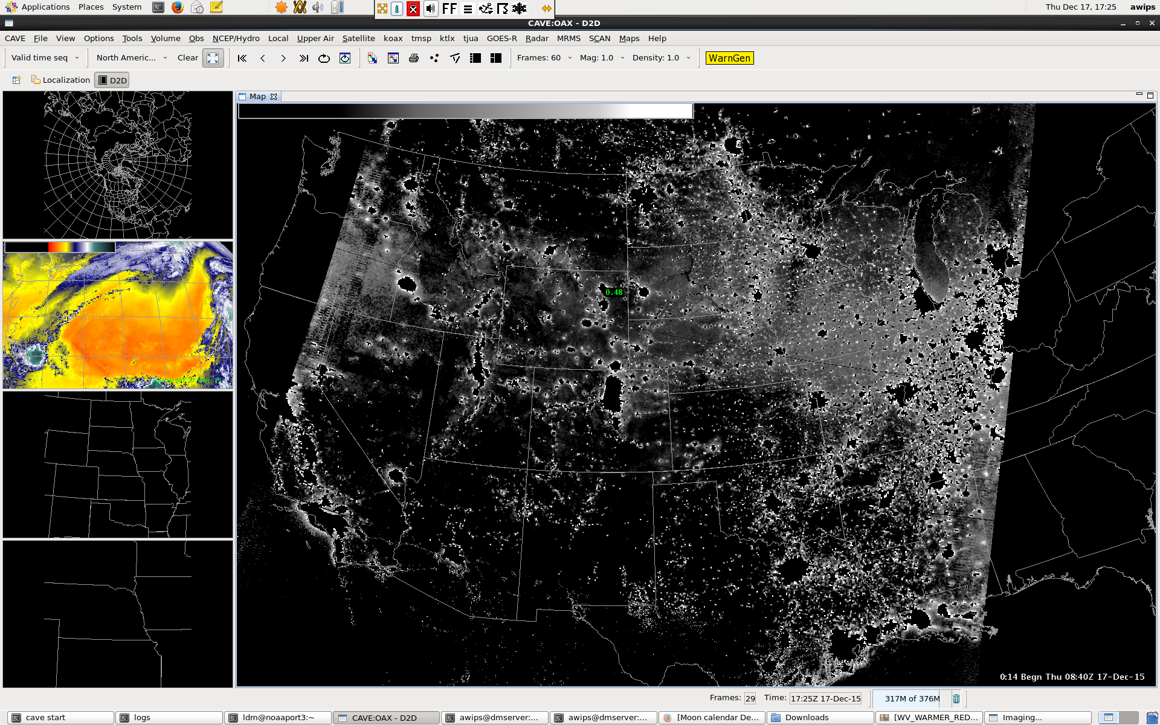
Default NCC Display in AWIPS-II

Slide 6
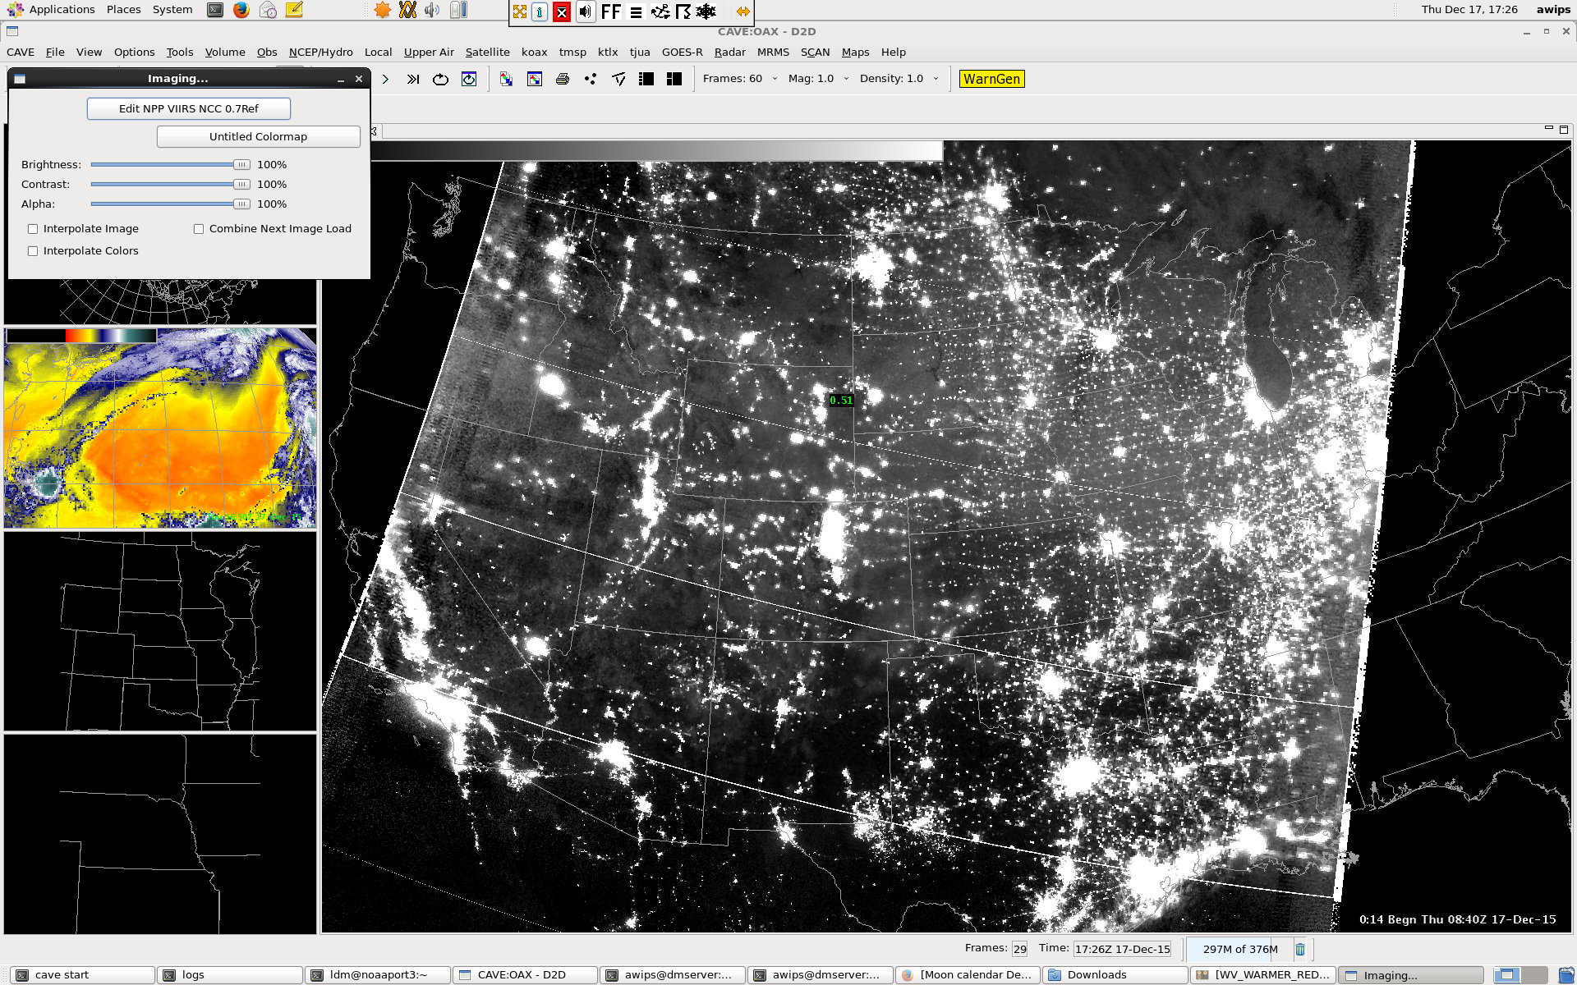
Reset top color to white
White lines are a known display bug. When you zoom in, they disappear.

Slide 7
Some Notes about Scaling (Color Tables)
Default: 0 to 1.6
No moon

Slide 8
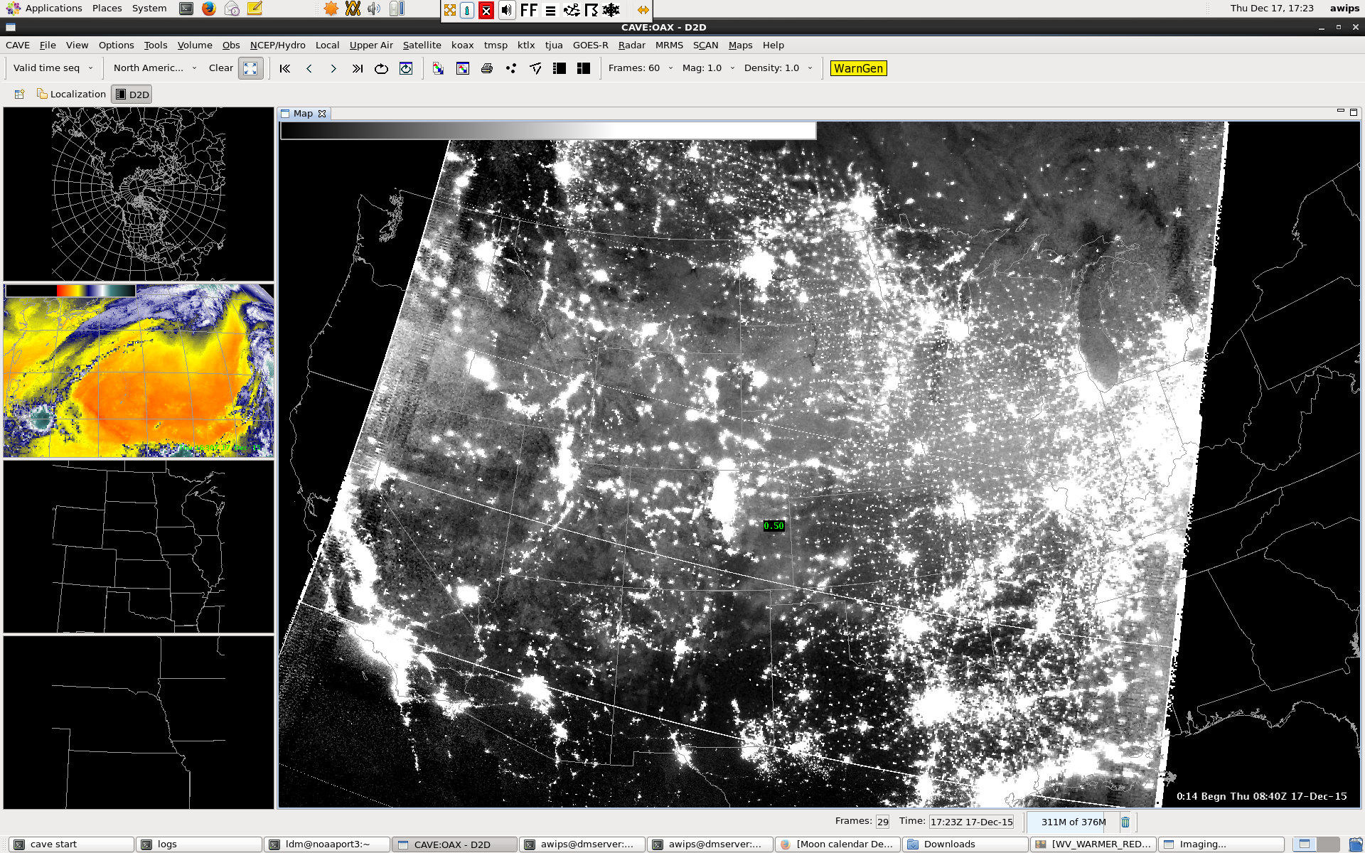
Some Notes about Scaling (Color Tables)
Recommended: 0 to 1.0
No moon

Slide 9
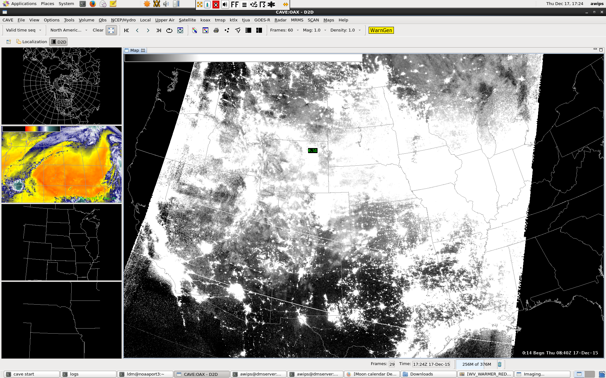
Some Notes about Scaling (Color Tables)
Extra stretched: 0 to 0.5
No moon

Slide 10
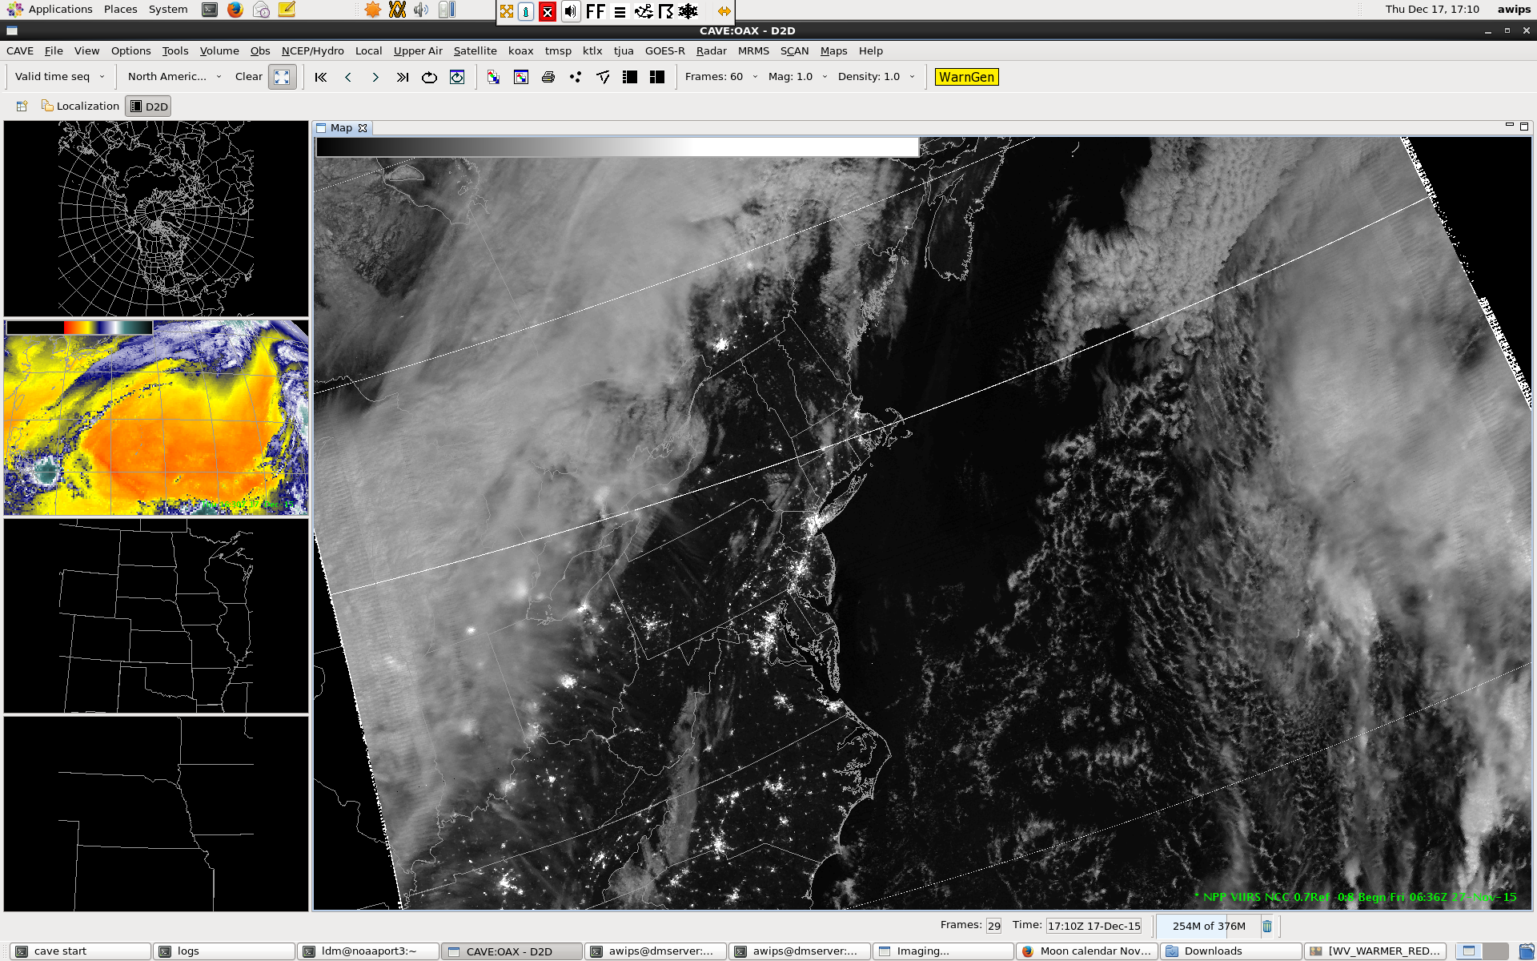
With Moonlight
Scaled: 0 to 1.0

Slide 11
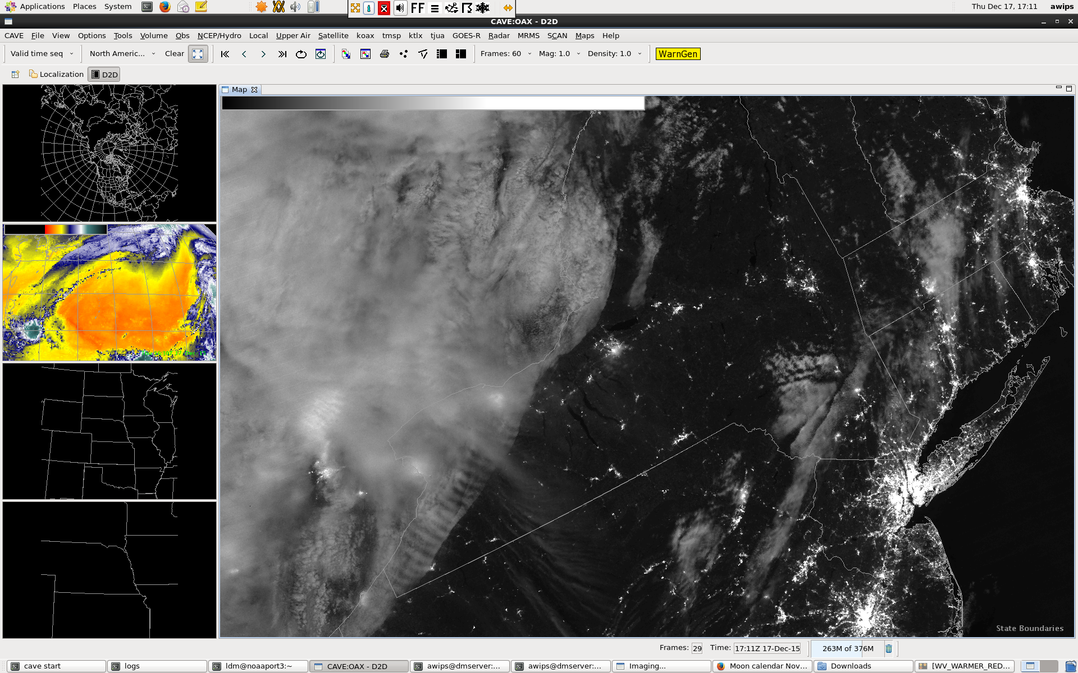
With Moonlight
Scaled: 0 to 1.0
NOTES:
- Lines missing
Reduced area of city lights
Lack of noise

Slide 12
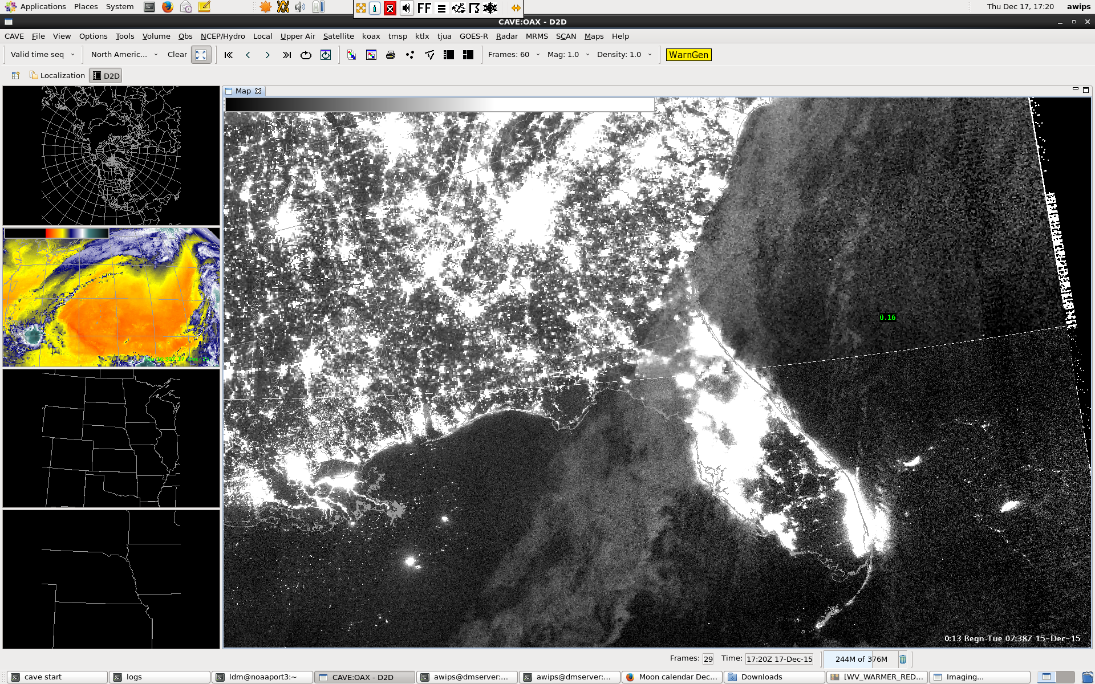
City Lights Expand Under Clouds
Scaled: 0 to 1.0
No moon
NOTES:
Scattering of city lights by clouds makes city lights appear larger
Also look for crisp vs. fuzzy edges

Slide 13
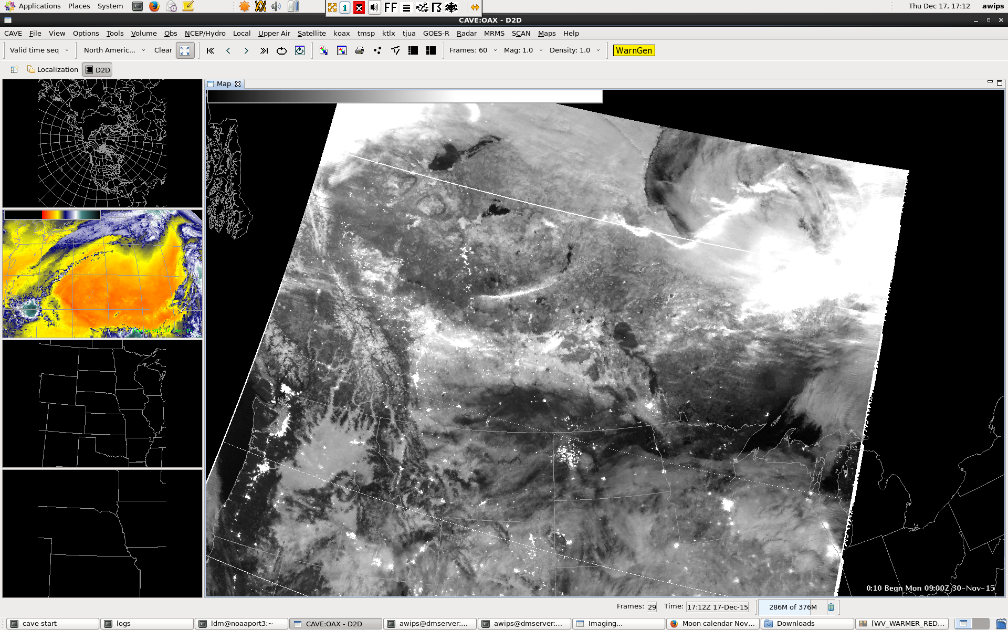
Snow, Low Clouds and Auroras
NOTES:
Auroras are saturating (> 1.0) near Hudson Bay
Look for snow and low cloud signals
Scaled: 0 to 1.0
With moon

Slide 14
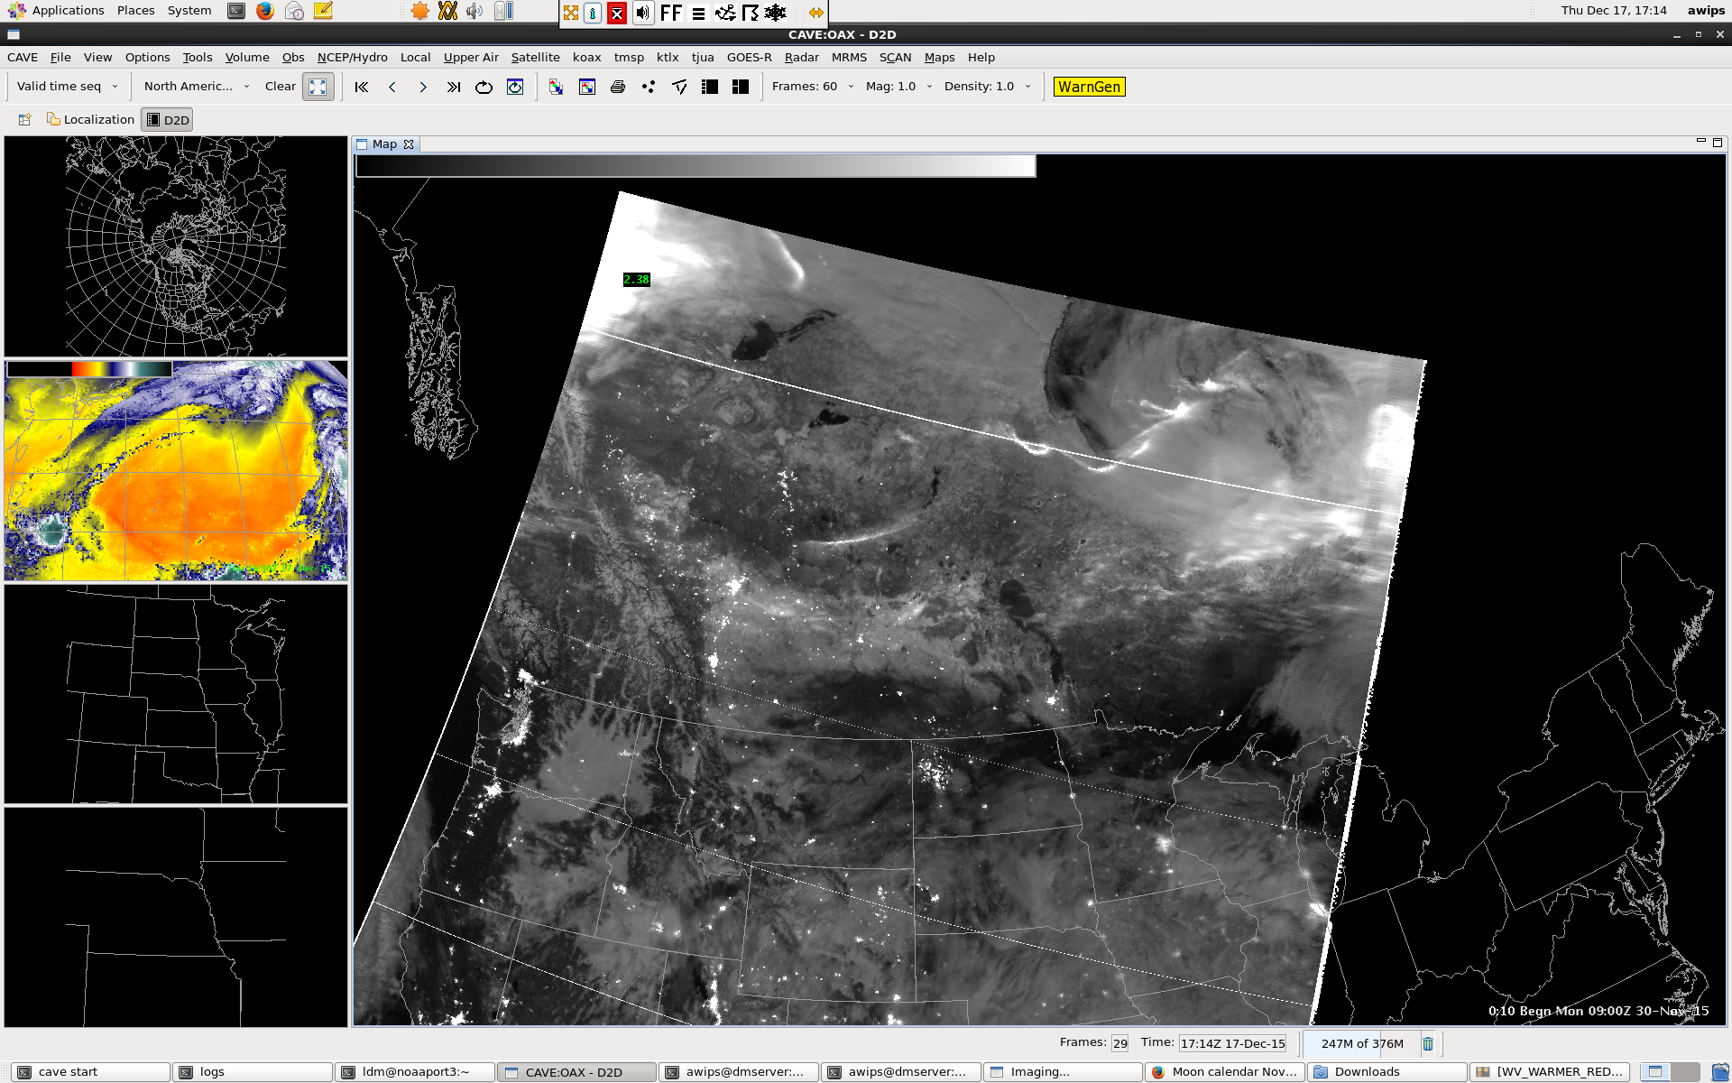
Snow, Low Clouds and Auroras
NOTES:
Reduced saturation in aurora
Made clouds darker
Scaled: 0 to 1.6
With moon

Slide 15
Typical Values
Typical NCC Values | With Moon | Without Moon
Clouds | 0.8-1.2 | 0.25-0.75
Snow | 0.7-1.2 | 0.20-0.75
City Lights | 2-20 | 5-1000
Auroras | 1.5-20 | 2-500
Bare Ground | 0.1-0.4 | 0.0-0.25
Scale accordingly!
Check out our NCC Quick Guide on the NOAA Vlab!
VLAB.NCEP.NOAA.GOV/WEB/GOES-R-END-USER-MISSION-READINESS-PROJECT/DAY-NIGHT-BAND

