Slide 1
Validated Stage 1 Science Maturity Review for VIIRS Land Surface Albedo
Dongdong Wang, Shunlin Liang, Yuan Zhou
University of Maryland, College Park
Yunyue Yu
NOAA/NESDIS/STAR
December 11th, 2014

Slide 2
Outline
Algorithm Cal/Val Team Members
Product Requirements
Evaluation of algorithm performance to specification requirements
  Evaluation of the effect of required algorithm inputs
  Quality flag analysis/validation
  Error Budget
Documentation
Identification of Processing Environment
Users & User Feedback
Conclusion
Path Forward

Slide 3
Albedo EDR Cal/Val Team Membership
 | Name | Institute | Function
JPSS-STAR | Land Lead: Ivan Csiszar | NOAA/NESDIS/SATR | Project Management
 | EDR Lead: Yunyue YU | NOAA/NESDIS/SATR | Team management, algorithm development, validation
 | Shunlin Liang | UMD/CICS –project PI | algorithm development, validation
 | Dongdong Wang | UMD/CICS | algorithm development, validation, monitoring
 | Yuan Zhou | UMD/CICS | algorithm development, validation, monitoring
 | Marina Tsidulko | IMSG | STAR AIT support: product verification, testing
 | Mike Ek’ team | NOAA/NWS/NCEP | User representative
 | Leslie Belsma | JPSS/DPA | algorithm Manager (JAM) for Land
NASA Land PPEATE
 | Robert Wolf’ team | NASA/GSFC | Cal/Val support
NASA S-NPP Science Team
 | Miguel Roman | NSAS/GSFC | algorithm (DPSA) development, product validation
 | Crystal Schaaf | UMB | algorithm (DPSA) development, product validation

Slide 4
L1RD Requirements
Albedo EDR
Attribute | Threshold | Objective
Albedo Applicable Conditions: day time, Clear only
a. Horizontal Cell Size
Nadir | 4 km | 0.5 km
b. Mapping Uncertainty, 3 Sigma | 4 km | 1 km
c. Measurement Range | 0 to 1.0 | 0 to 1.0
d. Measurement Precision ( 1 sigma) | 0.05 (albedo unit) | 0.02
e. Measurement Accuracy (bias) | 0.08 (albedo unit) | 0.0125
f. Refresh | At least 90% coverage of the globe, every 24 hours (monthly average) | 4 hrs
Notes:
Note: ( ) values are the most recent update request.

Slide 5
Data Product Maturity Definition
Provisional Maturity:
Product quality may not be optimal
  LSA from the new LUT is able to meet requirements
Incremental product improvements still occurring
  Continuous efforts to improve the algorithms
Version control is in effect
General research community is encouraged to participate
  LSA status and issues are posted and discussed in meetings
Users urged to consult the EDR product status
May be replaced in the archive
Ready for operational evaluation
Validated Maturity:
Product performance is defined and documented over a wide range of representative conditions via numerous and ongoing ground-truth and validation efforts
Clear documentation of product performance exists that includes all known product anomalies and their recommended remediation strategies, regardless of severity level
Product analyses are sufficient for full qualitative and quantitative determination of product fitness-for-purpose
Testing has been fully documented
Ready for long term monitoring
Product improvements continue through the lifetime of the instrument
Validated Stage 1:
Using a limited set of samples, the algorithm output is shown to meet the threshold performance attributes identified in the JPSS Level 1 Requirements Supplement with the exception of the S-NPP Performance Exclusions
Notes:
To be modified

Slide 6
History of algorithm changes/updates
Date Submitted | Update/DR# | Description | Status
7/7/11 | DR 4303 | IngMsdCoefficients_ViirsSurfAlbedoStruct has two problems. Not only does it need to be wrapped in a "pragma pack(4)", but it also contains several 'long' variables (which are 4 bytes on nppdev1, but 8 bytes on moddev64)... | Open - Not a science team issue
5/4/11 | DR 4265 | Surface Albedo Summary Quality flag does not count “fill” pixels. The summary quality flag is defined as "Exclusion Summary" and "Percent of pixels with one or more exclusion criteria flags" which does not meet the intent of the summary quality flag | Deferred
1/13/11 | DR 4187 | Surface Albedo Mission Quality Flag for Ice Concentration exclusion. The code outputs "fill" data for any ice fields that are less than 0.99 ice concentration, but no no quality flag to indicate why the data is "fill" from the ice concentration test. There is a spare bit available in the current output set that could be used to flag the test. | Deferred
1/13/11 | DR 4186 | Surface Albedo Quality indicator needs another level. Recommend a four level quality field:.. Good, Poor (degraded), Poor (excluded), and not calculated (excluded) - to replace the current three level field of Good, Poor, and not calculated. | Deferred
1/6/11 | DR 4183 | Surface Albedo Quality Flags are incorrect in the EDRPR. The code and EDRPR quality flag requirements differ. The problem comes about by the merging of the land, ice, and ocean albedo IP's that all tend to have different exclusions. | Closed 5/5/11 EDR PR updated.

Slide 7
History of algorithm changes/updates
Date Submitted | Update/DR# | Description | Status
4/30/12 | DR 4709 | Update pre-launch 2002 seeded data for BRDF Archival tiles because even after gridding is turned on, it will take many months for these tiles to be populated with VIIRS data. | Closed. CCR 474-CCR-12-0610 went into ops 10/12/12
4/30/12 | DR 4704 | The pre-launch LUT of BPSA regression coefficients used old spectral response functions. We generated a set of new regression coefficients after launch. This algorithm update is about replacing the old LUT with this new one and slightly adjusting some codes as needed | Closed. The results from the updated LUT was verified. CCR-12-0606,0889 into ops with Mx6.7
9/12/12 | DR 4901 | SA Jump in precision after Mx6.2. Cal/Val analysis of the Albedo EDR shows a substantial degradation of performance for data gathered after August 9th when Mx6.2 went operational. This might be caused by an incorrect LUT used for this algorithm. | Closed Did not occur after SA BPSA LUT DR4704 became operational in Mx6.7.
8/22/12 | DR 4882 | SA Fix BRDF Kernel Selection. BRDF derivation using a "best" fitting kernel model is selected from a multiple kernel combination approach. This is not necessary, and even may cause problems. Investigation shows that a fixed RossThick Li-Sparse Reciproral (RTLSR) kernel (which is the MODIS heritage) is the best approach for the VIIRS Gridded Albedo/BRDF derivation. | Closed.474-CCR-12-0607 passed AERB 16 Jan 13 Approved 16 Jan AERB for Mx7.1
3/28/13 | DR 7114 | 17-Day LSA GIP experienced failures in Mx6.7 due to the code was blindly using fill values for the coeff in the ProGipViirsGridToGridLSA when calculating Nbar, BlackSky, and WhiteSky causing the ProCmnScaler not to recognize the new fillvaules and causing a scale out of bound message | Closed.CCR_474-CCR-13-1031 passed AERB on17 May schedule for Mx8.0
6/14/2013 | DR 7241 | Land Surface Albedo Beta Maturity | Closed 474-CCR-13-0892 approved

Slide 8
History of algorithm changes/updates
Date Submitted | Update/DR# | Description | Status
9/6/2013 | DR7357 | VIIRS SA Most DPSA IP QA are just fill The DPSA IP quality flag is making it difficult to evaluate the DPSA product because most of the QA are just fill value. | Status: Analysis. Has not been submitted to DRAT. 20 Sept B.Yu discussed at Land biweekly. Data from non-retained LSA granulated IP data pulls Dec 13 and Mar 14 should help in this investigation.
6/14/2013 | DR 7224 | JPSS-1 Alg Improvements Recommended - Surface Albedo Provide one blended albedo product rather than current two of BPSA and DPSA. Surface Albedo cal/val team recommendation as a JPSS-1 algorithm enhancement. | Status: Analysis.
4/16/2013 | DR 7148 | GIP Increase in use of Climatology in NDVI Rolling Tiles Description: The updates to the NDVI rolling tiles that occurred from March 22 and April 8 show a significant increase in the number of cells that fall back to observations from the previous 17-day update or climatology. | Status: Investigation identified the need to “tune” the threshold error that the RMSE is compared to in order to set NBAR NDVI retrieval quality flag. This threshold has never been tuned since the system became operational. It is likely that refining this quality flag threshold could further improve the dynamic updates.
4/6/2013 | DR 7149 | SA Delivery of DPSA Swath Granulated IP for Diagnostics Description. Request access to two granulated albedo IPs, the VIIRS-GridIP-VIIRS-Land-Surf-Albedo-Mod-Gran and the VIIRS LSA-IP order to compare the BPSA algorithm to the DPSA algorithm. The gridded DPSA GIP is currently available, but VIIRS-GridIP-VIIRS-Land-Surf-Albedo-Mod-Gran is needed to access quality flag information that is not included in the DPSA GIP nor the VIIRS LSA-IP. However, the VIIRS LSA-IP does have both the granulated DPSA and BPSA swath needed to compare algorithm performance. | Status. Analysis. Interim: VIIRS LSA-IP and VIIRS-GridIP-VIIRS-Land-Surf-Albedo-Mod-Gran IPs for specific requests being manually extracted from I&T and uploaded to GRAVITE for analysis of DPSA performance. Long term. Request for routine access on hold pending resolution of what SA grid-gran processing output is optimal for DPSA analysis.

Slide 9
History of algorithm changes/updates
Date Submitted | Update/DR# | Description | Status
23 Apr 14 | DR 7635 | VIIRS LSA LUT Update for Provisional Effectivity Description: Refine the VIIRS Land Surface Albedo (LSA) BPSA LUT, and add more angle intervals. The LUT dependence on land cover types (desert and non-desert) is introduced in this implementation for the first time. The TOA reflectance correction due to H2O and O3 is removed. LSA Provisional Maturity effectivity date is dependent on implementation of this LUT update | Closed. DR7635/CCR-14-1726 VIIRS LSA Provisional Maturity: Approved 17 Apr: STAR Provisional Review; Approved 4 Jun 14 by AERB 474-CCR-14-1722- VIIRS LSA LUT Update for Provisional Effectivity (DR7635) implemented 21 Nov 2014 in Mx8.6

Slide 10
Evaluation of algorithm performance
Findings from Provisional Review
  Validation with limited data sets demonstrate the VIIRS BPSA algorithm can reliably retrieve LSA over both dark and bright surfaces.
  Comprehensive validation is needed to better understand uncertainties of LSA products and provide comprehensive validation reports.
Improvements since Provisional
  A new LUT was proposed at Provisional Review, to accounting for multiple aerosol types and surface anisotropy.
  This LUT has been implemented.
Cal/Val Activities for evaluating algorithm performance:
  Quality flag analysis
  Validation with field measurements
  Comparison with existing satellite products

Slide 11
Example of LSA: temporal composite maps
Temporal averaged maps of surface albedo, May 8-23, 2012

Slide 12
Evaluation of algorithm performance
---- Validation methods
Collect a comprehensive database of field measurements of land surface albedo.
Limited sites have measurements of VIIRS years (2012-present).
Spatial representativeness of station measurements are evaluated by examining the high resolution satellite imagery of the sites.
Quality control of field data is applied.

Slide 13
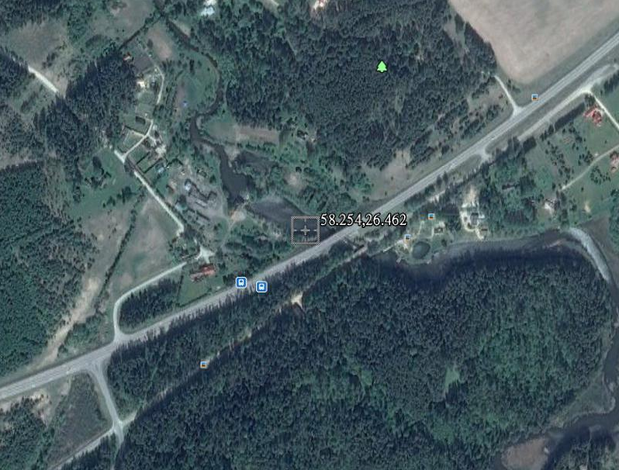
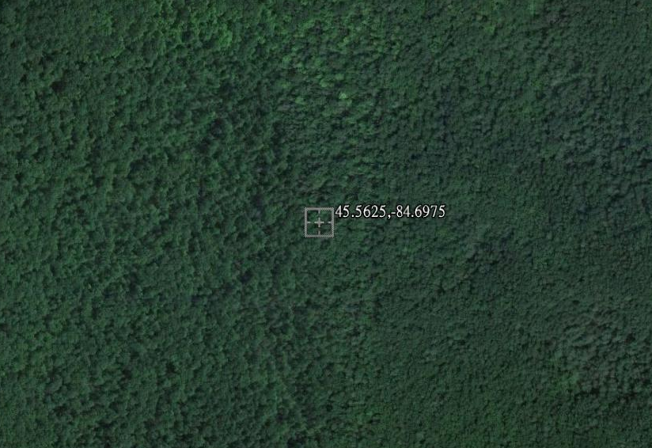
Evaluation of algorithm performance
---- Field stations
Data of 35 stations are collected, which include measurements of recent three years.
  11 AmeriFlux sites
  3 BSRN sites
  14 GC-Net sites
  7 SURFRAD sites
Only relatively homogenous sites are used in data comparison.
Information of land type, snow cover and cloud mask is used as ancillary data in validation.
Toravere
UMBS

Slide 14
Evaluation of algorithm performance
---- Validation results
Site | RMSE |  | Bias
 | VIIRS | MODIS | VIIRS | MODIS
AZ_Kendall_Grassland | 0.042 | 0.062 | -0.030 | -0.057
AZ_Lucky_Hills_Shrubland | 0.025 | 0.042 | 0.001 | -0.039
AZ_Santa_Rita_Creosote | 0.044 | 0.048 | 0.003 | -0.035
AZ_Santa_Rita_Mesquite | 0.026 | 0.033 | 0.007 | -0.028
IN_Morgan_Monroe_State_Forest | 0.043 | 0.063 | -0.032 | -0.058
MI_UMBS | 0.200 | 0.028 | 0.136 | -0.028
MI_UMBS_Disturbance | 0.243 | 0.039 | 0.171 | -0.032
MO_Missouri_Ozark_Site | 0.025 | 0.041 | -0.012 | -0.035
NE_Mead_irrigated | 0.032 | 0.141 | 0.007 | -0.047
NE_Mead_Rainfed | 0.209 | 0.184 | 0.088 | 0.096
Boulder | 0.051 | 0.117 | -0.017 | -0.049
GITS | 0.112 | 0.761 | -0.057 | -0.570
Humboldt | 0.114 | 0.112 | -0.071 | -0.096
Summit | 0.106 | 0.074 | -0.028 | -0.061
DYE-2 | 0.152 | 0.059 | -0.009 | 0.027
Saddle | 0.094 | 0.104 | -0.028 | -0.039
South-Dome | 0.109 | 0.095 | 0.055 | 0.046
NASA-SE | 0.142 | 0.241 | -0.043 | -0.086
Sioux_Falls | 0.114 | 0.078 | 0.048 | 0.009
Table_Mountain | 0.050 | 0.163 | 0.020 | -0.019
Desert_Rock | 0.038 | 0.011 | 0.029 | -0.009
Fort_Peck | 0.042 | 0.258 | -0.006 | -0.131
Penn_State | 0.081 | 0.073 | -0.066 | -0.035
Goodwin_Creek | 0.037 | 0.045 | -0.031 | -0.042
VIIRS data are generally better than MODIS products, with smaller RMSE and bias.
Both data sets have high accuracy for snow-free cases.
Large RMSE usually occurs at the cases of snow pixels and ephemeral snow.
Notes:
Plots descriptions needed here, or on the slide

Slide 15
Validation results for non-snow albedo
Further analyzing accuracy of non-snow albedo
Data over non-snow sites during non-snow seasons were used.
16-day mean was calculated to compare with MODIS data
VIIRS data have smaller bias and RMSE, well below the product threshold.
Notes:
Plots descriptions needed here, or on the slide

Slide 16
Validation results for snow albedo
Accuracy of estimating snow albedo was evaluated at GC-Net stations.
VIIRS generally has improved results.
Retrieval accuracy is strongly dependent on quality of cloud detection.
Temporal filtering can improve retrieval quality and data continuity.
With temporal filtering
Notes:
Plots descriptions needed here, or on the slide

Slide 17
Evaluation of the effect of required algorithm inputs
Required Algorithm Inputs
  Top-of-atmosphere reflectance SDR
  Cloud mask
  LUTs of regression coefficients
Evaluation of the effect of required algorithm inputs
  Impacts of accuracy of cloud masking (CM)
Notes:
Plots descriptions needed here, or on the slide.
May need more slides for more details? (2-5 slides)

Slide 18
Quality flag analysis/validation
We evaluated the quality of QF using the surface albedo EDR data from the new Mx8.6 codes.
  Most QFs of surface albedo EDR are inherited from upstream products.
  Quality of these QFs is determined by the quality of input information.
  Two QFs are related to computing land surface
    Albedo retrieval quality
    Out of range

Slide 19
Error Budget
Attribute Analyzed | L1RD Threshold | Analysis/Validation Result
Precision (RMSE) | 0.05 | 0.024 (non-snow)
Accuracy (Bias) | 0.08 | -0.006 (non-snow)
Precision (RMSE) | 0.05 | 0.065 (snow)
Accuracy (Bias) | 0.08 | -0.023 (snow)
Precision (RMSE) | 0.05 | 0.045 (combined)
Accuracy (Bias) | 0.08 | -0.013 (combined)
The current non-snow LSA retrievals meet L1RD threshold.
The performance of snow LSA is also comparable (slightly better) than the existing major LSA product.
However, RMSE of current snow retrievals are greater than the precision requirement.
Temporal filtering can reduce RMSE to 0.065 and bias to -0.023.
The snow-specific LUT is expected to improve the quality of snow albedo.

Slide 20
Documentation
The following documents will be updated and provided to the EDR Review Board before AERB approval:
  Updated ATBD
  Updated OAD
  README file for CLASS
A validation report (on the provisional product)

Slide 21
Major Users of LSA product
(Point of Contact)
U. S. Users:
  NOAA National Weather Service Environmental Modeling Center (Michael EK, Jesse Meng, Weizhong Zheng )
  USDA Agricultural Research Services(Martha Anderson)
  USDA Forest Service (Brad Quayle)
  NOAA/NESDIS Center for Satellite Applications and Research (Jerry Zhan)
  NOAA/NESDIS National Climate Data Center (Peter Thorne)
  Academy -- University of Maryland (Konstantin Vinnikov, Shunlin Liang, Cezar Kongoli )
  Army Research Lab ( Kurt Preston)
Potential foreign Users
  EUMETSAT (Yves Govaerts)
  Météo France (Jean-Louis Roujean)
  Academy: Italy IASMA Research and Innovation Centre (Barbara Marcolla), Beijing Normal University (Qiang Liu)

Slide 22
Identification of Processing Environment
Results shown here are based on the LUTs with BRDF considerations .
The BRDF LUTs have been implemented in Mx8.6.
Effective date of the LUT (BRDF version) is Dec 21, 2014.
Given the limited time span of new data from Mx8.6, the albedo data for this validation report are generated at our local facility with the same approach and LUT used in Mx8.6.

Slide 23
Conclusion
After two updates of LUTs of regression coefficients since launch, quality of LSA retrievals have been significantly improved.
A comprehensive database of field measurements of LSA for VIIRS years was compiled and used to validate VIIRS LSA data.
Validation results show the errors of the current non-snow LSA retrievals are well smaller than L1RD threshold.
The performance of snow LSA is also comparable (slightly better) than the existing albedo product, although RMSE of current snow retrievals are greater than the precision requirement.
Temporal filtering and a new snow LUT is expected to further improve the quality of snow albedo.
Team recommends algorithm validated stage 1 maturity.
The current LSA data still have some issues:
  LUTs of sea ice albedo has not been updated yet.
  Snow-specific LUT will improve quality of snow albedo.
  Temporal filtering is needed.
  Gridded data of LSA is suggested

Slide 24
Path Forward
Planned further improvements
  Update LUT of regression coefficients for estimating sea ice albedo;
  Develop a separate LUT for snow pixels and other major land surface types;
  Implement a temporal filtering to improve both quality and continuity;
  Propose a framework to generate gridded data set of LSA.

Slide 25
A specific LUT for snow albedo
A generic LUT is currently used for all surfaces other than desert.
This generic database cannot well represent anisotropy of snow reflectance.
A new snow LUT is under development.
Notes:
Plots descriptions needed here, or on the slide

Slide 26
Post-processing: temporal filtering
Temporal filter
  One single observation is used to estimate LSA.
  The current algorithm is sensitive to errors in cloud detection.
  A temporal filtering is needed to improve both quality and continuity, especially for snow pixels.
Notes:
Plots descriptions needed here, or on the slide

Slide 27
Granule vs Gridded Product
For end users (modeling community, data analysis), gridded data sets of surface albedo is needed.
Current surface albedo EDR is a instantaneous granule-based product.
Data users have to 1) covert map-projection and 2) conduct “temporal composite” before they can use the data.
We recommend to generate a higher level product: daily gridded land surface albedo.

Slide 28
Back-up Slides

Slide 29
Inter-comparison with MODIS albedo
Contiguous US maps of 16-day mean LSA from VIIRS and MODIS, during DOY 145-160, 2012
Comparing 16-day mean VIIRS albedo from BRDF LUT with MODIS blue-sky albedo. Data are limited to those with at least 8 clear-day observations during the composite period of 16 days.

