Slide 1
Validated Stage 1
Science Maturity Review
for
OMPS Total Column Ozone EDRs
Presented by
L. Flynn, NOAA
September 3, 2014
Notes:
Version 4:34 9/2/2014

Slide 2
Outline
Algorithm Cal/Val Team Members
Product Requirements
Evaluation of algorithm performance to specification requirements
  Evaluation of the effect of required algorithm inputs
  Quality flag analysis/validation
  Error Budget
Documentation
Identification of Processing Environment
Users & User Feedback
Conclusion
Path Forward

Slide 3
Ozone Cal/Val Team Membership
EDR | Name | Organization | Task
Lead | Lawrence Flynn | NOAA/NESDIS/STAR | Lead Ozone EDR Team
Member | Irina Petropavlovskikh | NOAA/ESRL/CIRES | Ground-based Validation Lead
Member | Craig Long | NOAA/NWS/NCEP | Product Application Lead
Member | Trevor Beck | NOAA/NESDIS/STAR | Algorithm development and ADL implementation
Member | Jianguo Niu | STAR/IMSG/SRG | Algorithm development, trouble shooting, Limb Profiler science
Member | Eric Beach | STAR/IMSG | Comparisons, ICVS/Monitoring, Data management
Member | Zhihua Zhang | STAR/IMSG | V8 Algorithms implementation & modification
JAM | Maria Caponi | JPSS/Aerospace | Coordination, DRs and CCRs
Member | Bhaswar Sen | NGAS | Current Algorithms
Raytheon team members with major contributions include Derek Stuhmer and Daniel Cumpton.

Slide 4
~ 2%
~ 3%

Slide 5
Independence and Long Term Stability
The OMPS ~3% total column ozone accuracy requirements were for its minimal performance as a stand-alone instrument.
By using other assets we can set/correct the product bias to close to 0%.
The long-term stability of the accuracy at 1% was also a stand-alone requirement, that is, the system was designed so that the products’ accuracy was not allowed to wander around between +3% and -3%.
Users expect a stable product – applications are negatively affected by both short term jumps and discontinuities and longer term drifts.
Over the course of a mission, new adjustments to the measurement characterizations are phased in as changes warrant.

Slide 6
Data Product Maturity Definition
Validated Stage 1:
  Using a limited set of samples, the algorithm output is shown to meet the threshold performance attributes identified in the JPSS Level 1 Requirements Supplement with the exception of the S-NPP Performance Exclusions

Slide 7
Nine Things to Know about the OMPS Total Ozone EDR
The algorithm uses information at 22 wavelengths obtained from 44 macropixels (20 or more spatial pixels) x 35 cross-track measurements.
Channels are combined three at a time to generate ozone, reflectivity and wavelength dependence of reflectivity (e.g., aerosol effects) estimates.
A single triplet is used to generate the heritage Version 7 ozone estimate.
A single triplet (317, 331 and 336 nm) is used to generate the SO2 Index. It shows the effect of inter-channel biases and its use is problematic at high Solar Zenith Angles.
Internal comparisons monitoring cross-track variations in ozone, reflectivity, aerosol and SO2 Index values provide direct information on inter-channel biases.
Absolute calibration of the reflectivity channels is tested by vicarious methods by using Greenland and Antarctic ice fields, cloud-free equatorial Pacific ocean, and minimum land values.
Absolute calibration of ozone sensitive channels can be set to agree with the validation “truth” data set of choice.
The First Guess IP and EDR products have been converging.
  Partial Cloud calculations are the same except for the use of differing Snow/Ice information
    Identical logic for cloud fractions and input for cloud top pressures
    Snow/Ice for NRT VIIRS in EDR is still erroneous – Snow/Ice tilings in 1st Guess are very good climatology; These will be updated daily starting in 2014
  Temperature data options – Climatology, NCEP, CrIMSS (and correction On/Off)
    Need to bring forecasts for the stratosphere into IDPS and turn on the correction for the IP.
The total ozone column products do not currently meet requirements; soft calibration adjustments to remove inter-channel and cross-track calibration errors in the SDR are necessary to achieve the performance.

Slide 8
Evaluation of algorithm performance to specification requirements
Improvements since Provisional
  Algorithm Improvements
    Restricted extrapolation of Profile Mixing Fraction
    Implemented stray light corrections in SDR
    Implemented Intra-orbital wavelength scale in SDR
  LUT / PCT updates
    Regular weekly updates of Dark corrections
Cal/Val Activities for evaluating algorithm performance:
  Ground truth and Satellite data sets

Slide 9
Evaluation of the effect of required algorithm inputs
Required Algorithm Inputs
  Primary Sensor Data
    Stray light including out-of-range contributions are now well corrected
    Measurement based intra-orbit wavelength scale adjustments are implemented
    New Day 1 and wavelength scale in testing
    Calibration Factor Earth (CFE) Soft Calibration in preparation
      One-percentile reflectivity
      OMI Ozone
      Aerosol and SO2 free regions
  Ancillary Data
    The TC EDR and First Guess IP have been converging in their use of external data. NRT products from VIIRS and CrIS are being replaced with Internal Calculations, Forecasts and UV specific climatologies.
  LUTs / PCTs
    RT LUTs are stable. Measurements radiance/irrradiance ratios are interpolated to table channel wavelengths. Corrections for SO2 absorption coefficients.
    Weekly dark updates are continuing.
    Bi-annual Solar reference diffuser measurements show a very stable instrument.
Evaluation of the effect of required algorithm inputs
  SDR Performance for most attributes meets requirements.
Notes:
B.i. Measurement-based wavelength scale adjustments – February 19 Mx8.1. DONE. Need to include dichroic interaction with wavelength and calibration factors. FUTURE
B.ii. Revised profile mixing fraction logic – March 17 in Mx8.3 (EDR only) DONE
B.iii. First version of OOR Table for the stray light correction -- May 2014 (SDR Table Tuning and Code Change)
New Table received. OOR cross-track dependence requires code change. CCR for Mx8.6. DONE
CCR to proceed with this for the Mx8.5 build. It is a change to the code and table dimensions. Minor ATBD and OAD and CDFCB changes. Change in 2-D OOR table to coincide with current code. DONE
B.iv. New Day 1 Solar irradiance spectra and wavelength scales. Should be set to middle of orbital scale variation. Cross-track dependence is complex. – September (SDR Table Tuning)
B.v. Soft Calibration adjustments to Day 1 Solar or CF Earth – September (SDR Table Tuning)
B.vi. Check flagging and logic for total ozone out of range and fill for triplet retrievals. (EDR)
B.vii. Possible bandpass changes -- ground to flight, intra-orbit. FUTURE.
OMPS TC V8
D.i. Provide 12 soft calibration adjustments
D.ii. Provide additional output -- standard profile and layer retrieval efficiencies (also in BUFR)
D.iii. Put in Linear-Fit SO2 module. (Eight Granules)
D.iv. Change to work with smaller FOVs (Test data 15x105)
D.v. Put in N-value fitting (Noise reduction, outlier identification and removal, and information concentration)

Slide 10
Important EDR/SDR Changes
DR7387/CCR1879 (SDR) TC SDR TC Stray Light Out-of-Range LUT update
DR4266/CCR411 Implemented partial cloud logic;
DR4955/CCR736 Replace cloud top pressure with UV-based climatology; Mx7.0.
DR4918/CCR829 Replace SO2 absorption coefficients.
DR7310/CCR1215 Restrict the profile mixing fraction in the OMPS NM EDR;
Turn on temperature corrections for the IP; can be done out of build.
CCRs actions include updates to appropriate documents, e.g., ATDBs.
Notes:
DR4266/CCR411 Implement partial cloud logic; Mx6.3.
DR4955/CCR736 Replace cloud top pressure with UV-based climatology; Mx7.0.
DR4918/CCR829 Replace SO2 absorption coefficients; completed out-of-build mid-2013.
DR7310/CCR1215 Restrict the profile mixing fraction in the OMPS NM EDR; DONE
Turn on temperature corrections for the IP; can be done out of build.

Slide 11
Open DRs Today
DR # | Short Description
7334 | Impact of dichroic shifts (Stable; Soft Calibration 7314)
7260 | Impact of wavelength scale shift (Small after correction)
7315 4818 | Bias and smear errors (Closed – Fixed 20140722 no impact)
7753 | VIIRS Cloud Fraction clean up (No impact on product)
5009 | QF 1 Bit 2 snow/ice fraction is set incorrectly (Redundant flags are set correctly – Note in Readme.)
7044 | VIIRS snow/ice (Replace NRT product with Daily Tilings) (In use in First Guess IP)
7235 7254 | Loss of CrIS temperature data; use of NCEP. (First guess has Temp correction turned off. Do not set degraded flag.)
7653 | V8 Algorithm for Total Ozone EDR (Future)
7655 | Day 1 Solar Spectra (Updates in testing)
7451 | Day 1 Wavelength Scale (Update to orbital average in testing)
7314 | Generate soft calibration coefficients (Set CFE using Equatorial Pacific Box, 1-percentile reflectivity = 4%, OMI TOz, no aerosol, no SO₂. Reduce SO₂ sensitivity if necessary.
Notes:
DR 7753(OMPS)-TC EDR VIIRS Cloud Fraction clean up
DR 7754(OMPS)-TC IP Temperature correction
DR 7235(OMPS)- Impact of missing CrIS data on OMPS retrievals
DR 7044(OMPS)- VIIRS snow/ice not well remapped to OMPS
DR 5009 – The TC EDR QF 1 Bit 2 snow/ice fraction is set incorrectly - Placeholders
with values of 1 were set prelaunch for the TC EDR snow/ice bit 2 in QF 1. This is incorrect and inconsistent with the SCF B4 snow/ice fraction >0 and it needs to be corrected.
DR 7655 OMPS TC SDR Ozone Day 1 solar irradiance spectra update and new wavelength scale
DR 7451 OMPS TC SDR OMPS NM Wavelength Scale (New analysis and middle of orbital pattern)
DR 7753(OMPS)-TC EDR VIIRS Cloud Fraction clean up
No longer used -- turn off VIIRS input.
DR 7754(OMPS)-TC IP Temperature correction
Investigate correction using NCEP forecasts vs CrIS retrievals.
DR 7235(OMPS)- Impact of missing CrIS data on OMPS retrievals
Turn off input as it will not be present.
Do not activate degraded performance flag.
DR 7044(OMPS)- VIIRS snow/ice not well remapped to OMPS
Turn off VIIRS input as tilings are superior. (Note Mx8.6 will use daily tilings.)

Slide 12
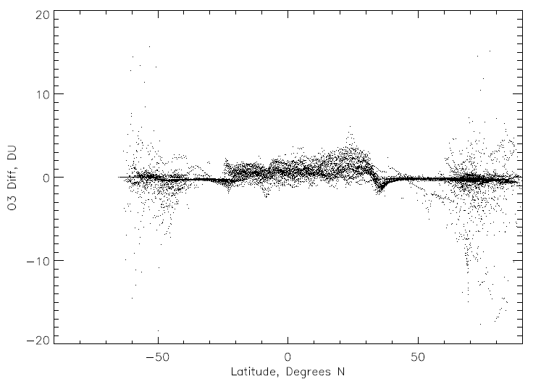
Differences in Temperature Corrections using NCEP Forecast versus CrIMSS Profiles

Slide 13
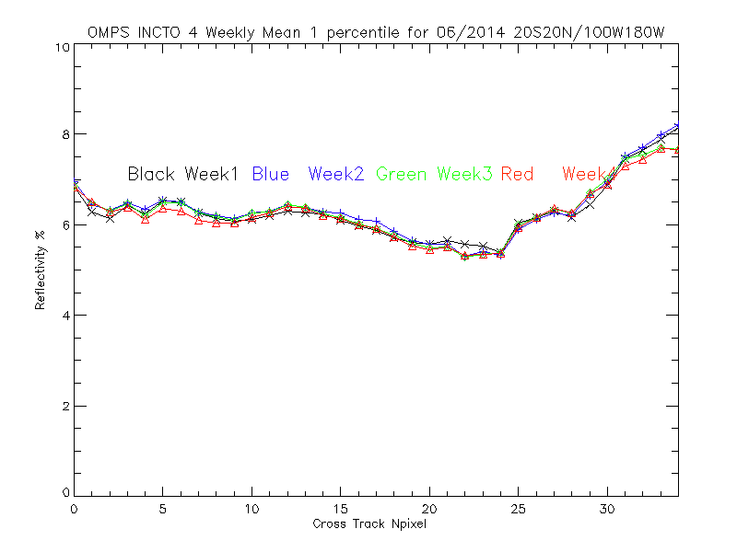
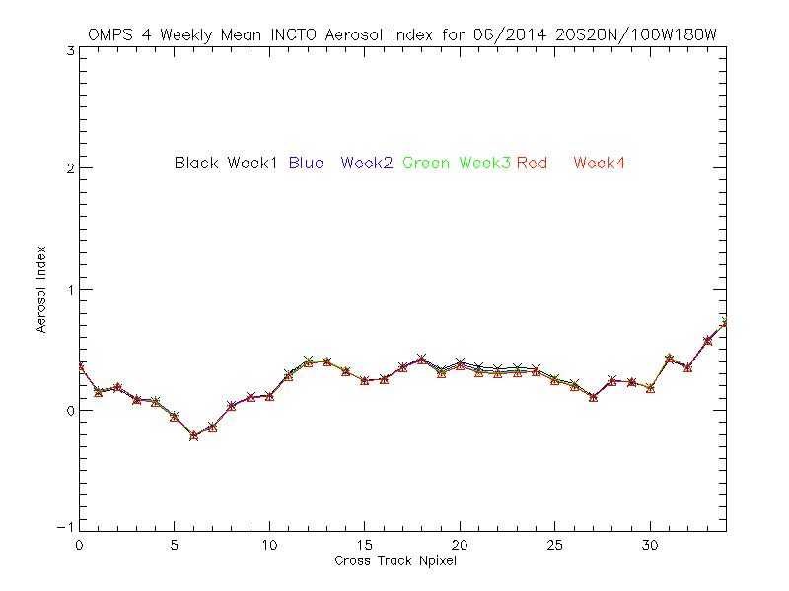
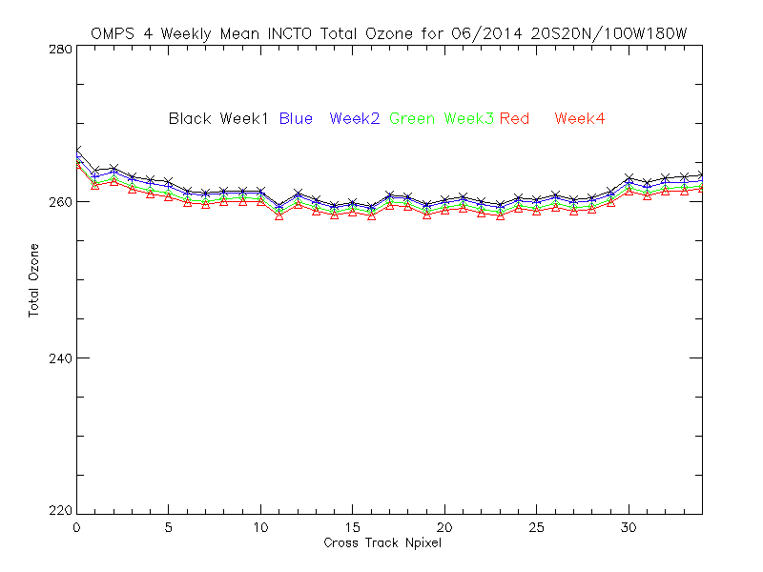
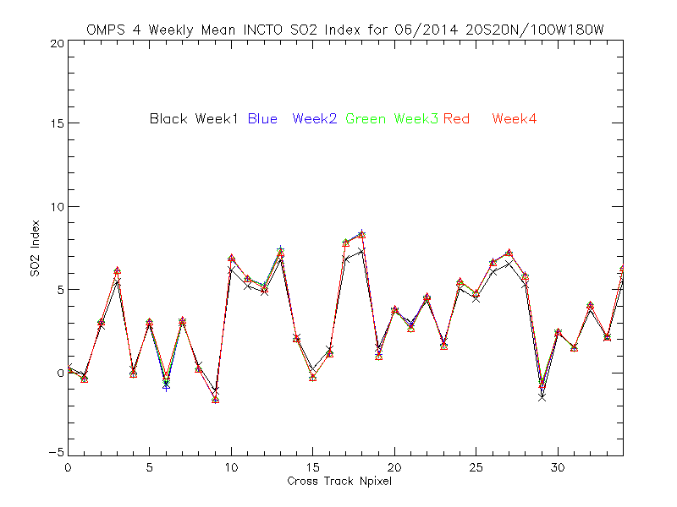
Internal Consistency and Vicarious Calibration/Validation
DR 7314 OMPS TC EDR: Generation of soft calibration coefficients (CFE) – Use Equatorial Pacific Box, Minimum Reflectivity = 4%, no aerosol, no SO2, Toz set to OMI TOz. Reduce SO2 sensitivity if necessary.
Weekly average Effective Reflectivity, Total Column Ozone, Aerosol Index and SO2 Index values, for June 2014 for a latitude / longitude box in the Equatorial Pacific versus cross-track pixel.
SO₂ exclusion

Slide 14
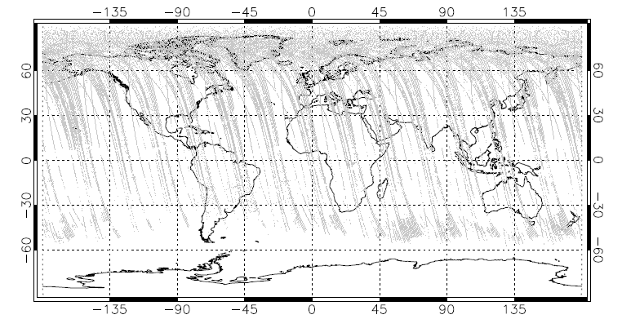
SO2 Error Currently Set

Slide 15
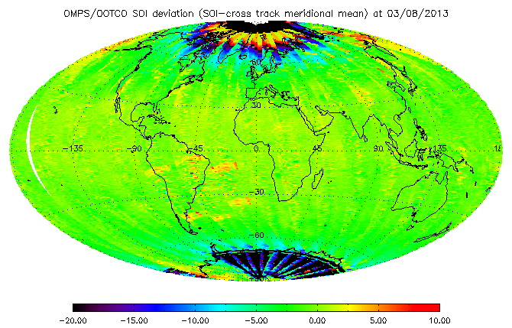
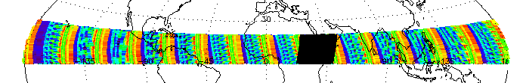
SO2 Map After Removal of Cross-Track Biases
High Solar
Zenith Angles
These features were removed with the change in SAA dark correction process.

Slide 16
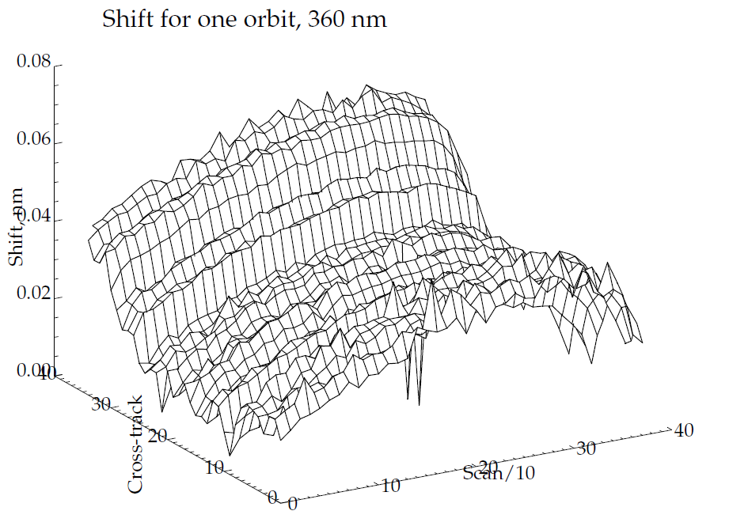
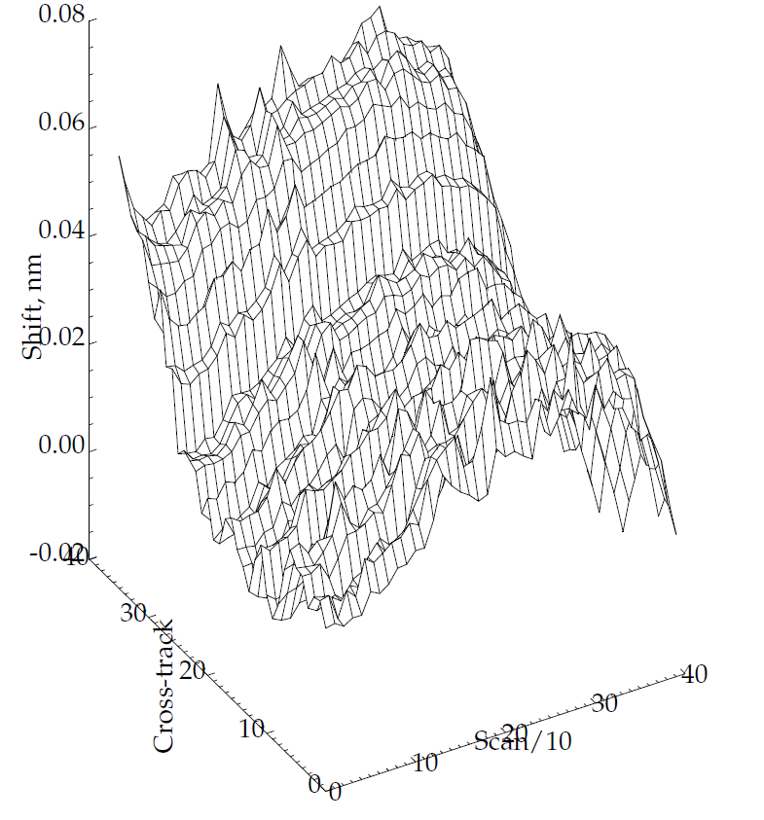
Comparison of cross-track and orbital patterns of estimated Earth radiance scales relative to the current day 1 solar from the proposed method using 346 nm to 380 nm with those from an analysis in an SO₂ product formulation. The two sets of results agree well in both along orbit and cross track variations. The results for every tenth scan are used to create the figures.

Slide 17
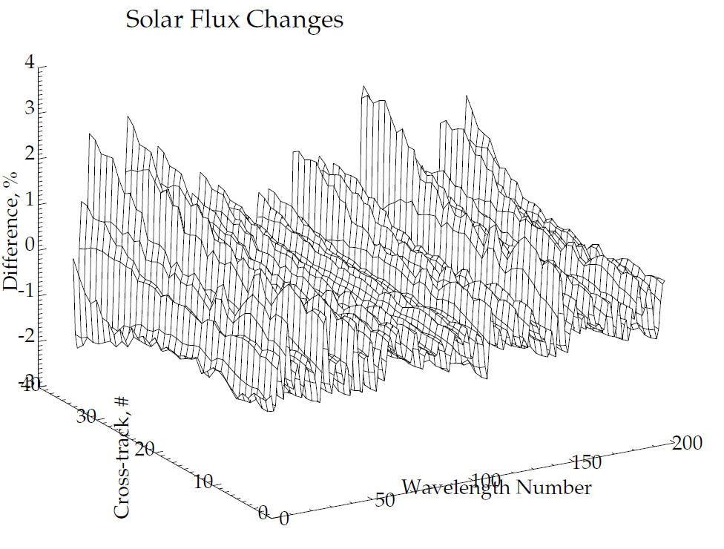
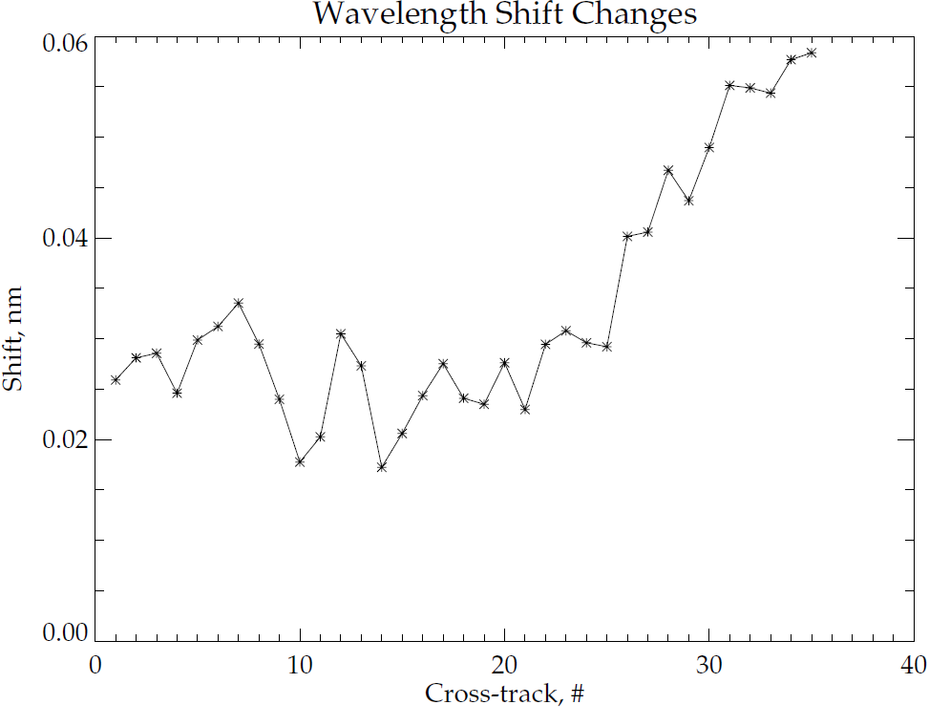
Comparison of Results for Test Granule
SOMTC_npp_d20130205_t1500128_e1500502_b06615_c20130205221511027836_noaa_ops.h5
SOMTC_npp_d20130205_t1500128_e1500502_b06615_c20130812180617128986_ssec_cspp.h5

Slide 18
INCTO/OOTCO Error and Quality Flags
Error Flag
  Bit1 0 good, 1 large residual; Bit2 1 large SO2 Index&; Bit3 1 triplet inconsistency; Bit4 1 ozone out of range; Bit5 1 surface reflectivity out of range.
Quality Flag 1
  Bit1/Bit2 Quality 0 no retrieval, 1 low, 2 medium, 3 high; Bit3 1 input data quality is not good; Bit4 1 triplet selection is not consistent; Bit5 1 inconsistent residuals; Bit6/Bit7 0 SZA<80, 1 80<SZA<88, 2 SZA>88
Quality Flag 2 – Duplicates other flags or information
  Bit1 1 snow/ice present; Bit2 1 sun glint geometry over open water; Bit3 1 solar eclipse in FOV; Bit4 1 TOZ<50 or TOZ>650; Bit5/6 0 TOZ> 450*, 1 250<TOZ<450, 2 TOZ<250, 3 not used; Bit7 1 Aerosol Index Too Large, AI> 0.5; Bit8 Spare
South Atlantic Anomaly Flag – Climatological intensity
  0 0-10%, 1 10-20%, 2 20-30%, 3 30-40%, 4 40-50%, 5 50-60%, 6 60-70%, 7 70-80%, 8 >80%
Scene Condition Flag
  Bit1 0 Descending, 1 Ascending^; Bit2 1 Snow/Ice present #; Bit3 1 Troposheric Aerosols present; Bit4 1 Snow/Ice Fraction > 0; Bit5 1 Solar Zenith Angle (>80º); Bit6 1 Surface Reflectivity (>1.2 or <-0.05)
See references on in the Provisional Presentation for more details on these flags.
&EF B2 the SO2 Index is affecting performance as data with SO2 incorrectly estimated as greater than 6 DU are flagged as poor retrievals.
*QF2 B5/6 can be 0 when the condition is not checked in addition to when the total column ozone is greater than 450 DU. It is not affecting the algorithm performance.
^SCF B1 was not currently set properly according to the orbital A fix was implemented with Mx7.1 in June 2013. path, i.e., by checking the changes in latitude during a measurement. It was almost always set to 1, except for the first and last granules in a sequence of measurements as processed at IDPS. It did not affect the algorithm performance.
#SCF B2 is not currently set properly. It is set to snow/ice present almost everywhere. It is inconsistent with SCF B4 Snow/Ice Faction > 0. It is not affecting the algorithm performance.

Slide 19
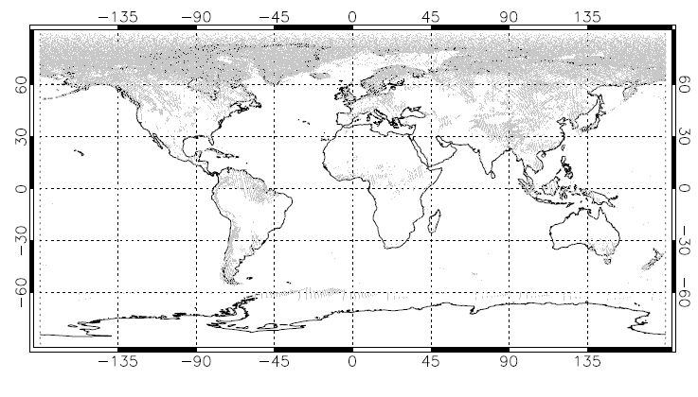
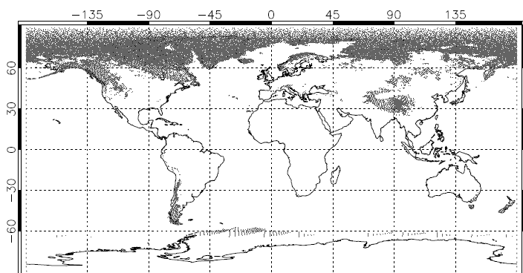
Bad Snow/Ice from VIIRS NRT. Figure shows results for a day in July 2014. Top is for VIIRS NRT product. Bottom is for Weekly tilings

Slide 20
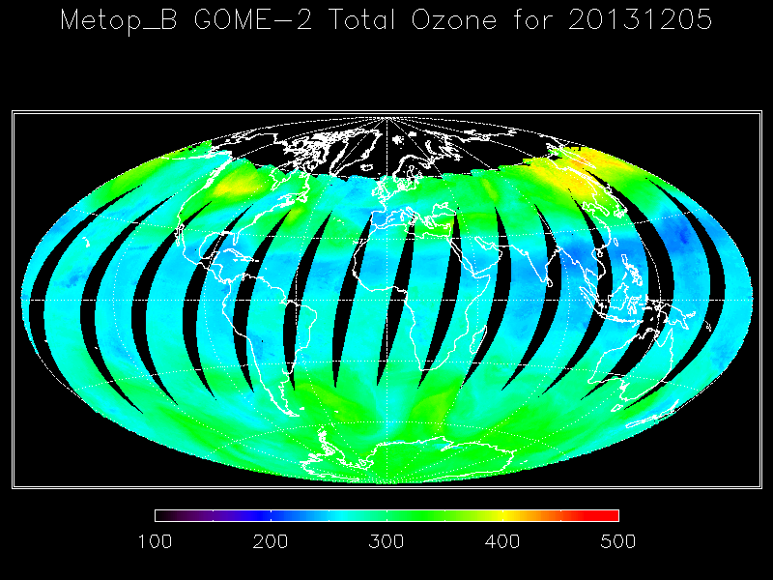
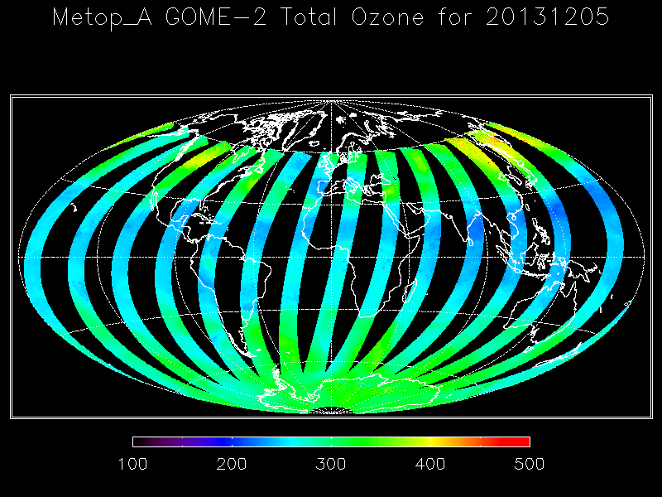
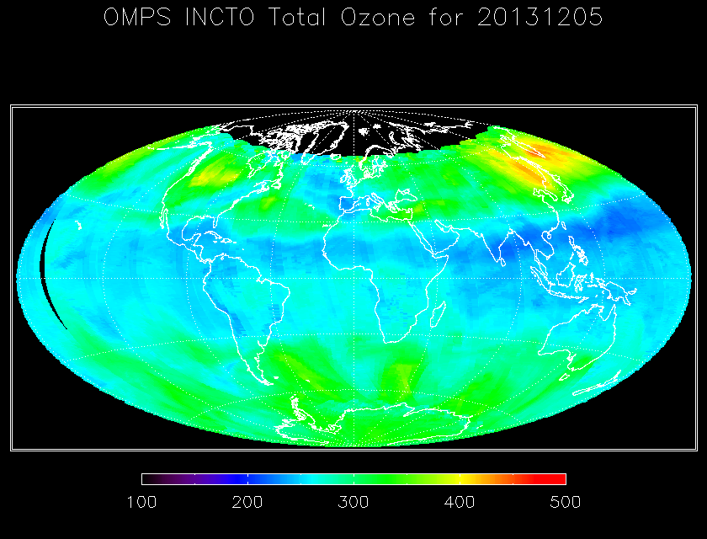
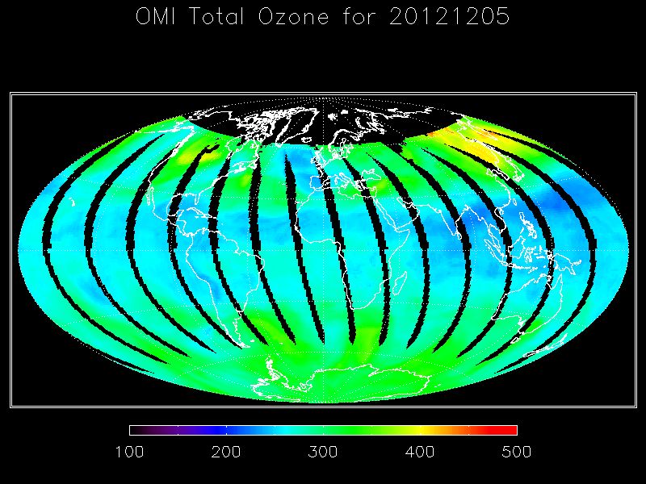
Comparisons among Total Column Ozone Products for MetOp-A/B GOME-2, NASA EOS Aura OMI and S-NPP OMPS (First Guess IP)

Slide 21
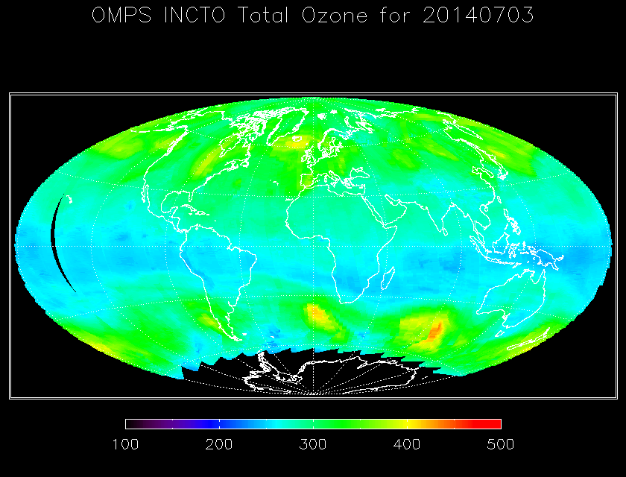
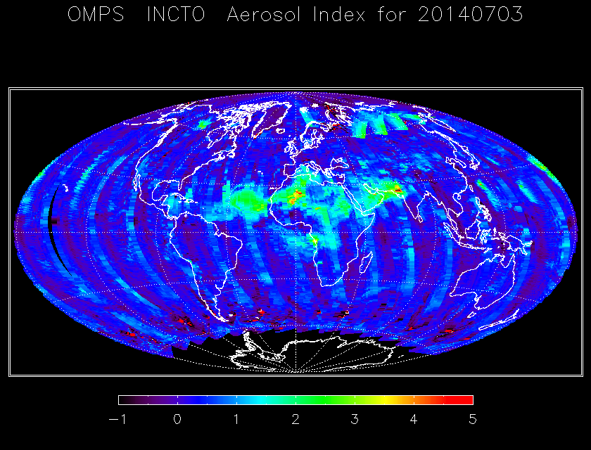
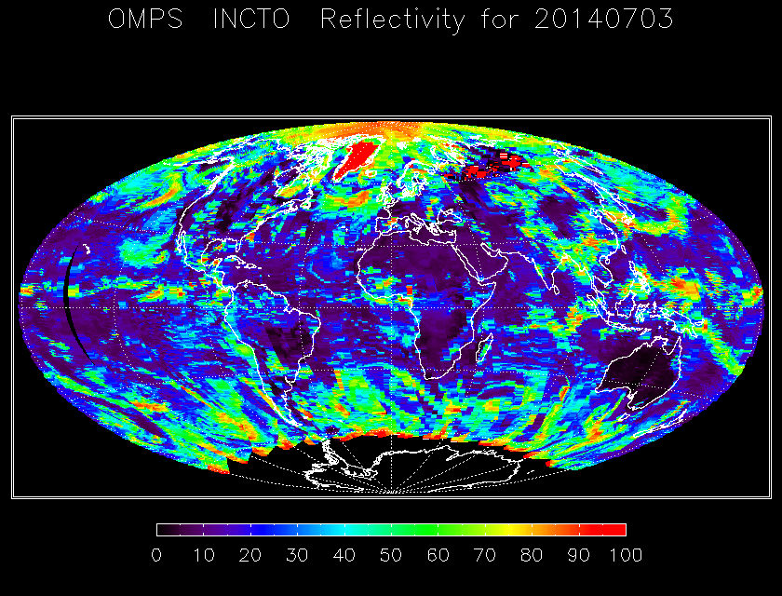
Current S-NPP OMPS (First Guess IP) products for July 3, 2014. Total Column Ozone, Effective Reflectivity and Aerosol Index.
Notes:
Need OMI Figure……

Slide 22
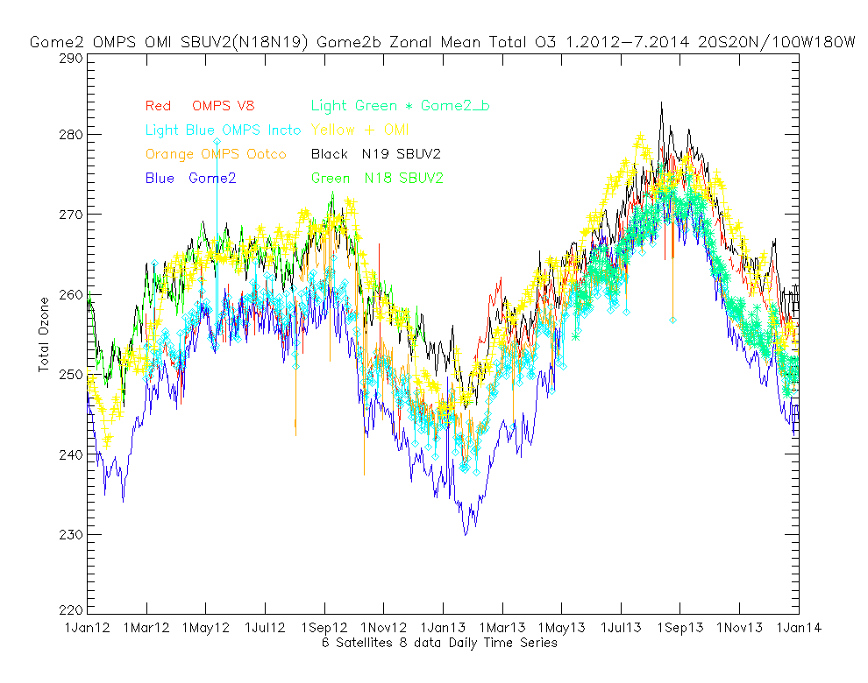

Slide 23
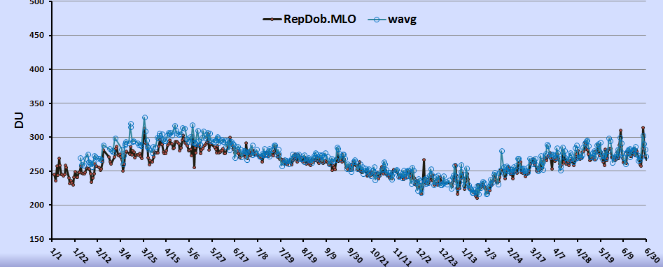
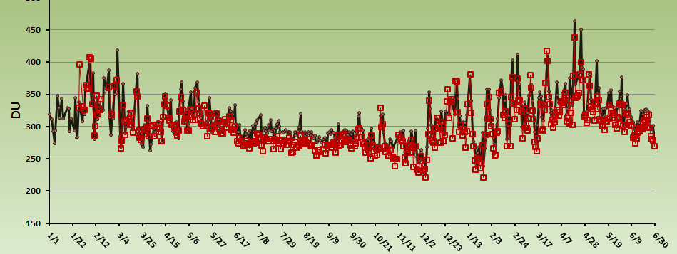
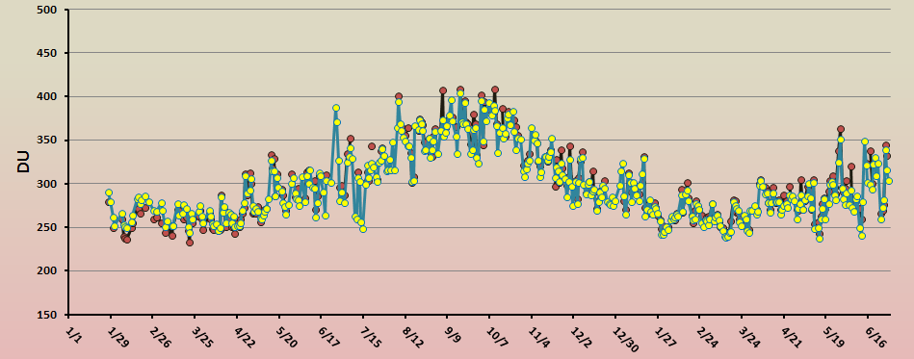
Comparisons of INCTO to three very good Dobson ground stations 1/2012 to 6/2013.
Notice the shift in biases in June 2012 with the introduction of new solar flux and wavelength scales.
INCTO and Dobson Mauna Loa 2012/2013
INCTO and Dobson Boulder 2012/2013
INCTO and Dobson Lauder, NZ 2012/2013

Slide 24
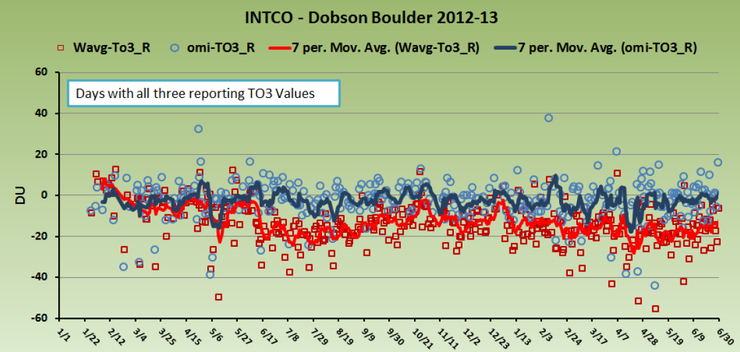
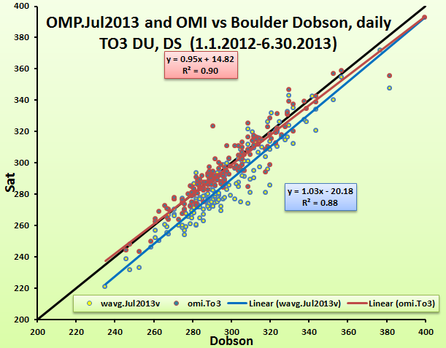
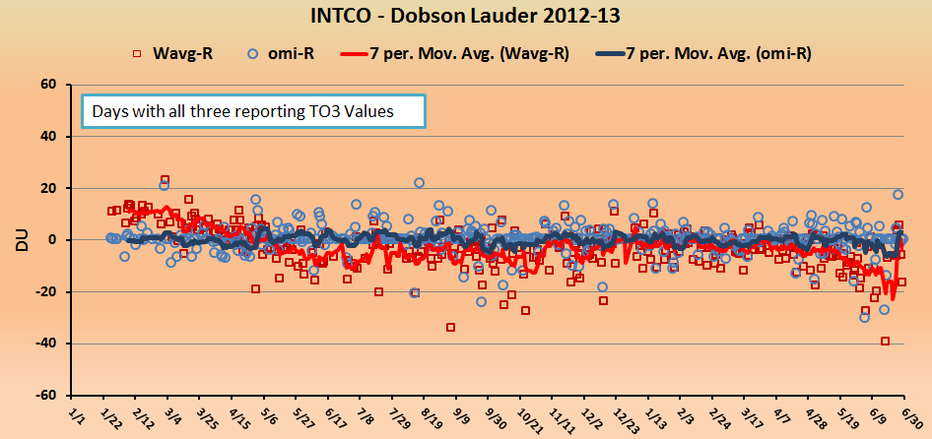
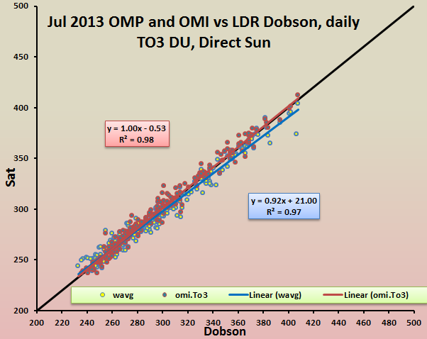
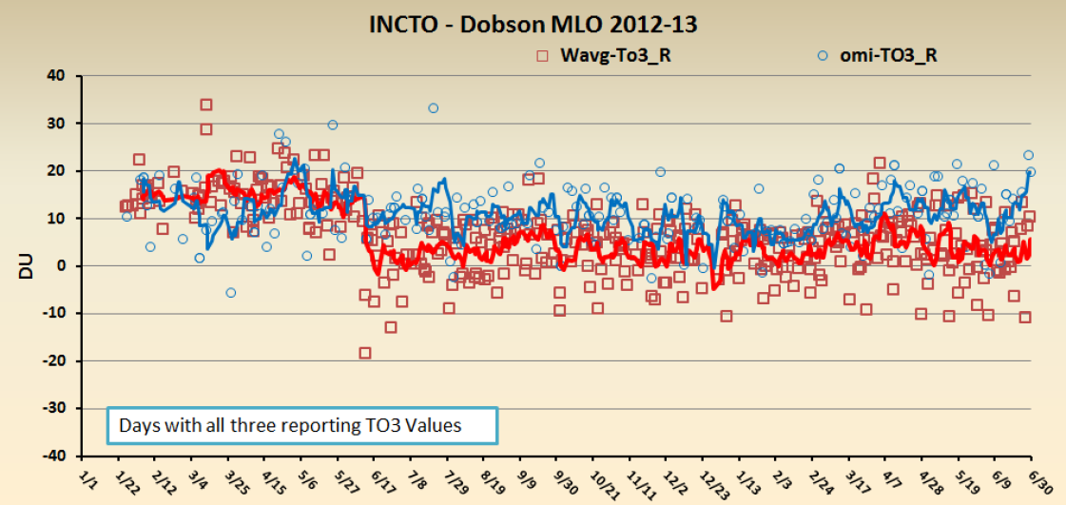
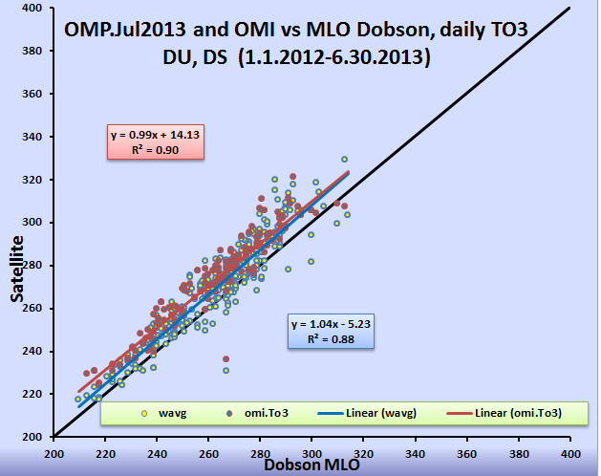
Blue OMI V8
Red OMPS INCTO
Red OMI V8
Blue OMPS INCTO

Slide 25
Nine Things to Know about the OMPS NM SDR
System linearity is stable and well-corrected.
Dark currents continue to trend higher but measurement signal-to-noise ratios remain high – weekly dark updates are flowing into the system and have good accuracy. The SAA dark strategy has been revised.
The offset biases are actually variable but the current constant corrections are superfluous unless they create negative radiances. They have intentionally been set to lower values to avoid zero truncation of negative intermediate quantities.
Stray light corrections are in place and an improvement for out-of-range contributions has been provided. Remaining errors are small.
Intra-orbital wavelength scale drifts have been identified and are related to variations in thermal gradients. A measurement-based approach to providing better estimates for each granule has been implemented. Day 1 solar wavelength scales will be set at the averages of the orbital excursions.
Transient spikes are affecting a very small fraction of smear calculations. Possible solutions are under discussion.
A second round of Day 1 Solar spectra with soft calibration adjustments is under development.
Soft calibration adjustments will remove much of the inter-triplet imprecision and cross-track biases and provide a zero-mean SO2 index.
The two and a half years of solar measurements show good long-term stability of instrument throughput and wavelength scales.

Slide 26
Instrument Performance – OMPS NM
Requirement | Specification/Prediction Value | On-Orbit Performance
Non-linearity | < 2% full well | < 0.46%
Non-linearity Knowledge | < 0.5% | ~0.1%
On-orbit Wavelength Calibration | < 0.01 nm | 0.01 nm#
Stray Light NM Out-of-Band + Out-of-Field Response | ≤ 2 | average ~± 0.5%^
Intra-Orbit Wavelength Stability | <0.02 nm | < 0.01 nm*
SNR | >1000 | > 1000 from SV and EV
Inter-Orbital Thermal Wavelength Shift | <0.02 nm | <0.01 nm
CCD Read Noise | <60 –e RMS | < 25 –e RMS
Detector Gain | >46 | ~42
Absolute Irradiance Calibration Accuracy | < 7% | 5%
Absolute Radiance Calibration Accuracy | < 8% | < 5%
# After new analysis for Day 1 wavelength scale.
^ After ground-based correction for TOz algorithm channels.
* After intra-orbit adjustments.
C. Pan
Notes:
From SDR provisional presentation with new notes by L. Flynn.

Slide 27
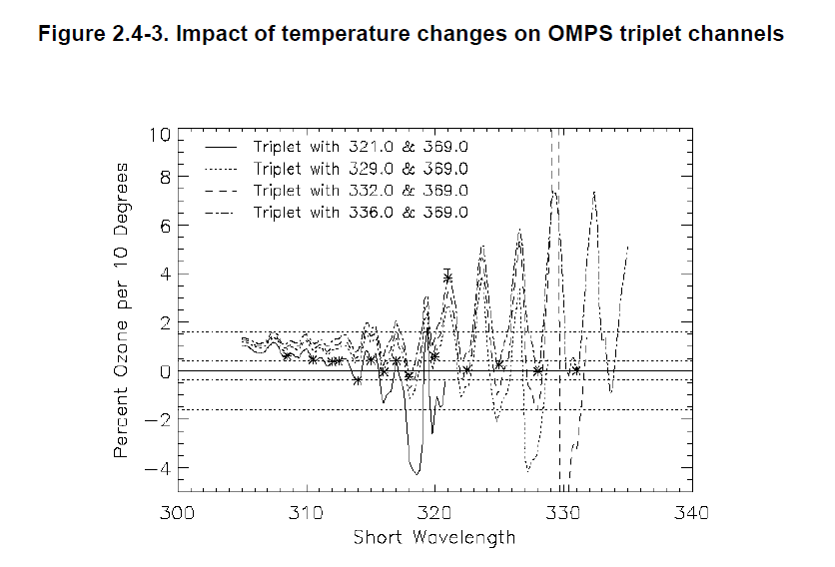
Example of Triplet Sensitivity Analysis
Notes:
From ATBD.

Slide 28
Documentation
The following documents will be updated and provided to the EDR Review Board before AERB approval:
  ATBD
474-00029 Joint Polar Satellite System (JPSS) OMPS NADIR Total Column Ozone Algorithm Theoretical Basis Document (ATBD) 20110422
  OAD
474-00066 Rev E: Joint Polar Satellite System (JPSS) Operational Algorithm Description (OAD) Document for Ozone Mapping and Profiler Suite (OMPS) Total Column (TC) Environmental Data Records (EDR) Software
  Updating Provisional README file for CLASS
Notes:
(CCR-14-1976 for Rev F) of 474-00077 NM SDR

Slide 29
Identification of Processing Environment
IDPS Mx8.6 (with planned revision for Mx8.8 February 2015)
The algorithm version is the Multiple Triplet IP and EDR algorithm.
    The EDR and First Guess IP have been converging in their use of external data. NRT products from VIIRS and CrIS are replaced with internal calculations, forecasts and UV specific climatologies.
IDPS Build: I1.05.08.05 (Mx 8.5)
EDR version: Mx 8.5
LUT Version: PS-1-O-CCR-13-0829-JPSS-DPA-002-PE
PCT Version: N/A
Environment for testing: Linux (ADL Mx 8.x) and AIX (ADA Mx 8.x)

Slide 30
Users & User Feedback
Users list
  NCEP, NASA, NRL, Environment Canada, EuMetSat
Feedback from users
  BUFR product in testing at NCEP, EC, and EuMetSat
Downstream product list
  NCEP assimilation (UV Index and weather)
  Ozone Hole Monitoring (Stratospheric Summaries)
  Ozone Layer Assessments
Reports from downstream product teams on the dependencies and impacts
  Calibration bias creates offsets with OMI total ozone products
  Request for V8TOz algorithm for consistency with OMI, GOME-2 and SBUV/2.

Slide 31
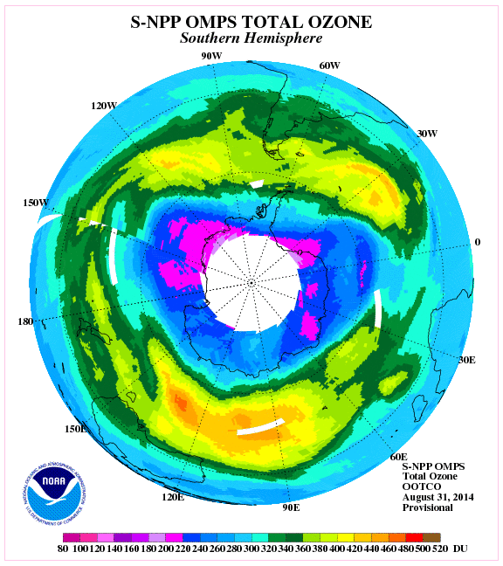
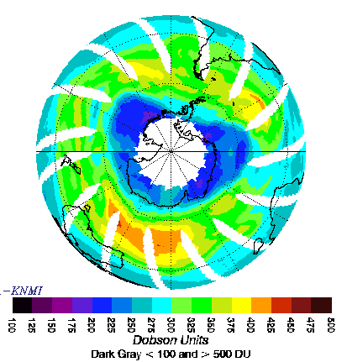
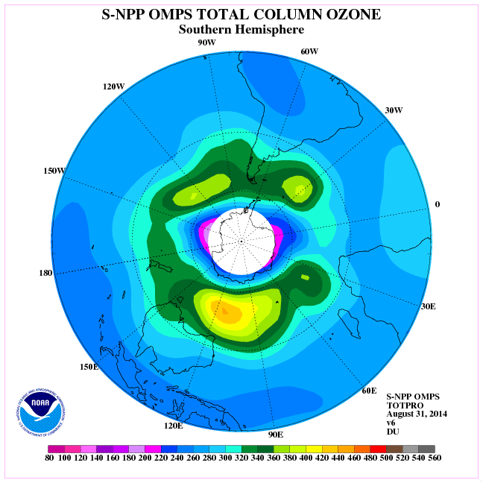
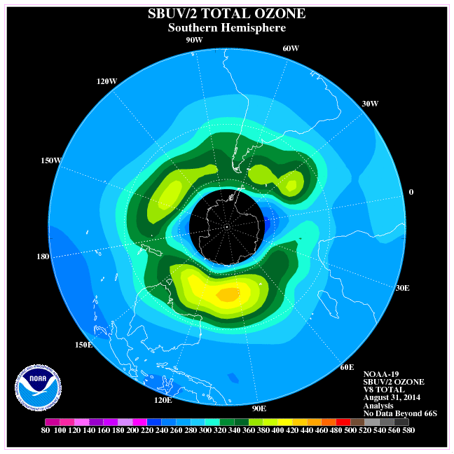
Total Column Ozone : Aug 31, 2014
OMPS NM
TOTAL OZONE
OMI
TOTAL OZONE
OMPS NP v6
SH
TOTPRO
SBUV/2 v8
SH
TOTPRO

Slide 32
Conclusions
Cal/Val results summary:
  Team recommends Validated Stage 1 Maturity
    Products in OOTCO (EDR) flagged with snow/ice present should not be used until VIIRS input is replaced. Products in INCTO (First Guess IP) are good.
    Data will have small changes in performance when CrIMSS temperature products are replaced with forecasts.
    Products will meet performance requirements after three Key SDR CCRs are implemented.

Slide 33
Path Forward
Planned further improvements
  Implement V8TOz with true SO2 retrieval using the OMI Linear Fit algorithm.
  Adapt system to process smaller FOV products.
Planned Cal/Val activities / milestones
  December 2014 Demonstrate reduced bias (and better cross-track consistency) of OMPS Column Ozone products with improved SDR versus OMI and SBUV/2
  March 2015 complete global validation with corrected snow/ice fields and forecast temperatures for Validated Stage 2.
  July 2015 demonstrate validation for annual variations and stability of products for Validated Stage 3.
Notes:
DR 7753(OMPS)-TC EDR VIIRS Cloud Fraction clean up
DR 7754(OMPS)-TC IP Temperature correction
DR 7235(OMPS)- Impact of missing CrIS data on OMPS retrievals
DR 7044(OMPS)- VIIRS snow/ice not well remapped to OMPS

Slide 34
Backup

Slide 35
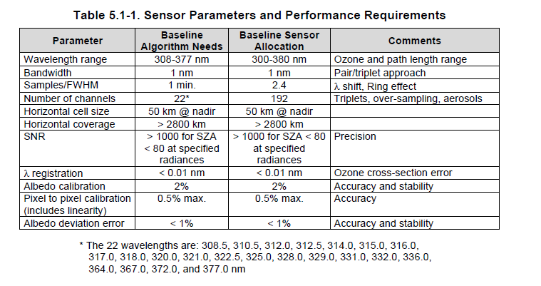
Brief mapping of sensor and algorithm performance
Pixel to pixel calibration will contribute to both Accuracy and Precision error budgets.
Notice that this allocation is at the 0.5% level.

Slide 36
Requirements (1 slide)
Product Requirements from JPSS L1RD
Attribute | Threshold | Objective
Geographic coverage
Vertical Coverage
Vertical Cell Size
Horizontal Cell Size
Mapping Uncertainty
Measurement Range
Measurement Accuracy
Measurement Precision
Measurement Uncertainty

Slide 37
Error Budget
Compare analysis/validation results against requirements, present as a table. Error budget limitations should be explained. Describe prospects for overcoming error budget limitations with future improvement of the algorithm, test data, and error analysis methodology.
Attribute Analyzed | L1RD Threshold | Analysis/Validation Result | Error Summary

Slide 38

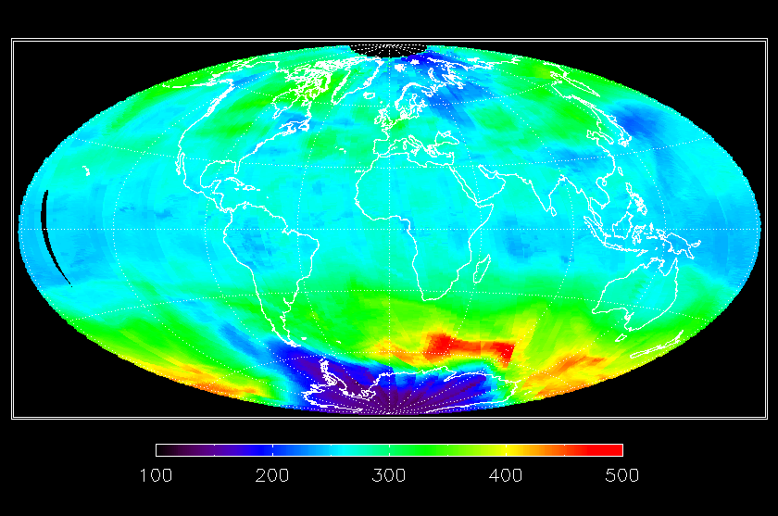
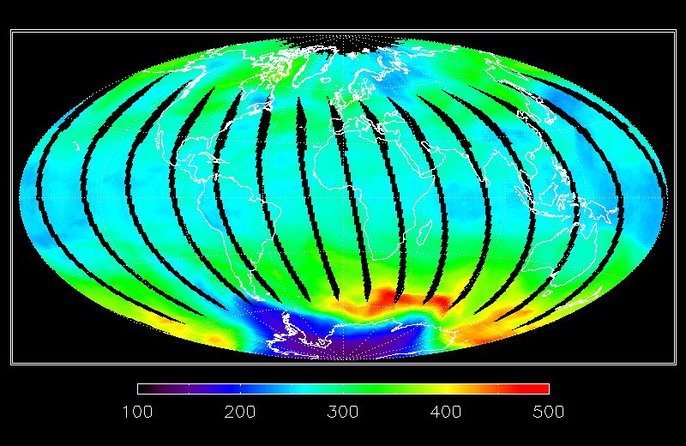
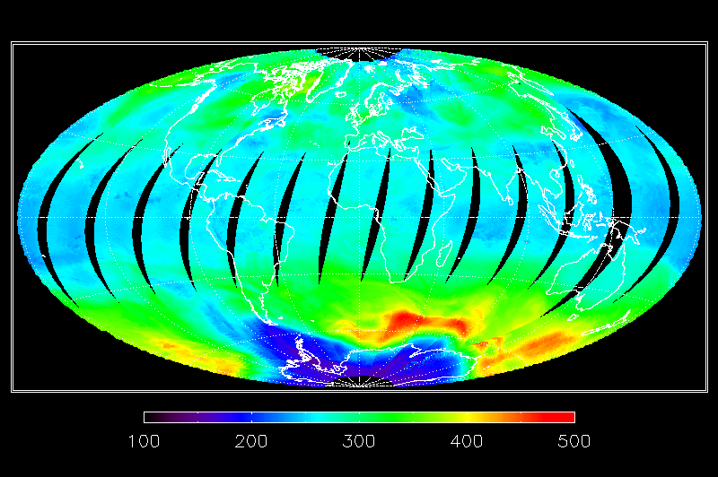
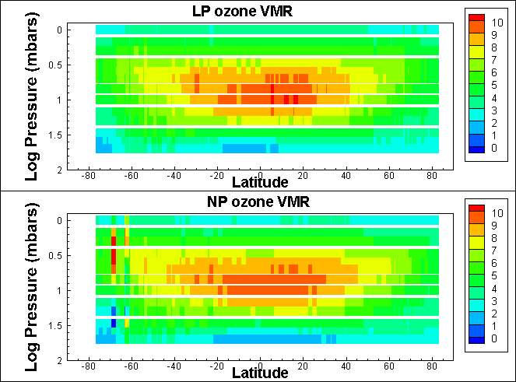
Provisional Maturity for S-NPP OMPS EDR products
Supports the CLIMATE Mission and the WEATHER & WATER Goals
The Ozone Mapping & Profiler Suite (OMPS) was launched on the Suomi National Polar Partnership (S-NPP) satellite on October 28, 2011. The OMPS is the next generation of operational ozone sensors for NOAA. Its products will replace existing ones from the Solar Backscatter Ultraviolet (SBUV/2) instruments.
NOAA/NESDIS has provided validation and analysis of the Total Column and Nadir Profile operational ozone products from the Interface Data Processing Segment (IDPS) to justify their advance to Provisional Maturity. This will be applied retroactively to the products as of March 1, 2013. Findings presentations & ReadMe files are provided with the products at CLASS.
Total Ozone (DU) from S-NPP OMPS (top left), NASA EOS Aura OMI (top right) and MetOp-A GOME-2 (lower left) total ozone maps for October 4, 2012. Ozone Hole conditions (< 220 DU) are present at the southern tip of South America.
The two figures on the right compare the OMPS Limb Profiler and Nadir Profiler ozone profiles for September 6, 2012. They show the zonal mean mixing ratios at pressures from 100 to 1 mbars versus Latitude. The Limb data has been smoothed vertically to be similar to the Nadir resolution. Refinements of both products are continuing. (Limb Profiler data and figures are from the NASA OMPS NPP Science Team.)
Significance: The OMPS instruments provide the measurements to continue monitoring atmospheric ozone.
Slide courtesy of L. Flynn; Maps by W. Yu.
Notes:
Profile figure from D. Rault

Slide 39
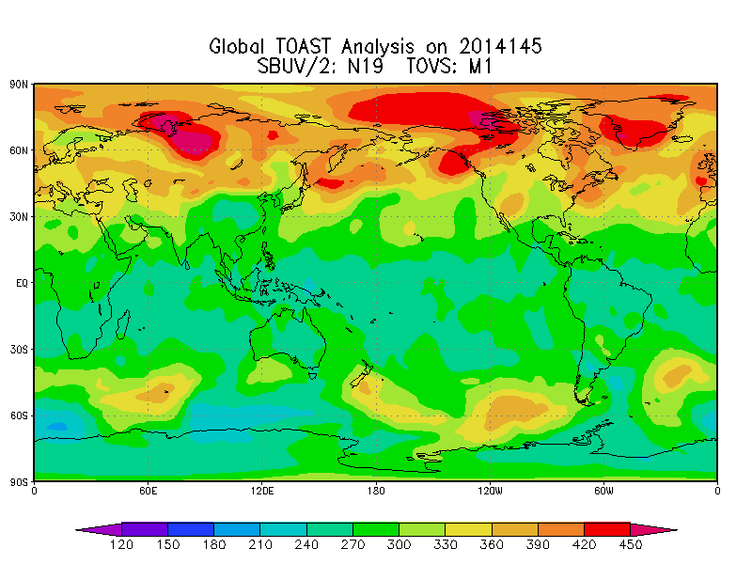
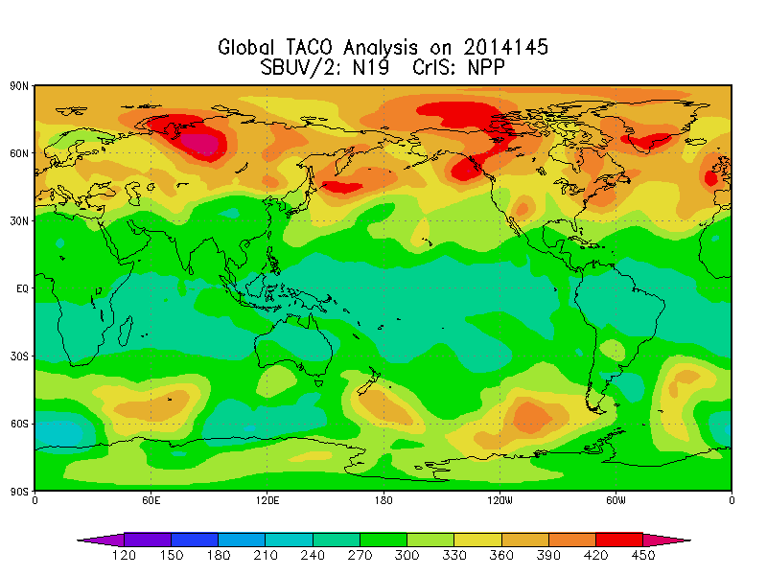
New Products from S-NPP OMPS
Supports the CLIMATE Mission and the WEATHER & WATER Goals
The Ozone Mapping & Profiler Suite (OMPS) was launched on the Suomi National Polar Partnership (S-NPP) satellite on October 28, 2011. The OMPS is the next generation of operational ozone sensors for NOAA. Its products will replace existing ones from the Solar Backscatter Ultraviolet (SBUV/2) instruments.
NOAA/NESDIS are now providing BUFR versions of the OMPS Nadir Ozone Profile and Total Column maps to users in NRT from the NDE system. This format is compatible with applications for the NWS and other operational users.
A newer version of the combined UV/IR total ozone maps (called TACO) using information from the CrIS Ozone product in place of HIRS is now in operational production at OSDPD. As soon as the OMPS Ozone Profile product advances to validated maturity, it will use that information in place of the SBUV/2 data.
The two figures on the right compare the current TOAST Product using HIRS and SBUV/2 (top) with the new (TACO) one using CrIS and SBUV/2. Validation studies confirm that the CrIS ozone product information is superior to the HIRS single channel retrievals.
Significance: The OMPS instruments provide the measurements to continue monitoring atmospheric ozone.
Slide courtesy of L. Flynn; Maps by J. Niu.

Slide 40
Total Ozone Path to Validation
New Day 1 solar spectra are under development to improve the corrections for intra-orbit wavelength scale variations.
Soft calibration adjustments are also under development to correct for cross-track calibration uncertainties and SO₂ sensitivity.
Both problems show repeatable behaviors that are now well-characterized.
The Total Ozone products from OMPS will be validated by the end of the year.

Slide 41
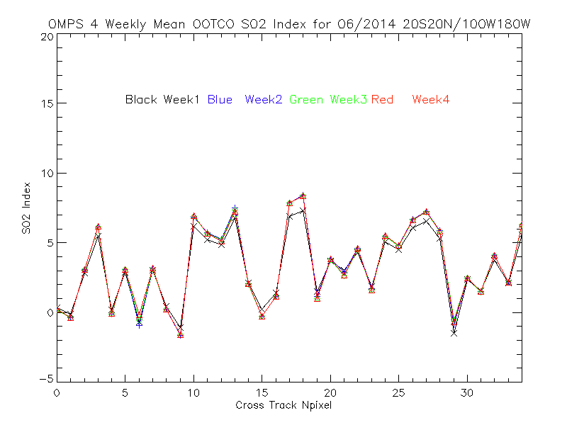
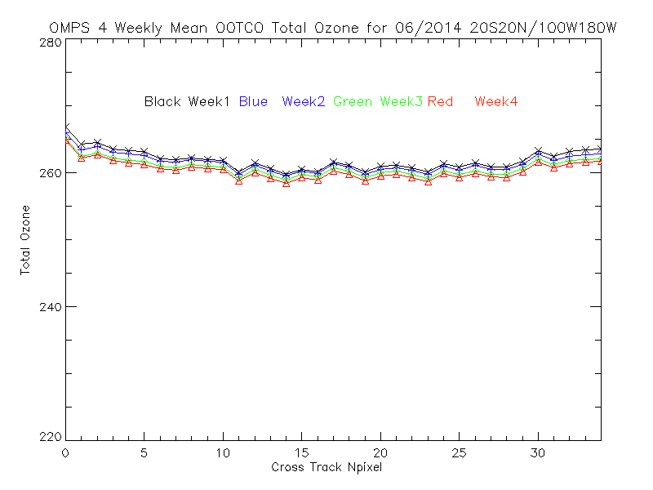
Current Total Ozone Deficiencies
4%
The wavelength quadruplet chosen for
the SO₂ index is too sensitive to calibration uncertainties. This leads to a large number of false positives.
Small uncertainties in the calibration produce a cross-track dependence in the total ozone with satellite view angle
The figures show weekly averages for June 2014 for a latitude/longitude box in the equatorial Pacific. The horizontal axes are cross-track position. These patterns are repeatable and will be removed with soft calibration adjustments.

Slide 42
Future Refinements for the Total Ozone Product
The total ozone product algorithm will be upgraded to the Version 8 TOMS algorithm currently in use at NOAA to produce operational products from the SBUV/2 and GOME-2 instruments.
The new algorithm will include an improved SO₂ product for detection of volcanic eruptions.

Slide 43
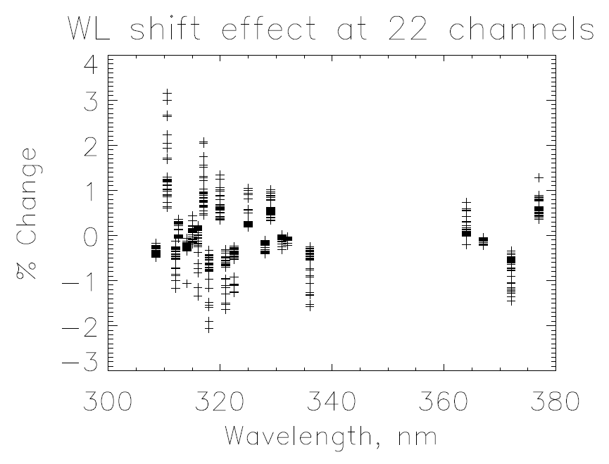
Wavelength shifts can be determined from Earth measurements
The cross-track and triplet differences in these changes contribute to both the accuracy and precision error budget. (DONE)

Slide 44
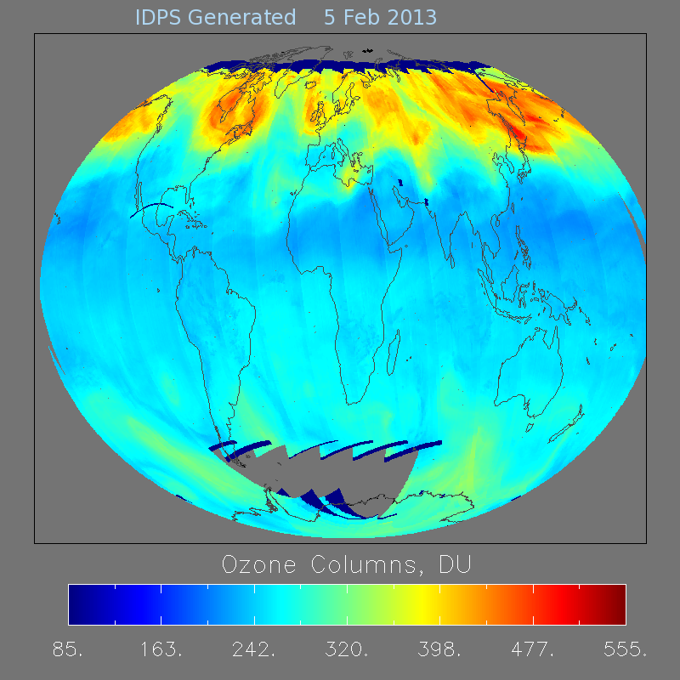
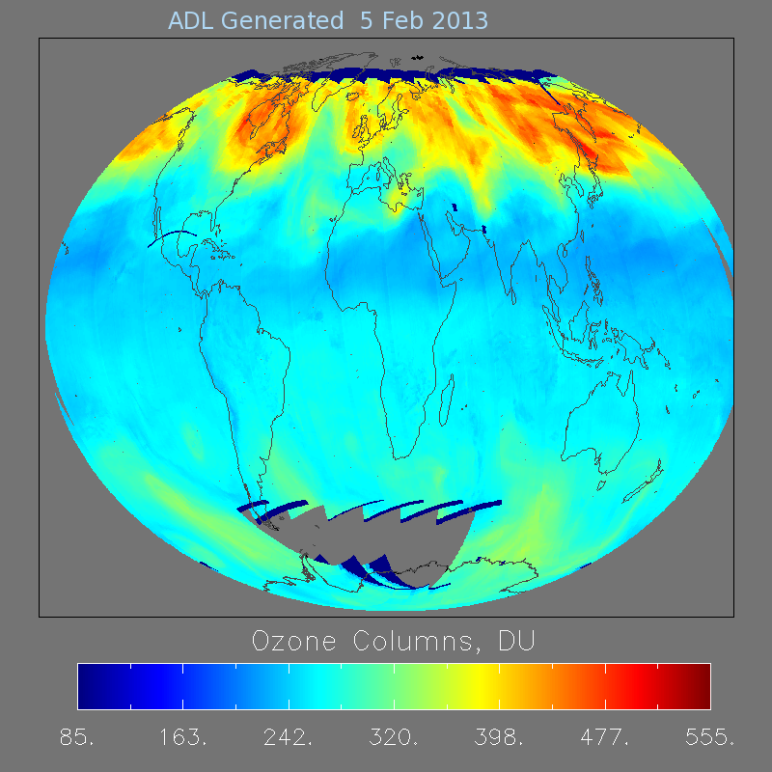
Comparison of INCTO Ozone wo/w wavelength scale knowledge
BEFORE
AFTER
Notice the reduced striping – better cross track consistency

