Slide 1
Validated Stage 1 Science Maturity Review for Surface Reflectance
Eric Vermote
Sept 04, 2014

Slide 2
Outline
Algorithm Cal/Val Team Members
Product Requirements
Evaluation of algorithm performance to specification requirements
  Evaluation of the effect of required algorithm inputs
  Quality flag analysis/validation
  Error Budget
Documentation
Identification of Processing Environment
Conclusion
Path Forward

Slide 3
VIIRS Surface Reflectance Team
Name | Organization | Major Task
Eric Vermote | NASA GSFC | SR EDR Algorithm Lead
Alexie Lyapustin | NASA GSFC | SR Cal Val Lead
Sadashiva Devadiga | NASA GSFC Sigma Space Corp | SR QA Lead
Ivan Csiszar | NOAA/STAR | STAR Land EDR Chair

Slide 4
Product Requirements
Attribute | Threshold | Objective
Geographic coverage | Land, Cloud Clear. | Global, All atmospheric condition
Vertical Coverage | NA | NA
Vertical Cell Size | NA | NA
Horizontal Cell Size | Nadir Moderate Resolution: 0.75km Image Resolution: 0.375 km
Mapping Uncertainty
Measurement Range
Measurement Accuracy* | 0.01 + 10% | 0.005 + 5%
Measurement Precision
Measurement Uncertainty
* The performance is dependent on both the spectral band and the magnitude of the reflectance (increased surface brightness results in a multiplicative error of 5%).

Slide 5
Data Product Maturity Definition
Validated Stage 1:
  Using a limited set of samples, the algorithm output is shown to meet the threshold performance attributes identified in the JPSS Level 1 Requirements Supplement with the exception of the S-NPP Performance Exclusions
  Product performance has been demonstrated to comply with the specification using a small number of independent measurements obtained from selected locations, period and associated ground-truth/field program efforts.
  Product is ready for use by centrals and in scientific publications.
  Improved versions could be available as further validation effort over representative conditions continue.

Slide 6
Evaluation of Algorithm Performance
Findings/Issues since Provisional Review
  SRIP not retrieved when SDR is flagged as poor quality: Band quality value “Poor” for each SDR band (bits 0-1: 0: Good, 1: Poor, 2: No Calibration) in most cases results from flagging of dual gain anomaly. SDR values from dual gain anomaly are good and retrieved SRIP under this condition has been found to be good.
  Software bug failing to initialize following variables could result in incorrect value for aerosol quantity flag in QF7 of SRIP when band4 is not retrieved: roatm = NA_FLOAT32_FILL); xrorayp = NA_FLOAT32_FILL; rho_atm_rho_mol = 0.0;
  Out of range aerosol values (retrieved but are outside of the set upper and lower limits) and retrieved high AOT values are unreliable or incorrect. SRIP is not retrieved when AOTIP is flagged as out of range and SRIP cannot be reliably corrected for aerosol if the retrieved AOT is incorrect.
  AOT is flagged as not retrieved when ephemeral water flag is turned ON in Cloud Mask. SRIP is not retrieved.
  Dust model wasn’t reliable. SRIP retrieved using the dust model was found to be of poor quality.

Slide 7
Evaluation of Algorithm Performance
Improvements since Provisional – The IDPS operational version of the SRIP and AOTIP algorithms were revised at Land PEATE to mitigate the issues and the revised algorithm was used to generate improved products in the C11 reprocessing at Land PEATE.
  Bypass SDR quality flag – good quality SRIP retrieved
  Remove the ephemeral water flag check in AOTIP – good quality SRIP retrieved.
  Retrieve SRIP when retrieved AOT is out of range. This change could not reliably fix the issue.
  While calculating the AOT over land skip the dust model.
  No LUT updates

Slide 8


Evaluation of Algorithm Performance
Global browse of Surface Reflectance IP generated using RGB composite of bands 5, 4, and 3 in SRIP – Data Day 2014178
IDPS operational version doesn’t process ocean pixels.
IDPS version of SRIP generated using Mx84 build version of the algorithm.
C11 reprocessing used proposed changes to SRIP and AOTIP algorithm.
IDPS – Mx84
Land PEATE – C11

Slide 9
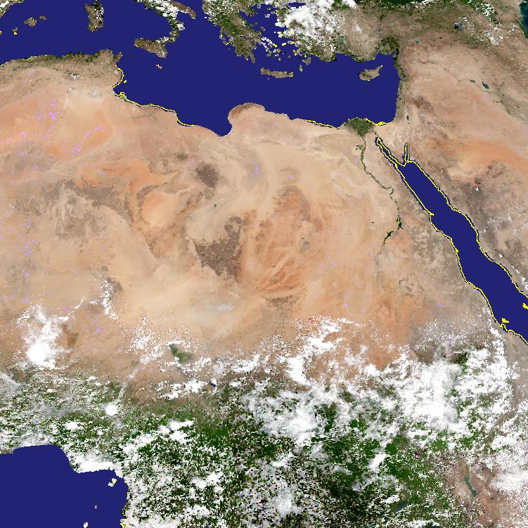
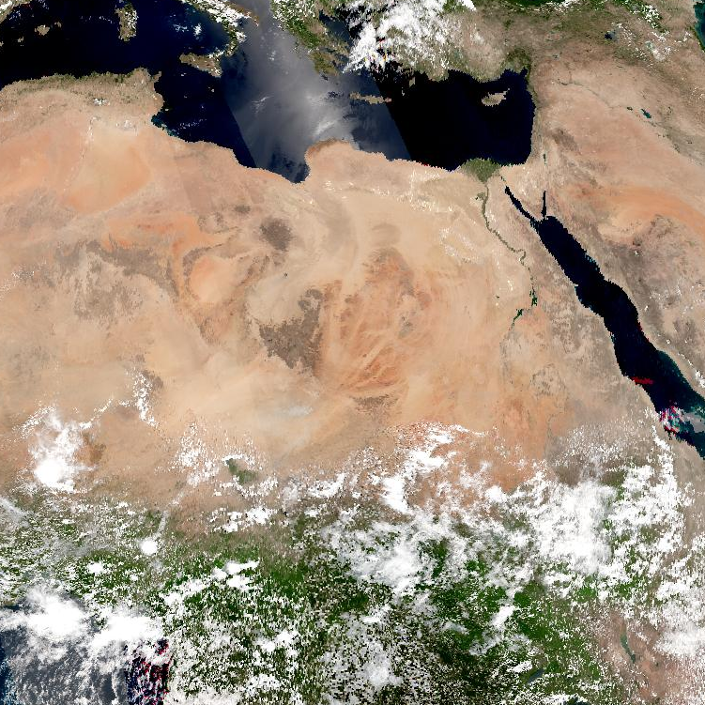
Evaluation of Algorithm Performance
IDPS – Mx84
Land PEATE – C11
One or more bands not retrieved in IDPS version due to bad SDR quality, but is retrieved in C11 reprocessing by ignoring the SDR QF

Slide 10
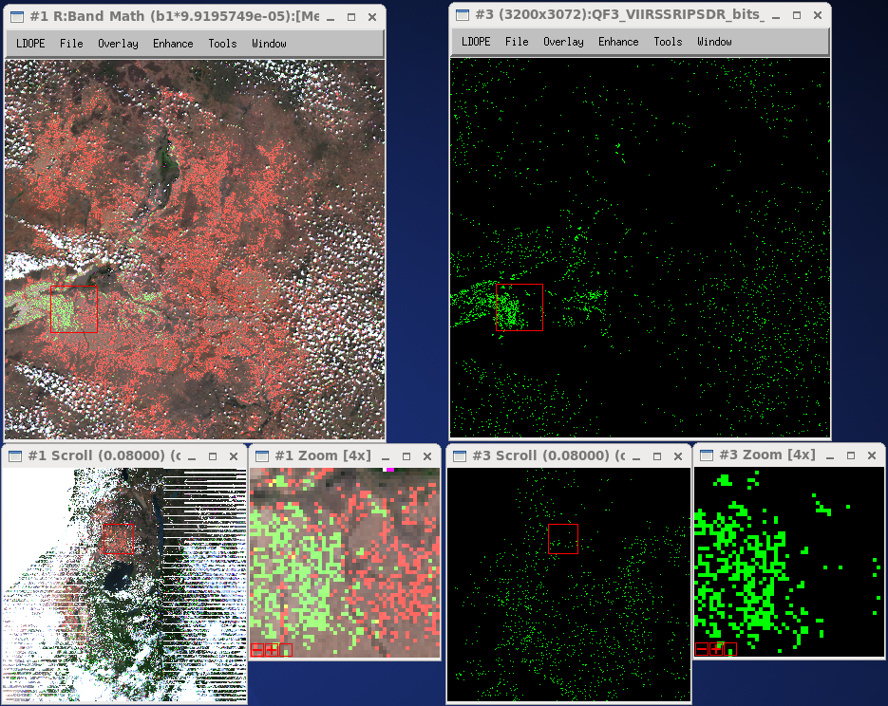
Evaluation of Algorithm Performance
Surface Reflectance, RGB composite of M5, M4, M3: 2014178, granule 11:20 (Africa)
Example: SDR Quality Flag Issue
M4 (Green band) not retrieved in IDPS version.
The SDR quality flag indicate bad quality for M4 SDR (Byte 2, Bit 3)

Slide 11
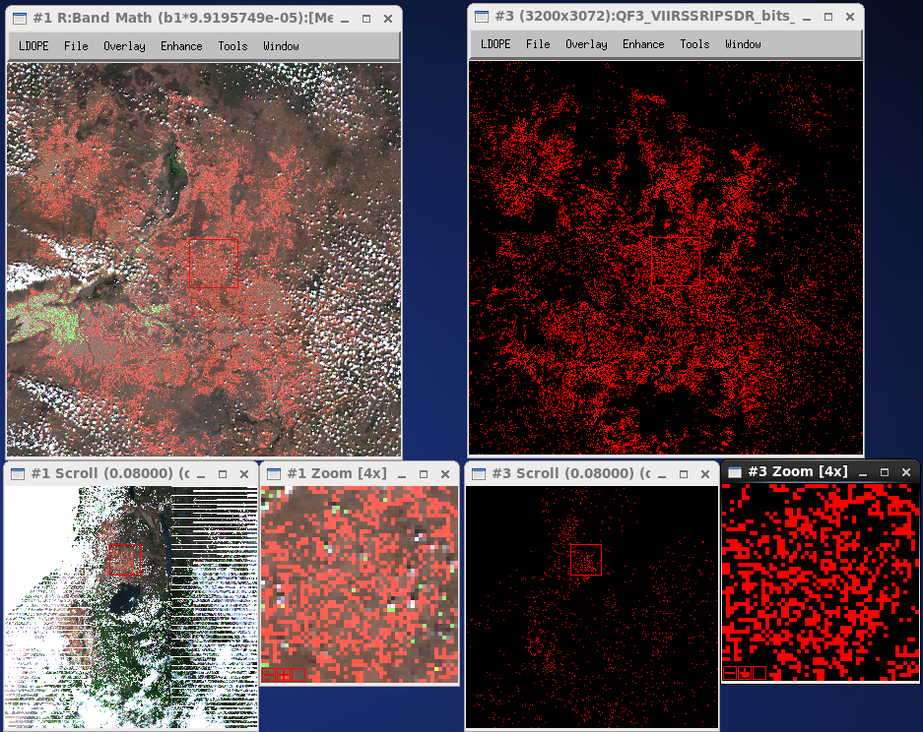
Evaluation of Algorithm Performance
Surface Reflectance, RGB composite of M5, M4, M3: 2014178, granule 11:20 (Africa)
Example: SDR Quality Flag Issue
M5 (Red band) not retrieved in IDPS version.
The SDR quality flag indicate bad quality for M5 SDR (Byte 2, Bit 4)

Slide 12
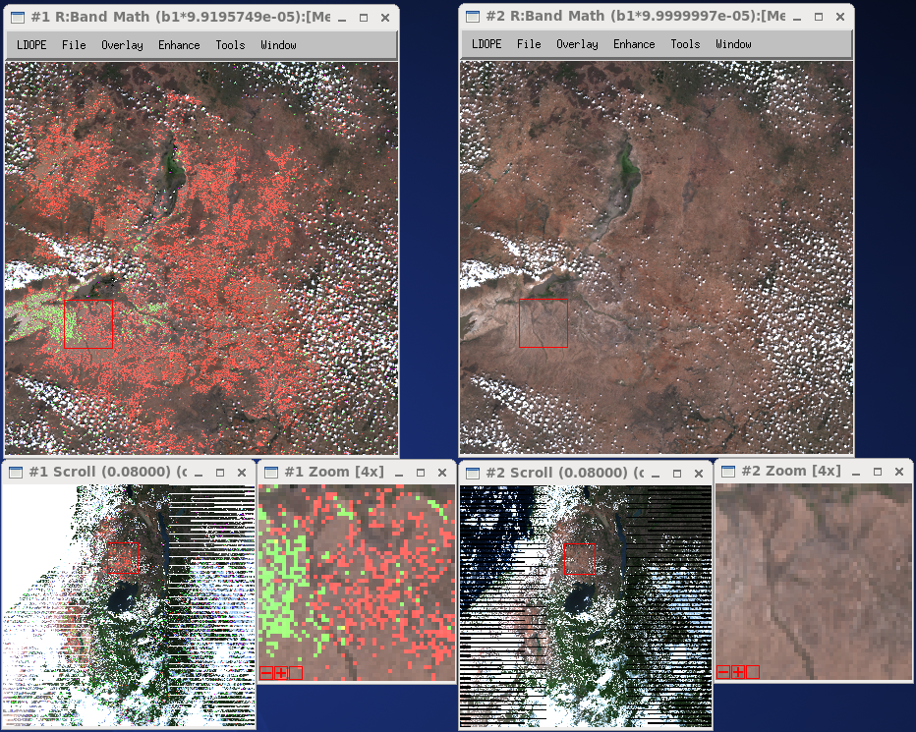
Evaluation of Algorithm Performance
Surface Reflectance, RGB composite of M5, M4, M3: 2014178, granule 11:20 (Africa)
Example: SDR Quality Flag Issue
IDPS – Mx84
Land PEATE – C11
M4 (Green band) not retrieved in IDPS version, but retrieved in C11
M5 (Red band) not retrieved in IDPS version, but retrieved in C11

Slide 13
Evaluation of Algorithm Performance
Cal/Val Activities for evaluating algorithm performance:
  Test / ground truth data sets
  Validation strategy / method
  Validation results

Slide 14
Evaluation of Algorithm Performance
Methodology for evaluating the performance of surface reflectance product (generic)
Subsets of Level 1B data processed using the standard surface reflectance algorithm
comparison
Reference data set
Atmospherically corrected TOA reflectances derived from Level 1B subsets
AERONET measurements
(τ_{aer}, H₂O, particle distribution
Refractive indices,sphericityeri)
Vector 6S

Slide 15
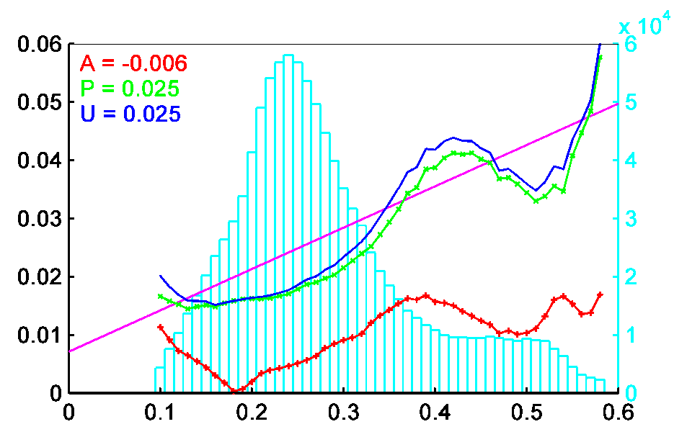
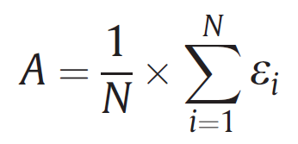
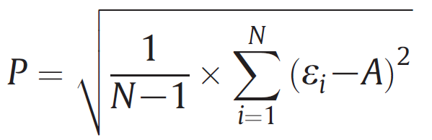
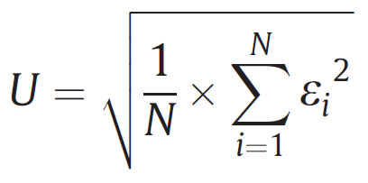
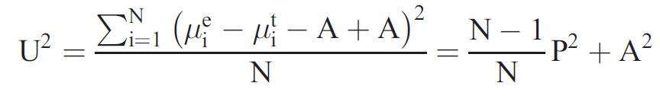
Evaluation of Algorithm Performance
Validation Metrics
Accuracy (A) = the bias
Precision (P) = the repeatability
Uncertainty (U) = the actual statistical deviation
S
A, P, U, S
Number of Occurrences
SR references
Specification (S) = Uncertainty requirement
From Vermote and Kotchenova, 2008

Slide 16
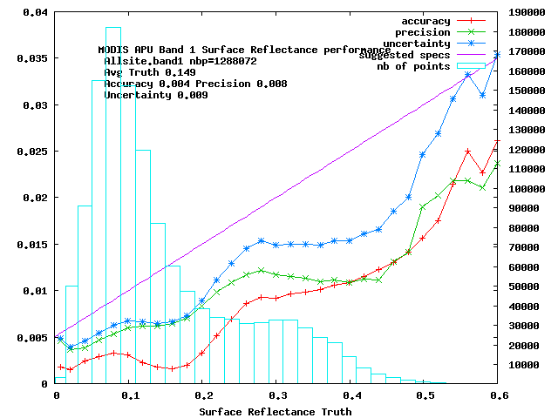
Evaluation of Algorithm Performance
MODIS Collection 5
1,3 Millions 1 km pixels
were analyzed for each
band.
Red = Accuracy (mean bias)
Green = Precision (repeatability)
Blue = Uncertainty (quadatric sum of
A and P)
On average well below magenta
theoretical error bar

Slide 17
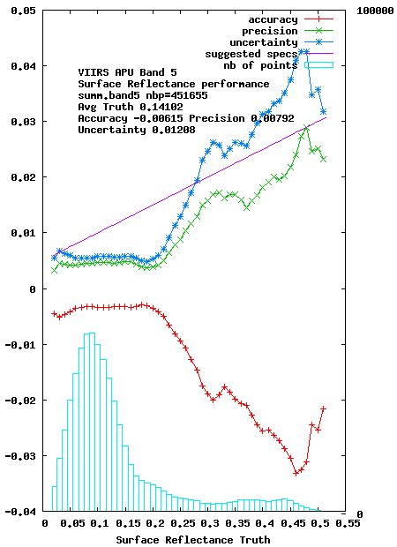
Evaluation of Algorithm Performance
VIIRS C11 reprocessing
450000 pixels
were analyzed for each
band.
Red = Accuracy (mean bias)
Green = Precision (repeatability)
Blue = Uncertainty (quadatric sum of
A and P)
On average well below magenta
theoretical error bar
RED band

Slide 18
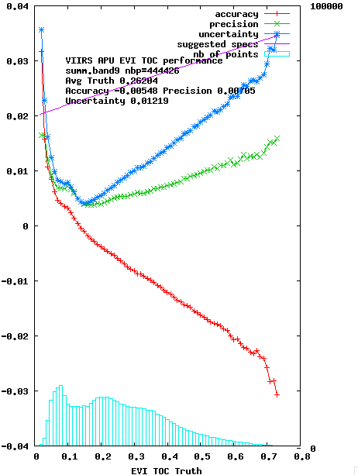
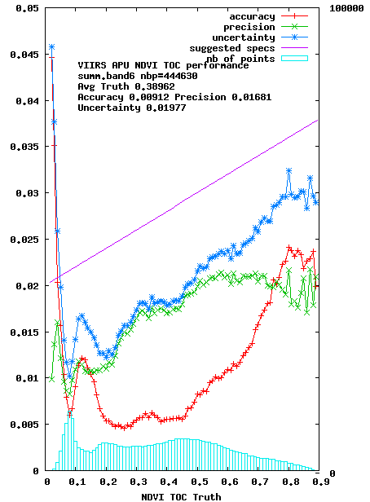
Evaluation of Algorithm Performance
VIIRS C11 reprocessing
NDVI
EVI

Slide 19
Documentation
The following documents will be updated and provided to the EDR Review Board before AERB approval:
  Current or updated ATBD
  Current or updated OAD
  README file for CLASS
  Product User’s Guide (Recommended)

Slide 20
Identification of Processing Environment
IDPS or NDE build (version) number and effective date – date the future build version addressing the identified DRs is in operation at IDPS
Algorithm version – Build version that would implement the DRs identified in the following slides
Version of LUTs used – operational version on the effective date
Version of PCTs used – operational version on the effective date
Description of environment used to achieve validated stage 1 – C11 reprocessing from Land PEATE

Slide 21
DRs – SRIP
Following DRs should be implemented in the IDPS SRIP process
DR# | Description | Status
DR XXXX (Land - SRIP) | Band quality value of “Poor” for each SDR band (bits 0-1: 0: Good, 1: Poor, 2: No Calibration) in most cases results from flagging the case of dual gain anomaly. SDR values from dual gain anomaly are good and retrieved SRIP under this condition has been found to be good. | Not submitted
DR XXXX (Land – SRIP) | In the SRIP process this Initialization is missing roatm = NA_FLOAT32_FILL; xrorayp = NA_FLOAT32_FILL; rho_atm_rho_mol = 0.0; It affects only if band 4 is not retrieved. The Aerosol Quantity flag in QF7 may not be correct. | Not submitted

Slide 22
DRs - AOTIP
Following DRs should be implemented in the IDPS AOTIP process
DR# | Description | Status
DR XXXX (Land – AOTIP) | Dust model is not working. Skip the dust model while retrieving AOTIP | Not submitted
DR XXXX (Land – AOTIP) | AOTIP sets the AOT Quality as “Not produced” if the Ephemeral Water flag in VCM is tuned ON in VCM. Bypass this check so the AOTIP would retain the default value (high) for the quality flag. | Not submitted
DR XXXX (Land – AOTIP) | AOTIP retrieval at the extreme range may not be correct. C11 reprocessing used the entire retrieved range by ignoring the out of range flag. Quality of SRIP from this change to AOITP didn’t improve. DR recommends that retrieval approach be fixed. This may have been addressed by the DRs 7595, 7596, 7597, 7598, and 4724 | Not submitted

Slide 23
Conclusion
Cal/Val results summary:
  Team recommends algorithm validated stage 1 maturity provided that all identified DRs are implemented

Slide 24
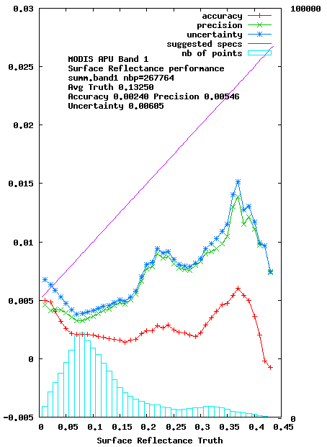
Path Forward
Planned further improvements – Update VIIRS SR (and aerosol) algorithm to MODIS collection 6
Collection 5
Collection 6

