Slide 1
Integrating Uncertainty in
Atmospheric Profile Validation
Tony Reale NOAA
Xavier Calbet AEMET
ITSC-20
Lake Geneva, Wisconsin
Oct 27 to Nov 3, 2015
1

Slide 2
OUTLINE
GRUAN and Uncertainty
NPROVS+
Estimating uncertainty components (
GSICS Article (COSMIC/GRUAN)
Estimating uncertainty components (
NPROVS+ (NUCAPS, AIRS, ECMWF: GRUAN)
Summary
σ, u1 and u2 )
σ, u1 and u2 )
2

Slide 3
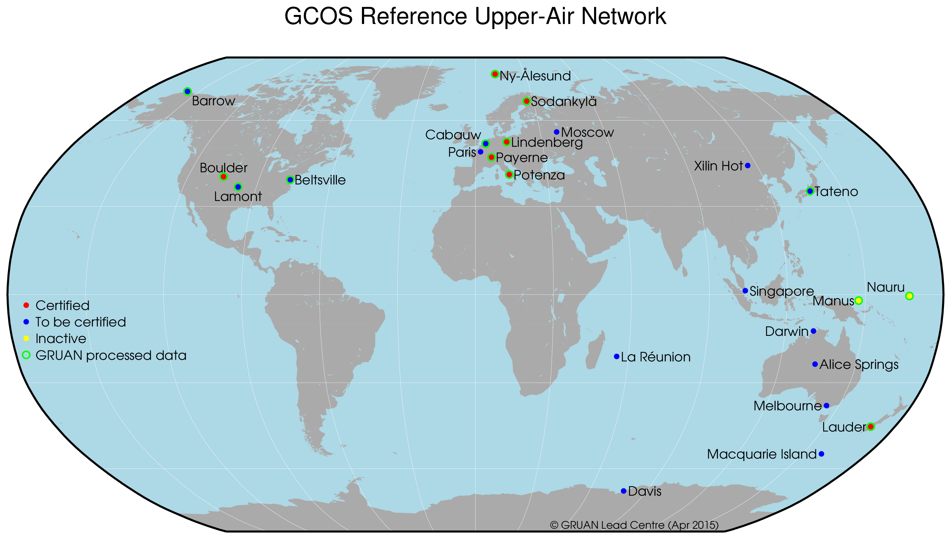
GRUAN processed RAOB include traceable uncertainty estimates for T, RH
(see Poster 12p.01)
3
Notes:
Latest GRUAN network
3

Slide 4
GRUAN Reference Measurement Principles
Given two measurement (m1, m2), their uncertainty (u₁, u₂) and their
systematic variability (σ), then two observations are consistent if
“k” .le. 2
1)
u2 is GRUAN uncertainty … given
u1 is SAT (or NWP) profile uncertainty … needed
σ is systematic variability between platform pair… needed
4
Notes:
u1 and sigma set to 0 in all subsequent plots. This is current restriction in preliminary “k” profile analysis implemented in NPROVS+ analytic interface; I refer to these as worst case scenarios because “K” values get smaller as sum of terms under square root get larger. We will change this later (funding?) to accept u1 and sigma profiles as they become available. Meanwhile, using some basic assumptions discussed in GSICS paper we project what u1 and sigma profiles mite look like

Slide 5
N P R O V S +
JPSS Funded Dedicated RAOB
DOE ARM (SGP, NSA, ENA)
CIMSS
(2) per week
GRUAN processed
dual vs single, etc
AEROSE
CALWATER
PMRF
Sterling Test Site …
+
... need better coordination with “other” intensive field experiments particularly if synchronized with
S-NPP
Global Climate Observing System (GCOS) Reference Upper Air Network (GRUAN)
5
Notes:
The right upper box indicate other (mainly RS92) obs in NPROVS+ that may or may not be in GRUAN. We are working with GRUAN to get all the JPSS funded dedicated (about 100 per site per year at the 3ARM sites) to be GRUAN processed. Mite also mention that GRUAN plans new v3 RS92 processing to correct some problems (also talk to Bomin). GRUAN has already processed portion of AEROSE (S Atlantic) … Bottom roght, we are always looking for more obs
5

Slide 6
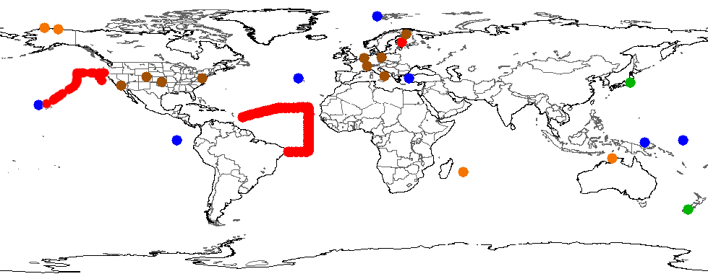
N P R O V S +
*
*
*
*
*
*
Integrated GRUAN and JPSS Funded (* ) Dedicated (S-NPP) RAOB Sites
Over 12,000 RAOBS (2000 Dedicated) since July 2013 … and counting
6

Slide 7
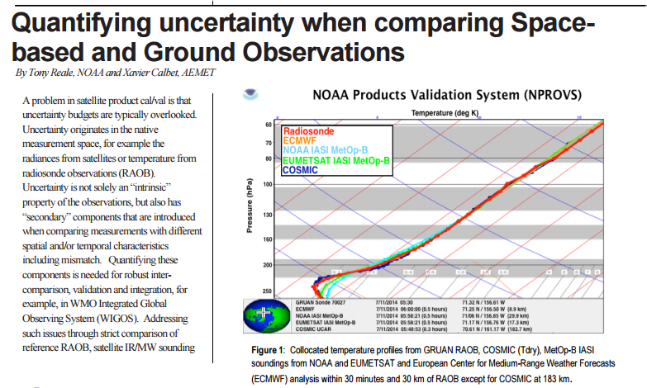
http://docs.lib.noaa.gov/noaa_documents/NESDIS/GSICS_quarterly/v9_no2_2015.pdf
7
Notes:
GSICS article …
7

Slide 8
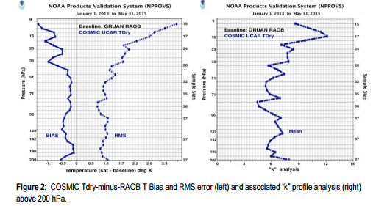
K ~ 6
2
-1.1
1.1
2.2
3
6
9
for k=2, sum under square root (1) is 9 (u1**2)
assuming u1 ~ u2 (0.15), then ~ 0.4K thru layer
σ
8
Notes:
One strategy is to estimate the more elusive sigma as discussed in GSICS Newsletter Article:
Summary:
Review of collocations shows average GRUAN uncertainty for layer (100 to 50 hPa) is about 0.15K. Assuming u1 = u2, “k” approximately 6, for k=2 then sume under square root must be 9 (u1**2); if u1=u2 the sigma = (7**1/2) (u1) ; if u1 about 0.15 ( I averaged these from the collocations) then sigma approximately equla 0.4K
8

Slide 9
Integrating
1) uncertainty based “k” profiles analysis
and
2) traditional specification based satellite products cal/val
provides
more robust cal/val approach :
NOAA NUCAPS
ECMWF
NASA AIRS v.6 (contain error estimates)
9
Notes:
Mom and pop statement. Next set of plots compare NUCAPS, ECMWF and AIRS vs GRUAN RAOB using RMS vs “k” … see Bomin
9

Slide 10
Unlike COSMIC Tdry,
projection of the uncertainty of SAT Temp (or H20)
as some multiple of GRUAN uncertainty
is not justified,
thus we can only address the sum under the square root (1)
However, for NWP Temp,
projection that uncertainty is on order of the GRUAN uncertainty
somewhat justified …
10
Notes:
The trick question is whether it is justified to say the GRUAN Uncertainty vs the uncertainty of given platform being compared to are similar (in vertical shape) or some multiple of each other:
Yes for GRUAN vs ECMWF (temp)
No for GRUAN vs ECMWF (H20)
No for GRUAN vs SAT
Yes for SATR vs SAT
10

Slide 11
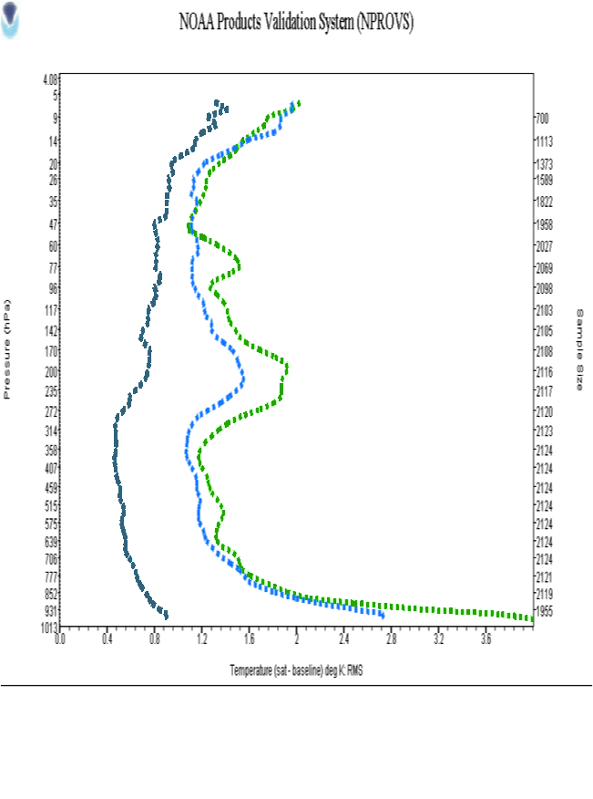
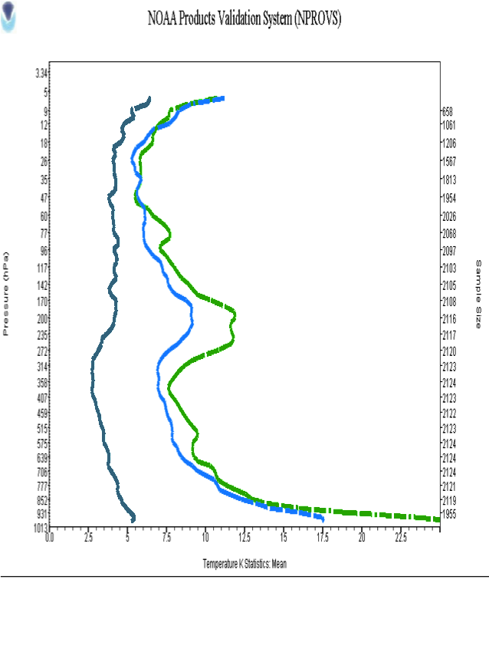
“Spec”
RMS (K)
“k”
based on GRUAN Uncertainty
2
Temperature
Temperature
0.8
1.6
3.5
8.5
Baseline: GRUAN Radiosonde
AIRS AQUA ECMWF NUCAPS NPP
for “k”=2, sum uncertainty under square root (1) in vicinity 500 hPa:
for SAT is 18(u1**2) … for ECMWF is 3(u1**2)
11
σ
for ECMWF, assuming u1 ~ u2 (0.13K), then ~ 0.1K thru layer
Notes:
Similar to GSICS paper, we project what the sum under the sq root sign must be for k=2
Can’t go any further than that for SAT (since the SAT u1 and GRUAN u2 different species) w/o estimate of either sigma or u1 …
But for ECMWF (temp) it is reasonable to assume that uncertainty profiles similar (at least in shape0 to GRUAN . Assuming they are same gives estimate of sigma =0.1. If we assume u1 is 2 (u2) then sigma essentially 0 … get it?
11

Slide 12
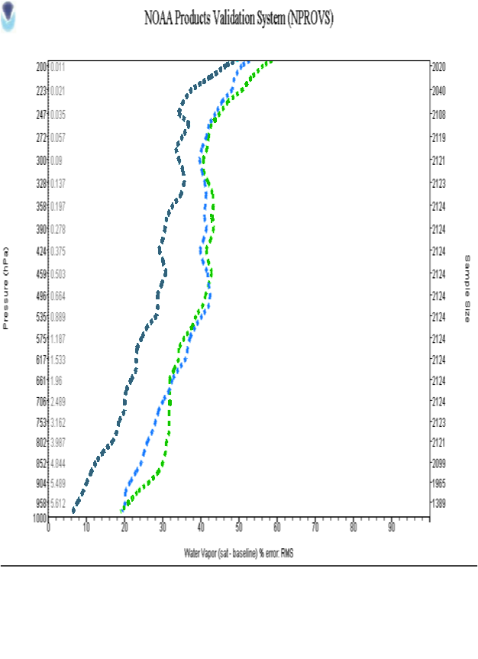
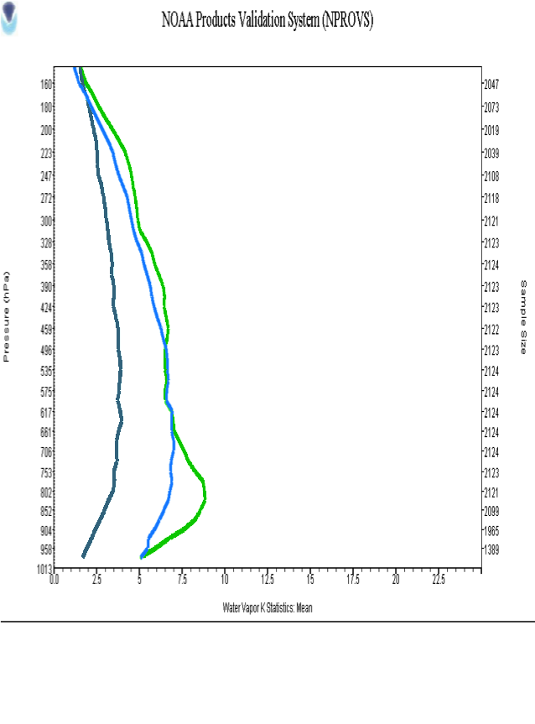
“Spec”
RMS ( % )
“k”
based on GRUAN Uncertainty
2
H20 Vapor Fraction
H20 Mix Ratio
20
35
4
7
Baseline: GRUAN Radiosonde
AIRS AQUA ECMWF NUCAPS NPP
for “k”=2, sum uncertainty under square root (1) in vicinity 600 hPa
for SAT is 12(u1**2) … for ECMWF is 4(u1**2)
12
Notes:
Similar to previous slide but for moisture …
Moisture is a lot trickier as it is initially defined in terms of RH (ie on GRUAN) and then we convert to Mix ratio
I notice also that uncertainty for GRUAN RH is a fn of the RH magnitude (not surprising) which is another erasin we convert to Mix ratio. Unfortunately RH is what RAOB measures so we are a bit stuck
12

Slide 13
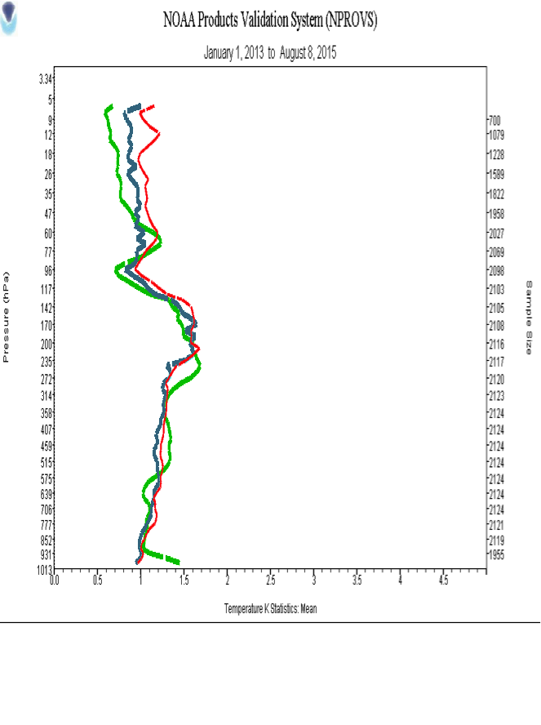
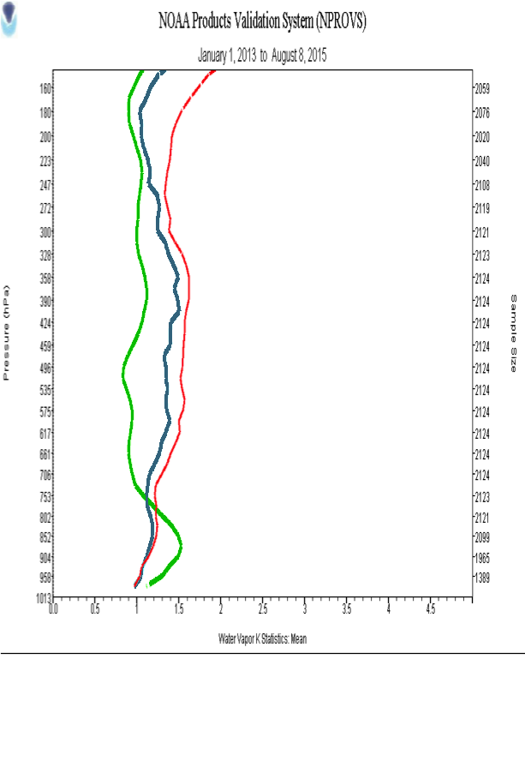
“k”
based on AIRS v6 “error”
“k”
based on AIRS v6 “error”
2
2
Temp
H20 Mix Ratio
Baseline: NASA AIRS v.6
GRUAN Radiosonde ECMWF NUCAPS NPP
All platforms have “k” less than 2 suggesting that reported AIRS v.6 “errors”
much larger than actual AIRS v.6 “uncertainty”
13
Notes:
All systems to the left of “k”=2; this strongly suggests reported AIRS v.6 errors much larger than actual uncertainty
Interesting for moisture that GRUAN has highest “K” , NUCAPS lowest “k” and ECMWF in middle …
13

Slide 14
SUMMARY
GRUAN reference RAOB provide traceable uncertainty
NPROVS+ analytic interface (PDISP) includes preliminary capability to integrate GRUAN uncertainty in “k” profile analysis
Need uncertainty for all profiles (u1) and “σ” for respective profile pairs
Analytic directions (GSICS article) and order magnitude estimate of 0.4K for “σ” in stratosphere for COSMIC Tdry vs GRUAN (u1 ~ u2)
Analytic directions for more robust satellite products cal/val integrating RMS and “k” profile statistics
Preliminary estimate of 0.1K for “σ” in vicinity 500 hPa for ECMWF Analysis vs GRUAN (u1 ~ u2)
Evolving GRUAN / NOAA satellite synergy … 3G, GAIA-CLIM, etc
14

