Slide 1
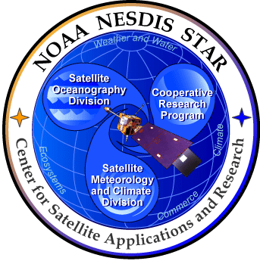
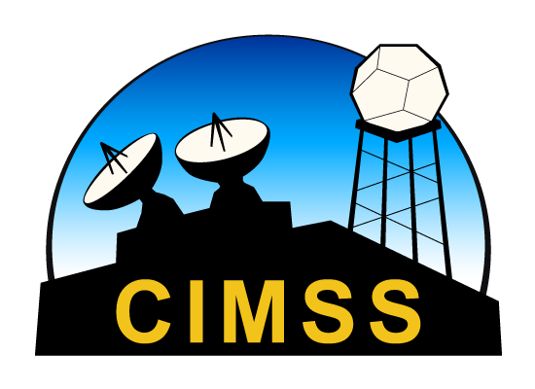
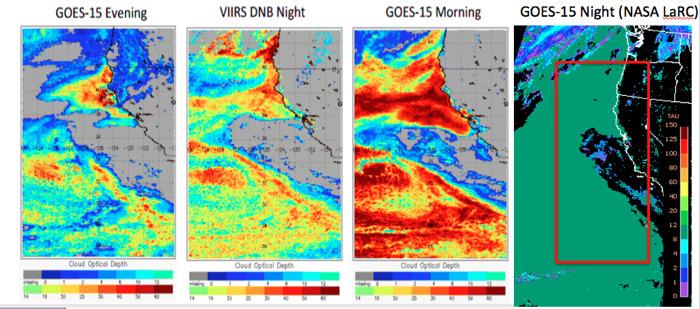
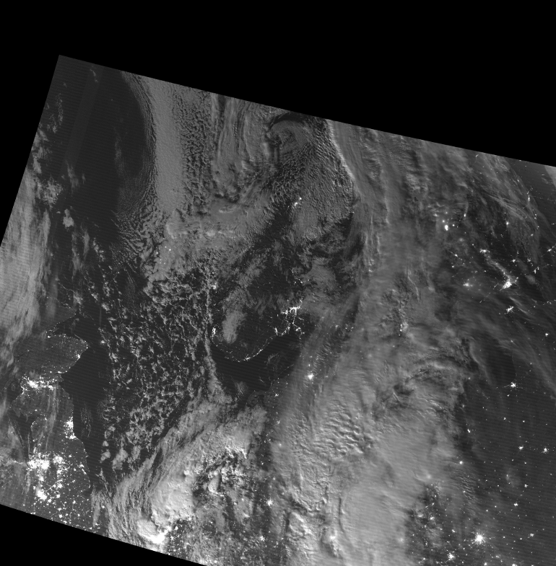
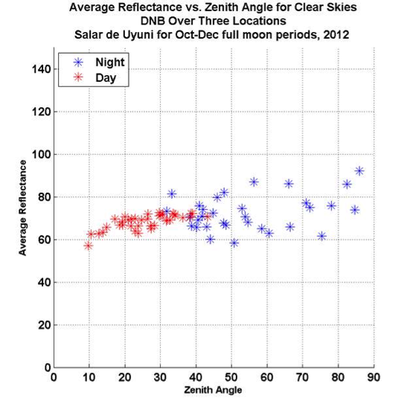
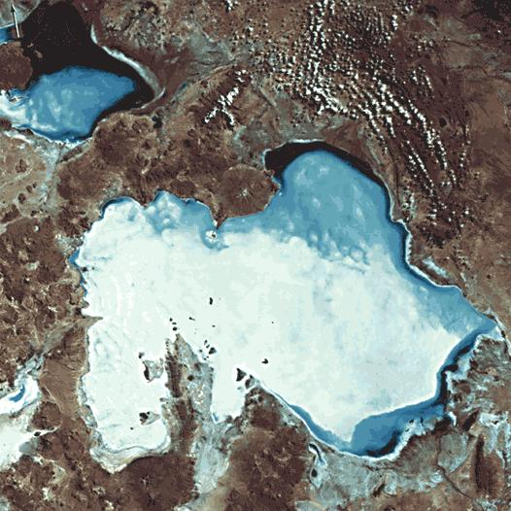
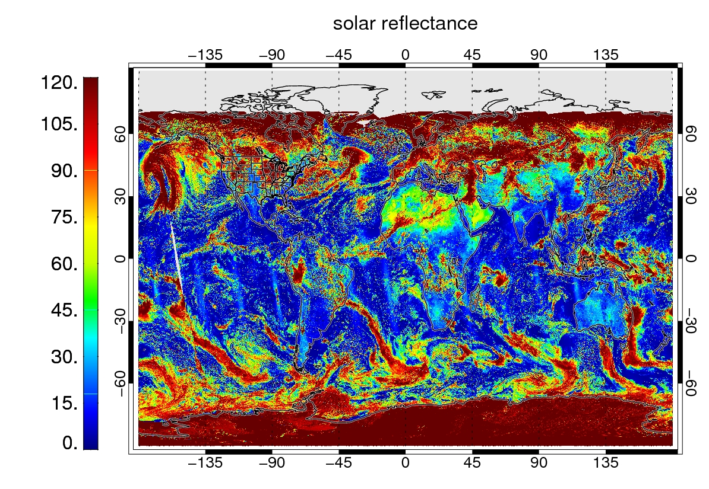
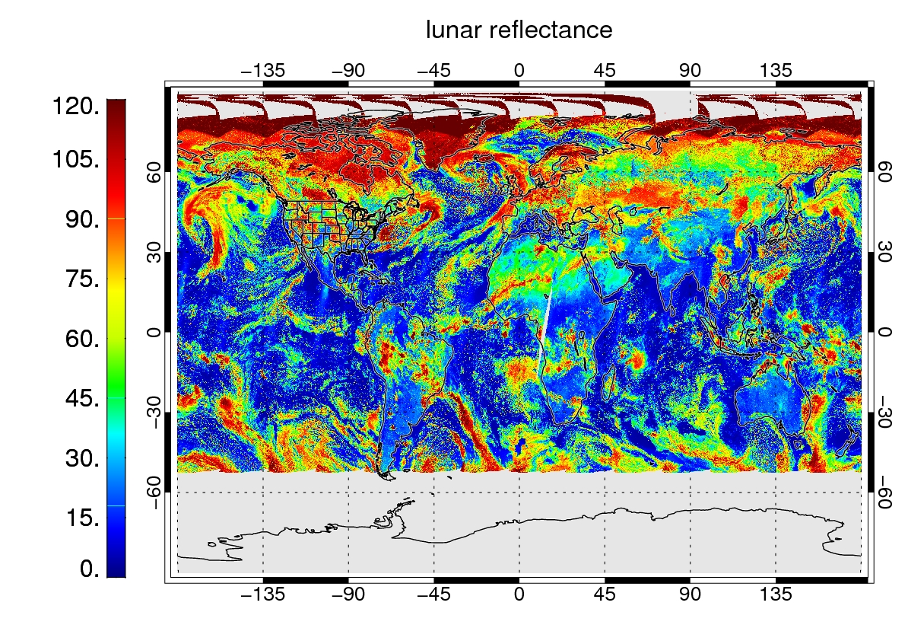
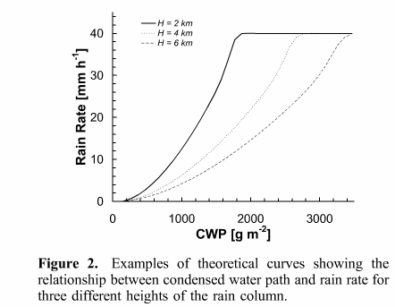
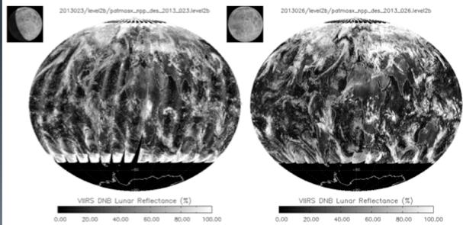
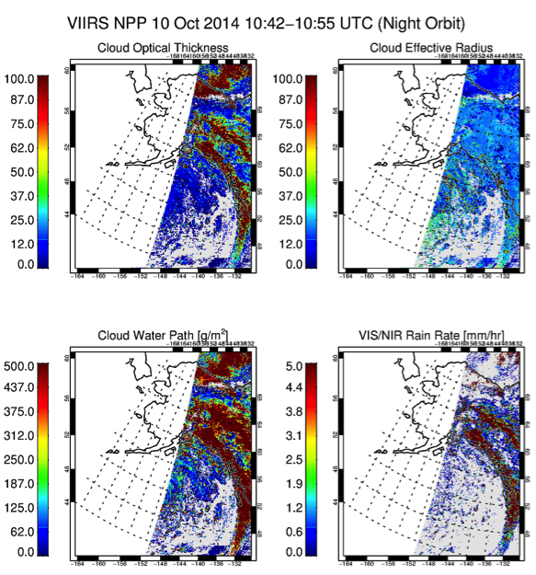
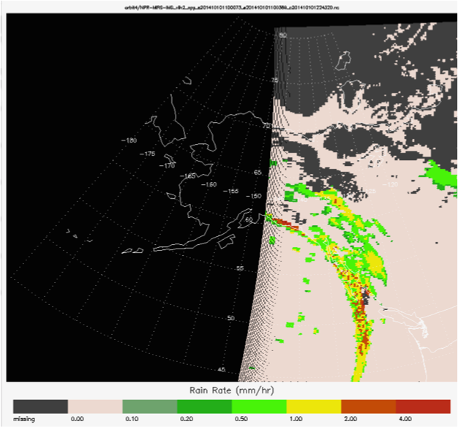
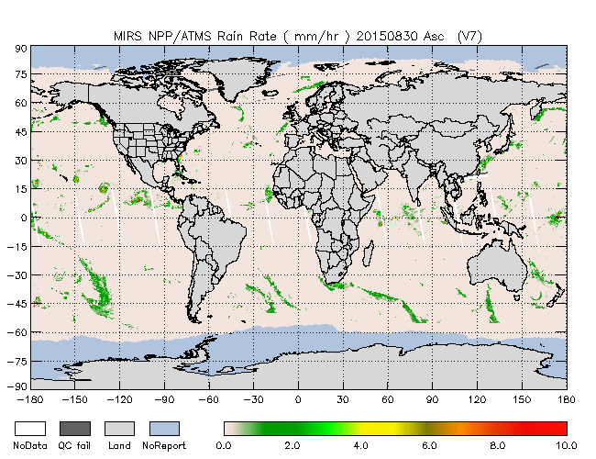
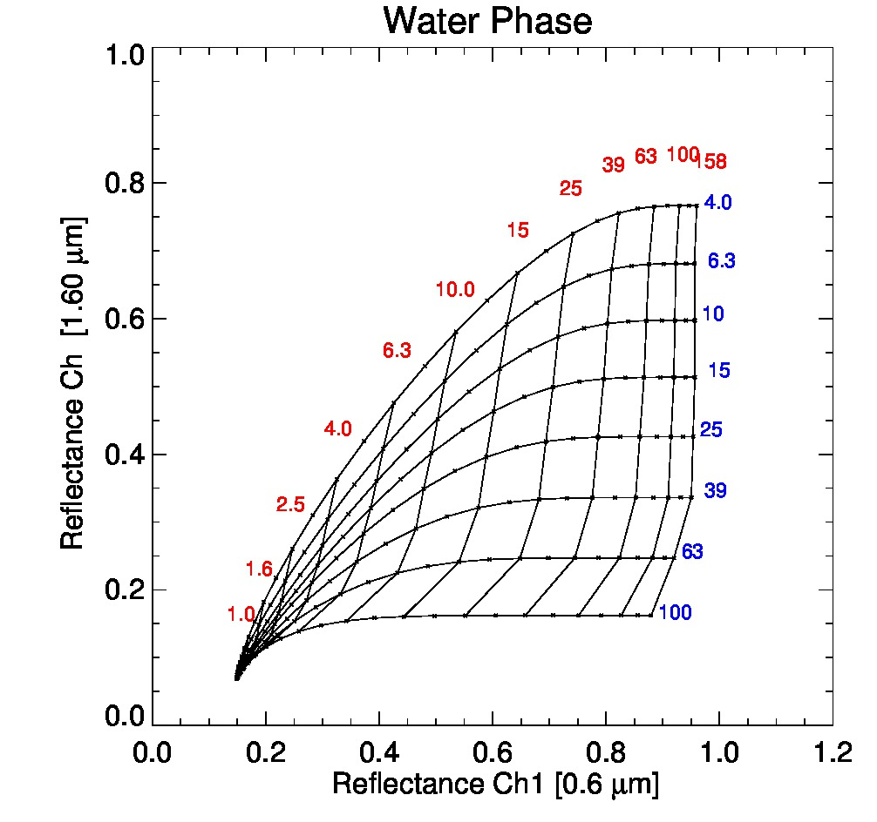
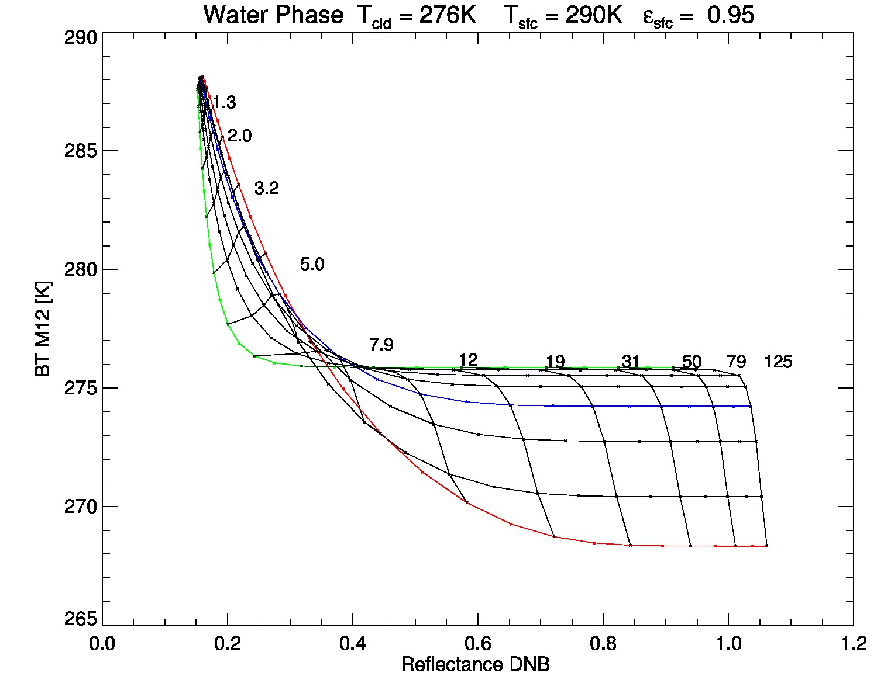
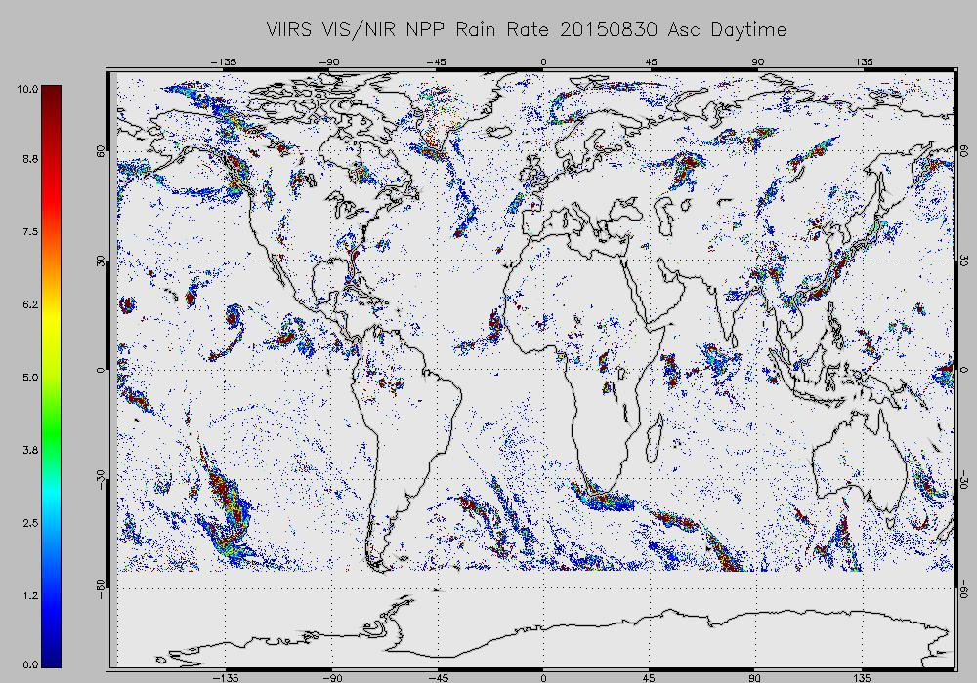
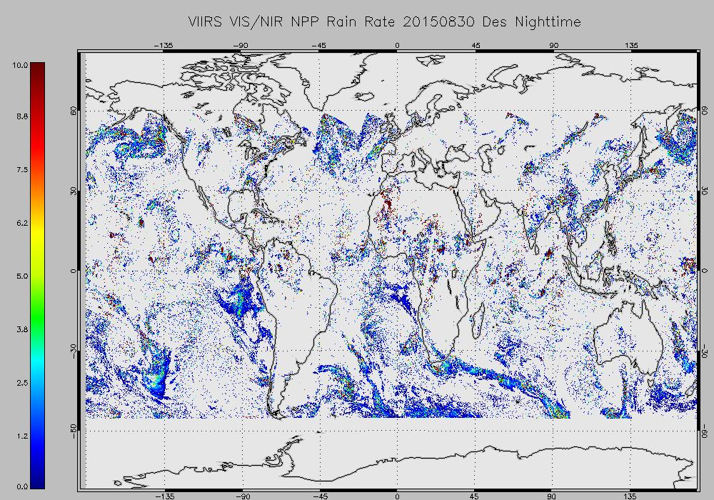
Consistency of reflected moonlight based nighttime precipitation product with its daytime equivalent.
Andi Walther¹ , Steven Miller³, Denis Botambekov¹ and Andrew Heidinger²
¹Cooperative Institute for Meteorological Satellite Studies, Space Science and Engineering Center, University of Wisconsin-Madison, Madison, WI
²Center for Satellite Applications and Research (STAR), NOAA / NESDIS, Madison, WI
³CIRA, Fort Collins, CO
Introduction
Rain rate can be estimated with empirical methods from cloud optical properties derived by VIS/NIR measurements. Several publications show examples for daytime techniques to derive rain rate.
The Daytime Cloud Optical and Microphysical Properties (DCOMP) is the official NOAA retrieval for GOES-ABI and VIIRS developed at University of Wisconsin.
The Nighttime Lunar Cloud Optical and Microphysical Properties (NLCOMP) algorithm is a reflected- moonlight-based retrieval for cloud optical properties Cloud Optical Thickness, Effective Radius and Cloud Water path which measures first time also at night by VIIRS Day/Night band channel.
This poster intents to demonstrate consistency between daytime and nighttime cloud and precipitation products.
Consistency of cloud products
between daytime and nighttime retrieval
Lunar Reflectance in VIIRS Day/Night Band
Moonlight is about 250,000 times dimmer than sunlight (approx. 10⁻⁵ Wm⁻²sr⁻¹). Current sensors (e.g. MODIS, VIIRS) are only able to detect signals around 10⁰-10² Wm⁻²sr^{-1.}
Day/Night band onboard NPP Soumi is the first sensor which is both sensitive to low-light in visible spectrum and providing a sufficient data depth with a 14-bit resolution.
Steven Miller (CIRA, Fort Collins) developed a lunar irradiance model from which we can derive for the first time visible reflectance at night if illuminated by moon.
Lunar reflectance is more complex than solar due to many components to consider ( lunar phase, lunar spectral surface albedo, Moon-Sun-Earth geometry, lunar zenith angle etc..) Thus, we expect overall uncertainty from 5-12% depending on lunar phase.
Comparison of the cloud optical depth evolution from VIIRS and GOES-15. All data is from April 26, 2013. Image on the right is NOAA/DCOMP applied to GOES-15 evening data is observed 6:30 PM local, the GOES-15 morning is observed at 9:30 AM local, the VIIRS Night retrievals are observed at ~1:30 AM local during full moon condition. The nighttime retrievals show the expected trend toward higher water content and optically thicker stratocumulus clouds at night owing to cloud top radiative cooling and destabilization.
Example VIIR scene with lunar illumination.
Estimation of Rain Rate from Microphysical Cloud Properties
Validation studies and global assessment shows good agreement between daytime (solar) reflectance and nighttime (lunar) reflectance.
We sufficient global lunar reflectance coverage at about 60% of time for cloud property retrievals.
Validation efforts: Image left shows daytime (reflected sunlight) and nightime ( reflected moonlight) reflectance for cloud-free scenes at Salar de Uyuni salt flat in Boliviw
[Wentz and Spencer,2013] and [Roebeling and Hollemann, 2011] developed a rain rate estimate technique which relies on Liquid water path and rain column height estimated by cloud top temperature
CWP | Cloud water path in g/m²
H | Rain column [km]
R | Rain Rate mm/h
CTT_{pix} | Cloud Top Temperature at pixel [K]
CTT_{max} | Cloud Top Temperature-warmest in 50km area [K]
dH | Minimal rain column in km; set to 0.6km
Lapse Rate | Lapse rate assumed to be 6.5K/km
Global distribution of visible reflectance of one day of VIIRS observations for day and night.
From Roebeling and Hollemann 2011
Nighttime Lunar Cloud Optical and Microphysical Properties retrieval (NLCOMP): The nighttime equivalent of DCOMP
Standard approach for DCOMP simultaneous measurements in a visible and in an absorbing Near-IR channel (VIIRS M-12 channel at 3.75 micron)
Use of solar reflectance, solar irradiance is known very accurately.
NIR channel is in mixed solar/terrestrial region of spectrum around 3.8 micron.
Forward model equation set for a given geometrical constellation is:
Standard approach for NLCOMP simultaneous measurements in a visible (DNB) and in an absorbing Near-IR channel (VIIRS M-12 channel at 3.75 micron)
Use of lunar reflectance. Lunar irradiance is not known accurately.
NIR channel is in mixed solar/terrestrial region of spectrum around 3.8 micron.
Forward model equation set for a given geometrical constellation is:
Images illustrate nighttime rain rate from VIS/NIR and in comparison to microwave-based MIRS/ATMS also on Soumi-NPP rain rate
Rain rate day/night consistency
Rain rate estimates from VIS/NIR approach are largely consistent to microwave-based retrievals.
Nighttime shows some ”false” alarms.
NLCOMP retrieval lacks on the reflectance term in the forward model of the Near infrared channel.
NLCOMP is implemented in CIMSS processing system CLAVR-x and provides routinely results.
Current version is limited to non-urban regions.
Difference to MW-based retrievals:
Less physical based retrieval
+ higher spatial resolution
+ over land results
DCOMP and NLCOMP information content illustration.
Global rain rate map for 30 August 2015. Upper panels show microwave-based ATMS/MIRS rain rate for ascending daytime ( left) and descending nighttime (right) orbit. Lower level shows the same for VIIRS VIS/NIR method.
Conclusions and Outlook
NLCOMP will help to close the nighttime observation gap of cloud optical properties and precipitation estimates. This will be especially valuable in high latitudes winter where cloud observations are missed for longer periods (example: clouds, icing and rain rate for Alaska)
NLCOMP work was funded by NOAA JPSS Risk reduction project.
VIIRS work funded by the JPSS Cal/Val Program.
PATMOS-x/CLAVR-x originally funded by NOAA/NESDIS/STAR and the NOAA PSDI Program.
The new DNB channel of VIIRS offers observations of low-light signals in a visible channel during night.
A lunar down-welling irradiance predictor was developed which enables us to use DNB lunar reflectance as an input of quantitative cloud retrievals.
DNB products are a part of CLAVR-x output
Comparisons to daytime results demonstrates consistency between day and nighttime observations of COD.

