Slide 1
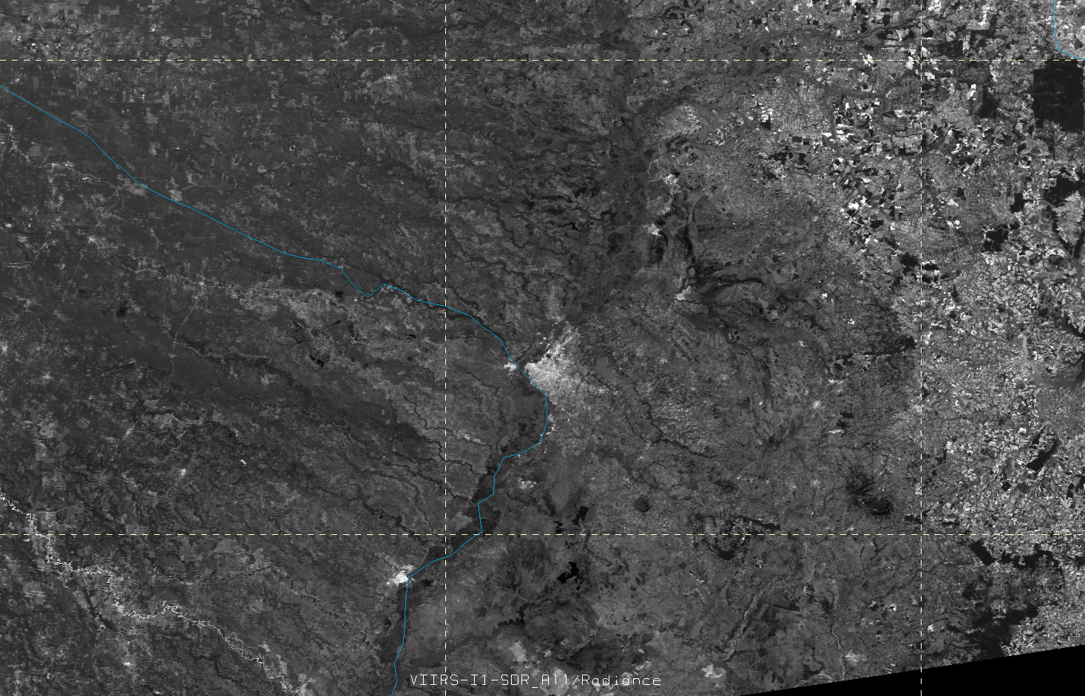
VIIRS I-band 1 Visible (375 m) – 2 June 2014 – Paraguay Flooding

Slide 2
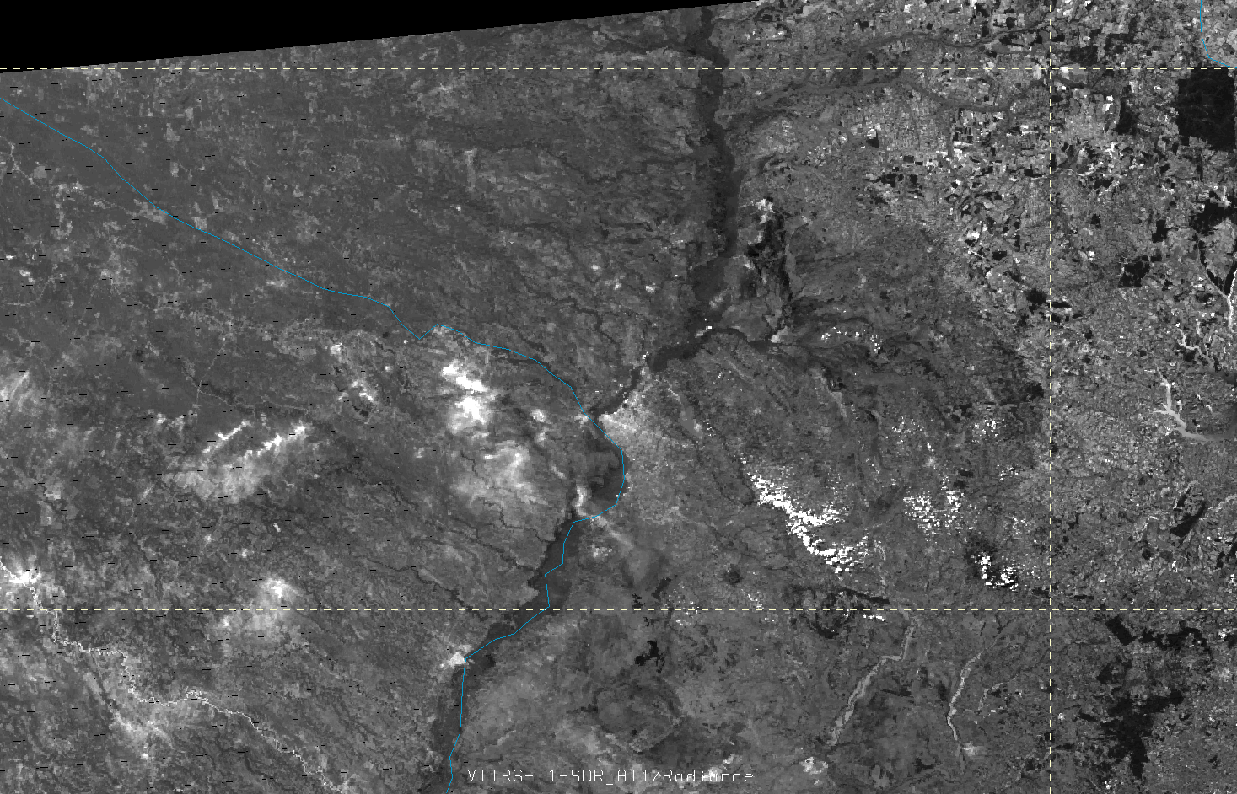
VIIRS I-band 1 Visible (375 m) – 30 June 2014 – Paraguay Flooding

