Slide 1
Flood Images from High Resolution SNPP VIIRS Products

Slide 2
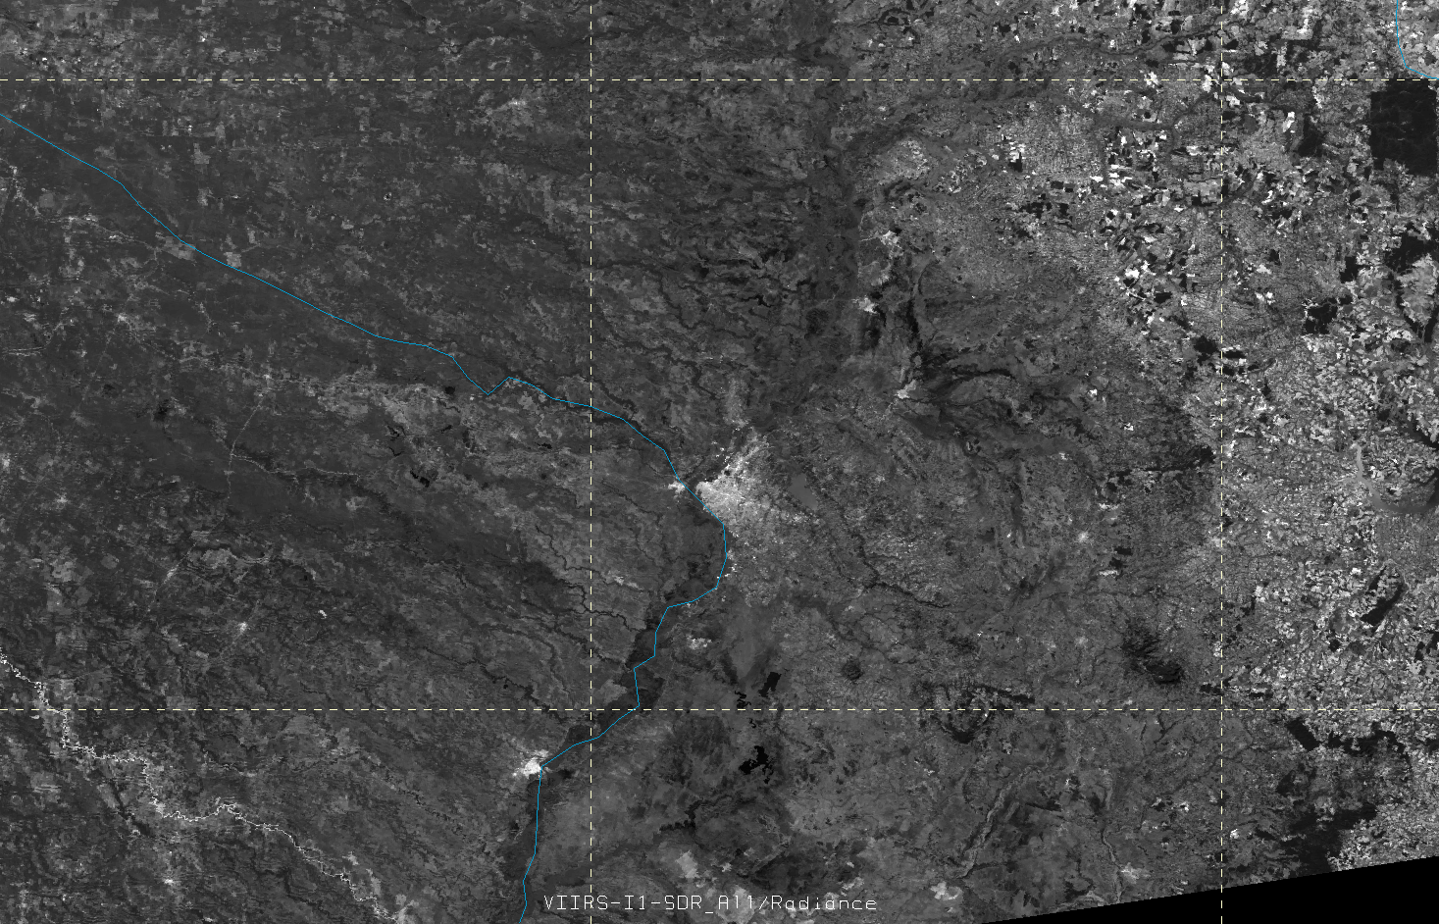
VIIRS I-band 1 Visible (375 m) – 2 June 2014 – Paraguay Flooding
High Resolution VIIRS Image before flooding (2 June 2014), by Dan Lindsey NOAA STAR CIRA

Slide 3
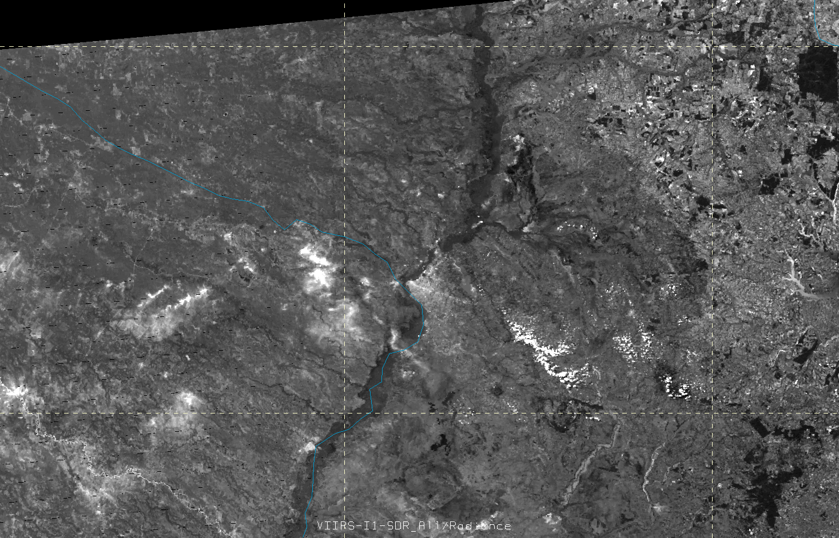
VIIRS I-band 1 Visible (375 m) – 30 June 2014 – Paraguay Flooding
High Resolution VIIRS Image after flooding (30 June 2014), by Dan Lindsey NOAA STAR CIRA

Slide 4
SNPP/VIIRS Flood Product
Dr. Sanmei Li and Dr. Donglian Sun (GMU)
The Suomi-NPP/VIIRS flood product is generated by VIIRS flood detection package which is initialized by JPSS Program Office, National Oceanic and Atmospheric Administration, USA.
The product is designed for automatic near-real-time flood detection with 375m resolution.
It detects flooding water in different water fractions from 1% to 100% which are shown in different colors from light green to red. The product also overlaps other information including open water (shown in blue), river/lake ice (shown in cyan), snow cover (white), cloud cover (shown in grey) and cloud shadow (shown in dark grey).
The SNPP/VIIRS flood detection maps on June 30, 2014 at 17:02 (UTC) presents an overview of flooding water over Paraguay and its neighboring countries.

Slide 5
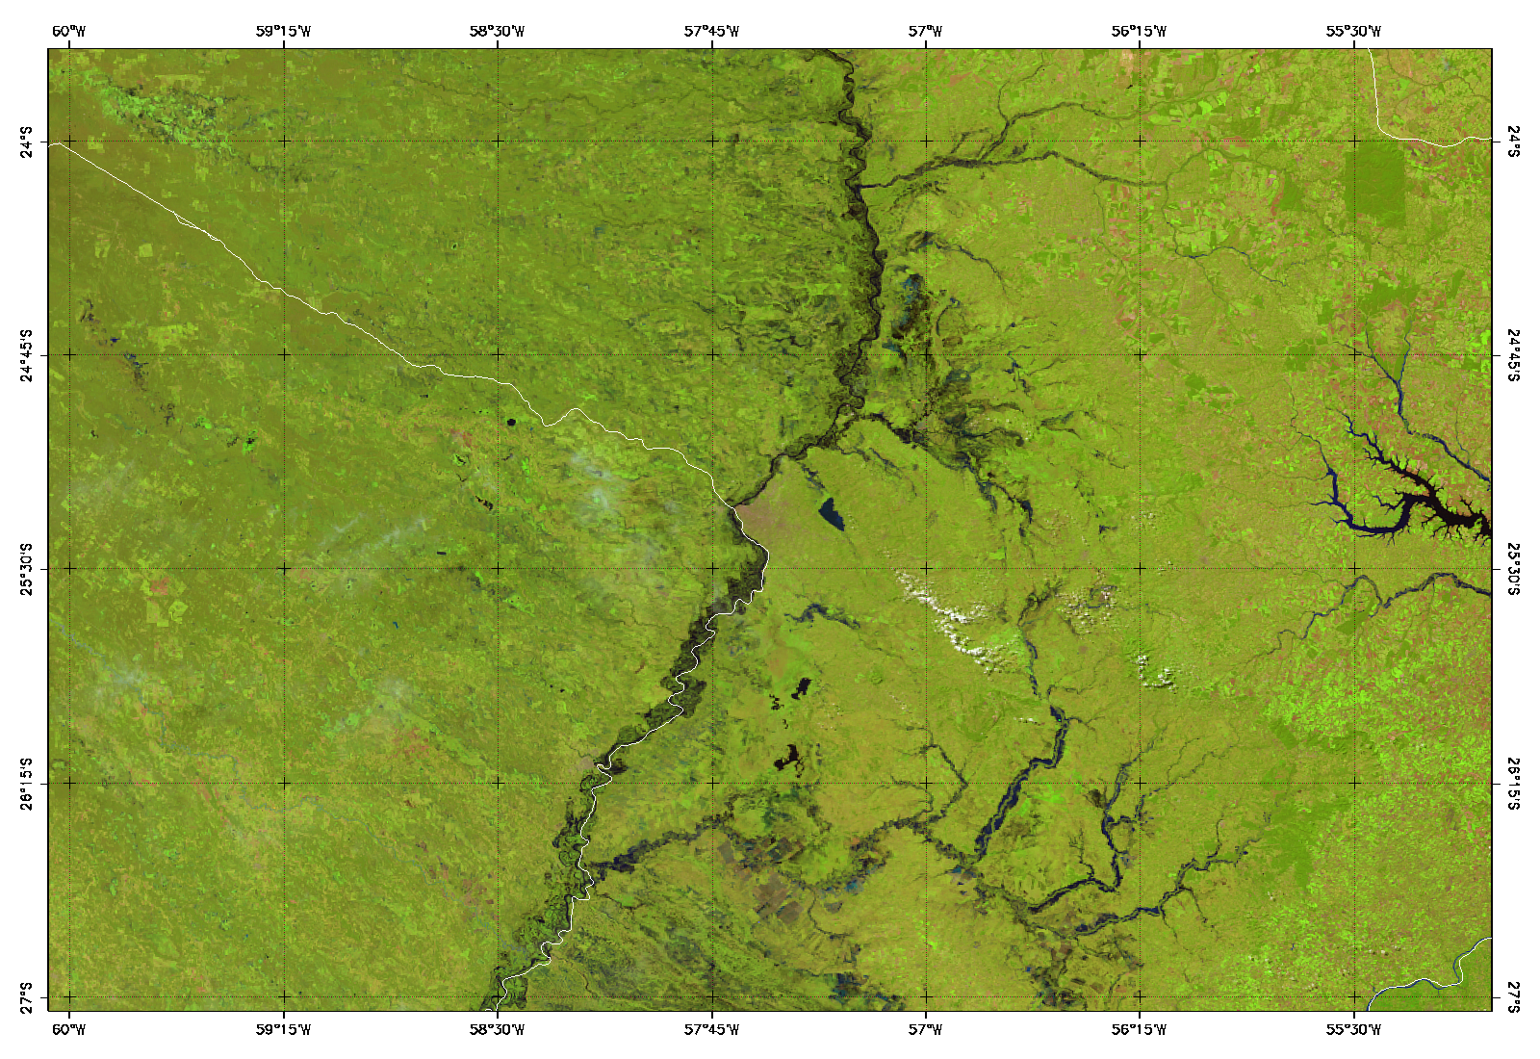
Asuncion
SNPP/VIIRS false-color image (composited by Imager bands 3, 2, 1) June 30, 2014 17:02 (UTC) around Asuncion, Paraguay
Sanmei Li (GMU)

Slide 6
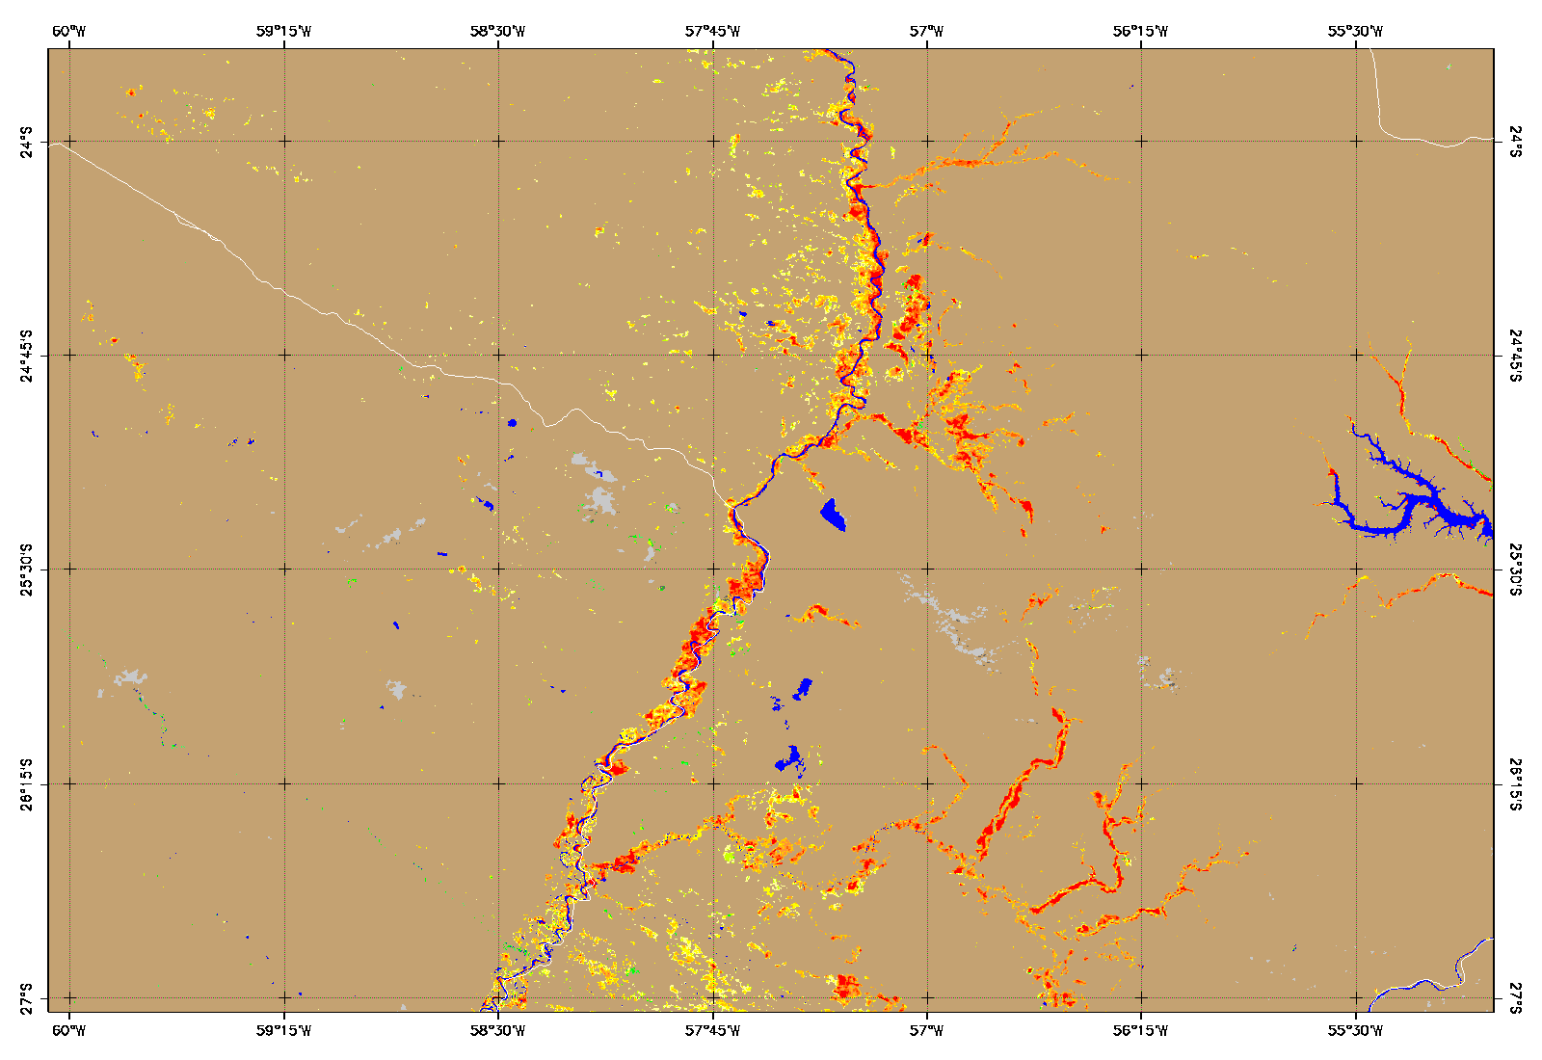
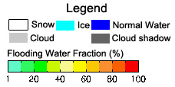
Asuncion
SNPP/VIIRS flood detection map June 30, 2014 17:02 (UTC) around Asuncion, Paraguay
Sanmei Li (GMU)

Slide 7
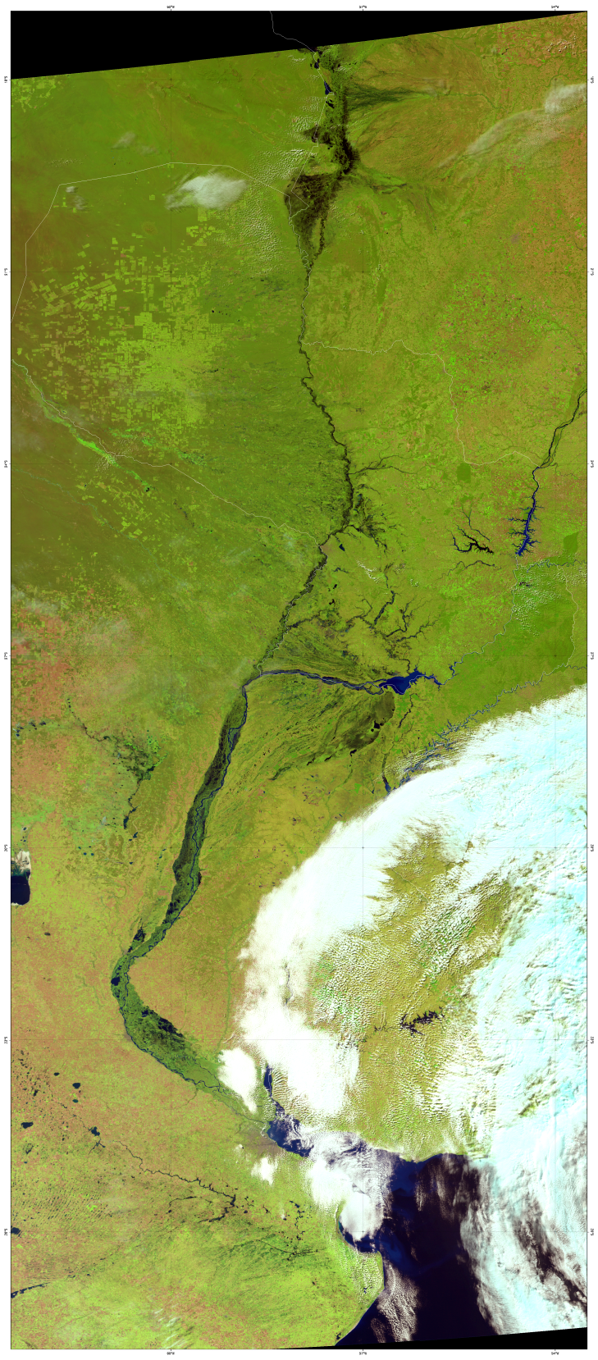
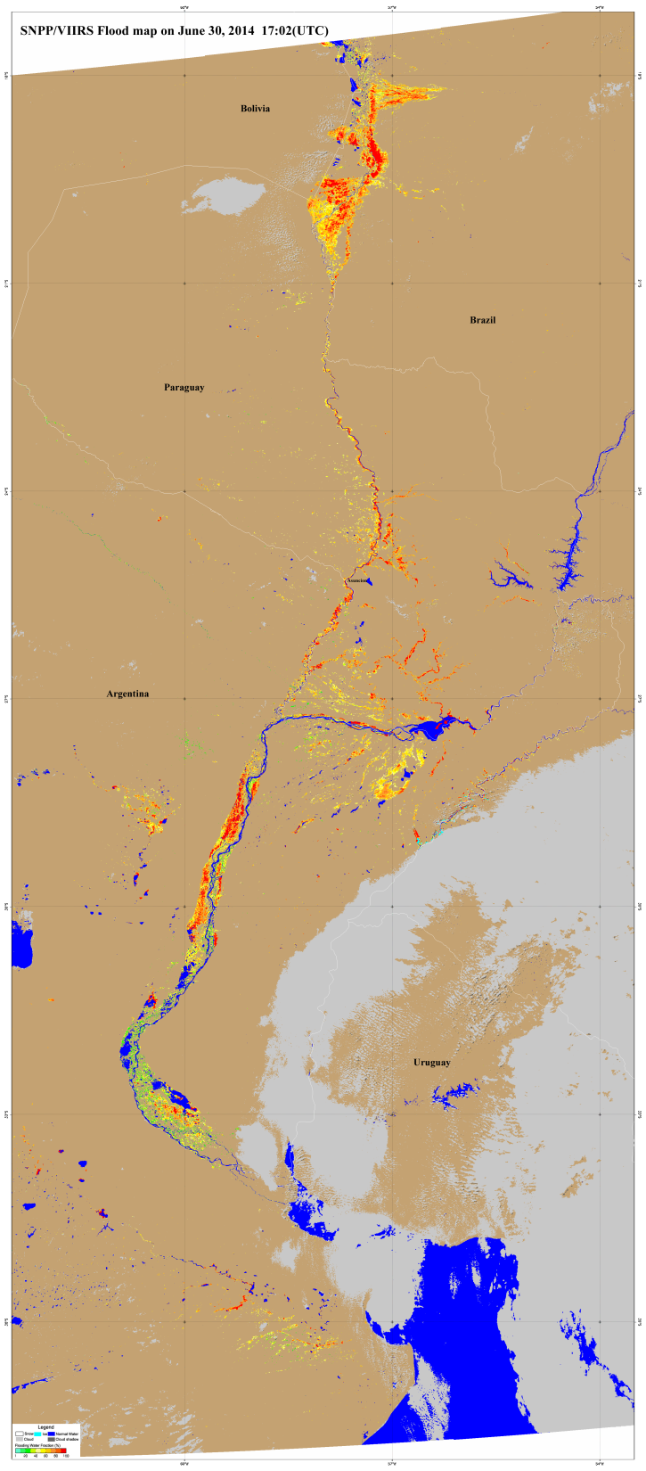
Left: SNPP/VIIRS false-color image (Composited by Imager bands 3, 2, 1) on June 30, 2014 17:02 (UTC)
Right: SNPP/VIIRS flood detection map on June 30, 2014 17:02 (UTC)
The images present an overview of the severe flood happening in South America.
Sanmei Li (GMU)

Slide 8
More VIIRS Imagery and Flood Products
Generated for Paraguay
More detailed false color images in png and tif by from Dan Lindsey (STAR/CIRA):
ftp://ftp.cira.colostate.edu/ftp/Seaman/JPSS/dan/
GeoTiff files of flooding products (which is about 58mb) can also be downloaded via this ftp site for GIS use, generated by Sanmei Li (GMU):
ftp://anonymous@ftp.ssec.wisc.edu/pub/incoming/WATER_VIIRS_Prj_SVI_npp_d20140630_t1702007_e1707411_b13851_ops_dev_019_2669_7414_01.tif
ftp://anonymous@ftp.ssec.wisc.edu/pub/incoming/WATER_VIIRS_Prj_SVI_npp_d20140630_t1702007_e1707411_b13851_ops_dev_019_2669_7414_01.tfw

Slide 9
VIIRS 90-m Water map in Paraguay

Slide 10
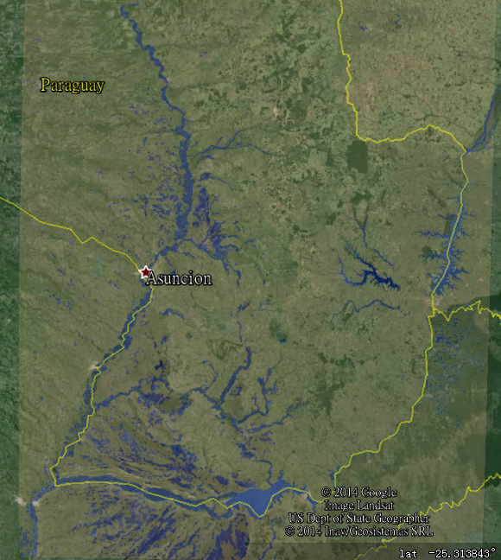
An overview of flood in Paraguay on June 30, 2014 by using VIIRS 90-m water map (light purple is water)

Slide 11
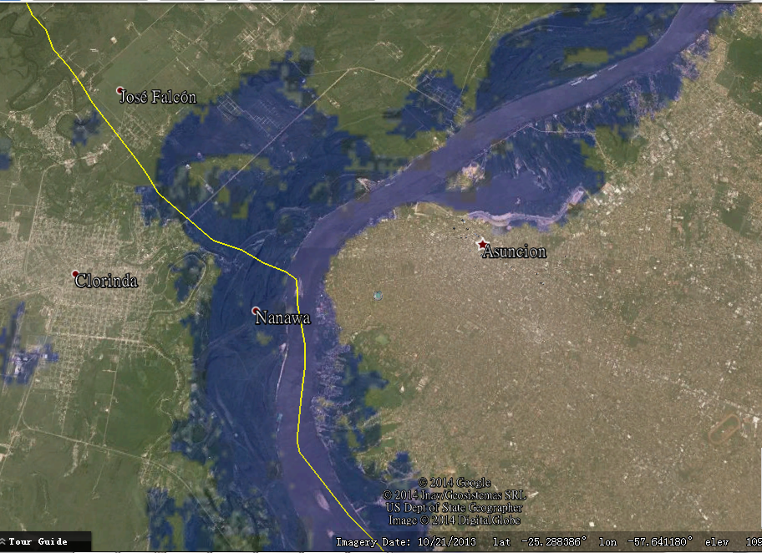
Flood near Asuncion

Slide 12
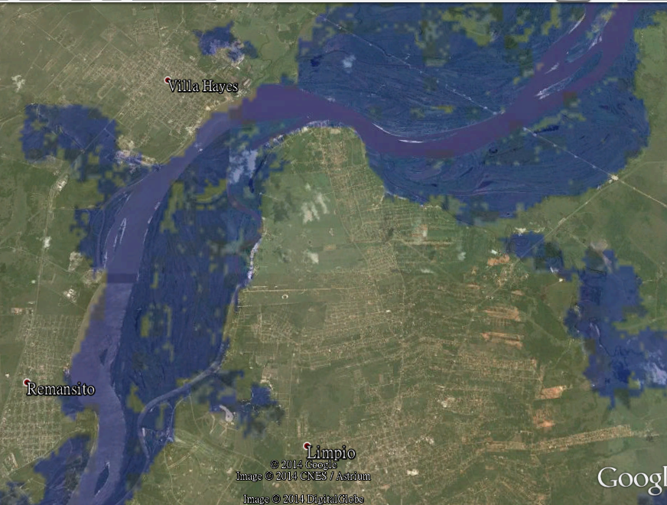
Flood near Villa Hays

Slide 13
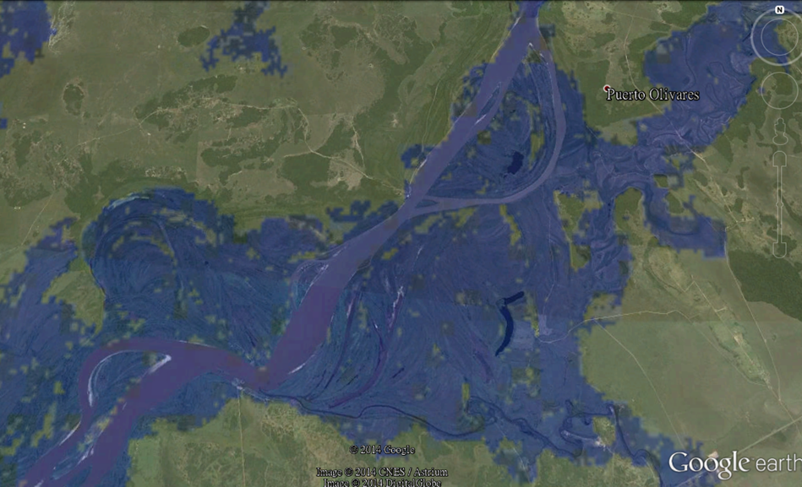
Flood near Puerto Olivares

Slide 14
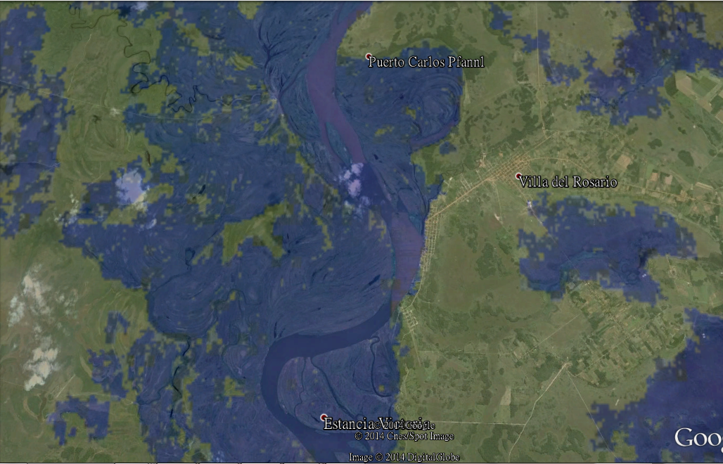
Flood near Villa Del Rosario

Slide 15
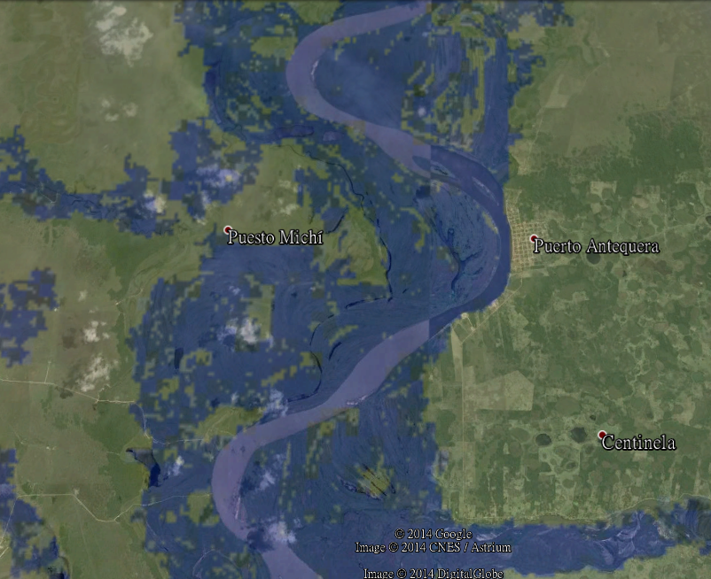
Flood near Puerto Antequera

Slide 16
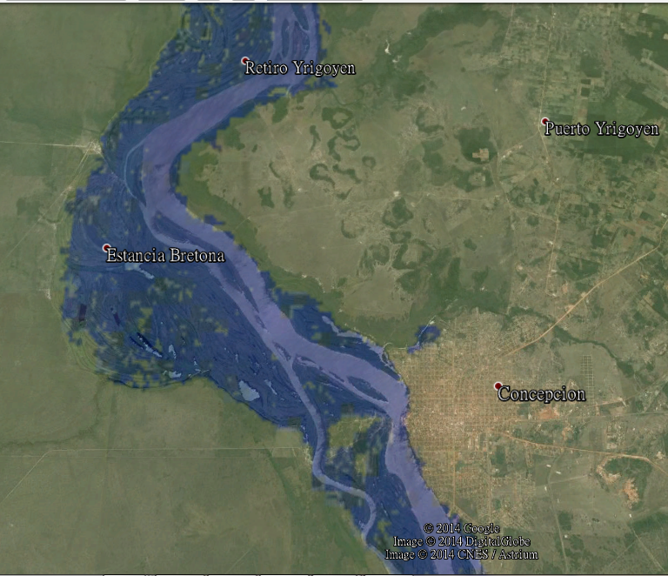
Flood near Concepcion

Slide 17
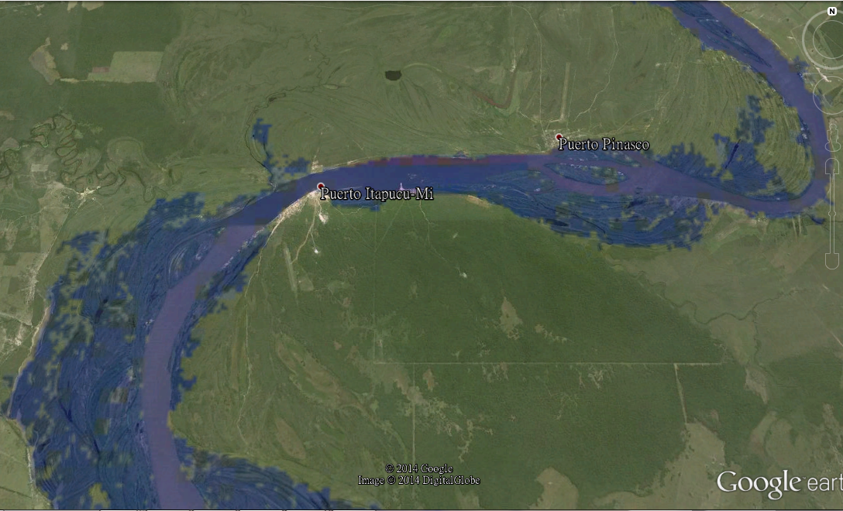
Flood near Puerto Itapucu-Mi

Slide 18
Surface Type Map

Slide 19
