Slide 2
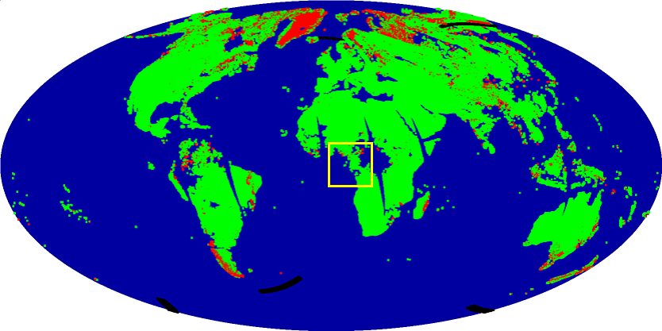
Snow Map 2003/193 Land PEATE, Test 8

Slide 3
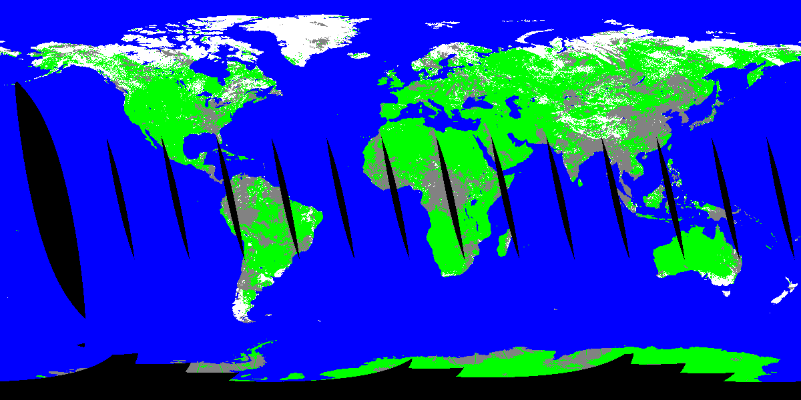
Snow Detections 2003/193 (Confident Clear)

Slide 4
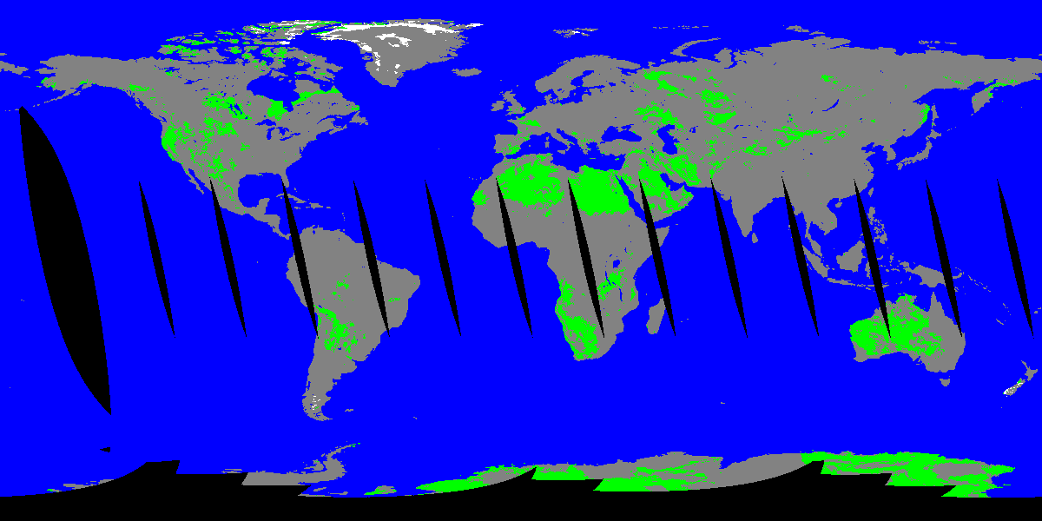
Thematic Map 2003/193 (Confident Clear)

Slide 5
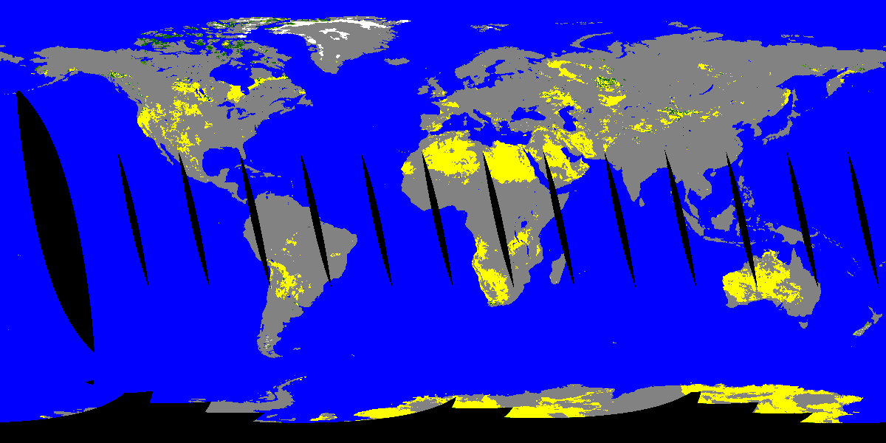
Snow Fraction 2003/193 (Confident Clear)

Slide 6
Snow Map 2003/193 Land PEATE, Test 8

Slide 7
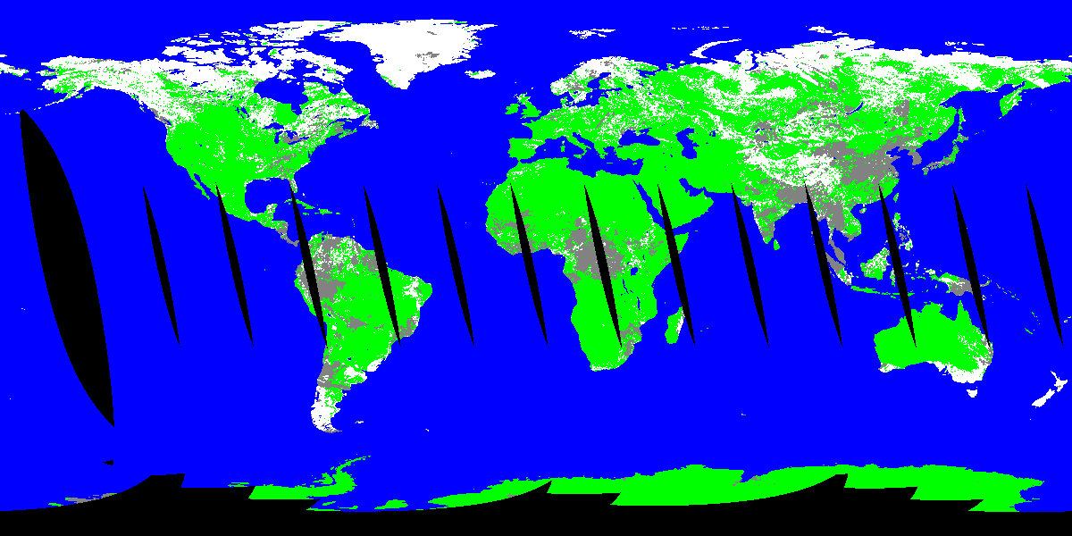
Snow Detections 2003/193 (Confident and Probably Clear)

Slide 8
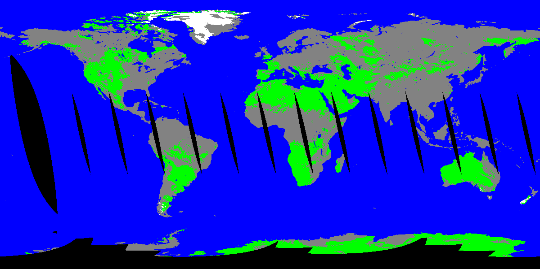
Thematic Map 2003/193 (Confident and Probably Clear)

Slide 9
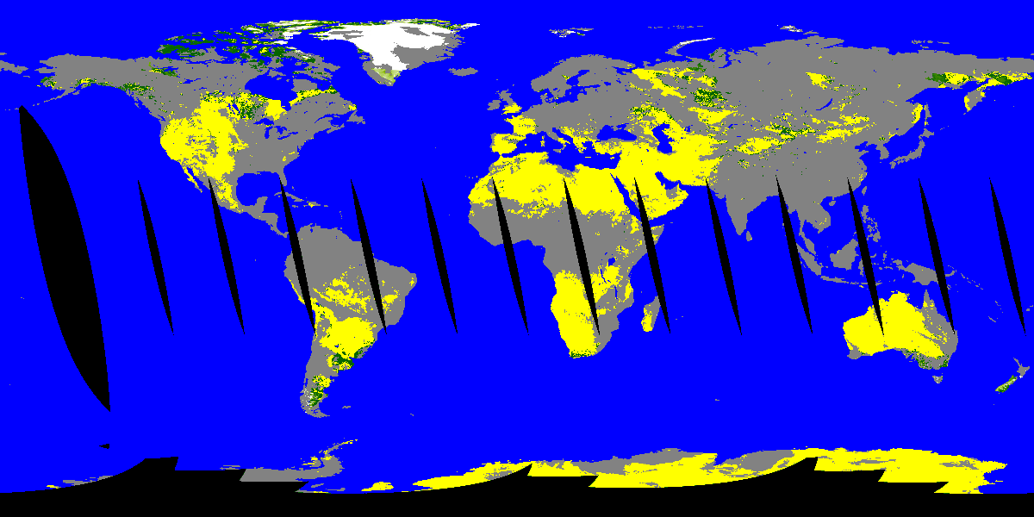
Snow Fraction 2003/193 (Confident and Probably Clear)

Slide 10
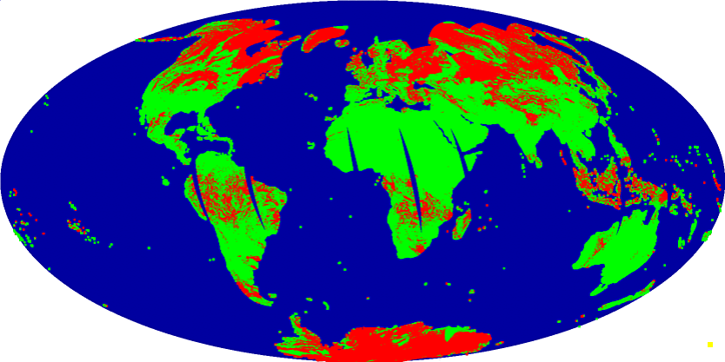
Snow Map 2003/033 Land PEATE, Test 6

Slide 11
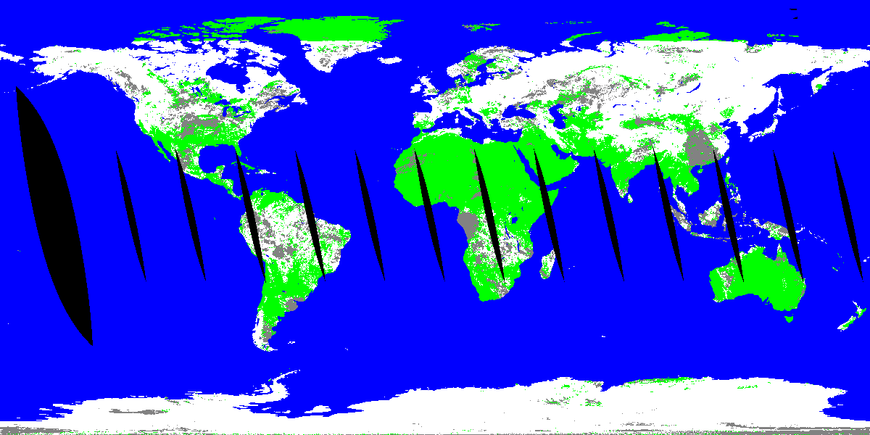
Snow Detection 2003/033 (Confident and Probably Clear)

Slide 12
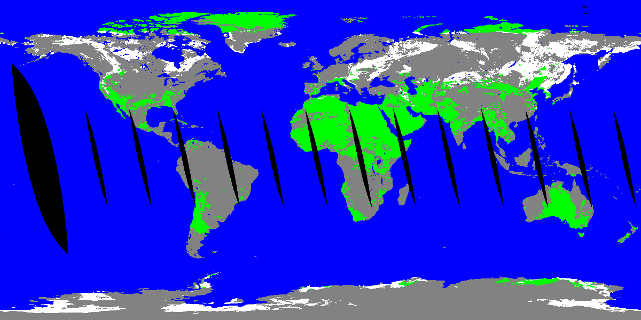
Thematic Map 2003/033 (Confident and Probably Clear)

Slide 13
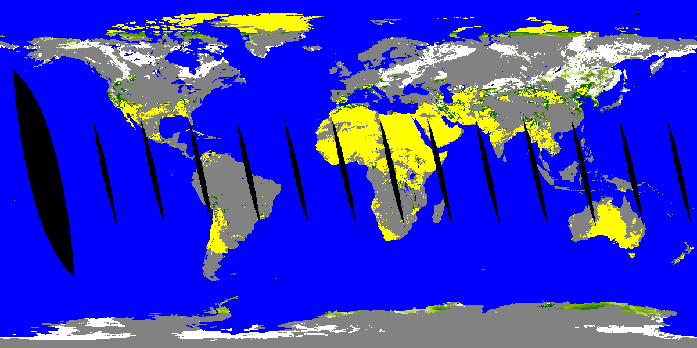
Snow Fraction 2003/033 (Confident and Probably Clear)

