Slide 1

Number of land and water pixels

Slide 2

Number of land pixels

Slide 3
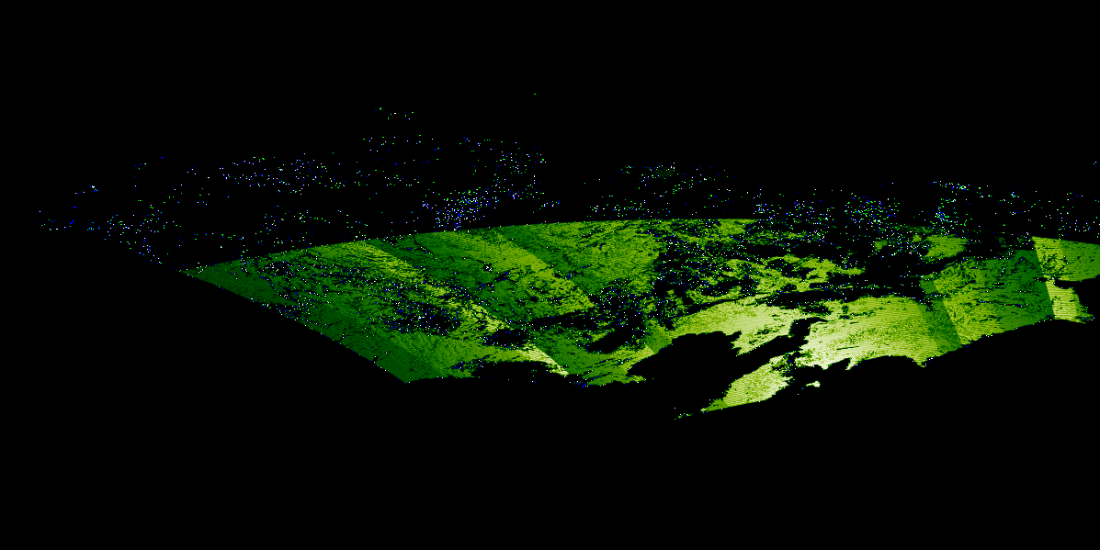
Number of cloud-free pixels over land

Slide 4

Number of cloud-free pixels (subset)

Slide 5
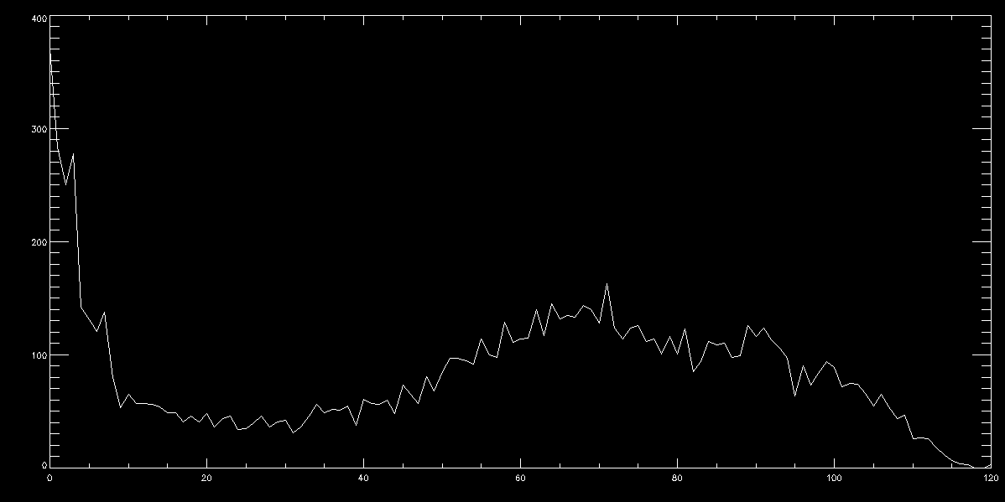
Histogram for Number of cloud-free pixels in subset

Slide 6
Number of land and water pixels

Slide 7
Number of land and water pixels

