Slide 1
CryoSat-2 Full-bit-rate SAR mode data over oceans
W H F Smith and L Connor
4 Nov 2010
DRAFT

Slide 2
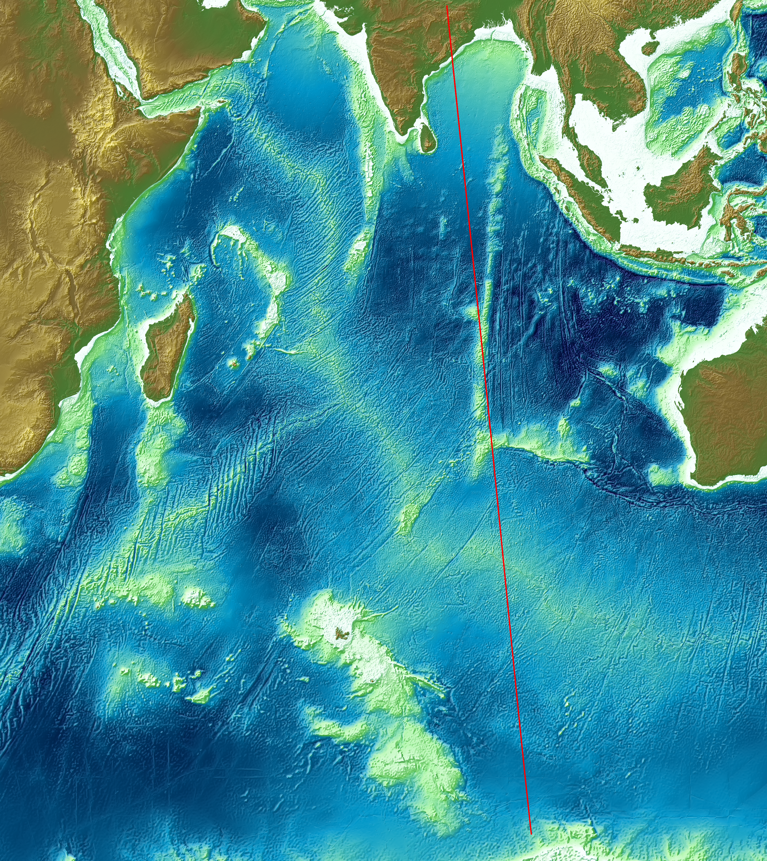
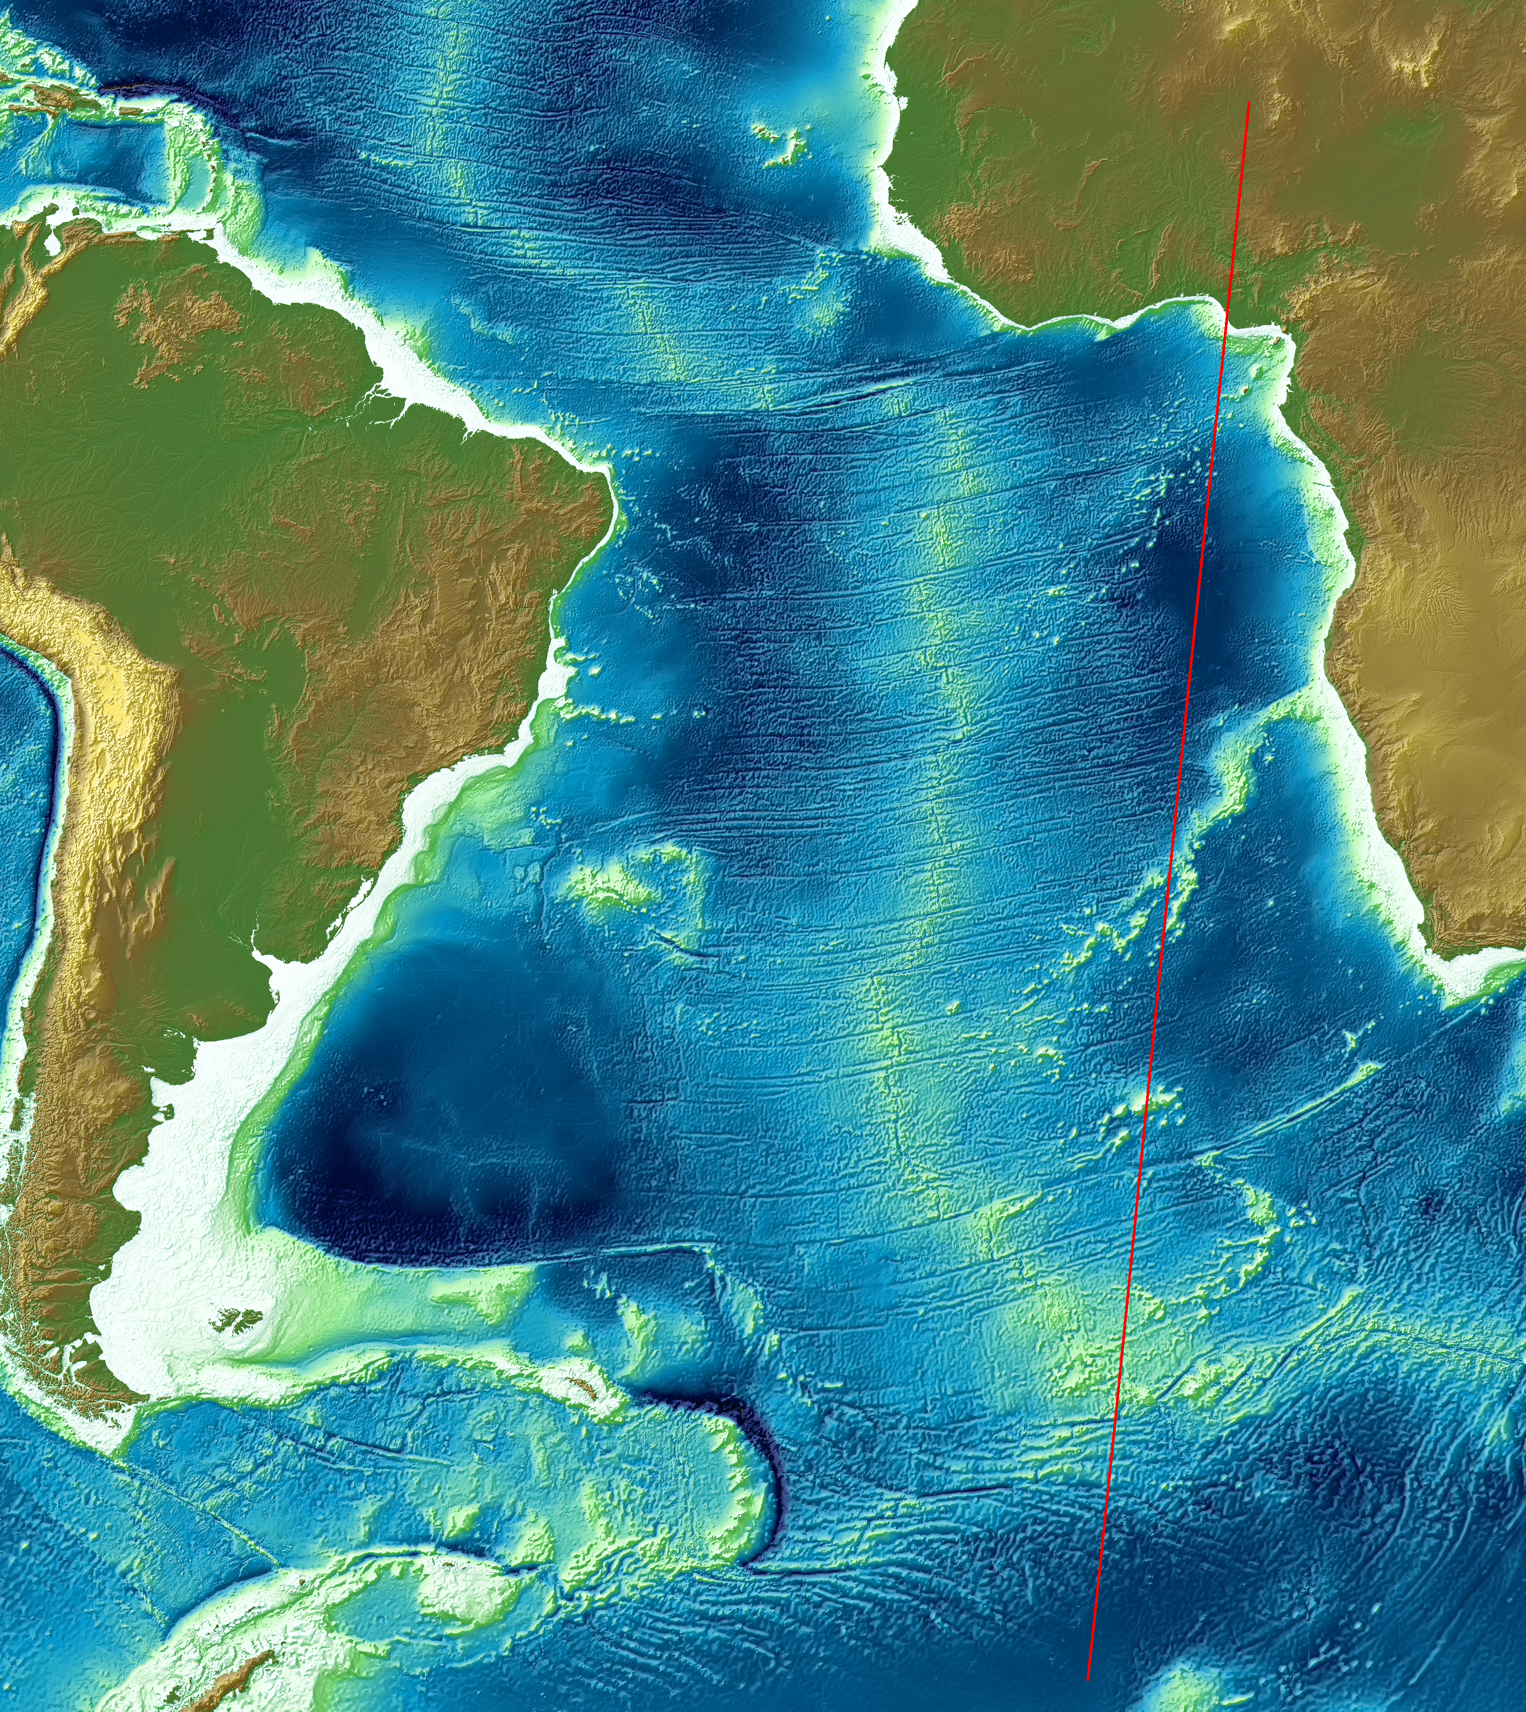
Two long passes
2010-06-09
2010-06-08

Slide 3
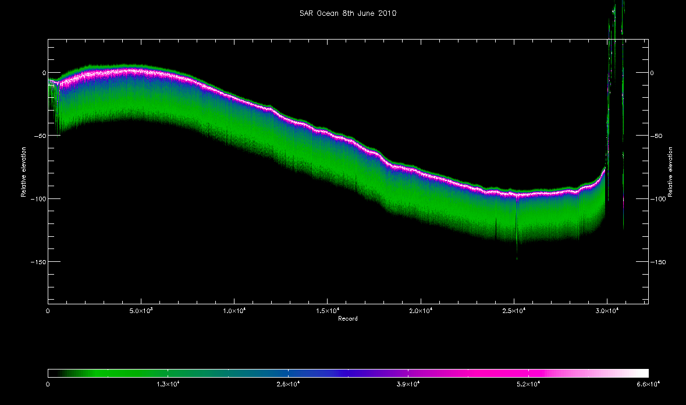
SAR mode (PRF 17.8 kHz), all data

