Slide 1
Can SMOS detect Melt Ponds?
C. Gabarró¹, P. Elosegui¹, G. Heyster²,
M. Huntemann² and L. Istomina²
¹ SMOS Barcelona Expert Centre – ICM (CSIC)
² PHAROS - University of Bremen
Notes:
1
1

Slide 2
Why to Melt Ponds on Ice ?
What are Melt Ponds?
Almost Fresh water over the ice due to the ice melting.
Start when Air Temp. > 0ºC
Why to measure?
Very important because strongly reduce albedo - radiative balance
Also important for climate prediction models

Slide 3
Modelling of melt water
Radiative transfer models of 4 layers have been use to simulate TB at 1.4GHz:
Layer 1 : Air: ε_1
______________________________R1 Fresnel Reflection coefficients
Layer 2: Melt water : ε_2
______________________________R2
Layer3: Ice : ε_3
______________________________R3
Layer 4: Sea water : ε_4
RTM: Burke et at. 1979, Ulaby & Mills and Heygster, 2011
Diel. Cnt: Vant et al. 1978 + Cox & Weeks 1983 model ; Klein & Swift, 1977.
Conclusions: A model of 3 layer can be used, since layer 4 (sea water) is not seen, since the layer 3 (ice) is almost optically infinitely thick.

Slide 4
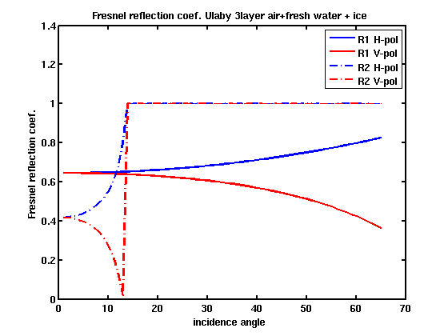
Modeling of melt water
3 layer model:
Fresnel reflection coefficients (R1 and R2), with typical values for temperature and salinity for melt water & ice are:
Layer 1 : air: ε_1, n1
______________________________R1
Layer 2: Melt water : ε_2, n2 ; n2>n3
______________________________R2
Layer3: Ice : ε_3, n3
Critical angle: from Snell low,
when n2>n3 and:
$$θ_{c}=\arcsin\left(\frac{n3}{n2}\right)$$
-> Then all the energy is reflected
and NON refracted, so R=1.
-> θc= [12-18]º as function
of Tice, Sice,Tmelt_water, Smelt_water

Slide 5
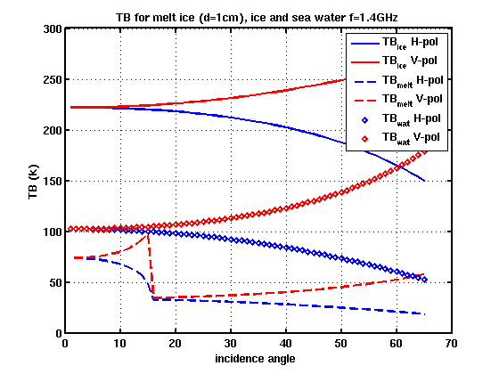
Modeling of melt water
Modelled TB for three different type of surfaces ice/Melt water over ice / sea water :
Two important changes show up
when few fresh water lays over
the ice:
A very sharp decrease on TBV
between inc. angles θ=[12-18]
depending on the S and T of
melt water and ice.
The TB both in H and V
decrease substancially from
TB_ice.
Ice
Sea water
Melt ice/Ice

Slide 6
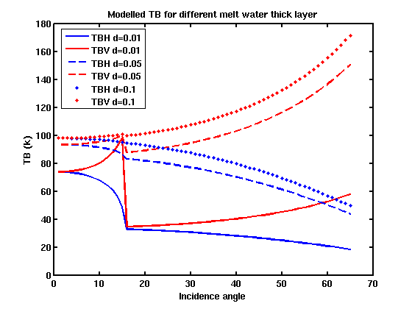
Modeling of melt water
Modelled TB varying thickness of the melt layer:

Slide 7
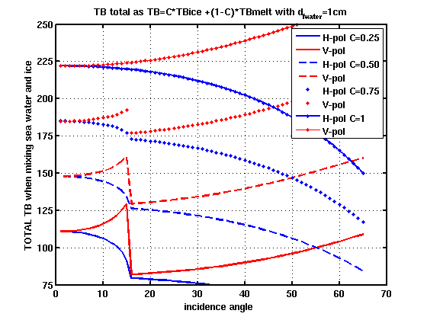
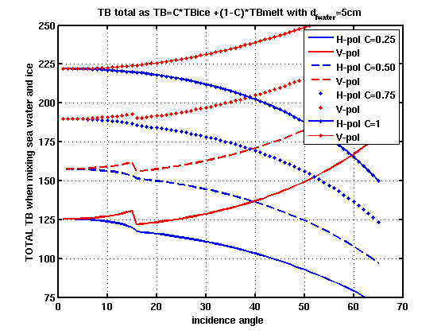
Modeling of melt water
TB with a fraction of ice: TB=C*TB_ice+(1-C)*TB_melt
TB thick_melt_wat=1cm
C is the ice concentration
C=100%
TB thick_melt_wat=5 cm
C=75%
C=50%
C=25%

Slide 8
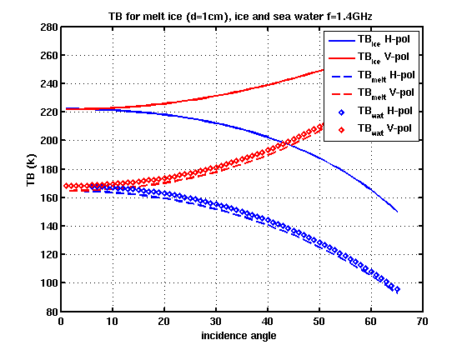
Modeling of melt water
Modelled TB for two different frequencies : 1.4 GHz and 19 GHz, thickness of fresh water= 1cm
Freq = 1.4 GHz
Freq = 19 GHz
Ice
Ice
Sea water
Sea water
Melt ice/Ice
Melt ice/Ice
Melt ponds not visible at higher frequencies

Slide 9
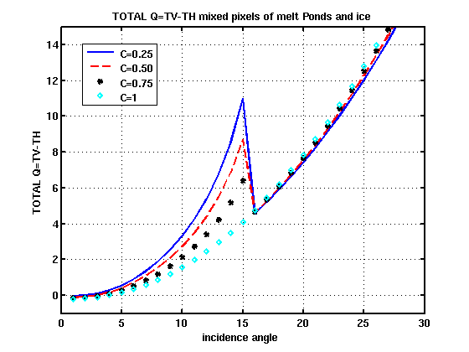
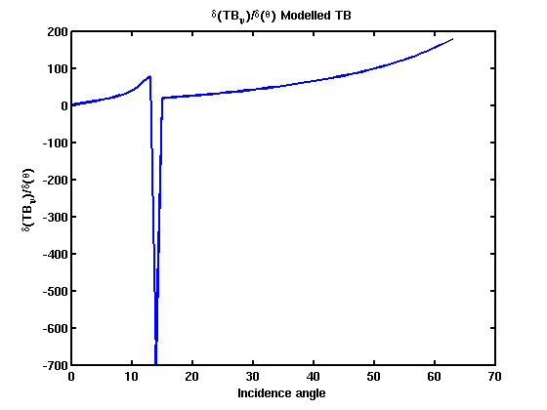
How can we detect melt ponds?
Q=TBV-TBH
Ice
Sea water
Melt ice/Ice
δ(TB_V)/δ(θ)

Slide 10
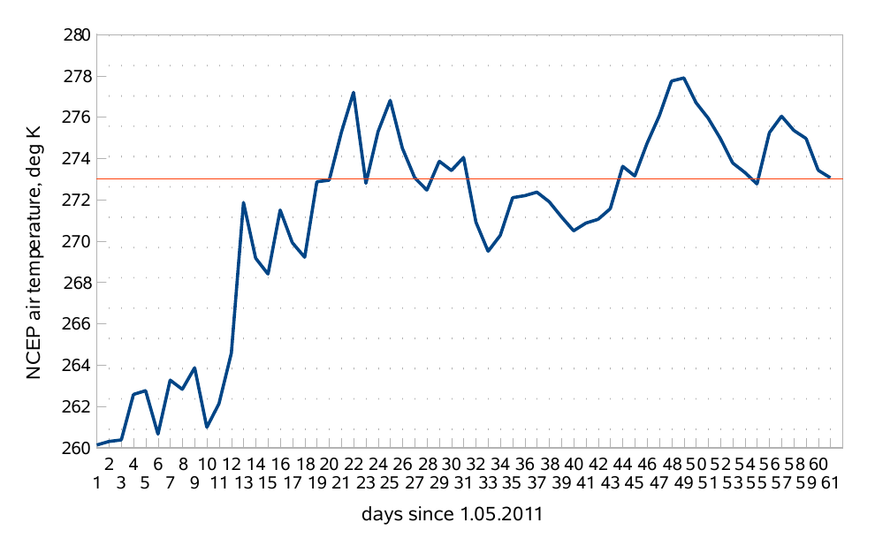
SMOS data analysis
Point Barrow region (North Alaska) because:
FY: Very flat ice coverage (no ridges and deformations)
Extended and shallow melt ponds
Melt ponds starts when Tair > 0ºC
Air temperature at the surface from NCEP reanalysis data
15 june 2011
73ºN / 156 W

Slide 11
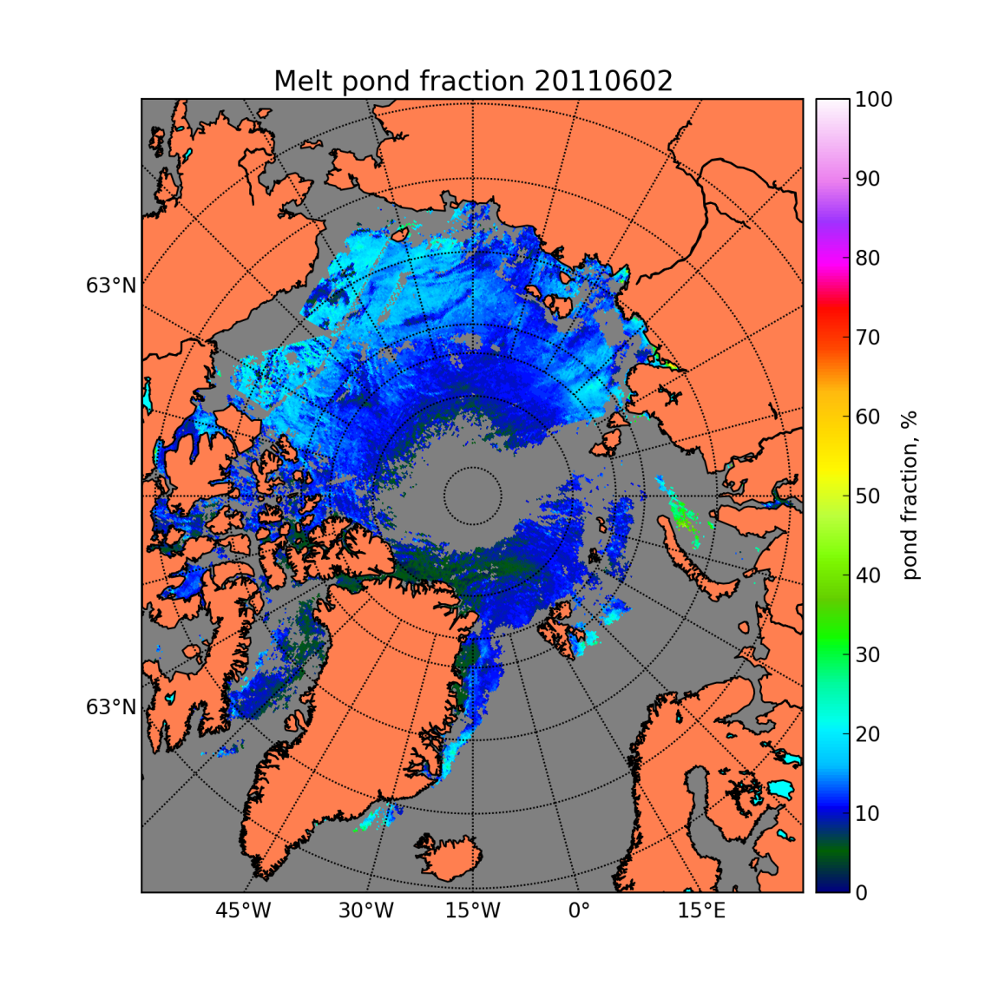
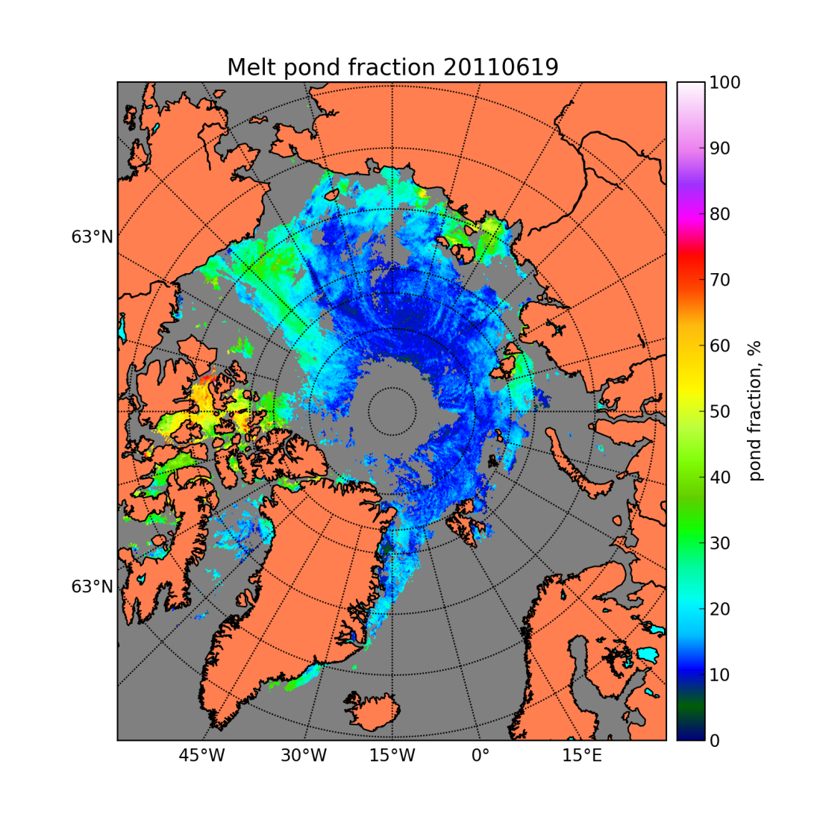
SMOS data analysis
Melt pond fractions retrieved from MERIS data, MPD algorithm, University of Bremen
Point Barrow : 73º N, -156 ºW
20110602
20110619

Slide 12
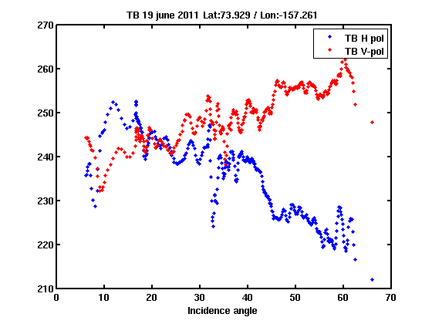
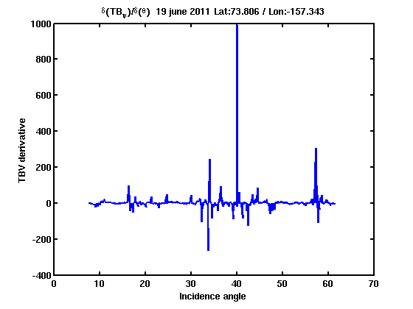
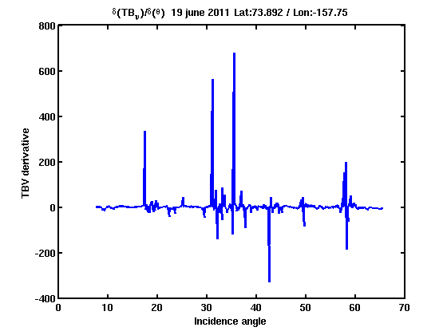
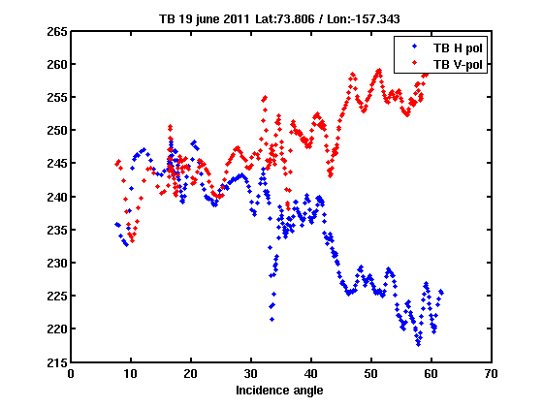
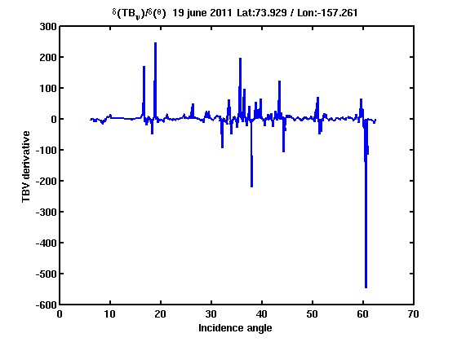
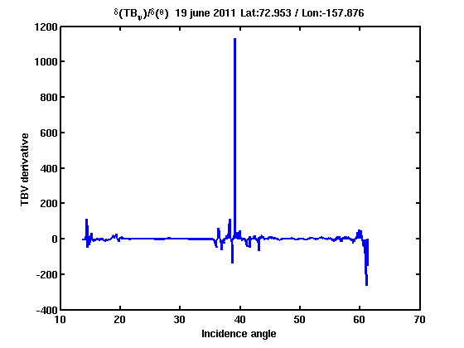
SMOS Data analysis
2 June 2011, Point Barrow, the Melting has NOT started.
TB_H/TB_V
δ(TB_V)/δ(θ)
δ(TB_V)/δ(θ)

Slide 13
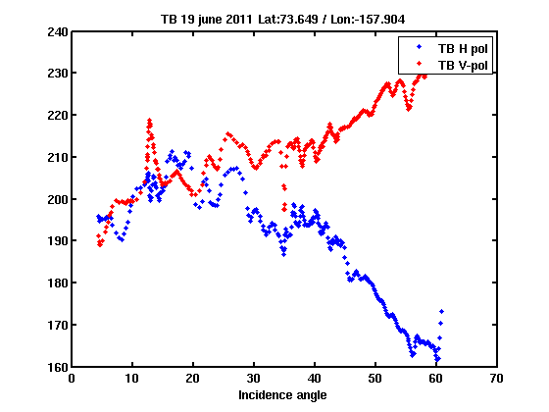
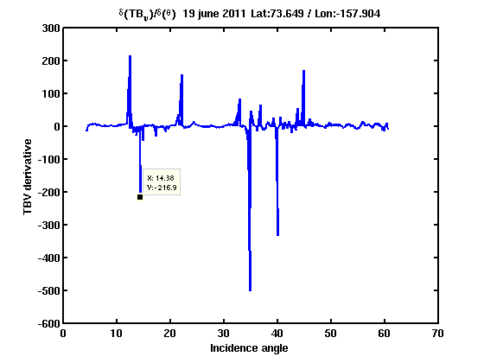
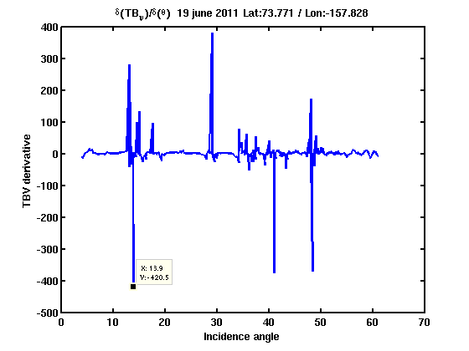
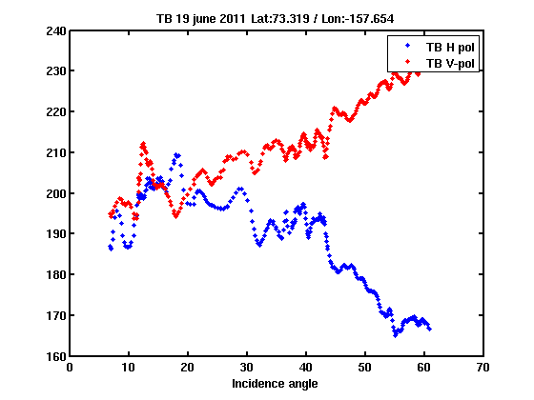
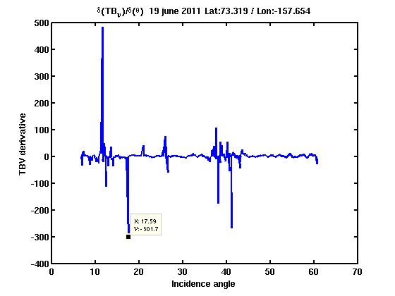
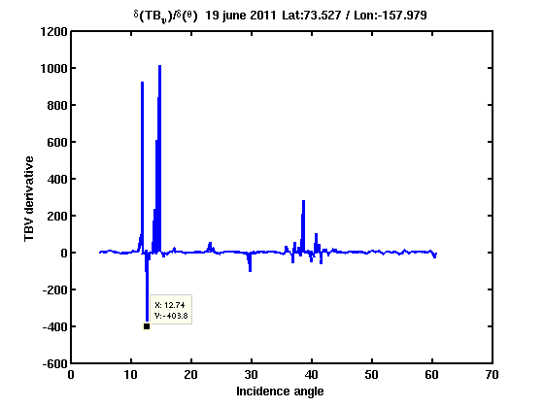
SMOS data analysis
19 June 2011, Point Barrow, the Melting has started.
TB_H/TB_V
δ(TB_V)/δ(θ)
δ(TB_V)/δ(θ)

Slide 14
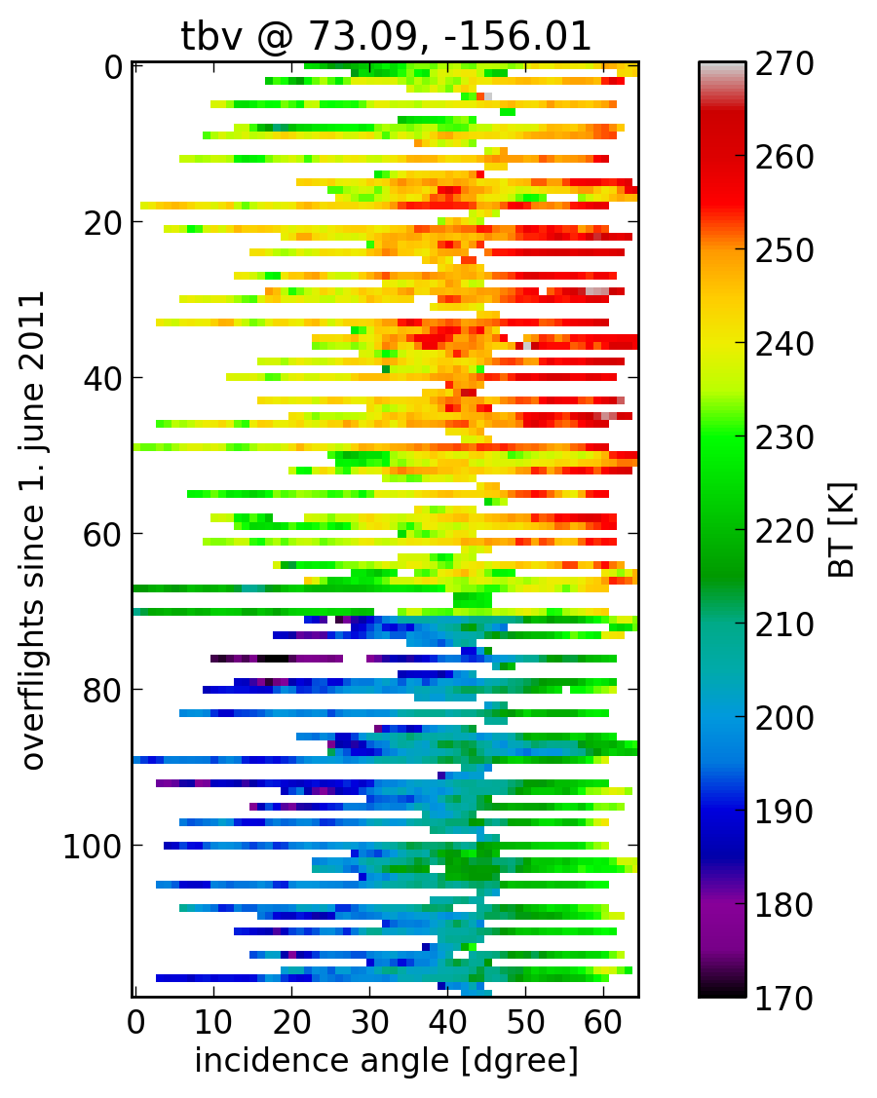
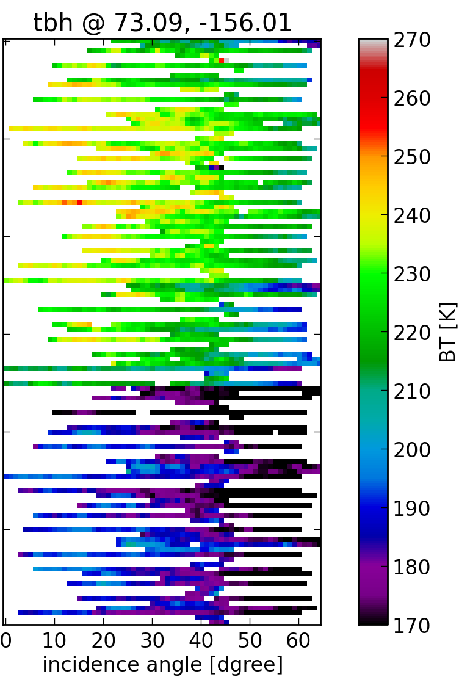
Can we see it with SMOS?
Hovmüller TB for a GP near Point Barrow
Time
1st June
Abrupt decrease
on TB
17 June
Melt Ponds?
30st June

Slide 15
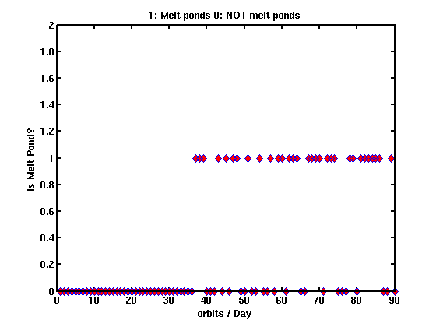
Can we see it with SMOS?
Temporal evolution of Melt ponds detected by SMOS
at Lat=[72N,74N], Lon=[154W,156W] (Point Barrow)
Test performed:
Is_Melt=1 if
I < 220
Min(derivative) @
θ=[12-18] < -100
Starts Melting
YES, IT IS MELT POND
NO, IT IS NOT MELT
POND
2 june
4 june
19 june
20 june
21 june

Slide 16
Conclusions
Theoretically, thin melt ponds could be detected at 1.4Ghz, since the penetration depth is higher than in other microwave sensors.
Theoretically, clear signature permits to differentiate melt ponds from ice and sea water, at low incidence angles (12-18º) due to the critical angle in the reflection coefficient.
Primary results shows that this signature may be observed with SMOS. But SMOS is very noisy specially at low incidence angles, so some corrections are needed:
Spatial bias correction should be applied (ITT?)
Better RFI filtering.
Find the cause for the mixing at θ=[30-40]º
More analysis and further work is required.

Slide 17
Thank you for your attention

Slide 19
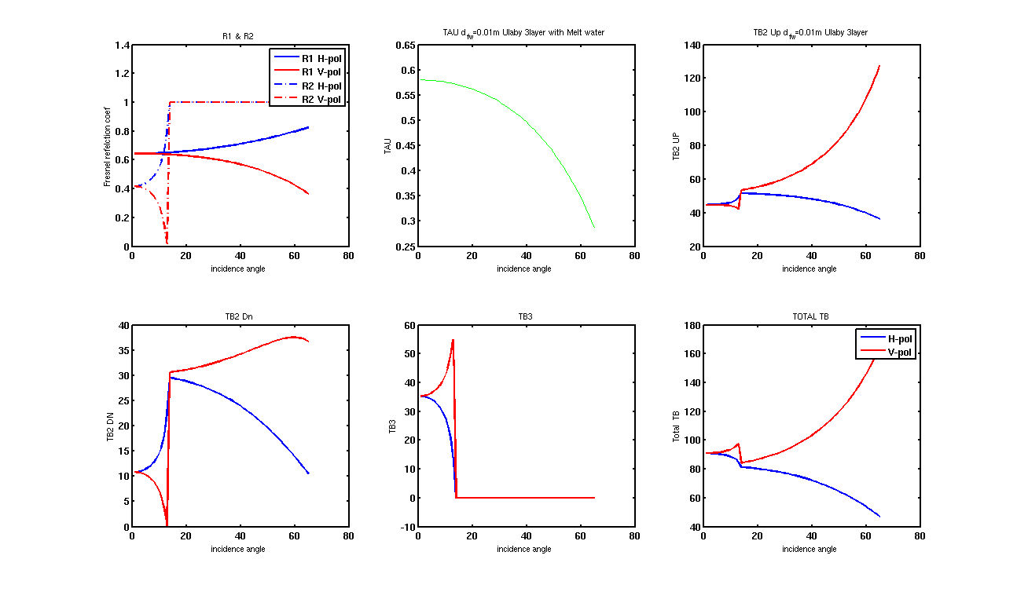
Modeling of melt water
So the measured TB at the satellite is the following:
thickness of fresh water= 1cm

Slide 20
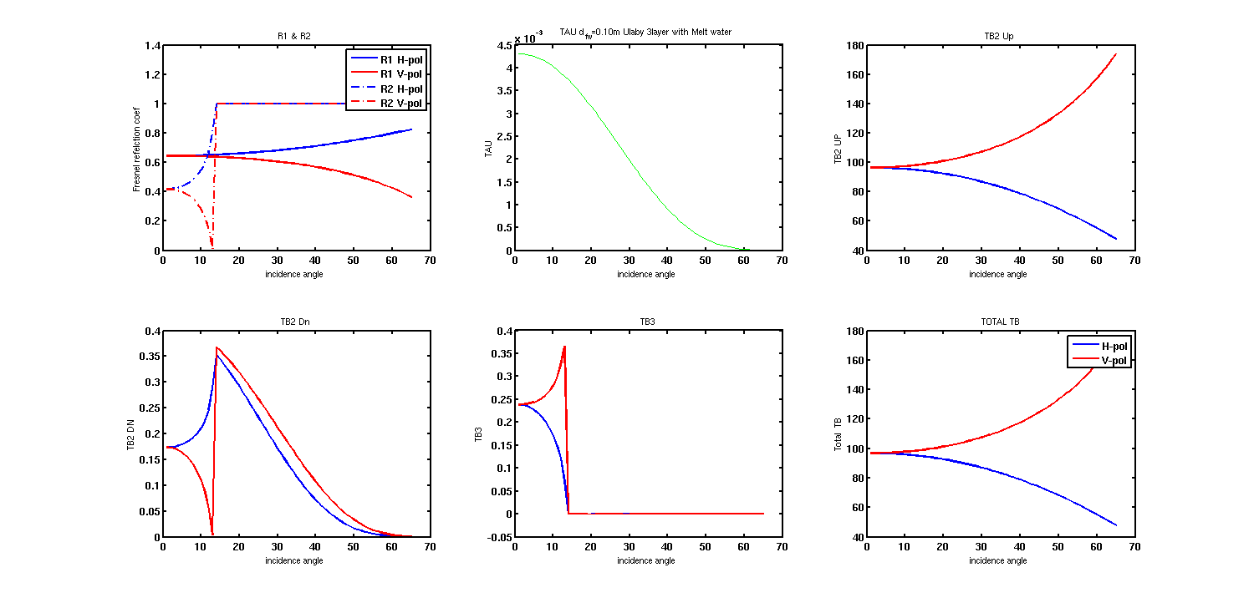
Modeling of melt water
So the measured TB at the satellite is the following:
thickness of fresh water= 10cm

