Slide 1
Passive microwave measurements of sea ice
Leif Toudal Pedersen, DMI
Natalia Ivanova, NERSC
Thomas Lavergne, met.no
Rasmus Tonboe, DMI
Roberto Saldo, DTU
Marko Mäkynen, FMI
Georg Heygster, U-Bremen
Anja Rösel, U-Hamburg
Stefan Kern, U-Hamburg
Gorm Dybkjær, DMI

Slide 2
Algorithm evaluation
Sensitivity to atmosphere
Open water dataset
Simulated data incl RTM corrected TBs from RRDP
Met/ocean data screening
Sensitivity to emissivity variations
100% ice dataset
Simulated data
Snow/ice/atmosphere data screening
Summer performance (snow/ice melt and melt-ponds)
SMMR vs SSMI vs AMSR-E performance
Thin ice performance
Potential resolution

Slide 3
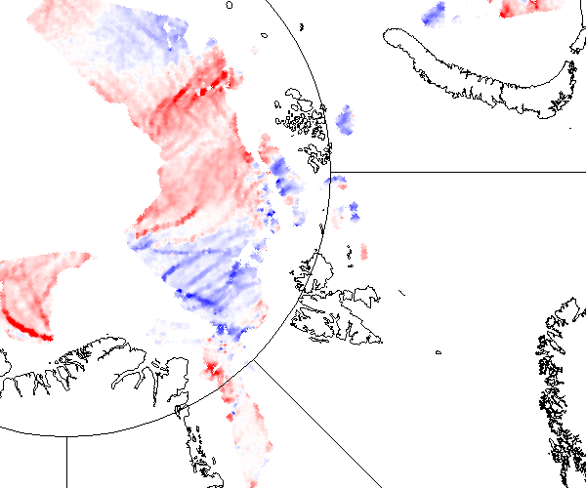
Convergence at ca. 100%
Deformation field between 20100109 and 20100110 from ENVISAT ASAR WSM
Dataset of daily data
from June 2007
to present
exists from PolarView/MyOcean at DTU
Red: Convergence
Blue: Divergence

Slide 4
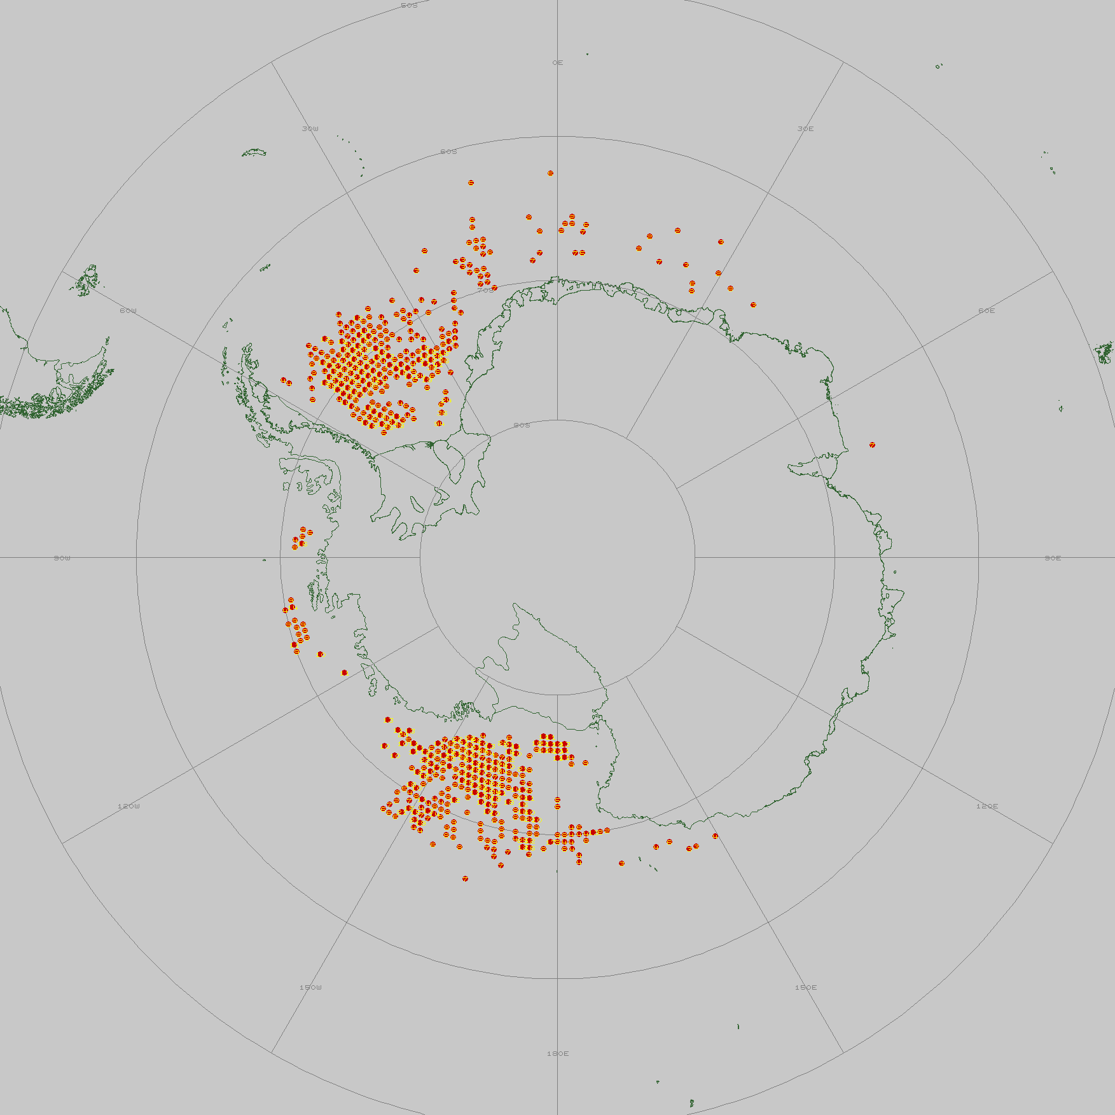
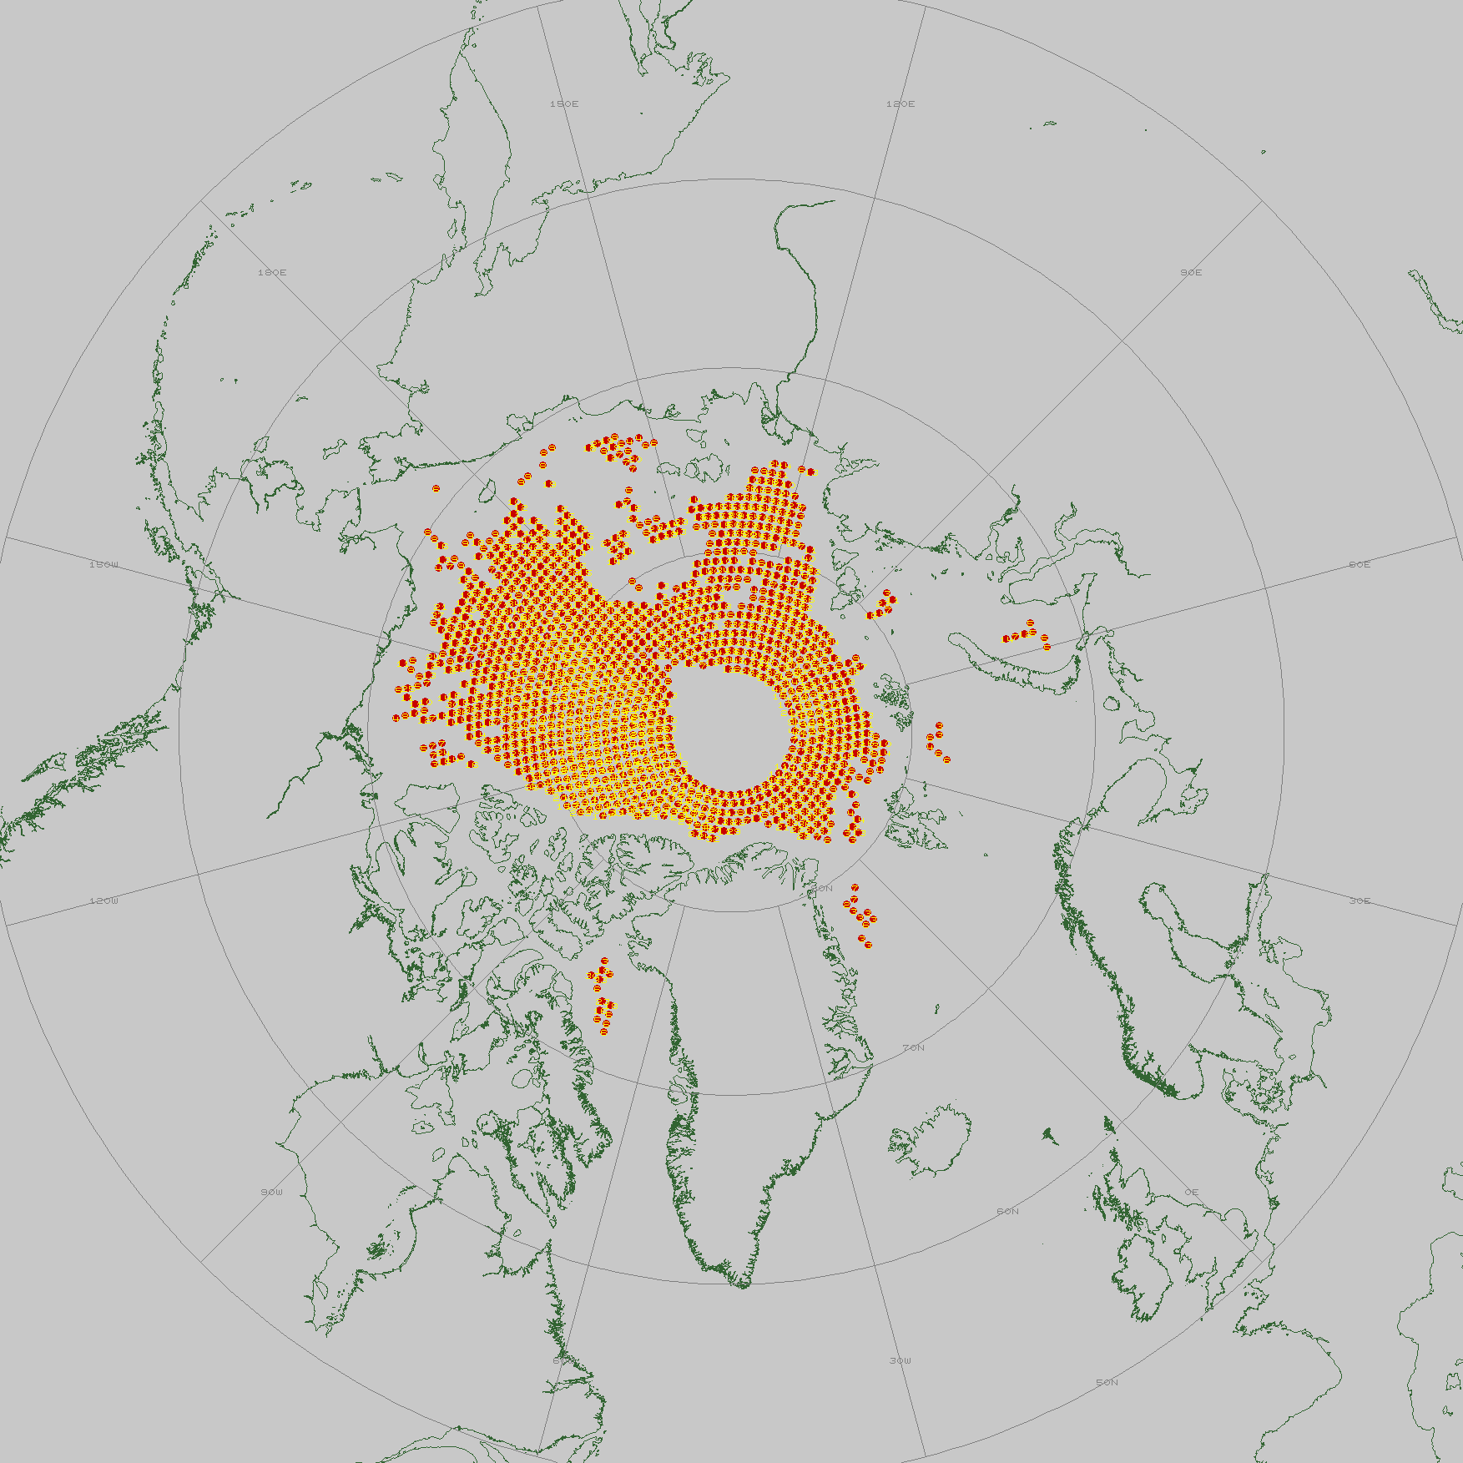
Distribution of validation data (2008 example)

Slide 5
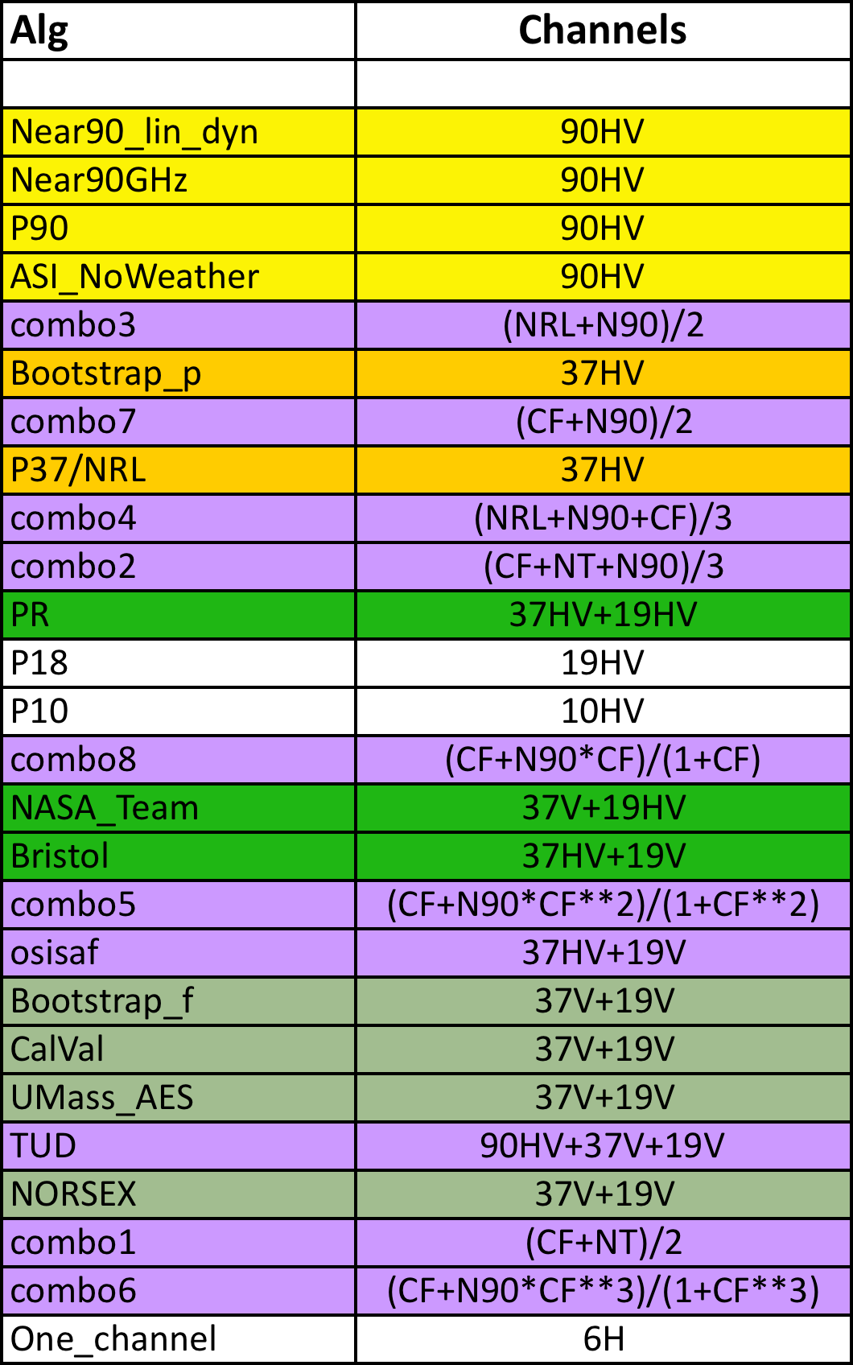
Algorithm portefolio
Some new algorithms (combinations) were added

Slide 6
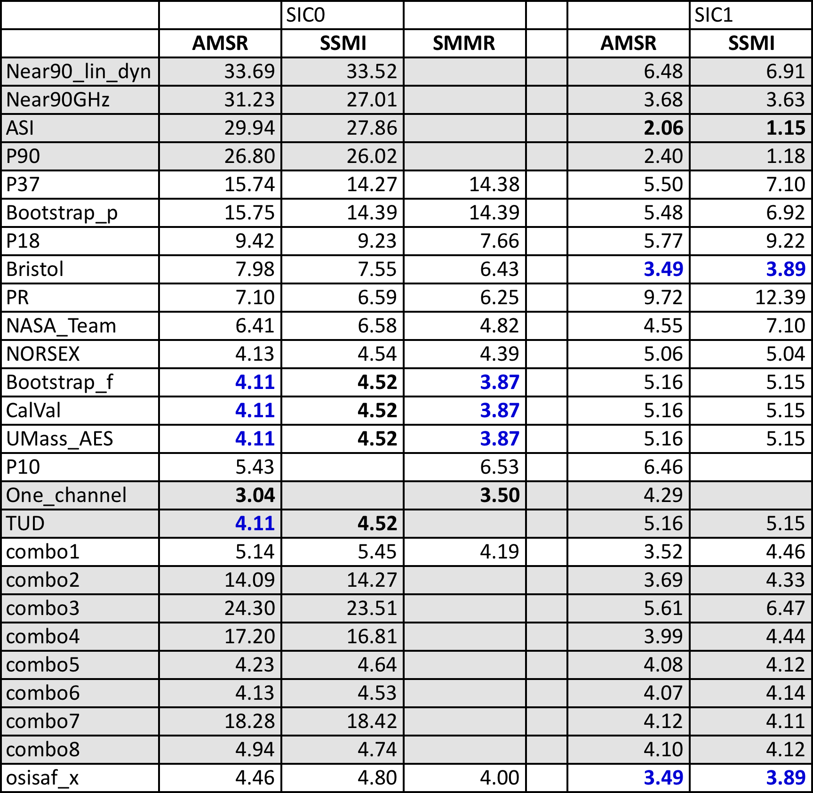
Main results for SIC0 and SIC1 No WF!

Slide 7
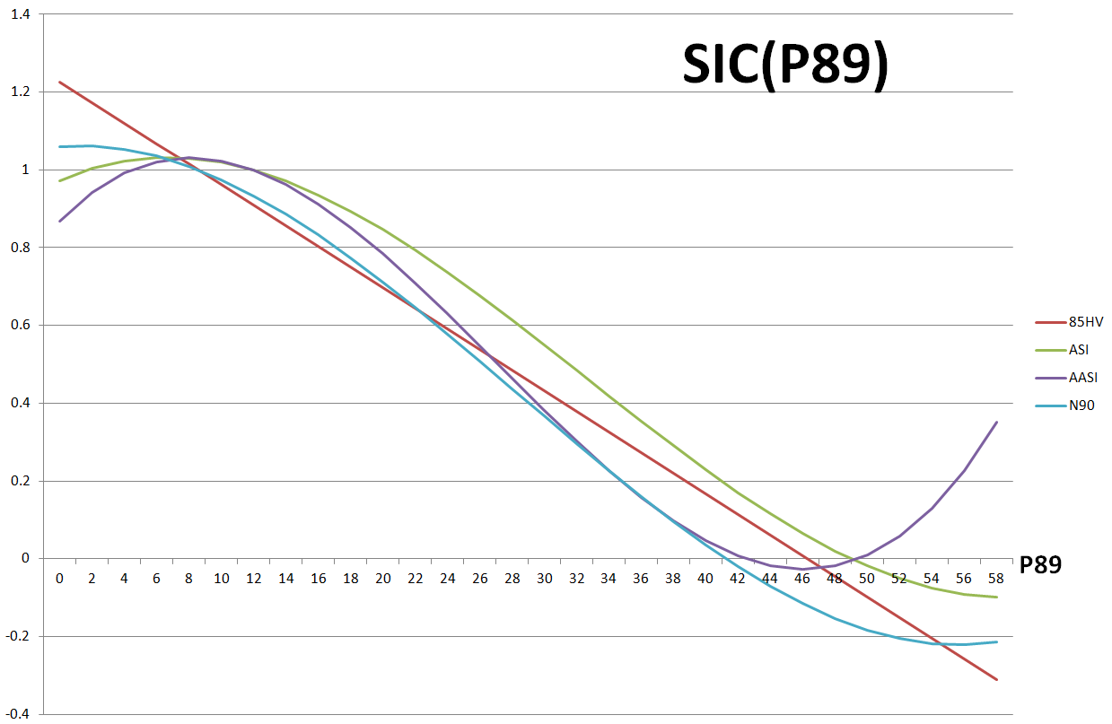
Workings of N90 algorithms

Slide 8
Artificial data combinations
Some algorithms have cut-offs/non-linearities that does not allow a thorough validation at only 0 and 100% ice.
We have generated a dataset of 15% ice and 85% ice using our 0% and 100%
SIC15 = 0.85*SIC0(t)+0.15*SIC100(avgFY)
SIC85 = 0.85*SIC100(t)+0.15*SIC0(avgW)

Slide 10
Algorithm comparison, SIC=15%, AMSR, no WF

Slide 11
Algorithm comparison, SIC=85%

Slide 12
NT2
Has a bias of 10-15% at 85% ice, so a lot of datapoints at 85% are truncated at 100%
Real performance at SIC=85% is something like 10% (estimated from SSMI results that are less biased)

Slide 13
AMSR Summer SIC=0

Slide 14
Weather filters
Weather filters are supposed to remove open water points that show ice because of atmospheric influence (set SIC=0) .
We have established further artificial datasets at 20, 25 and 30% SIC for testing of weather filters.

Slide 15
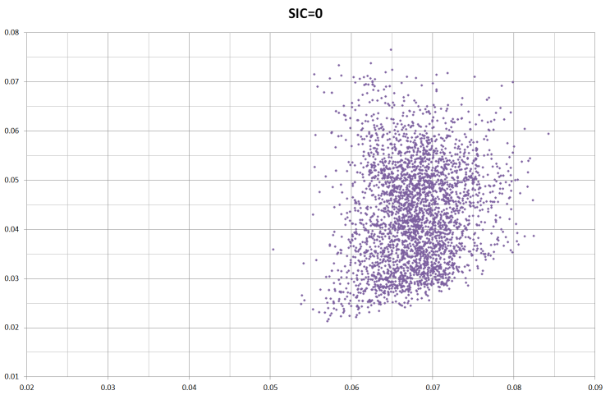
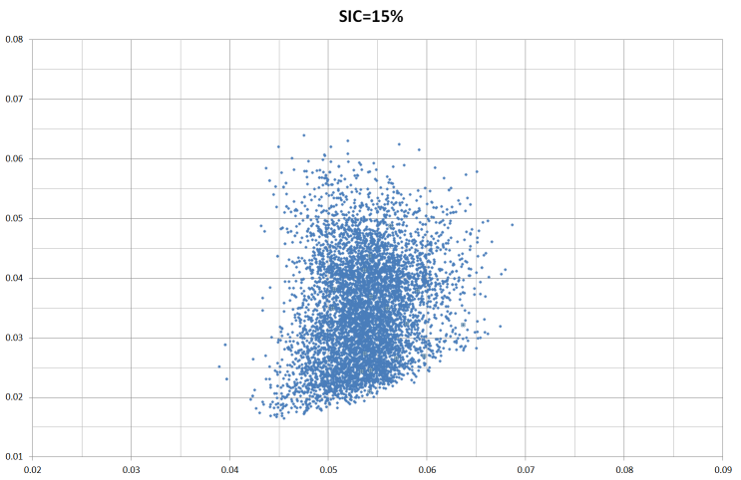
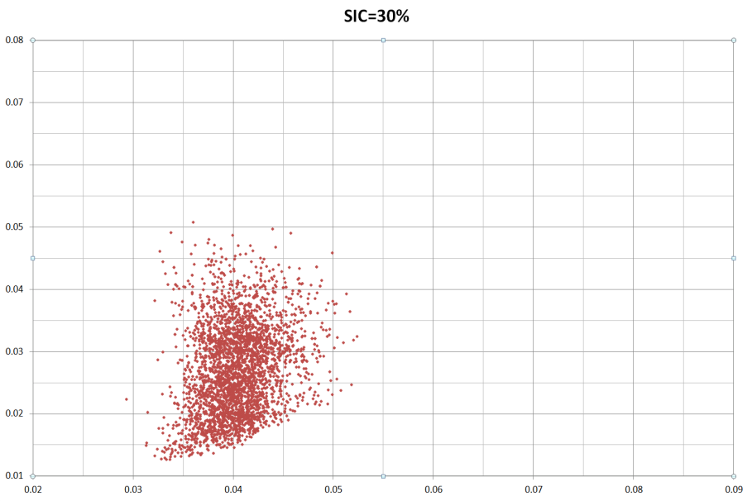
Weather filters
ICE
ICE
ICE
ICE

Slide 16
Weather filters
Tested and we found that they remove ice up to sic>25%
We therefore generated a subset of RRDP with appended ERA Interim
Calculated corrections of TBs due to wind, water vapour and temp. Tried CLW but it was bad
Applied all algorithms to this new set

Slide 17
Atmospheric correction
Upwelling + surface contrib.
Reflected downwelling contrib.
Reflected sky contrib.
T_{ap} = εT_{s} + n

Slide 18
Atmospheric correction Stdev at SIC=0 before and after Atm correction Still no WF

Slide 19
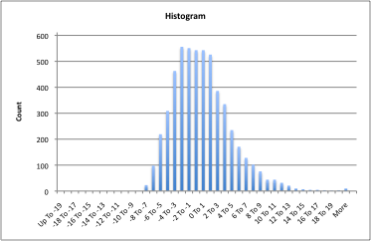
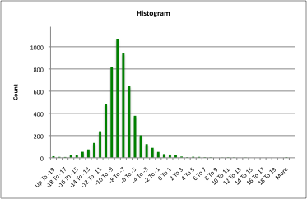
Atmospheric correction using RTM
CF algorithm before and after RTM correction with ERA INTERIM

Slide 20
IOMASA IRT
Simple assimilation of TB (0Dvar)
RTM + surface emisivity forward model
Climatology as background state
Using only 6, 10, 18, 23 and 37
Not 89 pt.
No SSMI pt

Slide 21
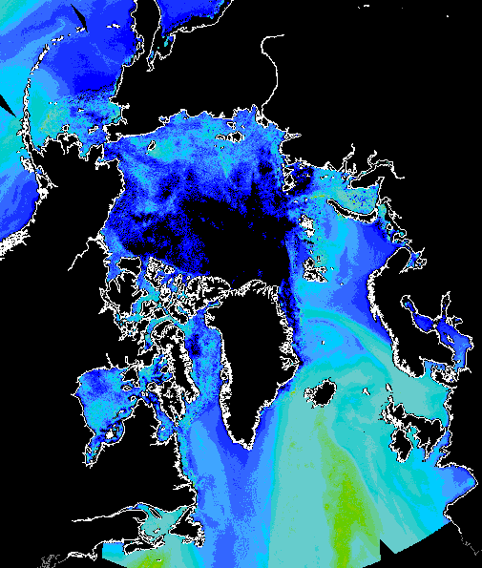
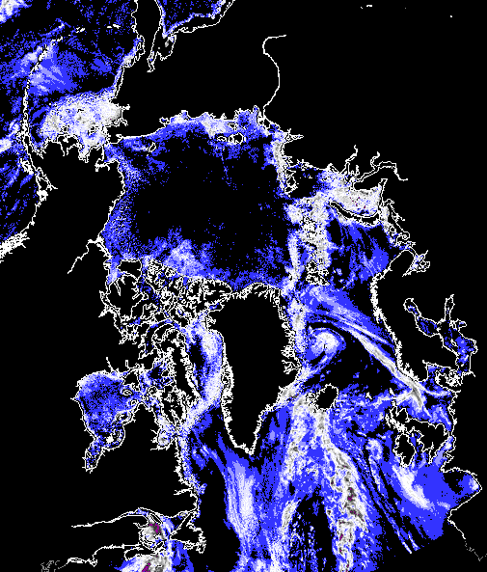
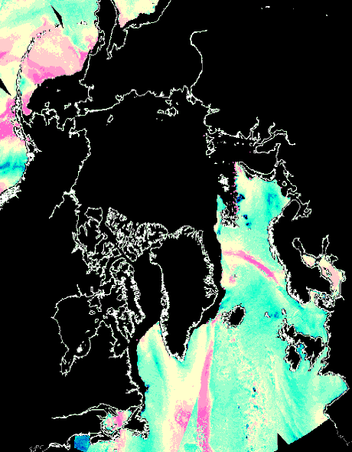
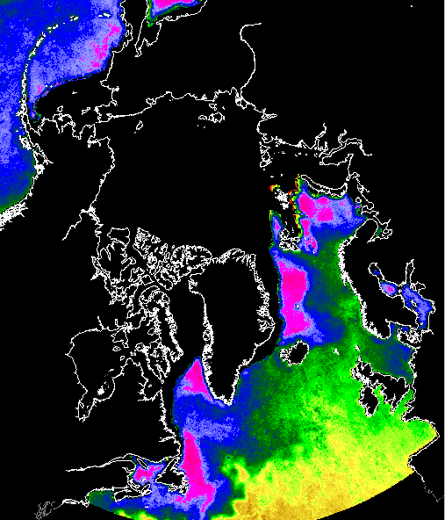
AMSR - February 4, 2006
Ice concentration
MY-fraction
Ice temperature
”Error”
Water Vapour
Cloud liquid water
Wind Speed
SST

Slide 22
RRDP results, SIC=0
Small RMS error
1.71%
Small bias
-0.05%

Slide 23
CF(rtm) vs IOMASA(irt) for SIC=0
Ice conc in %
Ice conc in fractions of 1
Stdev=2.50 (before atm 4.3)
Stdev=1.71

Slide 24
Algorithm comparison, SIC=15%, AMSR, no WF

Slide 25
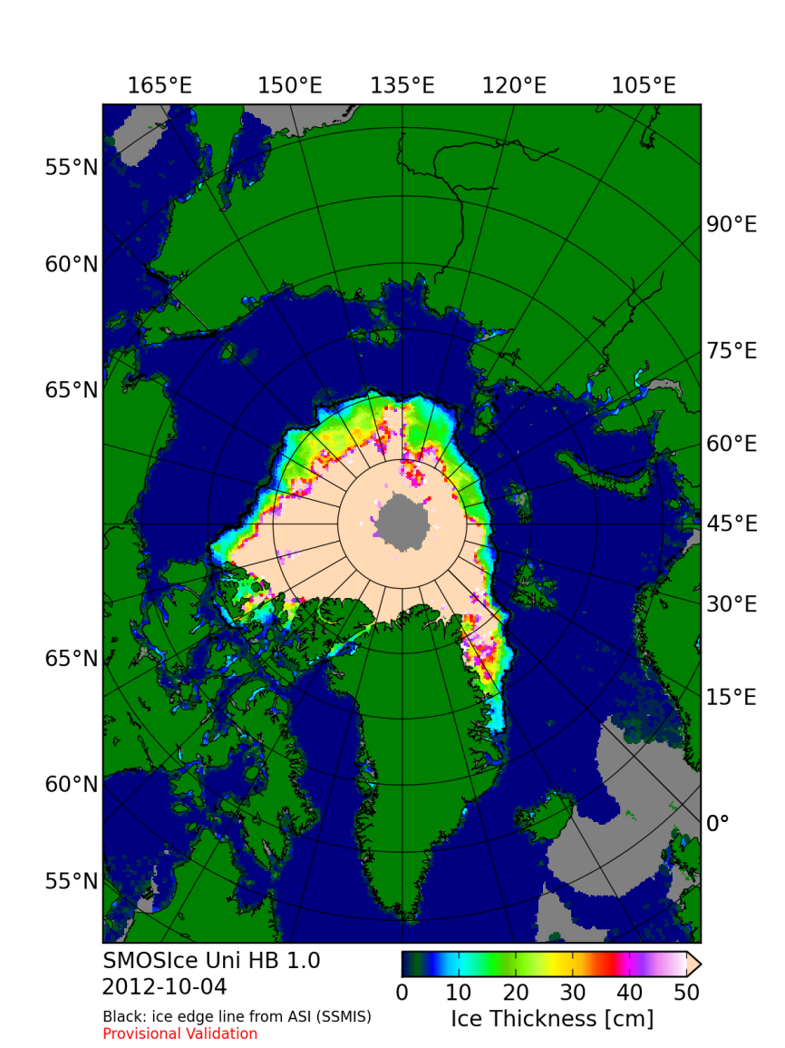
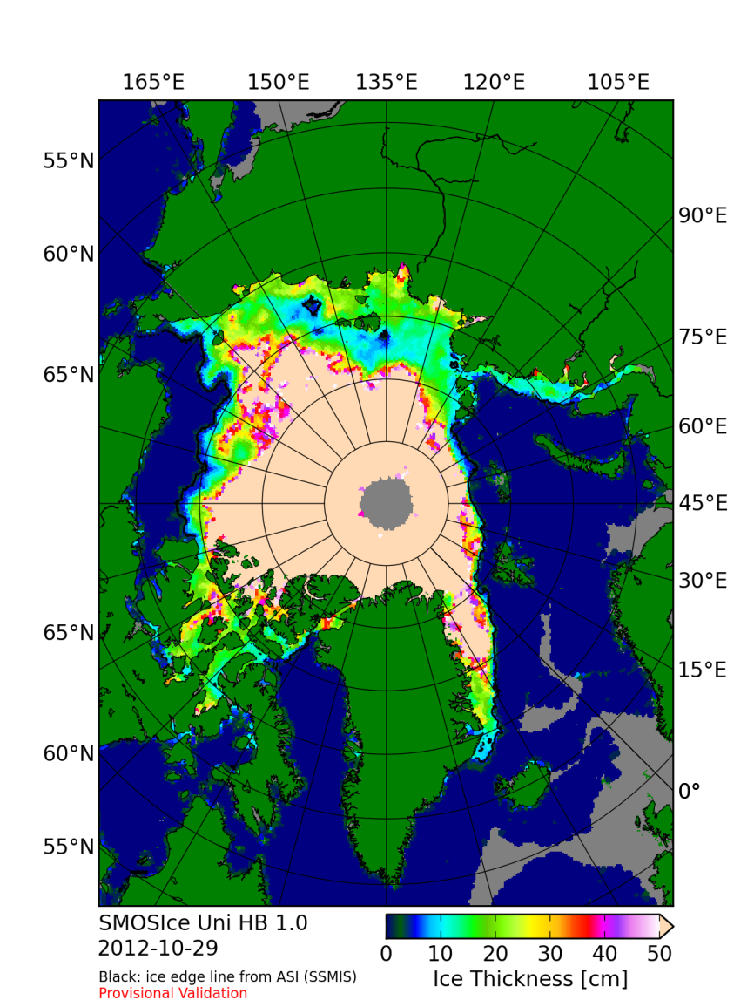
Use SMOS-ice product to identify extensive areas of thin ice (2010)
Thin ice

Slide 27
Concentration of 100% 10 cm ice
Concentration of 100% 20 cm ice

Slide 28
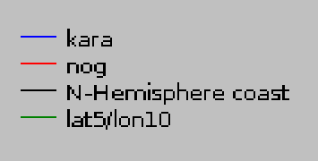
Melt pond dataset distribution

Slide 29
SIC vs (1-OW) OW is melt ponds + leads Combination of melted snow/ice that causes overestimation and OW that does the opposite

Slide 30
Data format for validation data Simple comma separated ASCII text file (.csv)

Slide 31
Conclusions
We select a relatively simple and linear algorithm (CF or OSISAF)
We perform atmospheric correction to TBs to reduce atm noise
We apply dynamic tie-points to accomodate residual sensor drift and seasonal cycle in signatures

Slide 32
The end
Thank you for your attention

