Slide 1
Description of Infrared Longwave, Midwave, and Shortwave Bands
Eric S. Maddy¹
2020/08/31
¹RTi, NOAA/NESDIS/STAR

Slide 2
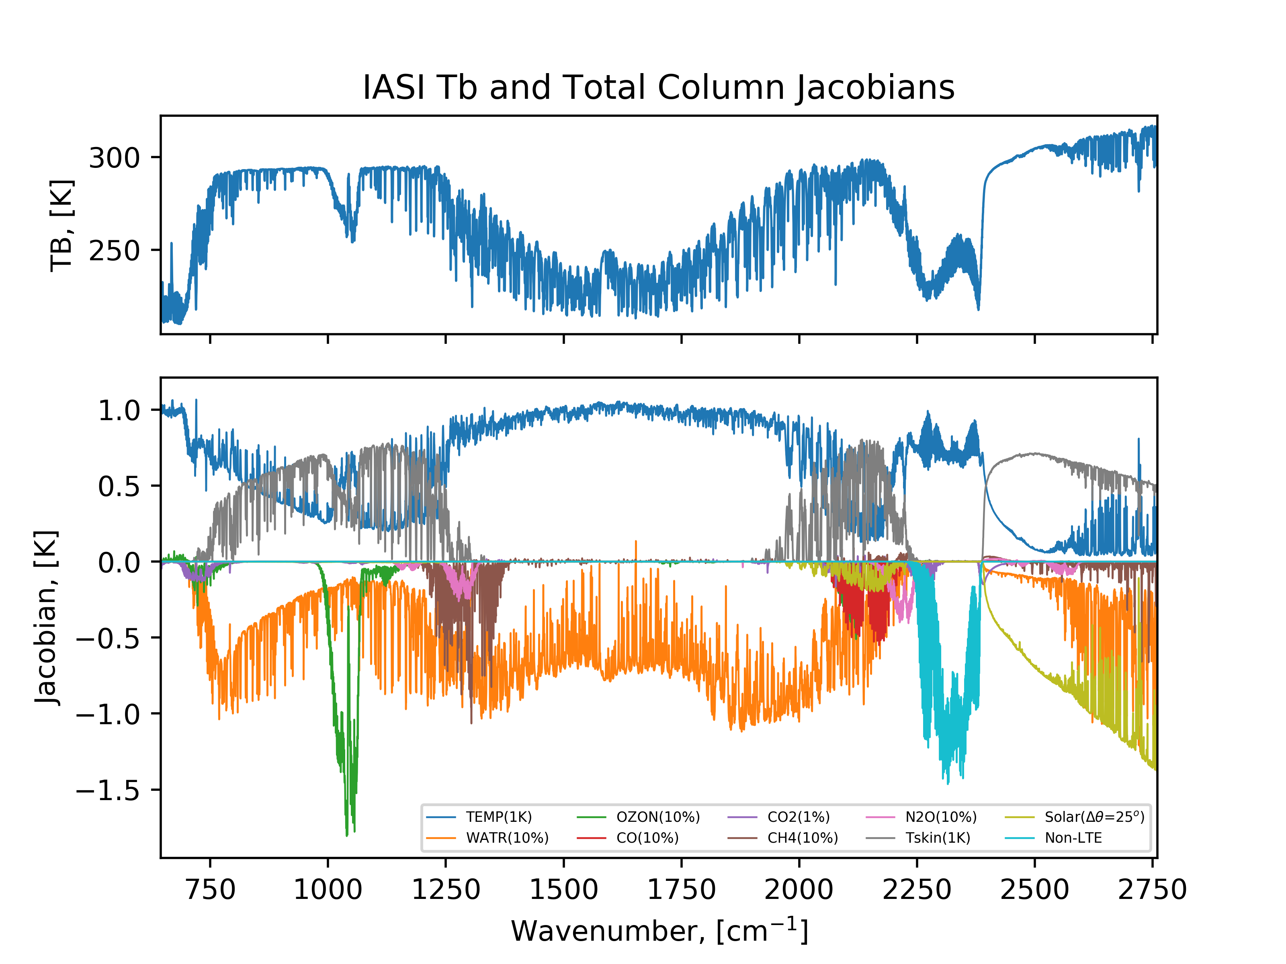
Typical Simulated IASI Infrared Spectrum and Sensitivities Geophysical State Perturbations and RTM Assumptions
Longwave
Midwave
Shortwave
Longwave
650cm⁻¹ to 1210cm⁻¹
15.5µm to 8.3µm
Midwave
1210cm⁻¹ to 2100cm⁻¹
8.3µm to 5.0µm
Shortwave
2100cm⁻¹ to 2760cm⁻¹
5.0µm to 3.6µm
Does not included “fixed” gases in fast CRTM model (e.g., CFCs, NH₃, HNO₃, SO₂, HDO, …)

Slide 3
Typical Simulated IASI Infrared Spectrum and Sensitivities Geophysical State Perturbations and RTM Assumptions
Longwave
650cm⁻¹ to 1210cm⁻¹
15.5µm to 8.3µm
Midwave
1210cm⁻¹ to 2100cm⁻¹
8.3µm to 5.0µm
Shortwave
2100cm⁻¹ to 2760cm⁻¹
5.0µm to 3.6µm
15µm and 4.3µm CO2 T(p) sounding
6.7µm Water Sounding
Does not included “fixed” gases in fast CRTM model (e.g., CFCs, NH₃, HNO₃, SO₂, HDO, …)

Slide 4
Overview of LW, MW, SW Ranges, Uses, and the Challenges in the Utilization of those bands
 | Longwave | Midwave | Shortwave
Spectral Range | 650cm⁻¹ to 1210cm⁻¹ 15.5µm to 8.3µm | 1210cm⁻¹ to 2100cm⁻¹ 8.3µm to 5.0µm | 2100cm⁻¹ to 2760cm⁻¹ 5.0µm to 3.6µm
Main Uses | T(p), Cloud, T_{skin}, O₃(p), H₂O(total) | H₂O(p), T(p), Cloud | T(p), Cloud, T_{skin}, H₂O(total)
Minor Species / Spectral Interference | CFCs, NH₃, VOCs | SO₂, CH₄, N₂O, HNO_{3,} HDO | CO, N₂O, NonLTE, Solar, HDO, CH₄
Spectroscopic Uncertainties (Estimated)^{1,2} | Line Parameters/Mixing : 0.2-0.5K | Line Parameters/Mixing : 0.2-0.5K | Line Parameters/Mixing: 0.2-0.5K NonLTE Parameterizations³ up to ~1K
Minor species in italics – directly affect ability to accurately sound temperature and/or moisture.
¹https://acp.copernicus.org/articles/13/6687/2013/acp-13-6687-2013.pdf
²https://amt.copernicus.org/articles/13/323/2020/amt-13-323-2020-discussion.html
³https://agupubs.onlinelibrary.wiley.com/doi/full/10.1029/2020JD032710

