Slide 1
Satellite User Needs Working Group (SUNWG)
Andy Heidinger, SUNWG Chair (Acting)
Ed Grigsby, SAE Director, SUNWG Co-Chair
Notes:
Most recent SUNWG Charter:

Slide 2
SUNWG Basics
Replaced the LORWG and GORWG to achieve an enterprise approach to ingesting and satisfying data, information, and services satellite user needs.
Chartered directly by NESDIS.
NOAA LO representation and critical input does not change.
SUNWG does not have an authoritative role, but instead provides informed recommendations for requirements setting and awareness regarding user needs assessment results, and product/performance impacts and risk issues to/from NOAA LOs and NESDIS Offices.

Slide 3
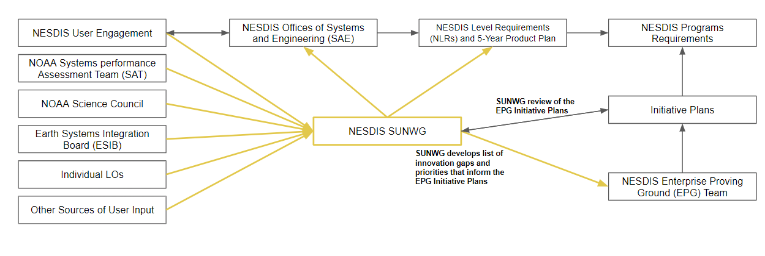
SUNWG Structure:
SUNWG Diversifies Where We Gather User Needs

Slide 4
NOAA LO Needs Drive Program Requirements
NOAA line office needs are captured by SAE for NOSC
NLR derived from NOSC needs
Program requirements flow from NLR
PROGRAM REQUIREMENTS
Program Requirements shaped by NESDIS Level Requirements and Strategic Objectives.
Program Requirements
NESDIS LEVEL REQUIREMENTS
NESDIS Level Requirements
Guided by user needs, federal policies and international agreements.
NOAA’s CORE MISSION
Science, Service and Stewardship
Implementing NOAA’s mission is foundational to the purpose of NESDIS.

Slide 5
SUNWG Functions
Review and assess emerging user needs in proven product-impacting science research, NOAA priorities, and user requests for potential on-boarding processes to operationalization;
Review and assess science relevant innovations for science impact on the user community and provide feedback and recommendations to inform NESDIS processes, plans and requirements development;
Assess mission impacts to NOAA LOs and Mission Service Areas for proposed technical and programmatic changes to NOAA satellites and/or ground systems and services;
Inform the NOAA integrated science community of emerging science, technology, implementation plans and relevant policy;
Provide input to the Product Portfolio Management process for planning for continuity and enhancement of current and future products and services; and
Support SAE validation and verification of program and project requirements, including annual review of the NESDIS 5-Year Product Plan

Slide 6
SUNWG Membership
Co-Chairs NESDIS Chief Scientist SAE Director | Principal Members Representative from each NOAA LO NESDIS Program Senior Scientists from LEO, GEO, SWO, STAR and NCEI
Advisory Members Representatives from NESDIS User Engagement, OCS, NCEI, STAR, OSPO, SAE and NESDIS Product Portfolio Managers (PPMs) NOAA US Group on Earth Observations (USGEO) Satellite Needs Working Group (SNWG) Representatives Representatives from any NOAA Program may be retained in an advisory capacity as needed Ad-Hoc Subject Matter Experts: Attend meetings as requested by Co-Chairs Representative from each NOAA executive-level boards/councils (i.e.. NOSC, NSC, NOCC, ESIB) Executive Secretariat Any NOAA employee of affiliate may attend meetings

Slide 7
Next Steps
Revised SUNWG Charter to be circulated for feedback and approval
Work Plan to be written
Briefing the NOSC

Slide 8
In Brief, the SUNWG:
Synthesizes and communicates the needs, requirements, goals, and objectives of NOAA Line Offices (LOs) and Executive-level Boards, Councils, and Committees to NESDIS regarding NOAA satellite capabilities;
Makes recommendations to NESDIS along the entire end-to-end lifecycle of NOAA satellite flight and ground system programs and/or requirements, including architecture, products, and/or services; and
Provide feedback to other NOAA cross-cutting Councils and Boards as appropriate, to communicate product and service requirements discussions and developments.

Slide 9
Possible SUNWG/SAT Collaborations
SUNWG may become the source of SAT assessments.
SUNWG could devote meeting(s) to SAT out briefs of assessments and thereby reduce overall meeting loads and amplify the impacts of the SAT assessments.

Slide 10
BACKUP

Slide 11
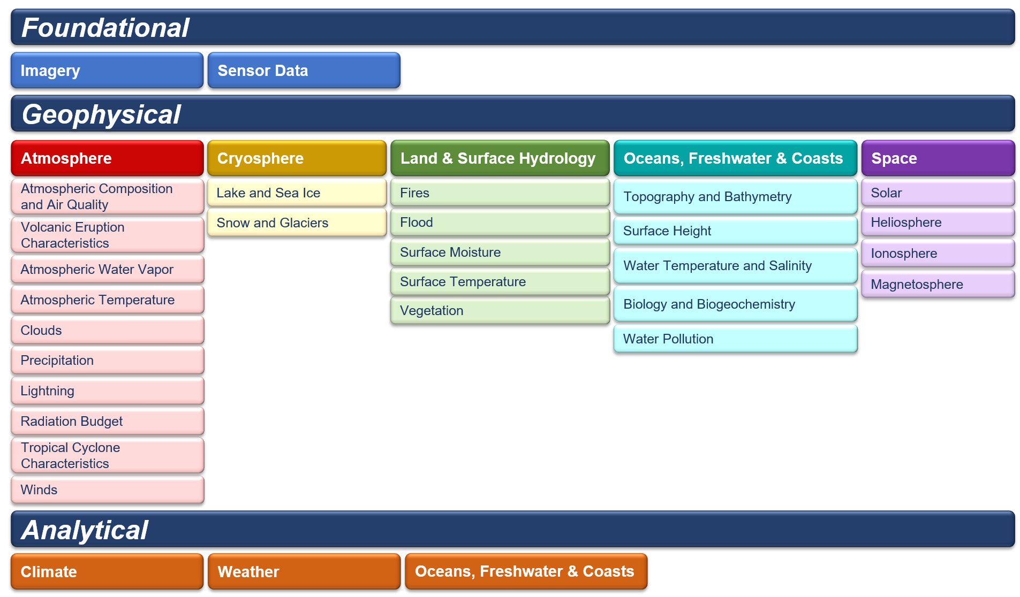
Refresher of NESDIS Level Requirements [REQ-001]
NLR REQ-001: NESDIS will provide environmental data, information, products, services, and reports in the Foundational, Geophysical, and Analytical thematic product areas.

Slide 12
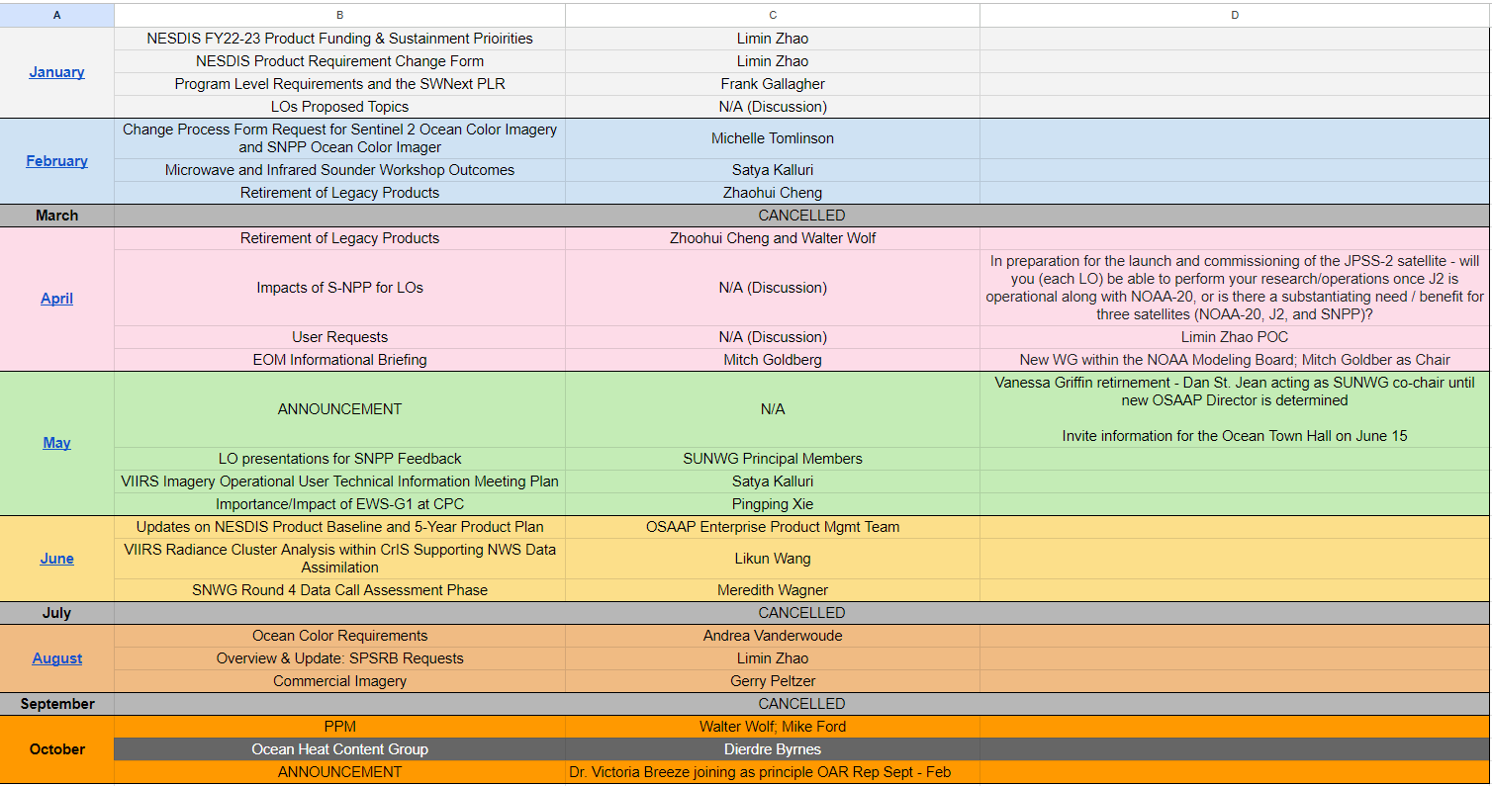
SUNWG 2022 Topics

Slide 13
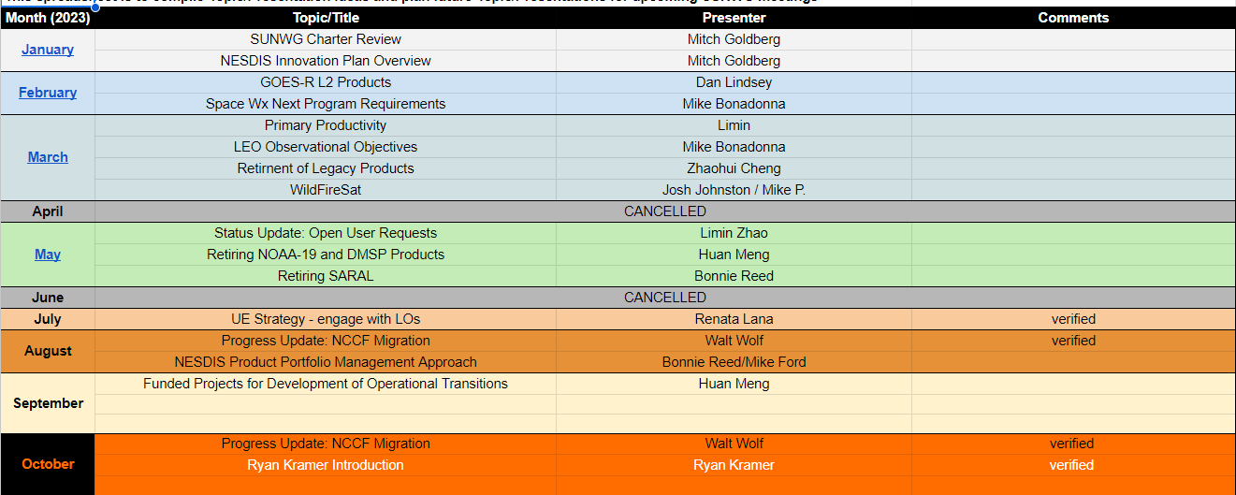
SUNWG 2023 Topics

