Slide 1
Sensors MW Accuracy Overall Assessment (Moving to High Freqs and Lower Noise) Eric S. Maddy^{1,2}, Sid Boukabara² ¹Riverside Technology, inc, ²NOAA/NESDIS/STAR
We vary spectral band coverage of MW sensors and assess the sounding performance of several sensor channel configurations in simulation
ATMS is used as a baseline for accuracy performance assessments
ATMS 23, 31, 50-57, 89, 165, and 183GHz band passes; and MicroMAS-2 118GHz and 204GHz band passes used for simulations.
Orbital parameters from real ATMS observations
Accuracy is also assessed as a function of sensor instrument noise.
Real ATMS and MicroMAS-2 NEDT
Improved noise
We use MIIDAPS-AI (Multi-Instrument Data Assimilation Preprocessing and Sounding-Artificial Intelligence), to perform soundings using testbed of simulations/geophysical profile pairs from NASA GOES-5 Nature Run
MIIDAPS-AI is an AI-based enterprise remote sounding algorithm - uses a deep neural network to retrieve geophysical parameters from satellite radiometric observations
Algorithms are trained in simulation over ocean-only and clear-sky
Algorithms/Sensors are assessed over ocean-only and clear-sky cases for an independent dataset
We only evaluate Temperature and Moisture Sounding for this presentation
Cloud/Precip, Surface, and other parameters can be assessed using same methodology

Slide 2
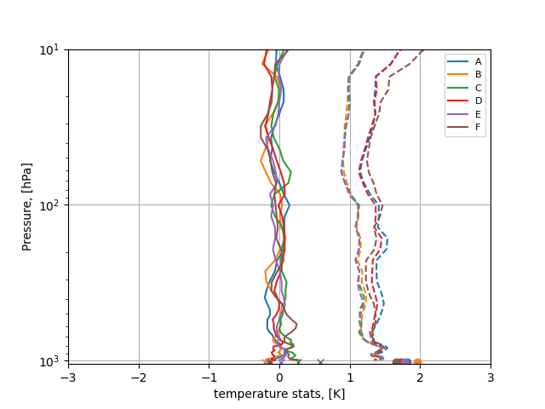
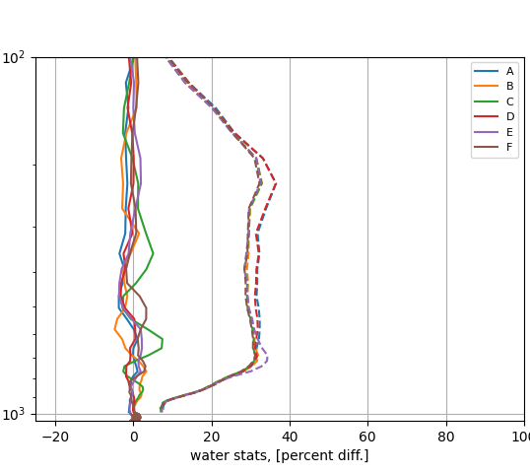
Sensors MW Accuracy Overall Assessment
A: ATMS Baseline channels, ATMS noise levels
B: A with Improved Noise (0.25K for 50GHz, 0.35K for the 183GHz)
C: A plus 118GHz and 204GHz w Improved Noise (0.25K for 50GHz, 0.35K for the 183GHz 0.3K for 118GHz)
D: A plus 118GHz and 204GHz but w Real Noise levels from ATMS, MicroMAS-2
E: A minus 23GHz, 31GHz but plus 118GHz and 204GHz, w Improved Noise (0.25K for 50GHz, 0.35K for 183GHz 0.3K for 118GHz)
F: A but 50GHz replaced by 118GHz and w 204GHz and Improved Noise (0.35K for the 183GHz 0.3K for 118GHz)
Temperature Bias and Standard Deviation
Moisture Bias and Standard Deviation
Significant improvement (>10%) in temperature and moisture sounding performance over current ATMS with improved noise for most sensor configurations.
Removal of low frequency and replacement of 50GHz with 118GHz with improved noise levels over current sensors (Sensor F) improves T in middle troposphere, but somewhat degrades performance in stratosphere. Removal of low frequency and replacement with higher frequencies (Sensor E) improves temperature, but somewhat degrades (~5%) moisture sounding in the lower troposphere.

