Slide 1
Benefits of HyMS Sensor
Eric S. Maddy
07/12/2021

Slide 2
Expected Benefits of a Hyperspectral Microwave Sensor (HyMS)
Enables cross calibration of sensors (subsample HyMS onto correlative sensor spectral response function)
RFI detection and mitigation
Improved observational information content –
Enhanced vertical resolution of moisture profiles,
Enhanced vertical resolution of temperature profiles,
Improved accuracy/precision of the T/Q profiles,
Sounding of boundary layer (penetration depth profile of many water sensitive channels),
Profiling of hydrometeors (cloud, ice, rain, snow, cirrus ice),
Improved accuracy of multiple parameters traditionally observed by microwave sounders and imagers: TPW, SST, LST, cloud, ice, snowfall, rain, SWE, SIC, etc.,
Depending on how low the freq range goes, improve quality of soil moisture, vegetation fraction, salinity, etc.,
Inference of new surface parameters via improved observation of spectral resonances - surface snow grain size, sea ice age, …
Increased signal to noise (and information content) via spectral averaging of channels with similar physical sensitivities ($\sqrt{number of channels}$) as opposed to spatial averaging (increased scene dwell time) which potentially mixes highly non-linear geophysical signals.
Improved understanding of fundamental physics/spectroscopy
More direct measurement of line widths/strengths, pressure induced shift of absorption lines.
Improved radiative transfer algorithm (line-by-line and fast model such as CRTM) accuracy as a result.
Expected improvement to NWP skills (due to improvement of RT quality and to increased information content)

Slide 3
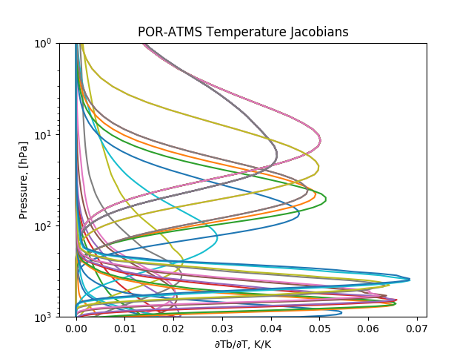
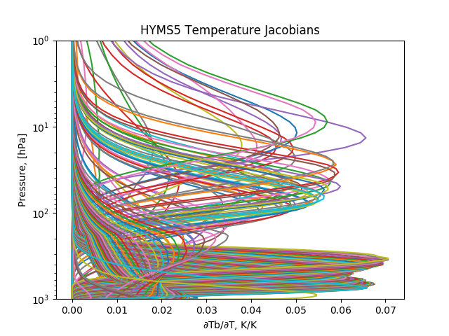
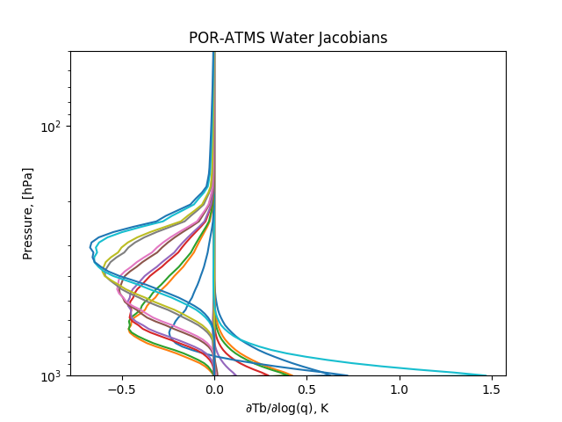
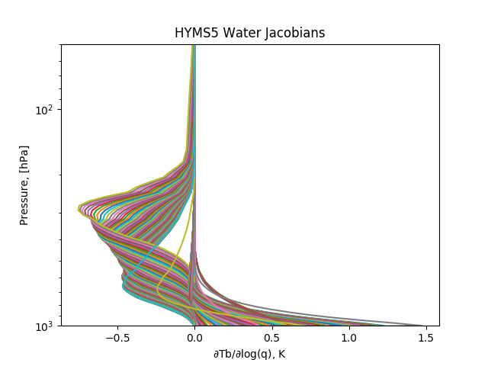
ATMS and 100MHz HyMS spacing
ATMS Temperature Jacobians
HyMS Temperature Jacobians
ATMS
22 bands (with side bands)
~40 total channels
HyMS
100MHz spacing at 23GHz,50-57GHz,183GHz within ATMS bandwidths
ATMS bands at 31GHz, 88GHz, 165GHz
~220 total channels
Hyperspectral Sampling, even at 100MHz, yields unique information over ATMS
Working on simulations with 10x – 100x finer spacing at 23GHz,50GHz,118GHz,and 183GHz.
1 - 10MHz.
Allows for a more optimal selection of hyperspectral band windows.
ATMS Water Jacobians
HyMS Water Jacobians

