Slide 1
5
Experience using 3D winds from ESA’s Aeolus: Impact on NWP
Kevin Garrett¹, Hui Liu², Kayo Ide², Lidia Cucurull³, Karina Apodaca⁴, Mike Hardesty⁵, Ross Hoffman², Katherine Lukens², Lisa Bucci³, Patricia Weir⁶, and Sid Boukabara¹
1: NOAA/NESDIS/STAR; 2: University of Maryland/CISESS; 3: NOAA/OAR/AOML
4: Colorado State University/CIRA; 5: University of Colorado/CIRES;
6: NOAA/NESDIS/OSAAP
Satellite and Information Service
SAT Briefing, September 14, 2020

Slide 2
Aeolus/NOAA NWP objectives and progress
Objectives
OSEs performed (so far)
Integrate L2B HLOS winds (Rayleigh clear/Mie cloudy) into NOAA FV3GFS 4DEnVar
Optimization of FV3GFS DA for TC environment assimilation (varQC)
Integrate into the HWRF model
Assess impacts (global/hurricane models)
Experiments run at C384/C192/L64 resolution (25 km Analysis/Forecast)
FM-A period: 12 Sep – 16 Oct 2018
FM-B period: 2 Aug – 16 Sep 2019
FM-B period 2: 2 Aug – 16 Sep 2019
Observing System Experiment Setup
 | Control run | Aeolus Experiment
All operationally assimilated observations | Yes | Yes
Aeolus L2B HLOS | No | Yes (Rayleigh clear + Mie cloudy winds)

Slide 3
Aeolus (Rayleigh clear) vs GFS FM-A period: 3 Sep – 31 Dec 2018
Stdv
L2B Uncertainty
Bias
L2B wind uncertainty, Stdv. and biases become larger after day 45 (Oct 20, 2018).
“Smallest uncertainty/biases”: Day 25–40, i.e., Oct 1-15, 2018.
Hot pixels evident for some days/layers

Slide 4
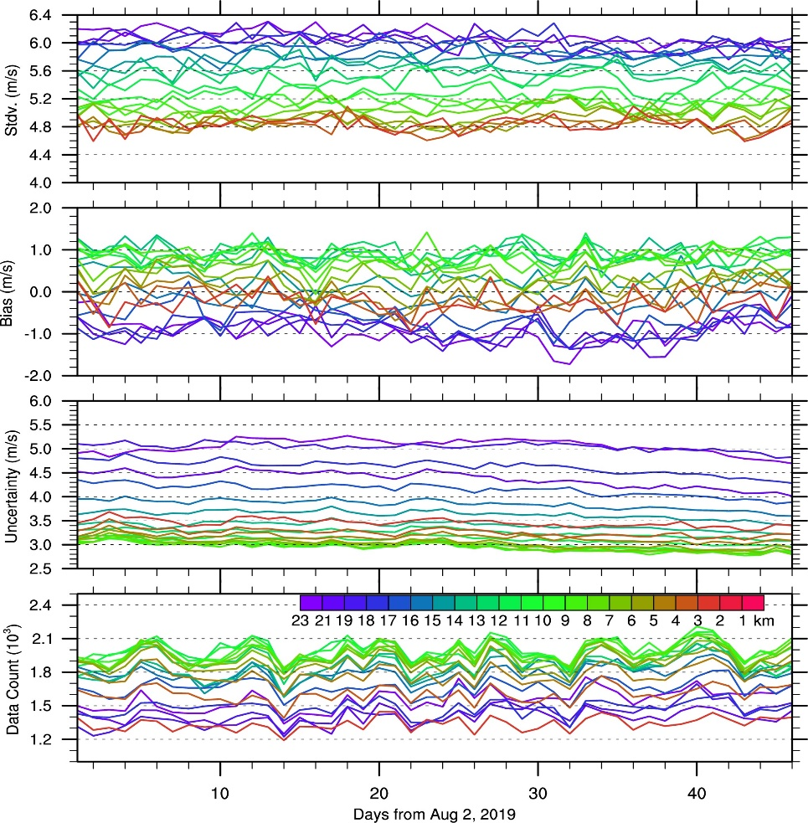
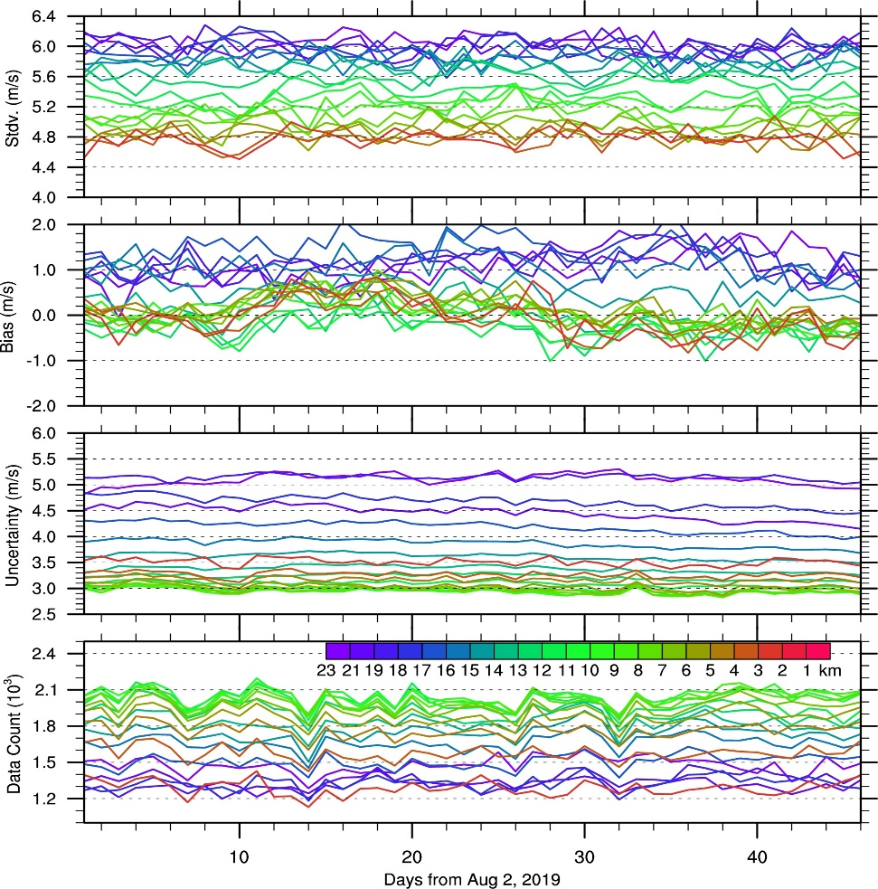
Aeolus (Rayleigh clear) vs GFS FM-B period: 2 Aug – 16 Sep 2019
Ascending
Descending
L2B wind uncertainty, Stdv. and biases stable over time
No hot pixels (during this part of FM-B period)

Slide 5
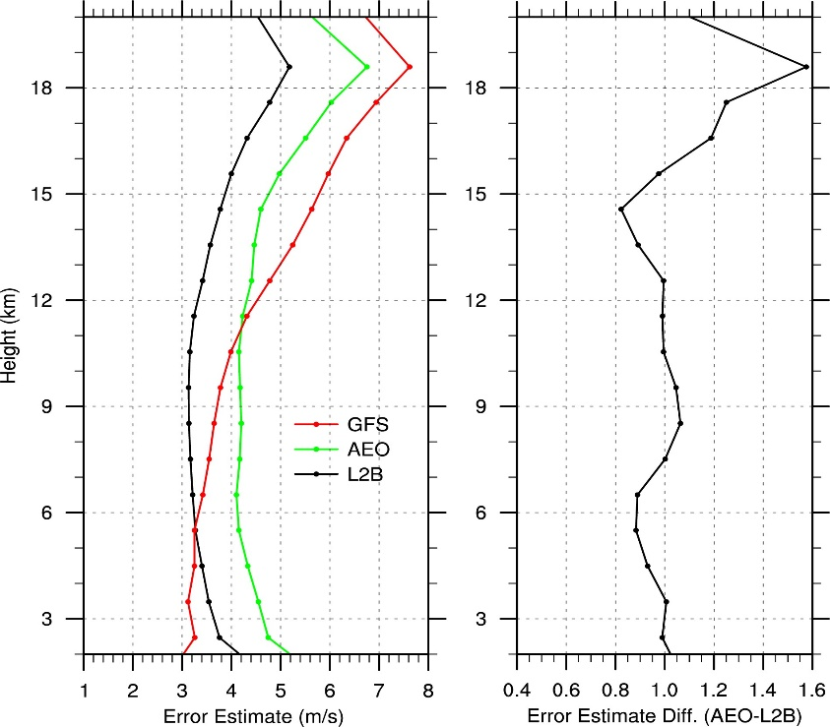
Data assimilation integration (QC, etc) FM-B example
Quality Control
Rayleigh winds, remove:
Rayleigh cloudy
Height < 2 km
L2B uncertainty > 12 m/s
Accumulation length < 60 km
Within 20 hPa of topography
Mie winds, remove:
Mie clear
L2B uncertainty > 5 m/s
Accumulation length < 5 m/s
Thinned to 90 km
Bias Correction
Linear regression
Function of orbit, latitude, wind speed
Global Error Estimates
Observation error
Use Hollingsworth-Lonnberg
Stratified by height, region

Slide 6
FM-A Period Assessment

Slide 7
Overall Impact on GFS Analysis/Forecast (FM-A period: Sep 12-Oct 16, 2018)
Zonal Mean Analysis/Difference
Summary Assessment Metrics
Aeolus
Aeolus-CTL
Region
95% CI
CTL
Aeolus
Better
u
Worse
NH SH TRO
Parameter
Better
v
Worse
Z T Wind RH
Level
Better
Analysis impact: SH/TRO above mid-troposphere (u)
Forecast impact: Significant positive impact in SH, positive impact on Wind and Temperature, above 700 hPa
Worse
250 500 700 850 1000
hPa

Slide 8
FM-B Period Assessment

Slide 9
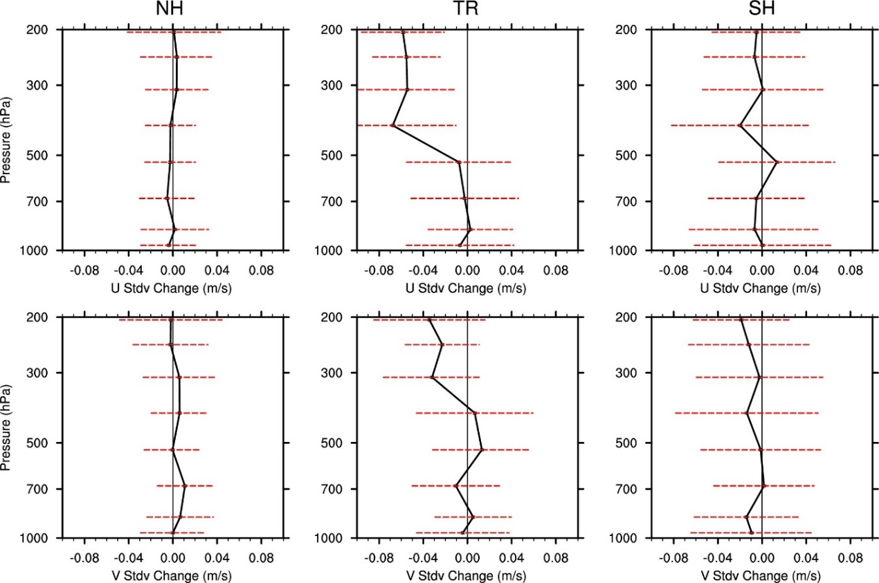
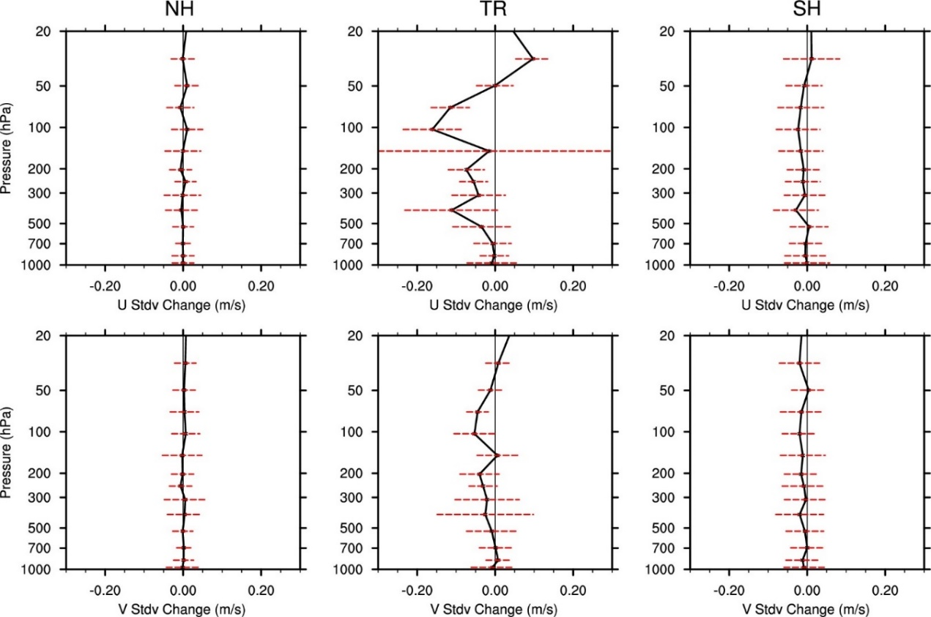
Stdv of GFS Background vs. Observations (Aug 2 – Sep 16, 2019)
Better
Worse
0
vs. Aircraft (Aeolus – CTL)
vs. Radiosonde (Aeolus – CTL)
u
v
Stdv of Aeolus-ACFT vs. CTL-ACFT.
Red lines indicate 95% confidence interval.
Stdv of Aeolus-RAOB vs. CTL-RAOB.
Red lines indicate 95% confidence interval.
Improvement of background fits in Tropics, mostly for u component

Slide 10
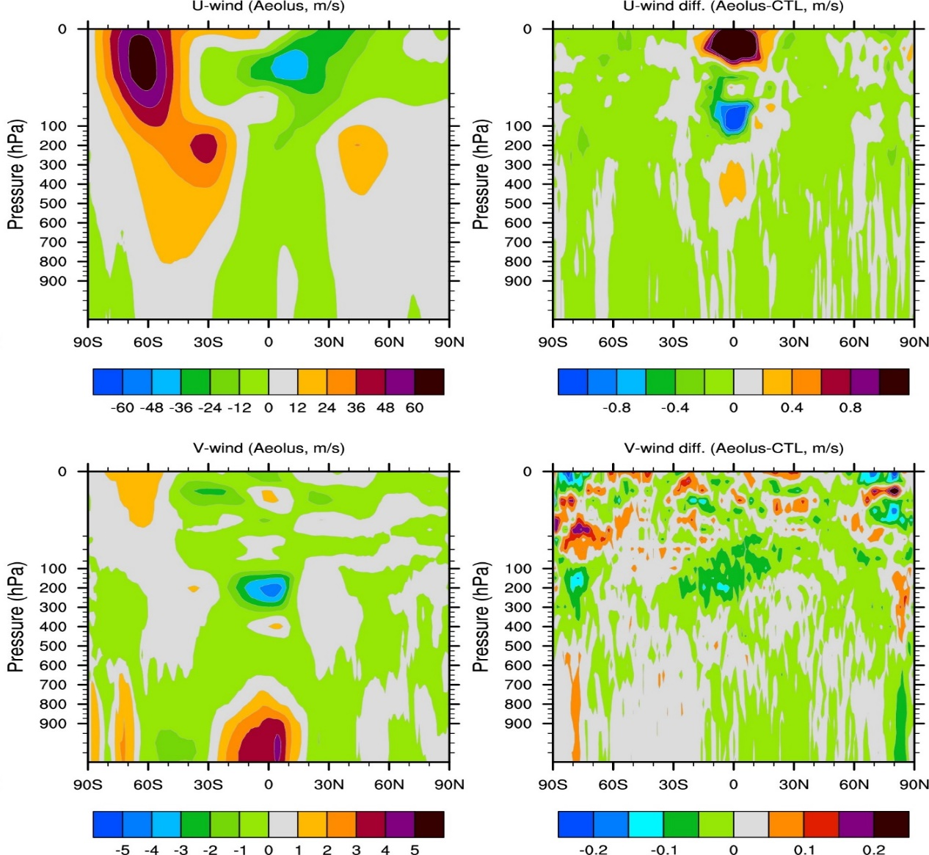
Impact on Wind Analysis (Aug 2 – Sep 16, 2019)
Zonal Mean
Aeolus
Aeolus-CTL
100 hPa U-wind
Aeolus-ECMWF vs CTL-ECMWF
u
v
Large reduction in analysis error in Tropical Easterly Jet

Slide 11
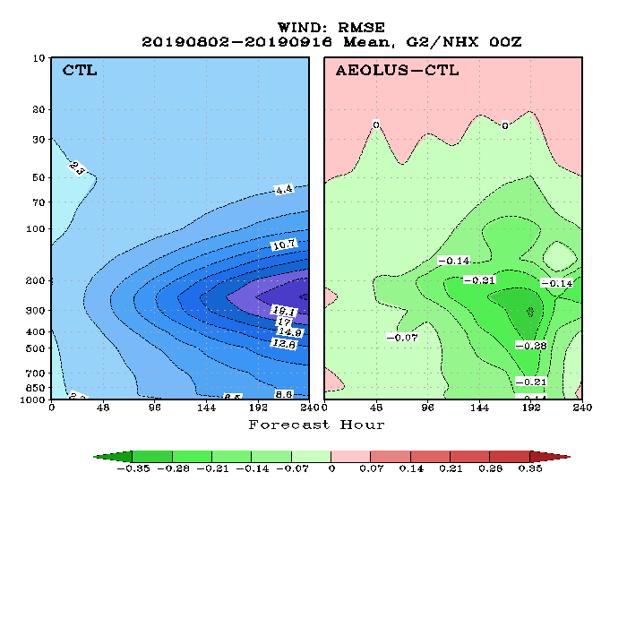
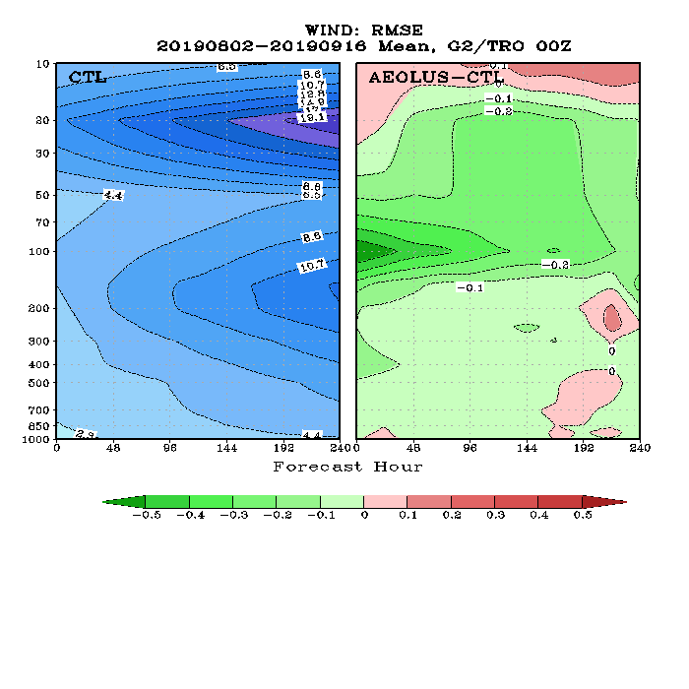
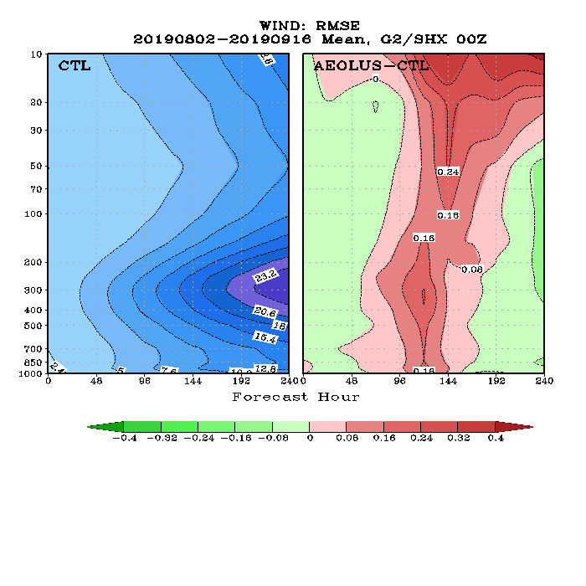
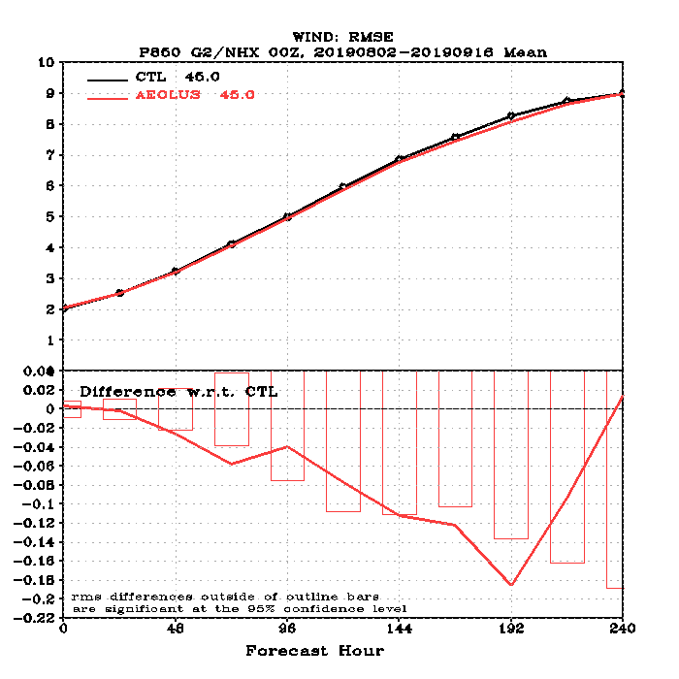
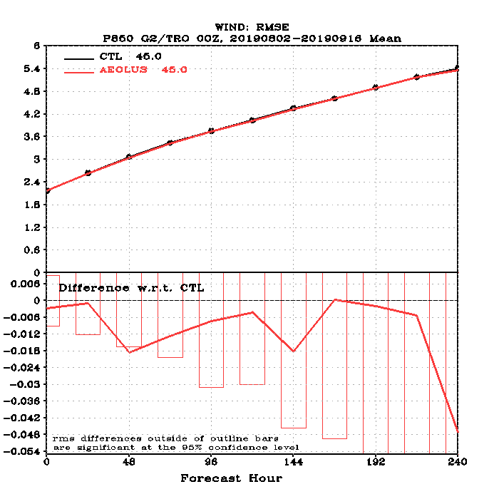
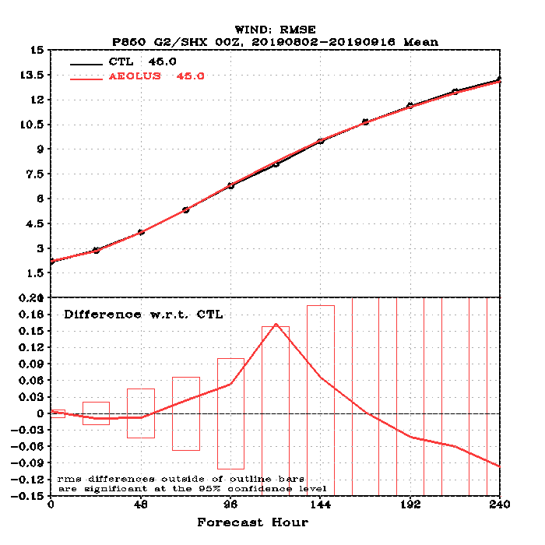
RMSE of Wind Forecast vs Forecast Hour (vs. ECMWF analysis, Aug 2 – Sep 16, 2019)
NH Wind RMSE
TRO Wind RMSE
SH Wind RMSE
u
CTL
Aeolus-CTL
CTL
Aeolus-CTL
CTL
Aeolus-CTL
Large improvement in NH and TRO wind forecast (not necessarily significant)
Degradation at Day 5-7 in SH wind forecast (not necessarily significant)
v
NH
TRO
SH
850 hPa Wind RMSE
Worse
Better
Diff.
Forecast Hour
Forecast Hour
Forecast Hour

Slide 12
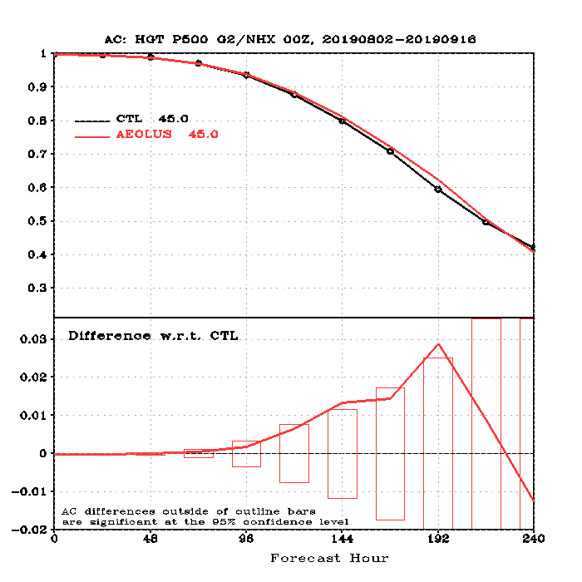
Overall impact on GFS Forecast (Aug 2 – Sep 16, 2019)
NH 500 hPa Height AC
Summary Assessment Metrics
Region
CTL
95% CI
Aeolus
Better
Worse
NH SH TRO
Parameter
Better
Better
Worse
Z T Wind RH
Worse
Level
Better
Overall impacts of Aeolus are similar between FM-A and FM-B periods except for region (FM-A in the SH, FM-B in the Tropics)
Worse
50 100 200 500 700 850 1000
hPa

Slide 13
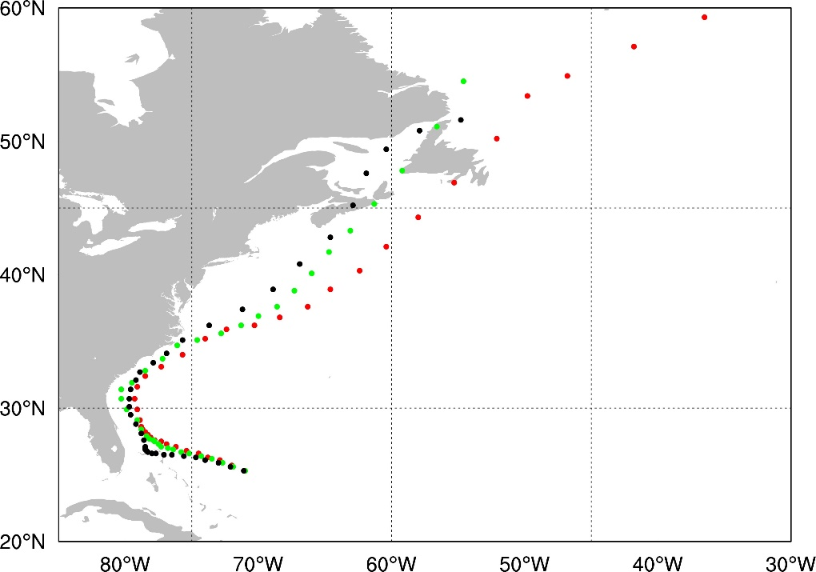
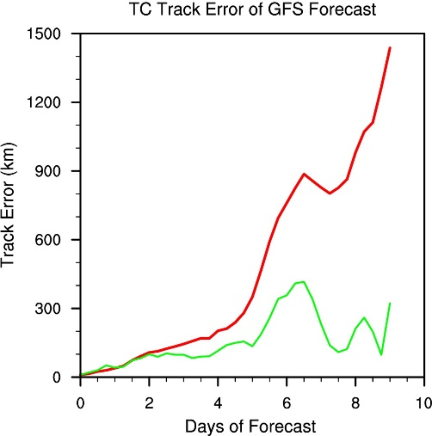
Ongoing Efforts
Evaluate and understand Rayleigh and Mie wind biases (vs. GFS background) from the latest version of FMB (reprocessed) (M1 correction).
Implement L2B processor using NOAA Aux data
Continue impact assessments
New seasons
More metrics, global/synoptic scale impacts
Case studies, high impact events, TCs, etc.
3D winds OSSEs (active/passive) (STAR, CIMSS, QOSAP)
10-Day Forecast of Hurricane Dorian (from Aug 31 00UTC 2019)
Acknowledgement: This work has largely been supported by
the NOAA/NESDIS/OPPA Technology Maturation Program

Slide 14
BACKUP

Slide 15
Backup

Slide 16
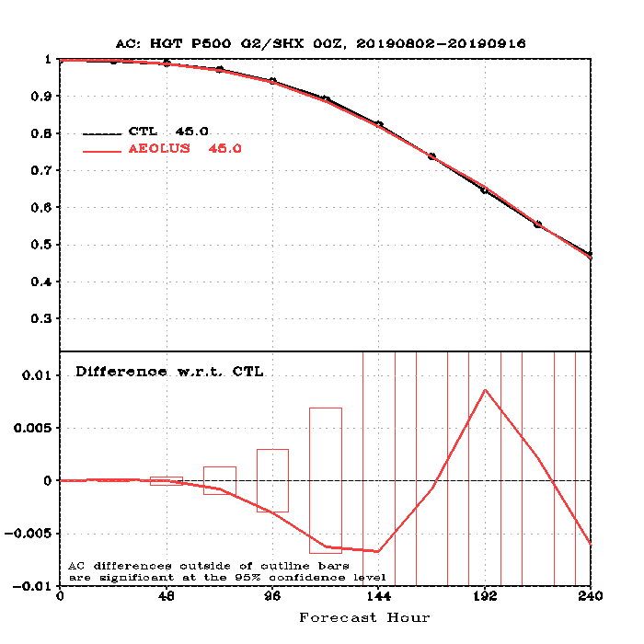
Anomaly Correlation of 500 hPa Height Forecast (vs. ECMWF analysis, Aug 2 – Sep 16, 2019)
NH
SH
Anomaly correlation is improved in NH
Better
Worse
Height forecast Anomaly Correction vs. Forecast Length (top); Difference of the Aeolus w.r.t. Control forecast (Bottom). Bars represent 95% confidence interval.

Slide 17
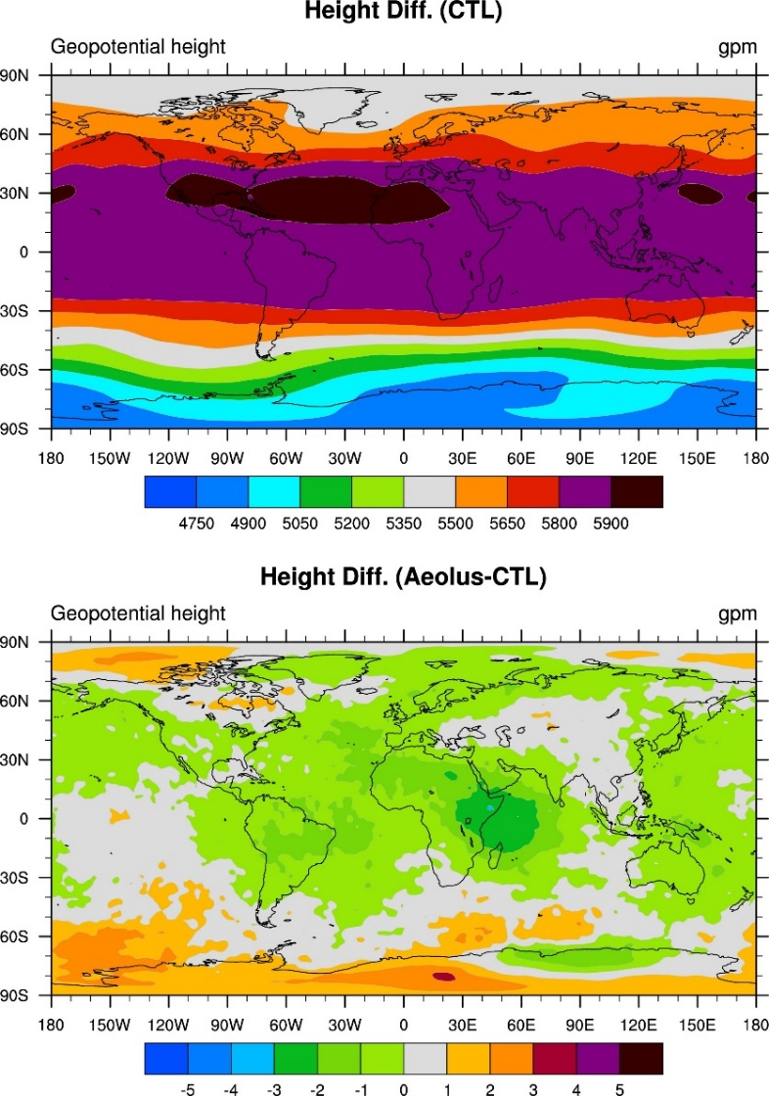
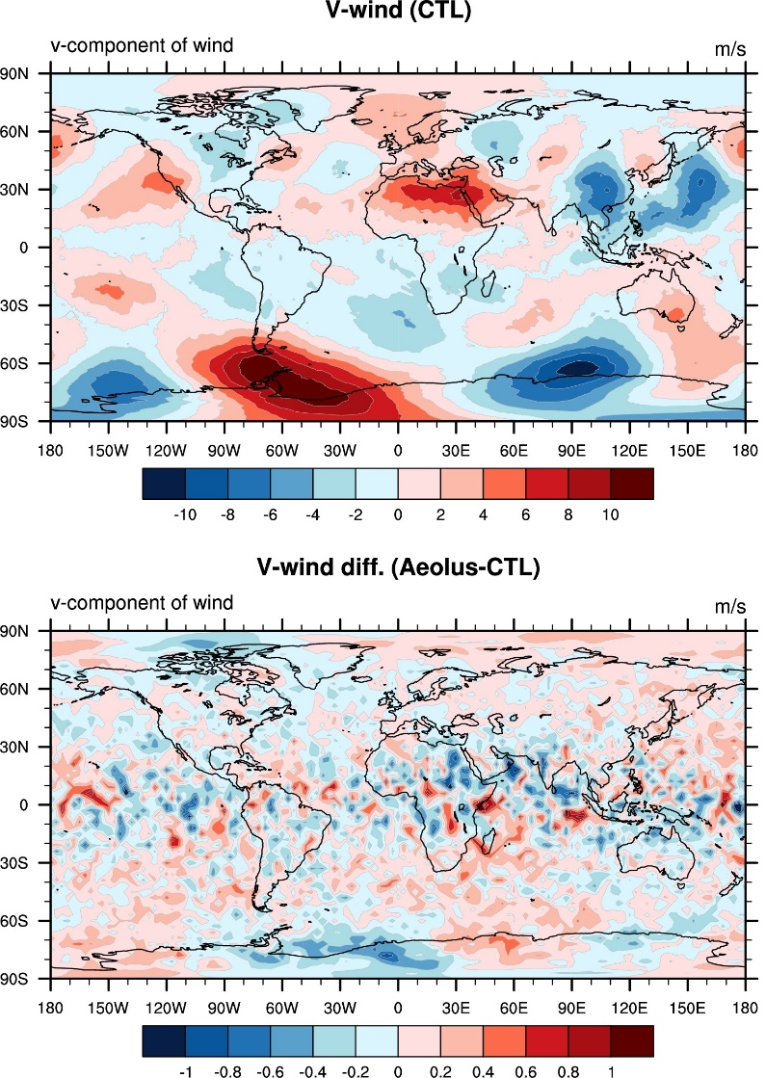
Mean Analysis Differences (Aug 2 – Sep 16, 2019)
100 hPa V-wind (CTL)
500 hPa Height
100 hPa U-wind (CTL)
500 hPa Height (CTL)
100 hPa U-wind (Aeolus-CTL)
100 hPa V-wind (Aeolus-CTL)
500 hPa Height (Aeolus-CTL)
Evident wind differences over Equatorial and polar areas.

Slide 18
RMSE of Wind Forecast at 850 hPa (vs. ECMWF Analysis, Aug 2 – Sep 16, 2019)
NH
TRO
SH
Worse
Better
Wind forecast RMSE vs. Forecast Length (top); Difference of Aeolus Exp w.r.t. Control forecast (Bottom). Bars represent significance at the 95%.
Forecast RMSE is reduced in NH and TRO

Slide 19
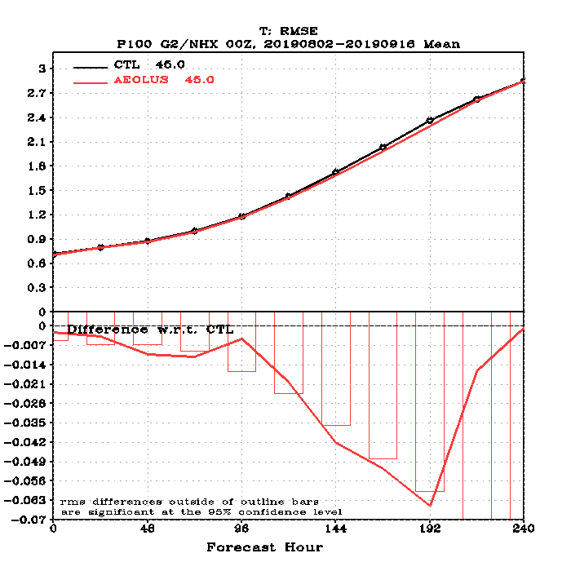
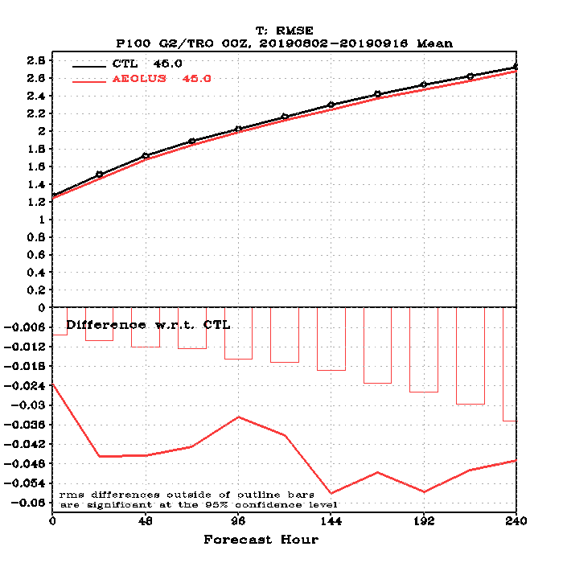
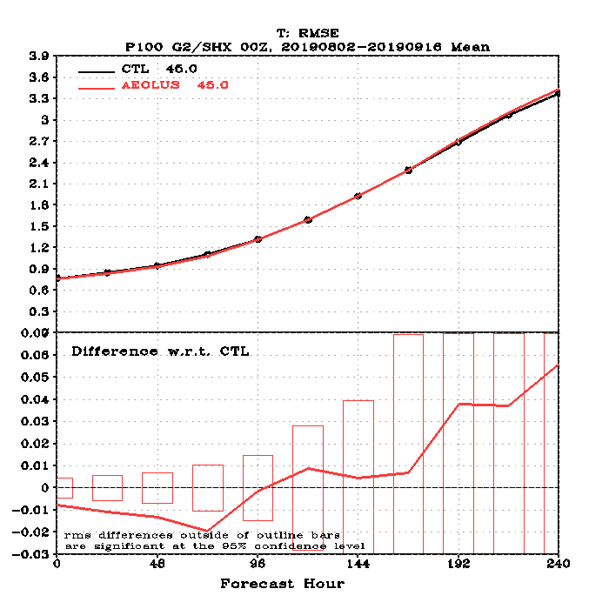
RMSE of Wind Forecast at 100 hPa (vs. ECMWF Analysis, Aug 2 – Sep 16, 2019)
NH
TRO
SH
Worse
Better
Wind forecast RMSE vs. Forecast Length (top); Difference of the Aeolus w.r.t. Control forecast (Bottom). Bars represent the 95% confidence interval.
Forecast RMSE is reduced by Aeolus winds in TRO and NH

Slide 20
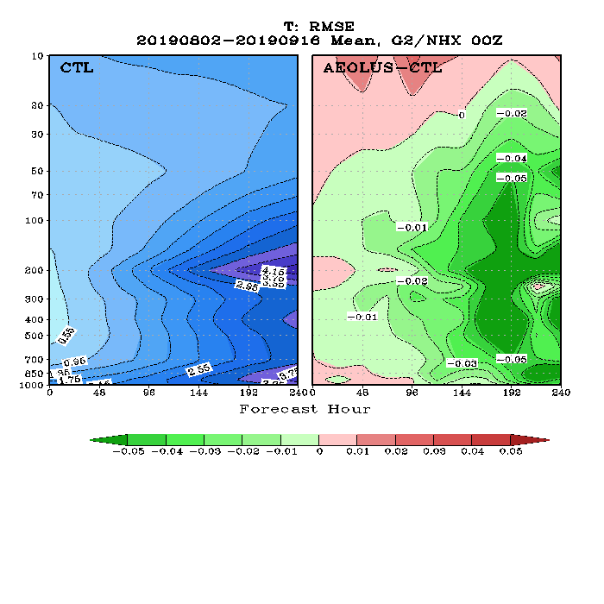
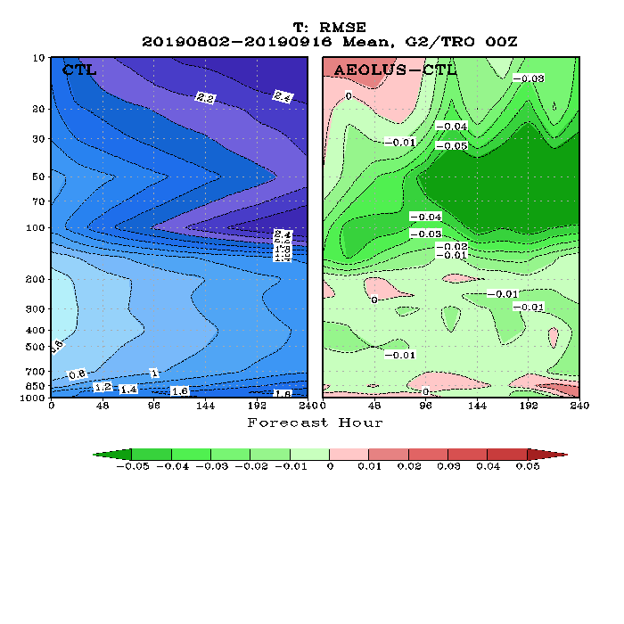
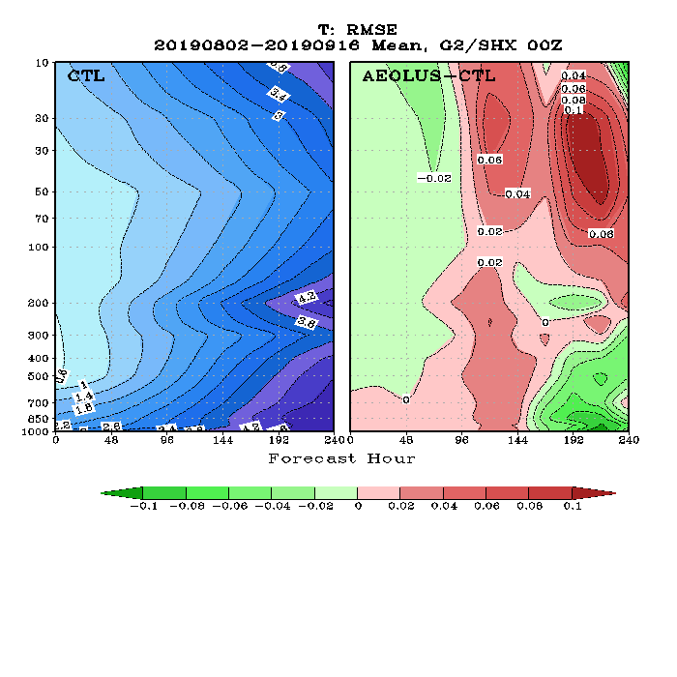
RMSE of Temp Forecast (vs. ECMWF analysis, Aug 2 – Sep 16, 2019)
NH
TRO
SH
Forecast RMSE is reduced in NH and TRO, but degraded in SH

Slide 21
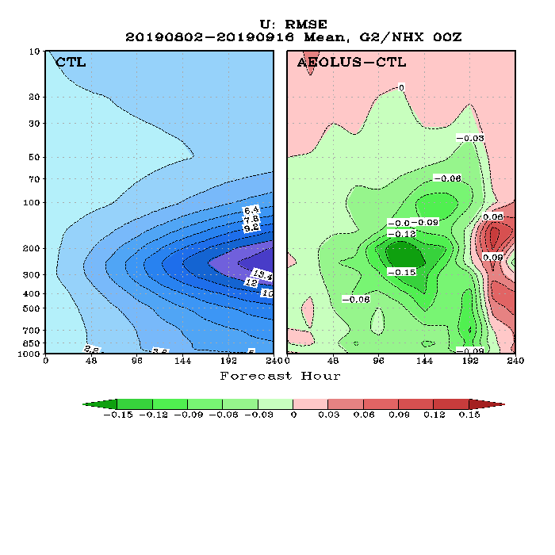
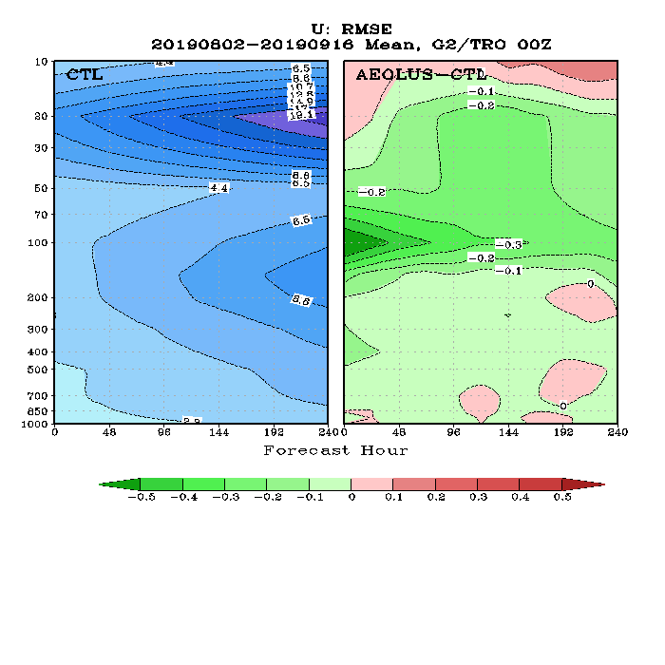
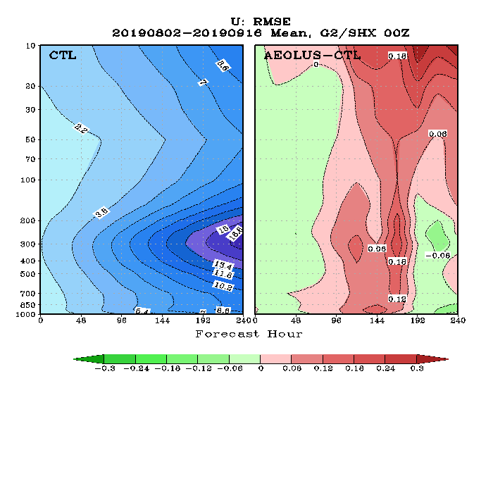
RMSE of U-Wind Forecast (vs. ECMWF analysis, Aug 2 – Sep 16, 2019)
NH
TRO
SH
RMSE is reduced in NH and TRO, but degraded in SH

Slide 22
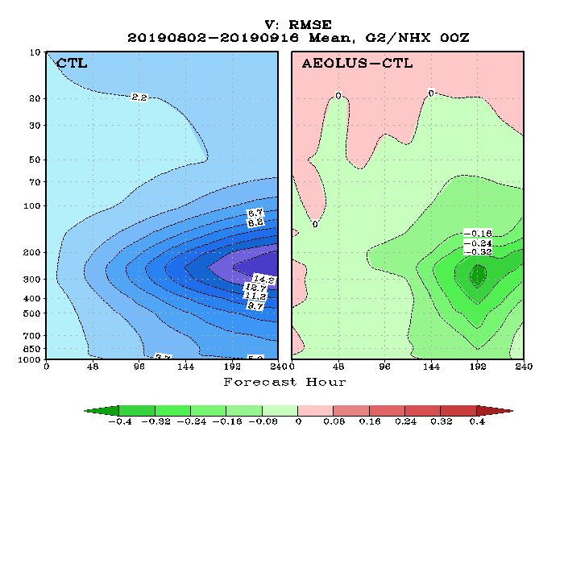
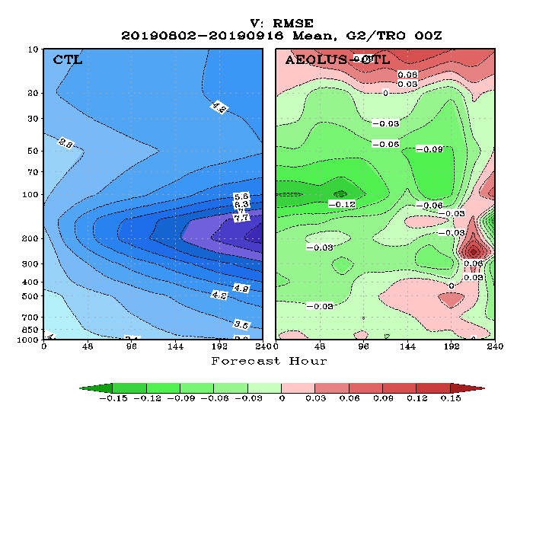
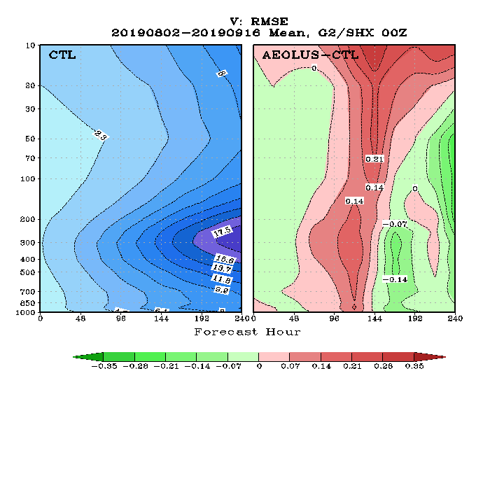
RMSE of V-Wind Forecast (vs. ECMWF analysis, Aug 2 – Sep 16, 2019)
NH
TRO
SH
RMSE is reduced in NH and TRO, but degraded in SH

Slide 23
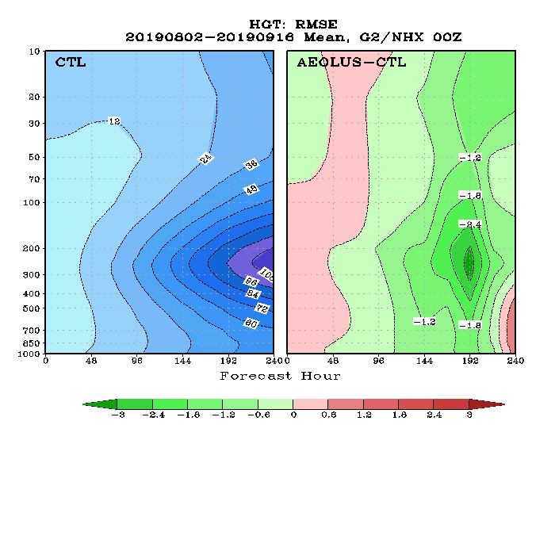
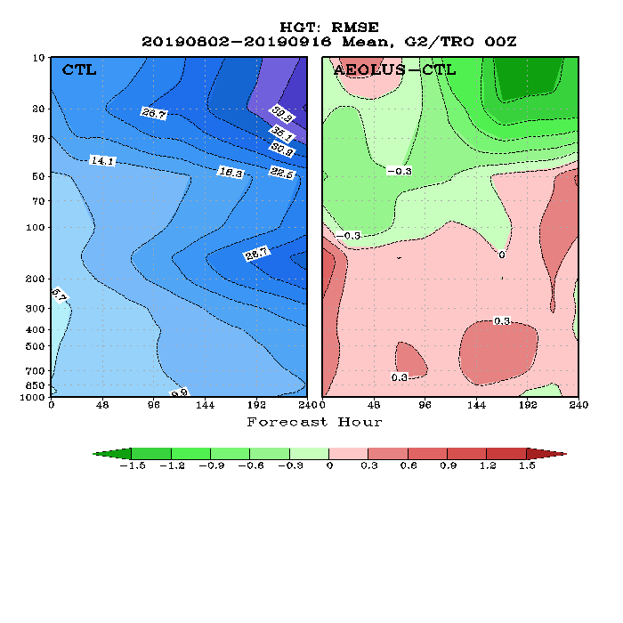
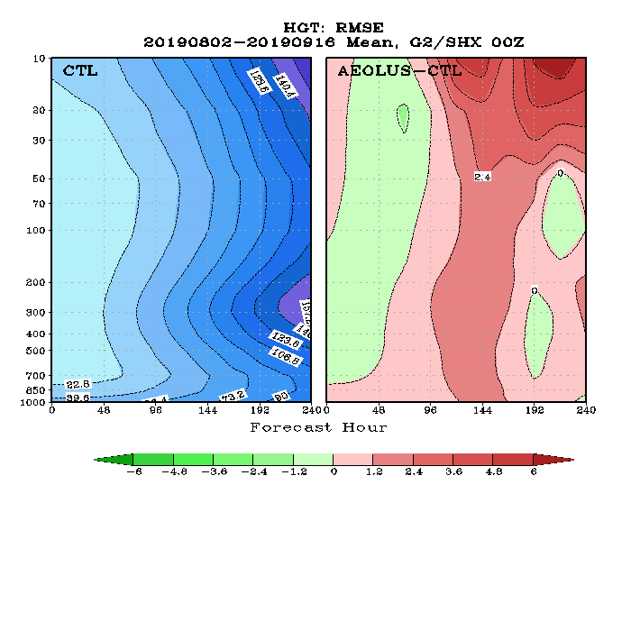
RMSE of Height Forecast (vs. ECMWF analysis, Aug 2 – Sep 16, 2019)
NH
TRO
SH
RMSE is reduced in NH and upper troposphere of TRO

Slide 24
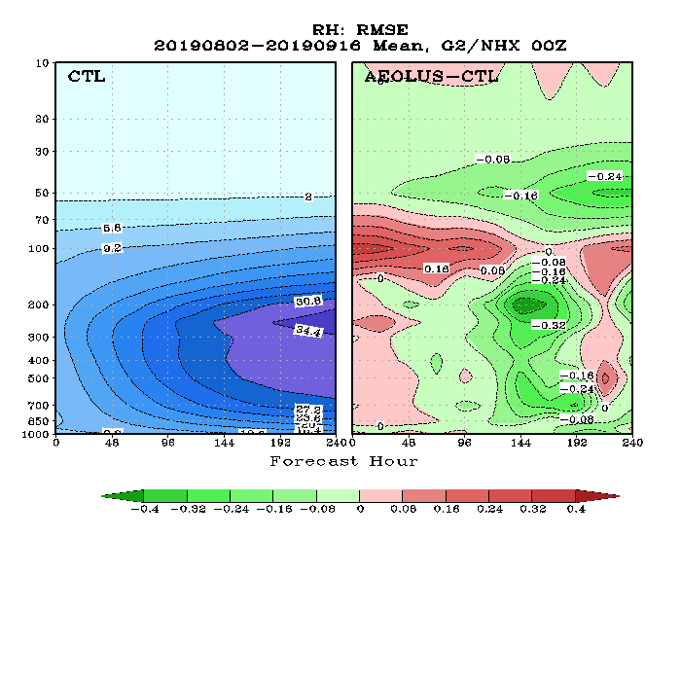
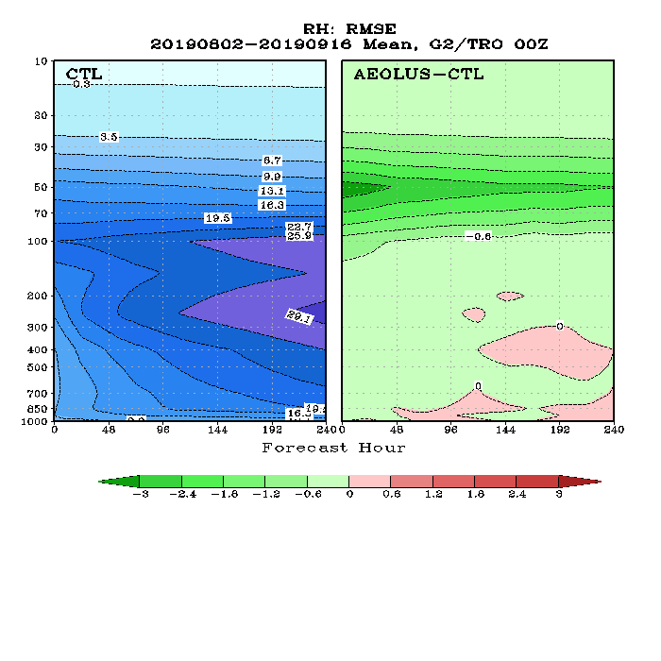
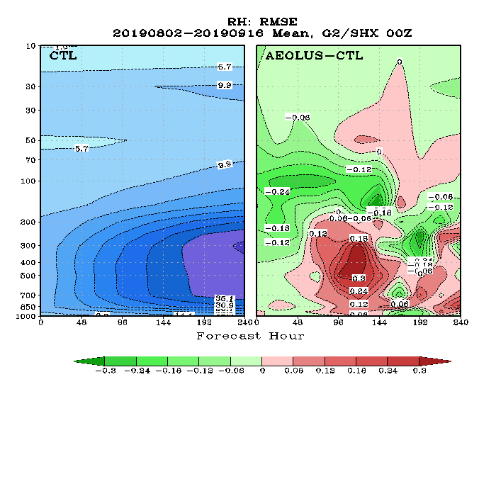
RMSE of RH Forecast (vs. ECMWF analysis, Aug 2 – Sep 16, 2019)
NH
TRO
SH
RMSE is reduced in lower stratosphere of Tropics

Slide 25
RMSE of 48-h U-wind Forecast at 100 hPa (vs. ECMWF analysis, Aug 2 – Sep 16, 2019)
u
RMSE is reduced over the Equatorial area
v

Slide 26
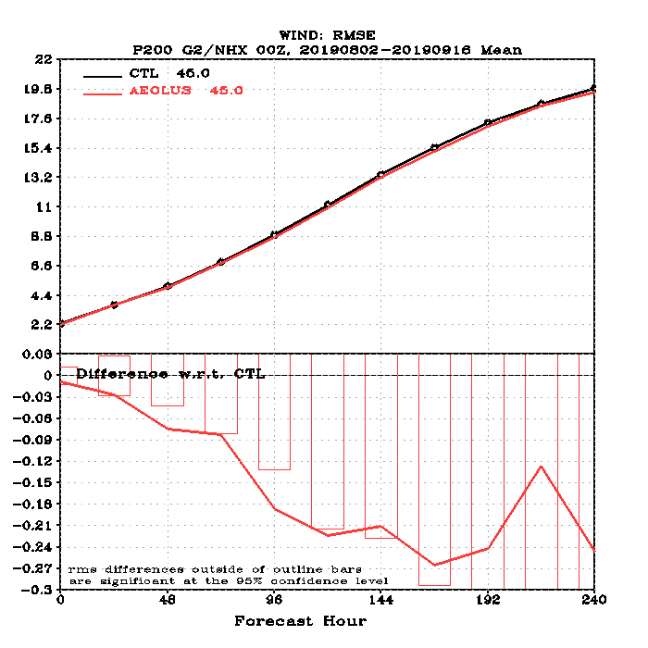
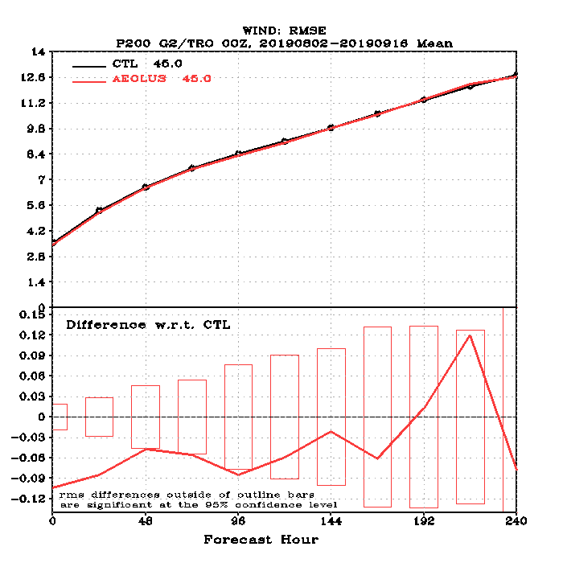
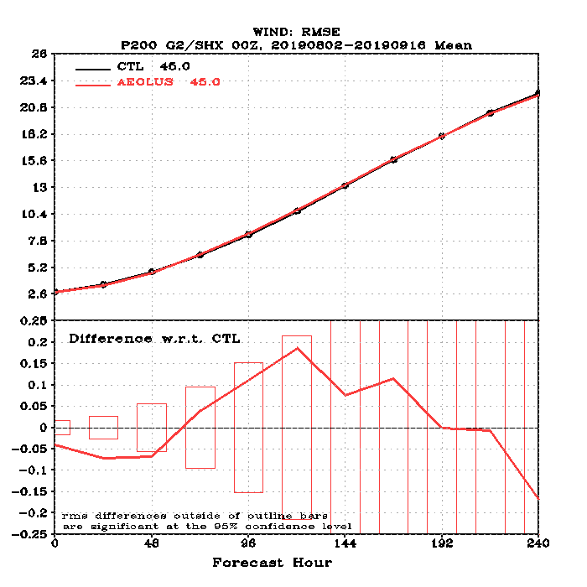
RMSE of Wind Forecast at 200 hPa (vs. ECMWF Analysis, Aug 2 – Sep 16, 2019)
NH
TRO
SH
Worse
Better
Wind forecast RMSE vs. Forecast Length (top); Difference of the Aeolus w.r.t. Control forecast (Bottom). Bars represent the 95% confidence interval.
RMSE is reduced in TRO and NH

Slide 27
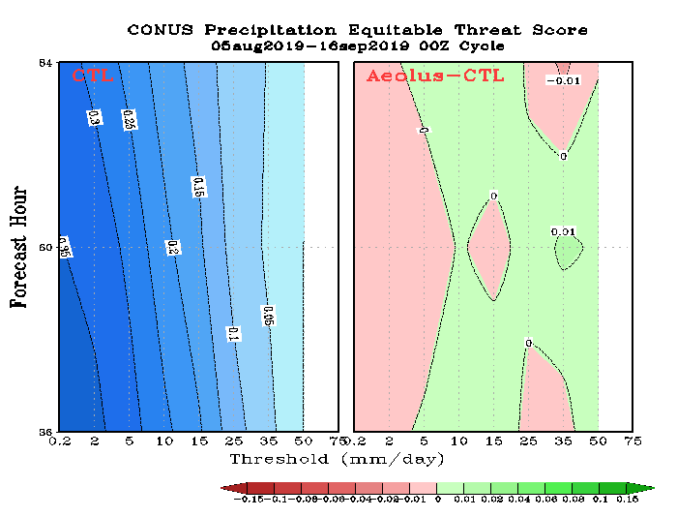
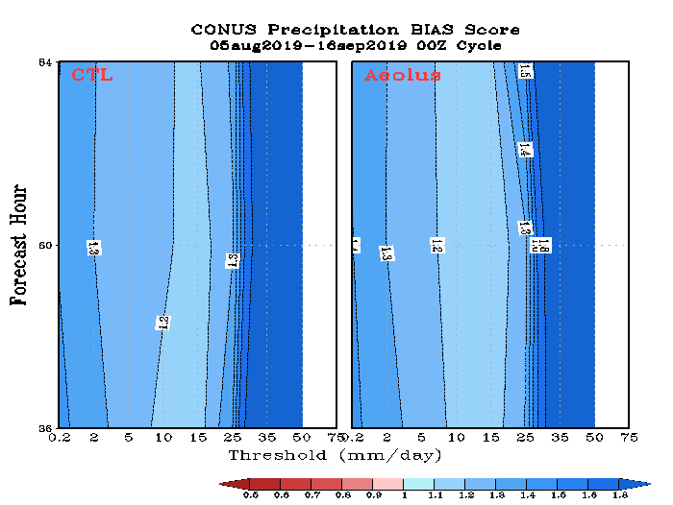
Precipitation Threat Skill Scores over CONUS
Skill score is slightly better for forecast > 10 mm/day

Slide 28
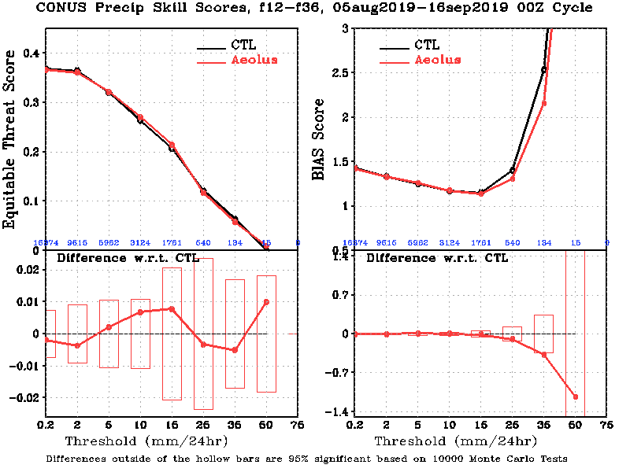
Precipitation Threat Skill Scores over CONUS (12-36 hour Forecast)
Differences are not statistically significant

Slide 29
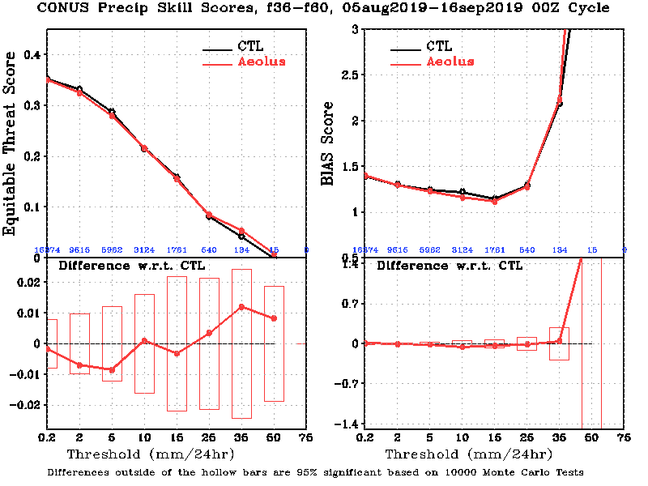
Precipitation Threat Skill Scores over CONUS (36-60 hour Forecast)
Differences are not statistically significant

Slide 30
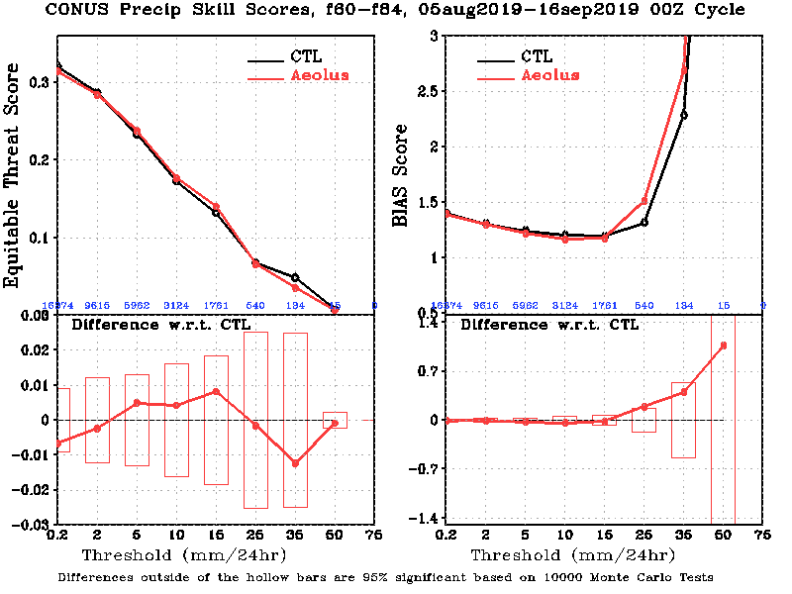
Precipitation Threat Skill Scores over CONUS (60-84 hour Forecast)
Differences are not statistically significant

