Slide 1
ASPEN Analysis: Inputs
Variables | ATMS SmallSat | TEMPEST-D | ATMS Enhanced
Relative Humidity | Accuracy same as ATMS | Accuracy same as ATMS | Accuracy increased by 15%
Air Temp: Profiles | Accuracy same as ATMS | N/A | Accuracy increased by 15%
Attribute | Single Sensor | C1 | C2 | C3
Temporal Refresh | 12 hours | 6 hours | 2 hours | 0.6 hours
Robustness | 1 | 2 | 6 | 12
Sensor/ Constellation | ATMS Cost (M) | ATMS SmallSat Cost (M) | TEMPEST-D Cost (M) | ATMS Enhanced Cost (M) | Exploitation Cost (M)
Single Sensor | $100 | $10 | $10 | $60 | $20
C1 (2 sats) | N/A | $17 | $17 | $102 | $22
C2 (6 sats) | N/A | $45 | $45 | $270 | $30
C3 (12 sats) | N/A | $87 | $87 | $522 | $42

Slide 2
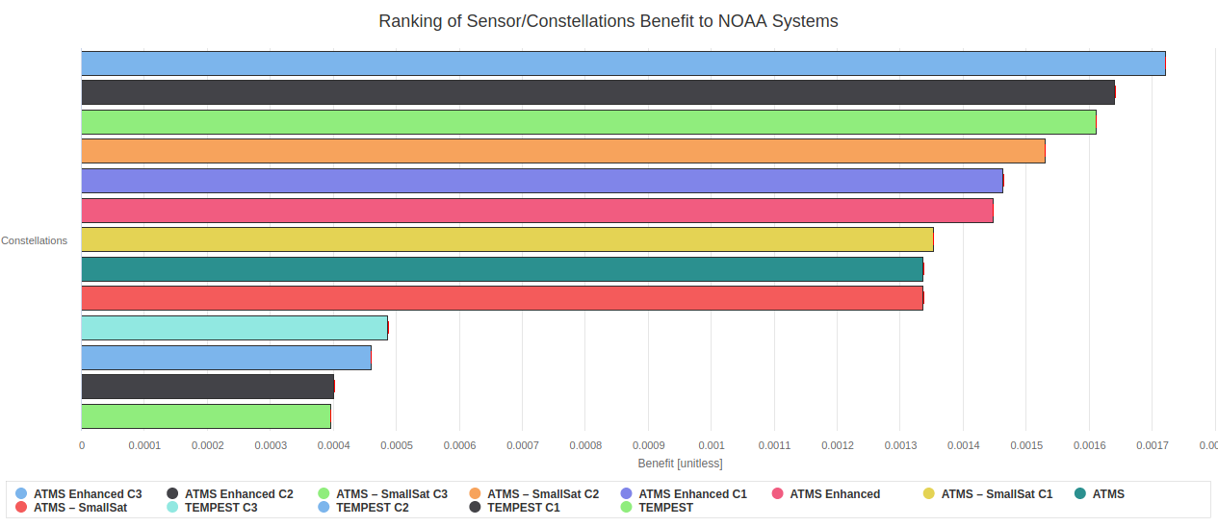
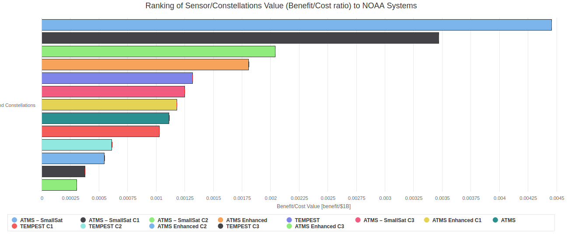
ASPEN Analysis: ATMS SmallSat, ATMS Enhanced, TEMPEST-D

