Slide 1
The Driving Applications in ASPEN and a suggested process to inform NOAA about the community's diverse set of corresponding Observational needs
Stacy Bunin
RTi
August 9, 2021

Slide 2
Driving Applications: Earth System
Category | Application Name | Source | Observables | Spatial Coverage
Earth System | Climate research and sensitivity | SAT | multiple | Global
 | CO2 flux estimates (CarbonTracker, GHG reporting) to verify climate forcing | SAT | CO2 and methane concentrations | Global
 | Unified Forecast System | ASPEN |  | Global

Slide 3
Driving Applications: Land/Hydrology
Category | Application Name | Source | Observables | Spatial Coverage
Land/ Hydrology | Fire weather | SAT | Fire location and intensity | Hemispheric-Global
 | Flood and ice monitoring | SAT | High resolution floodplain, river ice, sea ice | Oceans+North America+US Territories
 | Precipitation forecasting | SAT | Total and layer precipitable water | Oceans+North America+US Territories
 | Flood Forecasting | ASPEN
 | Land Surface Assimilation and Modeling | ASPEN

Slide 4
Driving Applications: Meteorology
Category | Application Name | Source | Observables | Spatial Coverage
Meteorology | Air quality forecasting | SAT | AOD, aerosol layer height, aerosol type, tropospheric columns of trace gases (formaldehyde, ozone, NO2, SO2, CO, etc) | Hemispheric-Global
 | Atmospheric profiles | SAT | Temperature soundings, moisture soundings | Oceans+N America+US Territories
 | Aviation weather | SAT | Cloud top height, thickness, volcanic ash, SO2 | Hemispheric-Global
 | High latitude and oceanic weather monitoring - Imagery (Vis, WV, IR) | SAT | Visible, water vapor, and infrared window (0.4-14 µm) imaging, including low-light imaging | Northern Oceans+N America+US Territories
 | High latitude and oceanic weather monitoring - Imagery: Microwave | SAT | 86 GHz and greater (37 GHz desired as well) | CONUS+AK+HI+US Territories
 | Marine forecasting - Surface Winds | SAT | Ocean surface wind vectors | Global Oceans
 | Marine forecasting - Wave Height | SAT | Consistent (evenly spaced in time) sea surface height and significant wave height | TC/Marine/Surface Analysis AOR
 | NWP data assimilation | SAT | Wind vectors over land and sea surfaces | Hemispheric-Global
 | Precipitation forecasting | SAT | Precipitation rate and type | Global
 | Precipitation forecasting | SAT | Precipitation rate | TC/Marine/Surface Analysis AOR
 | Surface visibility | SAT | Snow, fog, dust, etc. | TC/Marine/Surface Analysis AOR
 | Tropical latitudes and oceanic weather monitoring - Imagery: MW (Storm area) | SAT | 23, 37, 55, 85-91 GHz, TC warm core and convective structure evolution | TC/Marine/Surface Analysis AOR
 | TC moisture environment | SAT | Total and layer precipitable water | Atlantic and Pacific tropical basins
 | Severe Storms Monitoring | ASPEN
 | Regional NWP/Nowcasting/Short-term Forecasting | ASPEN

Slide 5
Driving Applications: Oceanography
Category | Application Name | Source | Observables | Spatial Coverage
Oceanography | Arctic Primary Productivity | SAT | chl, SST, others | Totality of Bering Sea, Beaufort, Chukchi, Gulf of Alaska, Aleutians
 | U.S. Pacific Islands Ocean Biology (HMS) | SAT | SST, Chl, Currents | Pacific Ocean Basin including Guam, Marianas
 | VHR Imagery (GEO INT) for marine mammal assessment, IUU enforcement, Rec Fish Stats Groundtruth | SAT | Panchromatic 8 band imagery | Gulf of Mexico, Cook Inlet, NEUS Continental Shelf, others
 | Harmful algal bloom monitoring | SAT | chlorophyll, SST | U.S. coastal zone, including Great Lakes
 | Water clarity | SAT | turbidity, attenuation | U.S. coastal zone, including Great Lakes
 | Habitat (Sanctuaries and estuaries) | SAT | chlorophyll, SSt, turbidity | U.S. coastal zone, including Great Lakes
 | Red tide index monitoring for gag/red grouper complex | SAT | Radiances | West Florida shelf
 | HAB monitoring for Stock Assessments | SAT | Radiances | West Florida, Gulf of Mexico
 | Coastal Water Quality to support Aquaculture Operation and Permitting | SAT | Radiances, Sediment products, Chl | U.S. Coastline
 | Regular Ecosystem Status Assessment/Reporting | SAT | Chl, SST, Radiances, NPP, others | U.S. EEZ, coastal
 | Dynamic Ocean Management Systems | SAT | Chl. SST, others | U.S. EEZ, coastal
 | Fisheries Management for Arctic (ice applications) | SAT | Various | Arctic, Antarctic
 | Navigation | SAT | Sea and lake ice | Global oceans
 | Sea Ice Monitoring | ASPEN |  | Arctic, Antarctic

Slide 6
Vetting the Tables
Brief overview of the tables at an upcoming SAT meeting
Determine SMEs for each application
Work with SMEs in small breakout groups for current requirements and future requirements
Meetings likely outside of SAT times
Focus first on the tables developed by the ASPEN team
Engage TPIO for individual application requirements
Align the TPIO applications with ASPEN applications

Slide 7
Vetting the ASPEN Application Tables
Applications with Direct use of Observations
ASPEN Team develops ARR/ATP Tables
TPIO
Validated tables for ASPEN
SMEs
SAT
NWP
Fires
Sea Ice
etc

Slide 8
Application Area teams: Earth System
 | Lead | Member | Member | Member | Member
UFS
Climate research and sensitivity
CO2 flux estimates (CarbonTracker, GHG reporting) to verify climate forcing

Slide 9
Application Area teams: Land/Hydrology
 | Lead | Member | Member | Member | Member
Fire weather
Flood and ice monitoring
Precipitation forecasting
Flood Forecasting
Land Surface Assimilation and Modeling

Slide 10
Application Area teams: Meteorology
 | Lead | Member | Member | Member
Air quality forecasting
Atmospheric profiles
Aviation weather
High latitude and oceanic weather monitoring - Imagery (Vis, WV, IR)
High latitude and oceanic weather monitoring - Imagery: Microwave
Marine forecasting - Surface Winds
Marine forecasting - Wave Height
NWP data assimilation
Precipitation forecasting
Surface visibility
Tropical latitudes and oceanic weather monitoring - Imagery: MW (Storm area)
TC moisture environment
Severe Storms Monitoring
Regional NWP/Nowcasting/Short-term Forecasting

Slide 11
Application Area teams: Oceanography
 | Lead | Member | Member | Member
Arctic Primary Productivity
U.S. Pacific Islands Ocean Biology (HMS)
VHR Imagery (GEO INT) for marine mammal assessment, IUU enforcement, Rec Fish Stats Groundtruth
Harmful algal bloom monitoring
Water clarity
Habitat (Sanctuaries and estuaries)
Red tide index monitoring for gag/red grouper complex
Coastal Water Quality to support Aquaculture Operation and Permitting
Regular Ecosystem Status Assessment/Reporting
Dynamic Ocean Management Systems
Fisheries Management for Arctic (ice applications)
Navigation
Sea Ice Monitoring

Slide 12
Backup Slides

Slide 13
ASPEN inputs
ASPEN is a rapid assessment tool based on the concept that the benefit of a sensor (or constellation) to an application (or to NOAA mission) is measured by its ability to satisfy the application (or NOAA mission)’s requirements.
It uses a standard template as an input tables in Excel/Google Sheet format
91 variables in Atmosphere, Biosphere, Cryosphere, Hydrosphere, Ocean, and Space categories
14 attributes

Slide 14
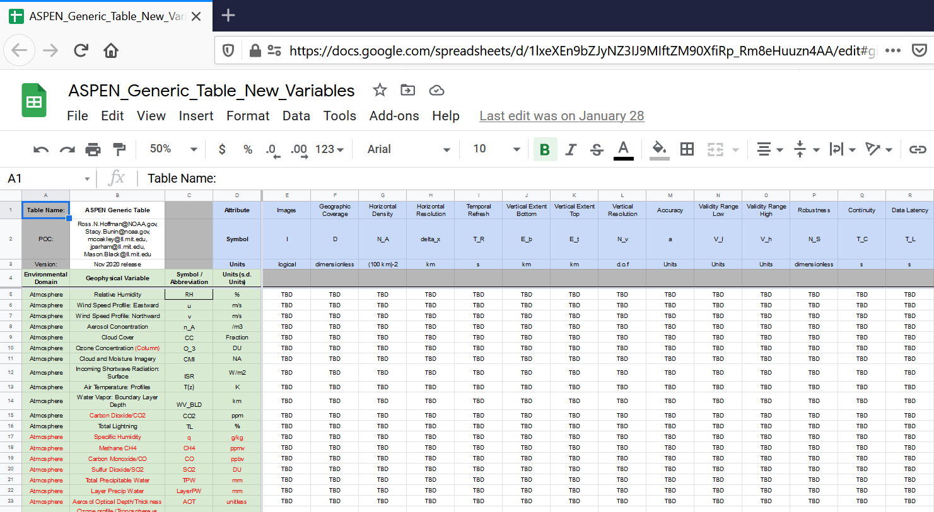
ASPEN Template

Slide 15
ASPEN attributes
Attribute | Units | Definition/Formulation
Images | logical | This parameter is represented by imagery
Geographic Coverage | dimensionless | Geographic region observed
Horizontal Density | (100 km)-2 | Number of observations within swath per (100 km) square region.
Horizontal Resolution | km | GIFOV or ground-projected instantaneous field of view
Temporal Refresh | s | Time between observations at a location, i.e, time to observe the geographic coverage region D.
Vertical Extent Bottom | km | Bottom of vertical region observed.
Vertical Extent Top | km | Top of vertical region observed
Vertical Resolution | d.o.f | Independent pieces of information in one GIFOV.
Error Standard Deviation | units | Estimated standard deviation of the errors. This is a composite s.d. over the appropriate subsets or dimensions such as over the vertical domain, over clear and cloudy conditions and over different surface backgrounds.
Validity Range Low | units | Low value that can be observed.
Validity Range High | units | High value that can be observed.
Robustness | dimensionless | Number of sources making this observation
Continuity | s | Time for which the observations can be intercalibrated for climate monitoring purposes.
Data Latency | s | Time from ‘image taken’ to full relay of data to a ground station.

