Slide 1
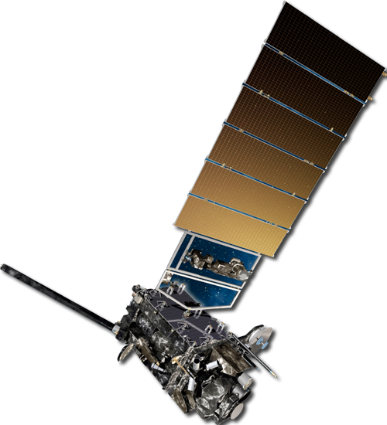
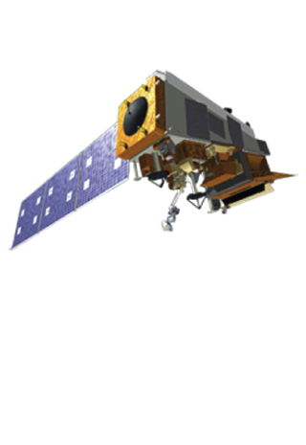
ASPEN: Advanced Systems Performance Evaluation tool for NOAA
Presentation for SAT
Stacy Bunin, RTi and NOAA/STAR
April 12, 2021

Slide 2
What is ASPEN?
A dynamic and user friendly tool that rapidly assesses the value of environmental data obtained from observing systems.
It provides numerical scores of the benefits of existing and proposed sensors and constellations to a single or group of applications.
It addresses the technical and scientific performance factors and provides also a benefit/cost ratio value assessment.
It is designed to be a science-based approach to perform comparative assessment of observation systems to support the decision process that leads to the design, selection and ultimately deployment of new space assets.

Slide 3
ASPEN methodology
Unit of measure
Collect sensor capabilities, application requirements and application priorities through expert elicitation.
Normalize the sensor capabilities by the application requirements.
Calculate the benefit of the sensor to the application as a weighted average.
Combine benefits for categories of application or for all of NOAA.
Calculate “values” as benefits divided by sensor costs.
The quality of ASPEN results strongly depend on the quality of the ASPEN inputs — sensor capabilities, application requirements, and priorities.

Slide 4
ASPEN Example: Mission Sensor/Constellation Based Benefit
Comparison of values/benefits hypothetical Smallsat constellations to help answer the question of Quality vs Quantity for all applications within ASPEN
Bottom Line: Multiple Smallsats in a constellation is beneficial for the NOAA mission, but more satellites does not always equal the best value.

Slide 5
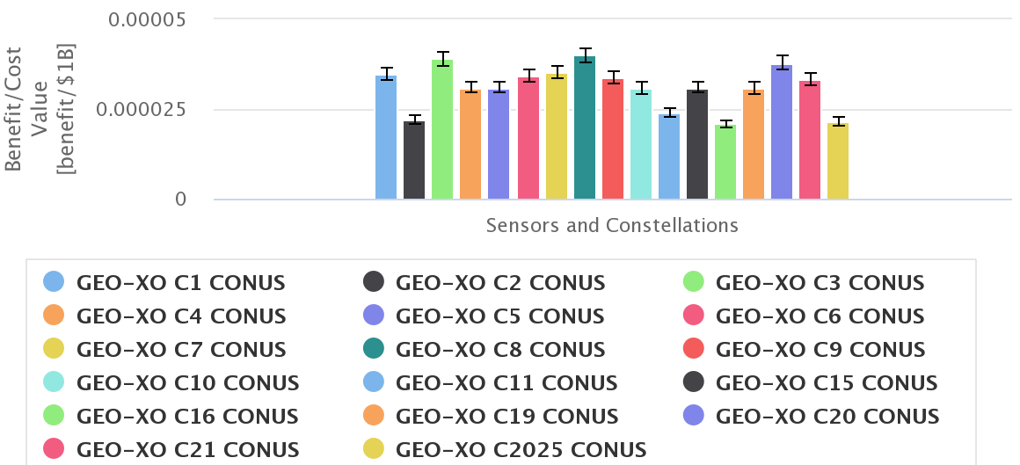
Constellations Assessment: Case of 17 Constellations (CONUS Views), Assessed against 5 apps rolled up to NOAA mission
Assessment of 17 constellations (CONUS View)
Comparison of 17 out of 22 constellations
CONUS View for all constellations
Applications selected: Fire, GNWP, Hurricane, Severe Storms, Coast Water Quality
Rolled up to NOAA Mission-level benefit
Benefit
Ocean Color and Atmospheric Composition added
Sounder added
Value
Imager, Sounder, and Lightning Mapper only
Bottom Line: Highest Value: constellations: 3,8 and 20. Constellation 16 seems to have the lowest benefit to cost ratio. Constellation 1 has high value but not #1

Slide 6
Plans for the Future
New features to ASPEN will include:
Cost sliders
Automatic report generation
Display uncertainty assessments
Additional SCP, ARR, and ATP tables
Other Plans:
Publication in progress
Review of inputs and methodology by external expertise

Slide 7
Conclusions
ASPEN is a tool to assess observing systems. It was developed with contributions from all other parts of NESDIS and major contributions from NOAA users
ASPEN is a rapid assessment tool based on the concept that the benefit of a sensor (or constellation) to an application (or to NOAA mission) is measured by its ability to satisfy the application (or NOAA mission)’s requirements.
ASPEN assessment also measures and compares the intrinsic geophysical capability of sensors/constellations
ASPEN accounts for both technical and strategic aspects
ASPEN accounts for both requirements and technical priorities of both sensors/constellations capabilities and attributes (resolutions, accuracy, etc)
ASPEN capabilities have been demonstrated for constellation(s) assessment, sensor design optimization, platform payloads selection, BAA studies assessment, commercial data buy assessment, projection of future requirements, etc.
7

Slide 8
Backup Slides

Slide 9
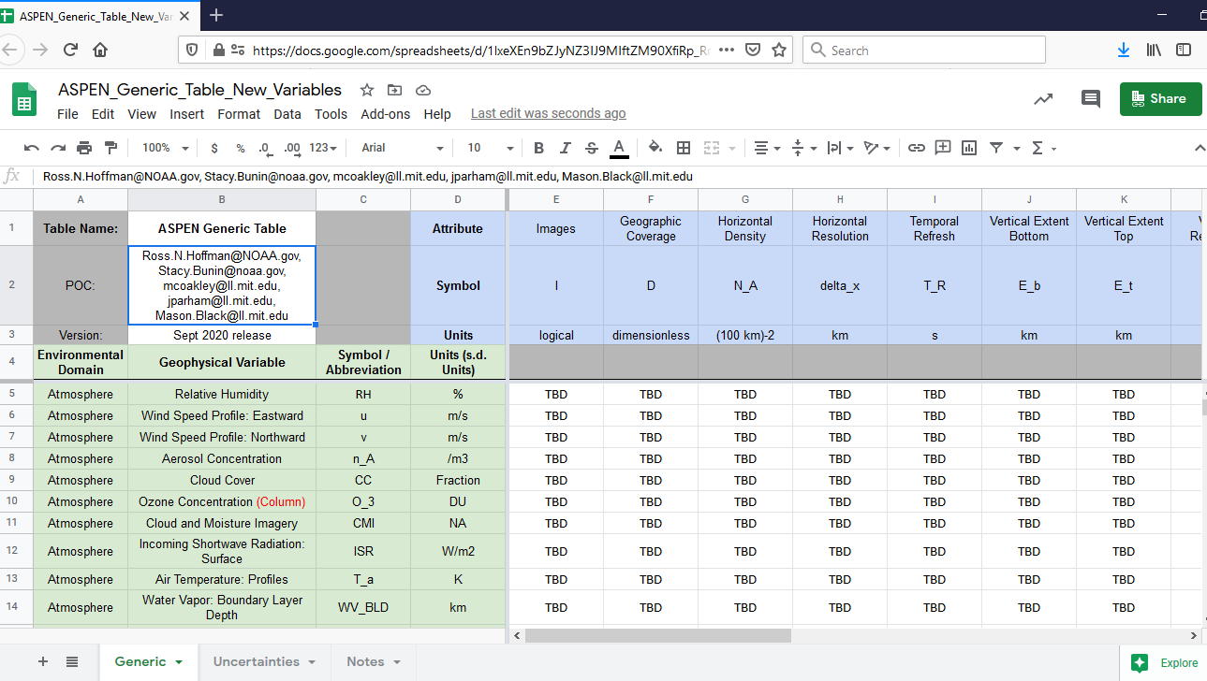
ASPEN Template

Slide 10
Sample Sensor/Constellation-based Performances (SCP) Table
Table Name: | SCP_ATMS |  | Attribute | Images | Geographic Coverage | Horizontal Density | Horizontal Resolution | Temporal Refresh | Vertical Extent Bottom | Vertical Extent Top | Vertical Resolution | Accuracy | Validity Range Low | Validity Range High | Robustness | Continuity | Data Latency
POC: | Ross.N.Hoffman@NOAA.gov |  | Symbol | I | D | N_A | delta_x | T_R | E_b | E_t | N_v | a | V_l | V_h | N_S | T_C | T_L
Version | Nov 2020 |  | Units | logical | dimensionless | (100 km)-2 | km | s | km | km | d.o.f | Units | Units | Units | dimensionless | s | s
Environmental Domain | Geophysical Variable | Symbol/Abbreviation | Units (Accuracy)
Atmosphere | Relative Humidity | RH | % | TRUE | Global | 16 | 25 | 43200 | 0 | 20 | 5 | 20 | NA | NA | 2 | 630720000 | 5400
Atmosphere | Wind Speed Profile: Eastward | u | m/s | NA | NA | NA | NA | NA | NA | NA | NA | NA | NA | NA | NA | NA | NA
Atmosphere | Wind Speed Profile: Northward | v | m/s | NA | NA | NA | NA | NA | NA | NA | NA | NA | NA | NA | NA | NA | NA
Atmosphere | Aerosol Concentration | n_A | /m3 | NA | NA | NA | NA | NA | NA | NA | NA | NA | NA | NA | NA | NA | NA
Atmosphere | Cloud Cover | CC | Fraction | NA | NA | NA | NA | NA | NA | NA | NA | NA | NA | NA | NA | NA | NA
Atmosphere | Ozone Concentration (Column) | O_3 | DU | NA | NA | NA | NA | NA | NA | NA | NA | NA | NA | NA | NA | NA | NA
Atmosphere | Cloud and Moisture Imagery | CMI | NA | NA | NA | NA | NA | NA | NA | NA | NA | NA | NA | NA | NA | NA | NA
Atmosphere | Incoming Shortwave Radiation: Surface | ISR | W/m2 | NA | NA | NA | NA | NA | NA | NA | NA | NA | NA | NA | NA | NA | NA
Atmosphere | Air Temperature: Profiles | T_a | K | TRUE | Global | 16 | 25 | 43200 | 0 | 50 | 8 | 2 | NA | NA | 2 | 630720000 | 5400

Slide 11
Sample Application-dependent Requirements Ranges (ARR) Table
Table Name: | ARR Global NWP |  | Attribute | Images | Geographic Coverage | Horizontal Density | Horizontal Resolution | Temporal Refresh | Vertical Extent Bottom | Vertical Extent Top | Vertical Resolution | Accuracy | Validity Range Low | Validity Range High | Robustness | Continuity | Data Latency
POC: | Ross.N.Hoffman@NOAA.gov |  | Symbol | I | D | N_A | delta_x | T_R | E_b | E_t | N_v | a | V_l | V_h | N_S | T_C | T_L
Version | Jan2021 |  | Units | logical | dimensionless | (100 km)-2 | km | s | km | km | d.o.f | Units | Units | Units | dimensionless | s | s
Environmental Domain | Geophysical Variable | Symbol/Abbreviation | Units (Accuracy)
Atmosphere | Relative Humidity | RH | % | NA | Global | [1,4,16] | [50,10,2] | [14400,7200,3600] | [10,5,0] | [10,50,100] | [0,3,8] | [24,16,8] | NA | NA | [0,2,3] | NA | [43200,14400,0]
Atmosphere | Wind Speed Profile: Eastward | u | m/s | NA | Global | [0.25,1,4] | [50,10,2] | [14400,7200,3600] | [10,5,0] | [10,50,100] | [3,8,15] | [8,5,2] | NA | NA | [0,2,3] | NA | [43200,14400,0]
Atmosphere | Wind Speed Profile: Northward | v | m/s | NA | Global | [0.25,1,4] | [50,10,2] | [14400,7200,3600] | [10,5,0] | [10,50,100] | [3,8,15] | [8,5,2] | NA | NA | [0,2,3] | NA | [43200,14400,0]
Atmosphere | Aerosol Concentration | n_A | /m3 | NA | NA | NA | NA | NA | NA | NA | NA | NA | NA | NA | NA | NA | NA
Atmosphere | Cloud Cover | CC | Fraction | NA | NA | NA | NA | NA | NA | NA | NA | NA | NA | NA | NA | NA | NA
Atmosphere | Ozone Concentration (Column) | O_3 | DU | NA | NA | NA | NA | NA | NA | NA | NA | NA | NA | NA | NA | NA | NA
Atmosphere | Cloud and Moisture Imagery | CMI | NA | NA | NA | NA | NA | NA | NA | NA | NA | NA | NA | NA | NA | NA | NA
Atmosphere | Incoming Shortwave Radiation: Surface | ISR | W/m2 | NA | NA | NA | NA | NA | NA | NA | NA | NA | NA | NA | NA | NA | NA
Atmosphere | Air Temperature: Profiles | T(z) | K | NA | Global | [0.25,1,4] | [50,10,2] | [14400,7200,3600] | [10,5,0] | [10,50,100] | [3,8,15] | [2.5,2,1.5] | NA | NA | [0,2,3] | NA | [43200,14400,0]
Ranges in Triples:
[14400,7200,3600]

Slide 12
ASPEN Variables - Atmosphere
Nitrogen Dioxide/NO2
Smoke (evaluated at night)
Hydrometer Size and Type (Low Cloud and Fog eval at night)
Aerosol Refractive Index
Effective reflectivity
Aerosol Layer Height
UV Aerosol Index
Formaldehyde/CH2O
Glyoxal/C2H2O2
Isoprene/C5H8
Volcanic Ash
Aerosol Particle Size
Aerosol Shape
Incoming (Downward) Longwave Radiation
Incoming (Downward) Shortwave Radiation
Outgoing Longwave Radiation
Net Solar Radiation at top of Atmosphere
Net Heat Flux
Nitric Acid (HNO3)
Nitrous Oxide (N2O)
Dust
Relative Humidity
Wind Speed Profile: Eastward
Wind Speed Profile: Northward
Aerosol Concentration
Cloud Cover
Ozone Concentration (Column)
Cloud and Moisture Imagery
Incoming Shortwave Radiation: Surface
Air Temperature: Profiles
Water Vapor: Boundary Layer Depth
Carbon Dioxide/CO2
Total Lightning
Specific Humidity
Methane CH4
Carbon Monoxide/CO
Sulfur Dioxide/SO2
Total Precipitable Water
Layer Precip Water
Aerosol Optical Depth/Thickness
Ozone profile (Troposphere vs stratosphere)

Slide 13
ASPEN Variables – Biosphere and Cryosphere
Biosphere
Cryosphere
Fire Radiative Power
Flood standing water: Extent
Normalized Difference Vegetation Index
Soil Moisture: Surface Wetness
Land Surface Albedo
Fires: Location and Size (taking size)
Land Surface Temperature
Surface Type
Fraction of Photosynthetically Active Radiation (FPAR)
Sea Ice Age
Sea Ice Concentration
Snow Water Equivalent
Ice Surface Temperature
Snow Cover
Snow Depth
Snow Grain Size
Sea Ice Motion, Local
Sea Ice Freeboard
Sea Ice Thickness
Currently in ASPEN
Possible future addition to ASPEN

Slide 14
ASPEN Variables – Hydrosphere and Ocean
Ocean
Ocean color: Chlorophyll-a Concentration
Salinity
Sea Surface Height
Sea Surface Temperature
Bathymetry
Wave Height
Global Sea Surface Wind Speed
Global Sea Surface Wind Direction
Ocean Color: Marine Oil / Pollution Extent
Suspended Sediment Concentration
Ocean Color: Colored Dissolved Organic Matter (absorp coef)
Pigments (beyond Chl-a)
Fluorescence
Water leaving radiance?
Phytoplankton composition
Absorbing aerosols
Hydrosphere
Cloud Liquid Water Path
Rain Rate
Cloud Drop Size (at Cloud Top)
Cloud Top Temperature
Precipitation Rate/Snowfall Rate
Cloud Base Height
Cloud Optical Depth
Cloud Top Height
Currently in ASPEN
Possible future addition to ASPEN

Slide 15
ASPEN Applications – Earth System, Land/Hydrology, and Space Weather
Earth System
Land/Hydrology
Unified Forecast System (UFS)
Assessments of Climate Changes & Its Impacts (CLI-ACC)
Climate Mitigation & Adaptation Strategies (CLI-CMA)
Climate Prediction and Projections (CLI-CPP)
Climate Science & Improved Understanding (CLI-SIU)
Science and Services and Stewardship Advanced (WRN-SSS)
Climate Forecast System Model (CFS NCEP/EMC)
Climate Monitoring
Fire Weather (WRN-FWX)
Fire Monitoring
Drought Monitoring
Flood Forecasting
Hydrology & Water Resources (WRN-IWF)
Land Surface Assimilation and Modeling
North American Land Data Assimilation System (NLDAS NCEP-EMC)
Sea, Lake, and Overland Surge from Hurricanes Model (SLOSH OST-MDL)
Search and Rescue Operations
Space Weather
Space Weather (WRN-SWX)
Currently in ASPEN
Possible future addition to ASPEN

Slide 16
ASPEN Applications – Meteorology
Aviation Weather & Volcanic Ash (WRN-AWX)
Global NWP
Global NWP T&Q Only
Hurricane Prediction
Hurricane/Tropical Storms (WRN-HUR)
Marine Weather & Coastal Events (WRN-MWX)
Public Weather (WRN-PWX)
Regional NWP, Nowcasting/Short-Term Forecasting
Severe Storms, Monitoring and Forecasting
Severe Weather (WRN-SEV)
Winter Weather (WRN-WWX)
Air Quality Monitoring
Aviation Forecasting
Extra-Tropical Storm Surge Model (ETSS OST-MDL)
Flash Flood Monitoring Program (FFMP OST-MDL)
Global Forecast System Model (GFC NCEP-EMC)
High-Resolution Rapid Refresh Model Predictions: CONUS (HRRR ESRL-GSD)
Hurricane Weather Research and Forecasting Model (HWRF NCEP-EMC)
Localized Aviation Model Output Statistics Program (LAMP OST-MDL)
Long Term and Seasonal Outlooks
North American Mesoscale Model (NAM NCEP-EMC)
Ozone Layer/Hole Monitoring
Probabilistic Tropical Cyclone Storm Surge Exceedance Products Model (PSURGE OST-MDL)
Radiation Budget Studies
Rapid Refresh Model (RAP NCEP-EMC)
Real Time Mesoscale Analysis (RTMA NCEP-EMC)
Routine Weather (WRN-RWX)
System for Convection Analysis and Nowcasting (SCAN OST-MDL)
Tsunami (WRN-TSU)
Volcanic Ash Monitoring
Currently in ASPEN
Possible future addition to ASPEN

Slide 17
ASPEN Applications - Oceanography
Coastal Water Quality (RC-CWQ)
Ecosystem Monitoring, Assessment & Forecast (HO-ECO)
Fisheries Monitoring, Assessment & Forecast (HO-FMA)
Habitat Monitoring & Assessment (HO-HAB)
Healthy Ocean Science Services and Stewardship Advances
Integrated Water and Prediction Information (WRN-IWPI)
Marine Transportation (RC-MTS)
Planning & Management (RC-PAM)
Protected Species Monitoring (HO-PSM)
Resilient Coasts Science Services and Stewardship Advances
Resilience to Coastal Hazards & Climate Change (RC-RCC)
Coastal Zone Management
Coral Reef Monitoring
Global Ocean Data Assimilation System Model (GODAS NCEP-EMC)
Global Ocean Forecasting
Harmful Algal Bloom Monitoring
Marine Weather Forecasting
Nearshore Wave Prediction System (NWPS NCEP-EMC)
Ocean Biology Monitoring
Oil Spill Monitoring
Polar Sea Ice Model
Real-Time Ocean Forecast System: Global (RTOFSGbl NCEP-EMC)
Real-Time Ocean Forecast System: High Resolution Basin (RTOFSBsn NCEP-EMC)
Sea Ice Analysis: Concentration, Global (SeaIceConcAnlGbl NCEP-EMC)
Sea Ice Monitoring
Sea Surface Temperature: Real-Time, Global (SSTRTG NCEP-EMC)
Search and Rescue Operations
Water Quality Monitoring
Wave Forecasting
WAVEWATCH III Wave Model: Global (WAMIII NCEP-EMC)
Currently in ASPEN
Possible future addition to ASPEN

