Slide 1
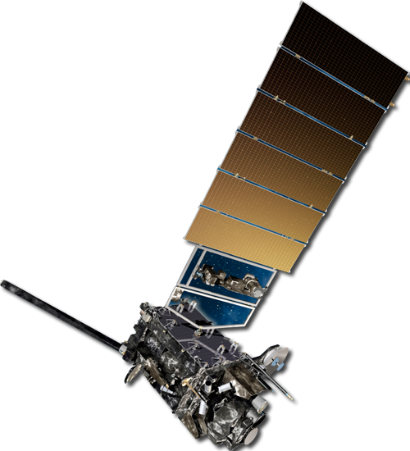
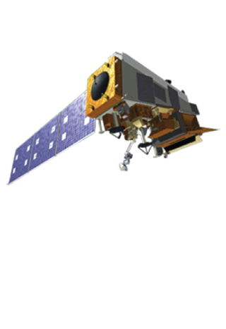
ASPEN: Advanced Systems Performance Evaluation for NOAA
ASPEN: An Objective Decision-Support Tool for Dynamically Assessing the Value of Existing and Proposed Sensors and their Combinations
S. Boukabara¹, R. Hoffman², S. Bunin³, D. Helms¹, L. Cantrell¹, M. Coakley⁵, R. Montoro⁶, M. McHugh⁶, M. Newton⁸ , L. Brown⁹, A. Carrion¹⁰, E. Maddy³, K. Hawley¹, V. Escobar, N. Shahroudi³, K. Lukens⁴, F. Gallagher¹, D. Spencer¹
¹National Oceanic and Atmospheric Administration (NOAA)
²University of Maryland (UMD)
³Riverside Technology Inc. (RTI)
⁴University of Maryland (UMD)
⁵MIT/LL
⁶GOES-R
⁸Carr
⁹ Caelum Research
¹⁰Velos
November 6, 2020

Slide 2
ASPEN Overview
Motivation: To have a comprehensive approach on how NOAA assesses the value and impact of observing systems. This could help in:
- Assessing observing systems performances
- Prioritize investments in the observing systems portfolio
- Ensure cost-effectiveness
- Optimize system design and performance
- Plan next generation space architectures
- Negotiate international partnership for data exchange
- Risk/Impact assessment of obs. Systems and data acquisition or termination decisions
- Assess Commercial data value/cost effectiveness

Slide 3
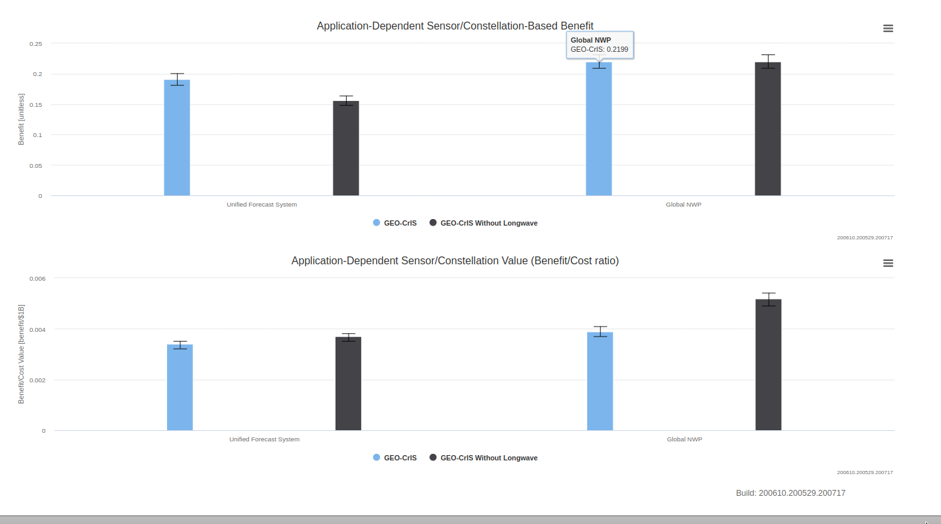
Sensor Design Support: Case of Hyperspectral IR on Geo (with or without LW)
Assessing two different versions of Geo-CrIS, Based on Current Global NWP and on Future UFS requirements
Comparison of values/benefits of Geo-CrIS (full spectrum) and Geo-CrIS (without LW), to Global NWP and UFS
Benefit to Global NWP is the same for both
But benefit to future UFS is greater for full-spectrum because of reliance on ozone and trace gases in UFS
UFS –Unified Forecast System
Global NWP
Value Assessment (Benefit/Cost Ratio)
UFS –Unified Forecast System
Global NWP
Bottom Line: ASPEN can help support the design of sensor design characteristic: bands, noise (NEDT) levels, footprint sizes, etc. By assessing their impacts on satisfying the applications requirements. It also offers the flexibility to check the value of sensors and/or constellations, using current and future requirements (an extra table to handle).

Slide 4
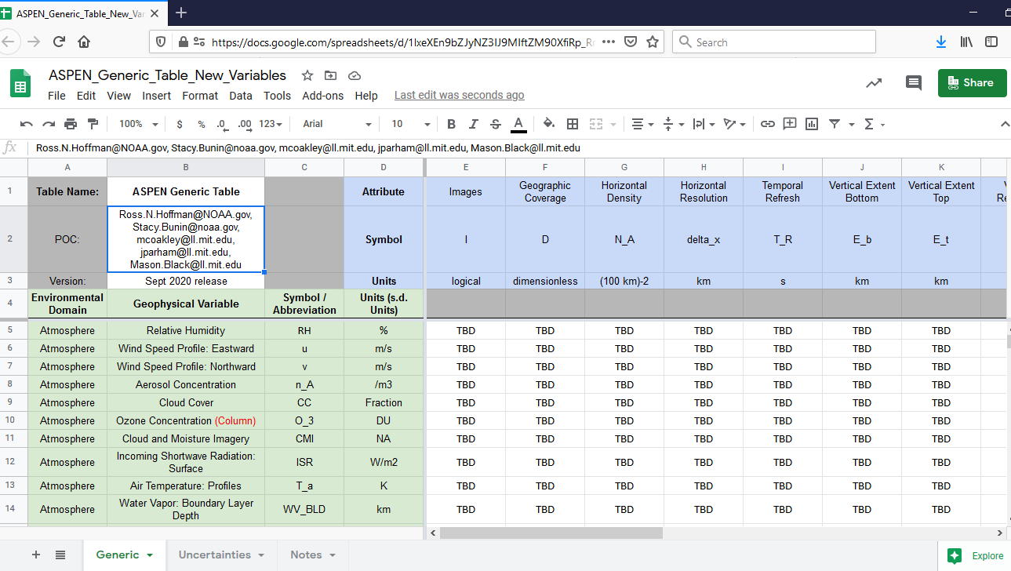
ASPEN Template

Slide 5
ASPEN Variables - Atmosphere
Nitrogen Dioxide/NO2
Smoke (evaluated at night)
Hydrometer Size and Type (Low Cloud and Fog eval at night)
Aerosol Refractive Index
Effective reflectivity
Aerosol Layer Height
UV Aerosol Index
Formaldehyde/CH2O
Glyoxal/C2H2O2
Isoprene/C5H8
Volcanic Ash
Aerosol Particle Size
Aerosol Shape
Incoming (Downward) Longwave Radiation
Incoming (Downward) Shortwave Radiation
Outgoing Longwave Radiation
Net Solar Radiation at top of Atmosphere
Net Heat Flux
Nitric Acid (HNO3)
Nitrous Oxide (N2O)
Dust
Relative Humidity
Wind Speed Profile: Eastward
Wind Speed Profile: Northward
Aerosol Concentration
Cloud Cover
Ozone Concentration (Column)
Cloud and Moisture Imagery
Incoming Shortwave Radiation: Surface
Air Temperature: Profiles
Water Vapor: Boundary Layer Depth
Carbon Dioxide/CO2
Total Lightning
Specific Humidity
Methane CH4
Carbon Monoxide/CO
Sulfur Dioxide/SO2
Total Precipitable Water
Layer Precip Water
Aerosol Optical Depth/Thickness
Ozone profile (Troposphere vs stratosphere)
Black: July 2020 version
Red: Nov 2020 version
Gray: Future version

Slide 6
ASPEN Variables – Biosphere and Cryosphere
Fire Radiative Power
Flood standing water: Extent
Normalized Difference Vegetation Index
Soil Moisture: Surface Wetness
Land Surface Albedo
Fires: Location and Size (taking size)
Land Surface Temperature
Surface Type
Fraction of Photosynthetically Active Radiation (FPAR)
Sea Ice Age
Sea Ice Concentration
Snow Water Equivalent
Ice Surface Temperature
Snow Cover
Snow Depth
Snow Grain Size
Sea Ice Motion, Local
Sea Ice Freeboard
Sea Ice Thickness
Black: July 2020 version
Red: Nov 2020 version
Gray: Future version

Slide 7
ASPEN Variables – Hydrosphere and Ocean
Ocean color: Chlorophyll-a Concentration
Salinity
Sea Surface Height
Sea Surface Temperature
Bathymetry
Wave Height
Global Sea Surface Wind Speed
Global Sea Surface Wind Direction
Ocean Color: Marine Oil / Pollution Extent
Suspended Sediment Concentration
Ocean Color: Colored Dissolved Organic Matter (absorp coef)
Pigments (beyond Chl-a)
Fluorescence
Water leaving radiance? (Couldn't include other radiances in ASPEN)
Phytoplankton composition
Absorbing aerosols
Cloud Liquid Water Path
Rain Rate
Cloud Drop Size (at Cloud Top)
Cloud Top Temperature
Precipitation Rate/Snowfall Rate
Cloud Base Height
Cloud Optical Depth
Cloud Top Height
Black: July 2020 version
Red: Nov 2020 version
Gray: Future version

Slide 8
ASPEN Attributes
Attribute | Units | Definition/Formulation | Also know as (AKA) | Comments
Images | logical | This parameter is represented by imagery |  | T or F.
Geographic Coverage | dimensionless | Geographic region observed | Spatial Coverage | E.g., CONUS, Global, Insitu GEO, ... includes insitu space observations. Values from MLR=Master_List_Regions
Horizontal Density | (100 km)-2 | Number of observations within swath per (100 km) square region. | Density | Tricky to specify for non-swath (i.e., along track or random) data.
Horizontal Resolution | km | GIFOV or ground-projected instantaneous field of view | Footprint Size | Warning, SPRWG says horizontal resolution is the spacing between observations.
Temporal Refresh | s | Time between observations at a location, i.e, time to observe the geographic coverage region D. | Sampling interval | Tricky to specify for non-swath (i.e., along track or random) data.
Vertical Extent Bottom | km | Bottom of vertical region observed. |  | Measured up from Earth's surface. Negative values in ocean.
Vertical Extent Top | km | Top of vertical region observed |  | Measured up from Earth's surface. Negative values in ocean.
Vertical Resolution | d.o.f | Independent pieces of information in one GIFOV. |  | Units are degrees of freedom. Influence of prior is eliminated by considering d.o.f. Should be 1 for surface or column amount.

Slide 9
ASPEN Attributes
Attribute | Units | Definition/Formulation | Also know as (AKA) | Comments
Error Standard Deviation | units | Estimated standard deviation of the errors. This is a composite s.d. over the appropriate subsets or dimensions such as over the vertical domain, over clear and cloudy conditions and over different surface backgrounds. | Precision | Other aspects of quality include bias, correlations, etc. that are not considered. The validity range and data continuity attributes are also realted to data quality. MLV=Master_List_Variables
Validity Range Low | Units | Low value that can be observed. |  | E.g., scatterometers can observe winds in the range [2,30] m/s. Units from MLV=Master_List_Variables
Validity Range High | Units | High value that can be observed. |  | E.g., scatterometers can observe winds in the range [2,30] m/s. Units from MLV=Master_List_Variables
Robustness | Dimensionless | Number of sources making this observation |  | Always 1 for a single sensor.
Continuity | S | Time for which the observations can be intercalibrated for climate monitoring purposes. | Long-Term Continuity | If not appropriate enter NA
Data Latency | S | Time from ‘image taken’ to full relay of data to a ground station. |  | Note that this includes processing time.

Slide 10
Discussion questions
Which variables are most important for future NWP?
Do any variables need to be added to ASPEN for future NWP?
Do other attributes need to be considered for ASPEN?

