Slide 1
Reviewing and Updating Requirements for Global NWP
NOAA Science Assessment Team
24 August 2021
Rick Anthes
anthes@ucar.edu
Notes:
14th Annual Symposium on Next Generation Operational Environmental Systems. Session 7: NOAA Satellite Observing System Architecture Study-Part II

Slide 2
Overall goals
Which variables (objectives) are most important for global NWP in the 2030-2050 time frame?
What are realistic¹ ranges for the attributes (accuracy, resolution, etc.) for these objectives? Narrow ranges if possible. Prepare for Program Level Requirements (PLR).
Priorities-which objectives and attributes are most important.
Review and synthesis of many previous impact and requirements studies.
Sanity check, scrub requirements
¹balance between performance level and costs. SPRWG ranges probably too large.

Slide 3
STUDY ASSUMPTIONS
Global NWP focus
Will rely on previous studies-no additional research
Will not consider costs explicitly (should be realistic, however)
Will not consider important non-satellite systems (e.g. radiosondes and aircraft) explicitly (but should be aware of these)
Will be done is short time (1-2 months)

Slide 4
Why? How does this fit with previous studies?
Summarize from big picture point of view-how all pieces of puzzle fit together-review and holistic synthesis
Make sure something important is not missing (objectives, attributes)
Make sure all global NWP requirements are met by NOAA’s LEO and GEO satellites and its partners
Synergies and not duplication in NOAA’s satellite missions
Narrowing from broad concepts to detailed, specific requirements
Convergence
Provide input to ASPEN

Slide 5
Definitions
Objective (requirement): something we want to obtain, e.g. global microwave soundings, 3D winds……
Attribute: property of objective; e.g. accuracy, precision, vertical resolution, latency, update rate….
Performance level of attribute, e.g. temperature uncertainty of 1 K, horizontal resolution of 100 km……

Slide 6
Attributes
Spatial coverage (e.g. global vs. regional)
Resolution
Horizontal: average spacing between observations
Vertical: minimum vertical scale at which observation provides useful information (footprint)
Footprint (characteristic scale of a single observation; minimum scale at which a single observation provides useful information)
Horizontal
Vertical
Update rate
Latency
Accuracy (bias)
Precision (uncertainty)
Anything else?

Slide 7
How to vary attribute performances
Global coverage (e.g. global vs. regional) Orbits-mix of GEO/LEO
Resolution (average spacing between observations)
Horizontal More satellites
Vertical Mix of technologies (e.g. IR, MW, RO), hyperspectral IR)
Footprint (characteristic scale of a single observation) Mix of technologies (e.g. IR, MW and RO)
Horizontal
Vertical
Update rate More satellites
Latency More satellites and ground stations, faster downloads
Accuracy (bias) Mix of independent technologies, better instruments, calibration.
Precision (uncertainty) Same as Accuracy, more satellites.

Slide 8
Performance Levels in SPRWG EVM
Study Threshold: The level at which decreases in capability no longer present a compelling investment.
Expected: The capability reflecting expectations from the users.
Maximum Effective: The level at which increases in capability no longer present a compelling investment.

Slide 9
Performance Levels in Oct. 2019 BAA
Threshold (lower bound)
Target (baseline)
Maximum (objective)
Program of Record
CrIS/NOAA 20
ATMS/NOAA 20
COSMIC-2

Slide 10
Suggested performance levels in this review (to narrow requirements range-move toward PLR)
Target (baseline): Roughly equal to today’s capability/POR. Do not want to consider degrading what we already have (gets back to baseline assumption)
Maximum (Objective, better): A significant improvement over today’s capability, but not unrealistic from either cost or technological/science considerations.

Slide 11
What baseline should we assume?
Zero (no satellite observations)
Build an ideal set of requirements from scratch and prioritize
Appealing on an intellectual level
More difficult and unrealistic-no one agency has the capability to develop such a system and we are not starting from zero
Baseline level (what we already have/expect)
NOAA POR and decisions that have already been made
Partner plans (EUMETSAT, India, Korea, Japan)
Easier and more realistic-start from what is already decided/planned
If we started with Zero, and developed the ideal set of objectives, the next step would be to identify what is already
there or planned, and then fill in the gaps. This would be similar to 2) above, so we might as well start there.

Slide 12
Priorities depend on the baseline
Zero
Need some of all systems in roughly equal proportions to maintain balance
Baseline
Need more of where we are deficient, and less of what is already there or in the pipeline

Slide 13
Metaphor-Healthy Life Requirements and Attributes
Air (oxygen level, air quality)
Water (amount, quality)
Food (amount, balance)
Shelter (size, temperature control)
Health (medicines, services)
Freedom (independence, freedom of speech, press)
Culture: art, music, sports (variety, quality, balance)
Priorities depend on what you already have and don’t have.

Slide 14
We already know a lot!
Previous studies on requirements and priorities
WMO OSCAR
NOAA-TPIO COURL
NSOSA-SPRWG
OSEs, OSSES, and FSOI impact studies of various observation systems by independent centers

Slide 15
What have these studies told us?
3D (X,Y,Z) observations of temperature (T), water vapor (q) and winds (V) are most important
There are three complementary ways of measuring T and q
Infrared (IR)
Microwave (MW)
Radio Occultation (RO)
There are several ways of measuring V from satellites
Atmospheric motion vectors (cloud tracking)
Doppler wind lidar (e.g. CALIPSO, AEOLUS)
Scatterometry (surface winds over oceans)

Slide 16
Balances are important-at any level of funding
Balance of T, q, and V
Balance of ways of obtaining T and q
IR
MW
RO
Balance of attributes (red indicates attributes easily varied-scalable with $)
Spatial coverage (i.e. global or regional)
Horizontal resolution (average distance between observations)
Update rate and latency
Vertical resolution/footprints (largely fixed for specific technology)
Accuracy and precision (largely fixed for single obs, can improve with number and variety of obs)

Slide 17
Sharing of data, metadata, and data processing techniques is important
No one agency or country can afford a complete system
Roughly 2/3 of the global observations that benefit NOAA/US global NWP come from foreign sources
Most of the smart people in the world do not work for us. We benefit from international expertise and cooperation
Therefore all publicly funded data should be provided completely free and without restrictions: data, metadata, and processing techniques

Slide 18
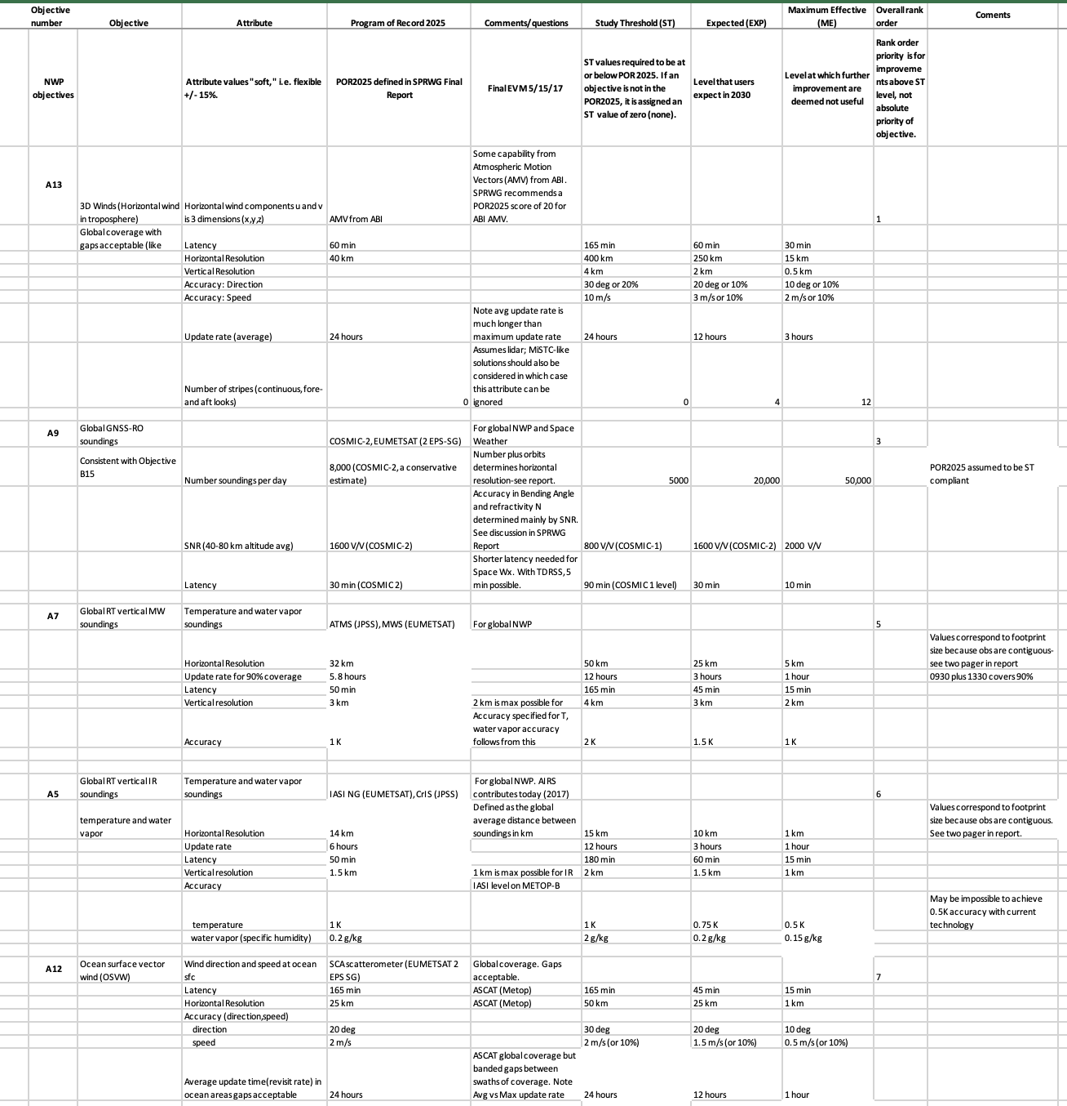
SPRWG EVM for Global NWP Objectives only
Priority order (for improvement over baseline)
3D winds
Radio occultation
Global microwave soundings
Global infrared sounding
Ocean surface vector winds
Are these still reasonable?
Are the recommended attributes and performance
levels realistic? How do they compare with BAA? Want
to narrow these.

Slide 19
Recent/future Workshops
https://meetings.wmo.int/impact-workshop-7/SitePages/
Tentative%20Program.aspx?CalendarDate=30/11/2020&amp;CalendarPeriod=week
Upcoming international workshop 13-17 September Joint WCRP-WWRP Symposium on Data
Assimilation and Reanalysis
https://events.ecmwf.int/event/217/page/109-registration

Slide 20
An overview of global Observing System Experiments for the atmosphere in the ECMWF system
Niels Bormann, David Duncan, Heather Lawrence, Tony McNally
Global observation impact
Benefits of present MW sounder constellation
Polar observing system experiments
Importance of data exchange

Slide 21
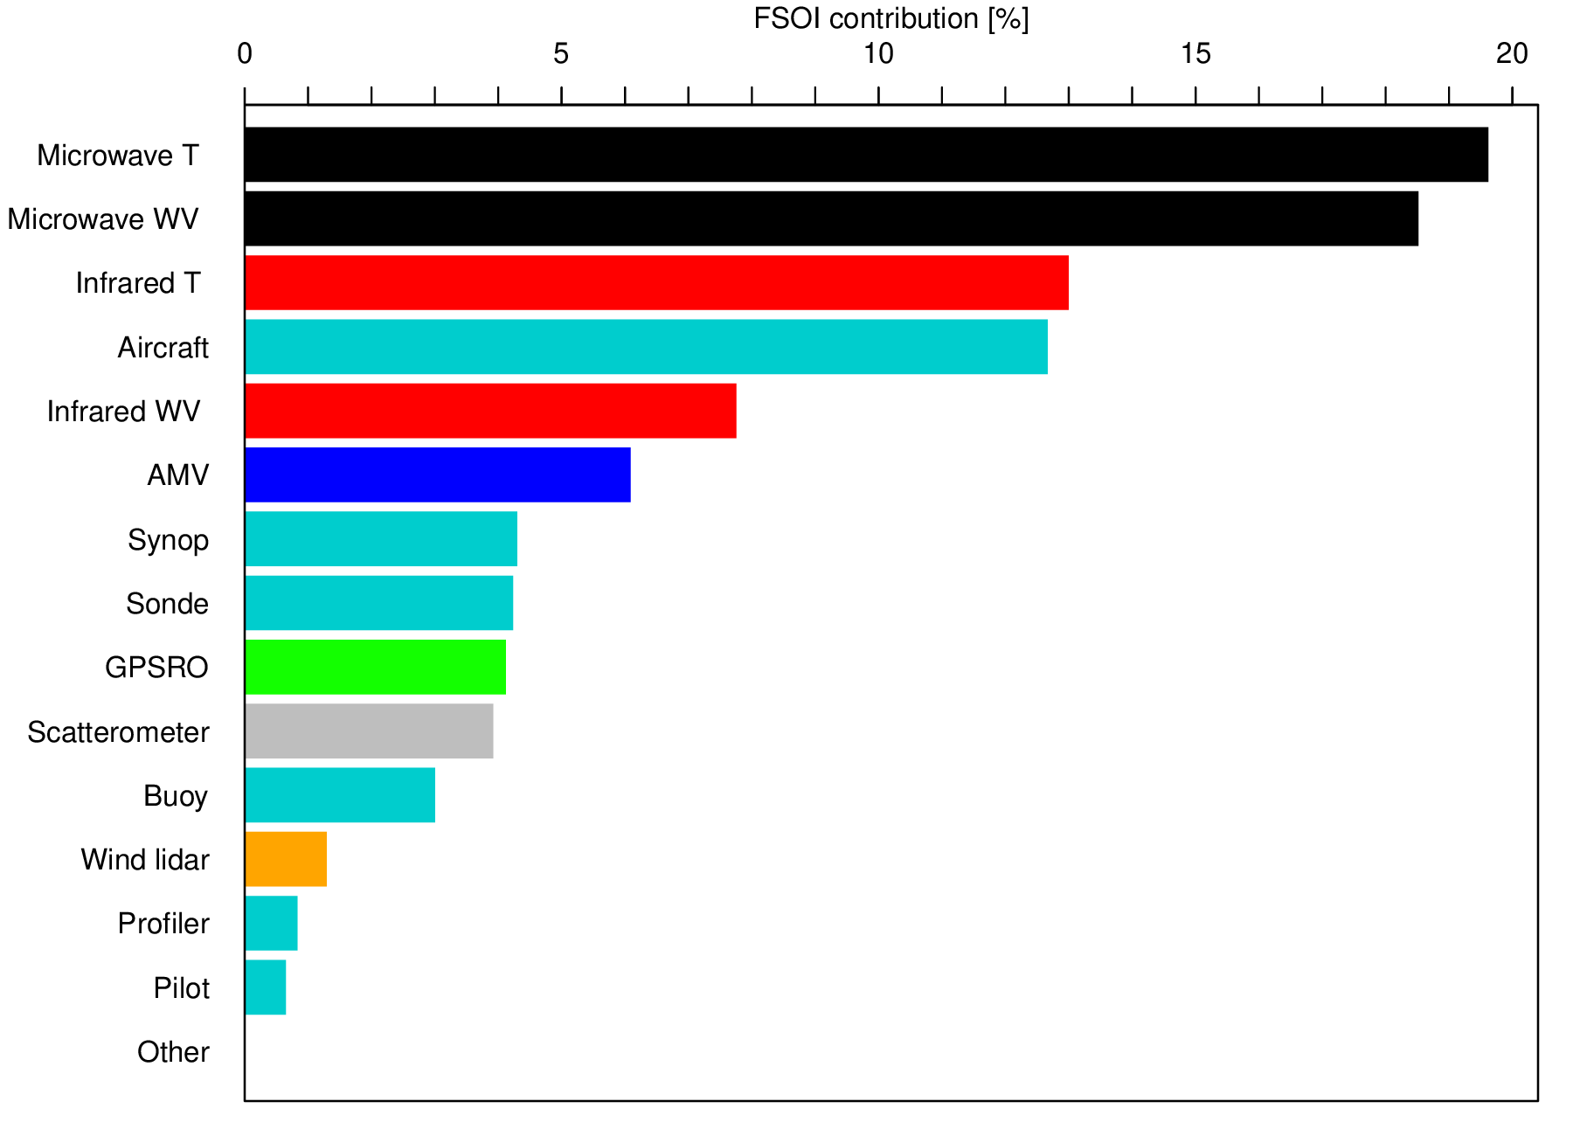
1) Complementary impact from all observing systems according to FSOI July 2019 & Jan 2020
7 AMSU-A, 2 ATMS
4 MHS, 2 ATMS, 2 MWHS-2, MWHS, 2 SSMIS, GMI, AMSR-2
Most of impact
slides like this
are based on
total number of
obs, not impact
per observation.
2 IASI, 2 CrIS, AIRS
(before Covid-19 reduction)
2 IASI, CrIS, AIRS; 5 geos
5 geos; 9 polar
8 satellites (before COSMIC-2, Spire)
3 ASCAT
Aeolus (Jan 2020 only)
Period: July 2019 & January 2020
(ie pre-Covid)

Slide 22
2) Why is there such a strong impact from MW radiances?
Hyperspectral IR:
Primarily clear channels assimilated;
2 orbital planes
MW sounding:
Increasingly assimilated in all-sky, over a wide range of surfaces;
many orbital planes
0
S-NPP, Aqua
Metop-A, -B,
FY-3C
0
S-NPP, Aqua
Metop-A, -B
21
3
21
3
NOAA-18
NOAA-15
18
6
18
6
F-17/18
NOAA-19
15
9
15
9
FY-3B
+ GPM,
Megha-Tropiques
12
(OSE period: 2016/18)
12

Slide 23
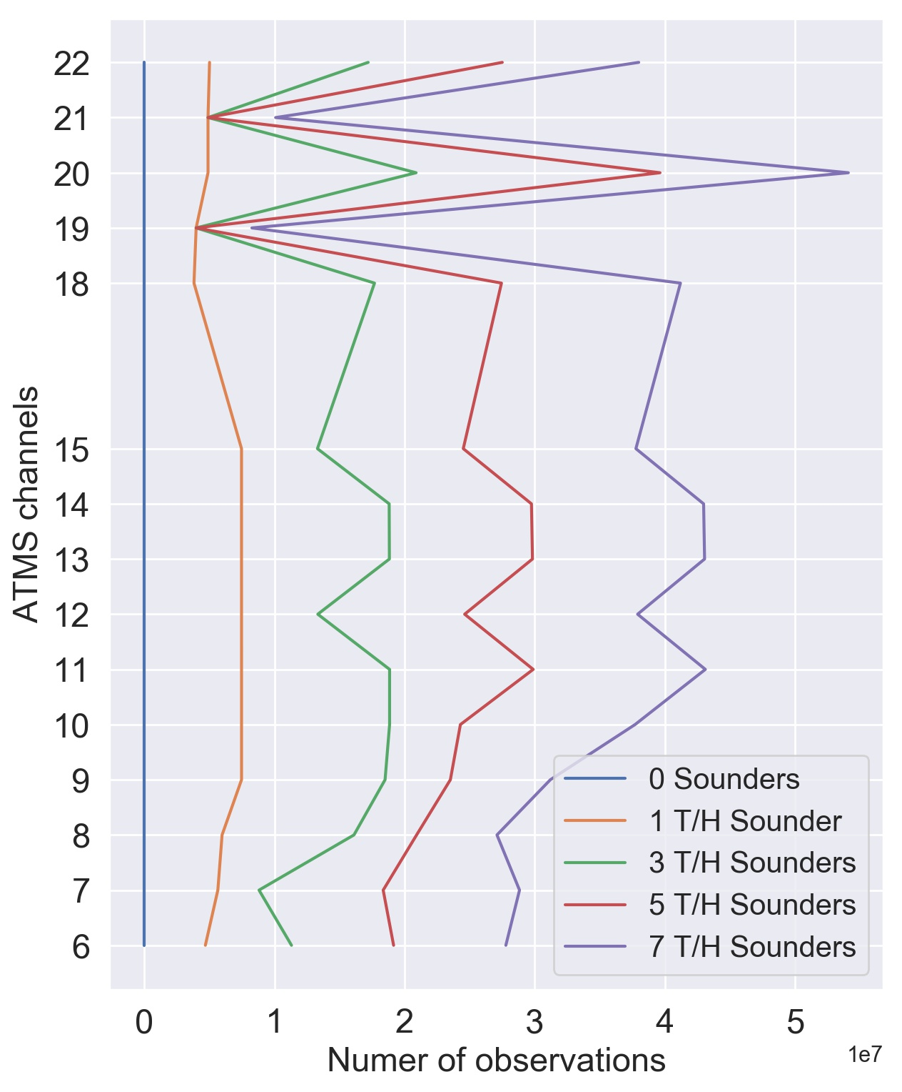
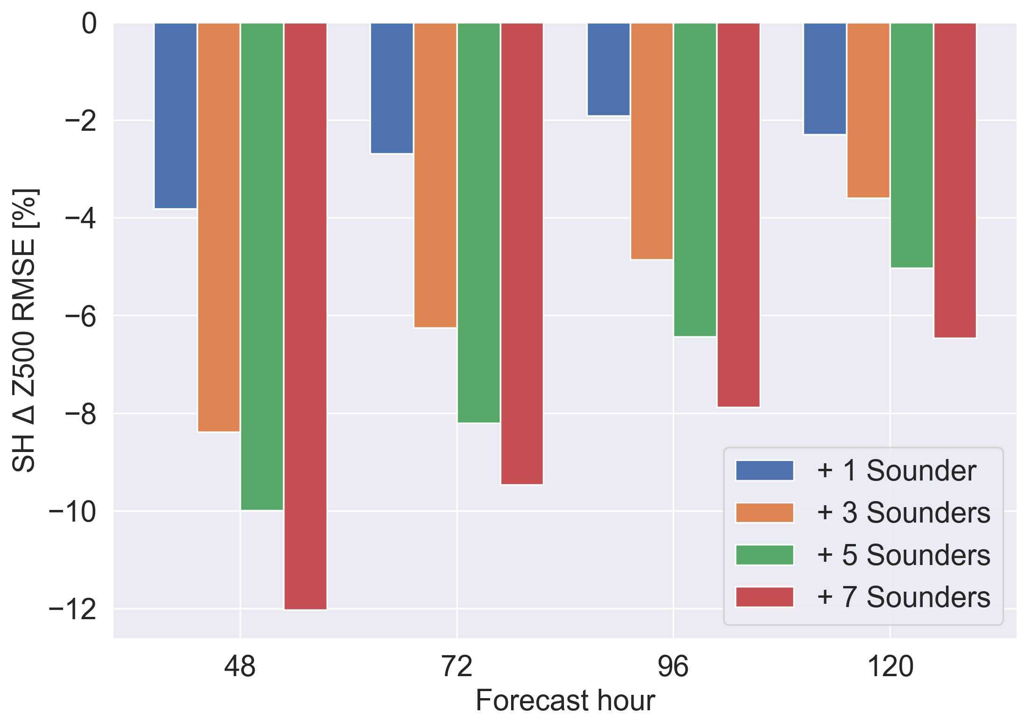
2) Continuing benefits from additional MW sounders
Details: Duncan and Bormann 2020
Control: Full observing system, but no microwave sounding data
Experiments: Control + either 1 / 3 / 5 / 7 MW sounders
Period: 1 June – 15 September 2018
Z500 hPa, Southern Hemisphere
Humidity
Normalised difference in RMSE of error [%]
Temperature
No indication of saturation of further benefits.
How to maintain this constellation?
Further improvements from even better temporal sampling?
Number of observations [10⁷]

Slide 24
4) Importance of data exchange
What if we only had US satellites? What if we only had European satellites?
use all satellites
use only European satellites
use only US satellites
Medium-range forecast error degradation compared to full system (500hPa)
S.Hemis
Tropics
N.Hemis
10% loss of skill
5% loss of skill
Forecast day
Forecast day
Forecast day
Using only US or only EU satellite data gives forecasts significantly inferior to using the full observing system. ….successful data exchange continues to be vital.
(Tony McNally)

Slide 25
Main points
Continue to see complementary benefits from all observing systems considered – all have their strengths.
Strong impact from MW data:
Continued protection of relevant MW frequencies is essential.
Increases in the temporal sampling from MW sounding data continue to be beneficial.
Investments in the use of satellite data are paying off (e.g., using MW data in all-sky conditions and over a wide range of surfaces).
Concerted efforts are needed to improve the use of satellite radiances over polar regions in winter (snow, sea-ice).
Successful data exchange continues to be vital for optimal forecast performance.
See also talks by Sean Healy and Mike Rennie on GPSRO and Aeolus impact.

Slide 26
Recent global Observing System Impact studies at Météo-France
J.-F. Mahfouf, H. Bénichou*, P. Chambon, N. Fourrié,
P. Moll, C. Payan, D. Puech, V. Pourret, D. Raspaud
CNRM/GMAP/OBS (Toulouse, France)
* DIROP/COMPAS (Toulouse, France)

Slide 27
Main conclusions and recommendations
Confirmation of known NWP impacts
Dominance of MW sounding data and conventional observations
Importance of GNSS-RO in the UTLS (T)
Positive impacts limited to the short range
AMVs (Tropics + SH: lower/upper troposphere) [V]
IR sounders (Low and mid-troposphere) [T, HU, V]
Aircrafts (not restricted to Northern Hemisphere) [V, T]
New NWP impacts (Aeolus wind profiles)
Importance in the upper troposphere (Tropics and S. Hemisphere)
Specific features
High measurement noise (6 m/s for clear sky winds)
Small fraction of additional observations (0.4 %)
Importance of (accurate) bias correction
Usefulness of in-cloud wind measurements (-> interest in future spaceborne Doppler radar wind mission)
Page 6

Slide 28
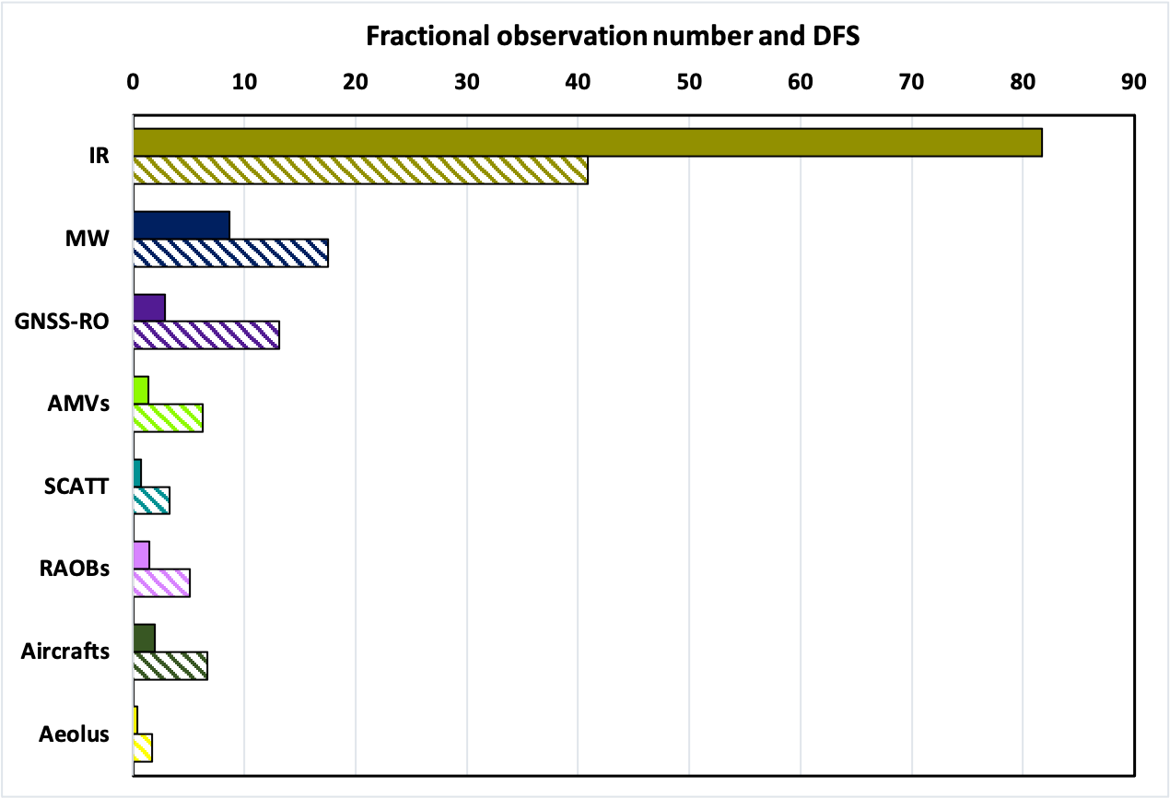
Information content : DFS
DFS= Degrees of Freedom for Signal (number of
independent pieces of information in a profile).
Conclusions from these experiments confirm a number
of already known impacts:
The dominance of the microwave sounders
(18 instruments) with an impact on temperature, wind,
humidity) at short and medium ranges.
- The direct and indirect (anchoring data for bias correction) impacts of bending angles from
GNSS-RO receivers is confirmed with large positive impacts on temperature in the upper
troposphere/lower stratosphere.
The impact of infrared hyperspectral radiances is
significant in the troposphere on all variables but
restricted to the short ranges. Such impact comes from
their large number (80 % of the total observations)
J.-F. Mahfouf
Obs
July 2020
DFS
Methodology : 1-day with 6 4D-Var assimilations (with perturbed observations) DFS from randomization method (Desroziers et al., 2006)
Page 7

Slide 29
Results from FSOI (1)
Top 5
IASI
AMSU-A / ATMS AMVs
RAOBs
Aeolus
Current status - 2 month period (July/August 2020)
Dry norm / dry adjoint model
Page 8

Slide 30
Global impact studies at the Deutscher Wetterdienst (DWD)
Alexander Cress, Andreas Anlauf, Robin Faulwetter, Michael Bender
Deutscher Wetterdienst, Frankfurter Strasse 135, 63067 Offenbach am Main, Germany
alexander.cress@dwd.de
Introduction
Polar impact studies (YOPP)
Aeolus wind lidar
Use of new radio occultation data (Cosmic 2)
Impact of microwave imagers
Use of ground-based GNSS observations
Impact of new Aircaft data (TAMDAR and MODE-S)
Conclusions
WMO Impact workshop, Nov-Dec 2020 Alexander Cress

Slide 31
Summary and conclusions
Radiosonde and AMVs are very important data sources in polar regions
Additional polar radiosondes show largest impact on synoptic and
planetary scales
Large positive impact of Aeolus on all hemispheres
Largest in the tropical upper troposphere/lower stratosphere
Large positive impact of additional RO data
(Cosmic2, Kompsat-5, FY-3D,PAZ)
Positive impact of microwave imager data
Ground-based GNSS data show positive impact in Europe and NH
Additional aircraft data (TAMDAR; Mode-S) show positive impact on
shorter time scales (up to 72 h).
WMO Impact workshop, Nov-Dec 2020 Alexander Cress

Slide 32
Impact of GNSS-RO in global NWP
Sean Healy and Katrin Lonitz

Slide 33
Background
GNSS-RO is useful component of the GOS. Information content largest in the upper-troposphere/lower-mid stratosphere temperatures
Good vertical resolution
Assimilation without bias correction (anchor measurement)
Good arguments for more GNSS-RO (e.g. OSSEs, EDAs)
Community (IROWG) target 20,000 profiles per day globally distributed with good temporal/spatial sampling
https://irowg.org/wpcms/wp-content/uploads/2020/05/IROWG7_Minutes_Summary.pdf
Significant increases in GNSS-RO numbers tested in an ongoing ESA study
COSMIC-2 > 4000 profiles in ± 40 degree latitude band
Spire > 5000 globally distributed

Slide 34
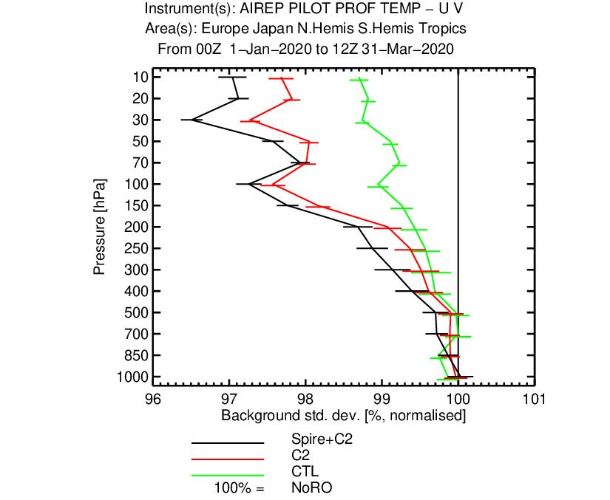
Impact of COSMIC-2 and SPIRE RO observations Global radiosonde Temperature and Vector wind departures
GOOD!
Temperature
Winds

Slide 35
Operational FSOI time series in 2020 (Spire from May 13-Sept 30, 2020)
Huge increase of RO impact
with addition of COSMIC-2
Another huge impact with
addition of SPIRE. With both
RO approaches impact of MW
Spire May 13
COSMIC-2 March 25

Slide 36
Summary
Tested significant increases in GNSS-RO numbers in 2020
Demonstrated that Spire data can be used in operations (Met Office have also shown this)
Good impact on upper-tropospheric/stratospheric temperature and winds (as expected). No indication of saturation
Good impact on tropospheric humidity. Tropical humidity signal driven mainly by COSMIC-2 data
Increase in GNSS-RO FSOI contribution during 2020
ESA study to do: Comparing EDA spreads with OSE results

Slide 37
A review of Observation Impacts through Data Denials and FSOI metrics at the Met Office
Brett Candy, James Cotton & John Eyre
www.metoffice.gov.uk
© Crown Copyright 2020 Met Office

Slide 38
Why revisit impact?
Typically we make one large package of changes per year to the operational system.
Switching on assimilation of instruments from new satellites – e.g. Metop-C, FY-3D, NOAA-20 Improved science in the treatment of existing observations – e.g. forward operators, quality control
Changes to the data assimilation scheme
Changes to the forecast model – e.g. parameterisations
Interventions.
Rejection of satellite instruments, channels etc and or conventional stations based on monitoring Routine changes to observation errors – reflects the weight in the analysis. Again based on monitoring
Two methods for assessing impact
Full data denial experiment – test withdrawal of observation from the assimilation scheme. Compare resulting forecast errors with a control run
Forecast Sensitivity to Observation Impact – runs as part of the data assimilation scheme and allows a diagnostic over time of impacts
Focusing on the global data model assimilation system. Forecast Parameters of interest are standard
variables representing the large scale flow in the troposphere

Slide 39
Data Denial Experiments
Category | Description | Key instruments
Aircraft | temperatures,U,V & RH from aircraft | AMDAR
AMVs | wind vectors from visible and IR imagers | MSG, AHI, GOES, Polar winds from AVHRR & VIIRS
Geostationary CSR | clear sky radiances from geo IR imagers | MSG,GOES,AHI
Ground-based GNSS | water vapour information from network of stations
GNSS RO | bending angles sensitive to temperature and humidity | receivers onboard Metop, FY-3D
Hyperspectral IR | radiances sensitive to temperature and humidity | AIRS,CrIS, IASI
MW sounders and imagers | radiances sensitive to temperature and humidity | AMSU-A, ATMS, AMSR2, MHS,MWHS-2
Radiosondes | profiles of temperature, winds and relative humidity
Scatwind | wind vectors over ocean | ASCAT, WindSat, ScatSat
Surface - land | temperature, relative humidity, pressure and winds from land stations
Surface - ocean | temperature, relative humidity, pressure and winds over ocean from buoys, ships and rigs
In Each data denial experiment (DDE):
One of the observation category is removed from the data
assimilation step – hybrid 4D-Var
Forecasts are compared to a control which uses all
observations as operations in late 2019 (present configuration).
DDEs were run over three month period: 15th August 2019-15th November 2019
Simplification compared to operations:
Reduced horizontal resolution
Effect of withdrawal of observations from ensemble
system is ignored (ensemble feeds into deterministic forecasts via forecast error matrix within hybrid 4D-Var)
Based on a sensitivity study it is likely that our
approach ignoring ensemble underpredicts effects at longer forecast range
We have not tested the impact of the following: windprofilers & Bogus observations.

Slide 40
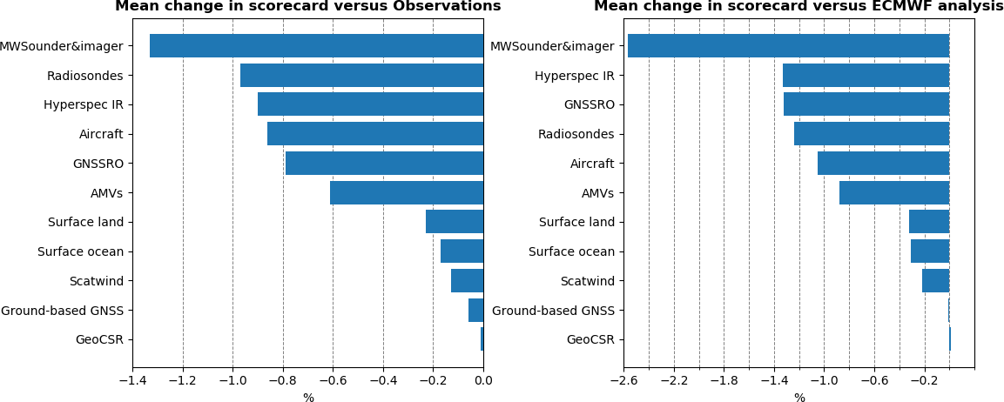
Data Denial Impact summary
Satellite Sounders, radiosondes and GNSSRO still give large impact. AMVs & Aircraft also important. Nearly all observation categories yield benefit.

Slide 41
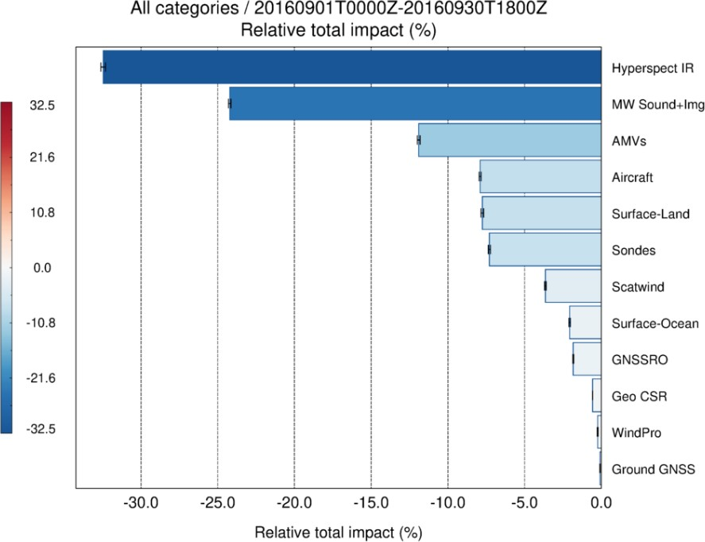
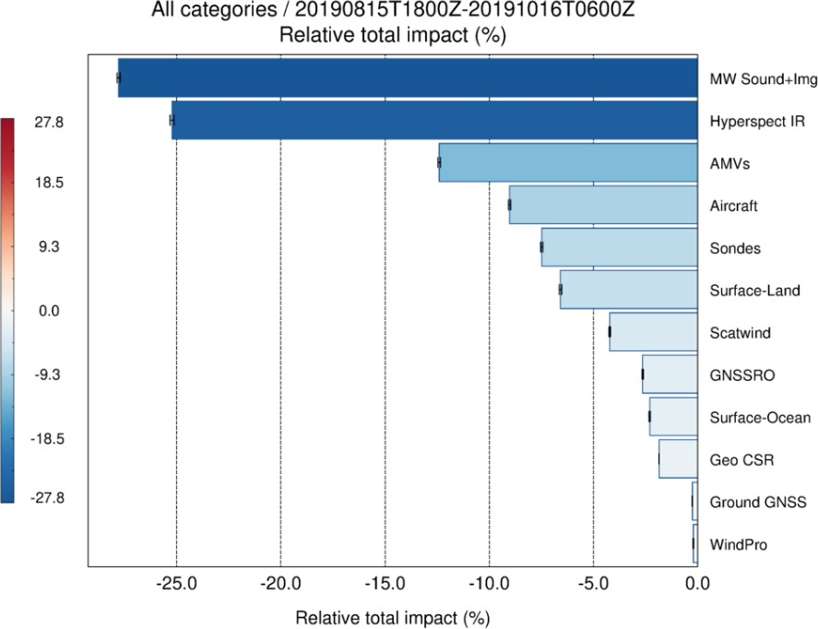
Forecast Sensitivity to Observation Impact (FSOI)
FSOI which is a diagnostic generated as part of the data assimilation system and is used
routinely at several NWP centres (Langland & Baker, 2004).
Generally the ranking based on FSOI is similar to the DDE results, except for GNSSRO, FSOI tends to underestimate impact. Over 50% of the impact, according to FSOI, is from satellite sounding. 2016 results very similar

Slide 42
Conclusions
The majority of observation types continue to show benefit for global NWP.
Microwave and IR sounders, radiosondes, GNSSRO give large forecast benefits. Aircraft and Atmospheric Motion Vectors are also important.
FSOI diagnostics give a similar picture. One notable difference is that FSOI appears to
underestimate the importance of GNSSRO. Order of importance (according to this metric) is also very similar to previous study in 2016.

Slide 43
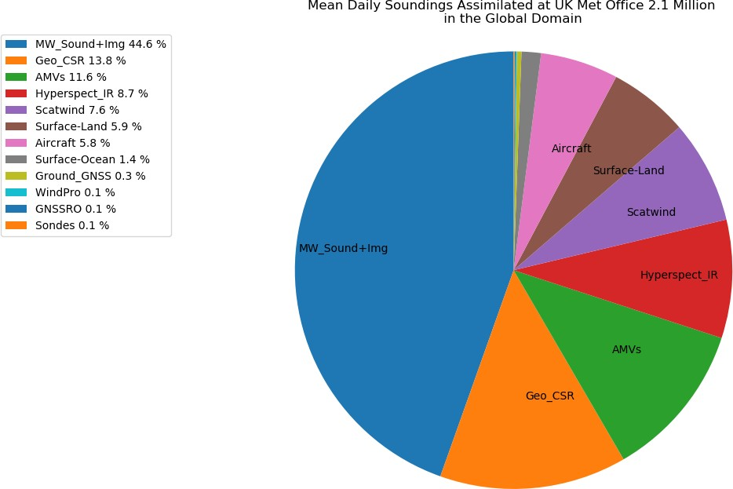
Observation coverage at OS43
Imbalance of MW, IR and RO
observations and winds:
MW 44.6%
GEO CSR 13.8%
AMVs 11.6%
Hyp IR 8.7%
Scat wind 7.6%
RO 0.1%

Slide 44
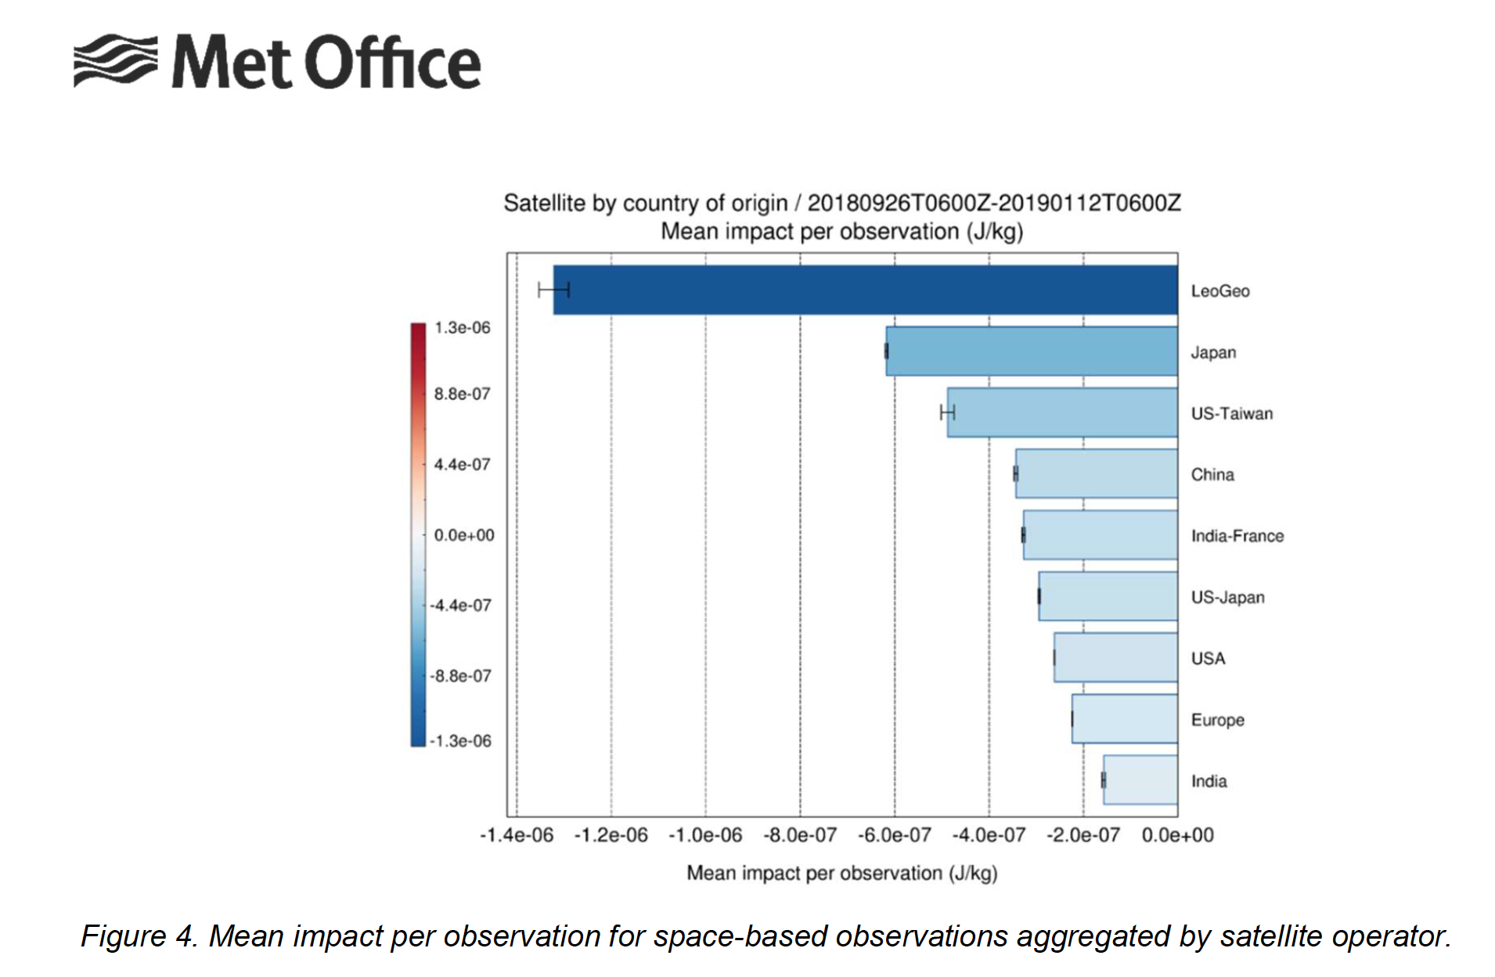
Impact per observation
All AMVs
Himawari-8
COSMIC-1 RO
Cotton and Eyre, 2019
Tech Rpt #636

Slide 45
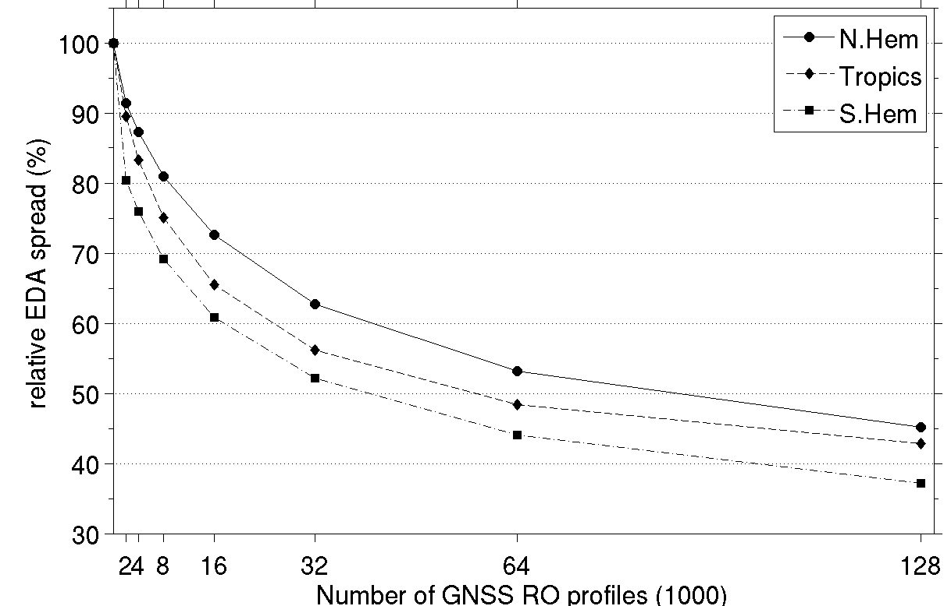
How many RO profiles is enough?
Temperature analysis at 100 hPa
~ 50 % of the impact
of 128 000 profiles
~ 25 million
bending
angles
per day
today
Large improvements up to 16 000 profiles per day
Even with 32 000 – 128 000 profiles still improvements possible
→ no evidence of saturated impact up to 128 000 profiles
(although the additional impact per observation is decreasing)
Harnisch et al. MWR 2013
Notes:
Scaling of GNSS RO impact (Harnisch et al. MWR 2013)

Slide 46
FSO, OSE and other Impact Studies at NCMRWF
V.S. Prasad
Suryakanti Dutta, C.J. Johny, Sujata Pattnaik,
John P George, Sumit Kumar, Indira Rani, M.T Bushair
vsprasad@ncmrwf.gov.in
https:www.ncmrwf.gov.in
7th (Virtual) Workshop on the Impact of Various Observing Systems on NWP 30 Nov – 3 Dec 2020

Slide 47
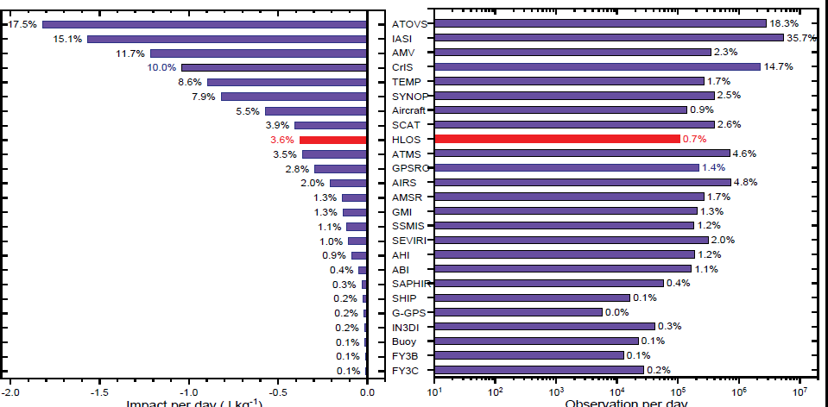
Both OSE & FSO were conducted to study the impact of AEOLUS.
Positive impact at 95% level of significance are observed from middle to upper atmosphere through OSE’s
A over all ~3% improvement in
forecast skill is observed in FSO.
Based on these results, Aeolus winds will be made operational at NCMRWF.
Observation impact on 24 hour forecast In NCUM.
7th Workshop on the Impact of Various
Observing ystem on NWP

Slide 48
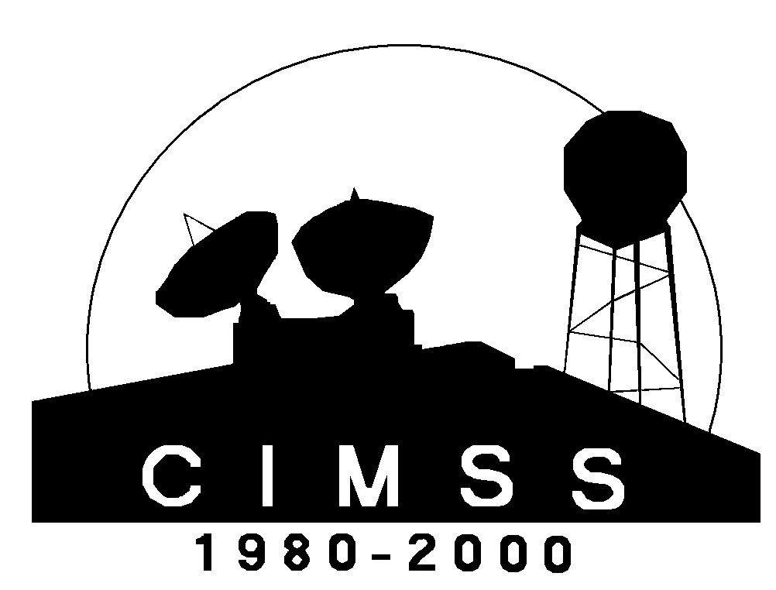
Assessing the Impact of Atmospheric Wind Observations
from Satellites and Aircraft at Global and Regional Scales
Ralph Petersen¹ and Patricia Pauley²
¹ University of Wisconsin-Madison, Cooperative Institute for Meteorological Satellite Studies (CIMSS), Madison, WI
² Marine Meteorology Division, Naval Research Laboratory, Monterey, CA
Availability of Good Quality (and Adequately Distributed) Observations is key to Understanding Weather, Now and into the Future.
Knowing where more observations are (and are not) needed is equally important for both observation system developers and data users

Slide 49
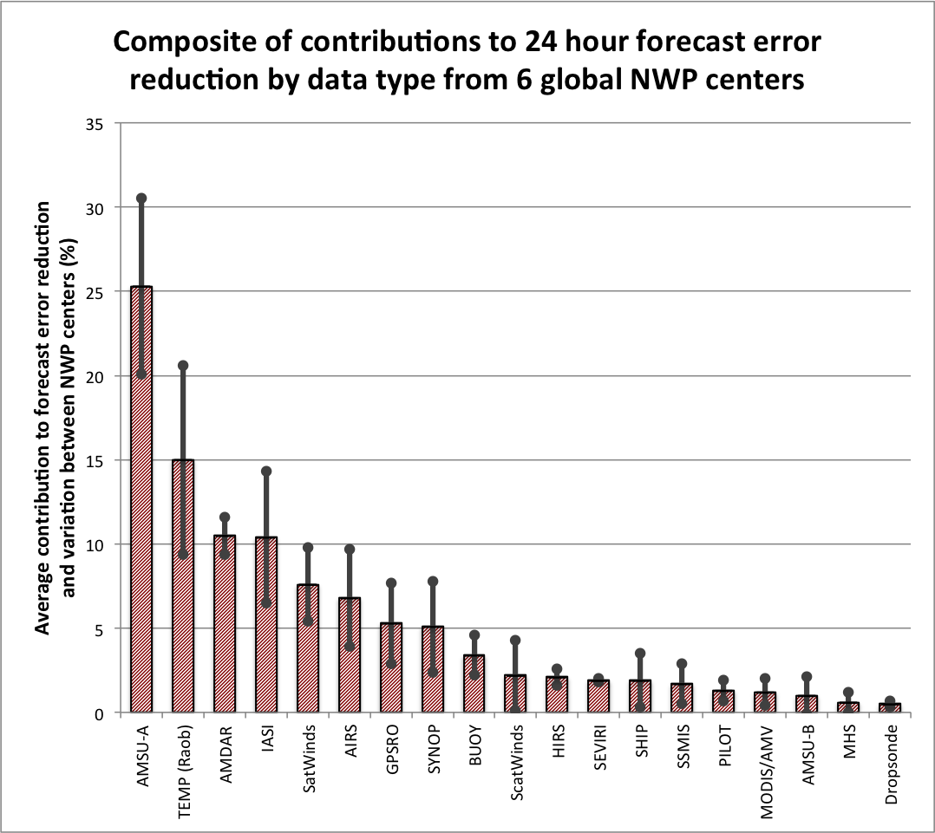
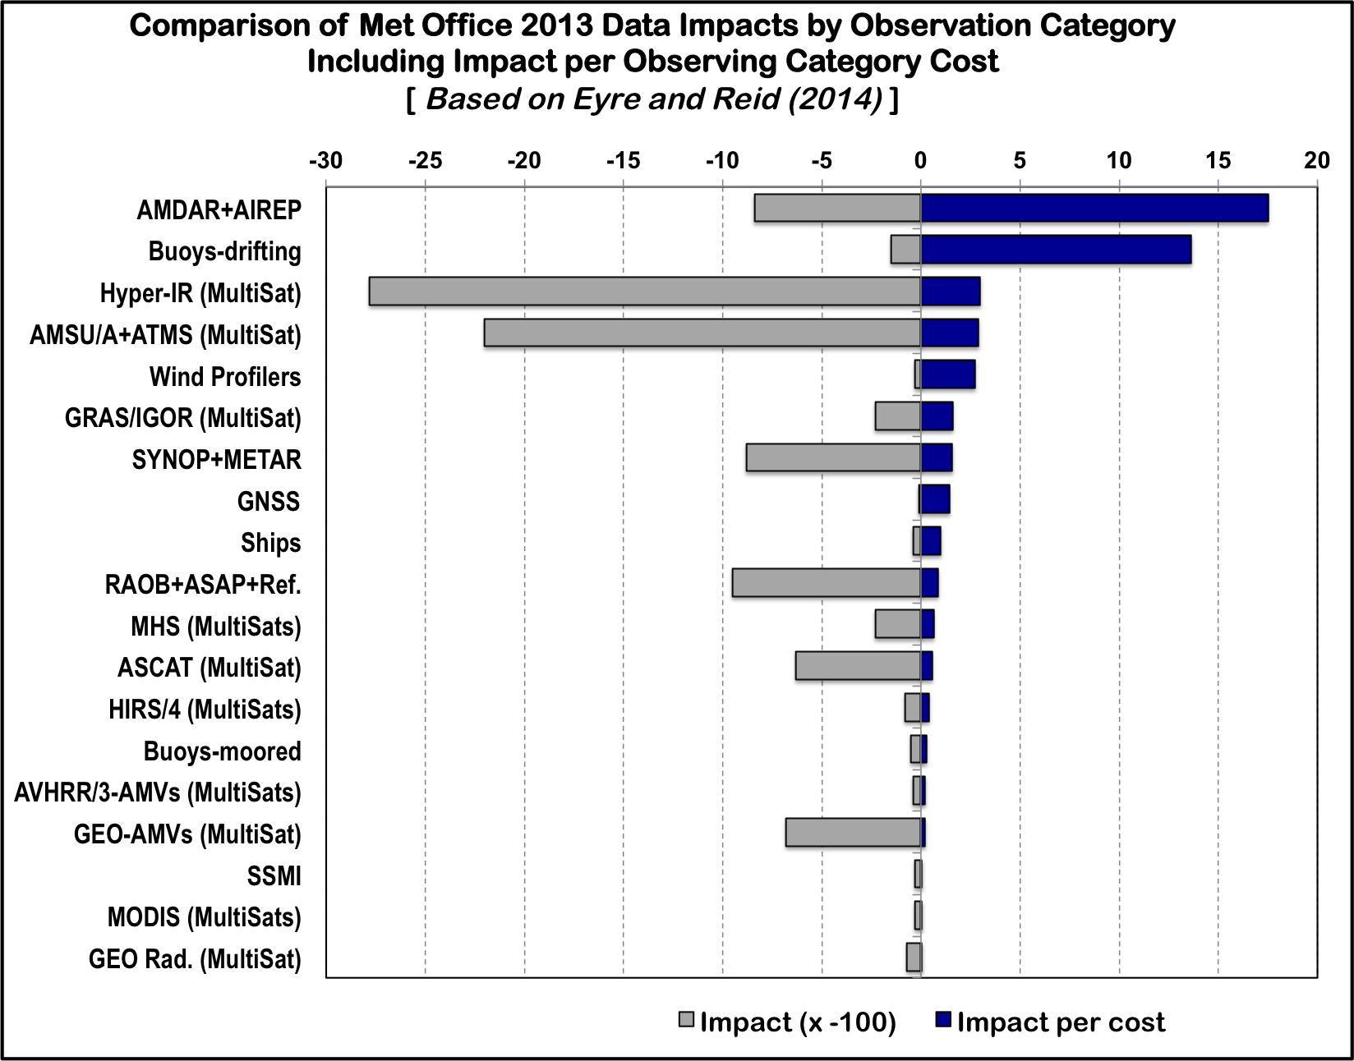
Review of total AMDAR Temperature/Wind Impacts
AMDAR Temperature and Wind data are among 3-5 most important data sources for global analyses across multiple NWP centers
Extremely Cost Effective (Very Low Cost / High Impact)
AMDAR in situ profiles including moisture could backfill for lost rawinsondes
Results from 2012 WMO Data Impact Workshop
More Cost
Effective
Greater Impact

Slide 50
Summary of AMDAR and Satellite Wind Impacts
AMDAR Temperature and Wind data are among 4-5 most important data sources for global assimilation across multiple NWP centers
Extremely Cost Effective (Cost/Impact) – Easy to expand
Impact of combined Temperature/Wind reports can easily surpass rawinsondes
Combined impact greater than Temp or Wind alone
In regions of abundant Aircraft Wind reports, impacts greater than Satellite winds
Aircraft Winds dominate 300-200 hPa (oceanic and land flight levels)
Largest upper-level impact of any wind observation
Very large impacts over land in when sufficient reports are available
Not available above 150 hPa – Need Radiosondes there
Satellite Derived Wind Observations continue to play important roles across the globe
Part of success of Satellite Winds within the Navy Assimilation System due to melding of multiple complimentary products from different providers
Overall, Winds have their largest impacts between 900-700 hPa and 400-100 hPa
Needed to define the vertical convergence/divergence couplet required for storm development
Globally, GEO Winds dominate other Satellite Wind sources
GEO Winds dominant data set at lower levels (1000-700 hPa) and the 400-300 hPa layer
Most important in Tropics, with slightly reduced impacts in mid-latitudes (especially in S.H.)
AVHRR Winds increase importance poleward of 40°, with much larger impact in S.H.
Polar Winds have larger impact in Southern Hemisphere

Slide 51
Lidar measured wind profiles from space
1
An overview of Doppler lidar technology and comparison with current and future wind measurement capabilities
Sara Tucker
Lidar Systems Engineer Ball Aerospace, stucker@ball.com
With special thanks to the Ball Aerospace OAWL development team & partners, including Mike Hardesty and Sunil Baidar of CU-CIRES
NOAA STAR Seminar - 25 July 2019 - NCWCP

Slide 52
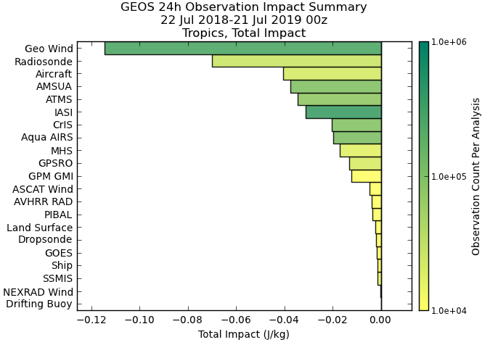
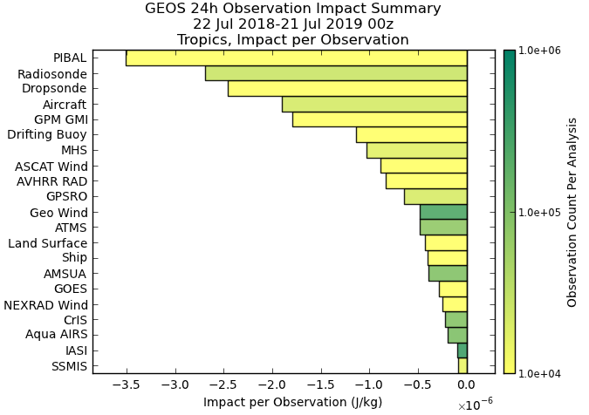
Wind observations have strong impacts on forecast
GEOS-5 Impact Summaries: July 2018-July 2019, Tropics
Observations that include winds (retrieved or measured)
Tropics, total impact
Tropics,
impact per observation
WMO: The greatest unmet observational need is still winds
52

Slide 53
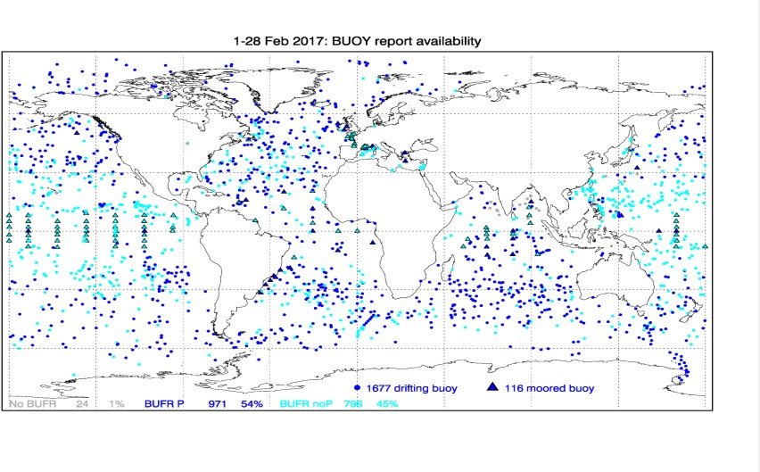
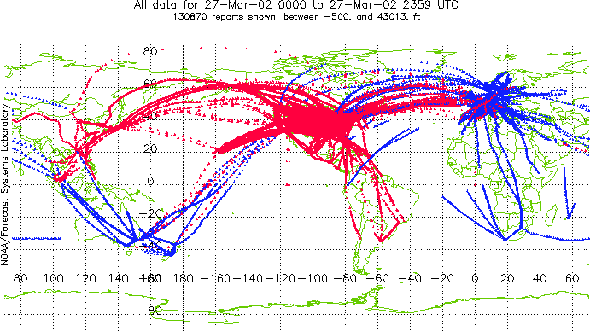
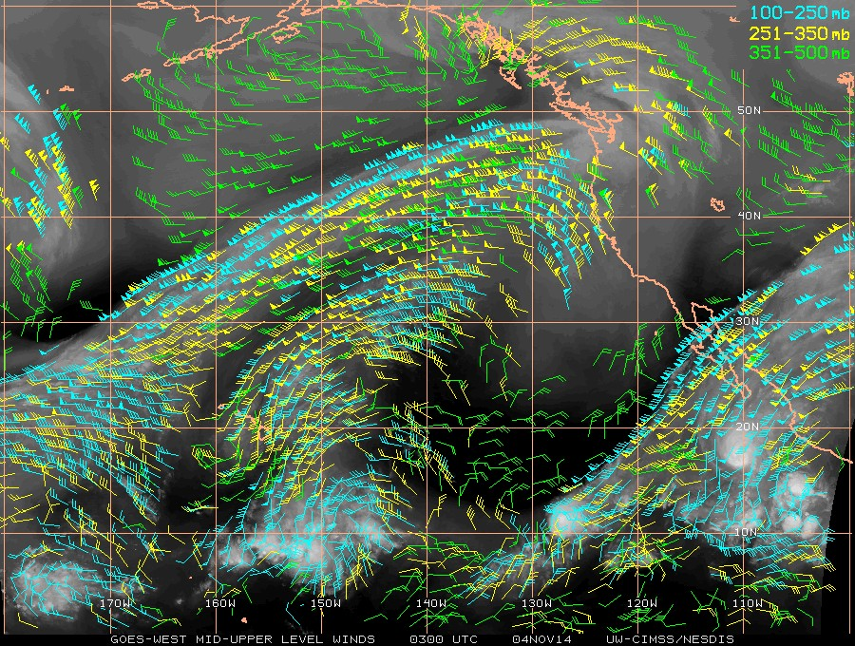
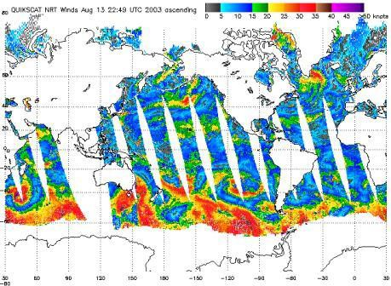
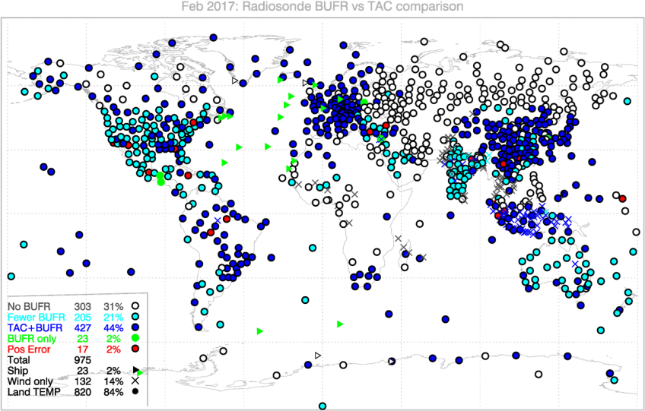
Existing global winds measurements
Surface
Motion Vector
(aerosol/cloud tracking)
In-situ Profiling
Surface Buoys
Aircraft
Radiosondes
Aircraft (in-situ)
Scatterometry
Radiosondes
Visible or water vapor channels Requires 3 cloud images, cloud brightness temp, cloud mask, cloud height, cloud top pressure
(for Water Vapor: GFS forecast temperature profile)
Requires Cloud/WV Features
53

Slide 54
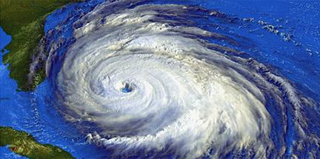
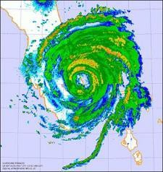
Wind lidar for operational weather
Space-based DWL can provide
Direct measurements of altitude resolved wind profiles to initialize forecast models and observe large scale dynamics
Provide Global coverage: including oceans, tropics, and SH
Multiple OSSE/OSE/etc. studies over decades show significant predicted impact:
Baker et al., Bulletin of the American Meteorological Society, 1995
Marseille, et al., Proc. 5th Intl. Winds Workshop, EUM-P, 2000
Riishojgaard et al., J. Applied Meteorology, 2004
Stoffelen, et al., Quarterly J. of the Royal Met. Soc., 2006
Marseille, G.J., A. Stoffelen, & J. Barkmeijer, Tellus A, 2008 (2 papers)
Weissman & Cardinali, Quarterly J. of the Royal Met. Soc., 2007
Atlas, et al., IEEE IGARSS, 2010
Baker, et al., Bulletin of the American Meteorological Society, 2014
Ma et al., Journal of Atmospheric and Oceanic Technology, 2014
Atlas, et al. Journal of Atmospheric and Oceanic Technology, 2015
ESA’s Aeolus operating on orbit – starting to look at impact of lidar wind measurements.
54

Slide 55
Essential Satellite Data for Global NWP

Slide 56
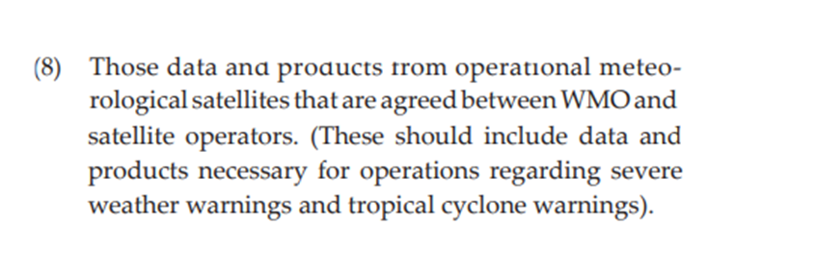
Essential Satellite Data for Global NWP Background (1/2)
International data exchange is a major purpose of WMO, WMO Convention, Art. 2b
Recent developments in the data provision landscape has triggered renewed attention to the issue of data access and availability for WMO applications, in particular for near-real-time applications such as nowcasting and numerical weather prediction. It is also recognised the global Numerical Weather Prediction (NWP) underpins all WMO application areas, including reanalysis in support of climate monitoring.
Need for a new Data Policy
At Cg-18, WMO established the Global Basic Observing Network (GBON). GBON is a subset of the surface-based subsystem of WIGOS, used in combination with the space-based subsystem and other surface-based observing systems of WIGOS, to contribute to meeting the requirements of global NWP, including reanalysis in support of climate monitoring.
This document formulates the data and associated requirements that providers of satellite data should fulfil to complement the GBON in meeting the essential needs of global NWP supporting operational meteorology and other application areas.

Slide 57
Essential Satellite Data for Global NWP Background (2/2)
New WMO Data Policy (“Res 42”) will give high level definitions in different disciplines
Weather, Climate, Hydrology, Atmospheric Composition, Cryosphere, Oceans, Space Weather
Considerations for Weather and Space-based Observations
All satellite data considered as essential for the performance and quality of numerical weather prediction output as reflected in the CGMS Baseline, subsequently adopted into the WMO Technical Regulations.
All data provided by the multi-purpose visible-infrared meteorological imagers flying the low-earth or geostationary orbit.
Purpose of the Position Paper “Essential Satellite Data for NWP”
Provide the linkage between the new Data Policy and WMO regulatory material (WIGOS Manual)
Hence also change of definition to Essential (previously Basic/Critical)
Define the Essential Satellite Data sets required by global NWP underpinning WMO application areas, critical for the protection of life and property. Free and unrestricted availability
Identify additional data that are required. Conditions may be placed.
Provide the principles that should apply to essential satellite data generation and distribution
Intended to all operators responsible for satellite data and products, in particular CGMS members
Approach
Follow WIGOS 2040 Vision
Noting a holistic Earth System Modelling approach=> NWP is core for WMO application areas
Can be seen as the satellite equivalent to GBON => Harmonisation of terminology
Complement to GBON and building on the Rolling Review of Requirements
A formulation of the user needs
57

Slide 58
Guiding Principles or Requirements
Make available globally all essential satellite data in real time or near real-time
Document instrument characteristics and processing steps
Engage with users and document potential impact on applications
Document algorithms and information to support validation and calibration of the data
Provide information on data latency, data format and processing tools available
Provide timely pre-operational data to users
Provide unrestricted access to archived data
Plan for sustained data provision
58

Slide 59
Draft table Essential Satellite for global NWP Following the current CGMS baseline
Type of satellite sensors^{[1]} | Principal applications driving spatial-temporal requirements in addition to global NWP^{[2]} | Main attributes of satellite data
Data from geostationary orbiting satellites (complete GEO ring with app 60 deg spacing)
Multi-purpose meteorological imagers (multispectral, visible, and infrared) | Nowcasting | Radiance products, Atmospheric Motion Vectors (AMVs )
Hyperspectral Infrared Sounder | Nowcasting | Radiance products, AMVs
Data from Low-Earth orbiting satellites
Multi-purpose meteorological imagers (multispectral, visible, and infrared) | Nowcasting, Ocean applications, Agricultural meteorology | Radiance products and geophysical products (e.g. Aerosol Optical Depth (AOD), AMVs, Sea Surface Temperature (SST)), from 3 sun-synchronous orbits
Hyperspectral Infrared Sounder | Atmospheric composition | Radiances from at least 3 sun-synchronous orbits
Microwave Sounder |  | Radiances* from at least 3 sun-synchronous orbits
Microwave Imager | Nowcasting, Ocean applications | Radiances SST, precipitable water, sea ice
Scatterometer | Marine meteorology and Ocean applications | 3 sun-synchronous orbits, backscattering cross-sections and surface winds, soil moisture
Radar altimeter | Ocean applications | Sea surface height, wind and waves, ice freeboard
Radio-occultation | Space Weather | Minimum 6000 occultations from low inclination orbits distributed geographically and temporally in local time, 1000 occultation from drifting high inclination orbits, and 7600 occultations from sun-synchronous orbits. Electron density profiles up to 500 km
Visible/UV Spectrometer and SWIR imaging spectrometer | Atmospheric Composition services in Urban and Populated Areas; Forecasting Atmospheric Composition | Ozone, aerosol properties
IR dual-angle view imagery for SST | Ocean applications, Sub-seasonal to longer prediction | SST
IR
MW
Scatterometer V
RO
59
^{1]} Following the sensor types in the CGMS Baseline for the Operational Contribution to the GOS, Manual on the WIGOS, Attachment 4.1, p 123, WMO-No. 1160
^{[2]} Observation requirements for WMO Application Areas are being maintained in the WMO Rolling Review of Requirements process (http://www.wmo-sat.info/oscar/applicationareas). The quantitative requirements for observing geophysical variables provide guidance for the definition of the spatial and temporal resolution of satellite datasets.

Slide 60
Summary of all these studies
A balanced set of observations is extremely important
IR, MW and RO soundings are all important. There are far fewer RO soundings and far fewer than the 20,000 profiles per day recommended by the WMO International Working Group on Radio Occultation
3D wind observations currently make a large impact, from radiosondes, AMVs, and Aeolus. There are many gaps in wind observations and relatively few direct measurements.
These findings support the recommendations of SPRWG that the highest priority for additional observations over today’s system are 3D winds and RO, in that order.

Slide 61
Next steps
Membership of small study group
Need template for ASPEN for temperature, water vapor and winds
Prepare a “strawman” recommendation for review and perturbation
Anything else?

Slide 62
Potential membership
Rick Anthes, Chair
Will McCarty (SAT, NASA GMAO)
Kevin Garret (SAT) STAR
Jim Yoe (SAT, NOAA NWS, former SPRWG member))
Ben Ruston (SAT, NRL-Monterey)
Bob Atlas (former SPRWG member)
Vanessa Escobar (SAT, NASA User Engagement)
David Helms (SAT, NOAA OSAAP TPIO)
Meredith Wagner (SAT, NOAA OSAAP TPIO)

Slide 63
Potential Strategic recommendations
Maintain/improve a balanced global observing system
Establish a policy of free and open exchange of data, metadata and processing detail without exception
Develop a flexible system that is continually adaptable to user needs and updated scientific results
Maintain robust research program of evaluation and impact (data denial experiments, OSEs, OSSEs, FSOI, verification/validation) and use of data in models (data assimilation studies). Make better use of what we already have and adjust constellation as required.

Slide 64
Potential Tactical recommendations
Run a few of the NSOSA solutions through ASPEN
Cost reality check of the “strawman”
Run the “strawman” recommendation through ASPEN
Perturb the “strawman” in several ways to test sensitivity
Based on what we already know, develop a specific integrated concept for NOAA’s satellite constellation and put it out for independent review by international experts.

Slide 65
BAA LEO SounderSat Oct 3, 2019
NOAA’s POR
NOAA-13 (1st satellite of JPSS Program)
JPSS-2 2022
JPSS-3 2026
JPSS-4 2031
COSMIC-2
NOAA’s Reference Constellation (baseline against which variations can be assessed)
Small Govt. sat with IR, MW, RO sounder
1-2 sat in each of 3 orbits (1330, 0530, and other) launched every 2-3 yrs

Slide 66
Sensor Requirements
IR Temperature and “Moisture” (Specific and relative humidities)
MW Temperature and “Moisture”
GNSS RO
Requirements Ranges at 4 levels
Lower bound (Threshold)
Target (baseline)
Maximum (objective)
Current POR (CrIS/N20 for IR, ATMS/N-20 for MW, COSMIC-2 for RO)

