Slide 1
Space Platform Requirements Working Group (SPRWG)-Methodology and Main Results
NOAA Science Assessment Team
9 August 2021
Rick Anthes
SPRWG Chair
anthes@ucar.edu
Notes:
14th Annual Symposium on Next Generation Operational Environmental Systems. Session 7: NOAA Satellite Observing System Architecture Study-Part II

Slide 2
Sid’s and Frank’s Charge
Overview of main findings in terms of requirements
Methodology for determining applications and requirements (attributes)
Assumptions made
Summarize which observables were requirements for applications and their attributes

Slide 3
History and Methodology
SPRWG formed in October 2015 with 18 members, NOAA and non-NOAA experts
Quasi-independent from NOAA, but with NOAA leadership guidance (Frank Gallagher and Karen St. Germain)
Structured approach according to Multi-Attribute Utility Theory (MAUT), led by expert from Aerospace Corporation, Mark Maier.
Three cycles
Final report May 15, 2017 178 pages details of process and findings.
Peer-reviewed BAMS articles September 2019 and March 2021
Main result was the Environmental Data Record (EDR) Value Model (EVM), which listed main objectives in priority order with their performance attributes.
Group A-weather, climate, ocean objectives
Group B-space weather objectives (not discussed here)

Slide 4
Multi-Attribute Utility Theory (MAUT)
Formal process to aid decision making under complex conditions and constraints, in this case evaluate NOAA space constellation alternatives
Develop utility function
Input—all performance attributes of an architecture alternative
Output---utility of the alternative-a single number
References at end of presentation

Slide 5
SPRWG Assumptions/Priorities
NOAA focus
Operations vs. research
Weather vs. climate, air pollution…..
Terrestrial weather and space weather
Atmosphere vs. oceans, ice, land, ecosystems, carbon cycle…….
Did not consider applications explicitly because most observations supported many different applications.
Did not consider costs

Slide 6
Definitions
Objective (requirement): something we want to obtain, e.g. regional RT imagery, global microwave soundings, ozone, ocean color…
Applications: activities were objectives are used, e.g. nowcasting, NWP, aviation weather, hydrology, oceanography…
Attribute: property of objective; e.g. accuracy, precision, vertical resolution, latency, frequency of measurement….
Performance level of attribute: capability, e.g. temperature uncertainty of 1 K, horizontal resolution of 100 km……

Slide 7
Performance Levels in EVM
Performance levels for objective attributes set at three levels of capability:
Study Threshold: The level at which decreases in capability no longer present a compelling investment; alternatives with capability below this level will be rejected. Guidelines were no objectives with ST level greater than Program of Record 2025 (POR given in Report and BAMS article).
Expected: The capability reflecting expectations from the users. Often, but not always, roughly equal to today’s capability.
Maximum Effective: The level at which increases in capability no longer present a compelling investment. Generally a significant improvement over today’s capability.

Slide 8
Example of an Objective Global real time IR soundings
Performance attributes at ST, EXP and ME levels
Horizontal resolution (km) 15, 10, 1
Update rate (hours) 12, 3, 1
Latency (hours) 3, 1, ¼
Vertical resolution (km) 2, 1.5, 1
Accuracy temperature (K) 1, 0.75, 0.5
Accuracy specific humidity (g/kg) 2, 0.2, 0.15

Slide 9
Process for generating EVM
Objectives identified
Selective/parsimonious-highest priority for NOAA operations
Serve many Applications. Did not consider separate applications as in COURL or OSCAR, because many overlap. Two major applications considered were NWP and nowcasting.
Quasi-independent-do not want objectives to overlap-important in evaluating or “scoring” various architectures
Based on many references, especially WMO OSCAR and NOAA COURL, plus publications and judgment by SPRWG. Deliberative and time consuming.
Objectives prioritized based on improvement over ST level. All objectives considered together; important because a strong case can always be made for one objective when alternatives are not considered.
Rationale for performance attributes and prioritization summarized in ”two pagers.” Important because of traceability of process-why we chose and prioritized the objectives.

Slide 10
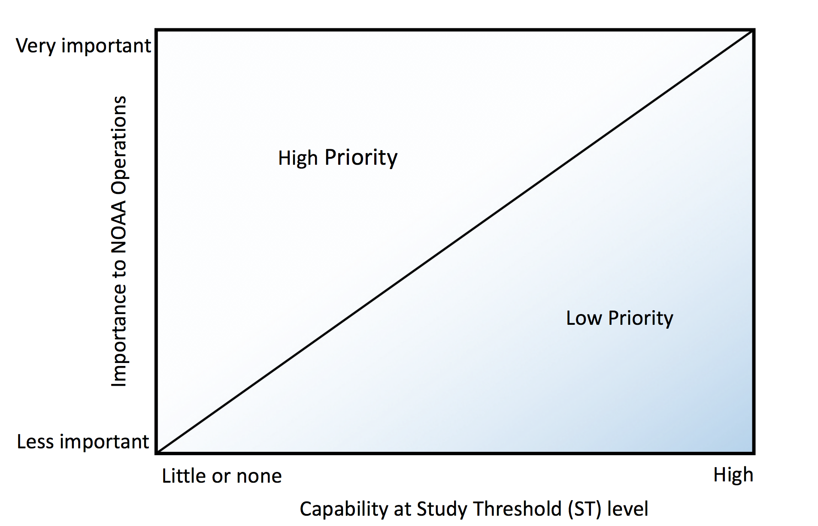
Priorities-based on improvement over ST level of
capability, NOT intrinsic priority to NOAA
3D winds
Incoming solar
radiation

Slide 11
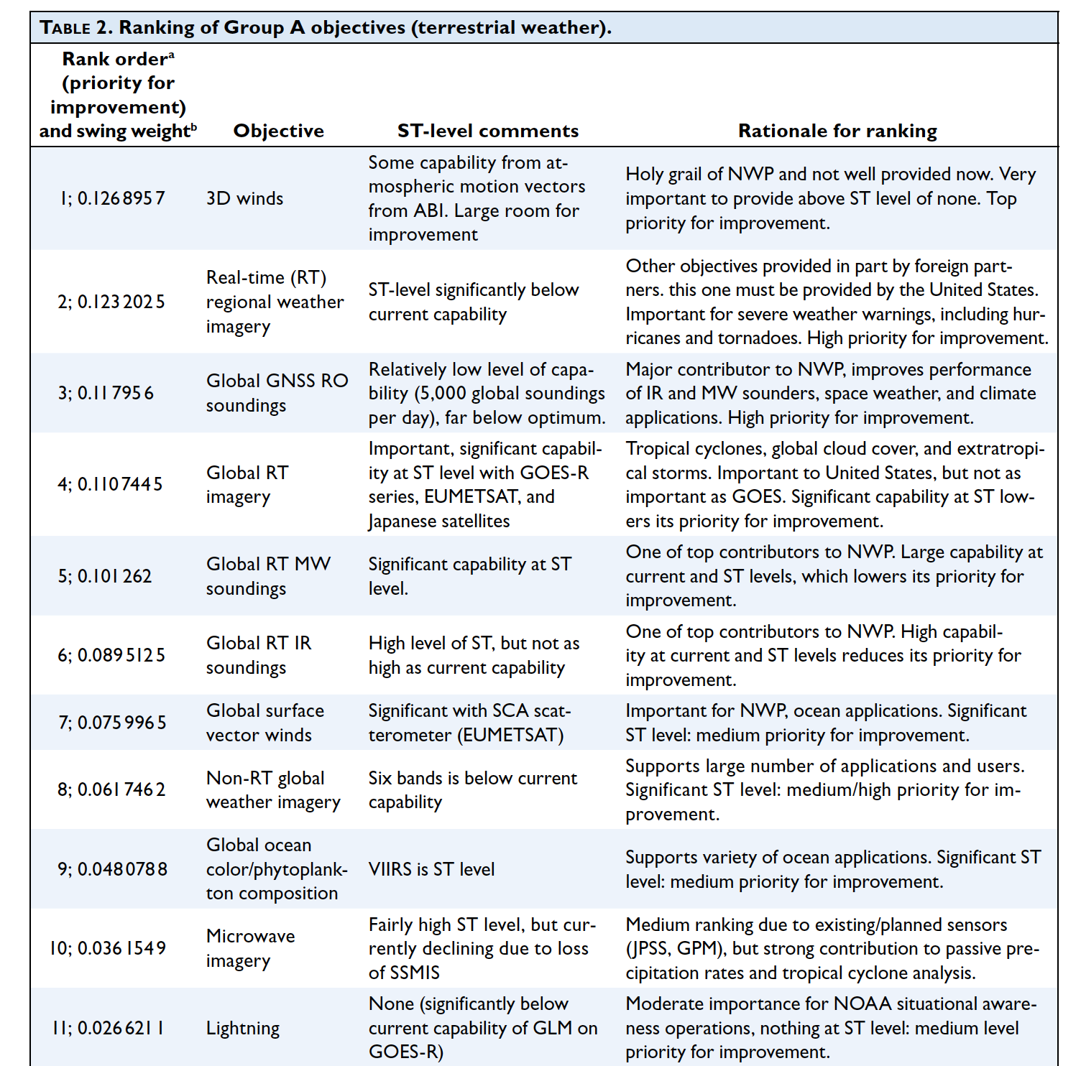
Group A Objectives in priority order with
summary of rationale for ranking (from
BAMS article). First 11 (out of 19) only.

Slide 12
Extra slides for backup

Slide 13
SPRWG Charge
Determine needs and relative priorities for weather, space weather and environmental remote sensing space-based observations in the epoch of 2030 in support of the NSOSA (NOAA Satellite Observing System Architecture) study
Priorities are NOAA operational functions
Develop the Environmental Data Record (EDR) value model (EVM)

Slide 14
SPRWG Membership: NOAA Line Offices, NASA, Academia, and Private Sector
Rick Anthes, Chair (UCAR)
Steve Ackerman (U Wisconsin, CIMSS)
Bob Atlas (NOAA, AOML)
Lisa Callahan (NASA GSFC)
Jerry Dittberner (Consultant)
Rich Edwing (NOAA, NOS)
Pam Emch (Northrop Grumman)
Michael Ford (NOAA, NMFS)
Bill Gail (Global Weather Corp)
Mitch Goldberg (NOAA liaison)
Steve Goodman (NOAA liaison)
Chris Kummerow (CSU)
Terry Onsager (NOAA, NWS, SWPC)
Kevin Schrab (NOAA, NWS)
Chris Velden (U Wisconsin, CIMSS)
Tom Vonderhaar (CSU)
Jim Yoe (NOAA, NWS, NCEP liaison)
Mark Maier (ADT) participated fully

Slide 15
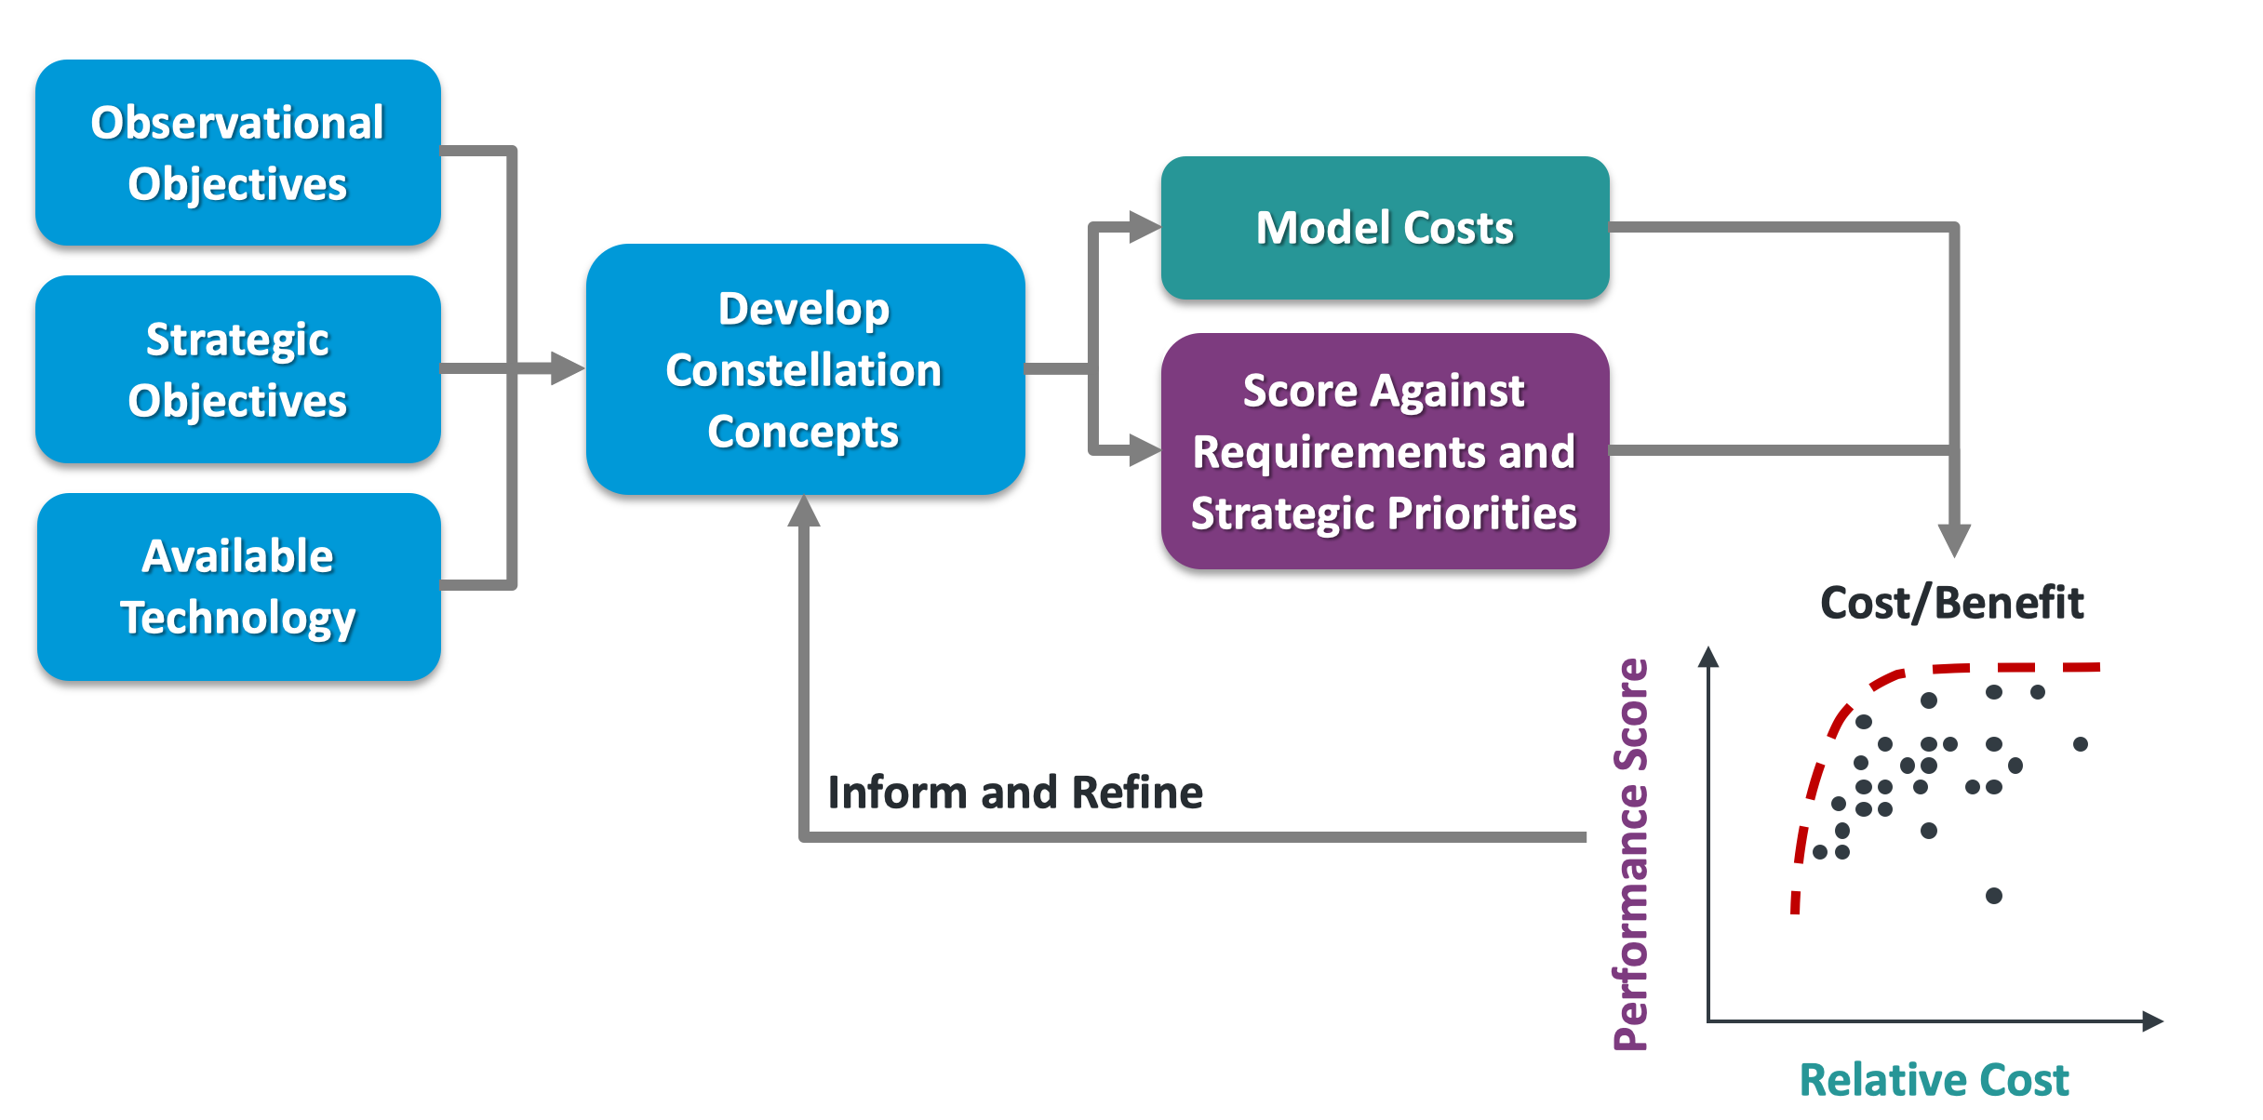
SPRWG Role in NSOSA Process
SPRWG
Architecture Development
Team (ADT)-Mark Maier

Slide 16
Major References
ESA, 2014: The Earth Observation Handbook 2015. 47 pp. [Available online at http://database.eohandbook.com]
WMO, 2013c: Observing Systems Capability Analysis and Review (OSCAR) Tool. [Available online at http://www.wmo.int/oscar/] OSCAR Version 2015-12-12.
NOAA Consolidated Observing User Requirements List (COURL); Version dated Dec 8, 2015. Spread sheet title: “COURL Request 12-08-15_loc.xls” . Most of the space weather objectives used an updated and revised version titled “SWX CORL_SWX_mods20151021.xlsx”.
Many other WMO, ESA, ECMWF, NRC references

Slide 17
Sounding Objectives (all real time)
A5 Global IR
A6 Regional (CONUS) IR
A7 Global MW
A8 Regional (CONUS) MW
A9 Global GNSS RO
Three technologies (IR, MW, and RO) chosen separately because no one technology could meet all the desirable attributes, such as accuracy, vertical resolution, all-weather capability.
Regional and global chosen separately because different orbits (GEO/LEO) necessary to meet desirable attributes.

Slide 18
Example of EVM: THREE SOUNDING TYPES FROM LEO

Slide 19
Use of EVM
Each objective scored for all proposed constellations based on weighted scores of each performance attribute of that objective
Cost of each constellation estimated
Overall score of each constellation plotted against cost in “efficient frontier” diagram

Slide 20
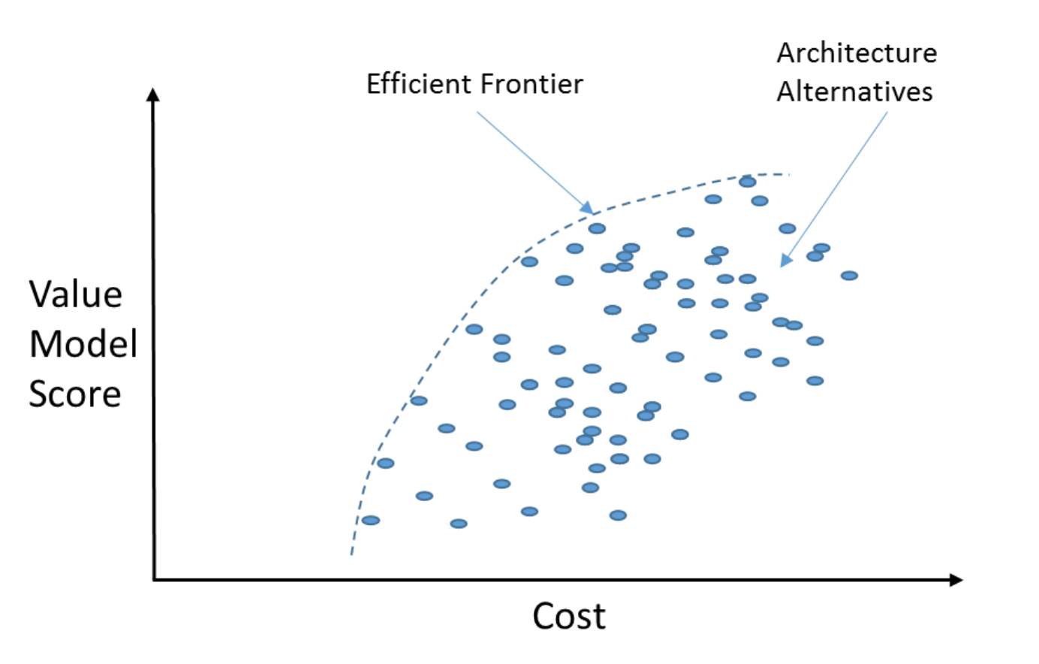
Efficient Frontier Chart-Schematic

Slide 21
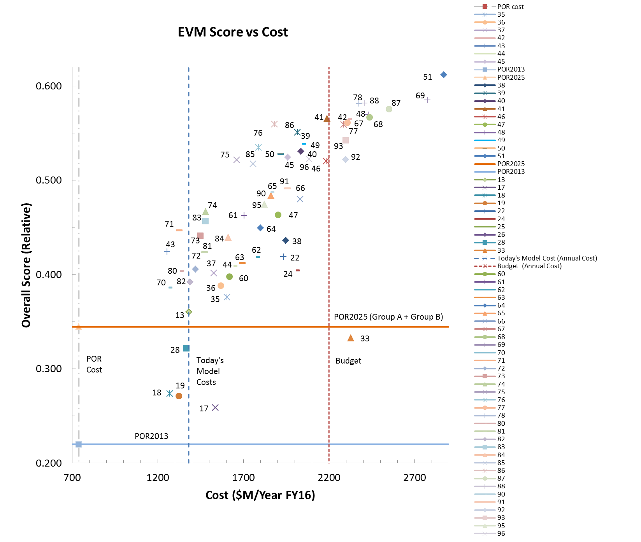
Example of an actual Efficient Frontier Diagram
Source: Mark Maier, ADT
Notes:
Fig. 6-4 From Chapter 6 of draft report. This is for illustration of a real frontier diagram only-I will not explain anything about this except to say that each number represents an specific constellation architecture that was studied.

Slide 22
SPRWG Final Report (May 2017)

Slide 23
September 2019 BAMS article

Slide 24
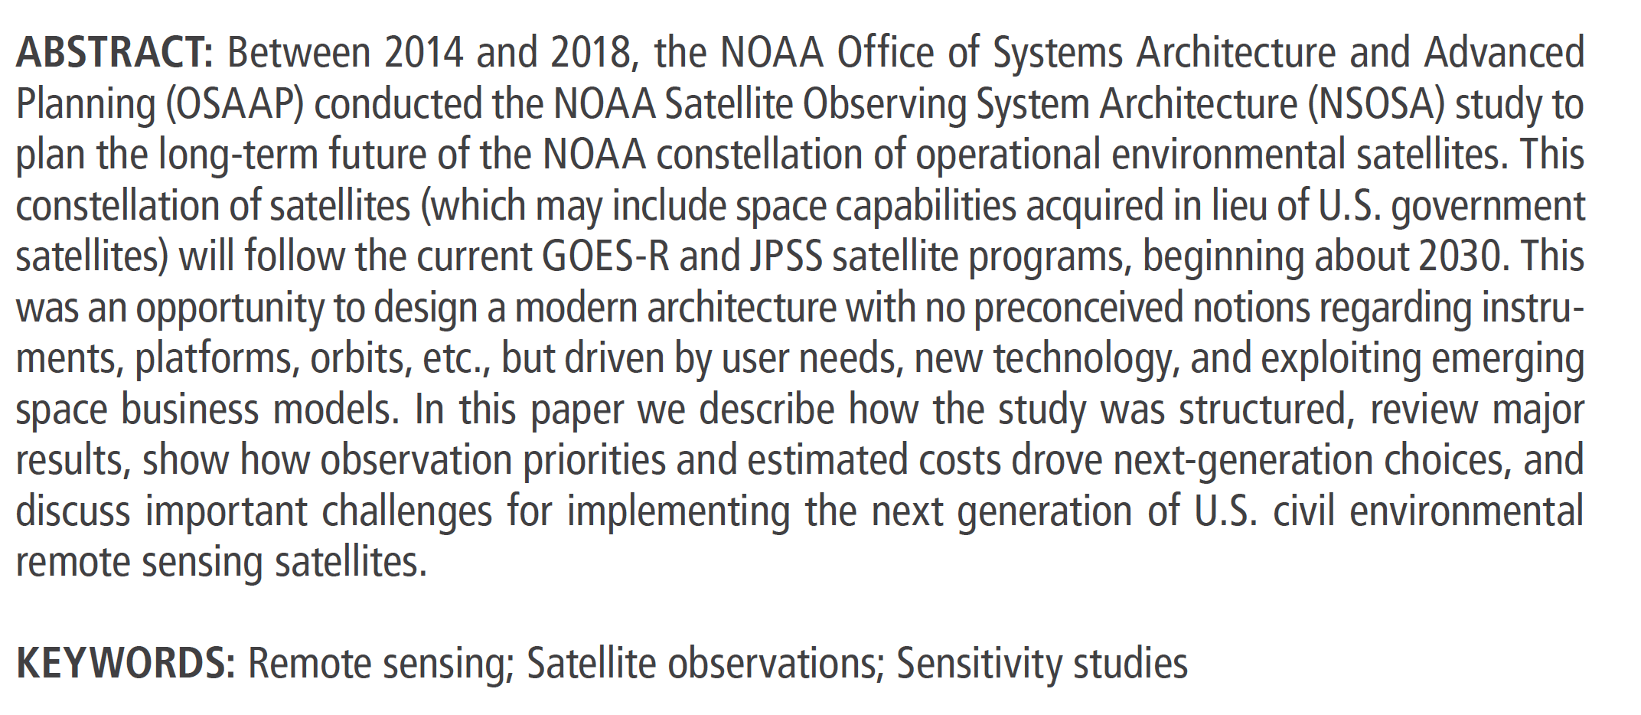
March 2021

Slide 25
References-Multi-Attribute Utility Theory (MAUT)
Decisions with Multiple Objectives: Preferences and Value Tradeoffs, Keeney and Raiffa, Cambridge University Press, 1993. The standard textbook on the theoretical and mathematical foundation of our approach.
Value Focused Thinking: A Path to Creative Decisionmaking, Keeney, Harvard University Press, 1996. Addresses the mixed heuristic and quantitative problems related to the practicality of building good, useful models within the framework of Decision with Multiple Objectives. Keeney points out that no real analysis fails for lack of rigor; it fails for having a poorly conceived model. One must avoid creating a model so rigorous that it collapses of its own weight, but yet still quantitatively captures the most important elements of the problem.
Smart Choices: A Practical Guide to Making Better Decisions, Hammond, Keeney, and Raiffa, Crown Business, 2002. A business school level introduction to both of the above. It emphasizes finding quantitative, but less than rigorous, practical models for decision problems. I recommend it strongly for understanding our approach.

