Slide 1

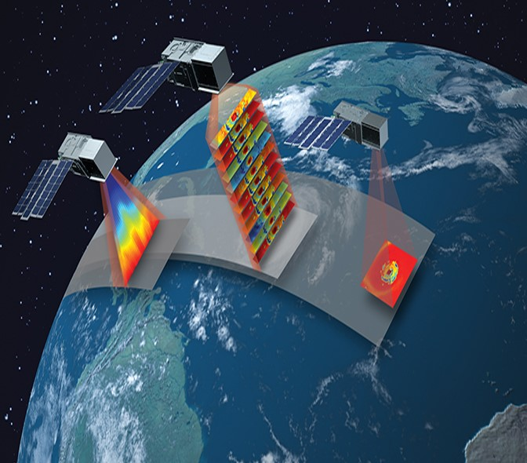
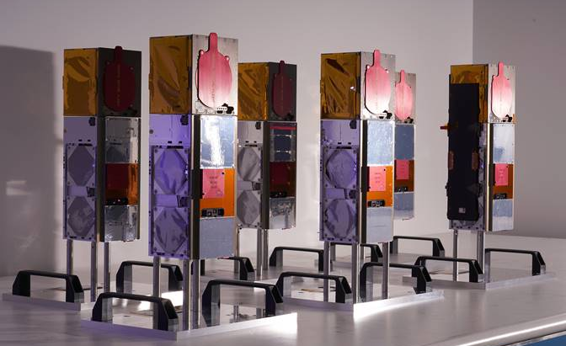








TROPICS: Time-Resolved Observations of Precipitation structure and storm Intensity with a Constellation of Smallsats
NASA Earth Venture Program led by MIT LL
  Principal Investigator: Dr. William J. Blackwell
  Project Scientist: Dr. Scott A. Braun (NASA GSFC)
  Innovative solution to provide temperature, moisture, and precipitation data for tropical cyclone studies
Constellation of six 3U cubesats
  2U spacecraft bus from Blue Canyon Technologies
  1U microwave radiometer payload from MIT LL
Momentus to provide Pathfinder launch in June 2021
Astra to provide three launches in first half of 2022
Notes:
Overview of TROPICS program

Slide 2

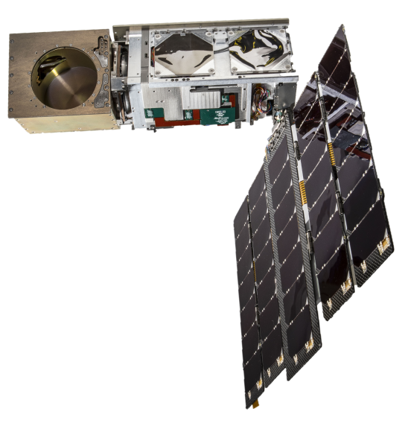
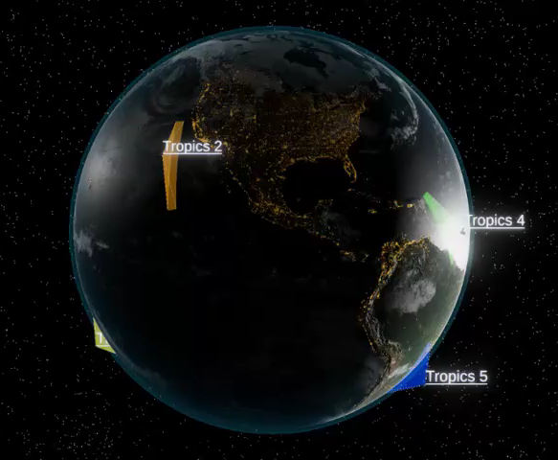
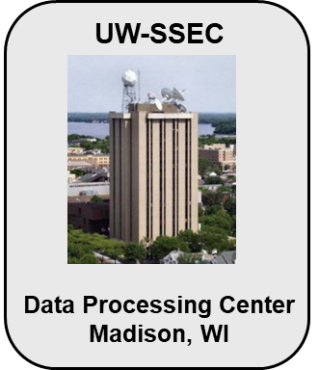
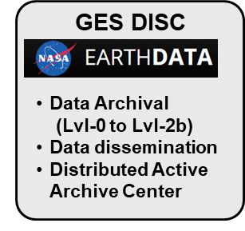
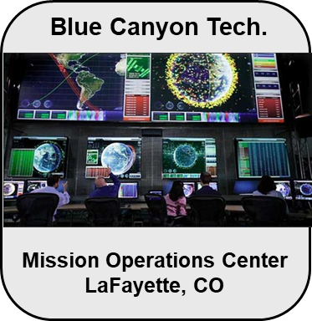
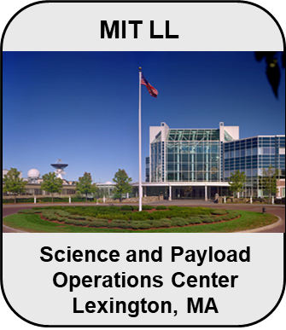
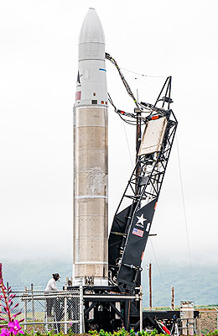
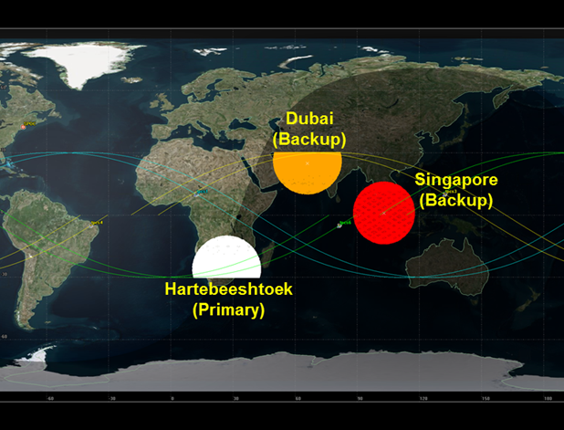
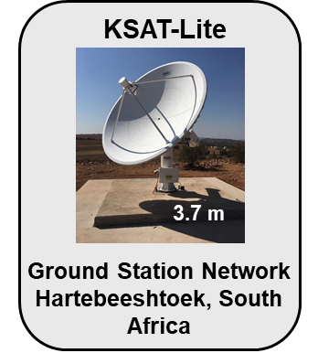
TROPICS Mission Overview
550 km 30° inclination
3U CubeSat: 10 cm x 10 cm x 36 cm
Mass: 5.4 kg
Blue Canyon Technologies bus
LL passive millimeter-wave payload
S-band Innoflight radio
Deadshot
Astra Space was awarded three launches from Kwajalein Atoll into three orbital planes
Mission has six CubeSats with a year-long science operations
Launch window is Jan. 8 to July 31, 2022 (all three within 120 days)
Better than 60-min. media revisit rate
Astra Rocket 3.1
TROPICS Ground Station Network

Slide 3



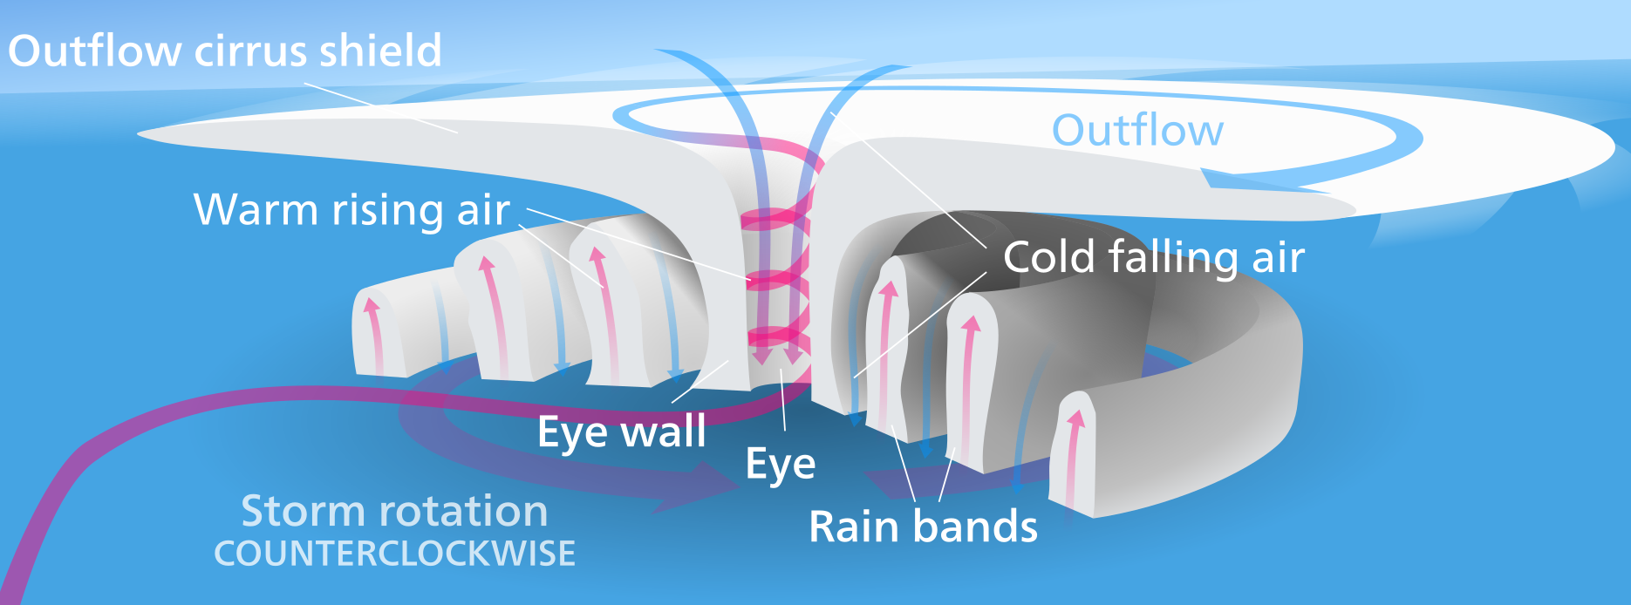


TROPICS Science Objectives and Team
Radiance Calibration and Validation
Temperature and moisture profiles
Improved Tropical Cyclone Forecasting
Tropical Cyclone Intensity
Precipitation

Slide 4
TROPICS Channel Set
TROPICS Chan. | Center Freq. (GHz) | Bandwidth (GHz) | RF Span (GHz) | Beamwidth (degrees) Down/Cross | Nadir Footprint Geometric Mean (km)* | Measured NEdT (K)
1 | 91.656 ± 1.4 | 1.000 | 89.756-90.756, 92.556-93.556 | 3.0/3.17 | 29.6 | 0.66
2 | 114.50 | 1.000 | 114.00-115.00 | 2.4/2.62 | 24.1 | 0.96
3 | 115.95 | 0.800 | 115.55-116.35 | 2.4/2.62 | 24.1 | 0.82
4 | 116.65 | 0.600 | 116.35-116.95 | 2.4/2.62 | 24.1 | 0.86
5 | 117.25 | 0.600 | 116.95-117.55 | 2.4/2.62 | 24.1 | 0.79
6 | 117.80 | 0.500 | 117.55-118.05 | 2.4/2.62 | 24.1 | 0.81
7 | 118.24 | 0.380 | 118.05-118.43 | 2.4/2.62 | 24.1 | 0.90
8 | 118.58 | 0.300 | 118.43-118.73 | 2.4/2.62 | 24.1 | 1.03
9 | 184.41 | 2.000 | 183.41-185.41 | 1.5/1.87 | 16.9 | 0.58
10 | 186.51 | 2.000 | 185.51-187.51 | 1.5/1.87 | 16.9 | 0.55
11 | 190.31 | 2.000 | 189.31-191.31 | 1.5/1.87 | 16.9 | 0.53
12 | 204.8 | 2.000 | 203.8-205.8 | 1.35/1.76 | 15.2 | 0.52

Slide 5


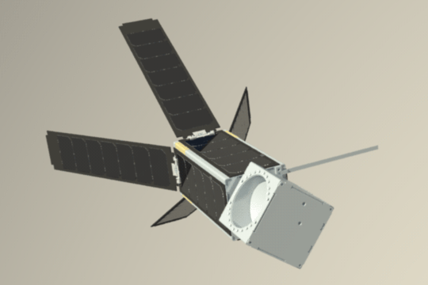
Scan Profile for TROPICS
Lunar and Solar Keep out
Rotation rate is 30 RPM (2 sec. period)
81 Earth Sector samples per scan
10 samples each in Space & ND Sectors
Integration time: 8.333 msec (1/120 second)
Spatial Information (at 550 km):
  Beamwidth (FWHM):
    W-band 3.0° DT (3.2° CT)
    F-band 2.4° DT (2.62° CT)
    G-band 1.5° DT (1.87° CT)
    Sample spacing: 1.5°
  Swath: ~2000 km
  Nadir footprint diameter
    W-band: 26-km DT, ~28-km CT
    F-band : 22-km DT, ~24-km CT
    G-band : 13.1-km DT, ~17.1-km CT
Both Cal. Sectors ~60º
Noise Diode Sector
Noise Diode Warmup
Deep Space Sector
Solar Array Keep Out
Index Pulse
interrupt
@ 0.0º
End Earth
acquisition
@ 330.0º
Earth Sector
(0 ± 60°)
Start Earth
acquisition
@ 210.0º
Noise Diodes Off
Earth
DT = down track CT = cross track

Slide 6
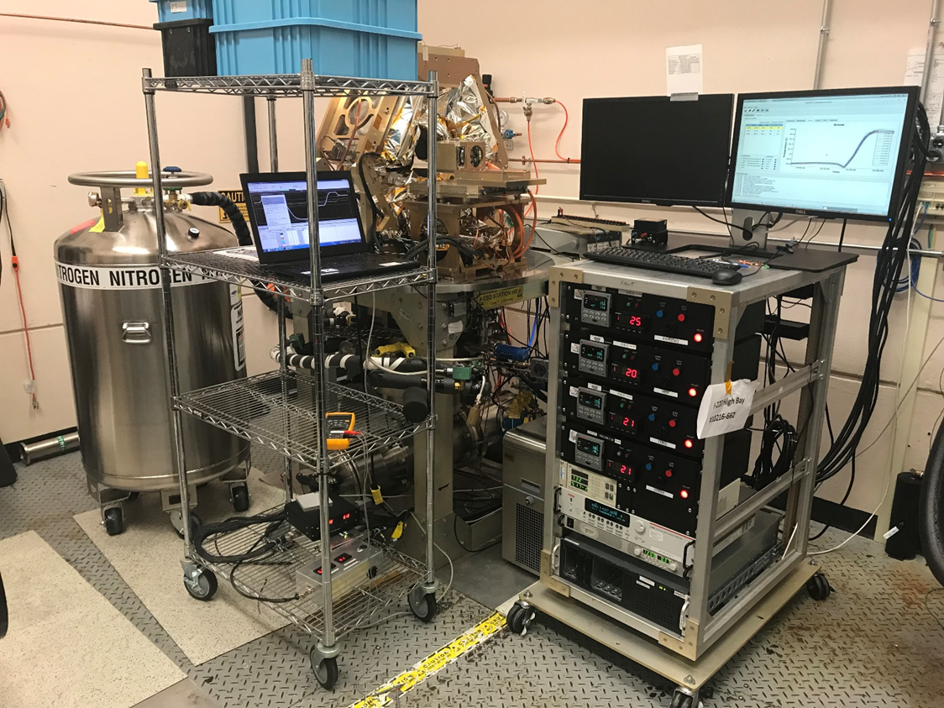
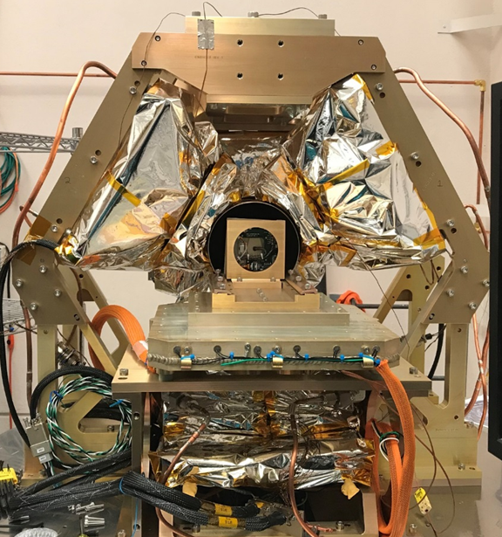
TVAC Radiometric Calibration
Calibration equipment allows detailed assessment of sensitivity, stability, and absolute accuracy
Noise diode assemblies are pre-screened at the component level
Notes:
In addition, I believe our calibration will be better than that of the high-dollar NOAA weather satellites, as we can calibrate with the entire satellite present.

Slide 7
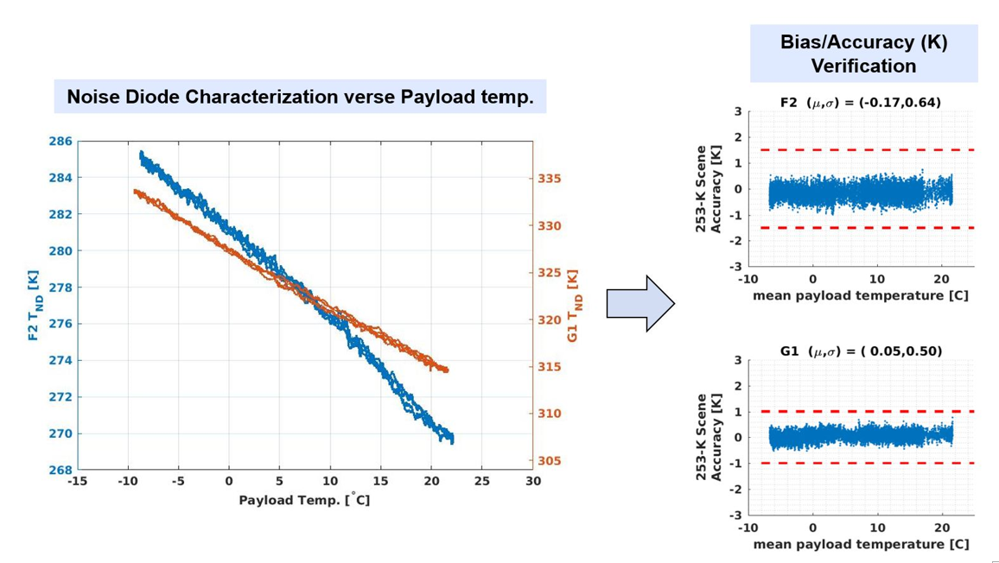
TVAC Calibration Permits
“Test As You Fly” Characterization

Slide 8
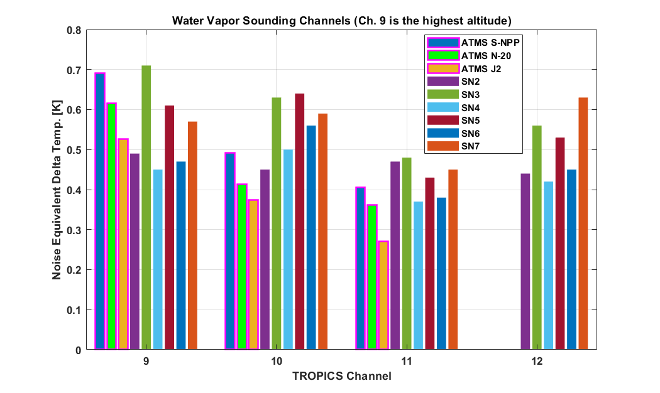
TROPICS Water Vapor Radiometer NEDT Performance
Comparable to ATMS

Slide 9
TROPICS Products and
Expected Performance
Product | Threshold Requirement (Uncertainty) | Baseline Requirement (Uncertainty) | Expected Performance (CBE) (Uncertainty)
Temperature Profile | 2.5 K | 2.0 K | 1.603 K
Moisture Profile | 35 % | 25 % | 17.15 %
Rain Rate | 50 % | 25 % | 18.3 %
Min Sea-Level Pres. | 12 hPa | 10 hPa | 7.8 hPa
Max Sustained Wind | 8 m/sec | 6 m/sec | 5.3 m/sec
Favorable performance achieved with multiple datasets and multiple retrieval algorithms.
One-year science collection period

Slide 10
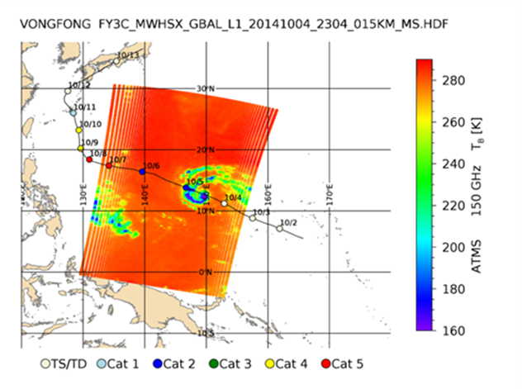
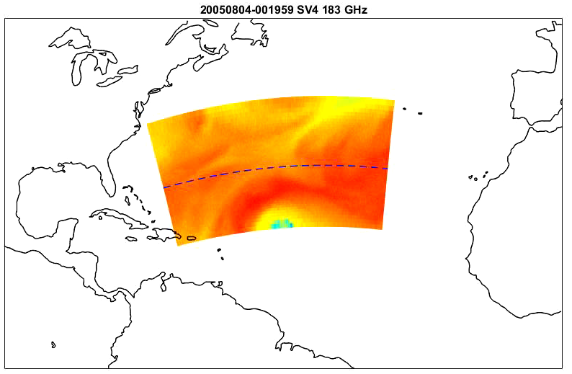
Analysis of Proxy Datasets to Assess and Optimize Performance
Proxy data was developed using modeled data from a Hurricane Nature Run (HNR) and the FY-3C MWHS-2 instrument
Proxy 1: HNR is a simulated TC dataset that match the spatial, temporal, and spectral frequency of planned satellite architecture in TROPICS mission data format
Proxy 2: FY-3C dataset is a collection of measured TC radiances from MWHS-2 that has similar bands (90, 118, & 183 GHz) to TROPICS, but slightly different spatial, noise, and spectral characteristics
The two proxies complement each other by balancing simulation errors and differences in hardware performance
Proxy datasets are available to the TROPICS Science Team and public user community
  HNR: https://www.nsstc.uah.edu/tropics/get_involved.html
  FY-3C: contact Prof. Bennartz at ralf.bennartz@vanderbilt.edu
Image from FY-3C MWHS of Typhoon Vongfong
Simulated TROPICS data derived from the Hurricane Nature Run showing temporal resolution of data

Slide 11
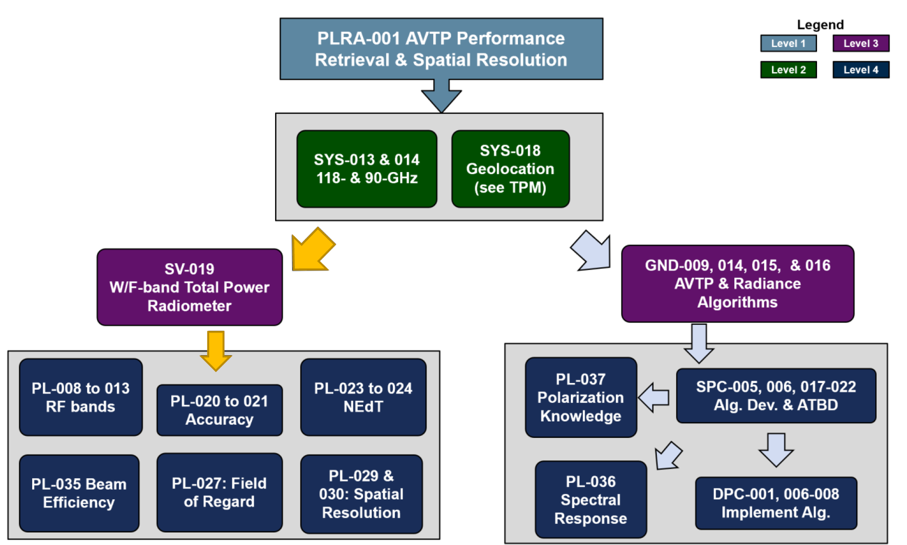
Requirements Verification

Slide 12
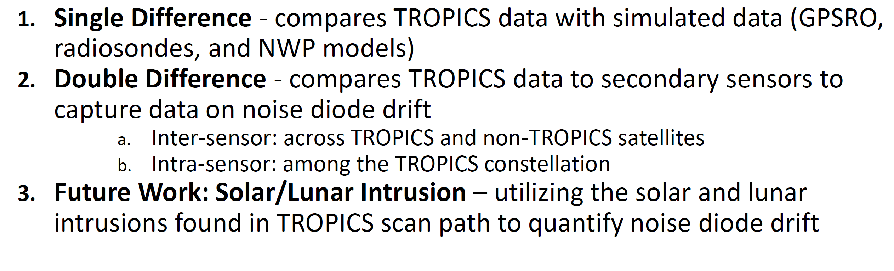
On-Orbit Calibration/Validation Radiance Comparisons

Slide 13
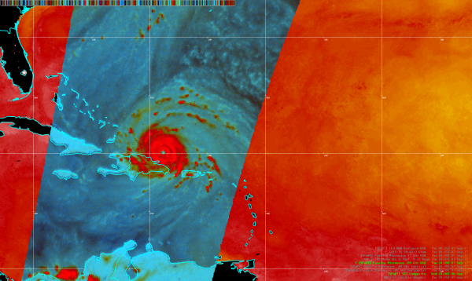
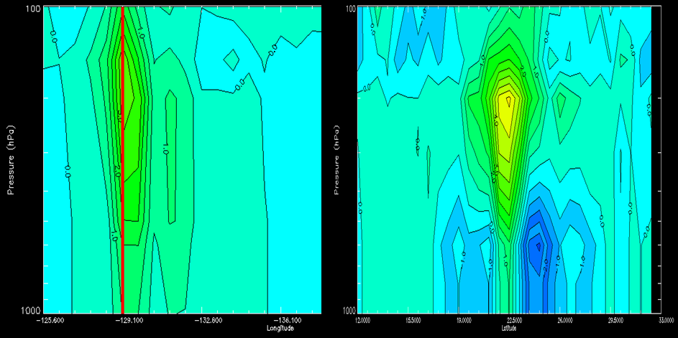
Tropical Cyclone Analysis and Nowcasting
Provide mission observations and imagery to operational hurricane forecasters who rely on satellite data to diagnose storm structure
Integrate data into decision maker decision support tools (e.g., N-AWIPS at NHC; upper right)
Application areas:
  Storm intensity through structure (lower right)
  Detection of warm core evolution
  Detection of eyewall replacement cycles
  Dry/Moist air penetrations
Data frequency requirements from 30 to 60 minutes; data latency requirements less than 1 hour (over 3 hours less useful in operations)
Potential users: NHC, JTWC, CPHC, Regional Specialized Meteorological Centers (Fiji, Australia, Tokyo, Delhi, Reunion)
Image: Derrick Herndon (U. Wisc. CIMSS
AMSU
ATMS

Slide 14
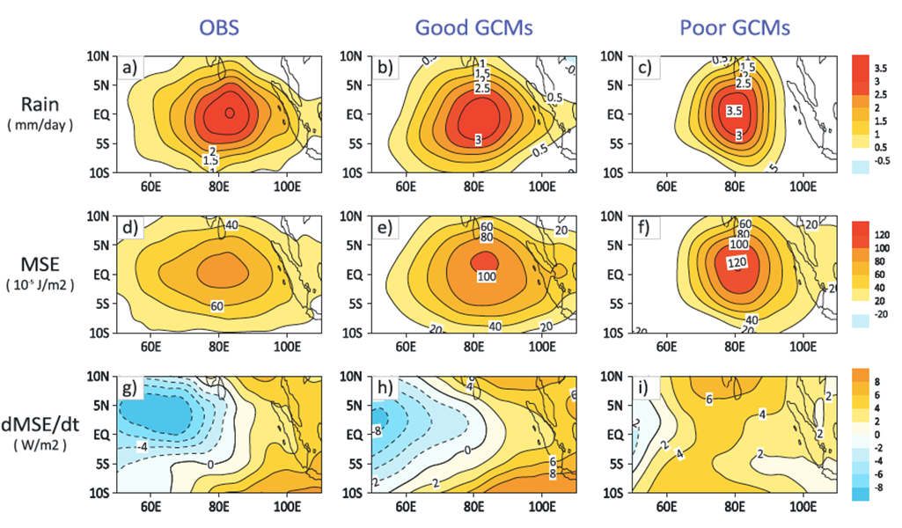
Tropical Dynamics
Applied research by scientific community to determine convective extremes that are not resolved well enough with current temporal frequency
Details can feed back into identification of season trends in precipitation, severe storms, and tropical convection
Application areas:
  Equatorial Kelvin and Rossby waves
  Madden-Julian Oscillation (right)
  Location and frequency of convection
  Saharan Air Layer
Data frequency requirements from 0.5 - 3 hours; data latency requirements from 3 – 6+ hours
Potential users: R2O/O2R groups like SPoRT and SERVIR to translate scientific results into usable products for weather and seasonal forecasting with multiple end users, training groups like ARSET and COMET
Image from Jiang et al. (2017) http://dx.doi.org/10.1002/2016JD025955

Slide 15
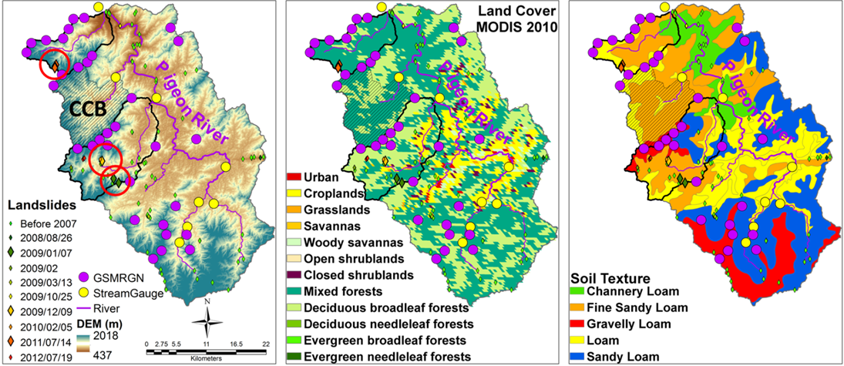
TROPICS Terrestrial Applications
High-temporal resolution precipitation data can supplement tropical regions without ground-based radar coverage
Desire to integrate these observations into other global precipitation analysis products (e.g., GPM IMERG)
Application areas:
  Detection, monitoring, forecasting, and warning of floods and landslides (right)
  Monitoring and forecasting for water accounting, agriculture, human consumption, and ecosystems
  Regional hydrometerological forecasting through data assimilation of moisture and temperature profiles into atmospheric models that drive hydrological and crop models
Data frequency requirements from 0.5 - 3 hours; data latency requirements from 0.5 - 6 hours
Potential users: U.S. Army Corps of Engineers, international agriculture, hydrologic modeling, reinsurance, USAID, World Bank, Global Flood Partnership, U.N. agencies, Red Cross
Image: Ana Barros (Duke University)

Slide 16
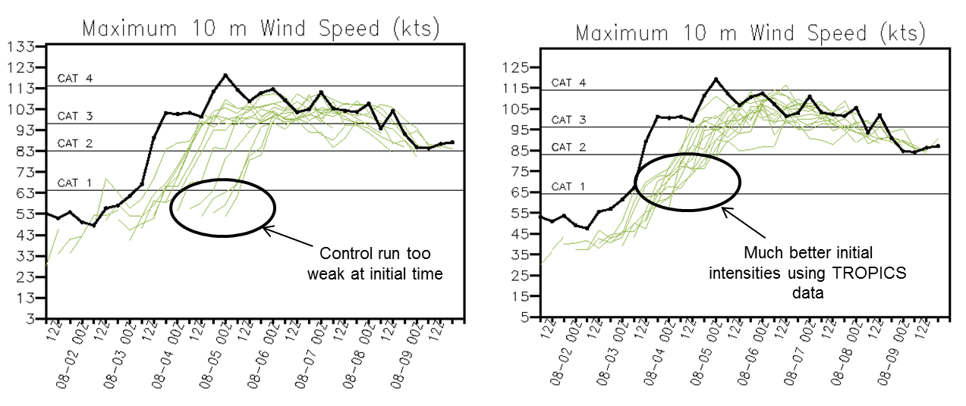
Tropical Cyclone Modeling and Data Assimilation
Assimilation of clear-sky passive microwave observations have the large impact on improving forecast track and intensity errors over the last 20 years but temporal frequency of data have not allowed for improved forecasts of inner core dynamics
OSSE studies have shown improved initial intensity with assimilation of simulated observations (below)
Application areas:
  Development of forward operators, bias correction, error covariances, and quality control
  Integration into global (GFS; ECMWF) and regional (HWRF) numerical modeling systems
Data frequency requirements of 30 – 60 minutes; data latency requirements from 2 - 6 hours depending on assimilation strategy
Potential users: NOAA/NCEP/EMC, NASA GMAO, MeteoFrance, UK Met Office, ECMWF
Control (no TROPICS)
With TROPICS
Image: Ana Barros (Duke University)
Figure: Bachir Annane (FIU; NOAA/AOML)

Slide 17
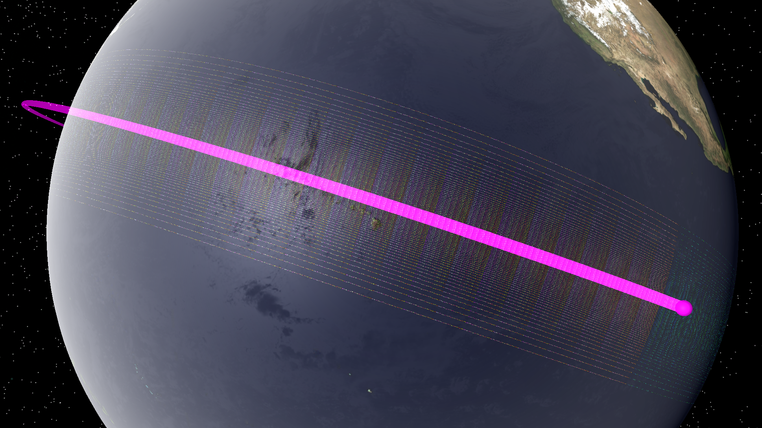
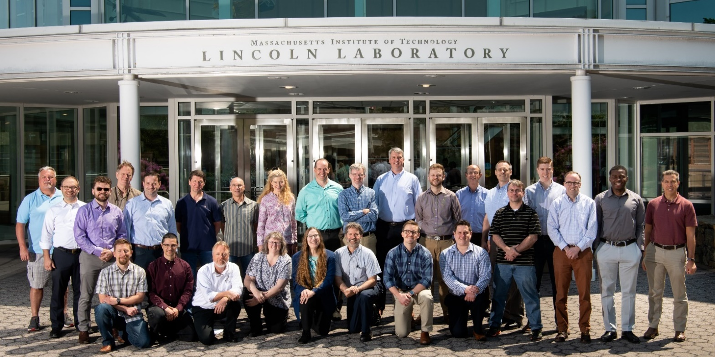
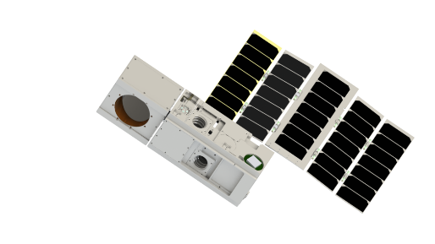
Questions?

