Slide 1
CIRA Feedback on NOAA Ground architecture planning
Andrew Jones with thanks to many at CIRA, especially…
Heather Cronk and Phil Partain
Cooperative Institute for Research in the Atmosphere (CIRA)

Slide 2
Outline
CIRA Large-Scale Cross-platform Examples
Hardware acceleration considerations (CEPH, CUDA)
Kubernetes/containers
Distributed Python (AsyncIO)
GitHub/GitLab use for code exchange/test/deployment
Tactical issues / Concluding Thoughts

Slide 3
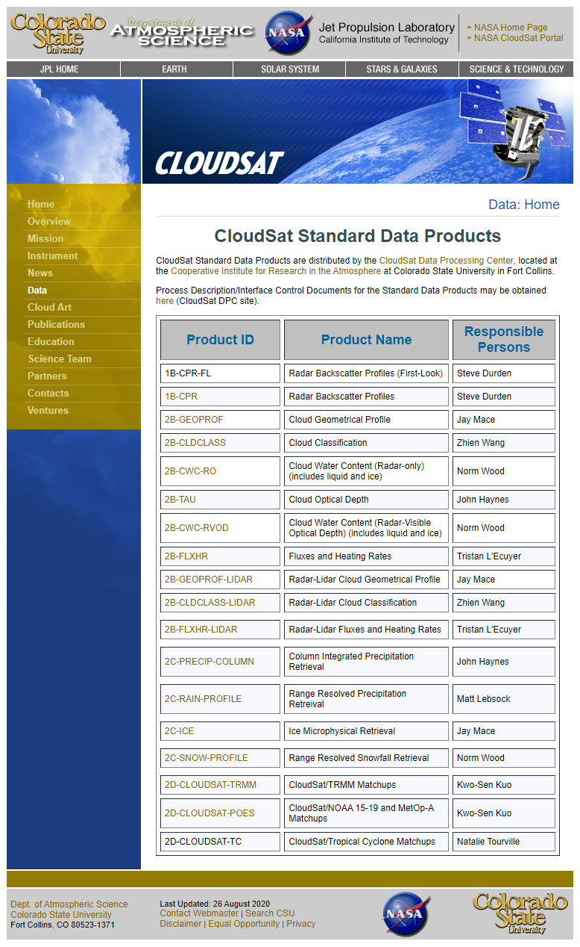
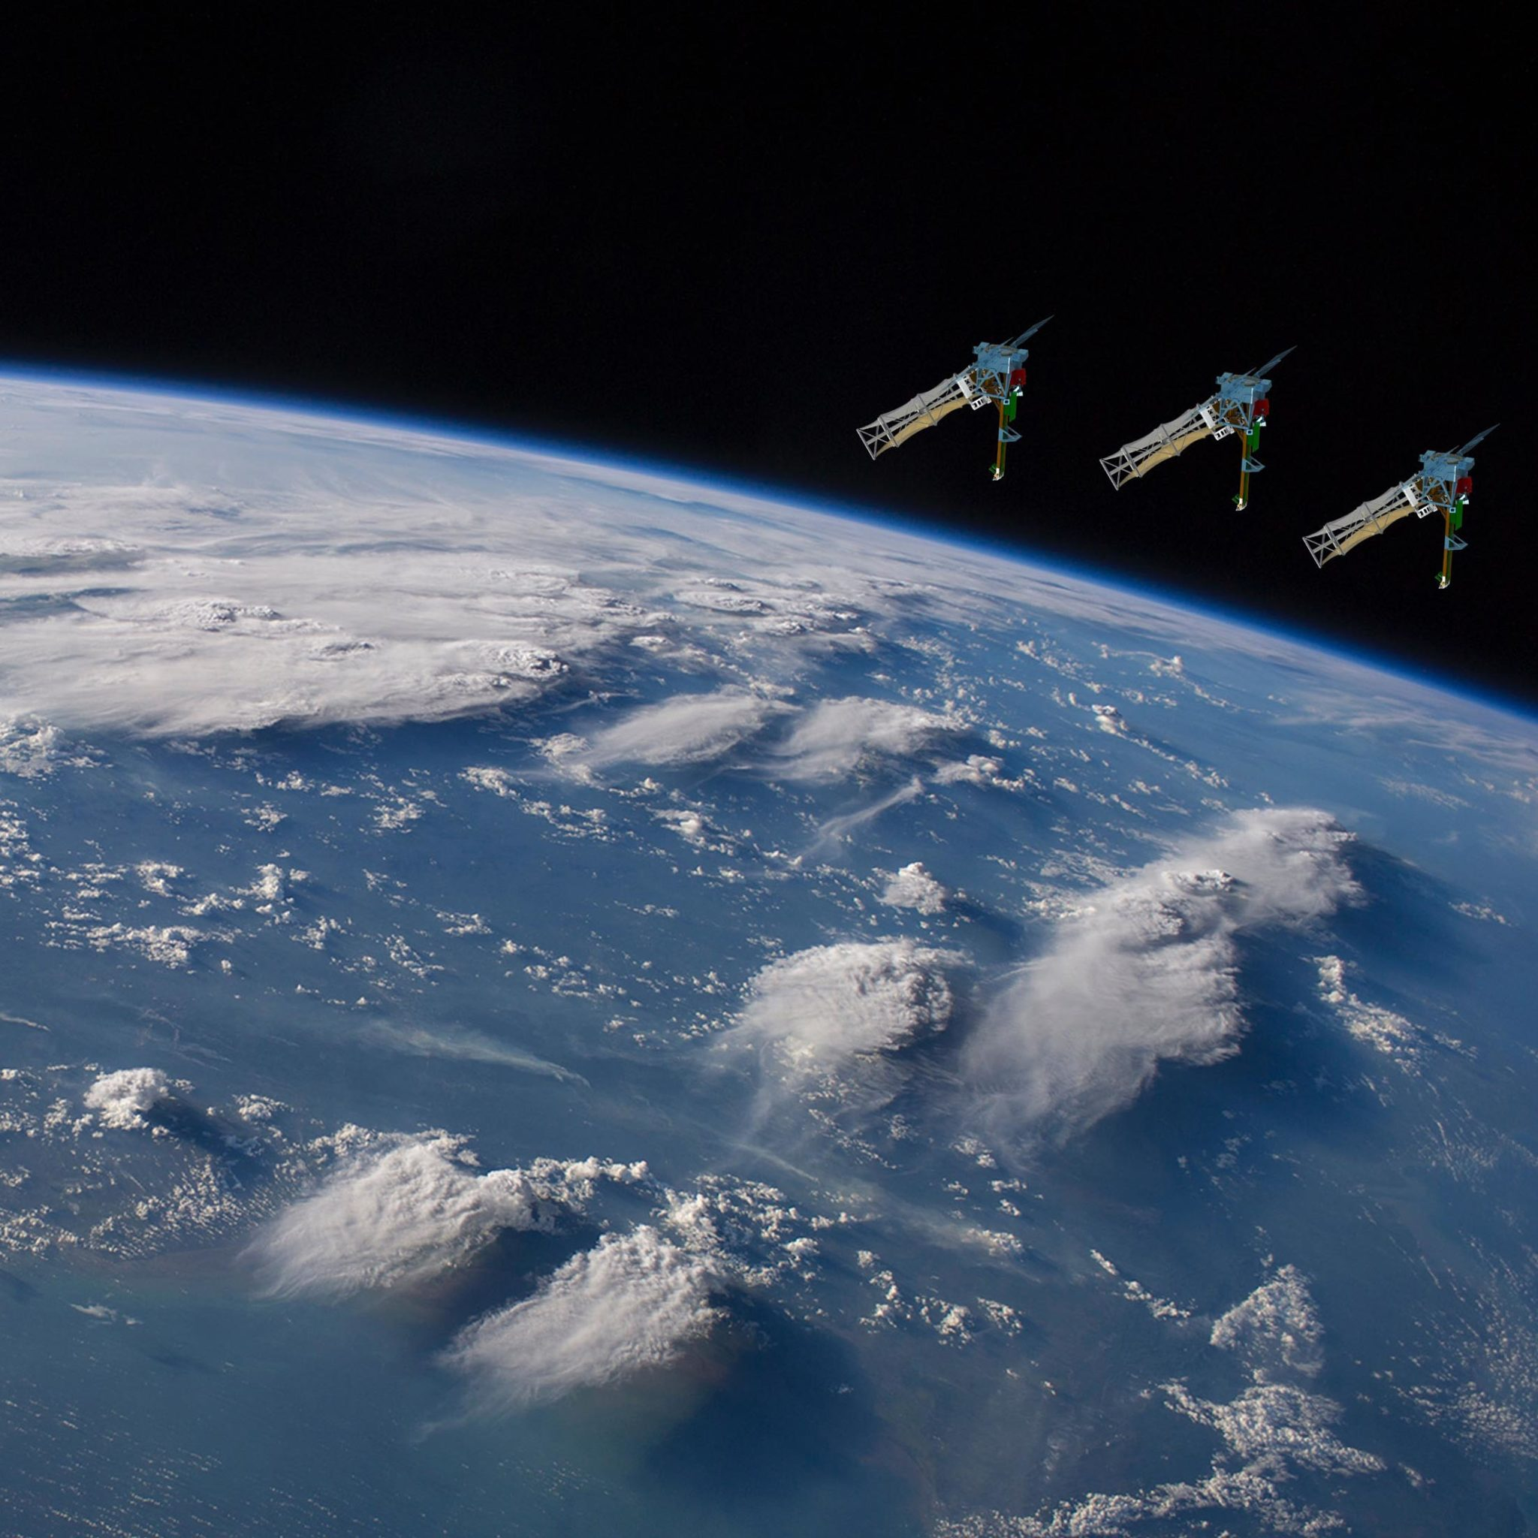
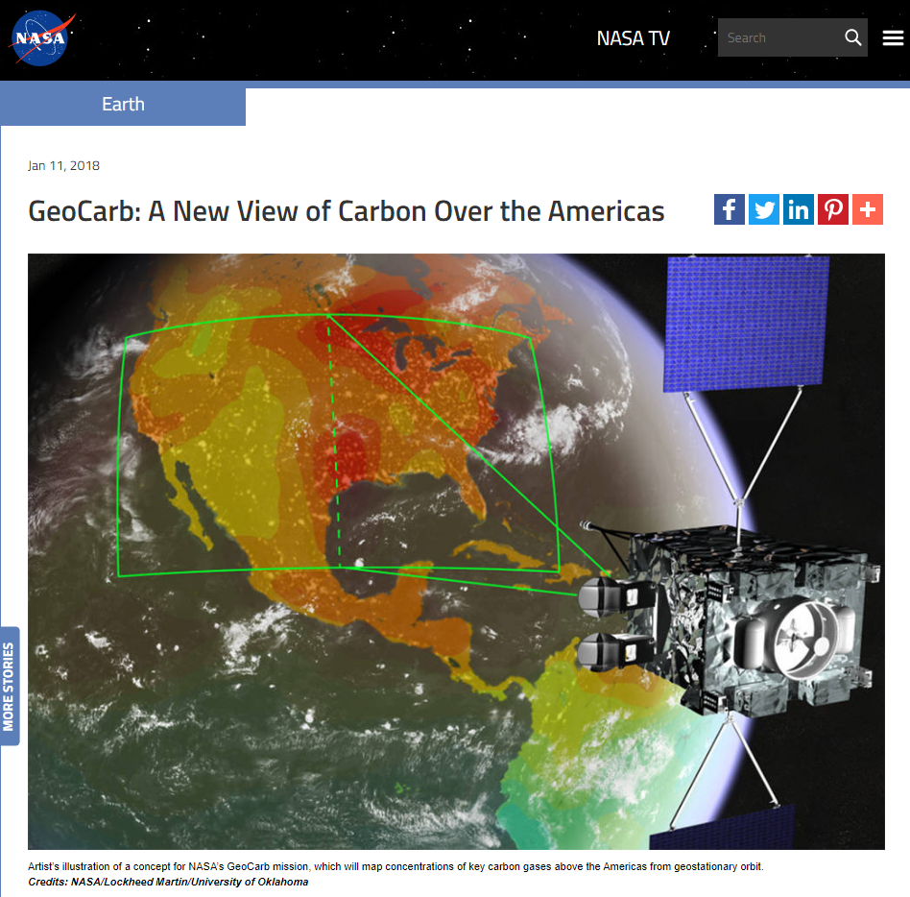
CIRA+NASA Large-Scale Examples
Polar in the A-train - CloudSat Data Processing Center https://cloudsat.atmos.colostate.edu – Launched in 2006
Geo – GeoCarb – (linked closely to OCO-2) – Launch 2024 https://www.ou.edu/geocarb/mission
Small Sats (3) – INCUS – Launch 2027 – based on Tempest-D radiometer / with precip. radar (RainCube) (INCUS = Investigation of Convective Updrafts)
INCUS

Slide 4
Hardware Acceleration Considerations
CEPH – Open, massively-scalable software-defined data storage – using a heterogeneous mix of distributed storage
Results in considerable performance improvements, simplifications, good redundancies, and cost savings
Used in many large CIRA data processing efforts
CUDA Compilers – Hardware Graphics Acceleration using GPU processors
Used mostly for ML/AI algorithm work
Issue: Portability issues – most cloud environments support CUDA workloads, however, CIRA runs many CUDA codes on special local GPU hardware enabled machines – usually on very high memory machines with access to special large data
Issue: CUDA Development requires massive input data sets – it is currently infeasible for CIRA to host all possible input data sets at a NOAA cloud facility without incurring very large costs. Some input data approach or exceed 1 PB in size and are unique to the developers. Currently universities incur significant additional ingress/egress data charges to cloud facilities, even if all NOAA provided data is free.
However, other more common NOAA-provided data inputs could be hosted within a NOAA cloud for cost-effective CUDA/GPU-based development – but many times mixed (i.e., “NOAA+non-NOAA”) datasets are required
We expect use of these methods to continue grow, however billing/adequate project reimbursement for cloud-based facilities remains a challenge (BIG DATA (can mean) = BIG COSTS)
Unique hardware-driven solutions may require specially identified NOAA project $ allocations
No single solution exists – Special plea: the simpler massive general distributed computing should not be convolved with the specialized CEPH/CUDA needs. The NOAA cloud should solve many more problems than it makes.

Slide 5
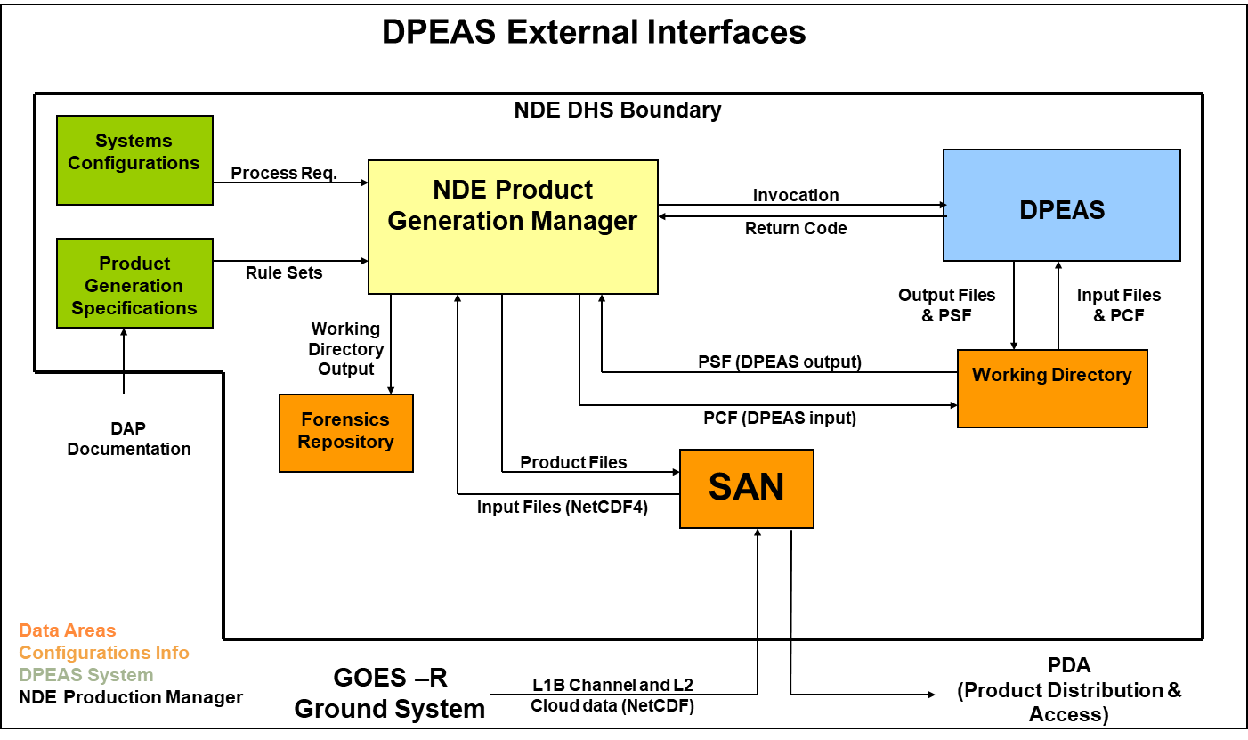
Example of a Blended Cross-Platform Product (~8 satellites) Generation within the current NOAA NDE Framework
The key is that all data are controlled by a unified and consistent coding framework, in this example it’s DPEAS, with it’s common set of software tools for merging and analyzing data
CloudSat DPC makes use of the cloudsat “core” libraries for a consistent set of tools
GeoCarb / INCUS will likewise have a “set” of helper tools – derived from the CloudSat experiences
Such sets of tools are easily shared to user communities for wide adoption
Tools such as these can live within a NOAA-cloud “container” for easy use by others
Compilation tools can be pre-configured for independent user development
Some users may require more help than others
All of these tools make heavy use of HDF-EOS and/or netCDF data file formats
From the Blended TPW/RR Metop-C ARR 2021

Slide 6
Kubernetes and Containers – What’s a Container?
Containers run as an isolated process on a host
Isolated file systems, separate networking stack
Shares kernel with host and other containers
Guest OS must be compatible with the host OS (Linux on Linux, Windows on Windows)
Light footprint, no performance hit
Makes one server look like multiple servers
Process isolation, eliminates conflicts
Portable, consistent runtime environment
Reduced hardware cost, maximizes resource use
https://blog.netapp.com/blogs/containers-vs-vms/

Slide 7
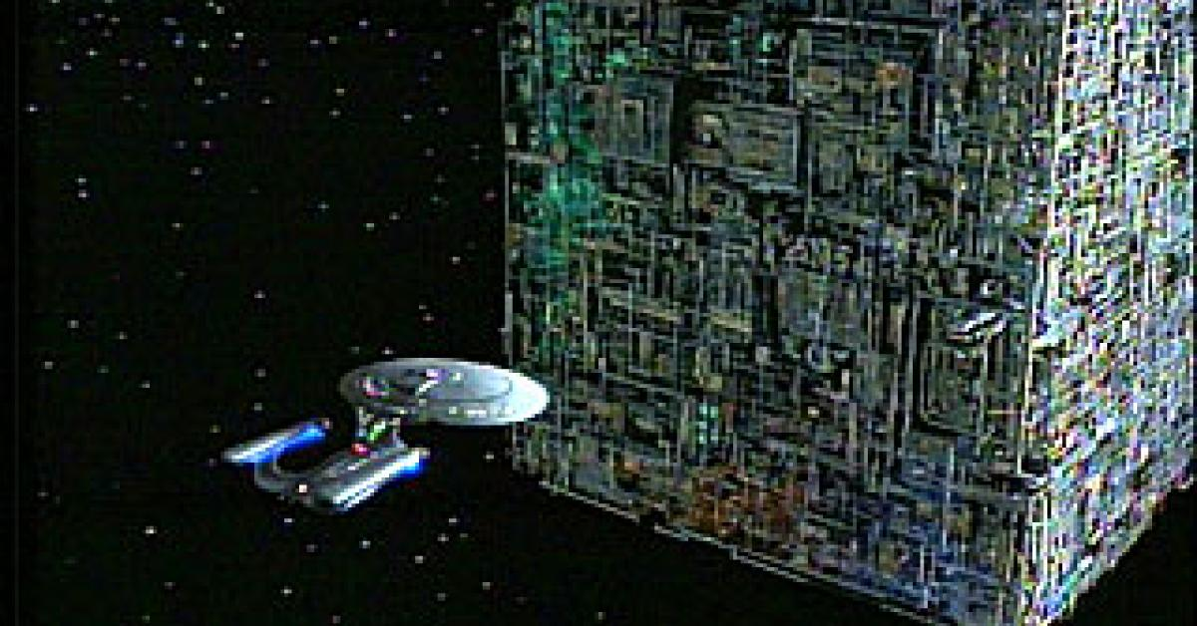
What Does Kubernetes Provide?
An API to configure and deploy containers
A general compute resource
Horizontal autoscaling
High availability for containers and Kubernetes itself
Role Based Access Control (RBAC)
Isolated namespaces
Service discovery
Rollbacks
A complex system with a steep learning curve
It’s intimidating

Slide 8
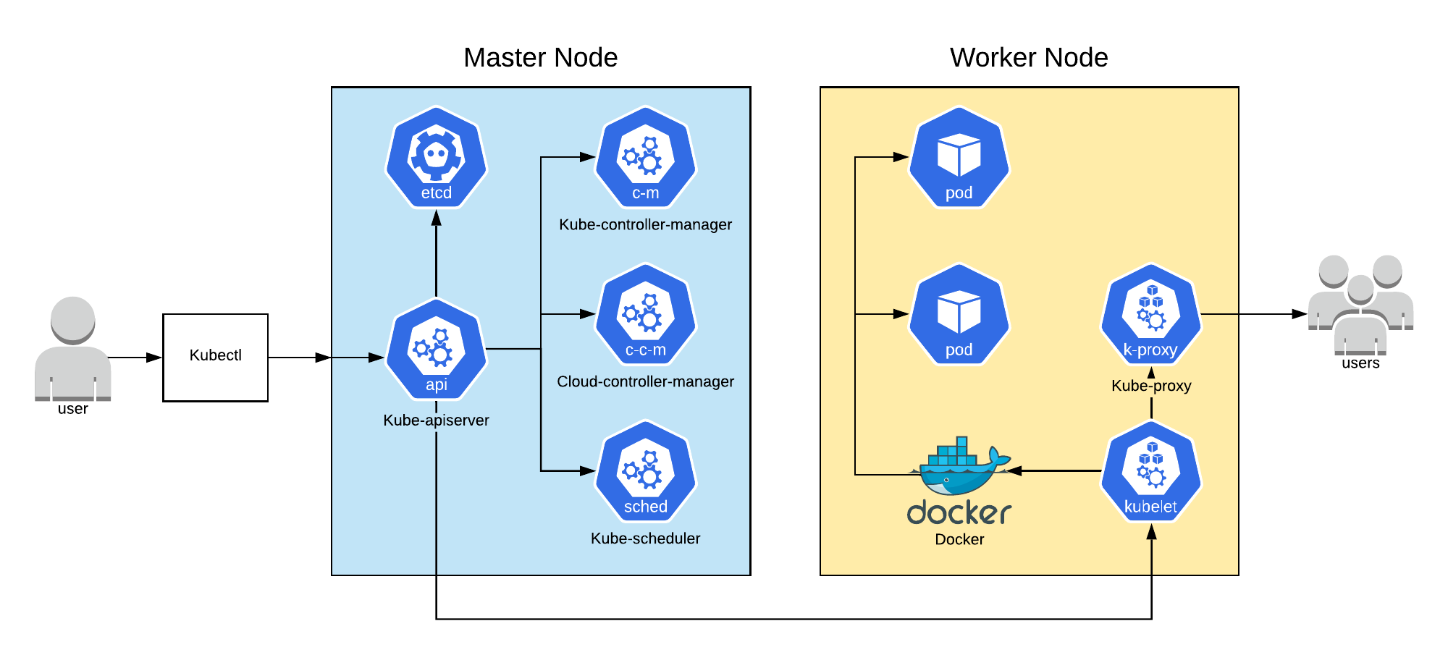
Kubernetes Architecture
Coordinates cluster activities
Where your applications run
Communicates with the worker nodes
Manages application deployment and scheduling
Generic compute resources
Can set up multiple masters in High-Availability (HA) mode (need an odd number for quorum)
Notes:
The Master Node coordinates cluster activities and communicates with the worker nodes to keep Kubernetes applications running
Manages the deployment and scheduling of the application across the nodes
Can set up multiple masters in High-Availability (HA) mode (need an odd number for quorum)
Assigns nodes to pods based on the resources and
predefined constraints. Sends instructions to the nodes
via the...

Slide 9
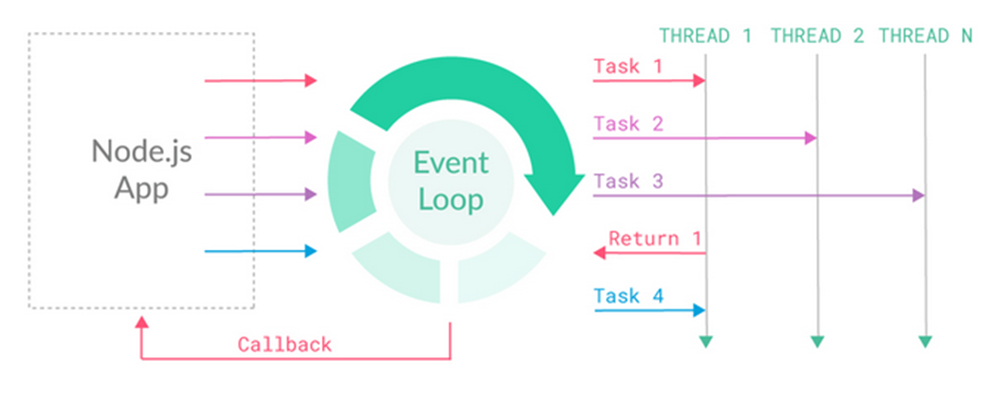
Distributed Processing – E.g., AsyncIO Python
Standardization and sharing of libraries that automate distributed processing
Python AsyncIO is an emerging example of this standardization process
Our CIRA-developed Data Processing and Error Analysis System (DPEAS) running at NOAA for the Blended Hydro Products makes use of distributed processing, many other NOAA production systems do as well – it would be good to standardize the process distribution to allow NOAA to orchestrate job distribution on the cloud.
AsyncIO may be a such a tool that may be more suitable to large IO jobs than MPI-codes.
Experimentation at CIRA is ongoing.
https://docs.python.org/3/library/asyncio.html
From https://nexocode.com/blog/posts/behind-nodejs-event-loop/

Slide 10
GitHub/GitLab for code exchange/test/deployment
Both GitHub and GitLab are extensively used for
Code exchange by science teams
Code tests – including extensive automation
Code deployment
Code updates / hot fixes
There are GitHub/GitLab automation tools to make the tools talk to each other
Not all users may wish to be as vested in the Continuous Integration / Continuous Delivery (CI/CD) deployment strategies
At CIRA we routinely buffer our scientists from the in-depth CI/CD operational issues
NOAA should do the same – and expose user-friendly code access in either GitHub or GitLab interfaces as the user requires. A single interface is not realistic, as we have many other customers with their own code exchange requirements.
NOAA security requirements for NOAA GitLab/GitHub access may be an obstacle.
Is it possible that NOAA could access CI-hosted GitLab/GitHub distributions instead?

Slide 11
Tactical Issues / Concluding Thoughts
Lots of very good solutions are moving forward, and CIs are getting great hands-on experience with the new tools All tools are going through rapid development
The complexity of the tool landscape can be overwhelmingly large to the average science user Sharing of good “solutions” and working examples is key
Methods to share knowledge through validated user groups, slack channels, social media groups could bridge users to learn to use “best practices”.
Huge chicken/egg problem – NOAA asks us, we ask NOAA about what we’re going to do. Ideally, we will do a few things well, and not prohibit innovative exploration of new tools.
OS standardization at CIRA is moving from CentOS (Red Hat equiv.) to AlmaLinux, and on Windows 10/11 - Ubuntu 20.04 LTS is being used successfully as a VM for Linux development.
Multi-OS codes are now common. NOAA should eventually identify a subset for NOAA-managed container development environments to limit the NOAA support complexities – this should integrate with any target distributed IO framework, and process job submission/coordination/job monitoring tools.
CIs will generally not be able to afford the purchase/use of the NOAA-enterprise-class job submission/monitoring tools – so we’ll likely continue to have CIs exploring new low-cost options for their own development purposes and then transferring codes into NOAA. Some may adopt NOAA provided tools.
As stated earlier: CI use of a NOAA cloud will occur for many projects, but not all projects will be able to do this due to the prohibitive size of their input data sets during their development phase. However, all algorithms should be able to be moved into the NOAA cloud for testing and eventual deployment into NOAA operations.

