Slide 1
Assessing the Sensors Calibration Needs in the Era of Smallsats/Cubesats: Summary
Flavio Iturbide-Sanchez¹, Dave Johnson², Larrabee Strow³, Edward Kim⁴, Quanhua (Mark) Liu¹ and Jim Jung⁵
NOAA/NESDIS/STAR.
NASA/Langley Research Center.
University of Maryland Baltimore County.
NASA/Goddard Space Flight Center.
University of Wisconsin-Madison/CIMSS/SSEC.
This presentation tries to address following calibration questions:
What calibration errors are covered by varBC in NWP?.
What types of calibration errors that are uncorrectable by VarBC and require sensor calibration?.
Do we need an on-orbit anchor reference sensor to achieve acceptable calibration for smallsats/cubesats or is hot/cold reference type of calibration enough for smallsats/cubesats (if possible)?.

Slide 2
Main Findings/Results
The new instruments should have very high short-term calibration stability, since these types of errors can not be corrected with VarBC.
The VarBC should not be used to correct large instrument calibration errors, since the assimilation VarBC models may likely not include parameterization terms that match possible large instrument bias error variability.
Having stable observations with high accuracy benefits the assimilation process, increases the impact of the assimilated observations and could help to anchor the data assimilation system. This is particularly important where observations are sparse and systematic model errors are large. Under this condition high probability exists of model biases affecting observation bias during varBC .
Defining the predictors for a particular satellite/sensor and channel could be a challenging process, particularly if the size of the constellation and the number of channels increases (IR hyperspectral sounders have thousand of channels). It is necessary to understand the maximum capacity that VarBC can handle.
Inter-calibration is a multidimensional problem, which should account for bias as a function of scan angle, scene temperature, solar zenith angle, etc. On-orbit inter-calibration requires a significant number of coincident observations. This is hard to do in a reasonable time with instruments on different platforms having short individual lifetimes, thus limiting the practicality of an on-orbit calibration reference instrument. However, having an on-orbit calibration reference instrument would benefit and complement the identification and characterization of some types of bias differences between the different sensors within a constellation.
Presently, there are products from specific operational infrared and microwave sounders that could be used as on-orbit calibration reference. For the infrared spectral region, this includes CrIS and IASI. For the microwave region, the GMI water vapor channels hold the required quality, while the ATMS and AMSU/MHS calibrated products are being considered.
Deploying a dedicated on-orbit calibration reference would be very expensive and it will likely not provide the coverage needed, in terms of spatial and spectral coverage, to quickly calibrate new sensors with short lifetimes.

Slide 3
Calibration Assessment of MW and IR Sensors
Instrument Calibration Issues | Impact on Measurement | Can it be calibrated with VarBC? | Can it be calibrated on ground ( or On-orbit: SNO, 3-way calibration, etc)?
Nonlinearity | Radiometric bias | No | 1: Requires full on-ground/on-orbit sensor characterization as well as a robust sensor design to meet mission requirements. 2:Benefits from frequent Intercomparisons and Intercalibrations.
Spectral errors (including Doppler shift effect) | Spectral and Radiometric bias | No | “1, 2”
Instrument reflector and antenna pattern effects | Radiometric bias | No | “1, 2”
Along-scan angle effects | Radiometric bias | Calibration should reduce this effect to reduce VarBC dependency/VarBC predictors at NCEP | “1, 2”
Orbital variation effects | Radiometric bias | Not Recommended to rely on VarBC to correct for fast and large orbital variation effects/VarBC predictors at NCEP | “1, 2”
Channel-to-Channel differences (due to detector differences in gratings spectrometers), FOV to FOV differences (in Fourier Transform Spectrometers) | Radiometric bias | Unfeasible for sensors with large number of detectors (like AIRS with > 2000 detectors/channels). Adds complexity (CrIS has 9 FOV/Band) | “1, 2”
Geolocation errors | Geometric and Radiometric bias | No | “1, 2”
The Sensor calibration should be responsible for providing high quality (nearly unbiased) measurements within predefined tolerance (specifications). The purpose of VarBC is to correct for both model and observed bias errors, not specific instruments calibration errors.

Slide 4
Recommendations (1/3)
The sensor calibration should primarily rely on highly stable observations at deep space and/or internal calibration targets. An on-orbit calibration reference could complement the calibration of sensors within a constellation.
Comprehensive on-orbit and pre-launch characterization and testing with high standards should be performed and is needed.
Mature calibration methodologies should be applied to facilitate the calibration of multiple sensors and to minimize the complexity and delays of commissioning multiple satellites over relatively short times.
It is important to recognize that VarBC requires a representative and large amount of data to estimate the bias correction. It is not recommended to rely on VarBC to handle any sensor calibration errors (nonlinearity, spectral shifts, etc.).
Calibration should provide nearly unbiased radiances (less VarBC dependency). It is expected that this would accelerate the radiance assimilation process (less amount of data would be needed to estimate the bias correction), particularly for short lifetime sensors.

Slide 5
Recommendations (2/3)
Low geolocation errors are highly important for NWP, particularly over heterogeneous regions. If these sensor on smallsats aim at higher spatial resolution, than the current instruments, geolocation will be even more critical.
Lower inter-channel and spatial correlations (attributed to 1/f noise) is required in MW sounders to improve the assimilation performance and have positive impact of the assimilated observations.
In general, sensors with low, random and uncorrelated noise characteristics are required to accelerate the assimilation of IR/MW sounder observations on SmallSats/CubeSats.

Slide 6
Recommendations (3/3)
IR and MW sounders on Smallsats/Cubesats could be very useful to support Regional weather forecast.
A demonstration mission would mitigate mission risks, in the calibration and assimilation process, and reduce the time required to use the data. The assimilation of new observations is shortened if observations from a similar sensor(s) have been assimilated before due to less extensive acceptance tests to demonstrate the assimilation performance. For example, SNPP CrIS took several months to implement, mostly for code changes and logistics. NOAA-20 CrIS was accepted 30 days after the last calibration change. (SNPP CrIS: First science data in Jan 2012; assimilated in April 2013 at NCEP, NOAA-20 CrIS: First science data in Jan 2018; assimilated in May 2018 at NCEP)
Include NCEP people in the calibration and requirements discussion. The experience and feedback from operational NWP environment is critical to enrich the discussion.

Slide 7
BACK UP

Slide 8
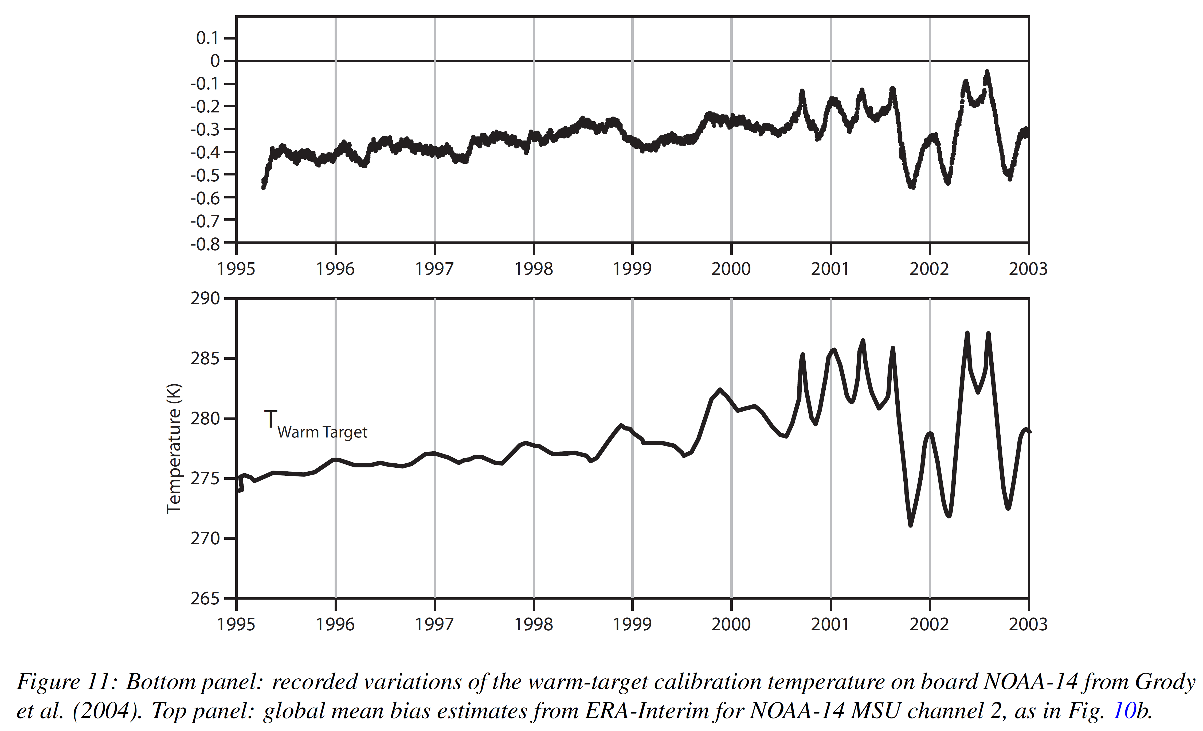
Variational Bias Correction: General Overview
VarBC has the major purpose to estimate and correct biases during data assimilation. The radiance biases for a particular satellite/sensor and channel are expressed in terms of a number of predictors (p_{i}) that could depend on the state of the instrument (scan, FOV, etc) or atmosphere. Then, the variational analysis will estimate the bias and the model state variables simultaneously.
VarBC estimated the MSU bias correction using all available observational information (including satellite data from other sensors).
This could be considered as an statistical procedure for cross-calibrating a sensor.
In order for this process to be successful, abundant amount of data is required.
NOAA-14 Microwave Sounding Unit (MSU) global mean bias derived from VarBC
Variations of the NOAA-14 MSU internal calibration warm-target.
This was associated to the satellite orbital drifts that affected the temperature of the on-board warm-target.
Dick Dee and Sakari Uppala, ECMWF, Technical Memorandum, 575, 2008

