Slide 1
Assessing the Sensors Calibration Needs in the Era of Smallsats/Cubesats
Flavio Iturbide-Sanchez¹, Dave Johnson², Larrabee Strow³, Edward Kim⁴, Quanhua (Mark) Liu¹ and Jim Jung⁵
NOAA/NESDIS/STAR.
NASA/Langley Research Center.
University of Maryland Baltimore County.
NASA/Goddard Space Flight Center.
University of Wisconsin-Madison/CIMSS/SSEC.

Slide 2
Main Questions to Address
What calibration errors are covered by varBC in NWP that should not be a concern for smallsats?.
What types of calibration errors that are uncorrectable by VarBC and require sensor calibration?.
Do we need an on-orbit anchor reference sensor to achieve acceptable calibration for smallsats/cubesats or is hot/cold reference type of calibration enough for smallsats/cubesats (if possible)?.

Slide 3
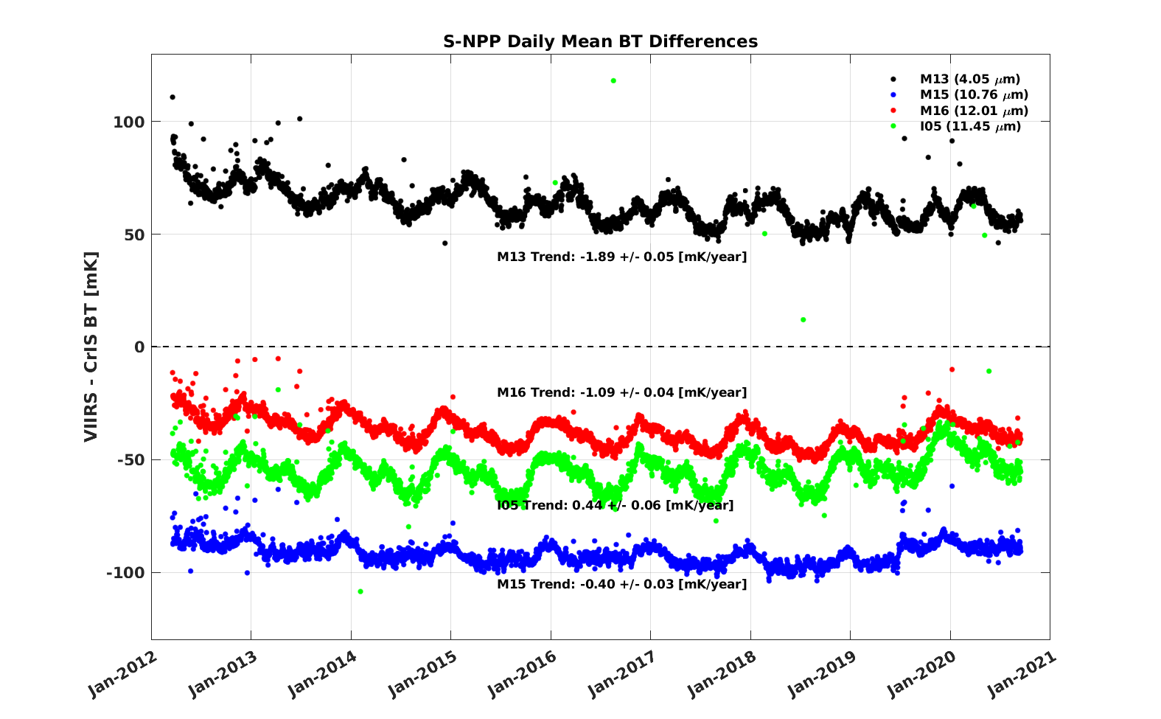
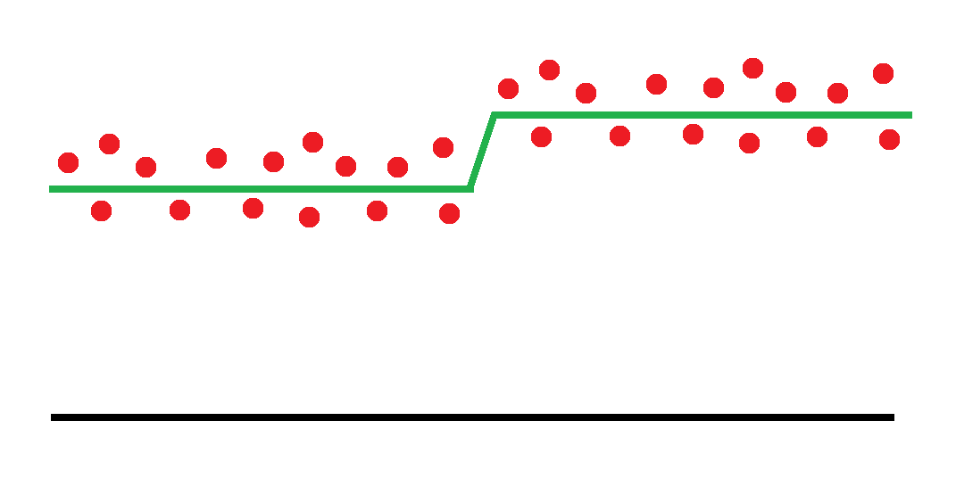
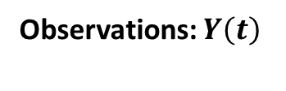
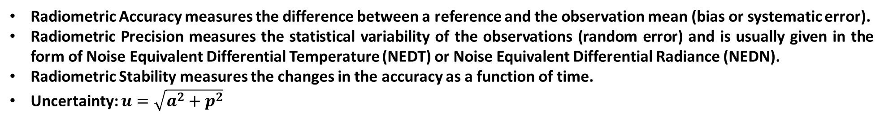



Critical Calibration Parameter
Stability
Secular trend
Seasonal variations
Observations: $Y\left(t\right)$
Observations Mean: $\overline{Y}\left(t\right)$
Stability: $a\left(t\right)$
Precision (p)
Accuracy (a)
Reference: $R\left(t\right)$
Courtesy of Dave Tobin, UW-Madison
Radiometric Accuracy measures the difference between a reference and the observation mean (bias or systematic error).
Radiometric Precision measures the statistical variability of the observations (random error) and is usually given in the form of Noise Equivalent Differential Temperature (NEDT) or Noise Equivalent Differential Radiance (NEDN).
Radiometric Stability measures the changes in the accuracy as a function of time.
Uncertainty: $u=\sqrt{a^{2}+p^{2}}$

Slide 4
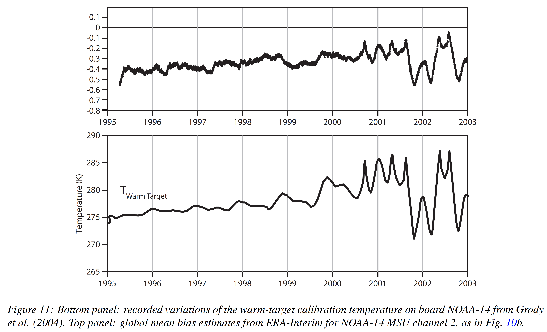
Variational Bias Correction: General Overview
VarBC has the major purpose to estimate and correct biases during data assimilation. The radiance biases for a particular satellite/sensor and channel are expressed in terms of a number of predictors (p_{i}) that could depend on the state of the instrument (scan, FOV, etc) or atmosphere. Then, the variational analysis will estimate the bias and the model state variables simultaneously.
VarBC estimated the MSU bias correction using all available observational information (including satellite data from other sensors).
This could be considered as an statistical procedure for cross-calibrating a sensor.
In order for this process to be successful, abundant amount of data is required.
NOAA-14 Microwave Sounding Unit (MSU) global mean bias derived from VarBC
Variations of the NOAA-14 MSU internal calibration warm-target.
This was associated to the satellite orbital drifts that affected the temperature of the on-board warm-target.
Dick Dee and Sakari Uppala, ECMWF, Technical Memorandum, 575, 2008

Slide 5
Sensor Calibration Needs for NWP Applications: Mature Calibration Methodologies working to Calibrate a Robust Sensor Design
Long-term calibration stability is needed: Sensors require highly stable calibration references to provide long-term calibration stability, which should be longer than the VarBC spin up time.
Short-term calibration stability is needed: Sensors require robust designs to make the calibration insensitive to orbital thermal variations. Those calibration changes could not be detected by the VarBC under some conditions.
Reliable calibration is needed: Sensors requires a comprehensive on-orbit and pre-launch characterization and testing performed with high standards.
Mature calibration methodologies are needed: The calibration should be based on well-understood techniques to increase its reliability, maintainability and repeatability, facilitating the rapid transition to operations. This is particularly important for a constellation of sensors that could have short lifetime.

Slide 6
Requirements for an On-Orbit Calibration Reference
The main requirements are high long-term stability and accuracy.
For NWP applications the required accuracy should be about 0.3 K or less.
For Climate application required accuracy should be about 0.05 K/decade or less.
The spectral coverage of the reference sensor should span all channels of the monitored sensors.
The spatial coverage of the reference sensor should cover the area of the monitored sensors.
The scan angle dependence of the reference sensor should be well-characterized.
The reference sensor should have high geolocation accuracy.
Nominal decadal climate temperature trends are in the 0.1–0.2K per decade [Strow and DeSouza-Machado, Atmos. Meas. Tech.,2020]

Slide 7
Behind the Successful Calibration of Conventional Operational Microwave and Infrared Sounders for NWP Applications
Majority of operational infrared and microwave sounders highly rely 1) on rigorous ground TVAC testing and on-orbit characterization, 2) on observations at deep space and internal calibration targets characterized by its high radiometric stability, 3) and on well-established on-orbit methodologies to successfully meet the mission calibration requirements needed for NWP applications.
Having a robust instrument design along with proper pre-launch and on-orbit characterization has demonstrated to be critical for meeting successfully the mission requirements.

Slide 8
Typical Sensor Data Requirements for NWP Applications
Summary of representative levels of sensor data record (SDR) requirements for NWP applications, based on the JPSS program Level-1 Requirements for the ATMS and CrIS sounders
Sounder | Sensor Data Record Mission Requirements
 | NEDN/NEDT R.U.= mW/m²/sr/cm⁻¹ | Radiometric Accuracy | Spectral Stability | Geometric Uncertainty
CrIS (IR) | LWIR: <0.45 R.U. / <0.5 K at 287 BB; MWIR: <0.08 R.U. / <0.25 K at 287 BB; SWIR: <0.015 R.U. / <0.25 K at 287 BB; | LWIR: <0.5% (0.4-0.2K) at 287K BB; MWIR: <0.6% (0.3-0.2K) at 287K BB; SWIR: <0.8% (0.25-0.15K) at 287K BB; Percent of 287 K Blackbody radiance | 10 ppm | 1.5 km for a FOV=14 km diameter at nadir
ATMS (Microwave) | 22-33 GHz: < 0.8 K; 50-60 GHz: < 1-3.5 K; 85-183 GHz: < 1.0 K; | 22-33 GHz: < 1.0 K; 50-60 GHz: < 0.75 K; 85-183 GHz: < 1.0 K; | 22-33 GHz: < 10 MHz; 50-60 GHz: < 0.5-10 MHz; 85-165 GHz: < 200 MHz; 183 GHz: < 30 MHz; | -

Slide 9
ATMS vs TEMPEST-D: The Two-Point Calibration Principle
ATMS
TEMPEST-D
Internal Calibration Target View
Earth Scene
ATMS Scan Sequence. From ATMS ATBD
TB Mean and Standard Deviation (K)
The ATMS and TEMPEST-D sensors rely on the same calibration principle and provide calibrated observations with nearly the same quality. We recognize that those sensors have different designs, but at the same time those sensor have key similarities.
Cold Sky View
TEMPEST-D Scan Sequence. The TEMPEST-D absolute calibration accuracy and precision is within 1 K and 0.6 K, respectively From W. Berg et al. TGRS 2020.

Slide 10
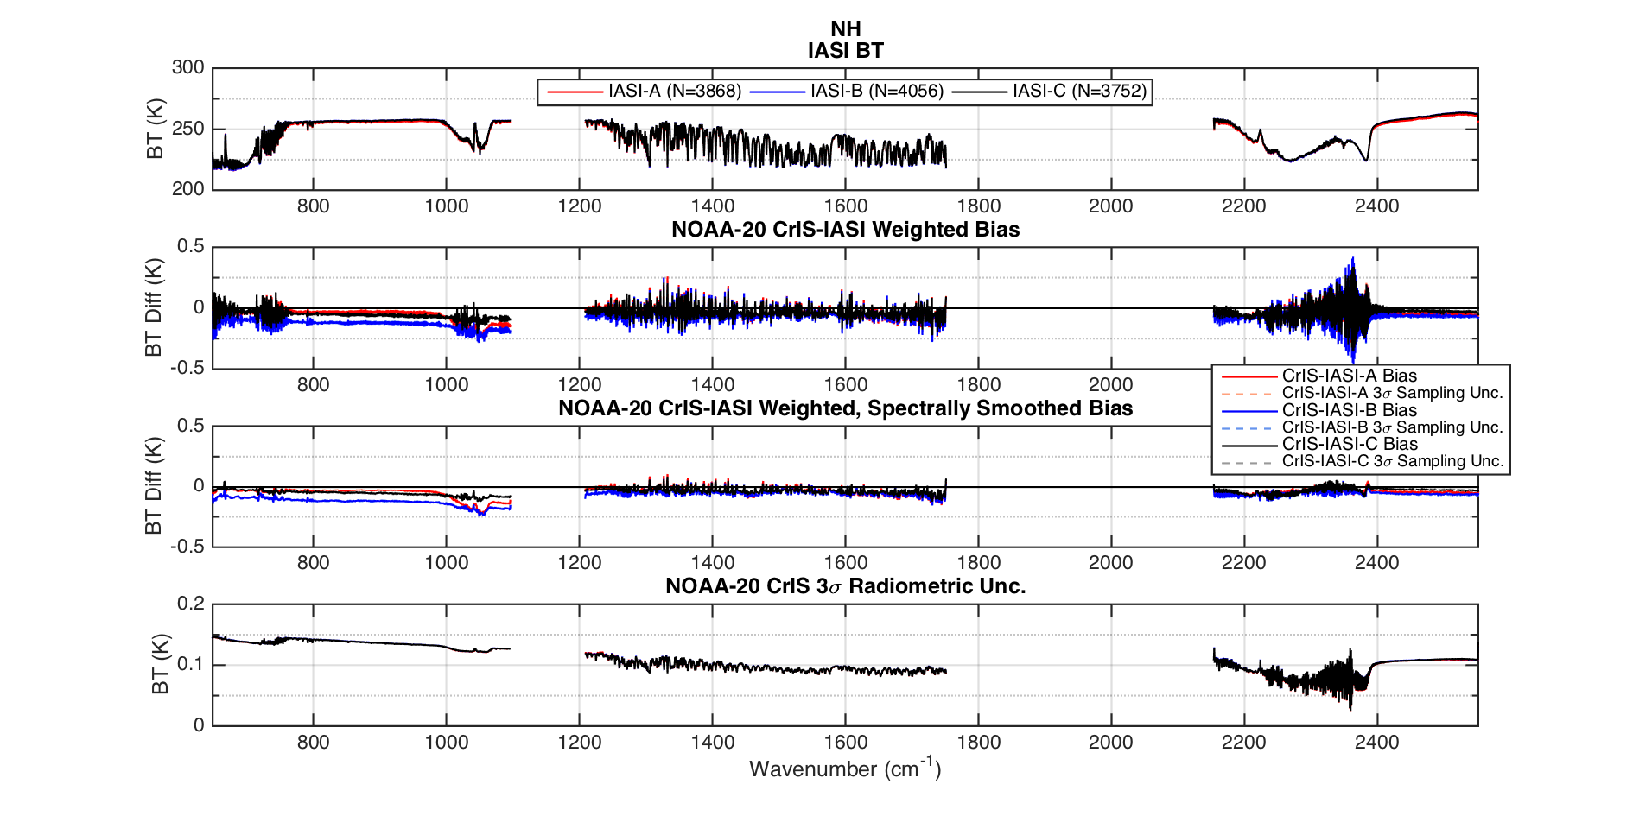
Radiometric Inter-comparison Between NOAA-20/CrIS and Metop/IASI: High Radiometric Agreement
NOAA-20/CrIS vs Metop/IASI-A,-B,-C biases are within 0.25 K for most channels.
NOAA-20/CrIS holds a radiometric uncertainty (3σ) under 0.15 K
This chart helps to understand the quality of the radiometric calibration found between IR sounders that have different designs and rely on the two-point calibration principle. Results show that those sounders have nearly the same quality of calibrated observations. It is expected that sensor that hold the same design could have nearly the same performance. If sensors are well characterized and calibrated, and have robust designs, they will meet the NWP requirements.

Slide 11
Pre-launch and On-Orbit Calibration Correction Activities: MW Sounders
Pre-launch:
  Nonlinear correction.
On-orbit:
  Nonlinear corrections¹.
  Scan position bias corrections.
  Antenna spillover corrections.
  Instrument and space-craft induced bias corrections¹.
  1: At NCEP VarBC “does not have” predictors for these calibration errors.

Slide 12
Pre-launch and On-Orbit Calibration Correction Activities: IR Sounders
Pre-launch:
  Nonlinear correction.
  Spectral calibration.
  Band-to-band coregistration.
On-orbit:
  Nonlinear corrections¹.
  Polarization corrections¹.
  Spectral corrections².
  Geolocation corrections¹.
  1: At NCEP, VarBC “does not have” predictors for these calibration errors.
  2: At NCEP, VarBC “accounts for some” spectral shifts.

Slide 13
1) What calibration errors are covered by VarBC in NWP that should not be a concern for Smallsats?.
Since VarBC requires a representative and large amount of data to estimate the bias correction, short-term calibrations variations (for example, those associated to orbital thermal variations) could potentially not be covered by the VarBC.
Long term calibration stability is the key behind VarBC. The VarBC does not work well for instruments with orbital variations, like those observed in the SSMIS sensor.
The estimation of radiances biases from VarBC could be affected by the presence of model biases, particularly where observations are sparse and systematic model errors are large.
In this case, having stable observations with high accuracy benefits the assimilation process, increases the impact of the assimilated observations and could help to anchor the data assimilation system.
In general, it is not recommended to rely on VarBC to handle any sensor calibration errors. The VarBC is designed to deal with the model errors, not specific instruments calibration errors (nonlinearity, polarization, etc.).

Slide 14
2) What types of calibration errors that are uncorrectable by VarBC and require sensor calibration?.
Defining the predictors for a particular satellite/sensor and channel could be a challenge process, particularly if the size of the constellation and the number of channels increases (IR hypespectral sounder have thousand of channels). It is primary to understand the maximum capacity that VarBC can handle.
The VarBC does not work well in regions with limited conventional observations (stratosphere).
Depending on the instrument design, the VarBC can not account for detector to detector differences on an instrument (e.g. CrIS has 27 detectors, 9 detectors per band, AIRS has 2378 detectors).
It is always preferable to have unbiased calibrated radiances. This helps to accelerate the radiance assimilation process, particularly for short lifetime sensors.

Slide 15
3) Do we need an on-orbit anchor reference sensor to achieve acceptable calibration for smallsats/cubesats or is hot/cold reference type of calibration enough for smallsats/cubesats (if possible)?.
Inter-calibration is a multidimensional problem, which should account for bias as a function of scan angle, scene temperature, solar zenith angle (or the diurnal variation in bias), and over time: beta angle dependence or annual variation (periodic), and secular trend (non-periodic) over life.
On-orbit inter-calibration requires a significant amount of coincident observations, which should include scan angle dependent observations (not just simultaneous nadir overpasses or SNOs) in order to achieve full instrument characterization. This is hard to do in a reasonable time with instruments on different platforms and with short lifetime.
Calibration changes occurring between sensor characterization will not be corrected, limiting the usability of the on-orbit calibration reference. However, having an on-orbit calibration reference would benefit and complement the identification and characterization of some type of bias differences between the different sensors within the constellation.
Presently, there are products from operational infrared and microwave sounder considered by the Global Space-based Inter-Calibration System community as on-orbit calibration reference. For the infrared spectral region, this includes calibrated radiances from the CrIS, IASI and AIRS. For the microwave region, the GMI water vapor channels hold the required quality, while the ATMS and AMSU/MHS calibrated products are being considered.
Deploying a dedicated on-orbit calibration reference could also result in an expensive mission.

Slide 16
Recommendations (1/3)
The sensor calibration should primarily rely on highly stable observations at deep space and internal calibration targets. An on-orbit calibration reference could complement the calibration of sensors within a constellation.
Comprehensive on-orbit and pre-launch characterization and testing with high standards should be performed and is needed.
Mature calibration methodologies should be applied to facilitate the calibration of multiple sensors.
It is not recommended to rely on VarBC to handle any sensor calibration errors.
Calibration should provide nearly unbiased radiances (less VarBC dependency). It is expected that this benefits the acceleration of the radiance assimilation process (less amount of data would be needed to estimate the bias correction), particularly for short lifetime sensors.

Slide 17
Recommendations (2/3)
Lower inter-channel and spatial correlations (attributed to 1/f noise) is required in MW sounders to improve the assimilation performance and have positive impact of the assimilated observations.
In general, sensors with low, random and uncorrelated noise characteristics are required to accelerate the assimilation and benefit the assimilation of observations.
Low geolocation errors are highly important for NWP, particularly over heterogeneous regions. If these sensor on smallsats aim at higher spatial resolution, than the current instruments, geolocation will be even more critical.

Slide 18
Recommendations (3/3)
A demonstration mission would benefit to mitigate mission risks, in the calibration and assimilation process, and to accelerate the data usage. The assimilation of new observations is shorten if observations from a similar sensor(s) have been assimilated before due to less extensive acceptance tests to demonstrate the assimilation performance. Example, SNPP CrIS took several months to implement, mostly for code changes and logistics. NOAA-20 CrIS was accepted 30 days after the last calibration change. (SNPP CrIS: First science data in Jan 2012; assimilated in April 2013 at NCEP, NOAA-20 CrIS: First science data in Jan 2018; assimilated in May 2018 at NCEP)
IR and MW sounders on Smallsats/Cubesats could be extended to support Regional weather forecast.
Include NCEP people in the calibration and requirements discussion. The experience and feedback from operational NWP is critical to enrich the discussion.

