Slide 1
Future RO data needs
Rick Anthes
27 June 2022
Presented to NOAA Systems Performance Assessment Team

Slide 2
NOAA has asked us for input on future RO needs to help in their planning
How many RO profiles per day are needed? Is there an upper limit to the number that would be useful for NWP? Is there a knee in the cost-benefit curve?
How should they be distributed, e.g.
Uniform globally or some latitudinal preference (e.g. more tropical or extratropical)?
Local time?
Should NOAA provide a basic backbone and fill in with commercial data? Or would all-commercial be acceptable? What does “backbone” mean? How many backbone profiles are needed?
Quality considerations?
How much of space weather needs could be covered?
What level data should NOAA obtain from vendors?
Where should the data be processed and distributed?

Slide 3
Process
Contacted leaders in RO community in weather, climate and space weather (the Team, next slide)
Consulted WMO International Radio Occultation Working Group (IROWG) recommendations and scientific literature.
Reviewed draft response with Team in virtual meeting May 12, 2022
Revised and shared with Team for further comments
Sean Healy, ECMWF and co-chair of IROWG, presented study to WMO CGMS 16 June
Appendix gives supporting material, details, and references

Slide 4
Contributors to this study
Rick Anthes (UCAR COSMIC, NOAA SAT) Tony Mannucci (JPL)
Ben Ruston (JCSDA) Andrea Steiner (Wegener Center)
Lidia Cucurull (NOAA AOML) Terry Onsager (NOAA SWPC)
Frank Gallagher (NOAA NESDIS) Eric DeWeaver (NSF AGS Climate Dynamics)
Sean Healy (ECMWF, co-Chair IROWG) Bill Kuo (UCAR COSMIC)
Bill Schreiner (UCAR COSMIC) Jan Weiss (UCAR COSMIC)
Harald Anlauf (DWD) John Dreher (US Air Force)
Patricia Weir (NOAA CDP) Terry Onsager (NOAA, SWPC)
Christian Marquardt (Eumetsat)
Axel von Engeln (Eumetsat)
Daniel Lee (Eumetsat)
Martin McHugh (NOAA Affiliate)
Neill Bowler (Met Office)
Nick Pedatella (UCAR COSMIC)
Ben Ho (NOAA STAR)
Uli Foelsch (Wegener Center, co-Chair IROWG)
Hui Shao (NOAA JCSDA, co-Chair IROWG)

Slide 5
BACKGROUND and SUMMARY
RO is one of the most impactful observations in NWP and science
Contributes to weather, climate, and space weather
Accurate and precise-can be assimilated without bias correction
High vertical resolution (200-300 m)
All weather (cloudy and clear), land and sea (no emissivity issues)
Increases impact of infrared and microwave sounding systems- correction will be especially important with SmallSat IR and MW calibration requirements
NWP impact increases steadily with number of observations up to at least 125,000 profiles per day

Slide 6
Science aspects of data sharing policy
Relevant to much more than RO, e.g. commercial development of MW sounders, scatterometers, long-range balloons, radar precipitation measurements from space…..
Free and open sharing of commercial data in real time without restrictions is a major benefit to science.
Science benefits by independent users in all countries using data (Imagine if COSMIC data had been restricted to U.S. users only)
Cost/benefit: Costs go down, benefits go up with full data sharing. All forecasts are better with full data sharing.
EUMETSAT’s 30 Member States voted unanimously for the free and unrestricted license instead, even at the price of getting (much) fewer occultations (C. Marquardt, EUMETSAT)
All RO data should be shared freely in real time under global license-this is to the advantage of all providers, users, science, and society.

Slide 7
How many RO profiles per day are needed? Is there an upper limit to the number that would be useful for NWP? Is there a knee in the cost-benefit curve?
Since IROWG-4 (April 2015 in Melbourne) IROWG has recommended at least
20,000 RO profiles per day.
Independent peer-reviewed scientific studies support this number, but
indicate that it may be conservative and should be revised upward. This will be
considered at IROWG-9 in Graz, Austria in September 2022
No evidence of saturation up to at least 125,000 profiles per day.
The most rapid increase of impact per observation is in the first 30,000 profiles;
about half of the total impact of RO is achieved with the first 30,000 profiles
This suggests that ~30K profiles per day may be close to a knee in the cost-benefit
curve, but this depends on the pricing per observations. If it is cheaper per
sounding for larger numbers, the optimum number of soundings will be larger.

Slide 8
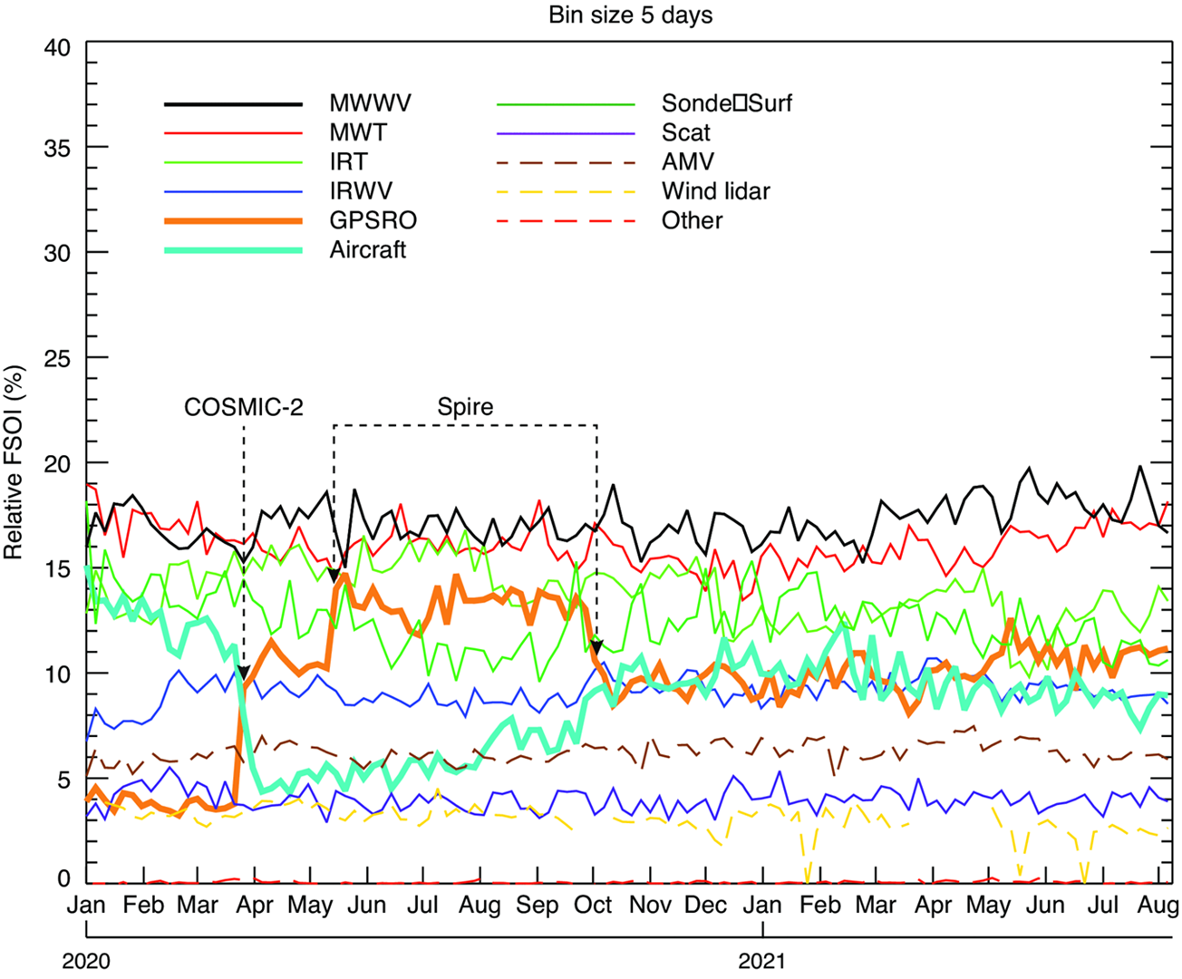
Increase of RO has huge impact on ECMWF operational modeI.
FSOI is a global integrated energy metric of overall forecast skill that is useful for comparing the relative impact of different observational systems.
A fair comparison of the
relative impact of these
observing systems by
his metric over this
period of time. FSOI has
been shown to give
similar results to data
denial experiments,
OSSEs, and Ensembles of
Data Assimilation (EDA)
experiments.
MWWV
MWT
IRT
IRWV
RO
Aircraft
Sonde/sfc
Scatterometer
AMV
Wind lidar
Other
COVID
Sean Healy, ECMWF
Notes:
Relative measure of impact of systems by this metric. Sum of all curves equals 100%

Slide 9
How should RO observations be distributed?
Uniformly globally---approximately equal horizontal
separation (resolution) at all latitudes over a day
Uniformly in local times (especially important for
climate and space weather)
Random sampling in space and time is best for climate
Will require a mix of orbits (polar and Equatorial).
Comment: Science is very clear on this answer.

Slide 10
Should NOAA provide a backbone and fill in with commercial data? Or would all-commercial be acceptable? What does “backbone” mean? How many backbone profiles are needed?
NOAA and its partners (e.g. EUMETSAT) should provide an RO backbone of 10,000
RO profiles per day, roughly the current number of COSMIC-2 and Metop profiles
Provide global data at all local times and shared to all without restrictions
Should be
government (public) designed, owned, and managed
meets defined quality standards
long lasting and stable
well documented and independently processed and archived in at least two places,
preferably more than two. Verification of results by independent centers with
independent scientists. True for commercial data as well.
Similar to GRUAN radiosonde network—a high-quality reference radiosonde network
that is useful for climate, calibration and validation of commercial RO missions and IR and
MW sounders.

Slide 11
Why is a backbone needed?
We get all data, metadata, processing details-valuable for understanding the errors,
improving retrievals, reprocessing for research and reanalysis
Uniformity of quality--long-lived instruments with overlapping periods to monitor quality
and obtain long time series-important for climate, anchoring of NWP, and calibration of
IR and MW sensors.
Stability and reduction of risk (companies come and go, year to year budget and price
fluctuations)
Cost management-backbone with known costs helps control prices of commercial data.

Slide 12
Quality considerations? Are they different for commercial purchases and the backbone?
Current (April 2020) NOAA requirements: Latency<140 min, SNR>200, global coverage
Instead of SNR, it may be better to require RO profiles to pass certain quality metrics
Quality metrics (examples)
Latency-very important, especially for space weather.
space weather: 50% < 30 min is threshold, <15 minutes is goal
NWP: 50% < 6 h is threshold; < 3 h is goal
Uncertainties (random error standard deviations) in defined layers (e.g. 0-8, 8-30, 30-50 km)
Maximum biases in certain layers (e.g. 0-2 km, 2-5 km, 8-15 km)
“Stdv”(standard deviation of bending angle differences from climatology
between 60-80 km)-a measure of quality of occultation
Penetration depth-certain % (e.g. 80%) reaching at least 1 km from surface
Appendix gives more examples. Need an expert team to develop the requirements.
Notes:
Current (April 2022) NOAA requirements: Latency < 140-min; signal to noise ratio > 200; ~ global coverage

Slide 13
What level data should NOAA obtain from vendors?
NOAA should get Level 0, 1A and 1B as defined by EUMETSAT’s ROM SAF
as well as all the metadata
Level 0: Raw sounding, tracking and ancillary data, and other GNSS data before clock
correction
Level 1A: Full resolution excess phases, total phases, pseudo ranges, SNR's, orbit
information, navigation bits, and quality information
Level 1B: Bending angles and impact parameters, tangent point location

Slide 14
How much of space weather needs could be covered?
RO provides valuable information on the following space weather geophysical parameters:
TEC (total electron content in electrons/m²)
S4 amplitude scintillation index
Sigma-phi phase scintillation index
Electron number density profiles 100-600 km
RO cannot provide other important space weather observations such as coronograph imagery,
heliospheric imagery, auroral imagery, solar X-ray irradiance. See SPRWG report (NOAA 2018;
Anthes et al. BAMS 2019) for list of priority space weather observations.
Latency very important, more stringent than NWP, < 15 min goal <30 still useful (threshold)
TEC data should be phase connected above/below 0 degrees elevation angle-important to
obtain absolute TEC for the occultation portion of the observation

Slide 15
Where should the data be processed and distributed?
Data should be processed and continually monitored for quality by at least two reliable
institutions with expertise in RO retrievals and uses in NWP, climate and space weather.
More than two would be desirable for cross comparison of results. Similar to why
we need more than one forecast and climate models.
All RO data that NOAA and its partners obtains should be processed in near-real-time and
distributed free of charge to all users via the GTS.
RO data should also be reprocessed and made available to the research community via a
permanent archive within one year of acquisition.
Complete documentation should be available, maintained and updated for all NRT and
reprocessed data.

Slide 16
RO Modeling Experiment (ROMEX) A Proposed Experiment of opportunity Similar to an observational field experiment
OSSEs, FSOI, EDA spread all very useful, but all have limitations
Partners obtain and share all possible RO data for a certain period (e.g. 6 months)-take whatever data are available. Latency not an issue (research mode).
May reach 30,000 profiles per day-or even more in the near future!
Different centers can do forecast experiments, including data denial experiments, and obtain solid evidence of benefit vs number of profiles
Quality of different missions and sources can be compared for the same time period
Plausible numbers (just an example)
COSMIC-2 5,000
Metop, FengYun-3, Sentinel 6 4,000
SPIRE 10,000
PlanetiQ 10,000
GeoOptics ?
FY-3C ?
Total: 29,000 or more

Slide 17
ROMEX
Do in next two years (before COSMIC-2 fades)
Suggested time period (August-December)
Tropical cyclone season and one NH winter month
Role of partners
Processing centers process all the data
Modeling centers carry out modeling experiments
Commercial data companies provide all data in delayed time with no restrictions
Government sponsors help with incremental costs incurred by processing and modeling centers
All partners benefit
Science: unprecedented data set for research
Modeling centers: data impact studies, data denial experiments
Commercial providers-showcase their data and show value of large RO data sets to customers

Slide 18
Appendix: Details and references

Slide 19
Expected Radio Occultation Numbers for NRT Use
C. Marquardt, A. von Engeln, R. Notarpietro
EUMETSAT, Germany
6 May 2022

Slide 20
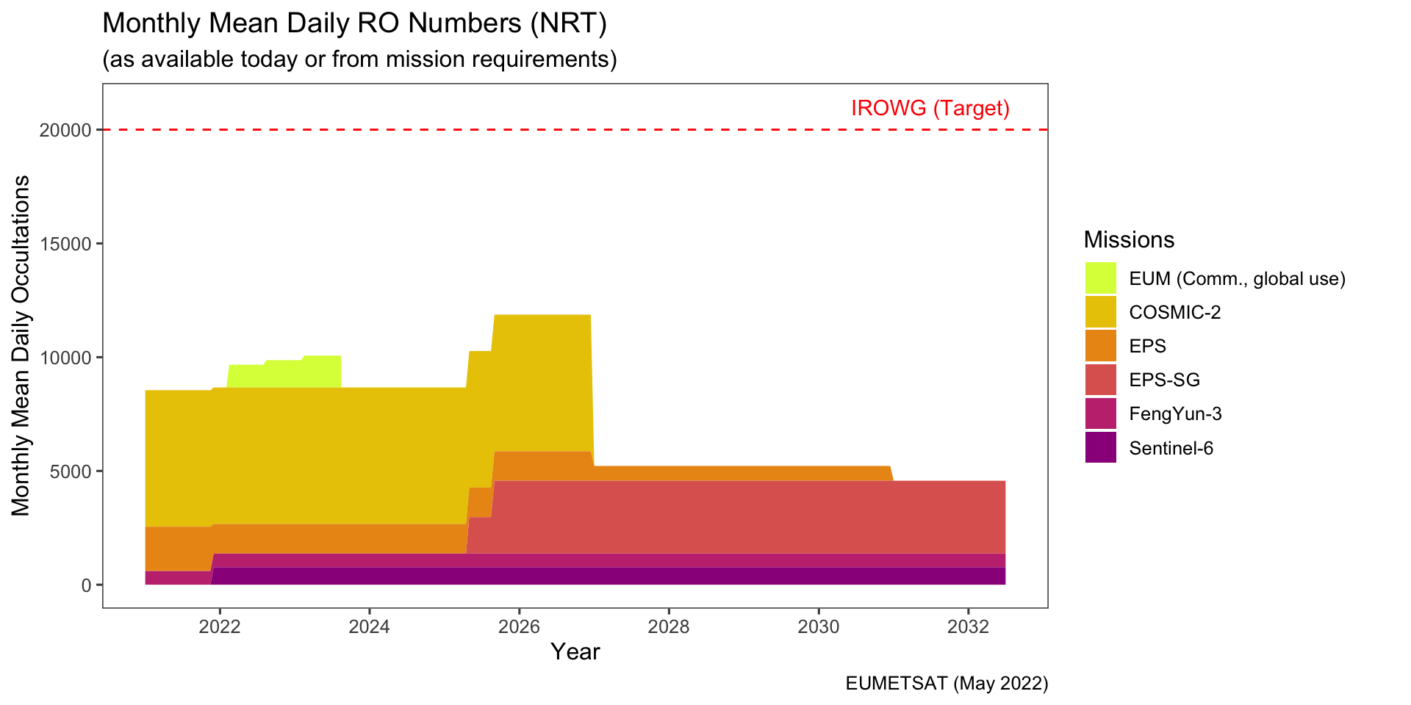

Slide 21
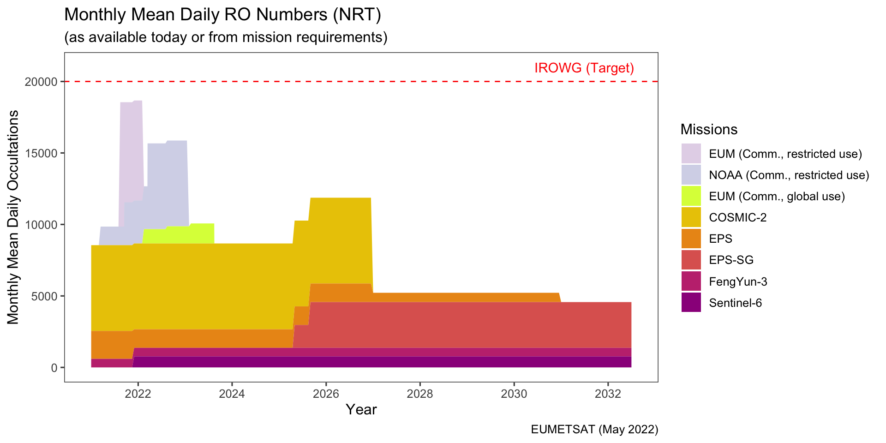

Slide 22
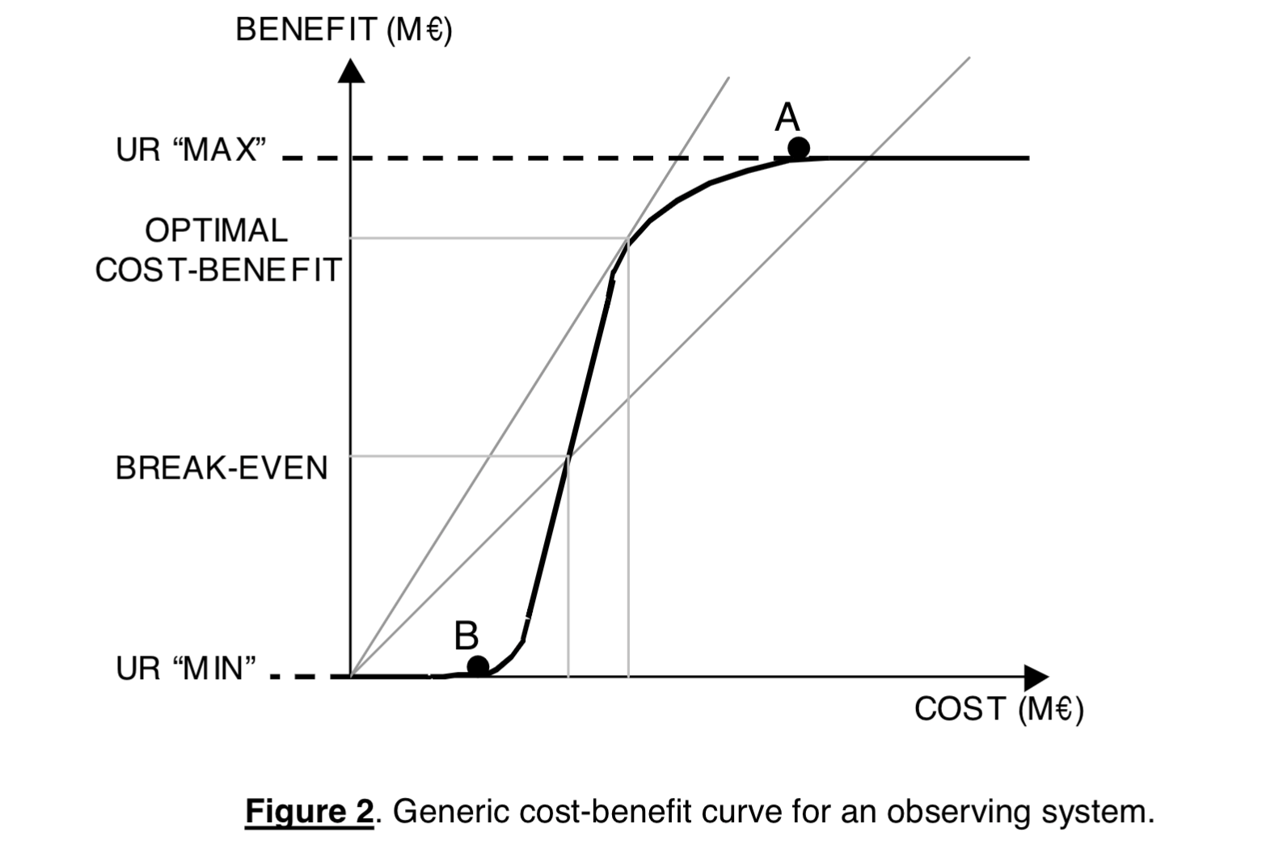
Cost
Is it better to spend ∆$ on ∆N RO observations rather than spend the same resources on
something else? Should be asked of all observational systems.
WMO’s guidance on the rolling-requirements review Fig. 2
https://wmoomm.sharepoint.com/:b:/s/wmocpdb/ETZhhknsfYJAlCBkkiMfftUBPsJpvtw64vNwiLUisgB-Ug?e=PEveDf)

Slide 23
Optimum Number of RO profiles per day
Harnisch et al. (2013) used ensemble of data assimilations (EDA) methods to evaluate the possible saturation of GNSS-RO observation impact on ensemble spread with up to 128,000 additional soundings per day. They found that saturation had not been reached at the maximum level of 128,000

Slide 24
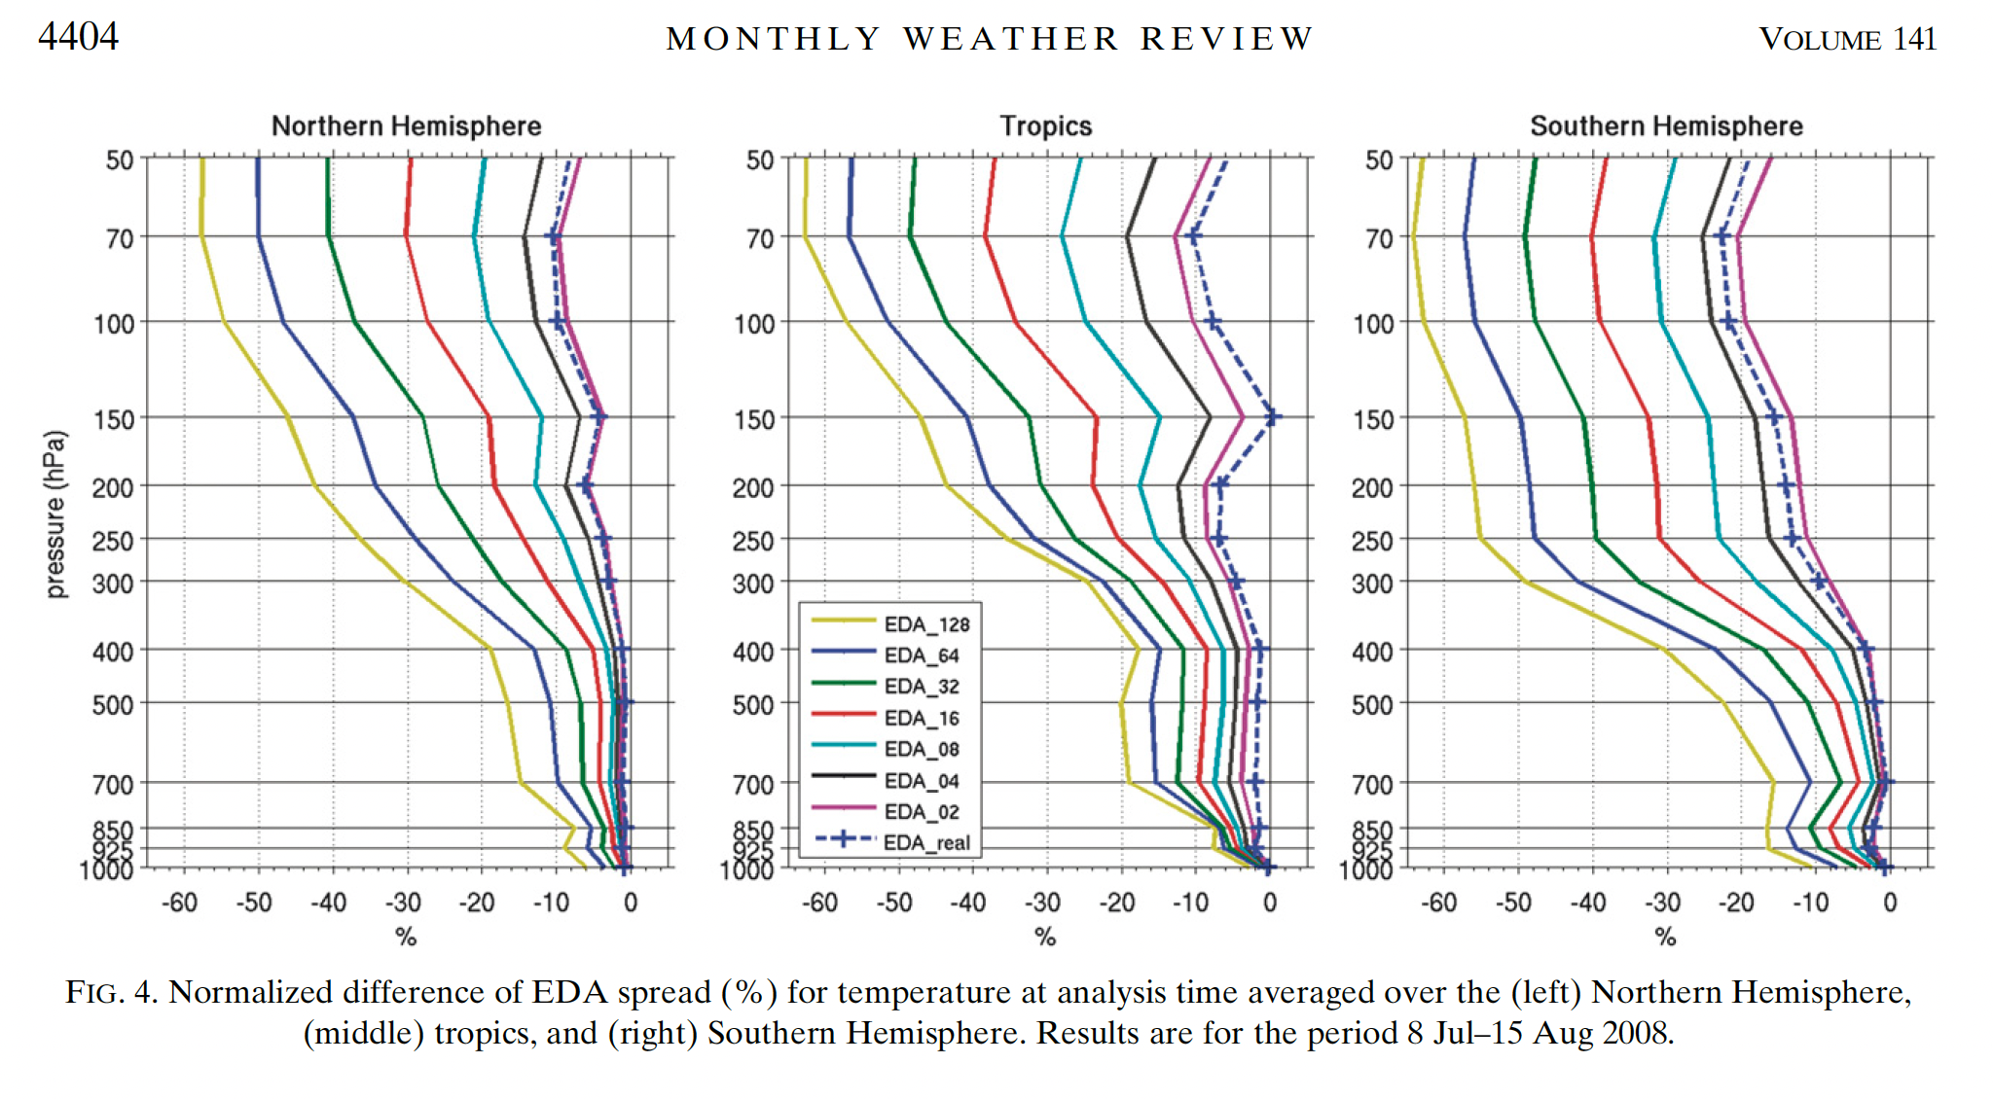
About half the gain between
16 and 32K profiles per day
Harnisch et al. 2013

Slide 25
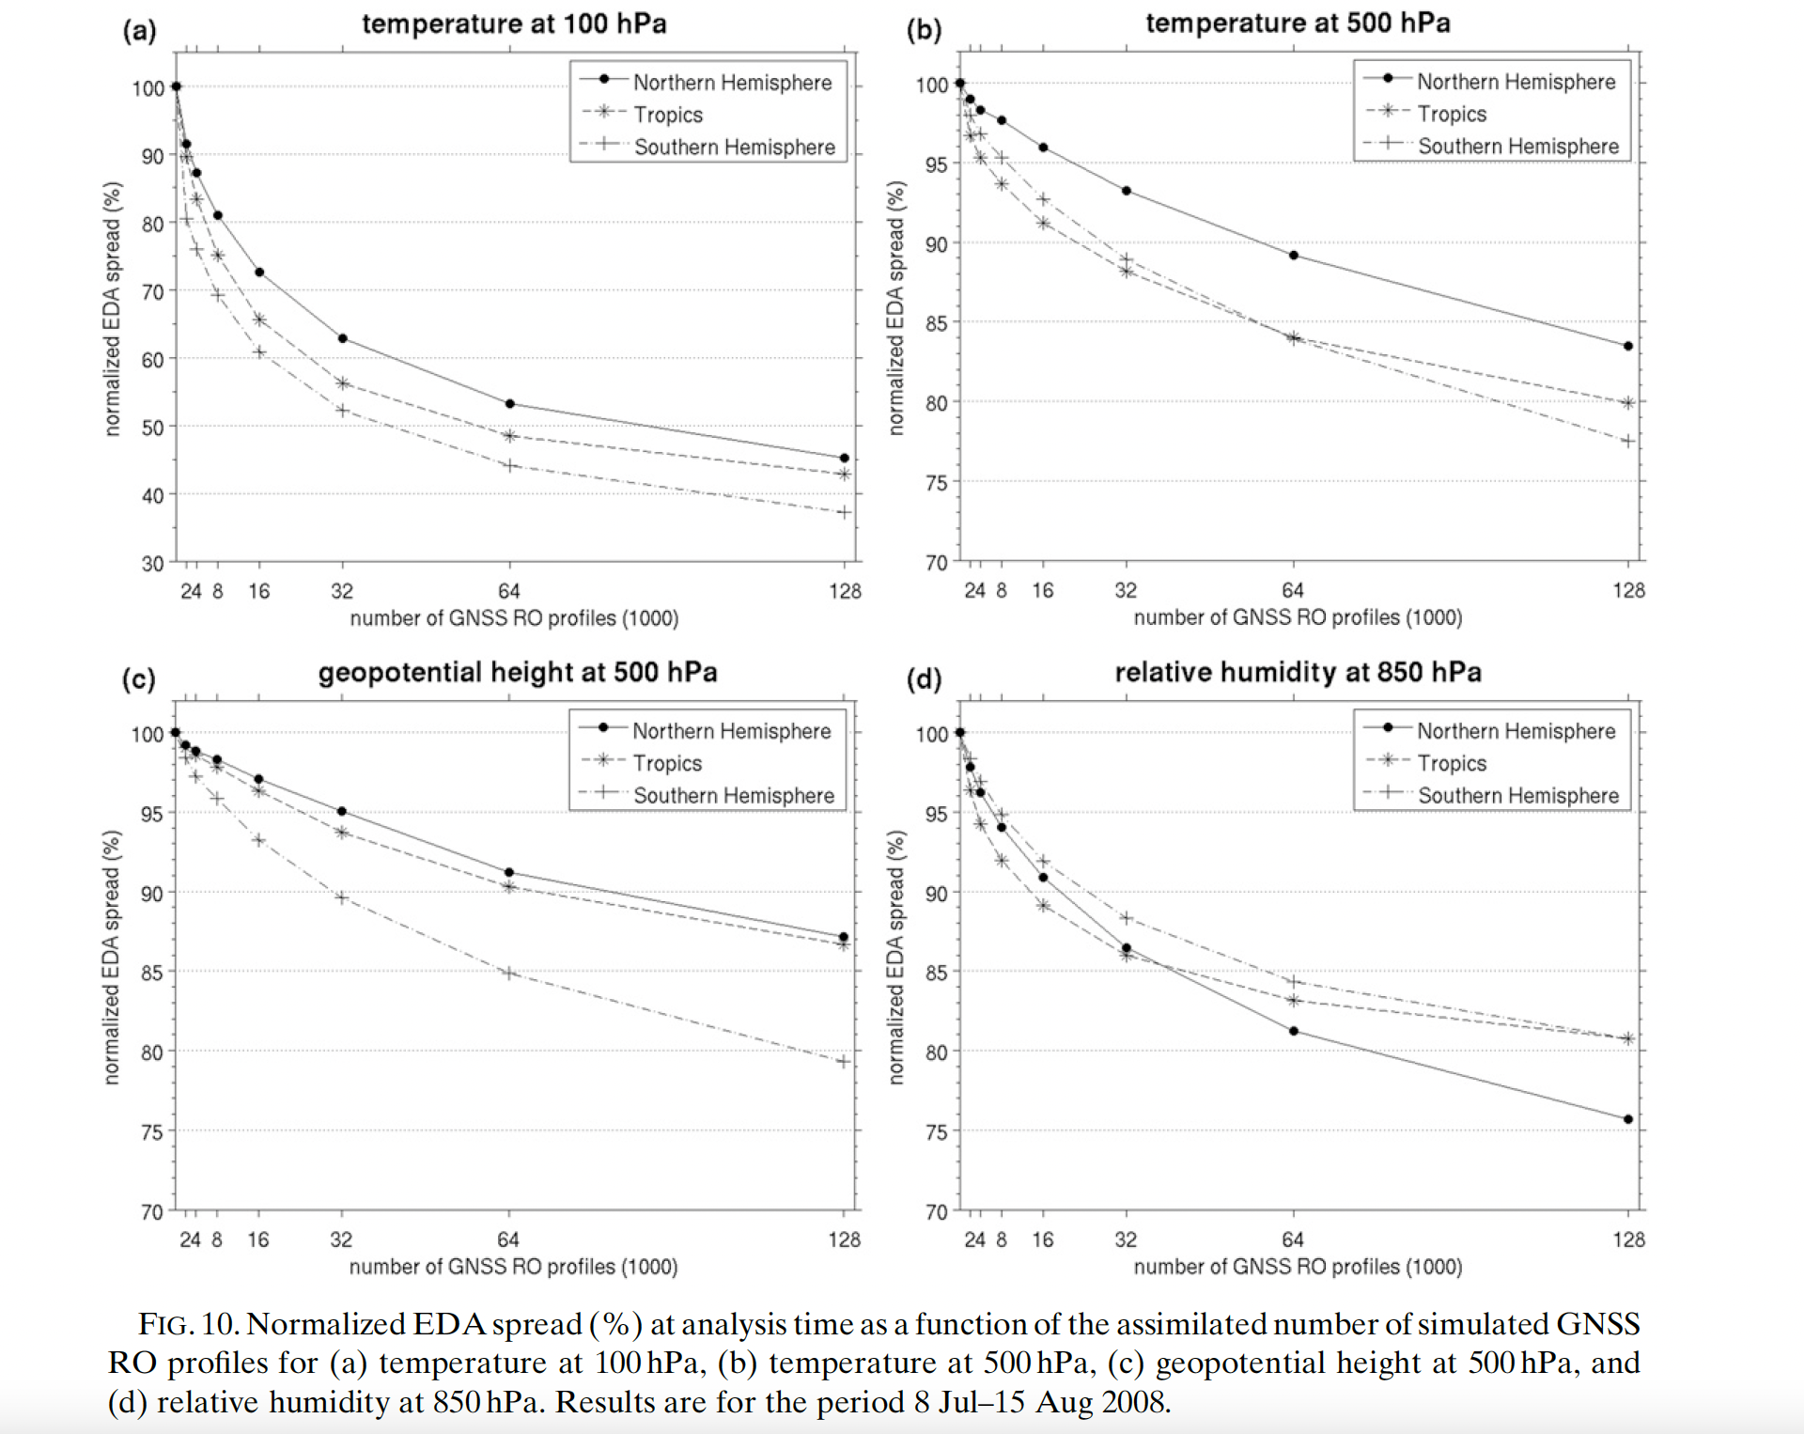
50% of impact reached at
~30,000 profiles/day
Evidence of inflection in benefit vs cost.
Varies between ~15,000 and 50,000 per
day depending on variable
Harnisch et al. 2013

Slide 26
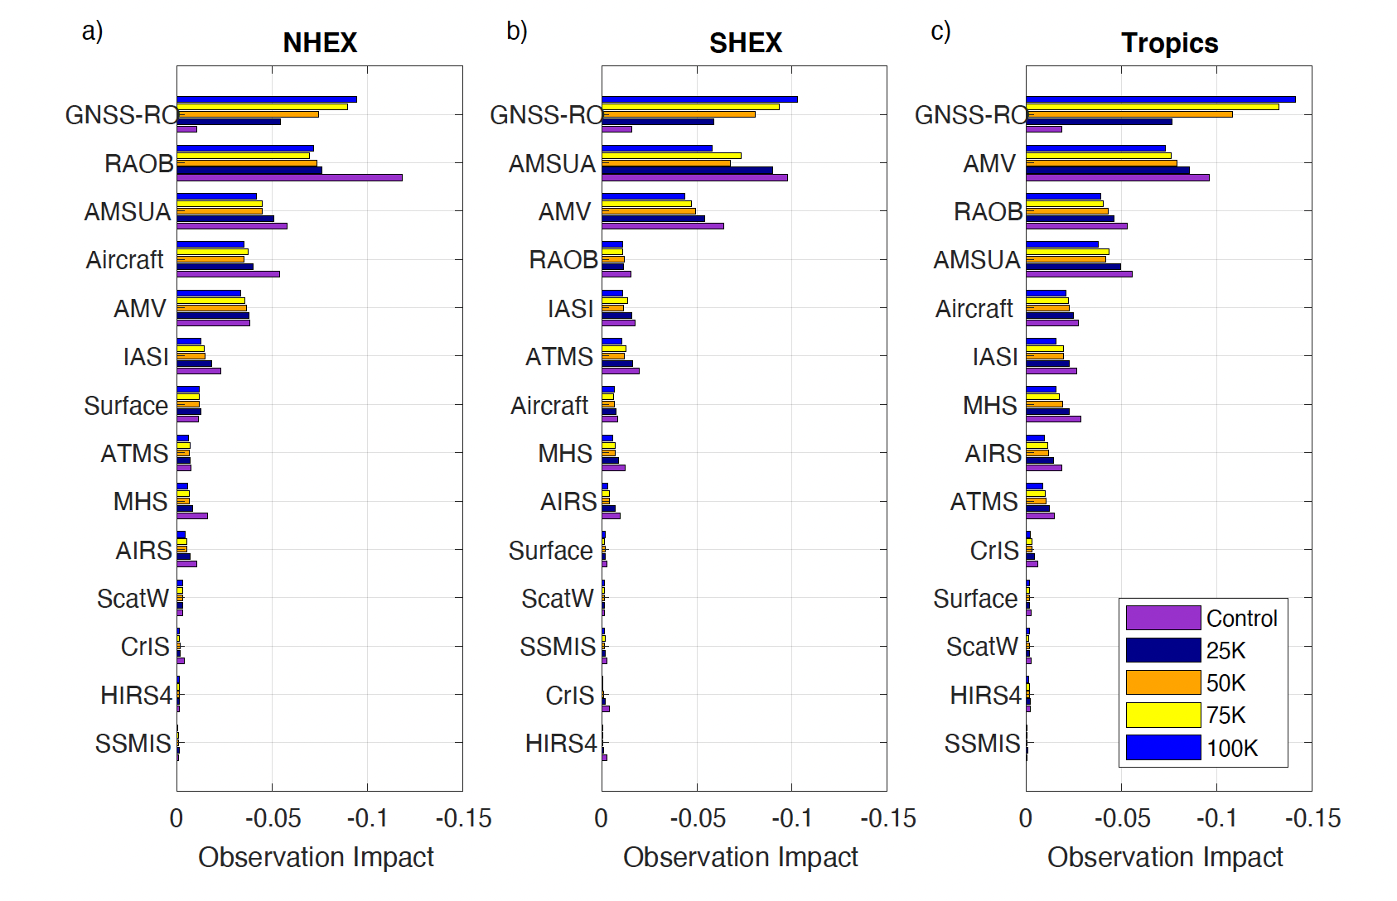
Harnisch et al. (2013) results confirmed by Privé et al. 2022
Changes in impact of different observing systems as number of RO profiles increase from 2015 availability. Note rapid growth of RO impact for 1st 25,000 profiles. No saturation at + 100K.
Fig. 22 Privé et al. 2022
FSOI estimates of net observation impact, 24 hour global total wet energy norm, J/kg. a) NH; b) SH; c) Tropics. Control, purple; 25K case, black; 50K case, orange; 75K case, yellow; 100K case, blue

Slide 27
Results from recent studies
Lonitz, K., C. Marquardt, N. Bowler and S. Healy, 2021: Impact Assessment of Commercial GNSS-RO data, ESA Contract Report 15 Nov. 2021.
https://www.ecmwf.int/en/elibrary/20240-final-technical-note-impact-assessment-commercial-gnss-ro-data
Key points
About 5,000 SPIRE and 4,000 COSMIC-2 profiles/day, plus Metop, KOMPSAT-5
Large positive impact on nearly all forecast metrics, including winds, for both centers (as expected)
SPIRE observations, with a lower SNR than COSMIC-2, had a similar positive impact on forecasts
Different SPIRE satellites appear to have different BA uncertainties.
SPIRE BA have significantly higher BA uncertainties than Metop above 30 km.
Actual impact of increasing numbers of RO profiles on forecasts agrees with EDA results, supporting need for increasing RO observations above 10,000 per day at least.

Slide 28
Quality considerations (Could be different for backbone and commercial data)
Signal to noise ratio (SNR)
Random errors (uncertainties)---Little evidence of impact
Bias errors---Higher SNR may produce slightly smaller biases, but this is uncertain
Penetration depth---Higher SNR produces deeper penetration and more observations
in challenging atmospheres (such as those with high water vapor, large horizontal
gradients of temperature or water vapor). Confirmed by several independent studies.
The current NOAA requirement for commercial data is 200 V/V. This is probably more than adequate. EUMETSAT’s
Requirement is 100 V/V and this seems adequate)

Slide 29
Other Quality metrics (Examples)
Require a percentage of profiles purchased from vendors to meet certain metrics:
Penetration depth: At least 80% reach 1 km MSL over tropical oceans
Latency: At least 50% reach GTS within 15 minutes of observation time; at least 75% within 1 hour
Uncertainties (relative error STD) in bending angles must meet following minimums between 30°S-30°N
40 km 5%
10-30 km 2%
0-5 km 15%
Biases in bending angles must not exceed following between 30°S-30°N
5-50 km 1%
0-5 km 8%
(Biases should be with respect to some known and trusted data set, such as ERA5)
Exact metrics and their minimum values should be established by team of experts.

Slide 30
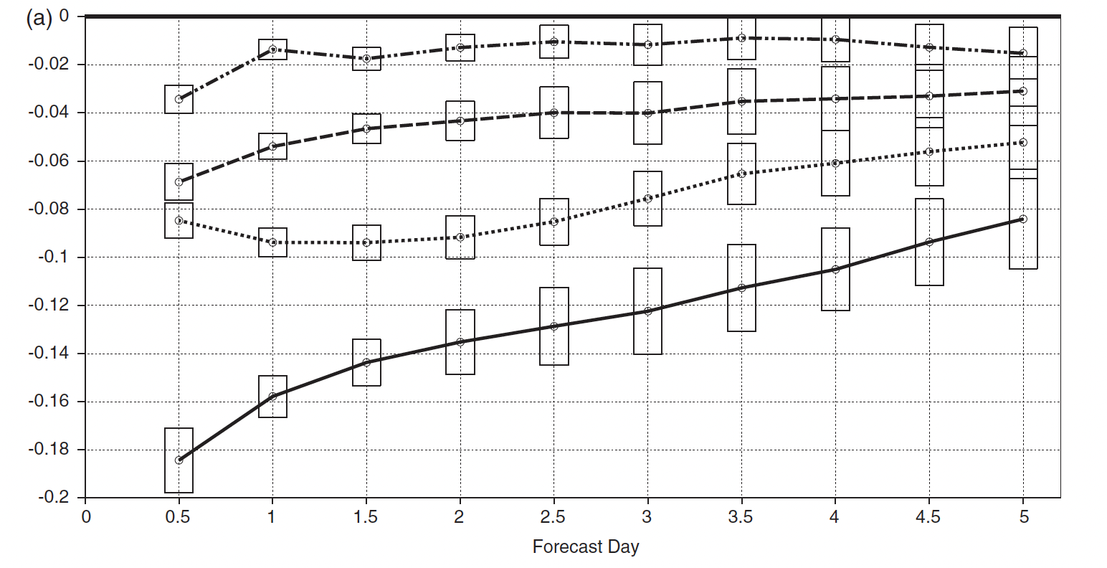
Latency
“Using dedicated satellite data denial experiments, it is shown that the lattermost 3 hr of observations are significantly more influential on the quality of the assimilation and forecasting system than the first 3 hr of data. Furthermore, it is found that the last 3 hr of data even outperforms the 6 hr of data (i.e. twice the number of observations) located in the first half of the window.” (McNally, 2019).
0-3
0-6
9-12
6-12
FIGURE 4 The fractional loss of forecast accuracy (in terms of r.m.s. errors for 500 hPa geopotential height, normalized with respect to errors of the control) when satellite data are denied from different times of the assimilation window. Forecast errors are evaluated against the ECMWF operational analyses and statistics are aggregated over the Northern Hemisphere Extratropics (20–70◦N) and (Remove last 6 hr (solid), remove last 3 hr (dotted), remove first 6 hr (dashed), remove first 3 hr (dot-dashed)

Slide 31
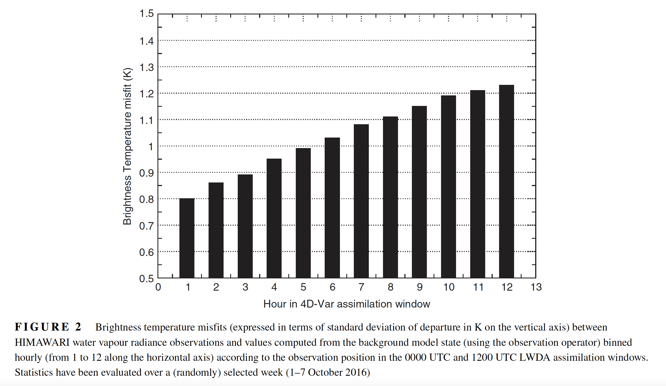
Brightness T misfit (STD K) increase with hour in assimilation window
12 h old
1 h old
McNally QJRMS 2019

Slide 32
NOAA definitions of data levels:
Level 0
Unprocessed raw instrument data as received from the observing platform excluding communication artifacts introduced by ground system.
Level 1a
Telemetry data that have been extracted but not decommutated from level 0 and formatted into time-sequenced datasets for easier processing. Level 1a formats are NOAA's internal formats and are only used for NOAA processing. They only exist briefly for the purpose of creating the level 1b datasets
Level 1b
Discrete, instrument-specific datasets derived from level 1a containing unprocessed data at full resolution, time-referenced, and annotated with ancillary information including data quality indicators, calibration coefficients and georeferencing parameters.
Level 2
Derived geophysical variables at the same resolution and locations as the level 1 source data.
Level 3
Products mapped on uniform space-time grid scales, usually with some completeness and consistency.
Level 4
Model output or results from analysis of lower level data e.g.variables derived from multiple measurements.
https://www.ngdc.noaa.gov/wiki/index.php/NOAA_Processing_Levels

Slide 33
LEO Sounding Satellite (Soundersat) Concept Exploration Broad Area Announcement BAA-NOAA-LEO-2019 Oct. 3, 2019
Lower bound threshold of 800 V/V too high. More realistic SNR ranges 100, 800, 1600

Slide 34
References
Anthes, R.A., M. W. Maier, S. Ackerman, R. Atlas, L. W. Callahan, G. Dittberner, R. Edwing, P. G. Emch, M. Ford, W. B. Gail, M. Goldberg, S. Goodman, Christian Kummerow, T. Onsager, K. Schrab, C. Velden, T. Vonderhaar, and J. G. Yoe, 2019: Developing Priority Observational Requirements from Space using Multi-Attribute Utility Theory. Bull. Amer. Meteor. Soc., 100, 9, 1753-1774, https://doi.org/10.1175/BAMS-D-18-0180.1
Bowler, N., 2020: An assessment of GNSS radio occultation data produced by Spire. Q. J. Roy. Met. Soc., 146, 3772-3778. https://doi.org/10.1002/qj.3872
Cucurull, L. and M.J. Mueller, 2020: An Analysis of Alternatives for the COSMIC-2 Constellation in the Context of Global Observing System Simulation Experiments, Wea. and Forecasting, 35, 51-66. https://doi.org/10.1175/WAF-D-19-0185.1 (and other references on OSSEs)
Harnisch, F., S. Healy, P. Bauer, and S. English, 2013: Scaling of GNSS radio occultation impact with observation number using an ensemble of data assimilations. Mon. Wea. Rev., 141, 4395– 4413. DOI: https://doi.org/10.1175/MWR-D-13-00098.1
Ho, S.-P., and Coauthors, 2020: Initial assessment of the COSMIC-2/FORMOSAT-7 neutral atmosphere data quality in NESDIS/STAR using in situ and satellite data. Remote Sens., 12, 4099, https://doi.org/10.3390/rs12244099
IROWG, 2020: Summary of the Seventh International Radio Occultation Workshop; Elsinore, Denmark; 19-25 September 2019, 7 May 2020,
IROWG (2021): Report of IROWG Activities: Outcome and Recommendations from the IROWG-8 Workshop. CGMS-49 IROWG-WP-01 V3, 28 April 2021.
https://irowg.org/wpcms/wp-content/uploads/2021/07/CGMS-49-IROWG-WP-01.pdf
Lonitz, K., C. Marquardt, N. Bowler and S. Healy, 2021: Impact Assessment of Commercial GNSS-RO data, ESA Contract Report 15 Nov. 2021.
https://www.ecmwf.int/en/elibrary/20240-final-technical-note-impact-assessment-commercial-gnss-ro-data
Marquardt, C., A. von Engeln, A. Nardo, and A. Andres, 2020: EUMETSAT Assessment of Spire Commercial RO Data. Technical Report EUM/TSS/TEN/20/1179102, 53 pp. Available from www.eumetsat.int
McNally, AP, 2019: On the sensitivity of a 4D-Var analysis system to satellite observations located at different times within the assimilation window. Q J R Meteorol Soc., 145:2806–2816. https://doi.org/10.1002/qj.3596
Privé N.C., R.M. Errico and A. El Akkraoui, 2022: Investigation of the potential saturation of information from Global Navigation Satellite System Radio Occultation observations with an observing system simulation experiment. Mon. Wea. Rev. https://doi.org/10.1175/MWR-D-21-0230.1

Slide 35
WMO Unified Policy for International Exchange of Earth System Data
“Members shall provide on a free and unrestricted basis the core data that are necessary
for the provision of services in support of the protection of life and property and for the
well-being of all nations, at a minimum those data described in Annex 1 to this resolution
which are required to monitor and predict seamlessly and accurately weather, climate, water
and related environmental conditions.”
Core data include radio occultation. Or at least according to Vision for the WMO Integrated Global Observing System in 2040
Backbone data.
Radio occultation is also an essential-climate-variable (ECV)
WMO Resolution 4.1/1 (Cg-Ext(2021)) approved October 2021
https://ane4bf-datap1.s3-eu-west-1.amazonaws.com/wmocms/s3fs-public/ckeditor/files/Cg-Ext2021-d04-1-
WMO-UNIFIED-POLICY-FOR-THE-INTERNATIONAL-approved_en_0.pdf?4pv38FtU6R4fDNtwqOxjBCndLIfntWeR

Slide 36
WMO International Working Group on Radio Occultation (IROWG) Recommendations
IROWG-7 Denmark 19-25 September 2019.
At least 20,000 occultations per day, globally distributed and providing good sampling of diurnal cycle (important for NWP, climate, space weather)
Any commercial data should be purchased with a world license, so the data are available to all.
Ensure that all information necessary for independent processing centers to process raw level 0 data (phase, amplitude, orbit data, including metadata and associated documentation) to climate products is freely available (applies to government and commercial RO data). This includes long-term archiving.
Strong support for a “backbone” of agency (government) funded RO missions with long-term commitment.

Slide 37
NWP Sub-group recommendations
At least 20,000 occultations per day, global coverage and all local times of at least COSMIC-1 quality
COSMIC-1 quality
80% penetrate below 2 km altitude

Slide 38
Climate Sub-group recommendations
Ensure continuity and long-term availability of climate quality RO measurements with global coverage over all local times.
Operational RO missions for continuous global climate observations need to be established and maintained as a backbone to ensure continuity with at least 20,000 occultations per day.

Slide 39
Space Weather Sub-group recommendations
Acquire high quality near real-time RO space weather measurements, spanning level-0 data to retrieval products, at middle to high latitudes with full local time coverage in standard formats with needed metadata and documentation.
The quality of these data and products should meet COSMIC-2 requirements
Absolute TEC (3 TCU)
Relative TEC (0.3 TECU)
S4 amplitude scintillation index (0.1)
Sigma-phi phase scintillation index (0.1 rad)
Latency COSMIC-2 requirements of 30 min with goal of 15 min

