Slide 1
Advances in Hyperspectral Microwave Sounding from Space
Antonia Gambacorta¹,
Mark Stephen¹, Fabrizio Gambini², Priscilla Mohammed⁴, Dan Sullivan¹, John Blaisdell³, Isaac Moradi⁵ , Yanqiu Zhu¹, Will McCarty¹, Greg Blumberg¹, Joseph Santanello¹ and Jeff Piepmeier¹
NOAA SAT Meeting - November 29th, 2021
¹ NASA Goddard Space Flight Center (GSFC), Greenbelt, MD 20771
² University of Maryland Baltimore County (UMBC), Baltimore, MD 21250
³ Science Applications International Corporation (SAIC), Reston, VA 20190
⁴ Morgan State University (MSU), Baltimore, MD 21251
⁵ University of Maryland (UM), College Park, MD 20742

Slide 2
Motivations, Trade Studies, Applications
Hyperspectral Microwave Measurements have been long advocated by meteorological and space agencies worldwide to improve temperature, water vapor and hydrometeors retrieval from space.
Recent advances in Photonic Integrated Circuits (PICs) technology have opened a new era of hyperspectral microwave instrument development. Our team at GSFC has been awarded the development of a Hyperspectral Microwave Photonic Instrument (HyMPI), configured to provide extended, high spectral resolution coverage in the microwave domain of the Earth’s thermal radiation.
This presentation provides preliminary results showing significant enhancements in the thermodynamic retrieval vertical structure with respect to POR products that can be key to numerous climate and weather forecasting applications, particularly in the PBL.
Our goal is to actively engage the science community during this critical trade study phase and seek feedback on product requirements that can help consolidating instrument specifications and its science and applications’ traceability.

Slide 3
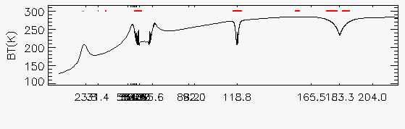
HyMPI’s Baseline Configuration
RFI
window
window
window
window
window
H₂O
O₂
O₂
H₂O
23.8 30.4 50–57.3 88.2 92 118.8 165.5. 183.3 204.0
ATMS/TROPICS Channel Frequencies (GHz)
HyMPI Frequency Coverage (20 – 220 GHz)
The design presented in [Aires et al., 2015; Aires et al., 2017] was used as a reference design with some augmentation.
One of HyMPI’s baseline configurations is characterized by continuous spectral coverage along the oxygen absorption lines in the 52.6-57.3 GHz, 63.3-67.9 GHz (spectral resolution 10 MHz), and 113.7-123.7 GHz spectral bands (spectral resolution 20 MHz), used to retrieve the vertical temperature profile. It has full-spectrum coverage in the water vapor absorption line centered in the 173.3-193.3 GHz band (spectral resolution of 40 MHz), used to retrieve the vertical water vapor profile. In addition to 22 “window” channels from Aires et al., 2015, we have studied the full interstitial window regions.
Red bars are regions of Radio Frequency Interference

Slide 4
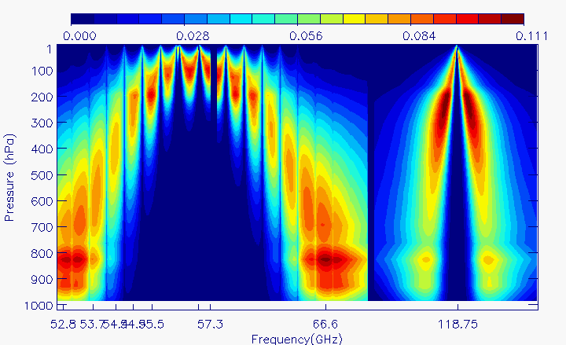
Brightness Temperature Sensitivity Analysis to Temperature
(K/Km)
1-K temperature perturbations in each 1 km-pressure layer of the atmospheric profile have been applied to measure the response in brightness temperature in the oxygen bands (10 – 20 MHz resolution).
For comparison purposes, ATMS and TROPICS spectral channel frequencies are highlighted by blue and green arrows, respectively.
Pressure (hPa)
52.8 54.4 55.5 57.3 65.6 118.75
53.7 54.9
(GHz)
ATMS channels
TROPICS channels
52.6 - 57.3 GHz 63.3 - 67.9 GHz 113.7 - 123.7 GHz
HyMPI Temperature Frequency Coverage

Slide 5
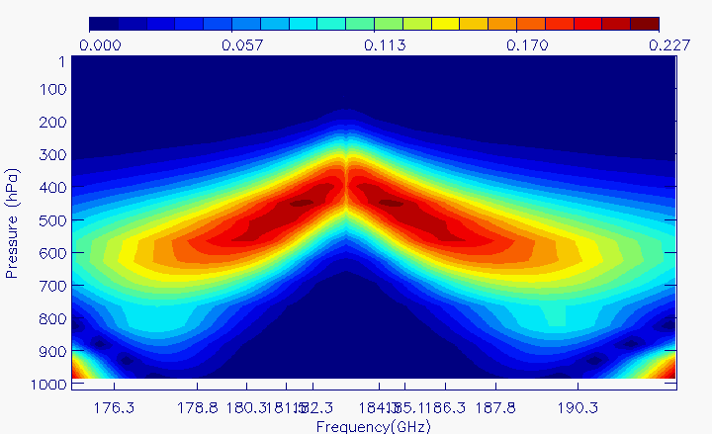
Brightness Temperature Sensitivity Analysis to Water Vapor
K/(Km)
5% water vapor perturbations in each 1 km-pressure layer of the atmospheric profile have been applied to measure the response in brightness temperature in the water vapor band (40MHz spectral resolution).
For comparison purposes, ATMS and TROPICS spectral channel frequencies are highlighted by blue and green arrows, respectively.
Pressure (hPa)
176.3 178.6 180.3 182.3 184.3 186.3 187.8 190.3
(GHz)
181.5 185.1
ATMS/TROPICS channels
HyMPI Water Vapor Frequency Coverage (173.3-193.3 GHz)

Slide 6
Brightness Temperature Analysis – a few remarks
MW domain spectrally purer than the infrared: the high redundancy is fully exploitable to increase signal to noise, with significant benefits on retrieval performance (see ahead slides 9 and 10).
HyMPI will enable an unprecedented fine resolution observations of extended window regions where the water vapor continuum is important.
Those measurements will be critical to improve spectroscopy and forward modeling, which in turn will benefit retrieval performance, numerical weather and climate prediction models, and enable new physics discoveries.

Slide 7
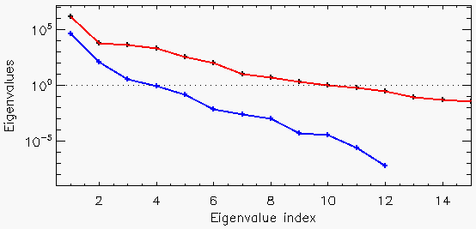
Information Content Analysis – Water Vapor
We perform a singular value decomposition from preliminary ~3000 simulated spectra (land, ocean, clear sky and cloudy scenes), using HyMPI’s and the 12 ATMS water vapor and window channels.
HyMPI will increase the retrieval water vapor vertical resolution from at least three coarse layers to an effective vertical profile of at least ten layers.
HyMPI
Noise floor
ATMS

Slide 8
Vertical Resolution Study – Water vapor Averaging Kernels
ATMS
HyMPI
HyMPI fills the mid-troposphere - 800 hPa gap in the ATMS retrieval vertical resolution and sensitivity.
Nearly doubles the retrieval vertical resolution along the full extent of the mid/upper tropospheric column, and
Significantly increases both vertical resolution and sensitivity in the PBL.
PBL

Slide 9
Retrieval Impact Study – RMS Error Performance (Ocean, clear, global sample)
HyMPI reduces the POR temperature Root Mean Square (RMS) error (left) by 50% in the PBL and 20% in the mid/upper troposphere.
Water vapor RMS error (right) improves by ~50% in the PBL and along the full extent of the mid/upper troposphere.
Both improvements, in the PBL and the free troposphere above, will potentially enhance the identification of the PBL height.
First Guess
118/183 GHz
ATMS
HMW
PBL

Slide 10
Retrieval Impact Study – Bias Error Performance (Ocean, clear, global sample)
HyMPI reduces the POR temperature BIAS error (left) by 50% in the PBL.
The water vapor BIAS error (right) almost reaches zero in the PBL domain and all along the free troposphere.
The improvements shown, both in the PBL and the free troposphere above, will lead to significant enhancement in the identification of the PBL height as well.
First Guess
118/183 GHz
ATMS
HMW
PBL

Slide 11
Stratocumulus Cloud Scenario
Figure a) is a cloud liquid water profile from the area. Figure b), c), and d) show the first guess, ATMS and ATMS + HyMPI derived water vapor departure from the truth at 875 hPa.
HyMPI provides significant enhancement in the water vapor at the top of the PBL. Improved water vapor fields in stratocumulus cloudy scenes are critical for cloud-climate feedbacks and numerical weather prediction.

Slide 12
Conclusive Remarks and Outlook
This presentation provides preliminary results showing significant enhancements in the thermodynamic retrieval vertical structure with respect to POR products that can be key to numerous climate and weather forecasting applications, particularly in the PBL.
What driving applications (improved and new) can we develop? What are the requirements?
Our goal is to actively engage the science community during this critical trade study phase and seek feedback on product requirements that can help consolidating instrument specifications and its science and applications’ traceability.

Slide 13
Back up slides

Slide 14
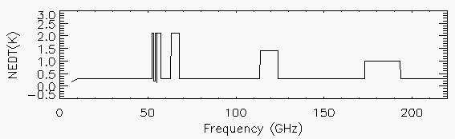
RFI
window
window
window
window
window
H₂O
O₂
O₂
H₂O
23.8 30.4 50–57.3 88.2 92 118.8 165.5. 183.3 204.0
ATMS/TROPICS Channel Frequencies (GHz)
HyMPI Frequency Coverage (20 – 220 GHz)

