Slide 1

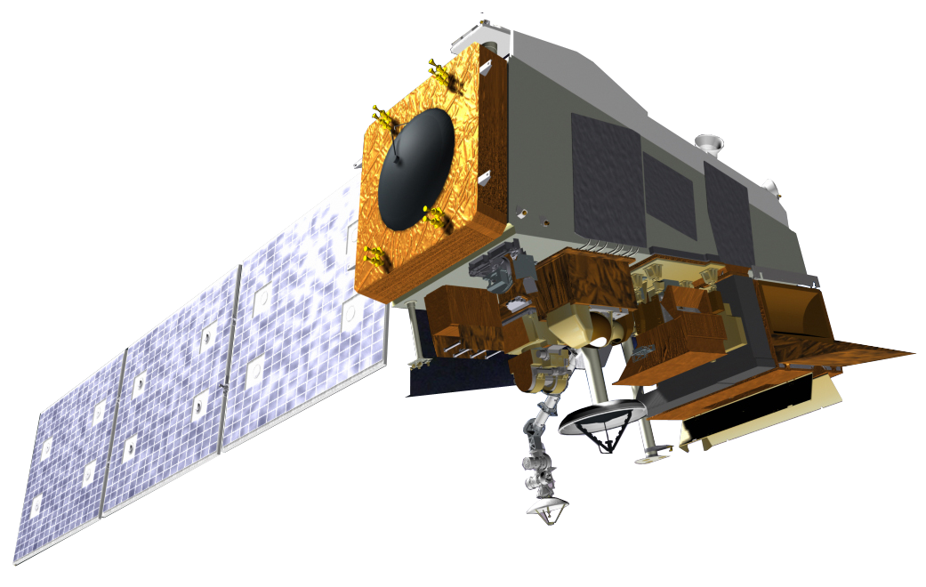
The Value of Two Satellites in the Same Orbit
for Nowcasting and Climate
Monitoring
Short version from AMS 2020 ANNUAL conference
Mitch Goldberg, NESDIS Chief SCIENTIST
Lihang Zhou, JPSS Product Development Manager
JPSS Program, LANHAM, MD

Slide 2





JPSS Payload Capability
JPSS Instruments |  | Measurements & Products | Vendor
 | ATMS – Advanced Technology Microwave Sounder | High vertical resolution temperature and water vapor information critical for forecasting extreme weather events, 5 to 7 days in advance | NGES
 | CrIS – Cross-track Infrared Sounder
 |  |  | Harris
 | VIIRS – Visible Infrared Imaging Radiometer Suite | Critical Imagery products, including snow/ice cover, clouds, fog, aerosols, fire smoke plume, vegetation health, phytoplankton abundance/chlorophyll | Raytheon
 | OMPS – Ozone Mapping Profiler Suite (Nadir Mapper, Nadir Profiler, Limb - S-NPP, JPSS-2+) | Ozone spectrometers for monitoring ozone hole health, recovery of stratospheric ozone, and for UV index forecast | Ball Aerospace
 | CERES – Clouds and the Earth’s Radiant Energy System (S-NPP & JPSS-1) | Scanning radiometer that supports studies of Earth Radiation | CERES – NGAS

Slide 3
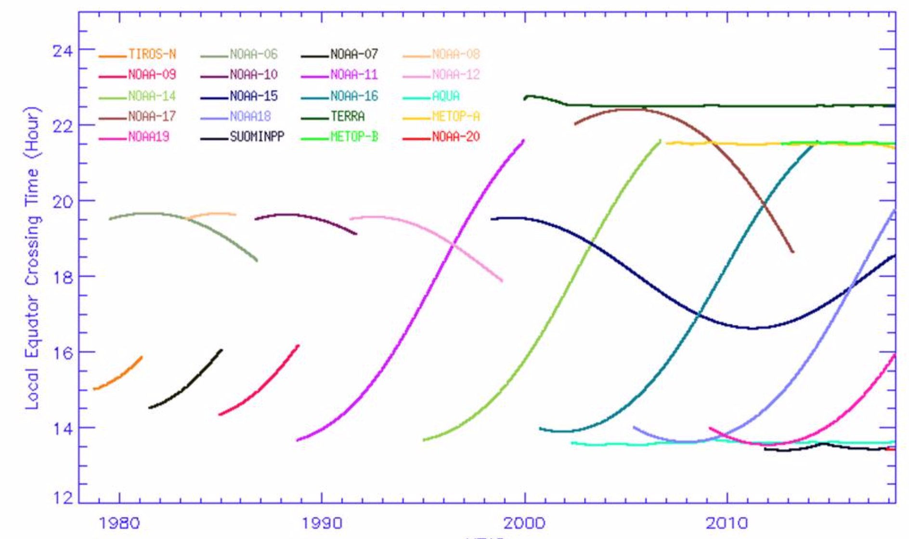
Good temporal coverage of sounder data because of legacy POES satellites and MeTOP series.

Slide 4
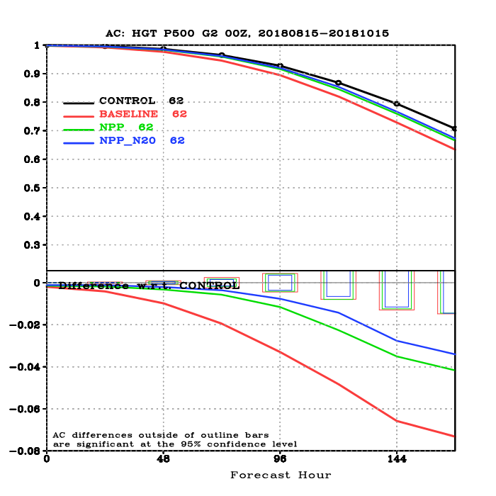
Value of two JPSS satellites for NWP
500 hPa anomaly corrections (AC) - approximately represents middle of the troposphere (~ 16000 feet) steering currents to predict storm movements
(AC = 1 is perfect, 0.5 - unreliable). (Credit: Jim Jung)
Baseline has no satellite data; Control is all observations
Global
As model resolution improves and have rapid updates (i.e. every hour vs 6 hours),
the importance of a global constellation grows. A regional model running at 6AM local
time will have no JPSS data because JPSS has a local time of 13:30/1:30
Notes:
These next 2 slides are global statistics. High level briefings probably don’t care about NH vs SH statistics so these will be more appropriate.

Slide 5
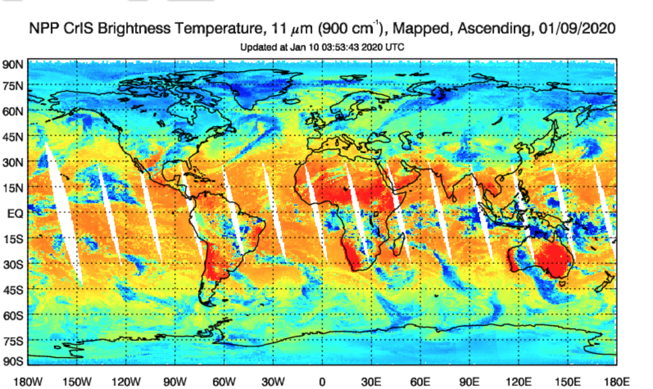
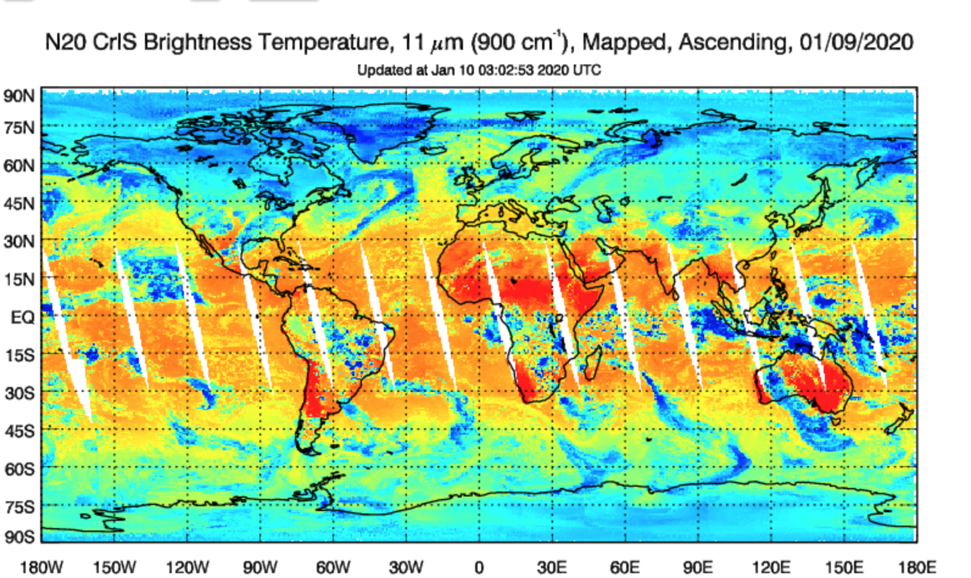
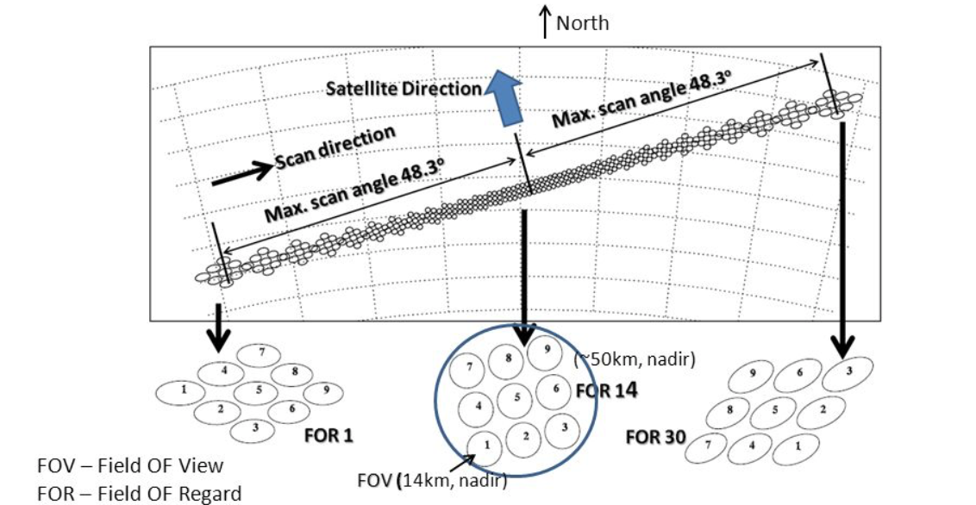
Better global coverage with two satellites

Slide 6
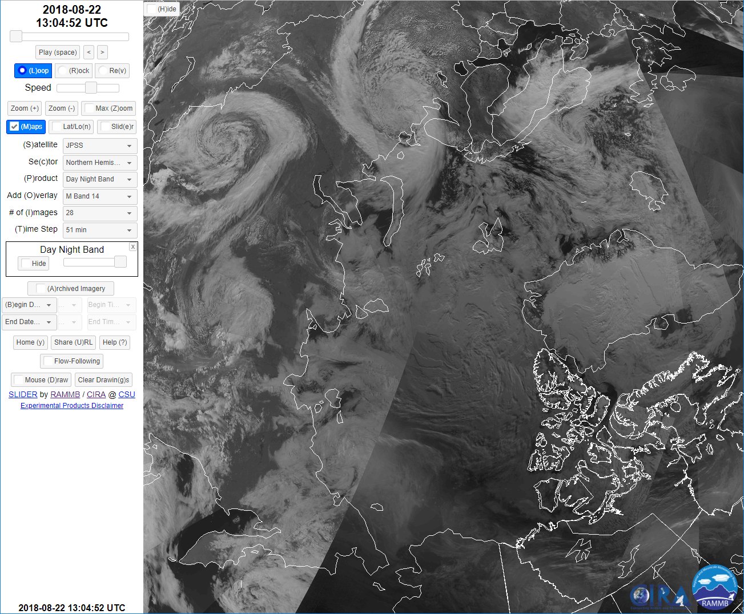
Twice the VIIRS

Slide 7
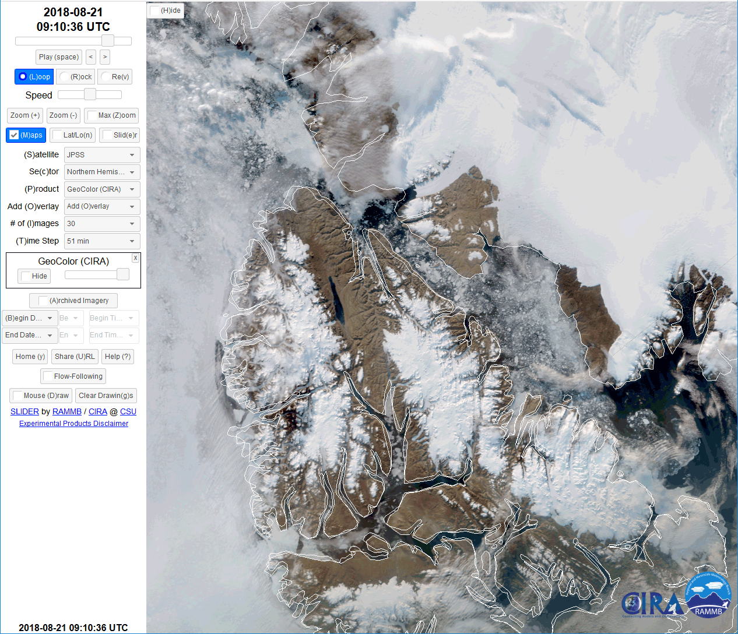
Half orbit separation enables better tracking of features at higher latitudes
Ice - Nares Strait between Greenland and Ellesmere Island, Canada. August 21, 2018
SNPP and NOAA-20 (750 meter resolution)

Slide 8
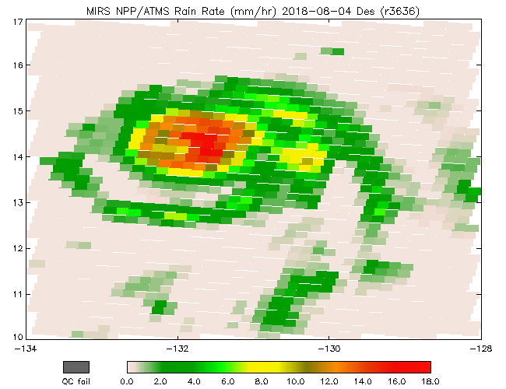
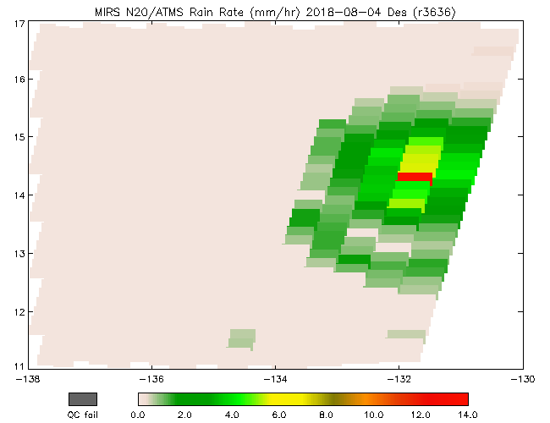
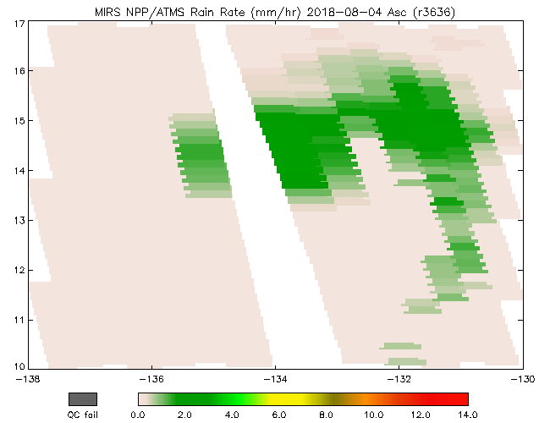
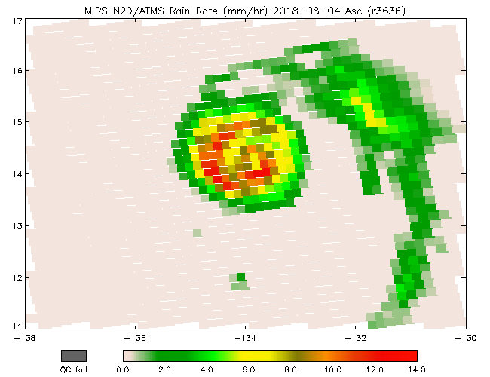
Better with two satellites – half orbit separation
SNPP 2018-08-04, 1015 UTC
N20 2018-08-04, 0924 UTC
Des
Doubling the number of ATMS overpasses increases odds that TCs fall within the (near nadir) “sweet spot” of swath.
Swath edge
SNPP 2018-08-04, 2304 UTC
N20 2018-08-04, 2213 UTC
Asc
Swath edge

Slide 9
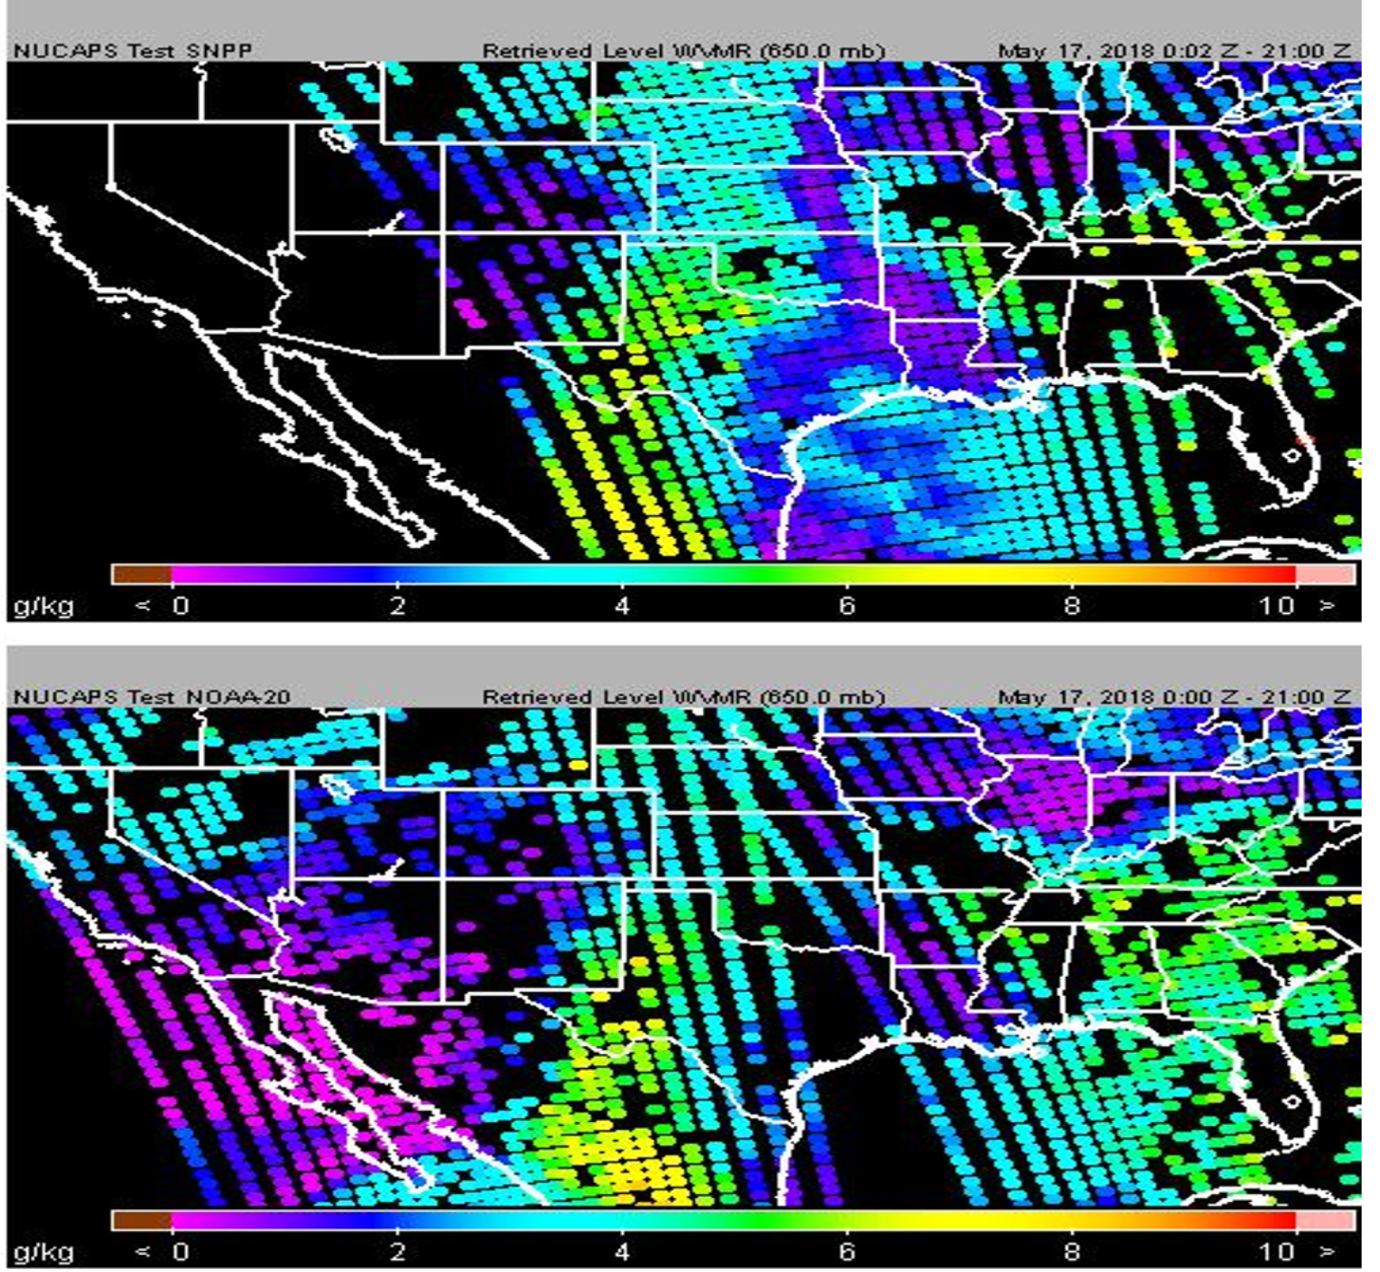
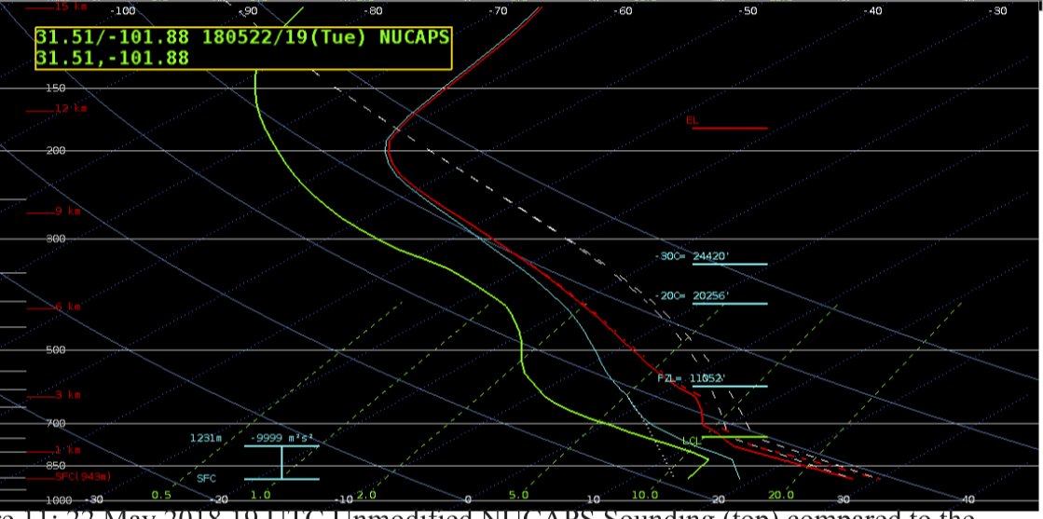
Better with two Satellites
Feedback from Forecasters
“NUCAPS gradients are helpful for situational awareness prior to convective development”
“A swath of NUCAPS soundings came in from a 1941 UTC pass… and showed high CAPE and modest mid-level lapse rates, thus supporting my idea of sub-severe convection”
“I had a chance to use NUCAPS to monitor the air mass in front of the squall line and found it to be a useful tool in the forecast process. It identified steep lapse rates and some mid-level drying that contributed to the high wind threat”
“NUCAPS is useful as a pre-storm analysis tool…to determine convective potential”
“NUCAPS gave me confidence in the wind threat”
“NUCAPS showed environments that were becoming more moist and unstable, which would lead to SPS or SVR late in the forecast shift”
“I used gridded NUCAPS mid-level lapse rates to verify my initial analysis of the atmosphere. I compared NUCAPS to HRR/GFS/NAM and SPC Mesoanalysis. NUCAPS was the closest to the SPC Mesoanalysis, which added confidence to my perception of severe threat and which areas to watch.”
9

Slide 10
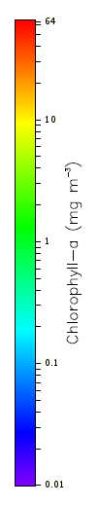
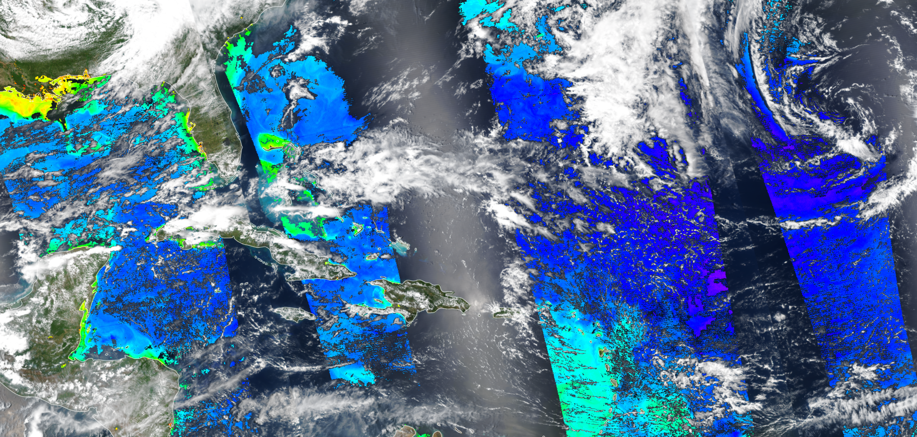
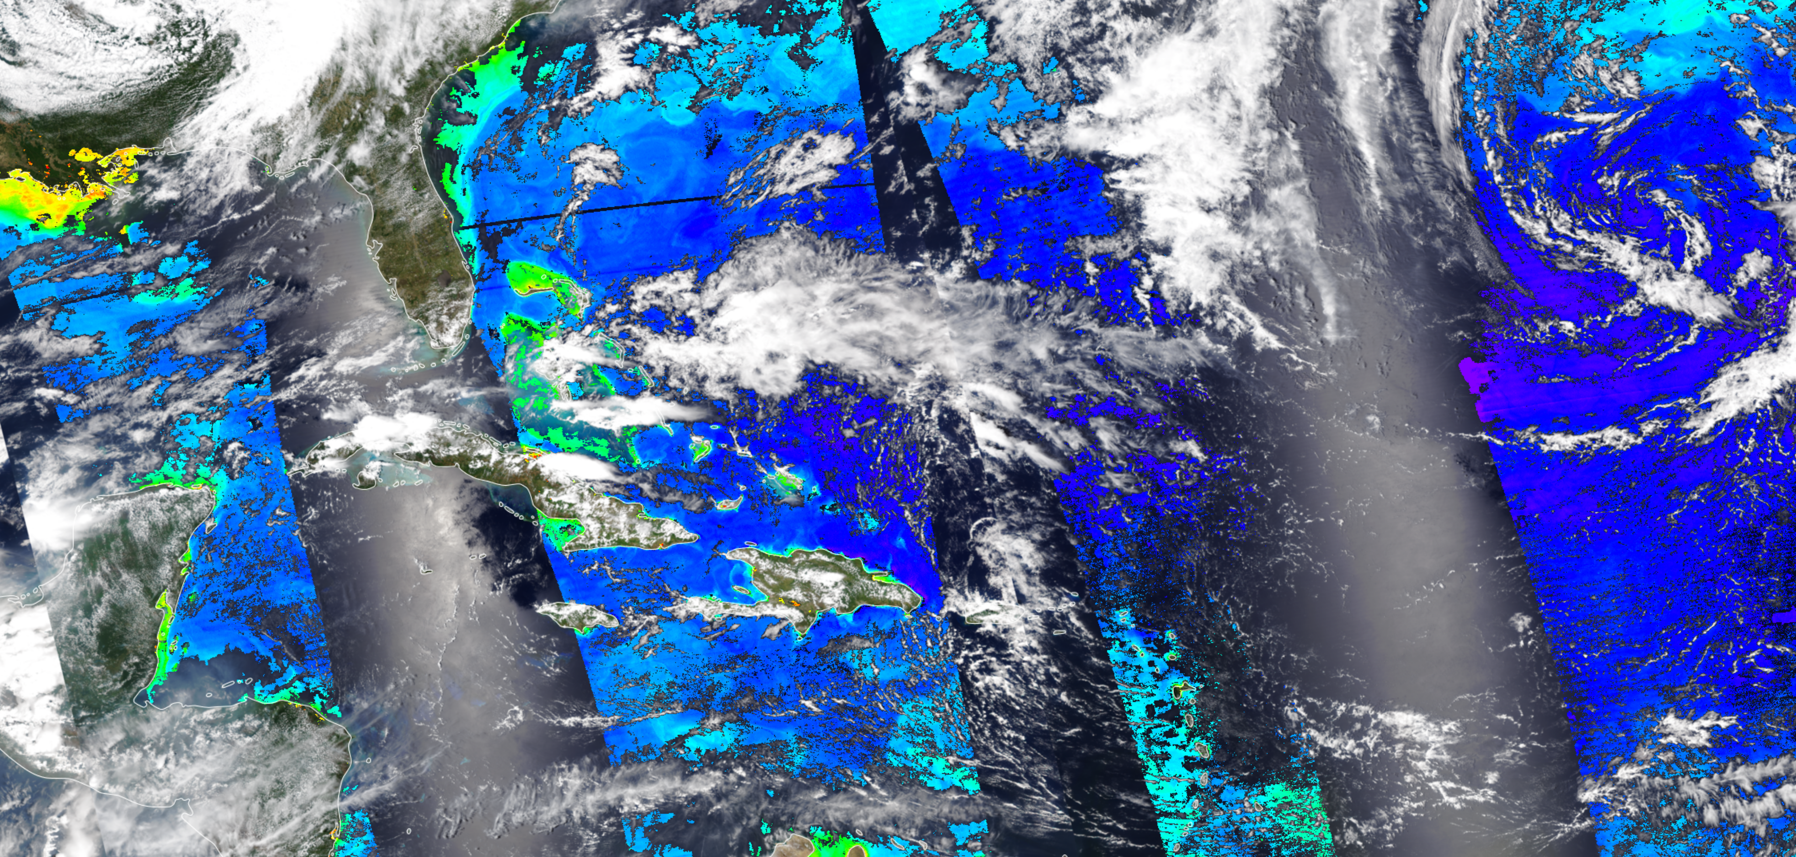
NMFS and NOS use satellite ocean color products for a variety of marine ecosystems applications (e.g. HABs) - coverage is critical
April 26, 2018
SNPP
NOAA-20
May 5, 2018
Sequence of derived Chlorophyll-a products from SNPP, NOAA-20, combined SNPP and NOAA-20, and Sentinel 3A. 50 minute separation of SNPP and NOAA-20 alleviates issue of no product in sun glint. Addition of Sentinel 3A and later 3B will fill in remaining gaps and provide exceptional daily global coverage. Enterprise algorithms used for SNPP/JPSS VIIRS and Sentinel 3 OCLI enables blending.
10

Slide 11
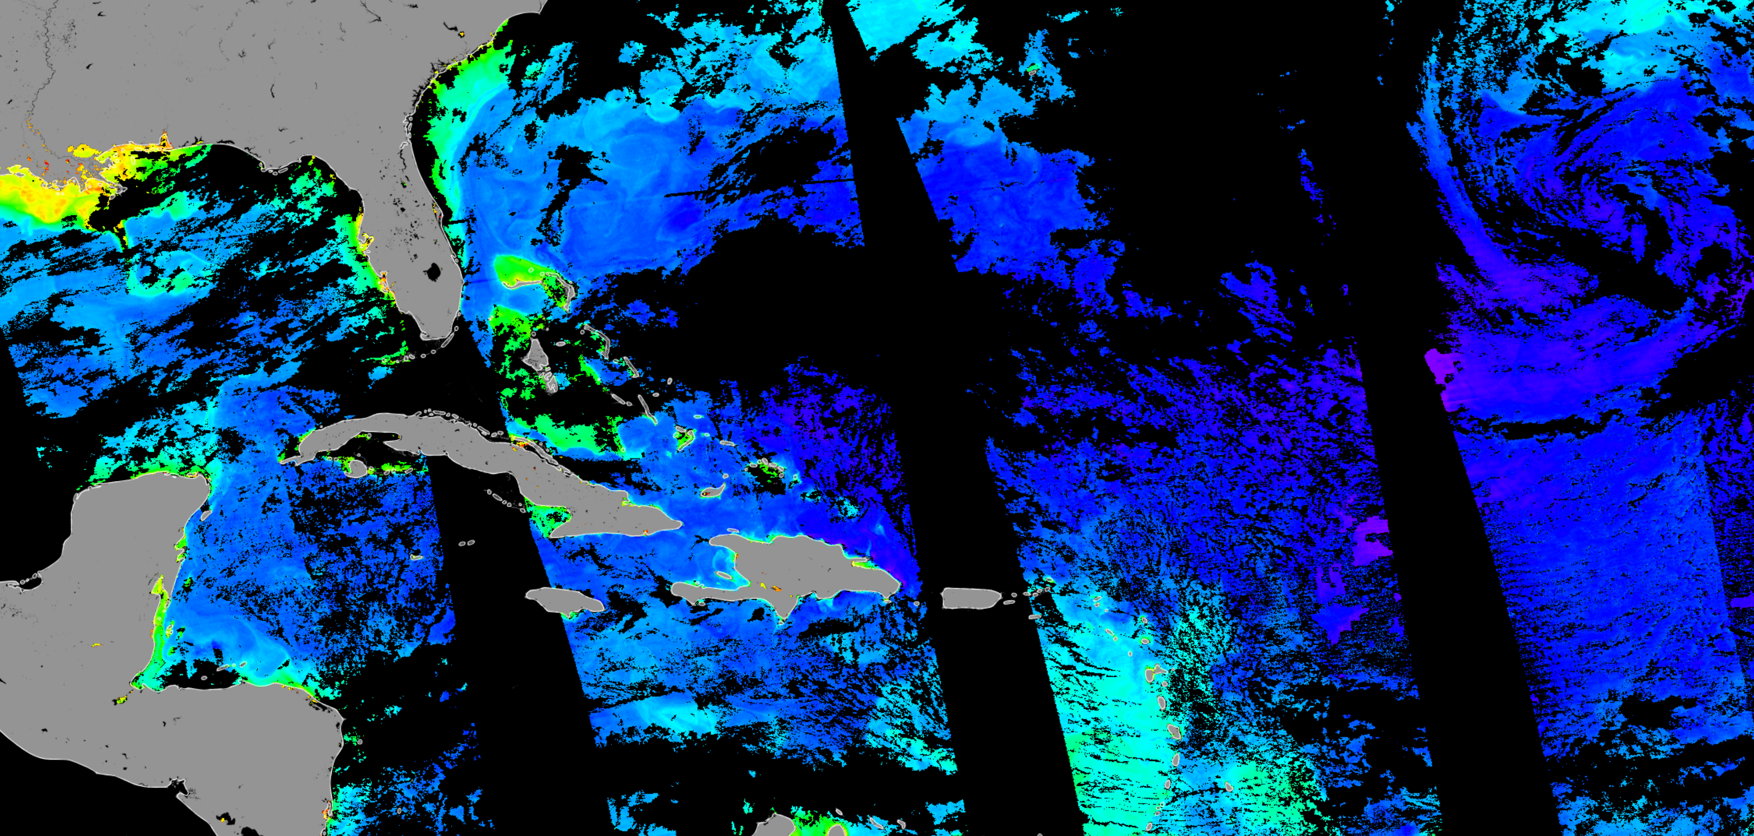
NMFS and NOS use satellite ocean color products for a variety of marine ecosystems applications (e.g. HABs) - coverage is critical
April 26, 2018
May 5, 2018
COMBINED
Sequence of derived Chlorophyll-a products from SNPP, NOAA-20, combined SNPP and NOAA-20, and Sentinel 3A. 50 minute separation of SNPP and NOAA-20 alleviates issue of no product in sun glint. Addition of Sentinel 3A and later 3B will fill in remaining gaps and provide exceptional daily global coverage. Enterprise algorithms used for SNPP/JPSS VIIRS and Sentinel 3 OCLI enables blending.
11

Slide 12
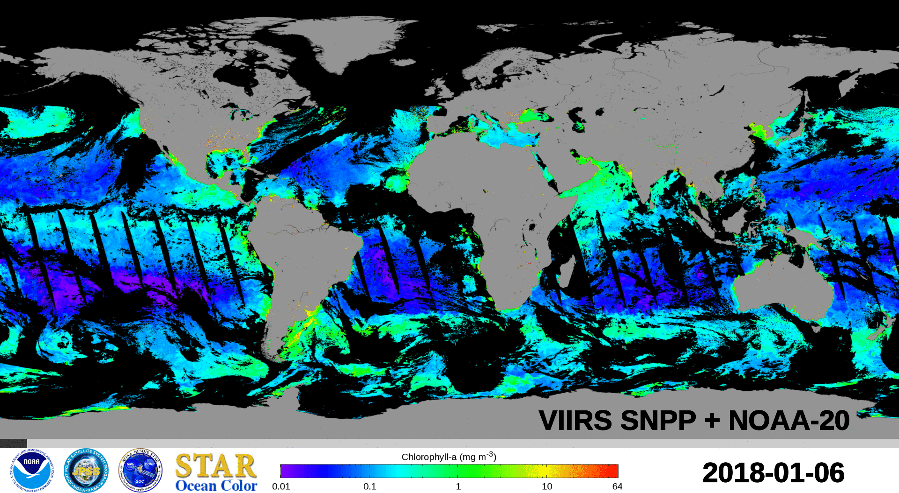
VIIRS-SNPP and NOAA-20 Merged Chl-a Images
(January 6-February 7, 2018)

Slide 13
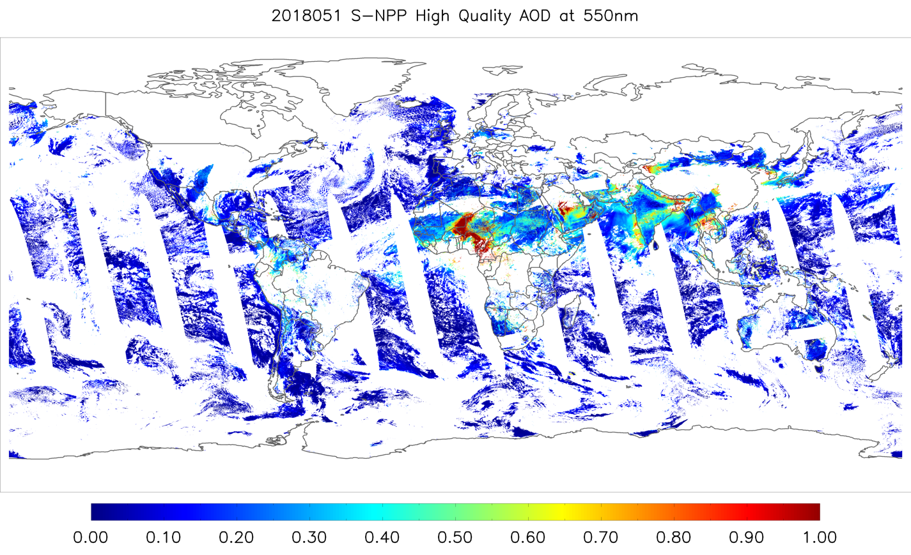
Aerosol Optical Depth (AOD)
S-NPP and NOAA-20 synergy (1)
S-NPP AOD on 02/20/2018
Credit: Shoba Kondragunta

Slide 14
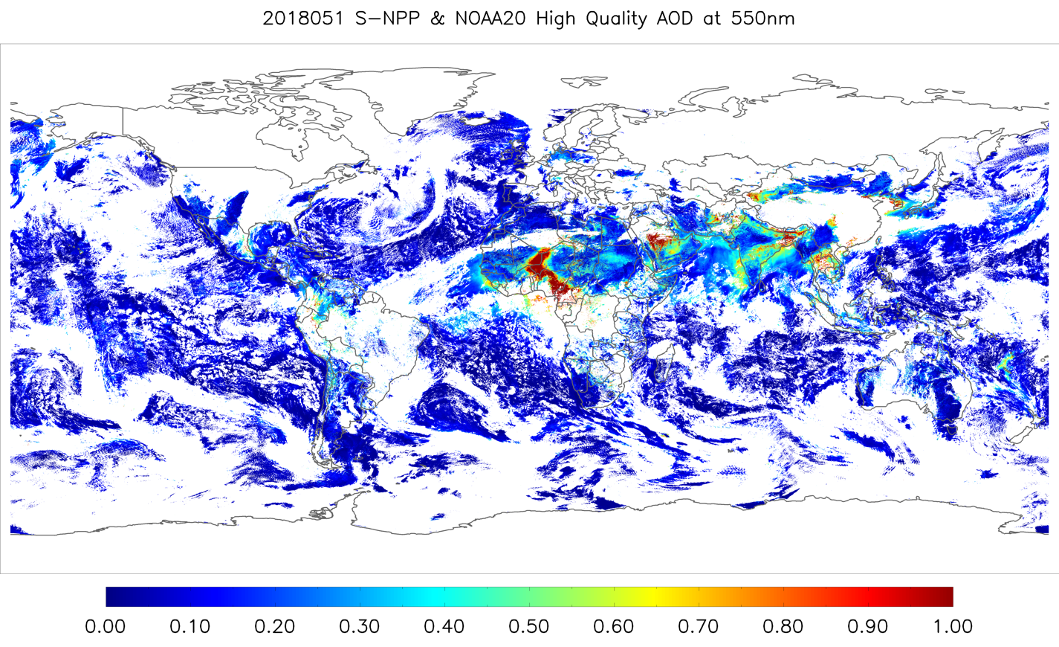
Aerosol Optical Depth (AOD)
S-NPP and NOAA-20 synergy (2)
NOAA-20 AOD overlaid on S-NPP AOD on 02/20/2018 (~50 min time difference)

Slide 15
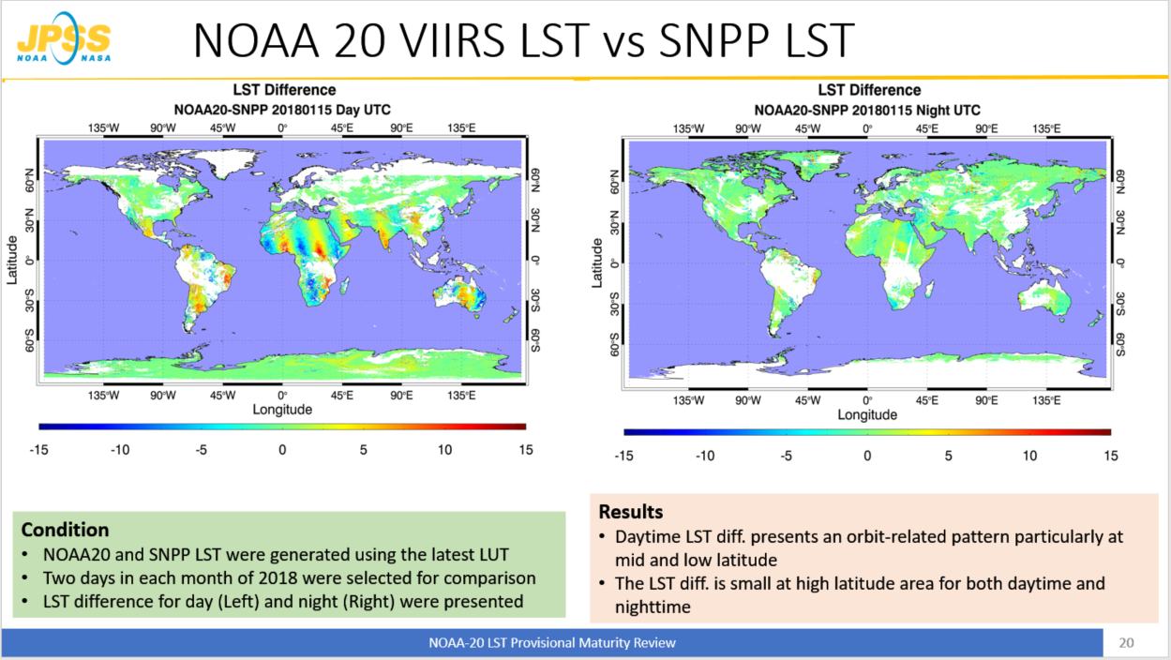
Two satellites provide higher confidence in accuracy of our products
Two satellites half orbit apart have an added advantage; Testing the consistency of SDRs and EDRs between same series of instruments. – However you must average over the repeat cycle range (16 days, 32, 48 … etc). Below is for just one day

Slide 16
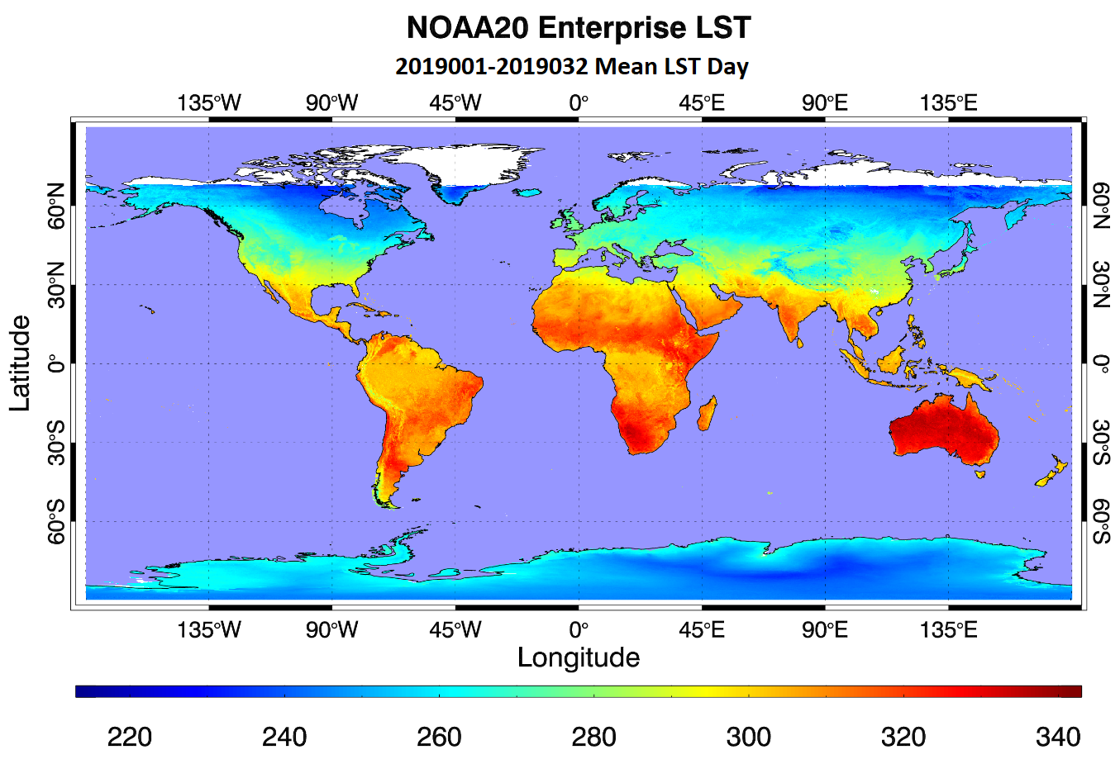
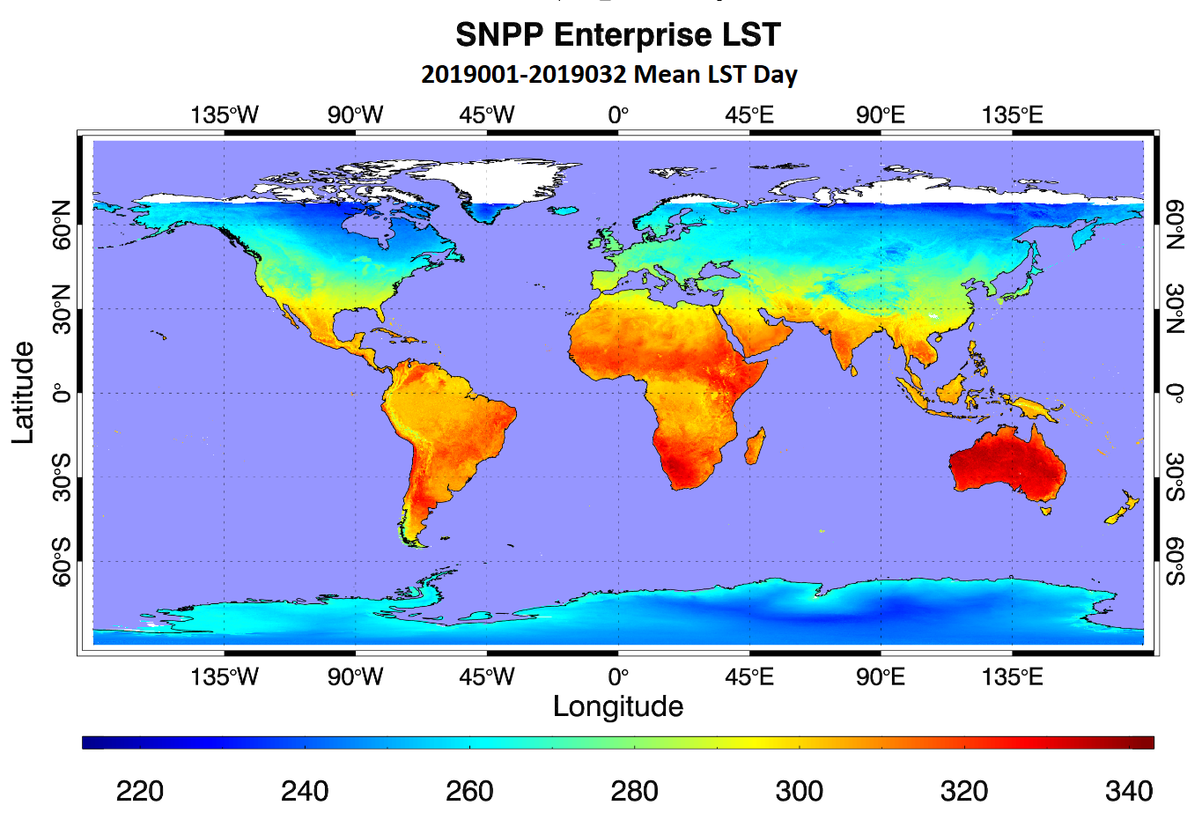
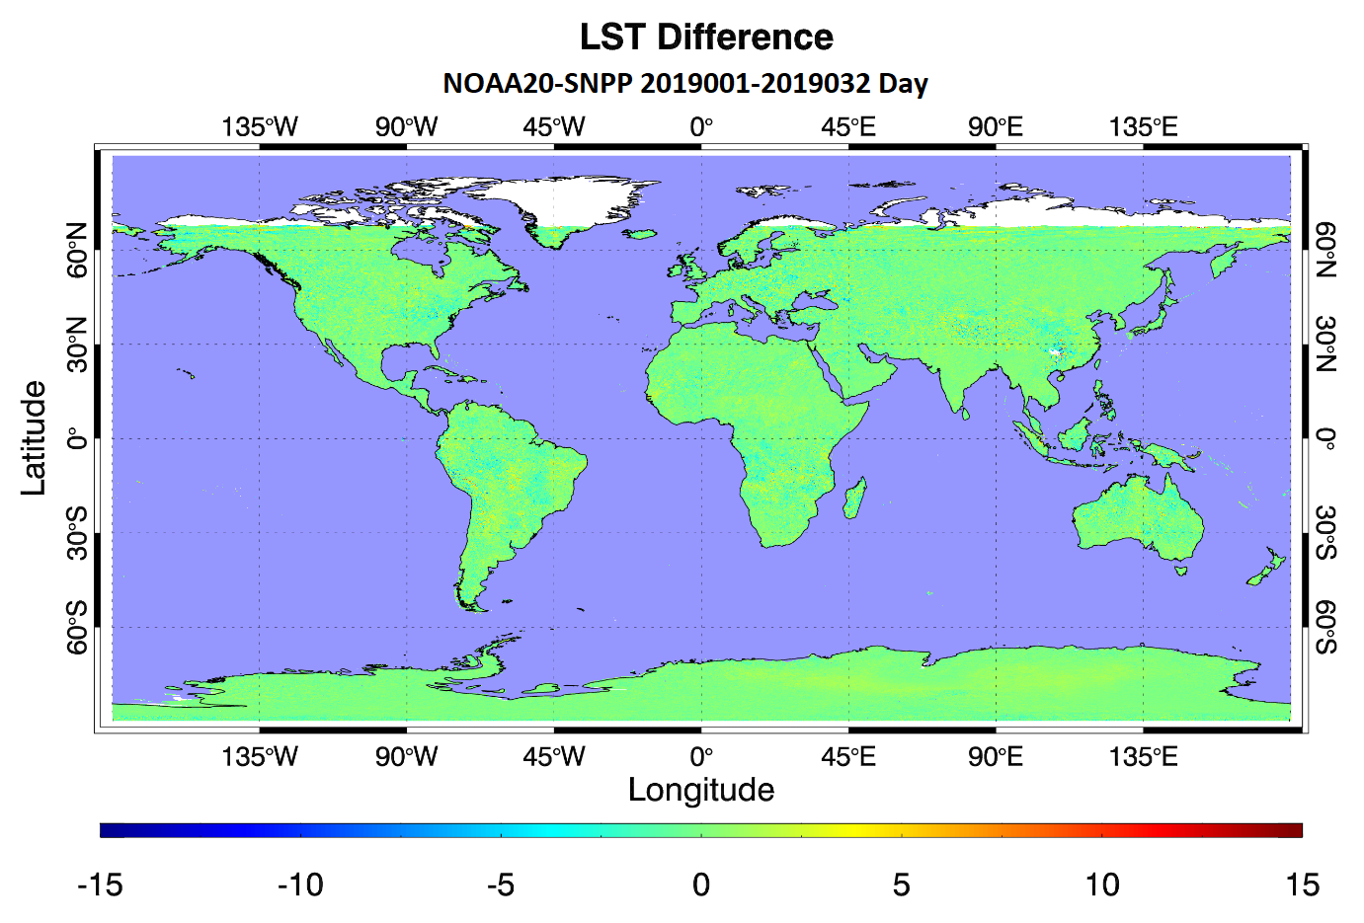
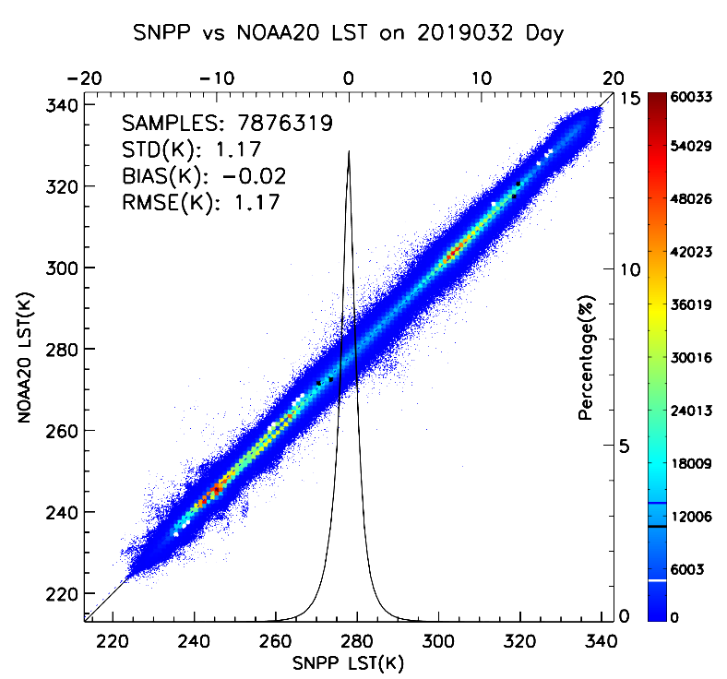
32 Day Mean LST: Day
Small bias and scatter!!

Slide 17
CrIS (SNPP, NOAA20 – 32 days (7/25-8/25/19))
Credit: Banghua Yan, STAR

Slide 18
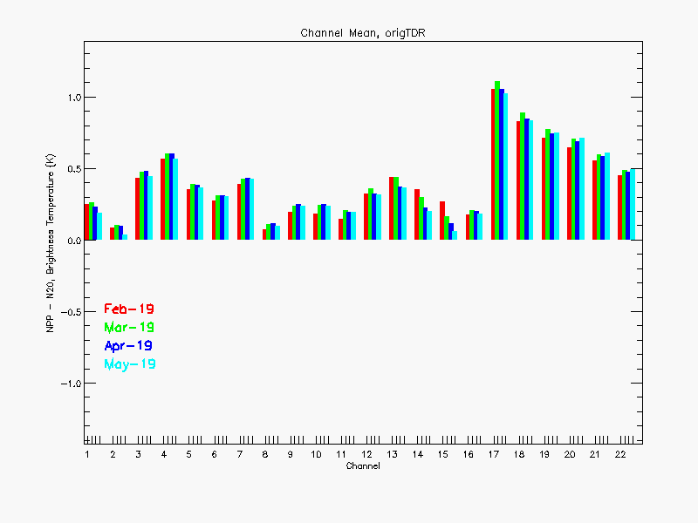
Stable orbits , two satellites in the same orbit enables stability monitoring for climate applications
Antenna Temperature differences between SNPP and NOAA-20 for 4 different months
Credit: Xingpin Liu, STAR/IMSG

Slide 19

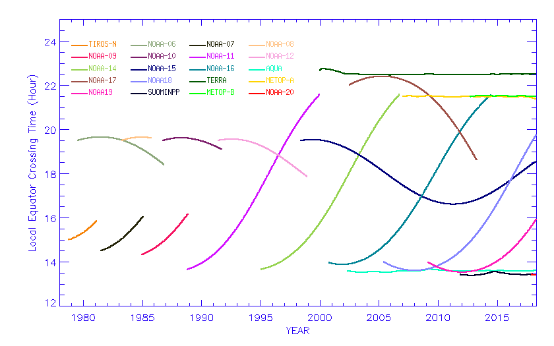
Satellite Orbital Drifts
MetOp-A, -B, and future –C have close to the same 9:30am stable morning orbits
Aqua, SNPP, NOAA-20, and future JPSS have close to the same 13:30pm stable afternoon orbits
Terra has a stable 10:30am morning orbit
All other satellite’s orbits drifted with time
Satellite local equator crossing time (LECT) for ascending orbits
(Plot is provided by STAR calibration team)
Notes:
Mitch provided long time support for project from the program side, such as leveraging funding.
And Fuzhong also provides program support and coordinate the CRTM team to work with our product development team. You may notice that most of my SDS science team members are from his Branch.
I also want to thank Changyong for his long time support from scince side. I can always count on his support when I need a discussion on science. even when I need support from his team members.

Slide 20
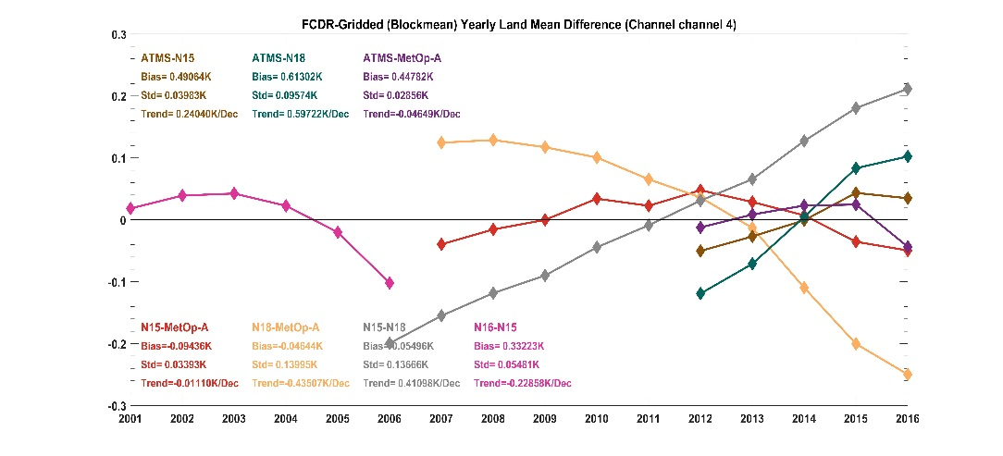
Challenges in Defining Reference Satellites
—Satellite Orbital Drifts Induce Bias Drifts
Satellite Orbital Drifts Cause
Changes with time in diurnal Sampling
Biases change with time
Need complicated bias correction algorithms to remove these time-varying biases
Inter-satellite difference time series for AMSU-A
satellite pairs.
Credit: Cheng-Zhi Zou. -- (see Wed 11 AM paper)
Notes:
This project focus on developing MSU/AMSU atmospheric temperature CDRs. The window channels will be addressed by another NOAA group.
In summary, we work on 15 atmospheric temperature channels, involving 15 satellites, with tempral coverage from late 1978 to present.
Each channel needs to be intercalibrated seperately.
With that, let me first talk about the MSU atmospheric temperature CDR development. The MSU started from 1978 on TIROS-N and ended on NOAA-14 in May 2007. So we don’t have MSU observations now. We have already completed the MSU CDR development and gained a lot of experiences. We have developed many new techniques for various bias correction procedure. So I am going to talk with more details on this instrument.

Slide 21
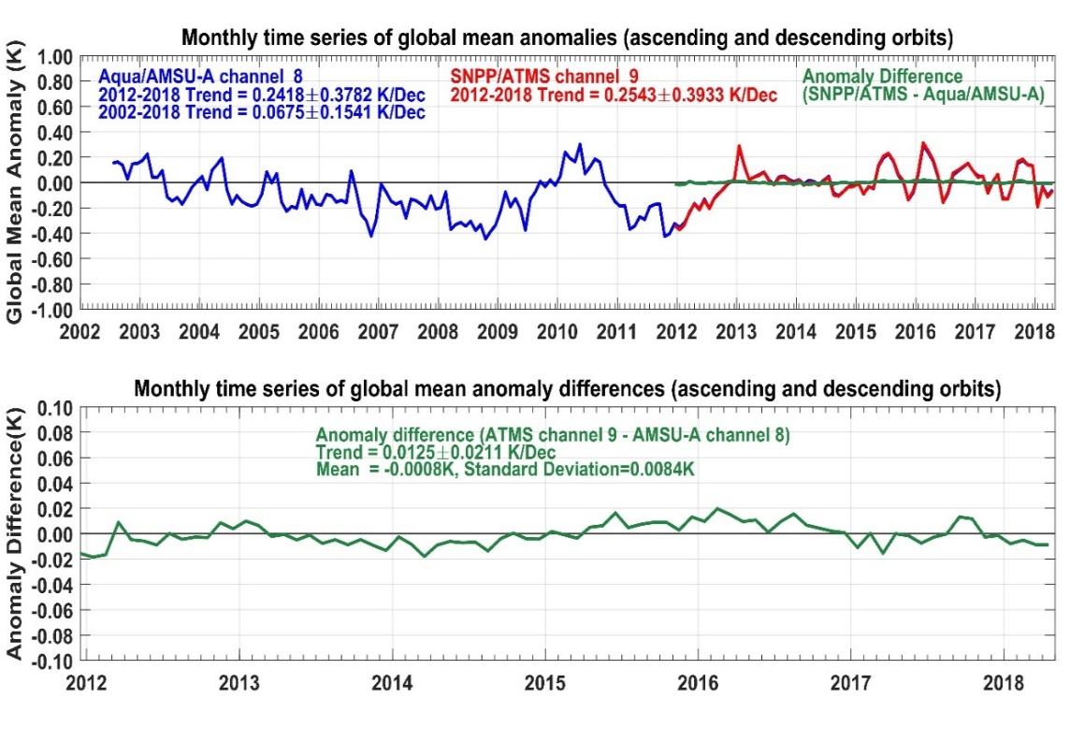
Stable orbits provide high confidence in long-term data records
Monthly global mean anomaly time series of brightness temperatures for AMSU-A channel 8 onboard Aqua (blue, top panel) versus ATMS channel 9 onboard SNPP (red, top panel) and their difference time series (green, top and lower panels). The AMSU-A and ATMS data are respectively from June 2002 and December 2011 to April 2018. The AMSU-A anomaly time series are overlaid by ATMS during their overlapping period with their differences shown as nearly a constant zero line in the same temperature scale. Amplified scale of temperature is used in the bottom panel to show detailed features in the anomaly difference time series. Both ATMS and AMSU-A data are from limb-adjusted views and averaged over ascending and descending orbits (plot from Zou et al. 2018).

Slide 22
Summary
Primary and secondary satellites configured in a half orbit separation are beneficial.
With respect to data assimilation the improvement of the second satellite is about 20% in a JPSS only scenario
But for nowcasting, ecosystem, situational awareness applications - the value of the half orbit separate is significant.
Furthermore the two-satellite configuration in the same orbit, same equator crossing time enables high confidence in both data products and long-term data records.

