Slide 1
Application Drivers for Observations
Dr. Mitch Goldberg
NESDIS Chief Scientist
May 10, 2021

Slide 2
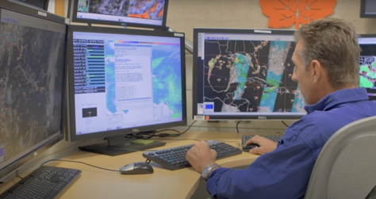
Applications drive NOAA services, and Observations drive Applications
Hence, better to define the applications needs prior to defining the observational needs
Applications will drive:
The type of observations and their attributes
Accuracy/Precision, Spatial, Temporal.
For example –
Microwave imagery/soundings support tropical storm monitoring in all weather conditions
AMSR2 and SSMIS supports that need, but is the room to run?

Slide 3
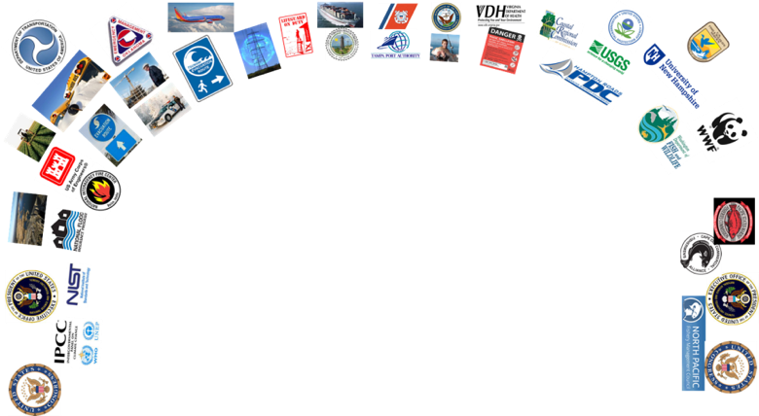
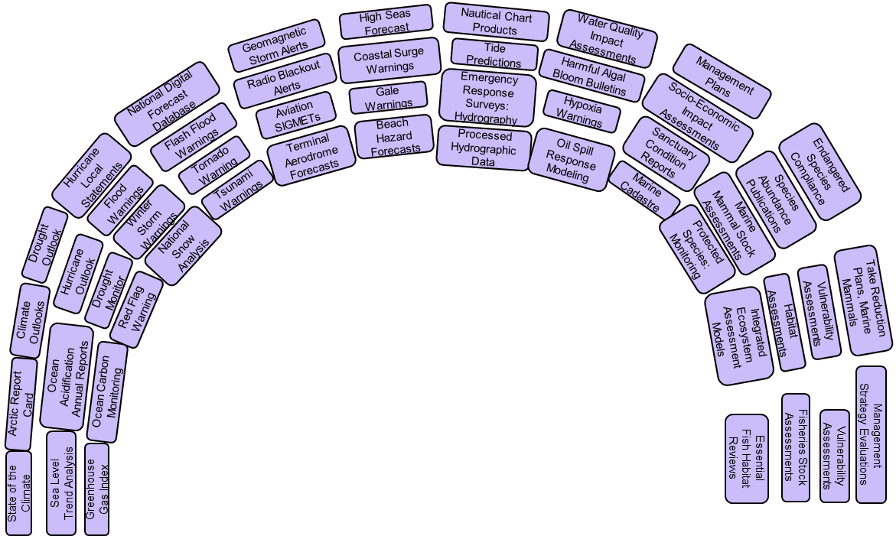
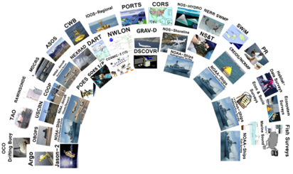
NOAA Satellites serves NOAA and partner services and stakeholders
Stakeholders
Services
Observations
Notes:
At NOAA we have observational systems feeding services and those services are used by numerous stakeholders.
Services include Hurricane forecasts, Drought Monitoring, Flash Flood Warnings. Harmful Algal Bloom alerts, Climate and Ecosystem Assessments.

Slide 4
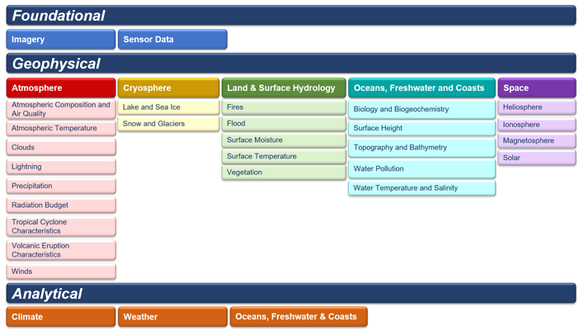
NESDIS Level Requirements: NLR REQ-001
NESDIS will provide environmental data, information, products and reports in the Foundational, Geophysical, and Analytical thematic product areas.

Slide 5
Application categories
Nowcasting, situational awareness (severe weather, fires, floods, HABs, precipitation, ecosystems, oil spills, ocean waves, ice)
Forecasts and projections
Assessments
Monitoring how the environment is changing, compares current with climatology to assess impacts. >>> (reference instruments, continuity, stable orbits)

Slide 6
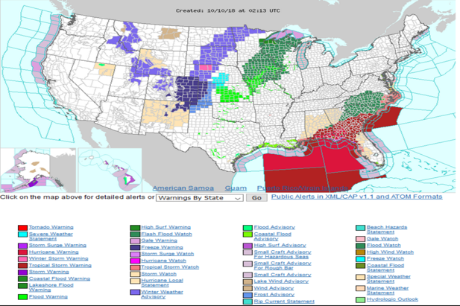
What observations are used today to support these warnings? Do we need to continue them? Can these warnings be improved? Are enhanced observations needed? Are there alternatives to the types of observations provide now?
NWS Warnings – October 10, 2018

Slide 7
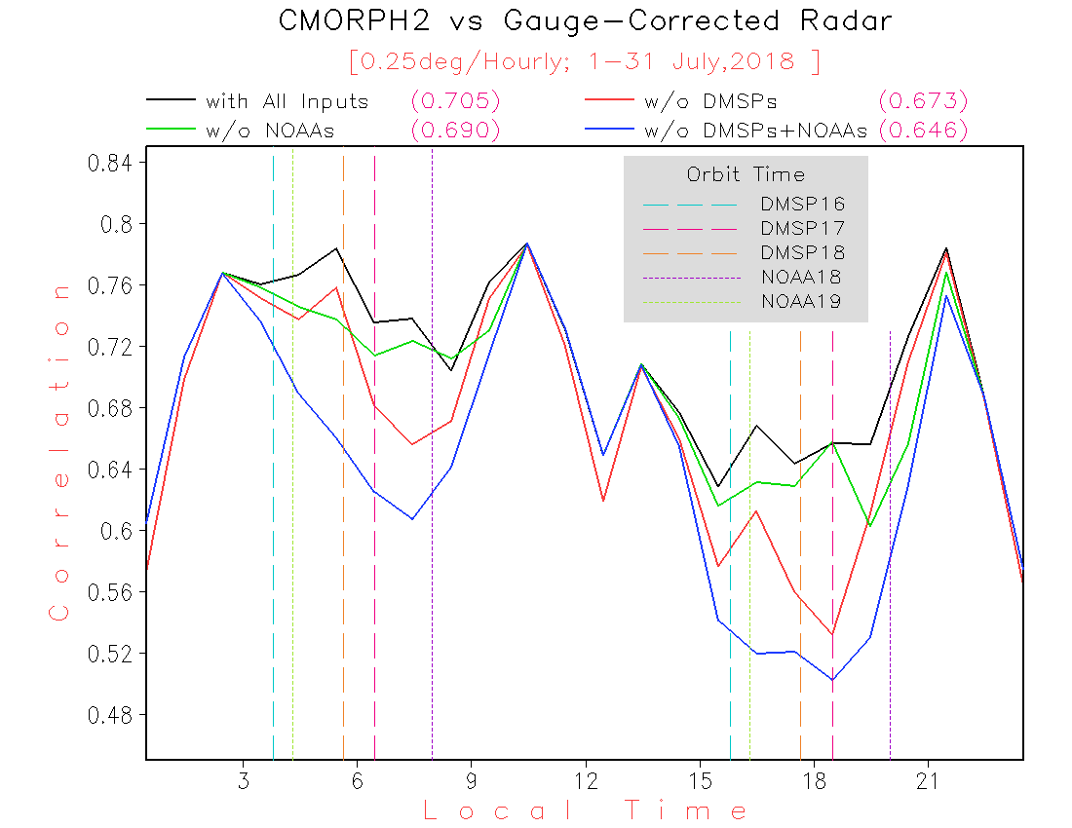
What services and applications drive precipitation products? NOAA Grand Precip. Challenge
What performance is needed and at what temporal/spatial resolution?
Satellite derived rain rates vs radar estimates correlation

Slide 8
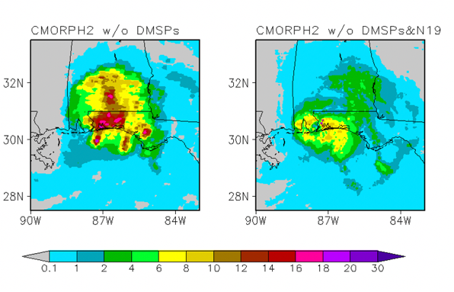
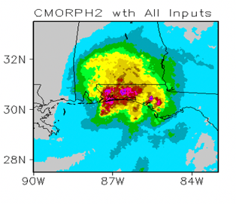
Hurricane Sally example
CMORPH2 for 11Z, 16 September 2020. ~ 6 AM
mm/hour

Slide 9
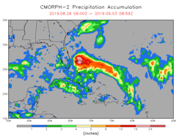
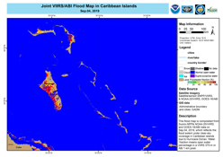
Hydrology & Flood Proving Ground Initiatives Supporting Hurricane Dorian
Precipitation rate estimates (@ 30 minutes interval, 2-hour latency)
derived from 12 LEO and 5 GEO satellites
Accumulated precipitation, nearly 2 feet of rainfall over Bahamas
NOAA NESDIS response to International Disaster charter
flood information for the Bahamas
LEO Satellites: DMSP-16/17/18, NOAA-15/18/19/20, SNPP, METOP-A/B, GCOM-W1, and GPM
17 Satellites!!
GEO Satellites: Himawari-8 (141E), GOES-17 (137W),GOES-16 (75W),Meteosat-11 (0-deg), Meteosat-8 (41.5E)

Slide 10
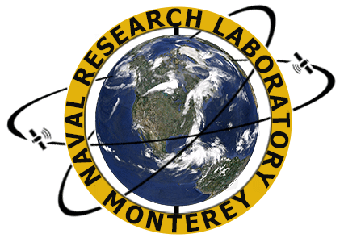
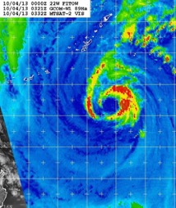
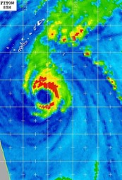
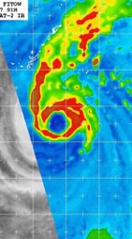
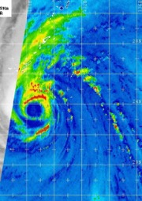
Temporal Sampling Enhancement
AMSR2 03Z
F-15 06Z
F-17 08Z
AMSR2 16Z
Notes:
AMSR2 flies in the afternoon orbit (Local Time of Ascending Node, LTAN is 1:30pm or 1330) which augments the existing DMSP early morning orbits (0530 and 0730) well temporally, frequently filling the 10-12 gaps of available SSM/I and SSMIS data with excellent resolution imagery (examples here do NOT use the final remapping software, thus appear coarse).
Acknowledgments: Naval Research Laboratory, Marine Meteorology Division, Monterey, CA
Kim Richardson, Mindy Surratt, Song Yang, & Jeff Hawkins
Source: AMSR-2 Products for Operational Applications, Jelenak, Chang, Zhan, Brennan, Sienkiewicz, Kussenson, Boukabara, JAXA-NOAA Meeting Nov. 2014

Slide 11
Tropical Storm Monitoring. - notional
Driving Applications | Jobs to be done | Current use of satellite information | How LEO is used | LEO Primary shortfalls
Tropical Storm Monitoring |  | LEO/GEO | Microwave detection of tropical cyclone centers are especially important when the center cannot be detected by visible or infrared because of clouds. Microwave penetrates clouds for thermal profiling of the tropical cyclone's warm core to assess intensity. Microwave sounders/imagers are also used to estimate rain intensity. | Spatial and temporal resolution. Finer spatial resolution provides more detail information on rainbands and center location. Currently AMSR2 provides the best spatial resolution, followed by SSMIS - but the temporal resolution is coarse ~ 8 hours. An analysis is needed to determine the knee in the curve with respect to temporal resolution. A TBD initial estimate is hourly

Slide 12
NWP
Driving Applications | Jobs to be done | Current use of satellite information | How LEO is used | LEO Primary shortfalls
NWP temperature and water vapor information |  | GEO/LEO | The observation types having the largest impact in NWP are currently microwave and infrared sounders because they provide vertical information of the temperature and water vapor needed by forecast models. Impacts from RO are increasing with better coverage. Microwave can penetrate clouds and providing more global coverage and the expense of lower vertical resolution, while infrared provides higher vertical resolution at the expense of poorer global coverage because of clouds. Therefore, both microwave and infrared sounders are deployed on LEO operational weather satellites. NWP needs global coverage. | Pending major shortfall because of upcoming gap in early morning orbit. For NWP with a 6-hour time window, global coverage during that time window is provided when there are at least 3 LEO orbits with ECT separated by 4 hours (eg. 1:30 5:30, 9:30, 13:30, 17:30, 21:30 GMT). Hourly regional models require higher temporal refresh, so maximum effectiveness may call for hourly temporal refresh. However hourly models initial state comes from the global model, so a temporal refresh of every 2 hours may be a reasonable goal. A higher temporal refresh can be used to derive 3D winds

Slide 13
Fires
Driving Applications | Jobs to be done | Current use of satellite information | How LEO is used | LEO Primary shortfalls
Fire detection and smoke forecasting |  | LEO/GEO | Fire perimeter lines need to be resolved at 500 meters or better. Fire radiative power needed for locating intense fires and used as input to smoke forecasts which depends on FRP | Pending major shortfall because of upcoming gap in early morning orbit. For higher latitudes at least 3 orbit planes are needed with ECT separated by 4 hours (eg. 1:30 5:30, 9:30, 13:30, 17:30, 21:30 GMT). However, assumes larger 3000 km swaths. -- Need to determine correct number of satellites to provide hourly coverage of vis/IR imagery. . For monitoring fire perimeters - 500 meter resolution or better highy desirable, but need to study trade space

Slide 14
Aviation – ash and clouds/turbulence
Driving Applications | Jobs to be done | Current use of satellite information | How LEO is used | LEO Primary shortfalls
Aviation needs/applications |  | LEO/GEO | Retrievals from LEO are used to more precisely estimate volcanic ash details, such as concentration and loading. Parallax issues tend to be extreme over the Bering and northern Alaska. LEO makes it much easier to more precisely geo-locate ash. 00 – 04Z is the mean convective peak over mainland Alaska which corresponds to early morning LEO coverage. Analyzing details of clouds especially over western Alaska and higher latitudes, also to some detail in the southern Mainland of Alaska. Data from LEO is the primary source the Alaskan Aviation Weather Unit (AAWU)uses to define cloud coverage details. | Pending major shortfall because of upcoming gap in early morning orbit. For higher latitudes at least 3 orbit planes are needed with ECT separated by 4 hours (e.g., 1:30 5:30, 9:30, 13:30, 17:30, 21:30 GMT). However, assumes larger 3000 km swaths. -- Need to determine correct number of satellites to provide hourly coverage of vis/IR imagery. Spatial resolution of 1 km or better highly desirable, but there is trade space.

Slide 15
Other Driving Applications
Snow and Ice monitoring
Air Quality
Ocean/Coastal ecosystems. – stock assessments and HABS

Slide 16
Summary: Services drives nowcasting, prediction and assessment needs which drives observational needs
Need to focus on application drivers
Define the driving applications
Translate to spatial, spectral, radiometric, temporal requirements
Identify the product and services which will benefit and communicate with their POCs and SMEs

