Slide 1
Overview of Existing and Upcoming Microwave and Infrared Sounders Characteristics: Both Classic and Smallsat Types
Presented by:
Flavio Iturbide-Sanchez
August 17, 2020

Slide 2
Benefits of Microwave and Infrared Sounders in LEO Orbit
IR and MW Sounders provide critical information for weather forecast prediction at National Weather Prediction (NWP) centers worldwide.
Observations from IR and MW sounder are valuable for several applications, including Atmospheric Composition and Climate Process Studies
IR sounders are capable of providing 3D structures of atmospheric temperature and water vapor with high vertical resolution.
Frequent observations from IR sounders at high spatial resolution are expected to contribute to the production of 3D Atmospheric Motion Vector (AMV) winds (critical for improving weather forecast).
Microwave sounders have the capability to provide all-weather 3D structures of atmospheric temperature and water vapor.
Frequent observations from MW sounders at high spatial resolution are expected to contribute to the better understanding of cloud evolution and precipitation process as well as to improve the tracking and intensity of tropical cyclones.

Slide 3
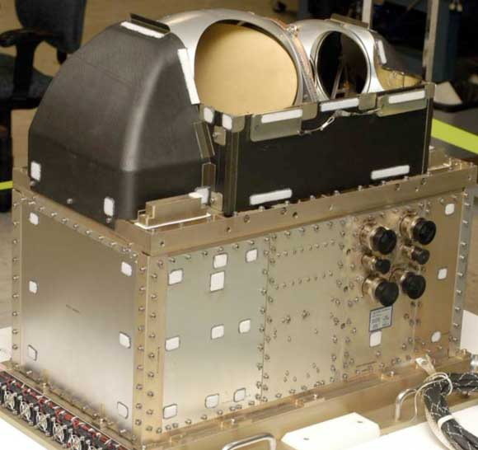
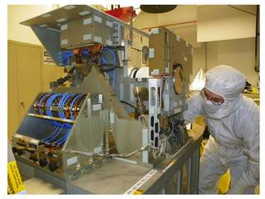
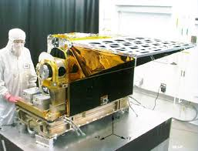
Present Generation of Microwave and Infrared Sounders in LEO Orbit
ADVANCED TECHNOLOGY MICROWAVE SOUNDER (ATMS)
CROSS-TRACK INFRARED SOUNDER (CrIS)
ATMOSPHERIC INFRARED SOUNDER (AIRS)
https://www.jpss.noaa.gov/
Credits: L3Harris Technologies
https://airs.jpl.nasa.gov/
These sounders are highly successful and capable instruments that has provided good value per year benefit.
These instruments were developed with technology from the 90s.
Typical power consumption, mass and volume is about 200 W, 200 kg and 1 (1x1x1) m³.

Slide 4
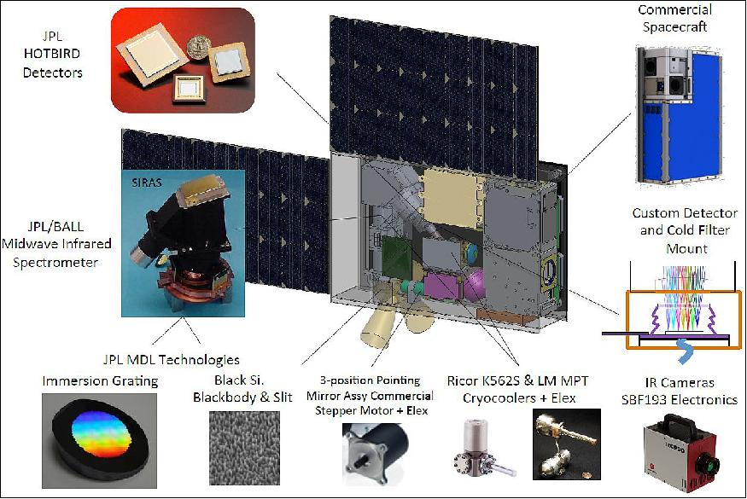
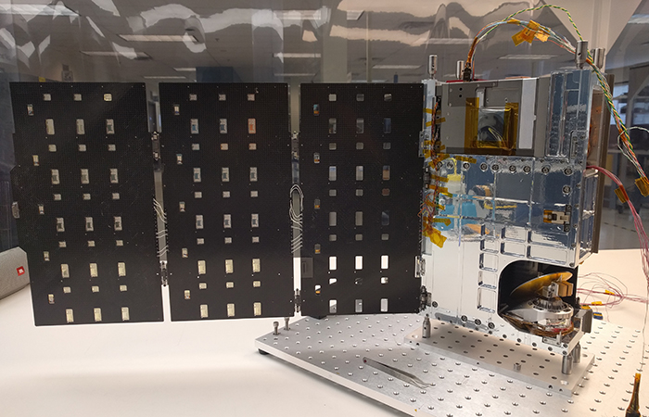
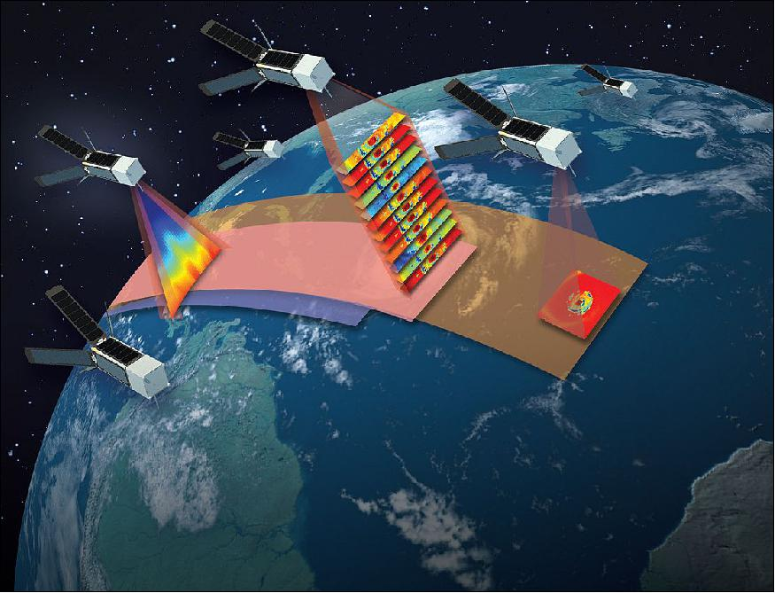
New Generation of Microwave and Infrared Sounders in LEO Orbit
TIME-RESOLVED OBSERVATIONS OF PRECIPITATION STRUCTURE AND STORM INTENSITY WITH A CONSTELLATION OF SMALLSATS (TROPICS)
3U CubeSat (30x10x10 cm)
TEMPORAL EXPERIMENT FOR STORMS AND TROPICAL SYSTEMS - DEMONSTRATION (TEMPEST-D) 6U CubeSat (30x20x10 cm)
CUBESAT INFRARED ATMOSPHERIC SOUNDER (CIRAS). 6U CubeSat (30x20x10 cm)
https://directory.eoportal.org/web/eoportal/satellite-missions/c-missions/ciras
https://www.jpl.nasa.gov/cubesat/missions/tempest-d.php
https://directory.eoportal.org/web/eoportal/satellite-missions/content/-/article/tropics
New instrumentation is being developed based present mature and advanced technology that has been demonstrated in last decades. Good opportunity to take advantage of these technology.
These instruments aim at demonstrating similar capabilities to present operational instrumentation at low cost, enabling the deployment of constellation of IR and MW sounders (higher temporal resolution).
Power consumption, mass and volume is less than 30 W, 15 kg and 0.027 (0.3x0.3x0.3) m³

Slide 5
Key Parameters of LEO Hyperspectral IR Sounders
Characteristic | Sensors | AIRS [1-3] | CRIS [4] | IASI [5] | CIRAS [7]
Spatial | Satellite Platform | EOS Aqua | S-NPP/NOAA-20 | MetOp-A/B/C | CubeSat 6U
 |  |  |  |  | 30x20x10 cm
 | Launch Year(s) | 2002 | 2011/2017 | 2008/2012/2018 | N/A
 | Orbital Altitude (km) | 705 | 824 | 817 | 450-600
 | Nadir Resolution (km) | 13.5 | 14 | 12 | 13.5
 | Scan Swath (km) | 1650 | 2200 | 2052 | 2000
 | Scan Cycle (s) | 2.67 | 8 | 8 | -
Spectral | Spectroscopic Method | Grating | Interferometer | Interferometer | Grating
 | Spectral Bands (cm⁻¹) | LWIR (649-1136) | LWIR (650-1095) | LWIR (640.2-1210) | MWIR (1950-2450)
 |  | MWIR (1212-1612) | MWIR (1210-1750) | MWIR (1210-2100)
 |  | SWIR (2169-2673) | SWIR (2155-2550) | SWIR (2100-2700)
 | Number of Channels | 2378 | 2211 | 8461 | 625
 | Spectral Resolution (cm⁻¹) | 0.55-2.0 | 0.625 | 0.5 | 1.2-2.0
Radiometric | NEdT@Temperature (K) | 0.07-0.5@250 | 0.06-0.5@270 | 0.2-0.6@280 | <0.5@250
Resources | Data Rate (Mbps) | 1.3 | 2.5 | 1.5 | 0.5/1.2
 | Mass (kg) | 177 | 175 | 236 | 12
 | Average Power (W) | 256 | 245 | 210 | 25
Geophysical | L2+ Products | Temperature/Water Vapor/Trace Gases | Temperature/Water Vapor/Trace Gases | Temperature/Water Vapor/Trace Gases | Temperature/Water Vapor

Slide 6
Key Parameters of LEO MW Sounders
Characteristic | Sensors | ATMS [8] | TEMPEST-D [9,10] | TROPICS [11]
Spatial | Satellite Platform | S-NPP/NOAA-20 | CubeSat 6U 30x20x10 cm | CubeSat 3U 30x10x10 cm
 | Launch Year(s) | 2011/2017 | 2018 | 2021
 | Orbital Altitude (km) | 824 | 400 | 550
 | Nadir Resolution (km) | 16-75 | 14-28 | 25-40
 | Scan Swath (km) | 2200 | 905 | 2025
 | Scan Cycle (s) | 2.67 | 2 | 2
Spectral | Number of Channels | 22 | 5 | 12
 | Frequency Range (GHz) | 23.8-183.3 | 89-183 | 91.5-205
Radiometric | NEdT (K) | 0.7-3.6 | 0.2-0.7 | 0.55-1
Resources | Data Rate (kbps) | 20 | 10.3 | 16
 | Mass (kg) | 85 | 3.8 | 3.8
 | Average Power (W) | 130 | 6.5 | 9.1
Geophysical | L2+ Products | Temperature/Water Vapor/Precipitation/Cloud Content/Surface Temperature | Water Vapor/Precipitation/Cloud Content | Temperature/Water Vapor/Precipitation/Cloud Content/

Slide 7
References
Main references:
[1] M. Chahine, “AIRS: improving weather forecasting and providing new data on greenhouse gases,” Bull. Amer. Meteor. Soc. 87, 911-926 (2006)
[2] Jet Propulsion Laboratory: https://airs.jpl.nasa.gov/mission/instrument/specs/
[3] W. P. Menzel, et al., “Satellite-based atmospheric infrared sounder development and applications,” Bull. Amer. Meteor. Soc., 99, 583-603 (2018)
[4] V. Zavyalov, ” Noise performance of the CrIS instrument,”, J. Geophys. Res.: Atmos., 118, 13108-13120 (2013)
[5] F. Hilton, et al., “Hyperspectral Earth observation from IASI: five years of accomplishments,” Bull. Amer. Meteor. Soc., 93, 347-370 (2012)
[6] C. Crevoisier, et al., ”Towards IASI-New Generation (IASI-NG): impact of improved spectral resolution and radiometric noise on the retrieval of thermodynamic, chemistry and climate variables,” Atmos. Meas. Tech., 7, 4367-4385 (2014)
[7] T. Pagano, et al., “The CubeSat Infrared Atmospheric Sounder (CIRAS) Technology Demonstration in Support of a Future Earth Observing Nanosatellite-Infrared (EON-IR) Atmospheric Sounde,” 2018 AMS Annual Meeting (2018)
[8] NOAA/NESDIS/STAR, https://www.star.nesdis.noaa.gov/jpss/ATMS.php
[9] S. C. Reising, et al., “Temporal Experiment for Storms and Tropical Systems Technology Demonstration (TEMPEST-D) mission: early results and potential science capabilities,” 2018 AGU Fall Meeting, Washington D.C. (2018)
[10] TEMPEST-D fact sheet, https://tempest.colostate.edu/TEMPEST-Fact-Sheet.pdf
[11] W. J. Blackwell, et al., “An overview of the TROPICS NASA Earth Venture Mission,” Quarterly Journal of the Royal Meteorological Society (2018)

