Slide 1
Spectral Characteristics of Infrared Sounders: Classic and Smallsat Types
Presented by:
Flavio Iturbide-Sanchez
August 31, 2020

Slide 2
Key Parameters of LEO Hyperspectral IR Sounders
Characteristic | Sensors | CRIS | IASI | IASI-NG | AIRS | CIRAS
Spatial | Satellite Platform | S-NPP/NOAA-20 0.95m x 0.96m x 0.74m | MetOp-A/B/C | MetOp-SG | EOS Aqua | CubeSat 6U
 |  |  |  |  |  | 30x20x10 cm
 | Launch Year(s) | 2011/2017 | 2008/2012/2018 | 2022 | 2002 | N/A
 | Nadir Resolution (km) | 14 | 12 | 12 | 13.5 | 13.5
Spectral | Spectroscopic Method | Interferometer | Interferometer | Interferometer | Grating | Grating
 | Spectral Range (cm⁻¹) | 650-2550 (Spectral Gaps) | 640-2700 (No Spectral Gaps) | 645-2760 (No Spectral Gaps) | 649-2673 (Spectral Gaps) | 1950-2450 (No Spectral Gaps)
 | Spectral Bands (cm⁻¹) | LWIR (650-1095) | LWIR (640.2-1210) | B1-B4 (645-2760) (No spectral Gaps) | LWIR (649-1136) | SWIR (1950-2450)
 |  | MWIR (1210-1750) | MWIR (1210-2100) |  | MWIR (1212-1612)
 |  | SWIR (2155-2550) | SWIR (2100-2700) |  | SWIR (2169-2673)
 | Number of Channels | 2211 | 8461 | 16521 | 2378 | 625
 | Spectral Resolution (cm⁻¹) | 0.625 (unapodized) | 0.25 (unapodized) 0.5 (apodized) | 0.125 (unapodized) 0.25 (apodized) | 0.55-2.0 | 1.2-2.0
 | Spectral Uncertanty (ppm) | 10 (Requirement) 2 (performance) | 1 (best performance) | 0.5 (objective) | < 10 (performance) 0.006ΔƲ-0.001ΔƲ ΔƲ=SRF full width at half maximum | -
 | Band-to-Band Coregistration | <1.4% of a FOV Diameter (230 urad) (50% FOV Width = 0.944º = 16476urad) | - | - | - | -
Resources | Data Rate (Mbps) | 2.5 | 1.5 | 6 | 1.3 | 0.5/1.2
 | Mass (kg) | 145 | 236 | 360 | 177 | 12
 | Average Power (W) | 110 W (SNPP), 102 W (NOAA-20) | 210 | 500 | 256 | 25
Geophysical | L2+ Products | Temperature/Water Vapor/Trace Gases | Temperature/Water Vapor/Trace Gases | Temperature/Water Vapor/Trace Gases | Temperature/Water Vapor/Trace Gases | Temperature/Water Vapor

Slide 3
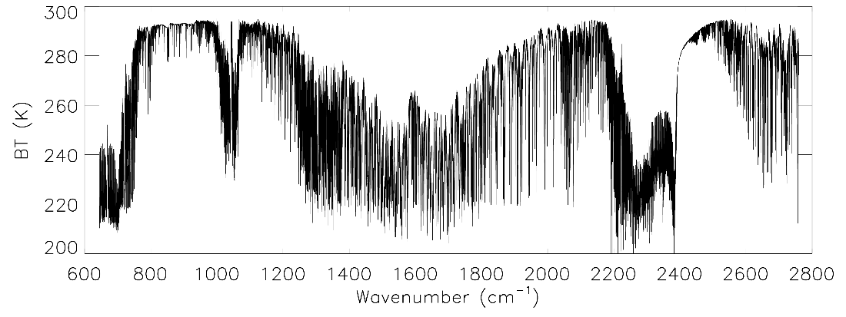
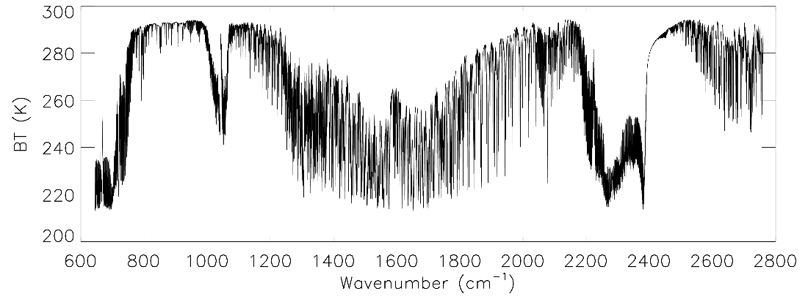
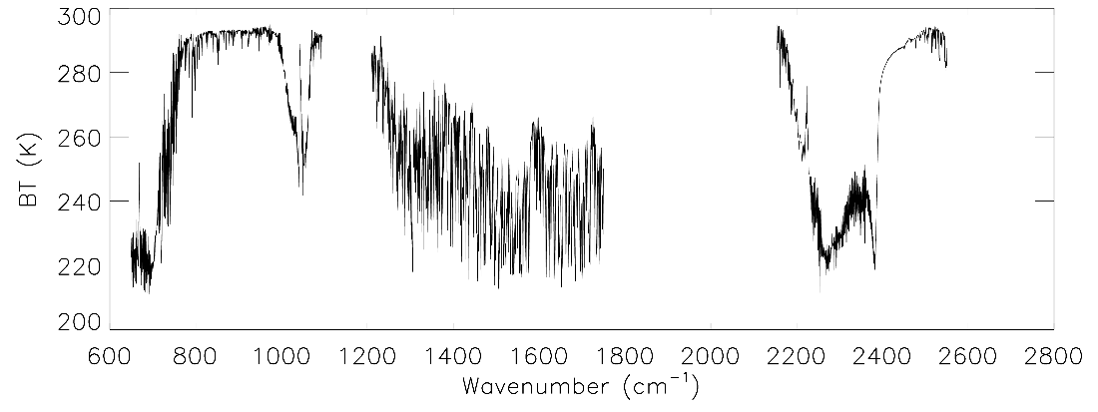
IASI-NG vs CrIS Spectral Characteristics
H₂O
H₂O
CO₂
NH₃
CH₄
CO
CO₂
• Spectral coverage: 645 - 2760 cm⁻¹.
• Spectral resolution: 0.25 cm⁻¹ after apodization (0.50 cm⁻¹ for IASI/apodized).
• Spectral sampling: 0.125 cm⁻¹ (0.25 cm⁻¹ for IASI).
IASI-NG L1B (unapodized)
SO₂
HNO₃
O₃
SO₂
HNO₃
N₂O
Spectral coverage (cm⁻¹) |  | Spectral Resolution (cm⁻¹) |  | Channels
IASI_NG | CrIS | IASI_NG | CrIS | IASI_NG | CrIS
645 - 2760 Without gap | 650-1095 1210-1750 2155-2550 | 0.125 (Unapodized) 0.25 (Apodized) | 0.625 (FSR) | 16921 | 2211 (FSR) 1305 (NSR)
IASI-NG L1C (unapodized)
IASI-NG L1B converted to CrIS

Slide 4
Spectral Bands vs Power Consumption/Volume
Electrical power is more limited in Smallsats.
Small satellites require cryo-coolers with high power efficiency, since those elements require significant power consumption.
Cryo-coolers and temperature radiators require significant volume.
Improvements in volume, mass and power consumption has been observed in new generation of cryo-coolers.
Reducing the number of spectral bands could help to reduce the size and power consumption of the cry-cooler system, reducing the instrument volume, power consumption and cost.

