Slide 1
Importance of Satellite Calibration
The NASA Perspective
Will McCarty
Global Modeling and Assimilation Office
NASA Goddard Space Flight Center
15 March 2021
SounderSAT Meeting

Slide 2
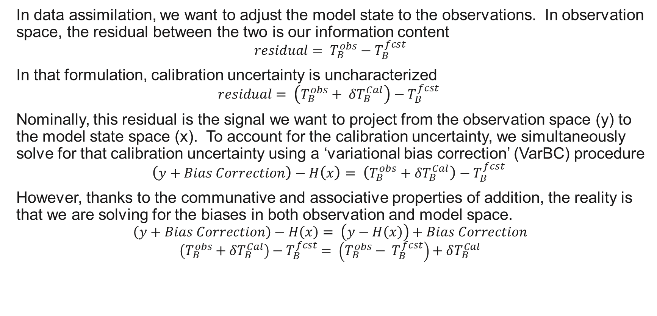
Background
In data assimilation, we want to adjust the model state to the observations. In observation space, the residual between the two is our information content
$$residual= T_{B}^{obs}−T_{B}^{fcst}$$
In that formulation, calibration uncertainty is uncharacterized
$$residual= \left(T_{B}^{obs}+ δT_{B}^{Cal}\right)−T_{B}^{fcst}$$
Nominally, this residual is the signal we want to project from the observation space (y) to the model state space (x). To account for the calibration uncertainty, we simultaneously solve for that calibration uncertainty using a ‘variational bias correction’ (VarBC) procedure
$$\left(y+Bias Correction\right)−H\left(x\right)= \left(T_{B}^{obs}+δT_{B}^{Cal}\right)−T_{B}^{fcst}$$
However, thanks to the communative and associative properties of addition, the reality is that we are solving for the biases in both observation and model space.
$$\left(y+Bias Correction\right)−H\left(x\right)= \left(y−H\left(x\right)\right)+Bias Correction$$
$$\left(T_{B}^{obs}+δT_{B}^{Cal}\right)−T_{B}^{fcst}= \left(T_{B}^{obs}− T_{B}^{fcst}\right)+δT_{B}^{Cal}$$

Slide 3
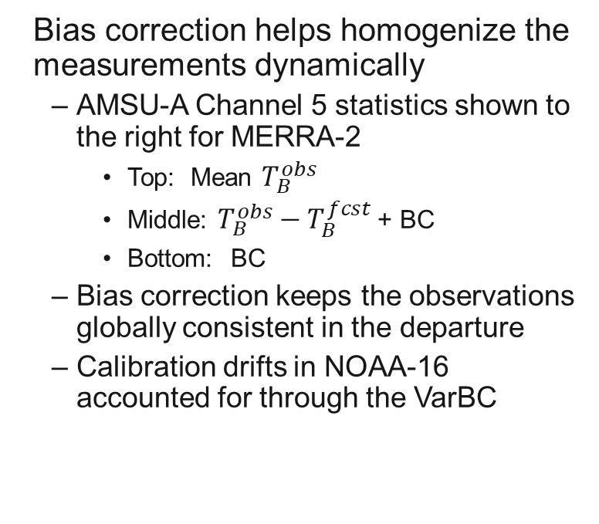
Bias Correction – The good
Bias correction helps homogenize the measurements dynamically
  AMSU-A Channel 5 statistics shown to the right for MERRA-2
    Top: Mean $T_{B}^{obs}$
    Middle: $T_{B}^{obs}−T_{B}^{fcst}$ + BC
    Bottom: BC
  Bias correction keeps the observations globally consistent in the departure
  Calibration drifts in NOAA-16 accounted for through the VarBC

Slide 4
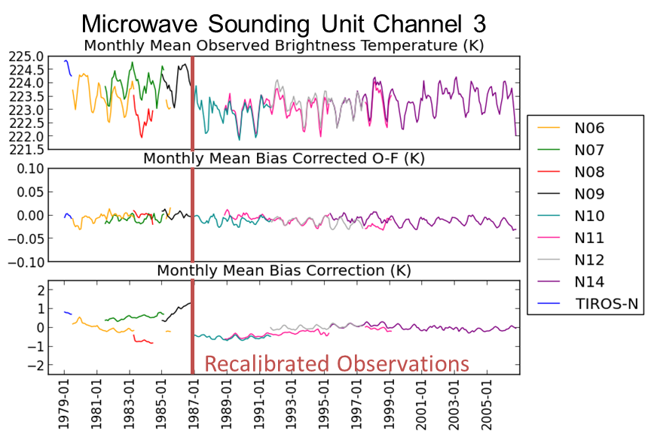
Bias Correction – The good
In MERRA-2, we used recalibrated/ homogenized radiances after 1987
  The calibration uncertainty is large in the earlier data stream
  Bias correction makes the background departures look indistinguishable on both sides of the transition

Slide 5
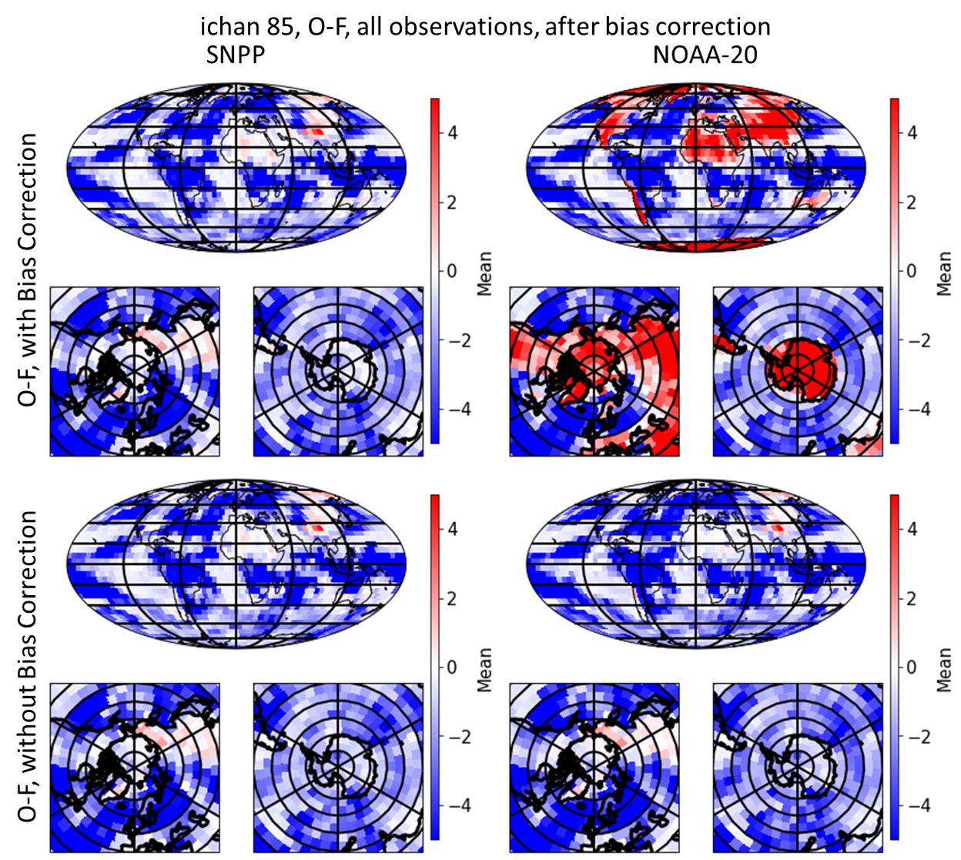
Bias Correction – The Bad
Variational bias correction can be finicky
  The plot to the left shows the departures for CrIS data from SNPP (left) and NOAA-20 (right), with bias correction (top) and without (bottom)
  Prior to bias correction, the data looks qualitatively consistent (bottom) between the two satellites
  In this example, the bias correction ended up getting into a non-physical space
    The qualitative differences between the satellites (top) was not realistic after bias correction was applied

Slide 6
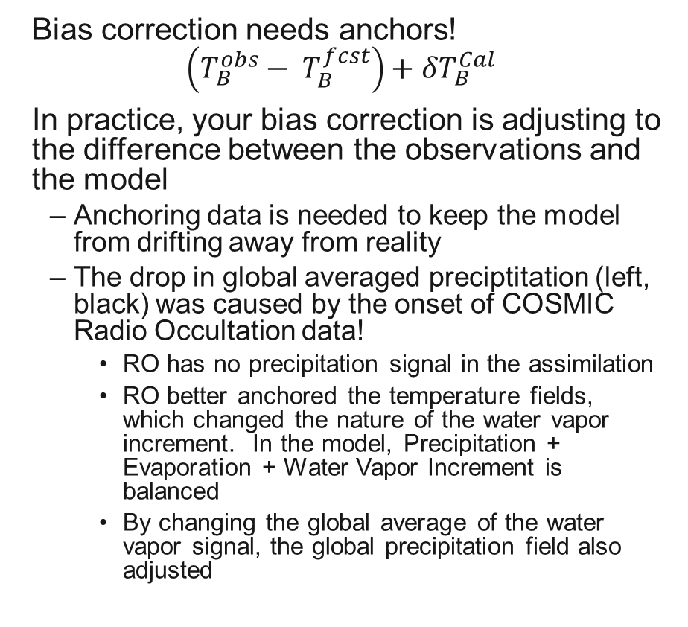
Bias Correction – The Ugly
Bias correction needs anchors!
$$\left(T_{B}^{obs}− T_{B}^{fcst}\right)+δT_{B}^{Cal}$$
In practice, your bias correction is adjusting to the difference between the observations and the model
  Anchoring data is needed to keep the model from drifting away from reality
  The drop in global averaged preciptitation (left, black) was caused by the onset of COSMIC Radio Occultation data!
    RO has no precipitation signal in the assimilation
    RO better anchored the temperature fields, which changed the nature of the water vapor increment. In the model, Precipitation + Evaporation + Water Vapor Increment is balanced
    By changing the global average of the water vapor signal, the global precipitation field also adjusted

Slide 7
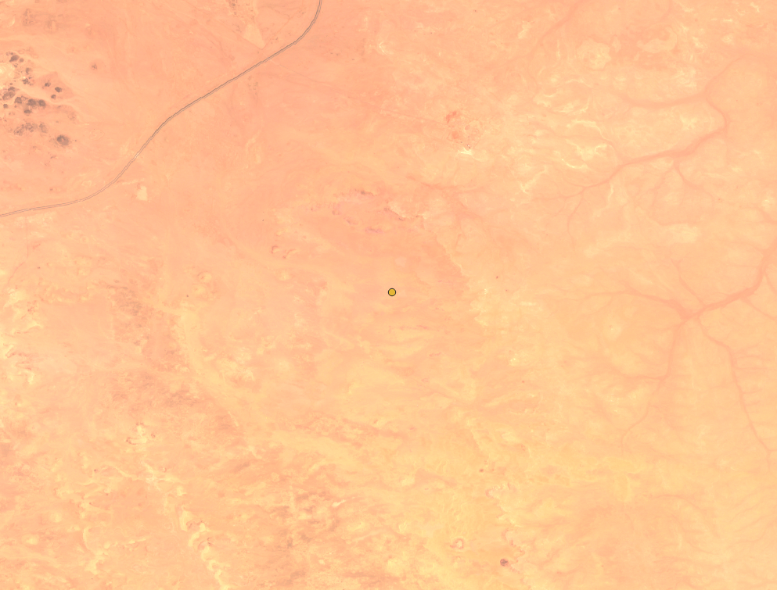
Conclusions
This applies to SounderSat because a constellation of small satellites will present new challenges
  VarBC may be able to intercalibrate the sensors and account for instrument drift
  Eyre (2016) showed that as you have more data, you need more anchors
  The best anchors we have are sondes (generally fixed in count) and radio occultation
    RO decreased over the 201Xs until the onset of COSMIC-2
    COSMIC-2 is not a global anchor
The figure to the left shows the variability in TOA reflectance for imagery from Planet
  Each dot is from different instrument of their constellation, showing the variability instrument-to-instrument

Slide 8
Will.McCarty@nasa.gov

