Slide 1
Translating User Needs into User Requirement
Overview of NOAA User Engagement and its Linkage to the Assessment of Observational Needs
Satellite and Information Service
Vanessa M. Escobar, Senior Scientist for NESDIS’ User Engagement Objective
Renata Lana, Director for Communications/Co-Lead for NESDIS' User Engagement Objective
Katherine Hawley, Lead Scientist for STAR User Engagement
August 09, 2021
Notes:
10 mins overview of the overall UE activities in NESDIS/NOAA, so that this technical SAT discussion be part of it

Slide 2
How 'regular technical discussions on observing systems and their usefulness to the NOAA systems, and their evolution in the future, is an integral part of the user engagement'
User engagement is a process which identifies the user needs that feed the integral parts of the technical discussions on observing systems and their usefulness to the NOAA Systems
Notes:
When asked to give a talk I was asked to:
I want to Flip this statement around to say ….

Slide 3
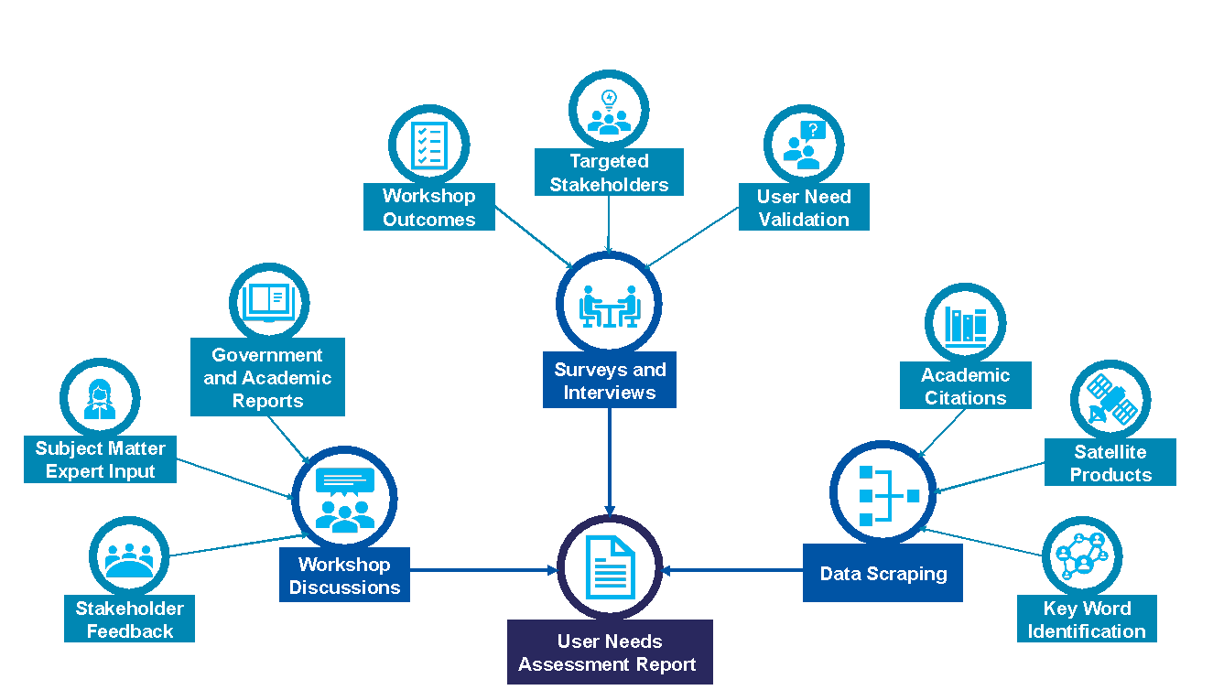
Before starting the UE Process…
Set the goals and expectation
Gather an understanding of existing user data and use this as baseline knowledge for your engagement
Notes:
What do you want out of your UE?
Turns out we know a lot about users and its important we bring that knowledge to the table…. So gathering a baseline… understanding what we already know will help with evolving bringing value to the process.

Slide 4
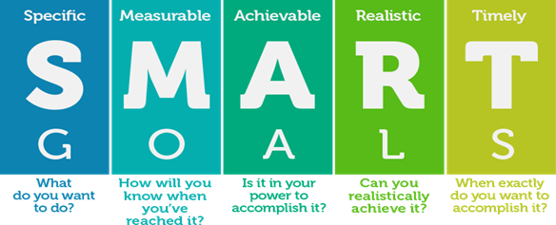
Q1. What are our organizational goals and objectives for UE
What are the goals of the organization?
What do we want to accomplish with UE?
What impact do we want to have with our information?
Who are our target users?
Where do we want to show value?
Where is the “last stop” for our services?
Notes:
We need to understand Internal priorities and goals. What are we trying to accomplish with UE? Are we lookkng to expand our users? Dig deeper into thematic areas? DO we have targeted users?
This helps frame the UE effort …. And most importantly What is achievable?
UE is done from a solution/mission/product agnostic perspective because not all the needs we collect will be applied to the same mission or Organization. This is why the goals are so important-you first have to identify what fall within our mission or organizational scope.
You wont satisfy all needs but you can identify those that pertain to you and your mission statements.

Slide 5
Q2. Are needs changing OR they evolving?
change is (countable) the process of becoming different, to transform
evolution is gradual directional change especially one leading to a more advanced or complex form; growth; development.
Notes:
User needs are fairly stable and tent to evolve over time. Although user needs can have abrupt changes, it usually the environment that changed as the needs of the users evolve to adapt to the changing environment.
So we need to stop and ask what are the needs changing and what are the needs that are evolving… and why. Is it service? Is it training? Is it technology? Is it organizational culture.
These are important things to ask because only some some will be in our control to address
The user needs for the satellite tech development tend to evolve over time.. Growing and developing into more advanced or mature ways of applying information.
Through our UE, we identify how needs are evolving in our baseline data research which allows us to ask better questions in our engagement … and we do this from a solution agnostic perspective.
If we only look at UE from the GEO or LEO perspective, we may miss how needs truly evolve and think they are changing.

Slide 6
Begin the process of translating user needs into user requirements
User Engagement
Identify/collect needs from the users
Solution agnostic
Thematic scale
Narrow needs down by importance, capability gap and satisfaction of needs to the user
Ranking survey
Prioritize user ranked needs with organization leadership (NWS Flood Program Lead, GEOXO XORWG)
Align user ranked needs to organization priorities
Translate the user ranked needs into recommended user requirements
^
Always checking in with:
Internal layout of priorities and goals
Notes:
Once Q1 and Q2 are addressed the process for user need translation can begin.

Slide 7
Breaking up UE into a 3-Step process
Strategic Planning
Products
Services
User
Community
Needs
Organizational Priorities
User Focused
Test
&
User Readiness
Research
&
Development
Value
User Need Prioritization
2
Maintenance
&
Sustainment
3
Step 2: User Needs prioritized to the capabilities of NOAA/NESDIS
Step 3: Value is realized when the products and services align with the needs of our customers
1
Step 1: Identify organizational goals, priorities for user engagement

Slide 8
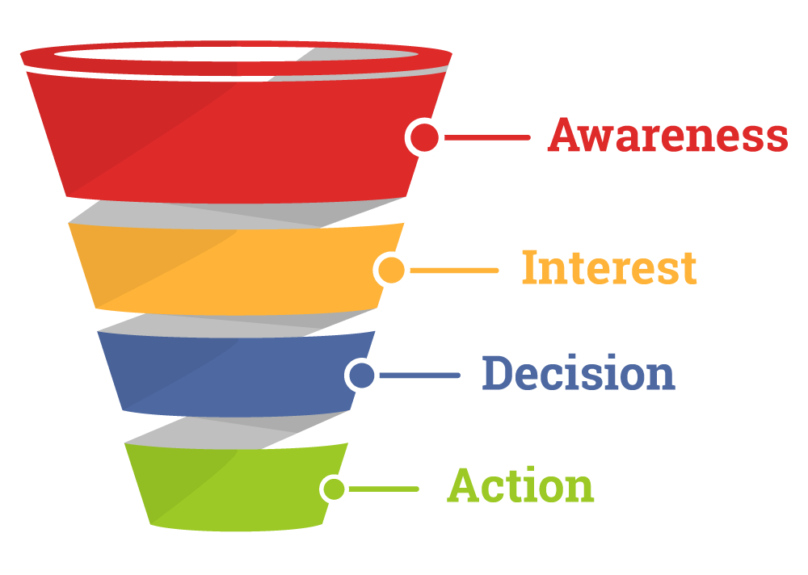
Mission Scaled Example: GeoXO and the user engagement translation
Early, solution agnostic engagement is critical for implementing user needs into mission decisions and milestones.
The decisions making frameworks of the user community is informing all stages of GeoXO development and NOAA user services
Engagement will continue throughout mission lifecycle and user feedback will integrate into all NOAA missions and services
GeoXO is currently Pathfinders to come forward now to participate in the early adoption of GeoXO data to help demonstrate a broad range of impact to society
User Need
Science Translation
NOAA Action
User Need | Geophysical Requirement | GeoXO Decision
Fire ignitions are not available quickly enough through satellite imagery, which forces response agencies to rely on in situ observations. | 1 km resolution on a geostationary Imager 3.9 μm band | The GeoXO Imager aims to have a 3.9 μm with 1 km resolution
Forecasting convective weather over the Gulf Stream is needed. | Hemispheric coverage of total lightning occurrence at low latency | A geostationary Lightning Mapper will provide hemispheric coverage of lightning occurrence
It is difficult to track and forecast Harmful Algal Bloom movement throughout the day. | Frequent detection of Harmful Algal Blooms | An Ocean Color instrument in geostationary orbit allows for tracking of Harmful Algal Blooms
Notes:
Gathering of needs at a granular level and translating needs into requirements
Translating needs to fit a technical observation need

Slide 9
Organizational Scaled Example: NWS Flash Flood Area Needs Assessment
Assessments (thematic applications) align with NWS Leadership priorities - provides direction to where NESDIS should focus and define greatest impact to operations.
NWS meteorologists issuing Flash Flood warning are the primary focus.
User needs are captured through a process of interviewing NWS employees and issuing a survey to NWS National Centers and WFOs
The decision making framework consists of prioritizing needs through the NWS Flash Flood Program Service Lead and the Water Resources Services Branch Chief, concurrence with NWS Executive Leadership and NWS Union
Results will be prioritized through NWS Service Area Leads, Branch Chiefs, NWS Executive Leadership and provided to NESDIS Leadership decision making and prioritization
Currently in the “decision” stage of the funnel
186 needs captured
84 needs prioritized by users
Next Steps: NWS Executive Leadership and NWS Union concurrence

Slide 10
Where is your last stop in the value chain?
Notes:
Motivation for UE is knowing your last stop!

Slide 11
Backup Slides

Slide 12
User Need → User Requirement → GeoXO Solution
User Need | Requirement | GEO-XO Solution
Fire ignitions are not available quickly enough through satellite imagery, which forces response agencies to rely on in situ observations. | 1 km resolution on a geostationary Imager 3.9 μm band | The GeoXO Imager aims to have a 3.9 μm with 1 km resolution
It is difficult to measure how high or low in the atmosphere (vertical profile) aerosols and other pollutants are. | Lower and Upper tropospheric retrievals of PM2.5 and Ozone | A UV/VIS very high spectral resolution spectrometer in geostationary orbit, designed for Atmospheric Composition retrievals
Real-time data for the full air column would benefit winter weather forecasting. | Retrievals of the vertical profile of temperature and water vapor available at low latency | An IR Hyperspectral Infrared Sounder will be able to provide retrievals of temp and WV profiles in clear sky regions
Forecasting convective weather over the Gulf Stream is needed. | Hemispheric coverage of total lightning occurrence at low latency | A geostationary Lightning Mapper will provide hemispheric coverage of lightning occurrence
Ocean imagery is not captured at a high enough temporal resolution (ideally hourly). | Ocean color retrievals at 1-2-hour daytime temporal cadence | A geostationary Ocean Color instrument will allow for OC retrievals every 1-2 hours during the day in clear sky regions
There is a need for a green visible band so that “True Color” products need not be estimated. | Imager spectral bands centered in the red, green, and blue portions of the spectrum | The GeoXO Imager will include spectral bands in the red, green, and blue portions of the spectrum, allowing for true color imagery
Horizontal winds in the troposphere are not measured in fine enough detail. | Wind vector retrievals throughout the 3-D troposphere | An IR Hyperspectral Sounder in geostationary orbit can be used to retrieve wind vectors in some areas at various vertical levels
Additional data on air pollution levels during heat waves is necessary. | High temporal retrievals of ozone, nitrogen dioxide, and PM2.5 | A UV/VIS very high spectral resolution spectrometer in geostationary orbit, designed for Atmospheric Composition retrievals
It is difficult to track and forecast Harmful Algal Bloom movement throughout the day. | Frequent detection of Harmful Algal Blooms | An Ocean Color instrument in geostationary orbit allows for tracking of Harmful Algal Blooms

Slide 13
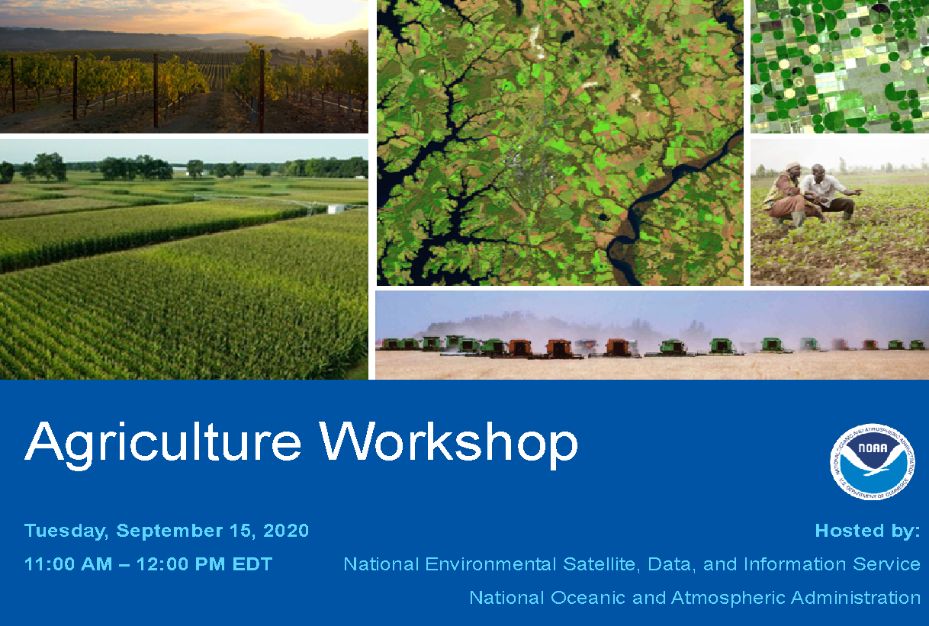
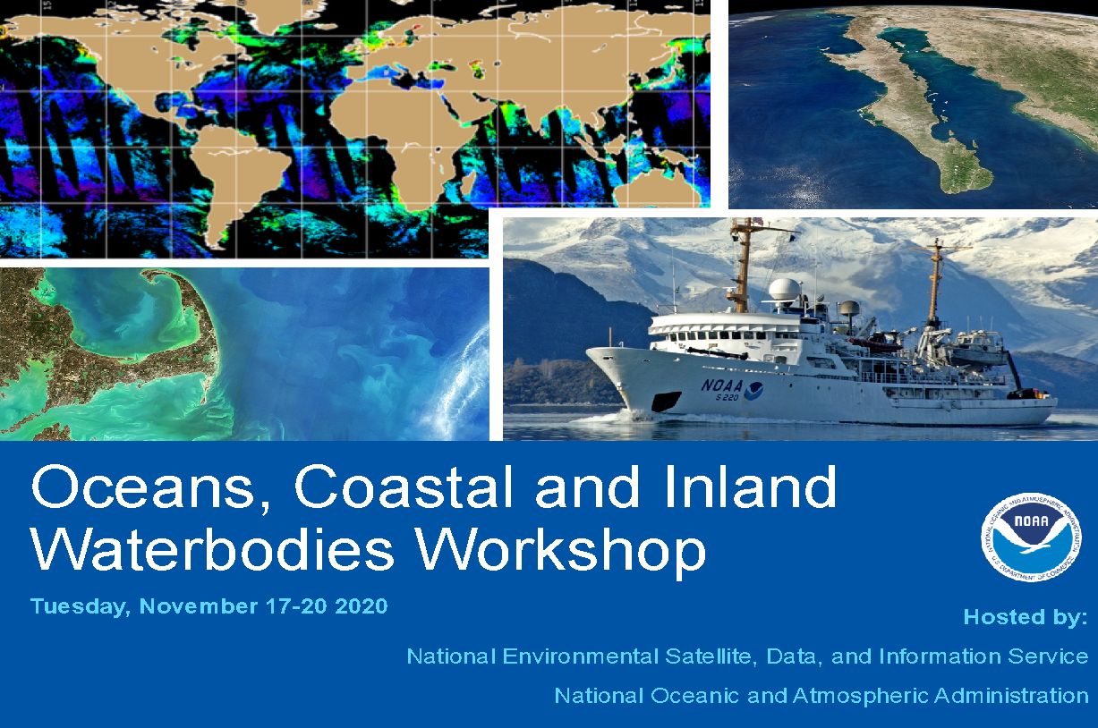
NOAA GeoXO Virtual Workshop Series
Fire Workshop
June 3 – 5, 2020
178 Total Attendees
Weather Workshop
July 20 – 24, 2020
233 Total Attendees
Human Health Workshop: July 28 – 31, 2020 207 Total Attendees
Agriculture Workshop: September 15 – 18, 2020 152 Total Attendees
Oceans Workshop: November 17-20, 2020 142 Total Attendees

Slide 14
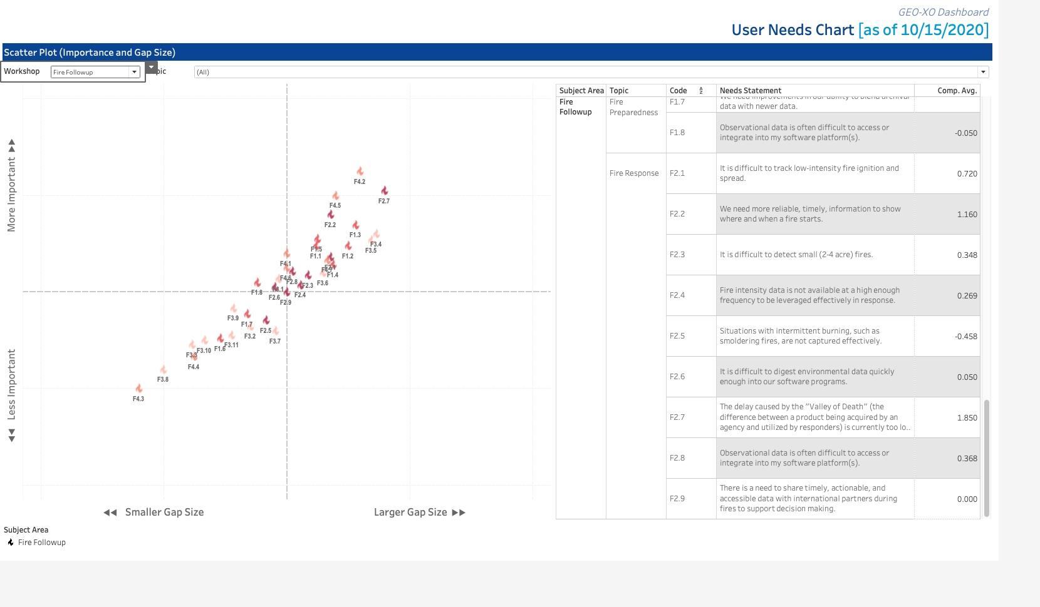
A collection of user needs across the the fire lifecycle also identified areas of greatest importance for NOAA to address. GeoXO translated these needs into user requirements and two are supported by GeoXO instrument selection.

Slide 15
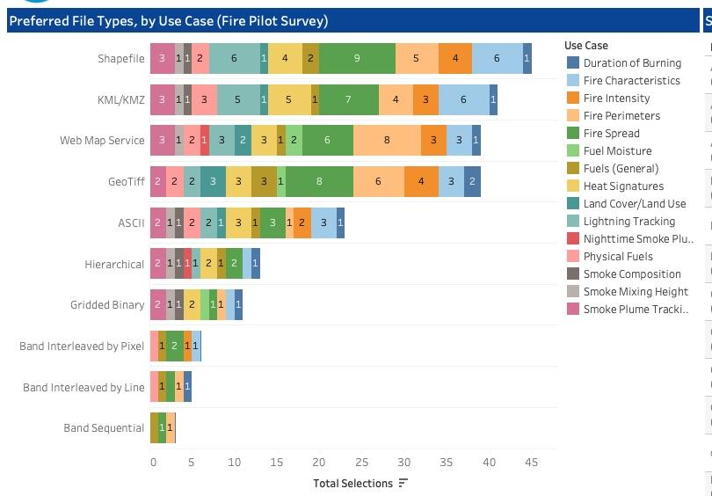
File Format, Product Delivery and Access play a large role in user satisfaction. GeoXO inquired about different file formats that would best accommodate the fire community. GEOXO decided GIS formats will soon be available across all GEO data; well ahead of the GeoXO launch.

Slide 16
GeoXO User Engagement Time Lines
GeoXO Reviews
MSR
SRR
SDR
PDR
CDR
MOR
<2020 2020 2021 2022 2023 2024 2025 2026 2027 2028 2029
GeoXO
Proxy Data
KMA COMS
GOCI (OC)
KMA GK-2B
GOCI II (OC)
NASA
TEMPO
(AC)
EUM MTG
LI (GLM)
EUM MTG
IRS (GXS)
NASA
GLIMR
(OC)
CMA FY4A
GIIRS (GXS)
EUM MTG
FCI (GXI)
EUM MTG/Sen4
UVN (AC)
GXI = GeoXO Imager
GXS = GeoXO IR Sounder
LI = GeoXO Lightning Imager
AC = Atmospheric Composition
OC = Ocean Color
DNB = Day Night Band (low light)
KMA GK-2B
GEMS (AC)
NOAA JPSS
VIIRS (DNB)
<2020 2020 2021 2022 2023 2024 2025 2026 2027 2028 2029
GeoXO
User
Engagement
XORWG
NESDIS Satellite Proving Ground
Begin GeoXO Risk Reduction
Involvement in annual testbed, proving ground and risk reduction activities and relevant conferences (2023+)
GeoXO
User
Workshops
Hire GeoXO Satellite Liaisons
After MCR, XORWG will evolve into an advisory body which will provide guidance on user engagement and risk reduction priorities.
Risk reduction will balance use of GeoXO Proxy Data and innovative uses of GOES-R and JPSS data.

Slide 17
User input to instrument selection must be complete before Mission Concept Review (MCR)
Value Study required by OMB prior to project approval (SRR)
Notes:
At each review, KDP, and milestone, the program is expected to be at certain maturity. Specific places where the agencies make decisions:
SRR: Requirements are baselined.
ASM and MS2: approval for major acquisitions.
MS2: program life cycle cost and schedule commitment to DOC.
MS3 and KDP-C: LCC and schedule commitment to Congress.
Details on each milestone can be found in NOAA/NESDIS Project Milestones Procedural Requirements NESDIS-PR-1223.1, Dec 2020
NASA Project Life Cycle Phases and Key Decision Point (KDP) combined with DOC Program Decision Milestones
Details on each NASA milestone can be found in NASA Space Flight Program and Project Management Handbook. NPR 7120.5

Slide 18
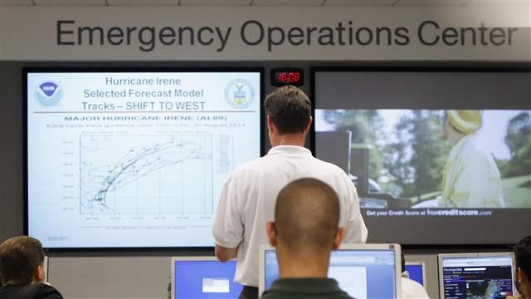
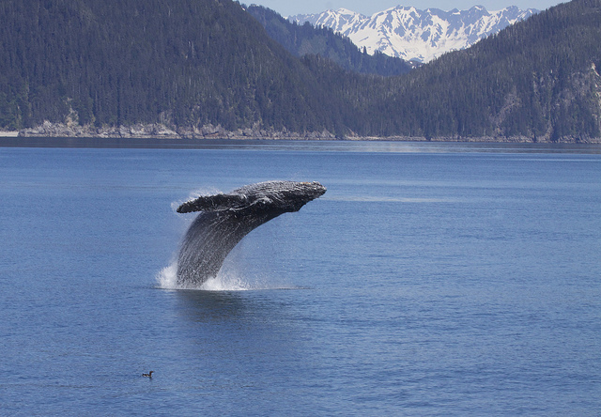
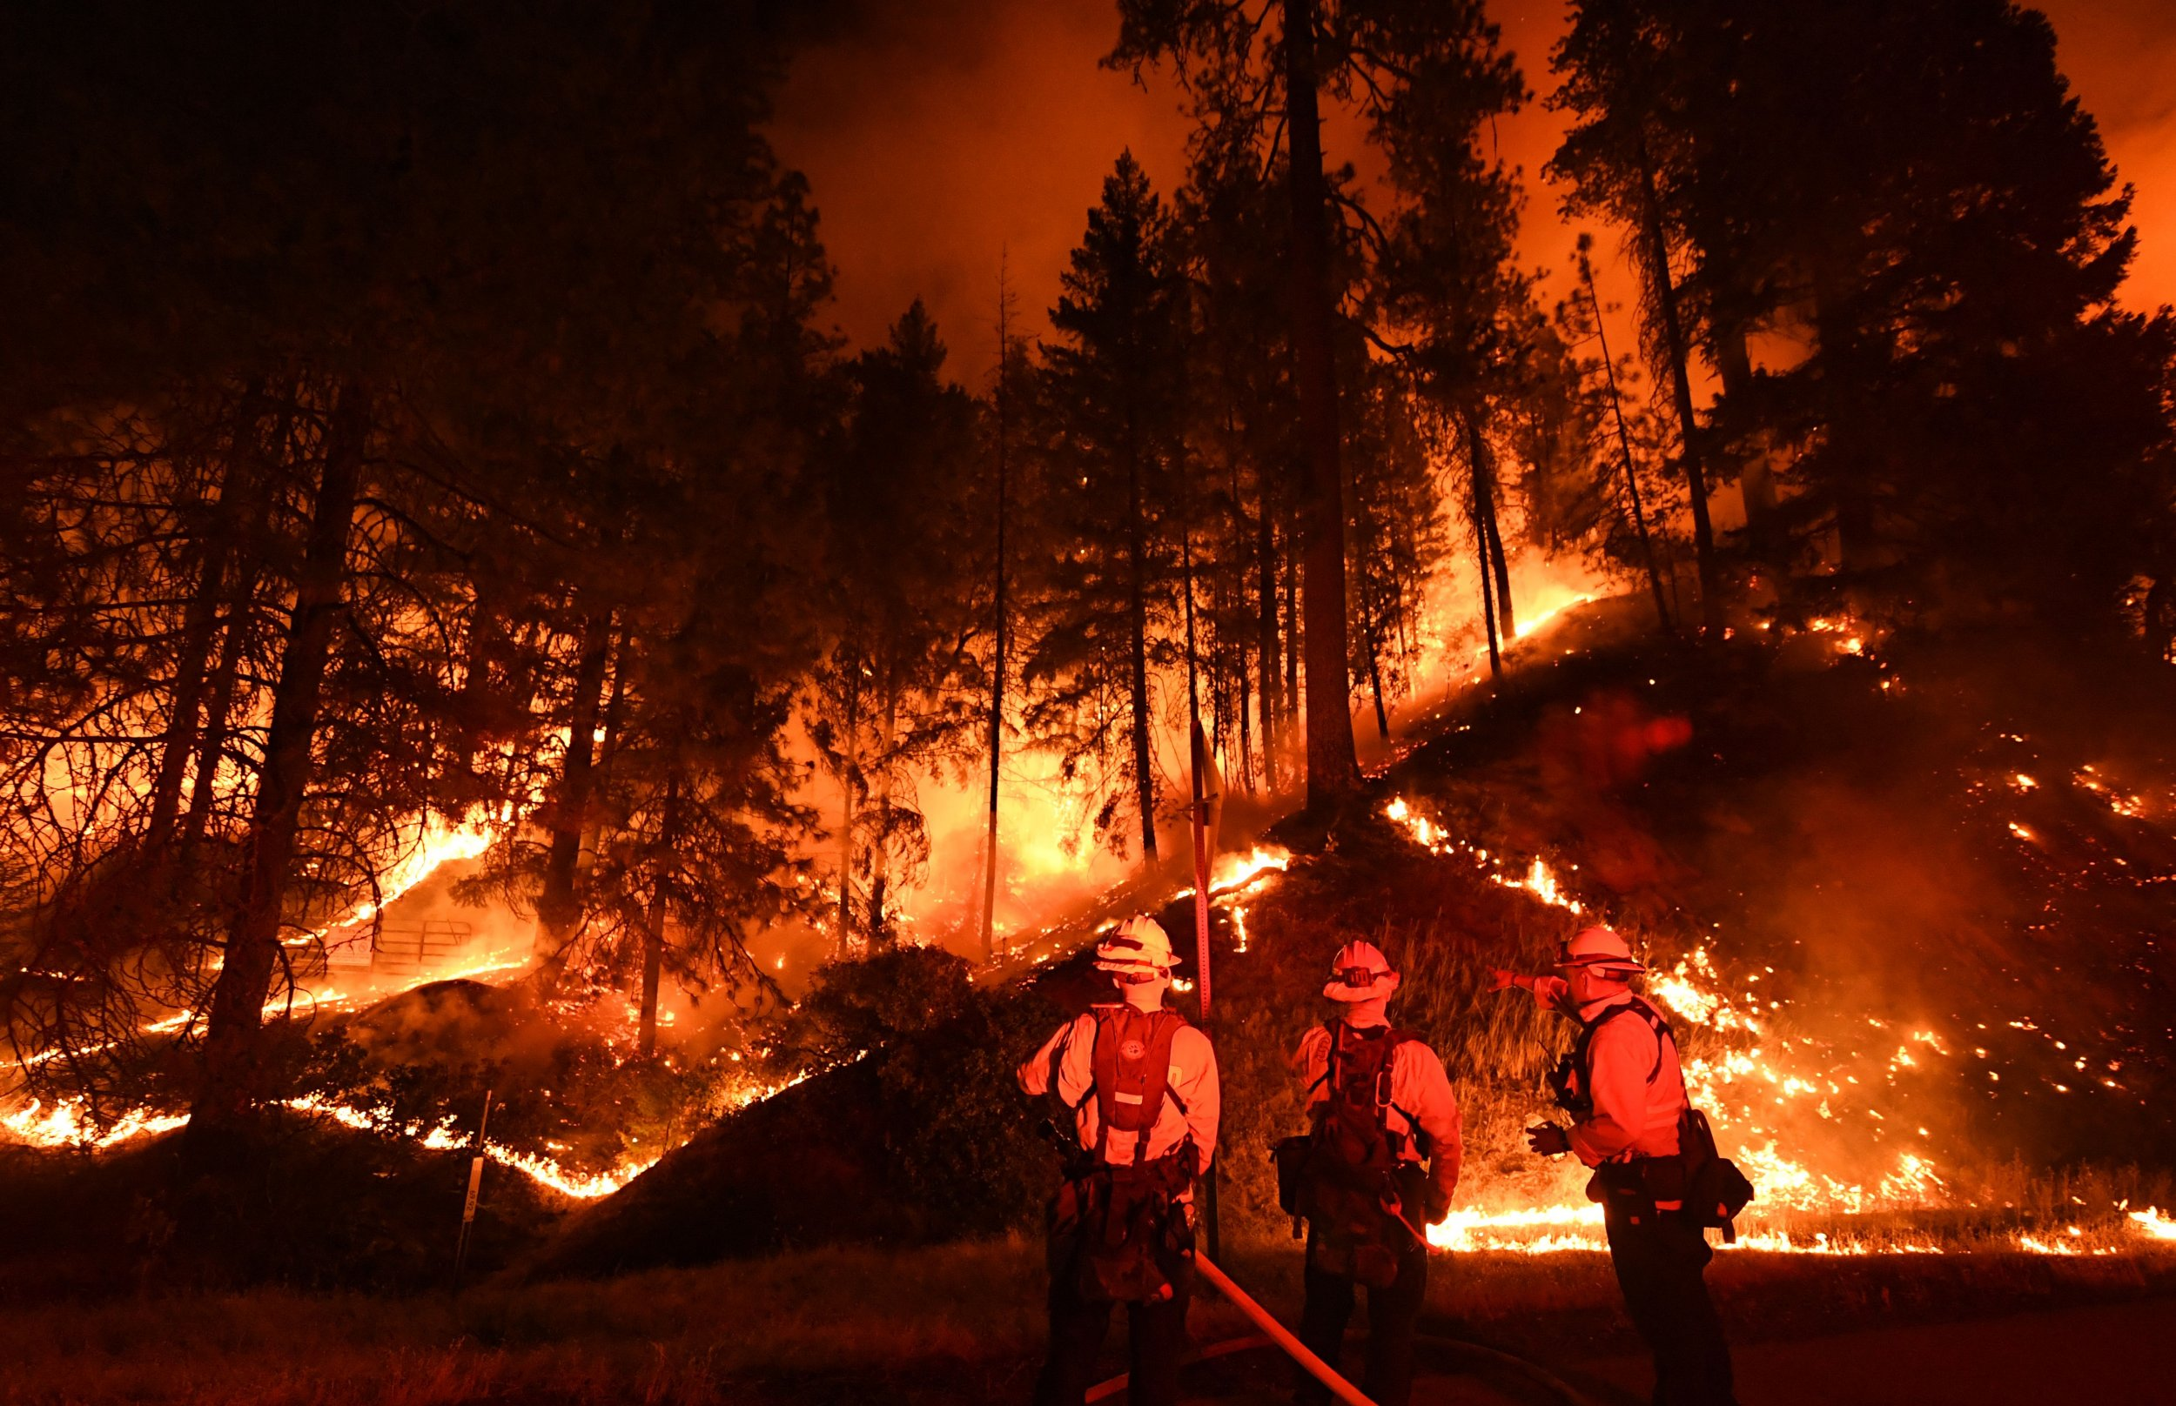
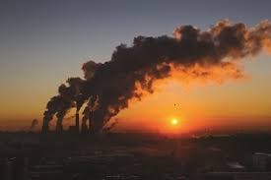
Example of some Pathfinder focus areas
What Pathfinders Gain
Direct interaction with the mission science teams for communicating impacts of the product will be used in areas of societal interest.
Perspective into new mission product design
Access to mission scientists for communicating improvements to future products
Opportunities for training and early release data for optimal readiness
How Pathfinders Contribute
Broader understanding of evolving needs in society
Influential feedback on product uses and real-world decisions.
More efficient ways of designing and delivering products to different user communities.
Collaboration with local, national and international organizations
Emergency Response
Whale Migration
Wildfire Detection
For more information on the Pathfinder program please email vanessa.escobar@noaa.gov
Urban Air Quality

