Slide 1
Error handling for satellite radiance observations in NWP
Tony McNally ECMWF

Slide 2
Context…we have a lot of satellites for global NWP!

Slide 3
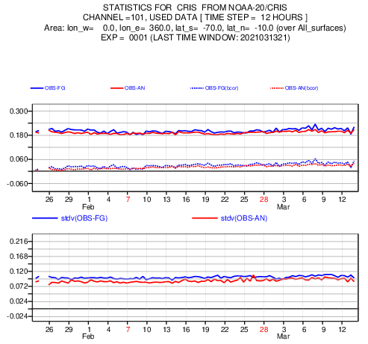
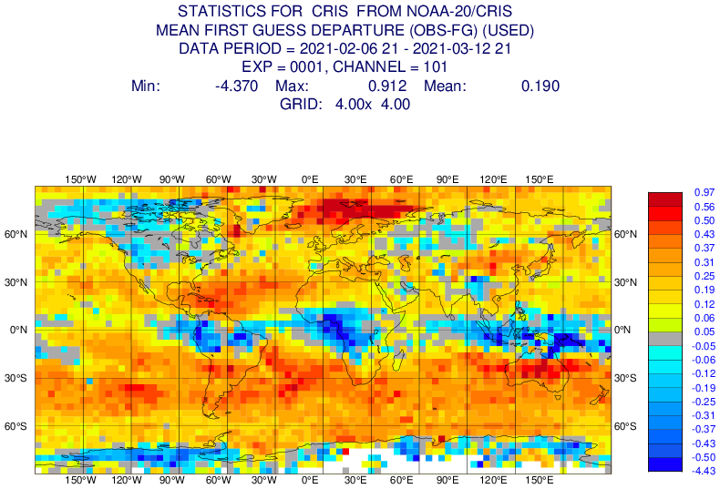
Context…how close are the models and observations ?
Compare observed radiance to value computed (with an RT model) from best prior estimate of the atmospheric state
Note the model is already very accurate!

Slide 4
What do observations do in our systems ?
i.e. …when there is a misfit between the model and the observations what do we adjust ?
Options for 4D-Var:
Adjust model state at that time and location (4D-Var increments)
Adjust estimate of model bias (adaptive Weak constraint 4D)
Adjust estimate of observation bias (adaptive constrained VARBC)
Reject the observation (VARQC / Huber Norm)
Note all of the above take place automatically + simultaneously, exploiting knowledge of the model and observation random errors

Slide 5
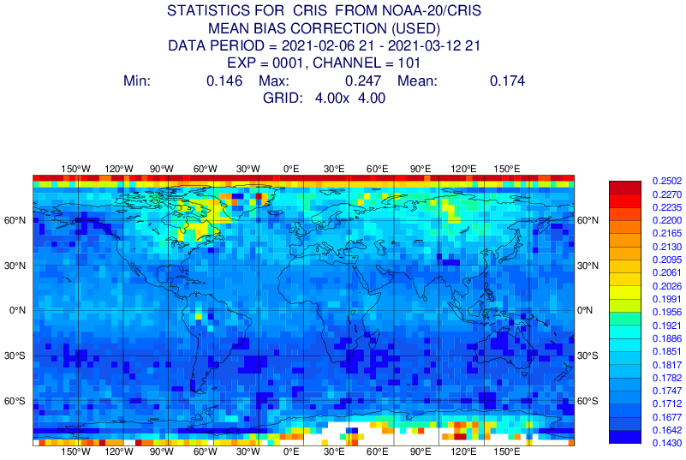
Systematic radiance errors and bias correction
Bias estimated by VARBC
Inside the 4D-Var, any observations assimilated without bias correction anchor the VARBC

Slide 6
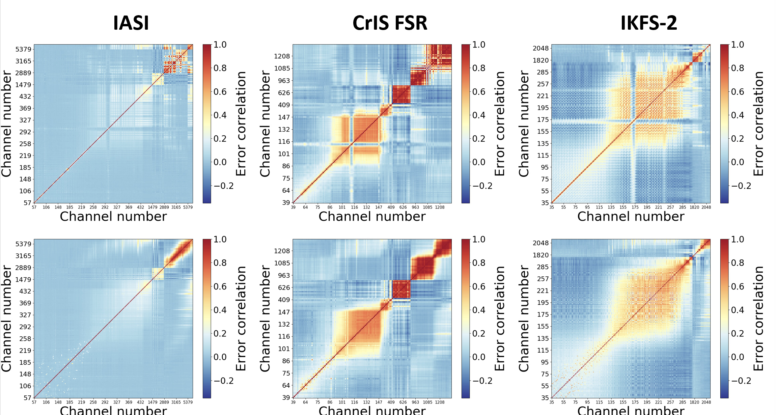
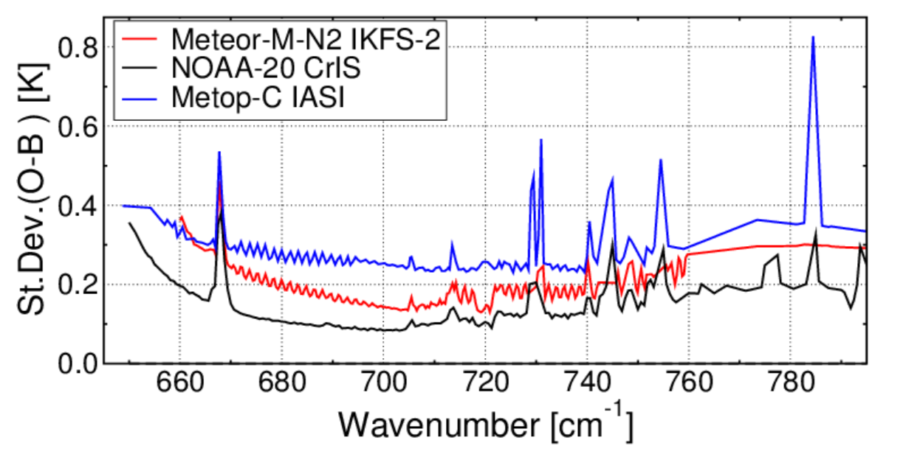
Modelling random radiance error covariances
Inter-channel correlation
Error magnitude
Note random errors are not handled adaptively !

Slide 7
Main messages
Tolerances are very small – total error budget just a few 0.1s of a kelvin
Big demands on time stability (as error models and corrections are adaptive, but cannot evolve quickly…e.g. around an orbit)
Big demands on accuracy of the instrument and the radiative transfer (and equally spectral calibration)
Big demands on corroborative observations to anchor bias corrections
ECMWF typically assimilates 70+ different sensors in real time and have limited resources available to dedicate to any single sensor that does not meet accuracy / stability standards. Problematic sensors will simply be ignored.

