Slide 1
NESDIS Next-gen Ground Architecture
Cooperative Institute for Satellite Earth System Studies (CISESS)
University of Maryland, College Park, MD
Director: Hugo Berbery
Presented by: Isaac Moradi
Thanks to the CISESS SAT team for their contribution!

Slide 2
Contents:
Ground Processing Services/Systems/Architecture
Observations
Data Acquisition
Pre and Post Processings
Product Retrieval
Data Fusion
Distribution Platforms

Slide 3
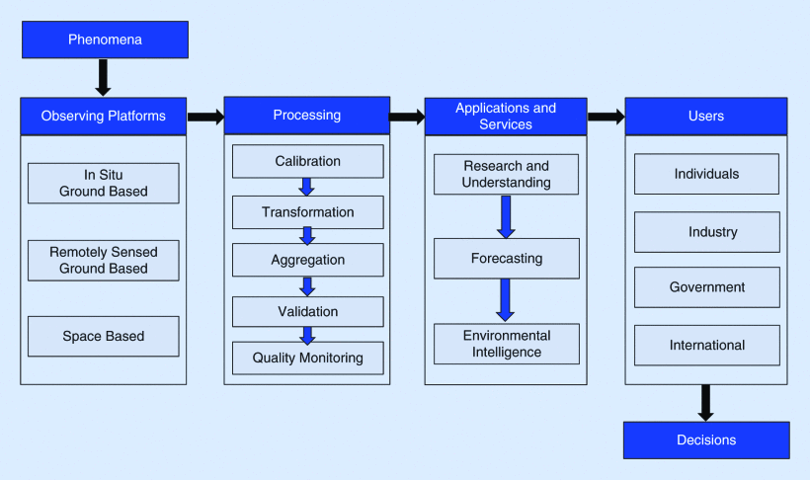
From Observations to Knowledge
Boukabara et al., 2021 [IEEE GRSM]

Slide 4
NESDIS Integrated Ground Services (IGS)
@ NOAA

Slide 5
Expected observations?
The NESDIS NGA should be designed to serve the future observing system:
Hyperspectral IR onboard geostationary satellites
Hyperspectral Microwave
Single Instrument Cubesats
Active Instruments (Radars & Lidars) with a large swath
Observations from the commercial sector likely to become a major contributor to the observing system
New observations/types are likely to be introduced to the observing system and NESDIS NGA should be flexible to accommodate these observations ASAP

Slide 6
Geostationary Extended Observations (GeoXO)

Slide 7
Data Acquisition
MTG - Infrared Sounder (IRS)
the Mid-Wave InfraRed (MWIR, 1600–2175 cm-1 or 6.25–4.6 μm) with 900 spectral channels
the Long-Wave InfraRed (LWIR, 700–1210 cm-1 or 14.3–8.3 μm) with 800 spectral channels
Has a spatial resolution of 4 km at nadir and ~10 km at the edges
The amount of data will dramatically increase because of introducing geo hyper IR and also hyper MW
The data may not be distributed in radiance format anymore and PCs be distributed
CrIS has 2211 channels with the size of the footprint varying from 14x14km at nadir to up to 48x24km on the edges.
CrIS swath 2200 km orbiting the Earth 14 times a day while GEO covers roughly ⅓ of the Earth and can provide images nominally every 30 minutes or even shorter time frames.

Slide 8
Pre and post processing
Unified pre and post processing systems - instead of instrument specific
Data formats should be unified to be able to handle multiple instruments with different observation type
Post-processing such as re-calibration and inter-calibration should be routinely performed for climate & weather applications
Climate data records should be routinely developed for climate applications
Collaborations among different national and international organizations is vital for meteorological observations

Slide 9
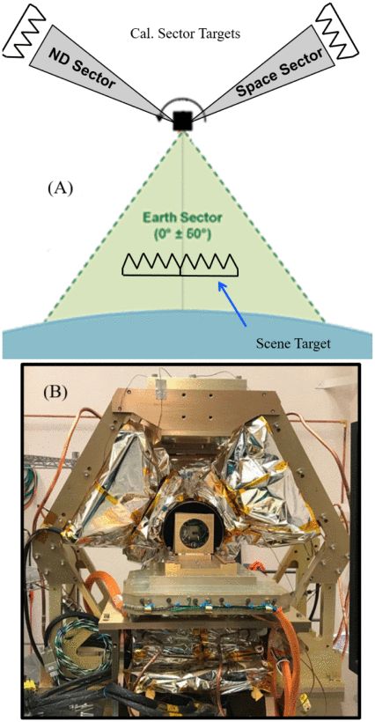
Calibration of Cubesats
Microwave Cubesats lack a reliable calibration system thus inter-calibration of observations from Cubesats is required even for weather applications
“... internal noise diodes are used for calibration, with long-term drifts measured on the order of 0.2% to 3.0% (approximately 0.4 K to 6.0 K) [Brown 2007]. Blackbody calibration targets such as used on ATMS have 0.14 K error or better for warm calibration [Kim, 2014].” [Crews, 2019]
Many intercalibration techniques rely on clear-sky observations so all-sky intercalibration should be considered
TROPICS [Leslie, 2020]

Slide 10
Product Retrieval
Developing products from merged data instead of a single instrument (IR/MW/Active/Visible/Ground Based)
Taking advantage of data from active sensors like Lidars for aerosols and radars for clouds and precipitation for refining the algorithms/products
Providing L2G data on a common grid
NESDIS forward models (e.g., CRTM) should be able to serve new data types (e.g., PC RTM)

Slide 11
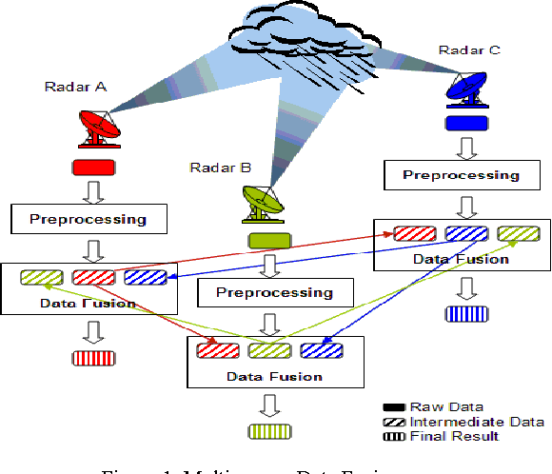
Data Fusion
No single instrument can provide a complete picture of the Earth system so data from multiple instruments need to be merged
Although reanalyses provide a comprehensive database for climate applications, the latency prevents them for real-time applications, e.g. aviation applications
Given the amount of data collected through different platforms, NOAA should take the lead on combining/fusing data from internal and external sources (e.g. EUMETSAT, commercial, citizen data from smart devices, cars, etc)
Data fusion across multiple sensors and platforms, ground-based, radar, passive infrared and microwave, active radar and lidar, scatterometers, visible, etc
Merging data from different/multiple orbits to achieve stereo advantages - geometric cloud height, improved vertical resolution
Lee, 2011

Slide 12
Data distribution
unified user friendly data format to serve both NWP and other communities and all the instruments rather than multiple formats
Modern state-of-the-art data access APIs with flexibility to extract the data needed for conducting local/regional analysis
APIs to support collecting data needed for specific purposes such as all data relevant to a specific tropical cyclone can be selected and retrieved . The data do not necessary need to be on the same server.
Platforms to allow accessing and combining satellite observations, ground based, and citizen data

