Slide 1
Science from a Hyperspectral Sensor
Christian Kummerow, CSU
(from work with NGC & NOAA BAA)
1. Sounding Capabilities
RFI Detection
3. On-orbit Intercalibration refence

Slide 2
HyMS Sounding Experiments
Used T1279 ECMWF Nature Run (~16km, 1 hr) to simulate both Hyperspectral (1 MHz) and ATMS sensor radiances, and then uses these radiances to assess how well the temperature and humidity profiles can be retrieved from simulated “observations” after characteristic sensor noise is added.
Always compare ATMS (as flying) with HyMS as projected by NGC. Up to 1 MHz channel resolution, with NEDT = 4.2K/sqrt(Bandwidth in MHz) in the K-band, 5.44K/sqrt(MHz)at V-band and 15K/sqrt(MHz) at G-band
Used an Optimal Estimation method for all retrievals. Similar to MIRS but currently only for clear air and oceans to keep simple. Had to adapt to Hyperspectral to handle 1000’s of highly correlated channels.

Slide 3
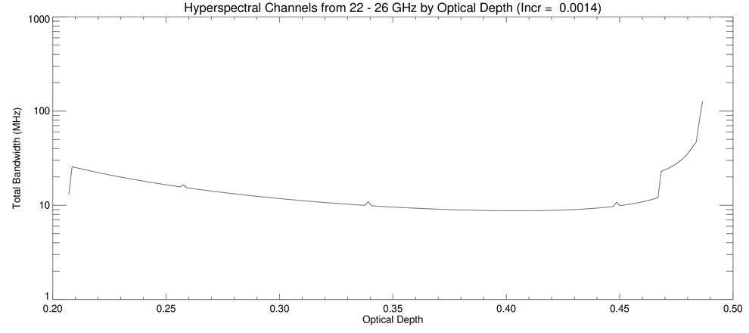
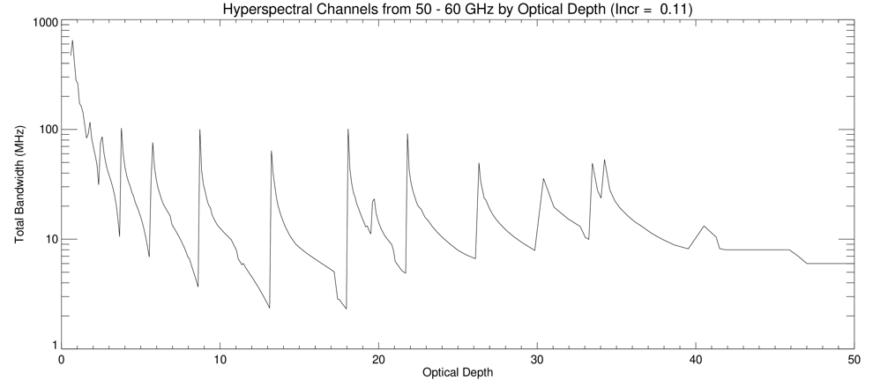
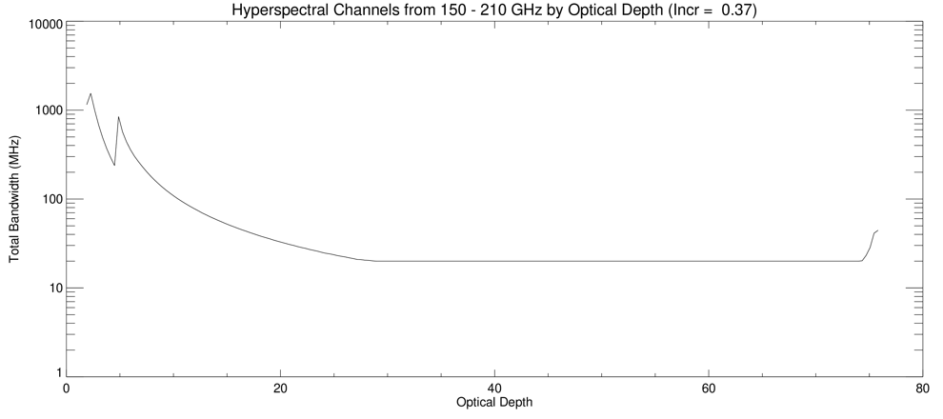
HyMS Effective Channels
Effective Channels are specified by Optical Depth within each band. Each band was allowed to have 200 effective channels.
NEΔT K/Ka : 4.2K/(n)^{1/2}
V: 5.8K/(n)^{1/2}
G: 15K /(n)^{1/2}

Slide 4
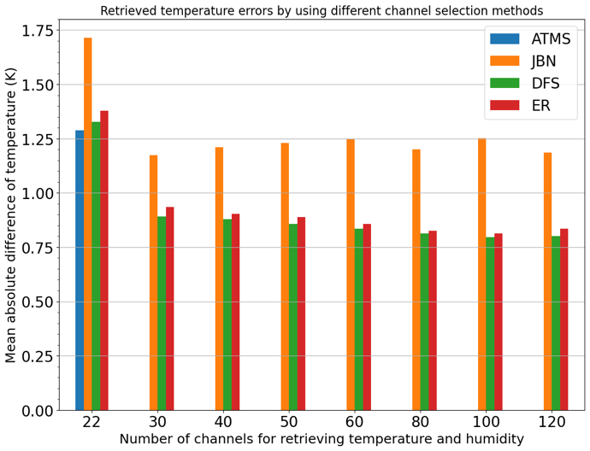
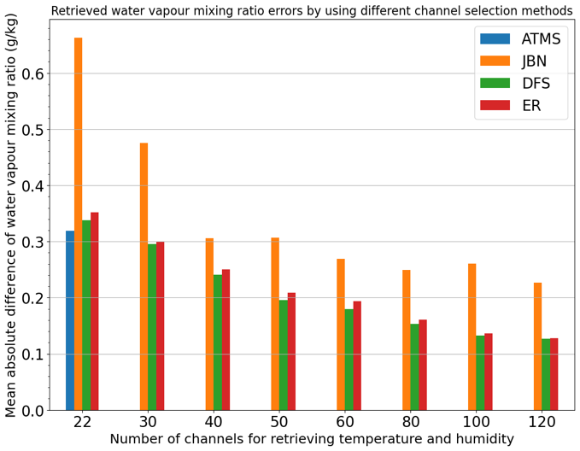
HyMS Retrieval Results
20,000 random pixels.
OE goes through a channel selection method that uses the most impactful pseudo-channel first, and so on until the number of specified channels is reached. Selection is based upon Jacobian, Degrees of Freedom of Signal, and Entropy reduction (i.e. OE metrics).

Slide 5
The 22 Channels from HyMS that were selected
 | ATMS |  | Hyper-Spectral Sensor (DSF)
Channel | Frequency (GHz) | NEDT (K) | Frequency (GHz) | NEDT (K)
1 | 23.8 | 0.7 | 22.379 | 0.374
2 | 31.4 | 0.8 | 25.963 | 0.828
3 | 50.3 | 0.9 | 50.236 | 0.25
4 | 51.76 | 0.7 | 50.853 | 0.21
5 | 52.8 | 0.7 | 52.107 | 0.34
6 | 53.596±0.115 | 0.7 | 52.338 | 0.4
7 | 54.4 | 0.7 | 54.474 | 1.09
8 | 54.94 | 0.7 | 54.653 | 0.52
9 | 55.5 | 0.7 | 55.194 | 0.64
10 | 57.290344 | 0.75 | 56.231 | 0.63
11 | 57.290344±0.217 | 1.2 | 56.348 | 0.56
12 | 57.290344±0.3222±0.048 | 1.2 | 56.965 | 0.94
13 | 57.290344±0.3222±0.022 | 1.5 | 56.967 | 1.38
14 | 57.290344±0.3222±0.010 | 2.4 | 57.598 | 0.78
15 | 57.290344±0.3222±0.0045 | 3.6 | 57.601 | 0.77
16 | 88.2 | 0.5 | 57.612 | 1.5
17 | 165.5 | 0.6 | 57.613 | 1.68
18 | 183.31±7 | 0.8 | 150.58 | 0.44
19 | 183.31±4.5 | 0.8 | 157.37 | 0.38
20 | 183.31±3 | 0.8 | 171.8 | 0.52
21 | 183.31±1.8 | 0.8 | 183.16 | 2.34
22 | 183.31±1 | 0.9 | 183.3 | 2.25

Slide 6
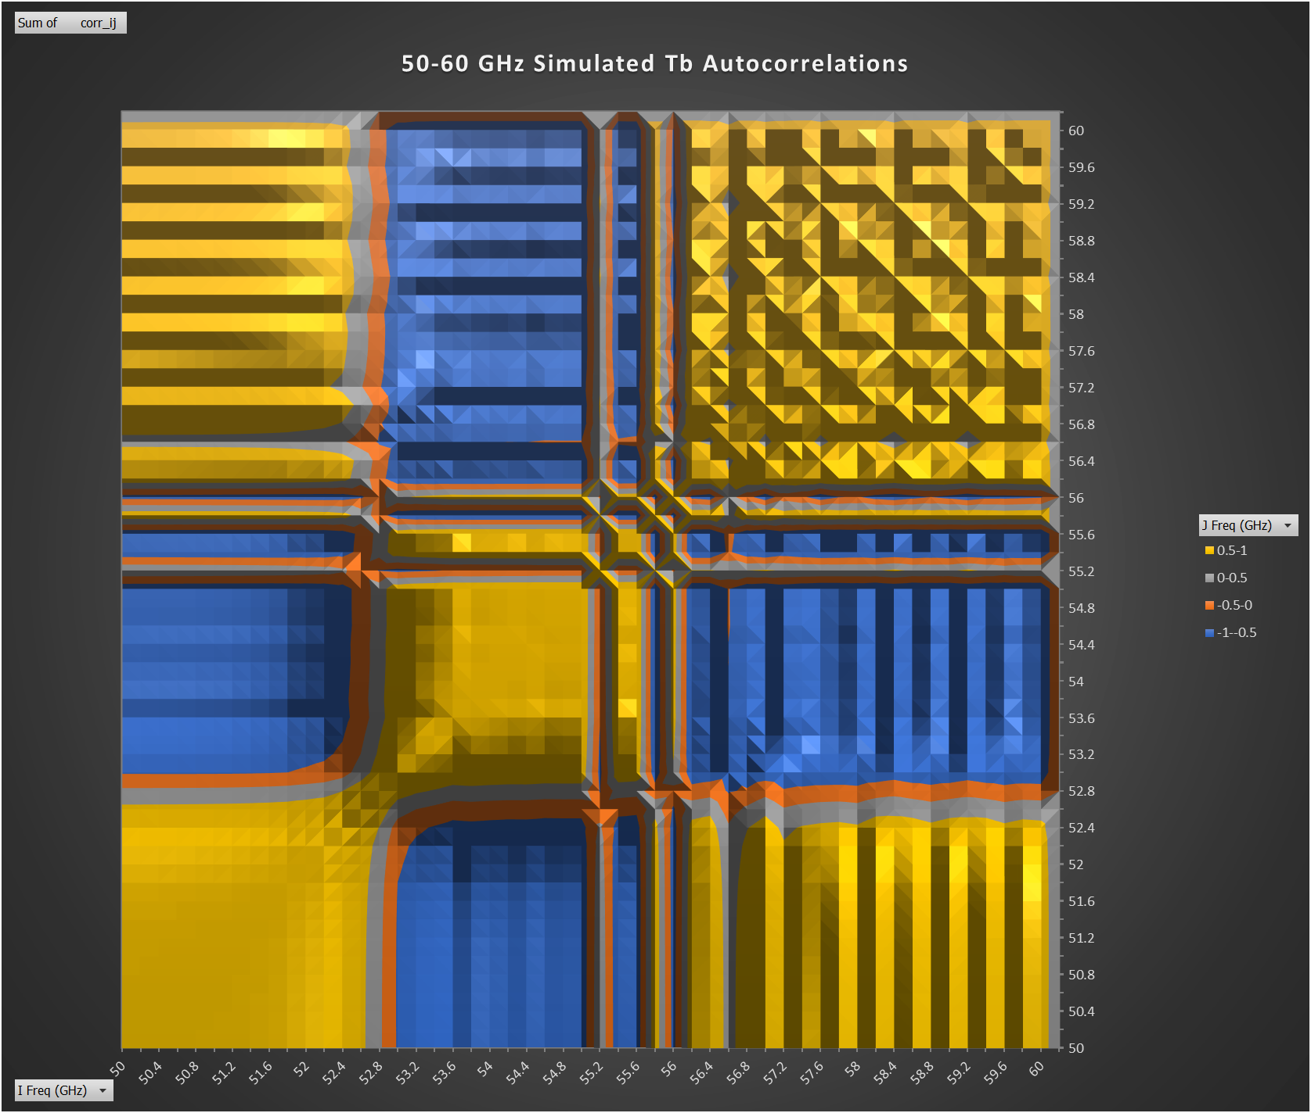
RFI Detection capabilities of HyMS
Developed a simple algorithm with computed Tb from T1279 ECMWF Nature Run (~16km, 1 hr) to compute correlations between all channel pairs (10 MHz channels were assumed here) in order to establish expected correlations.
Then added RFI at various levels and looked at correlations to assess if RFI could be detected.
Focused on 5G network transmitting below the 24.5GHz threshold set by the FCC in case filters are not as effective as advertised.
50-60GHz correlation matrix

Slide 7
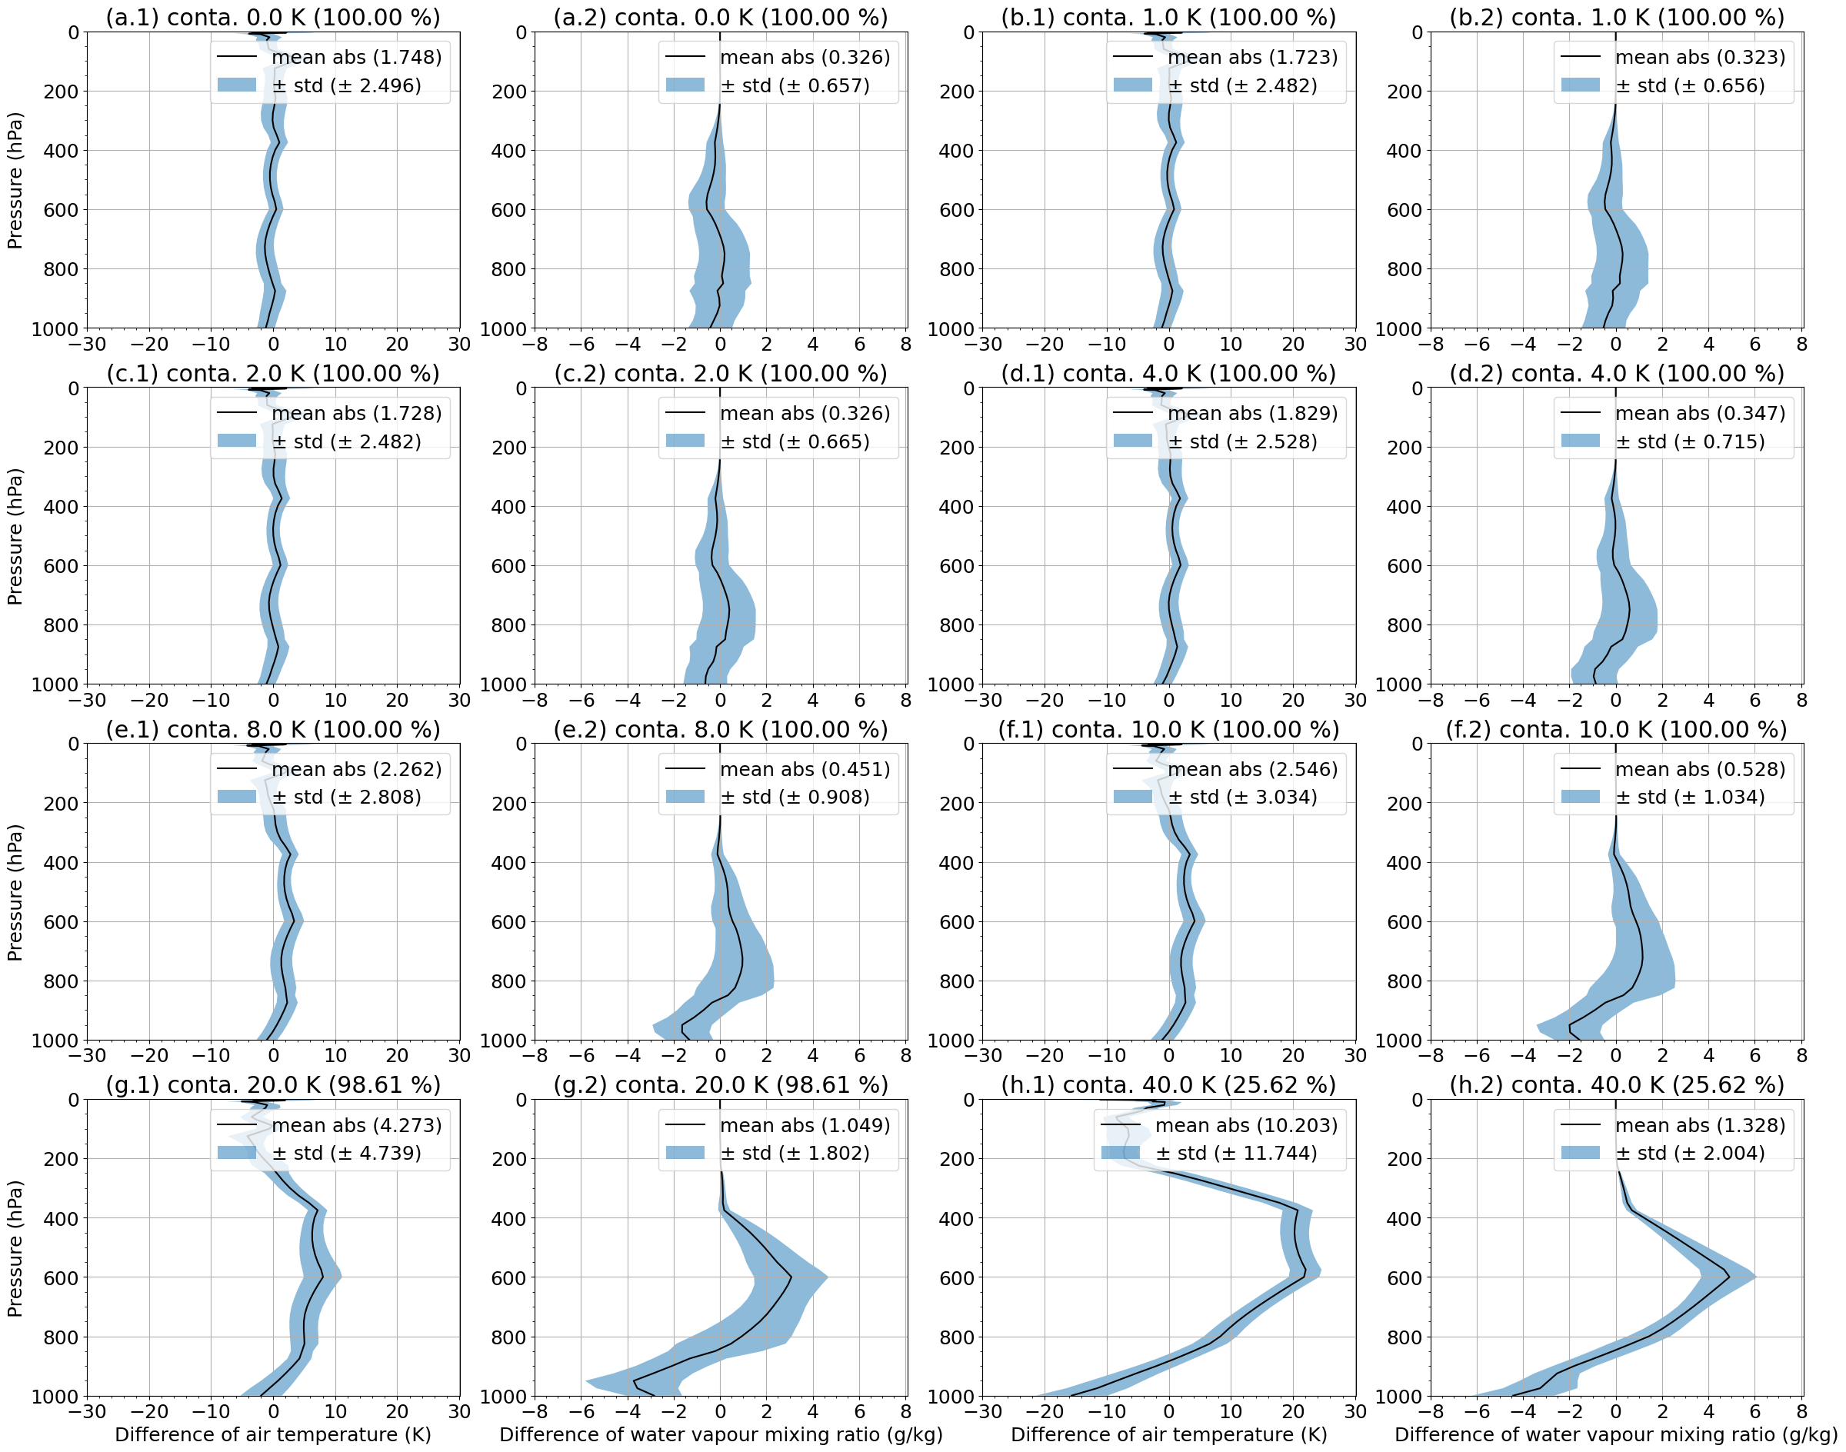
ATMS (OE) is not particularly good at detecting RFI

Slide 8
RFI Detection Capabilities of HyMS
(5% of pixels have RFI)
RFI Intensity (K) | ETS | Accuracy | TNR
10.0 K | 0.246 | 0.970 | 0.999
5.0 K | 0.273 | 0.964 | 0.999
4.0 K | 0.165 | 0.958 | 0.994
3.0 K | 0.166 | 0.935 | 0.969
2.0 K | 0.082 | 0.856 | 0.881
1.0 K | 0.045 | 0.836 | 0.860
0.5 K | 0.041 | 0.850 | 0.881
0.4 K | 0.012 | 0.850 | 0.877
0.2 K | 0.005 | 0.849 | 0.876
0.1 K | 0.001 | 0.840 | 0.875
Accuracy is fraction of correct detection Y/Y + N/N
Equitable Threat Score removes chance correct detection
True Negative Rate is prob. that there is no RFI if algorithm does not indicate any

Slide 9
Metrics for Temperature Error due to RFI
OE for ATMS vs Correlation Matrix for HyMS
Chan. 1 RFI [K] | Abs. Mean T Error [K] | T Error due to RFI [K] | SD Error [K] | SD Error due to RFI [K] | OE Convergence [%] | HS RFI Detection (TNR) 25% bandwidth affected by RFI | HS RFI Detection (TNR) 50% bandwidth affected by RFI | HS RFI Detection (TNR) 100% bandwidth affected by RFI
0 | 1.748 | n/a | 2.496 | n/a | 100% | n/a | n/a | n/a
0.1 | 1.744 | 0.004 | 2.494 | 0.002 | 100% | 87.7% | 87.6% | 87.5%
0.5 | 1.732 | 0.016 | 2.487 | 0.009 | 100% | 88.1% | 86.0% | 88.1%
1.0 | 1.723 | 0.025 | 2.482 | 0.014 | 100% | 99.4% | 88.1% | 86.0%
2.0 | 1.728 | 0.020 | 2.482 | 0.014 | 100% | 99.9% | 99.4% | 88.1%
4.0 | 1.829 | 0.081 | 2.528 | 0.032 | 100% | > 99.9% | 99.9% | 96.9%
6.0 | 1.915 | 0.167 | 2.638 | 0.142 | 100% | > 99.9% | 99.9% | 99.9%
8.0 | 2.018 | 0.270 | 2.808 | 0.312 | 100% | > 99.9% | > 99.9% | 99.9%
10.0 | 2.546 | 0.798 | 3.034 | 0.538 | 100% | > 99.9% | > 99.9% | 99.9%
20.0 | 4.273 | 2.525 | 4.739 | 2.243 | 98.61% | > 99.9% | > 99.9% | > 99.9%
30.0 | 6.872 | 5.124 | 7.644 | 5.148 | 58.92% | > 99.9% | > 99.9% | > 99.9%
40.0 | 10.203 | 8.455 | 11.744 | 9.248 | 25.62% | > 99.9% | > 99.9% | > 99.9%
50.0 | 12.590 | 10.842 | 14.494 | 11.988 | 15.10% | > 99.9% | > 99.9% | > 99.9%

Slide 10
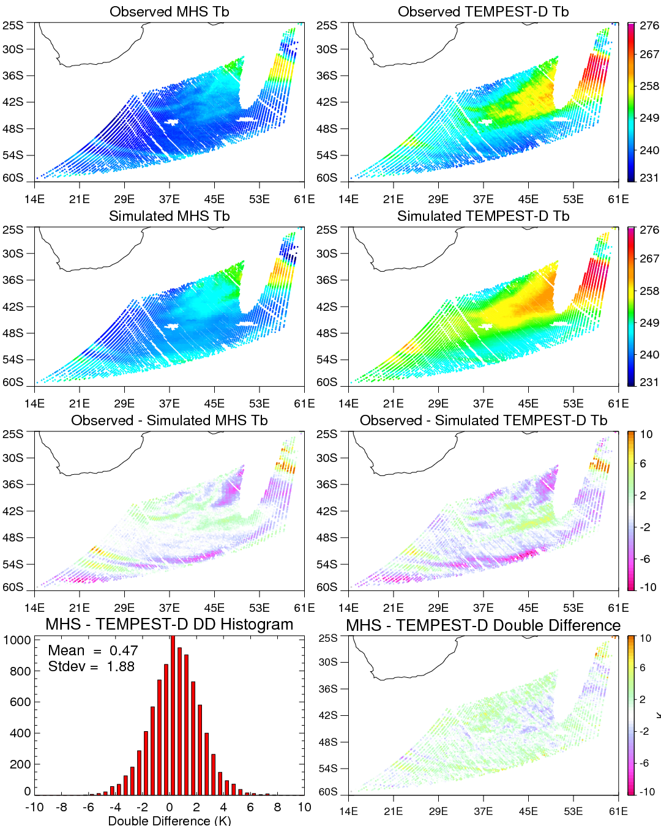
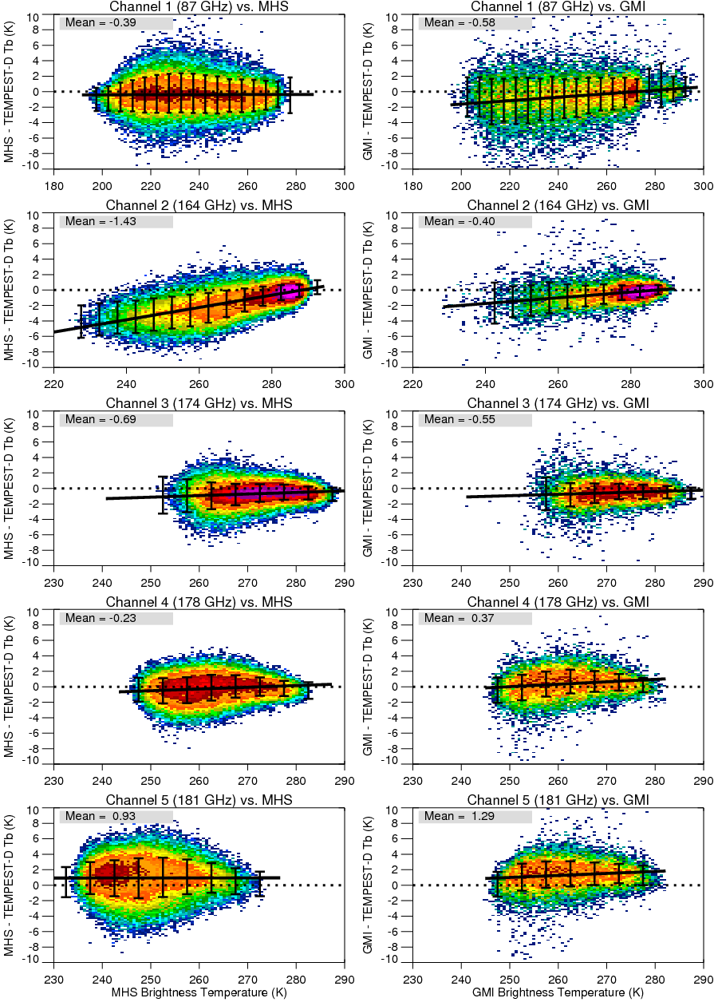
Satellite Intercalibration Double Difference Approach to using MHS to assess TEMPEST-D calibration
Observed (top), simulated (middle), and Tb differences (3rd row) from Dec 1, 2018, between the MHS 183±1-GHz channel (Left) and the TEMPEST-D 180.8-GHz channel (Right). Double-differences are shown in the bottom row.
Observed minus simulated double differences as a function of the observed Tb. Results using MHS (left) and GPM GMI as the reference sensor.

Slide 11
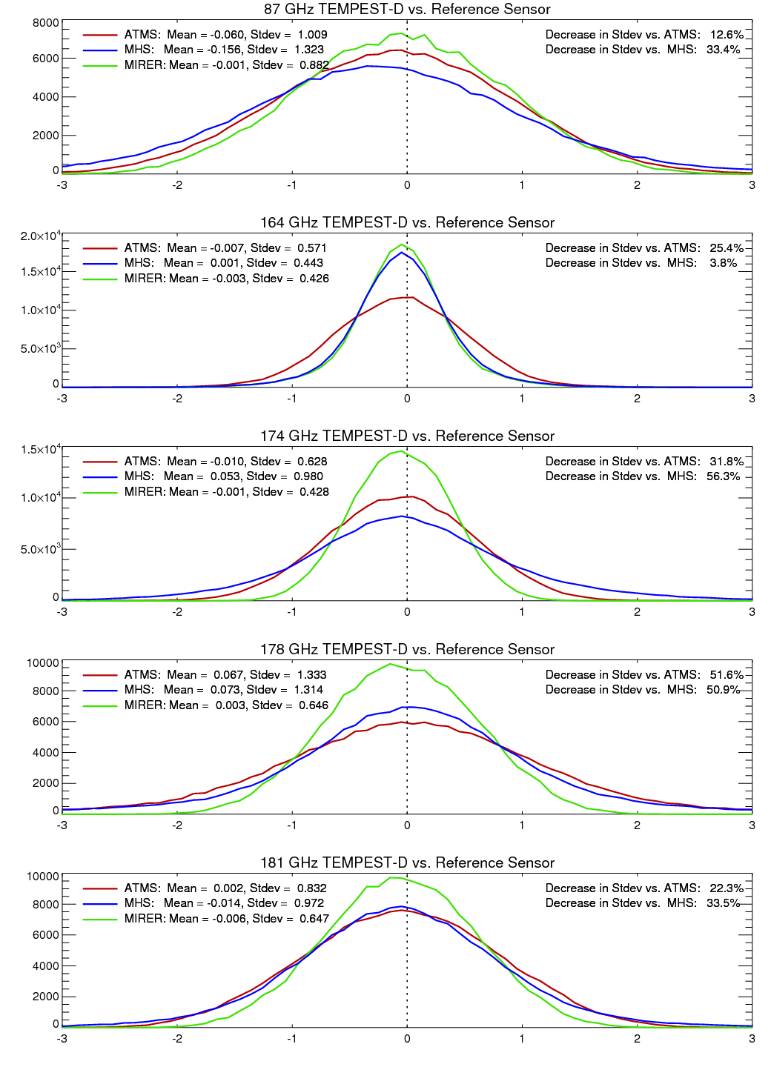
HyMS can match Target Sensor Spectral Response
Plot shows histogram of simulated double differences for TEMPEST-D (target sensor) versus three different reference sensors.
ATMS
MHS
HyMS (NGC MiRER)
Simulation uses ERA5 reanalysis for observed Tb, and ERA Interim reanalysis for Simulated Tb. This provides a measure of the impact of errors in the geophysical parameters on the DD results.
Width of distribution (i.e. Stdev) shows significant reduction for MIRER, although impact depends of difference between other reference sensors (i.e. ATMS, MHS) and TEMPEST-D.

