Slide 1
POES Legacy Studies
Impacts from sunsetting legacy satellite platforms
Kevin Garrett (NESDIS/STAR)
with inputs from:
Narges Shahroudi (Rti@NESDIS/STAR), Ricardo Todling (NASA/GMAO), Ben Ruston and Hui Christophersen (NRL), Stephen Weygandt and Haidao Lin (OAR/GSL)

Slide 2
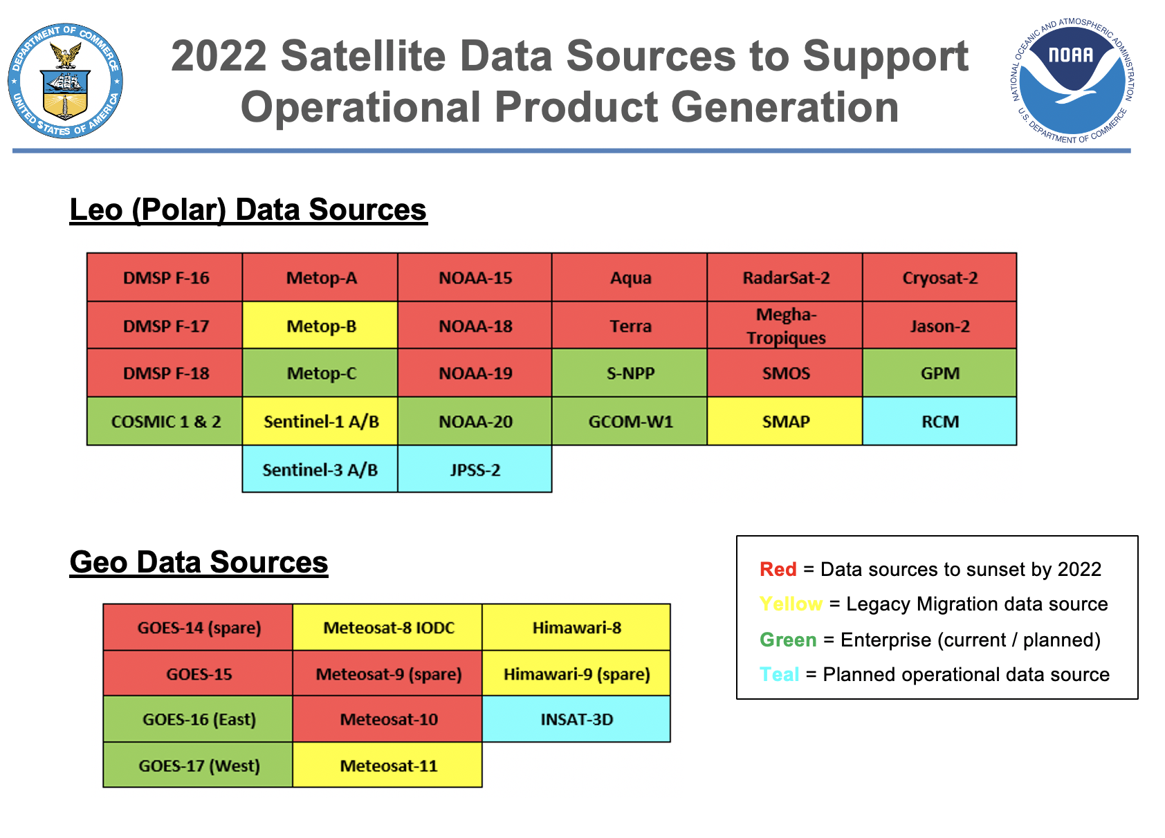
Background/Objectives
Potential for NESDIS to sunset observations from legacy platforms beyond their lifetime
Does expected negative impact from loss of legacy observations outweigh the cost to maintain operations?
Or will new observing assets compensate for any negative impact?
Four studies undertaken to investigate impacts on NWP
NESDIS
OAR
NRL
GMAO
Courtesy LORWG

Slide 3
Caveats
Not all control runs and data denials are identical
common denominator is denial of NOAA-15, 18, 19
Does not take into account satellite drift in 2022 +
Does not take into account new satellites which could offset negative impacts aside from GMAO COSMIC-2 study (MTG, Metop-SG, J2, AMSR3)
Studies limited to NWP impacts. No consideration for:
situational awareness product use from NCEP centers, NWS WFOs
climate data records

Slide 4
OSE Configurations
 | NESDIS | OAR | NRL | GMAO
NWP System | FV3GFS | RAP | NAVGEM | GEOS-5
Resolution | C384 (25 km) | 13 km | T425 (31 km) | C360 (25 km)
Time period | 8/2-9/30 2019 | 5/1-5/31 2020 | 3/1-6/1 2020 | 2/7-6/5 2020
Verification | ECMWF | Obs + Self | Obs + Self | Obs + ERA5 + Self

Slide 5
Control Runs
CONTROL |  | NESDIS | OAR | NRL | GMAO
Radiances
aqua | airs | 546788 | 3206
gpm | gmi | 0 | 0
gcom-w1 | amsr2 | 0 | 0
n15 | amsua | 45680 | 2468
n18 | amsua | 75175 | 9441
metop-a | mhs | 22158 | 11
metop-a | amsua | 87071 | 8586
aqua | amsua | 48138 | 403
f17 | ssmis | 33987 | 2976
f18 | ssmis | 0 | 0
f19 | ssmis | 0 | 0
metop-a | iasi | 1135878 | 72807
n19 | amsua | 90043 | 15136
n19 | mhs | 7109 | 3126
m11 | seviri | 6549 | 0
metop-b | amsua | 54351 | 8480
metop-b | mhs | 24656 | 10227
metop-b | iasi | 1128484 | 115258
npp | atms | 150660 | 6764
n20 | atms | 153267 | 9748
npp | cris-fsr | 524199 | 48776
n20 | cris-fsr | 519509 | 49505
metop-a | avhrr | 9908 | 0
n18 | avhrr | 9483 | 0
meghat | Saphir | 3248 | 0
metop-c | amsua | 0 | 0
metop-c | mhs | 0 | 0
metop-c | iasi | 0 | 0
GOES | snd/abi | (15) 16169 | (16) 10450
Assimilated
Not Assimilated
CONTROL | Control | OAR | NRL | GMAO
AMV
HIMAWARI-8 | 18305
METEOSAT-11 | 9778
METOP-A | 8224
METOP-B | 10310
NOAA-15 | 149
NOAA-18 | 927
NOAA-19 | 715
NPP | 415
GOES-16 | 139439
GOES-17 | 0
TERRA | 3640
AQUA | 9636
METOP-A ascat | 8116
METOP-B ascat | 8182
GPS
METOP-B | 6430
Terra-SAR-X | 4953
TanDEM-X | 1685
METOP-A | 6723
METOP-C | 0
KOMPSAT | 0
COSMIC-1 | NA at cycle
COSMIC-2 | 0

Slide 6
Data Denials
CONTROL |  | NESDIS | OAR | NRL | GMAO
Radiances
aqua | airs | 0 | 3158
gpm | gmi | 0 | 0
gcom-w1 | amsr2 | 0 | 0
n15 | amsua | 0 | 0
n18 | amsua | 0 | 0
metop-a | mhs | 22158 | 9
metop-a | amsua | 87071 | 8408
aqua | amsua | 0 | 403
f17 | ssmis | 0 | 2968
f18 | ssmis | 0 | 0
f19 | ssmis | 0 | 0
metop-a | iasi | 1135878 | 72809
n19 | amsua | 0 | 0
n19 | mhs | 0 | 0
m11 | seviri | 6549 | 0
metop-b | amsua | 54351 | 8480
metop-b | mhs | 24656 | 10055
metop-b | iasi | 1128484 | 115109
npp | atms | 150660 | 6719
n20 | atms | 153267 | 9688
npp | cris-fsr | 524199 | 50153
n20 | cris-fsr | 519509 | 49412
metop-a | avhrr | 9908 | 0
n18 | avhrr | 0 | 0
meghat | Saphir | 0 | 0
metop-c | amsua | 0 | 0
metop-c | mhs | 0 | 0
metop-c | iasi | 0 | 0
GOES | snd/abi | (15) 16169 | (16) 10456
Assimilated
Not Assimilated
CONTROL | Control | OAR | NRL | GMAO
AMV
HIMAWARI-8 | 18305
METEOSAT-11 | 9778
METOP-A | 8224
METOP-B | 10310
NOAA-15 | 0
NOAA-18 | 0
NOAA-19 | 0
NPP | 415
GOES-16 | 139439
GOES-17 | 0
TERRA | 0
AQUA | 0
METOP-A ascat | 8116
METOP-B ascat | 8182
GPS
METOP-B | 6430
Terra-SAR-X | 4953
TanDEM-X | 1685
METOP-A | 6723
METOP-C | 0
KOMPSAT | 0
COSMIC-1 | NA at cycle
COSMIC-2 | 0

Slide 7
NESDIS Results

Slide 8
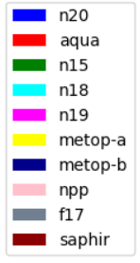
Data coverage
CONTROL
1 data assimilation cycle
Data Denial (PBO)

Slide 9
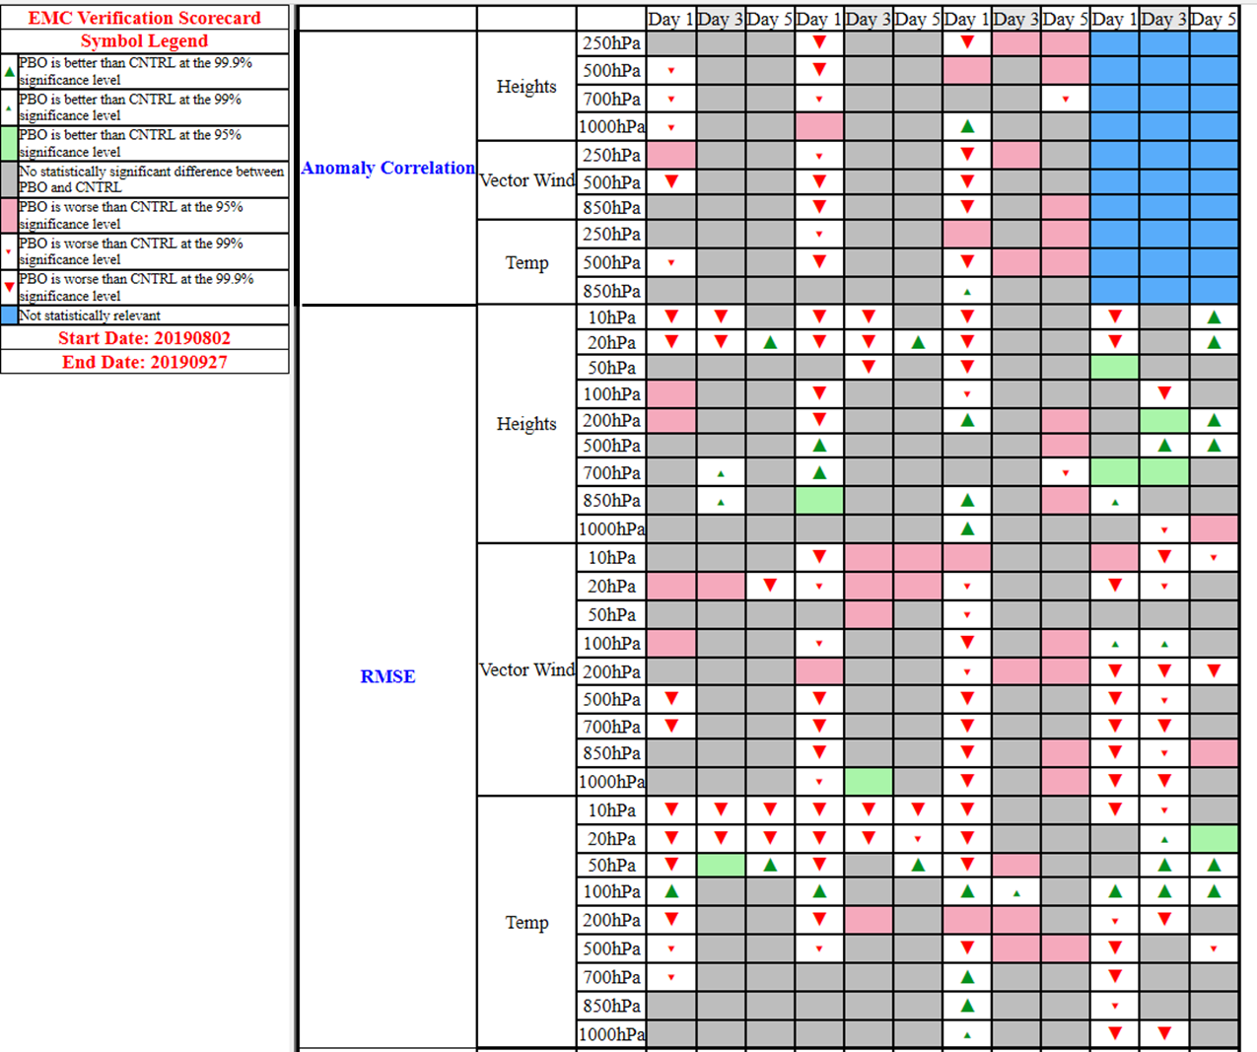
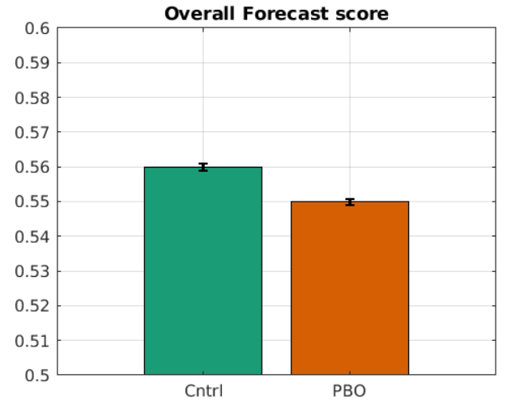
Summary impacts
Overall Forecast Score
Normalized (MinMax) for the two experiments
over one month for:
AC,RMSE,MAE
0h,24h,48h,72h,96h,120h,144h,168h
NHX,SHX,Tropics
HGT,T,Wind,RH
Levels: 250,500,700,850,1000
PNA
NHX
SHX
TRO

Slide 10
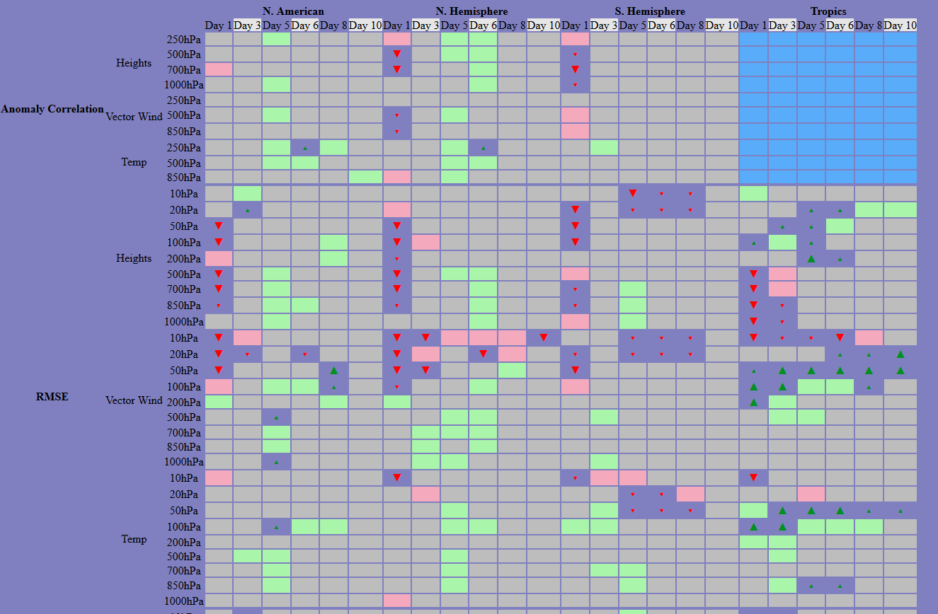
Degradation in context
PNA
NHX
SHX
TRO
Legacy Data Denial from control (left)
Aeolus addition on top of Control (above)

Slide 11
NESDIS Summary
Removal of POES Legacy sensors introduces gaps in spatial coverage to the DA system each cycle
Statistically significant degradation in SHX (HGT) and Tropics (Wind) and Globally (Q)
Degradation is consistent verified against ECMWF and in-situ obs
No statistical degradation in precipitation forecast over CONUS
Assessment of impact on TC track forecast ongoing
Reference NOAA-20 data denial started

Slide 12
OAR Results

Slide 13
Summary of regional impacts
12-h forecast CrIS BT verification
Analysis of bracketing retrospective experiments
Modest reduction in number of radiance observations for POES denial (~8%)
Modest degradation in forecast skill for POES denial as measured by radiosonde verification and CrIS BT verification
Impacts statistically significant for some levels and channels
Analysis of diurnal aspects to impacts
No strong diurnal variation in obs counts for POES legacy or other radiances
Weak diurnal patterns seen in aircraft verification, stronger signal seen in analysis verification (maximum impact for 09z-14z and 21z-02z initialization)
RAP partial cycling effectively brings in more radiance observations at 09z, 21z, which may be a significant factor in the diurnal cycle of impacts
Normalized forecast impact (positive = degradation for POES legacy denial)

Slide 14
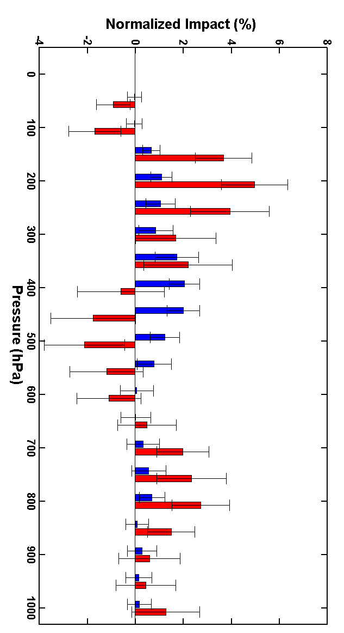
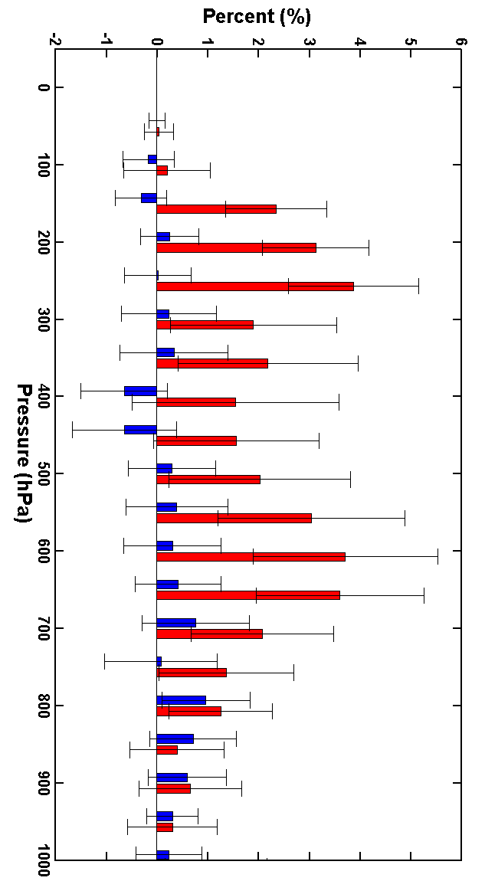
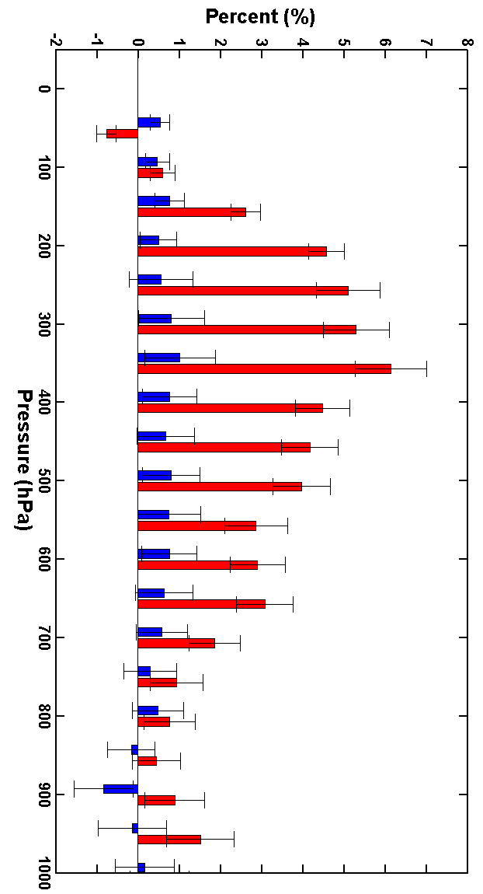
18-h Forecast Impacts
% impact by pres. level
0
100
200
300
400
500
600
700
800
900
1000
hPa
0
100
200
300
400
500
600
700
800
900
1000
hPa
0
100
200
300
400
500
600
700
800
900
1000
hPa
6%
6%
6%
18-h forecast
Radiosonde verification
Normalized forecast impact (positive = degradation for POES legacy denial)
Temperature
Relative
Humidity
Wind
POES denial
All radiance denial

Slide 15
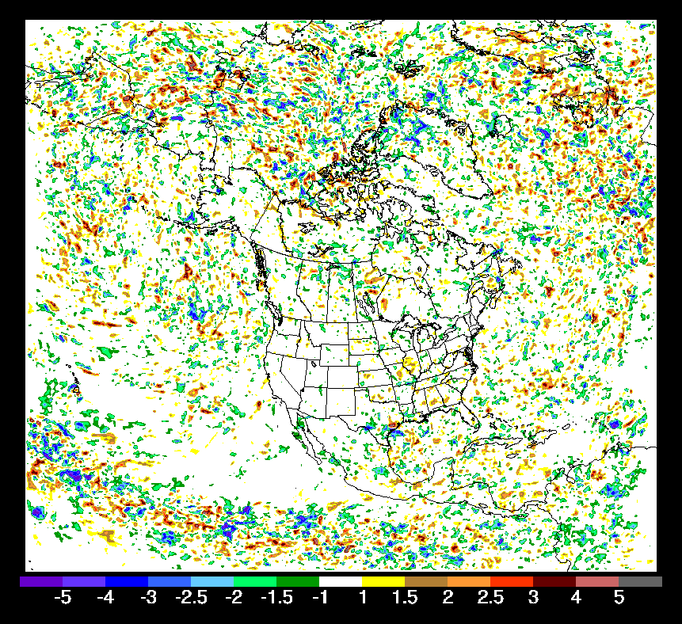
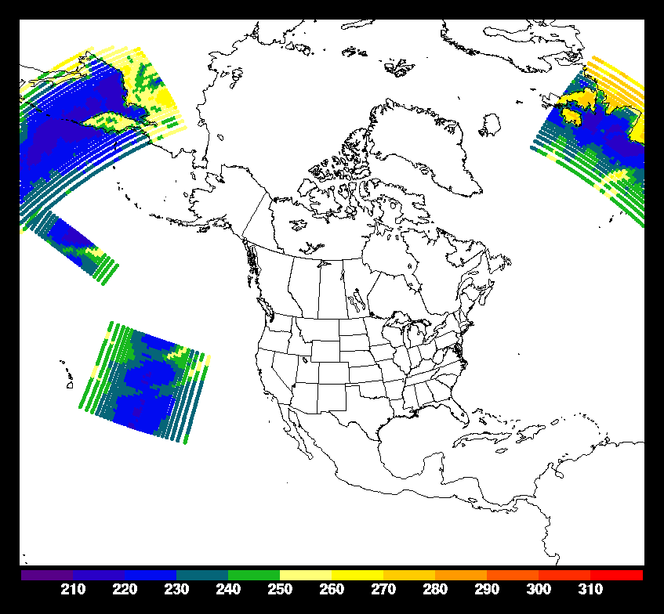
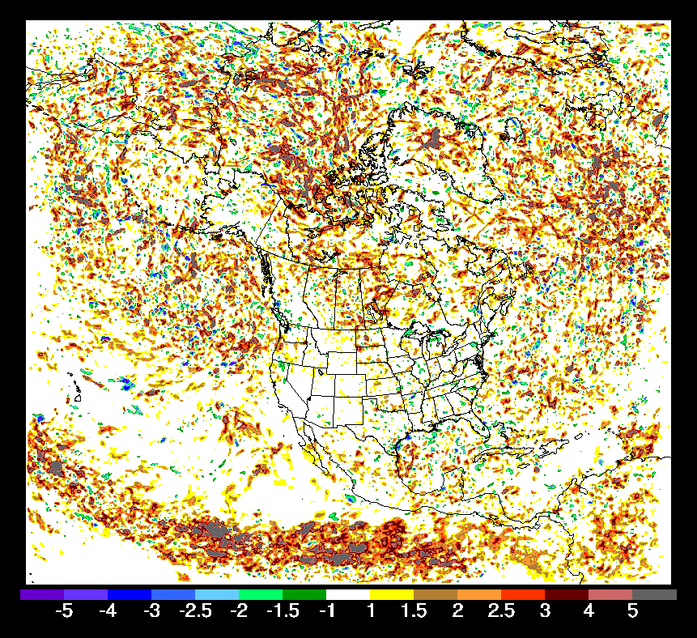
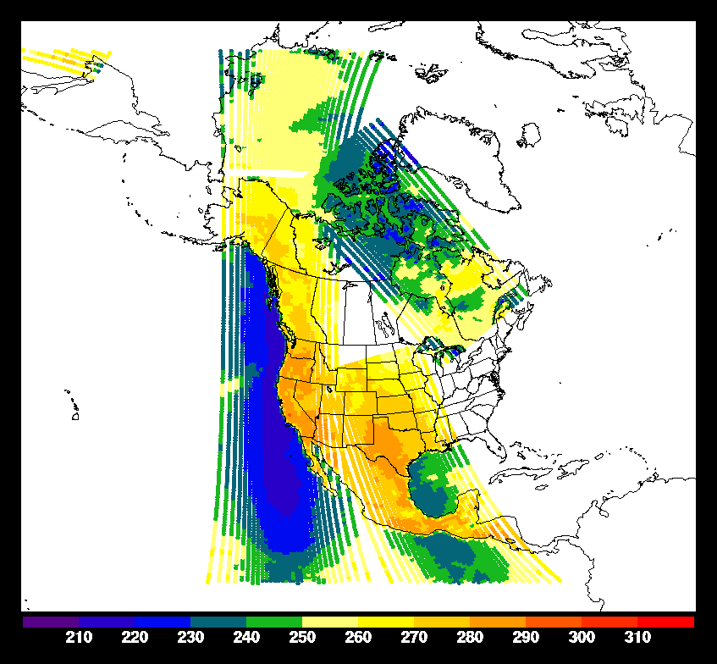
Diurnal aspects
Mta amsu
Mtb amsu
Aqua amsu
Mta mhs
Mtb mhs
Mta iasi
Mtb iasi
NPP atms
N20 atms
NPP cris
N20 cris
Aqua airs
f17 ssmis
G16 abi
Average radiance obs
counts by time of day
Plot of difference
for fcst. RMSE
(calculated vs.
CNTL analysis)
for POES
legacy denial
forecast minus
CNTL forecast
700 mb RH
Other radiances
08z init
+6h fcst
0 1 2 3 4 5 6 7 8 9 10 11 12 13 14 15 16 17 18 19 20 21 22 23 z
Small diurnal variation for aircraft verification, larger for analysis verification (partial cycle?)
N15 amsu
N18 amsu
N19 amsu
N19 mhs
Initialization time (z)
Mean Rel. hum.
RMSE diff
-0.03%
POES
legacy
Mean
Rel. hum.
RMSE diff +0.82%
0 1 2 3 4 5 6 7 8 9 10 11 12 13 14 15 16 17 18 19 20 21 22 23 z
Initialization time (z)
Ratio of POES legacy obs / other radiance obs
02z init
+6h fcst
0 1 2 3 4 5 6 7 8 9 10 11 12 13 14 15 16 17 18 19 20 21 22 23 z
6h fcst. Init. 23-03z
6h fcst.
Init. 9z-13z
Initialization time (z)
Control
Aircraft Temperature RMSE (K)
POES 1 denial
Obs denial 🡺 Improve
Obs denial 🡺 degrade
Initialization time (z)
(POES Legacy deny RMSE – CNTL RMSE)
0 1 2 3 4 5 6 7 8 9 10 11 12 13 14 15 16 17 18 19 20 21 22 23 z

Slide 16
NRL Results

Slide 17
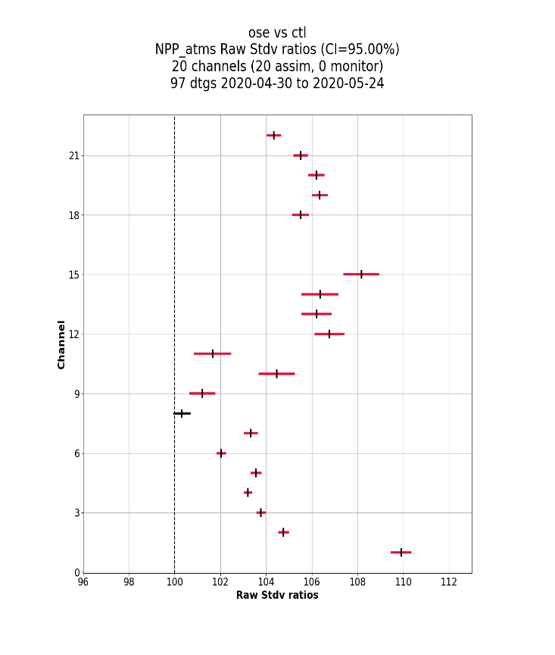
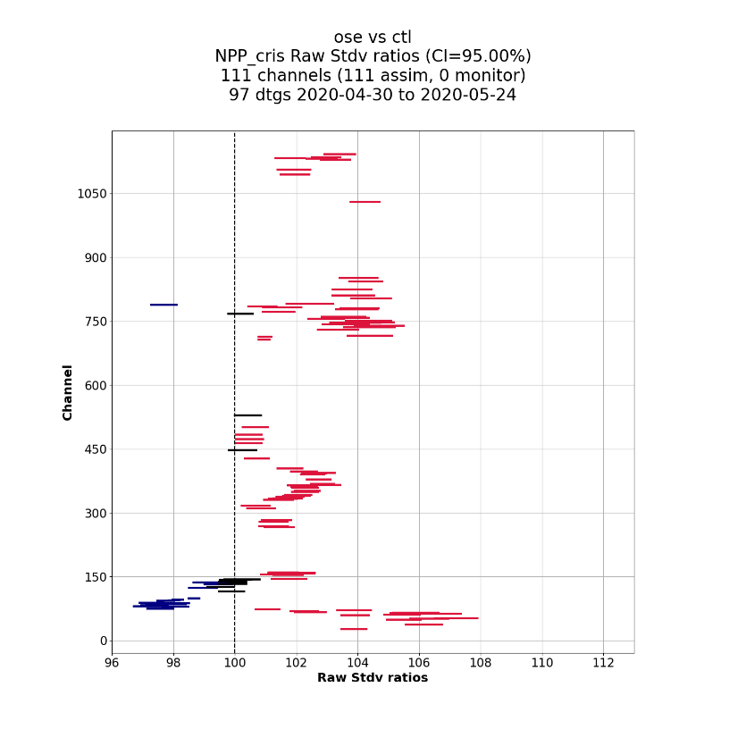
Fits to radiance
NPP ATMS
NPP CrIS
Verification period: 04/30/2020 – 05/24/2020
Percent change in the standard deviation of the innovation due to denying POES legacy data.
Significantly worsen the standard deviations of the innovations for almost all channels of ATMS and CrIS
Denial worse
Denial worse

Slide 18
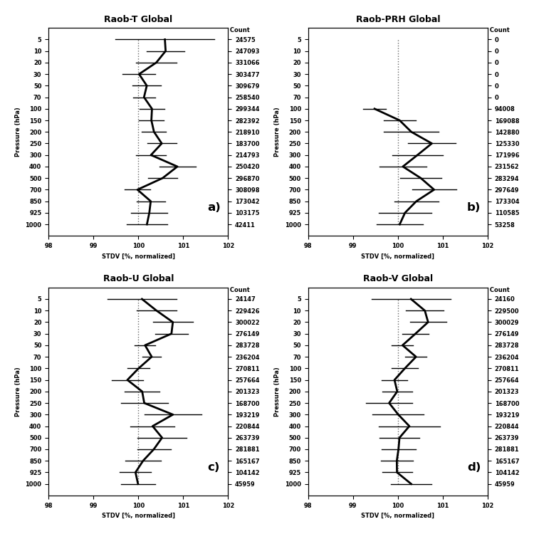
Fits to radiosonde
Percent change in the standard deviation of the innovation for the fit to radiosonde data denying POES and DMSP legacy data.
Though signal is not as strong as for ATMS or CrIS it does degrade for all variables.
Significant degradations:
temperature between 500 and 200 hPa
moisture between 700 and 500 hPa and some at 250 mb level
winds between 70mb and 10mb
Denial worse
Denial worse

Slide 19
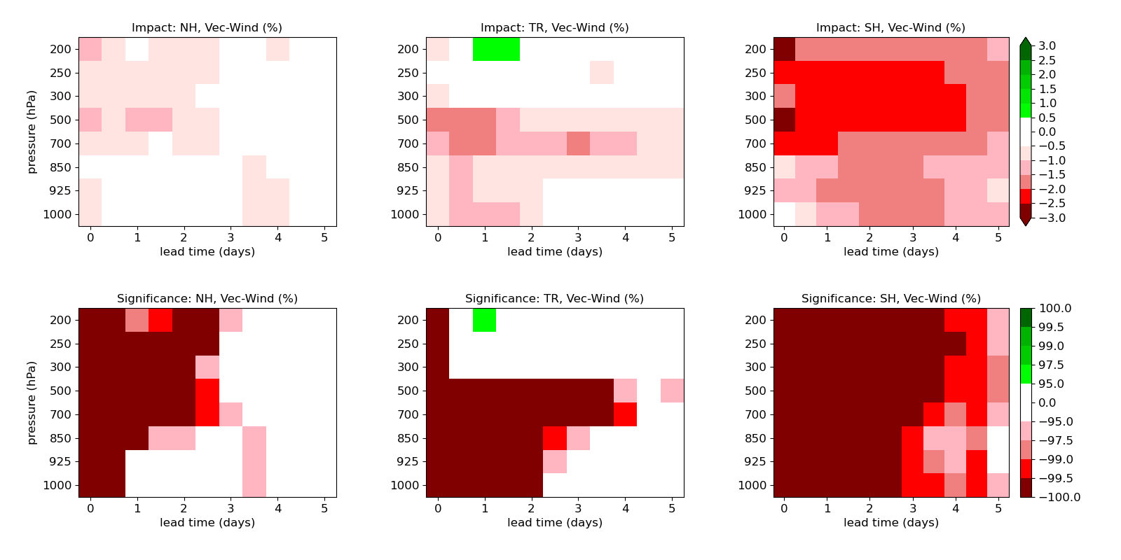
Verified vs ECMWF
Top panel: Impact (%)
Btm panel: significance(%)
Verification period: 04/01/2020 – 05/27/2020
Precipitable water
Vector winds
NH
TR
SH
NH
TR
SH
Pressure
Lead time
Impact: green-> deny experiment performs better than control; red-> deny experiment performs worse than control
Significance: colors indicates at least 95% statistical significance for the impact
When ECMWF-verified, denying POES data shows significant degradations for global precip. Water and vector winds

Slide 20
NRL Summary
Denying POES legacy data leads to significant degradations in the five-day forecasts of several key model variables at nearly all the model levels.
When verified against ECMWF analysis, significant degradations for winds and precipitable water at nearly all the model levels during the five-day forecasts were seen.
When verified against global radiosondes, significant degradations for winds and temperature at all the vertical levels during the five-day forecasts were seen.
Anomaly correlations for geop. heights at all the model levels have little change in NH, but have very noticeable drops in SH because of the removal of POES data.
The fit of background to the observations indicates worsening the standard deviations of the innovations for a number of existing sensors, particularly almost all the channels of ATMS, AMSUA, MHS and CrIS, as well as radiosondes.

Slide 21
GMAO Results

Slide 22
GEOS-5 Verification March 20
Score cards comparing
ERA5-verified (left) and
RAOB-verified (right) for up
to 5-day forecasts from
control and Data Denial
experiment (no POES).
ERA5-verified results show
clear deterioration in RMS
and COR in most variables,
levels and regions, esp. up
to about 3 days into fcst.
RAOB-verified results show
clear deterioration where
RAOBs are plenty – NHE –
esp. up to 3 days into fcst;
confirming std-dev comps
shown earlier.
ERA5 Verified
Radiosonde Verified

Slide 23
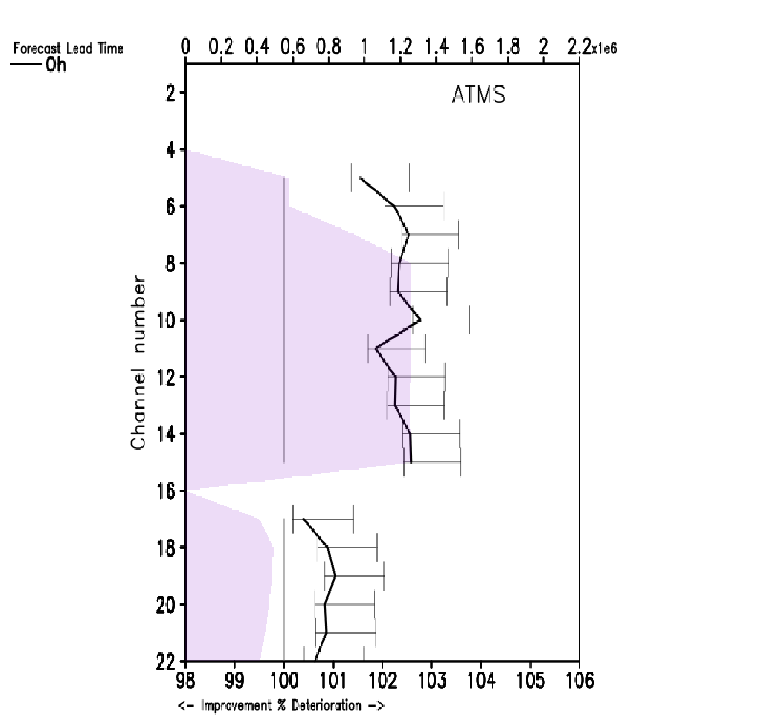
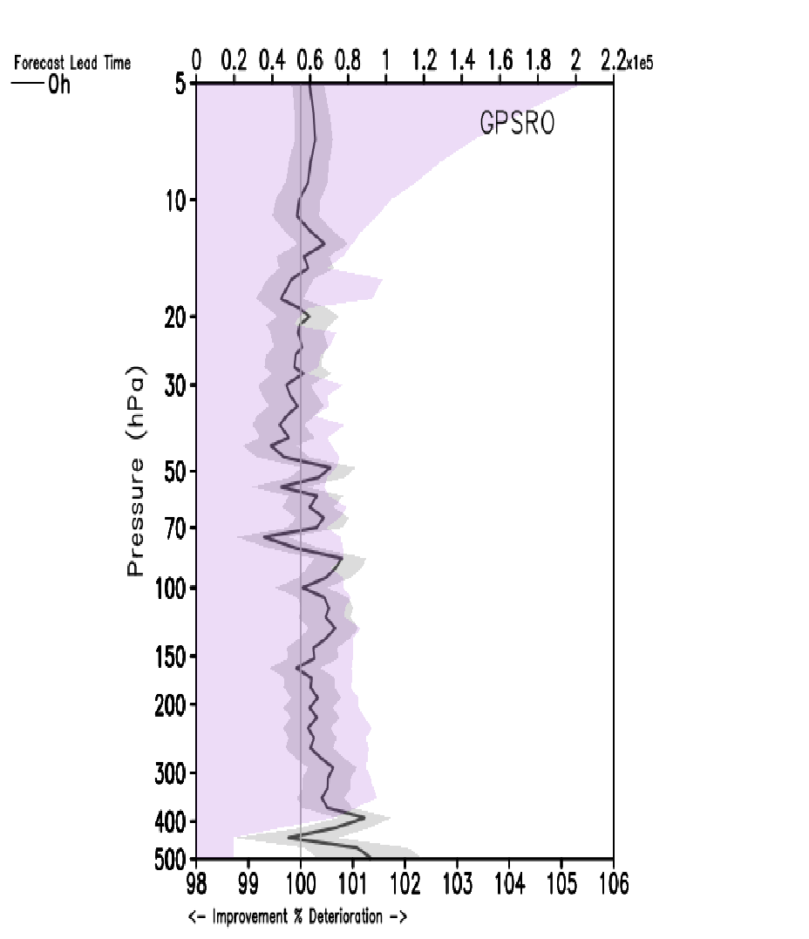
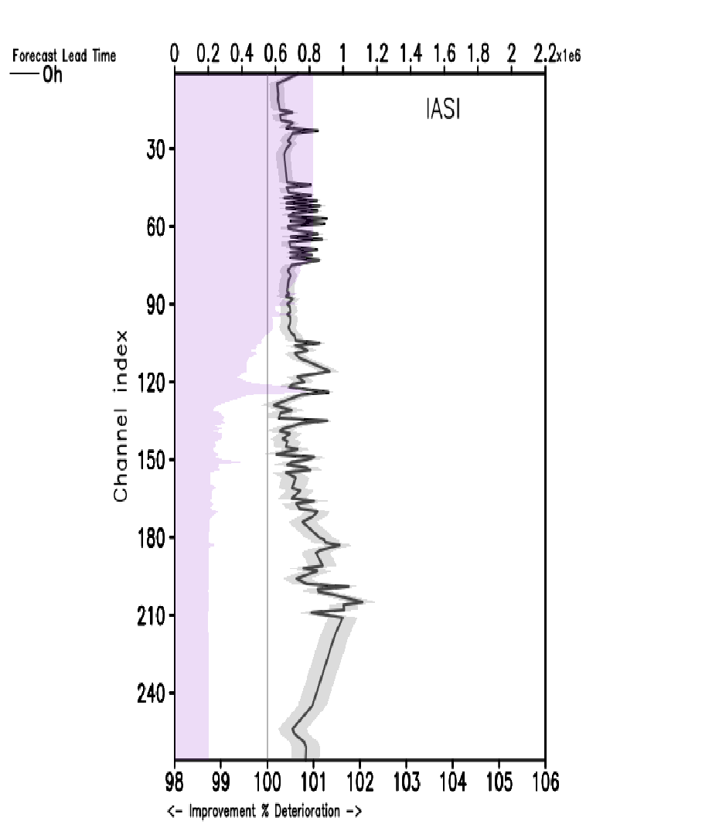
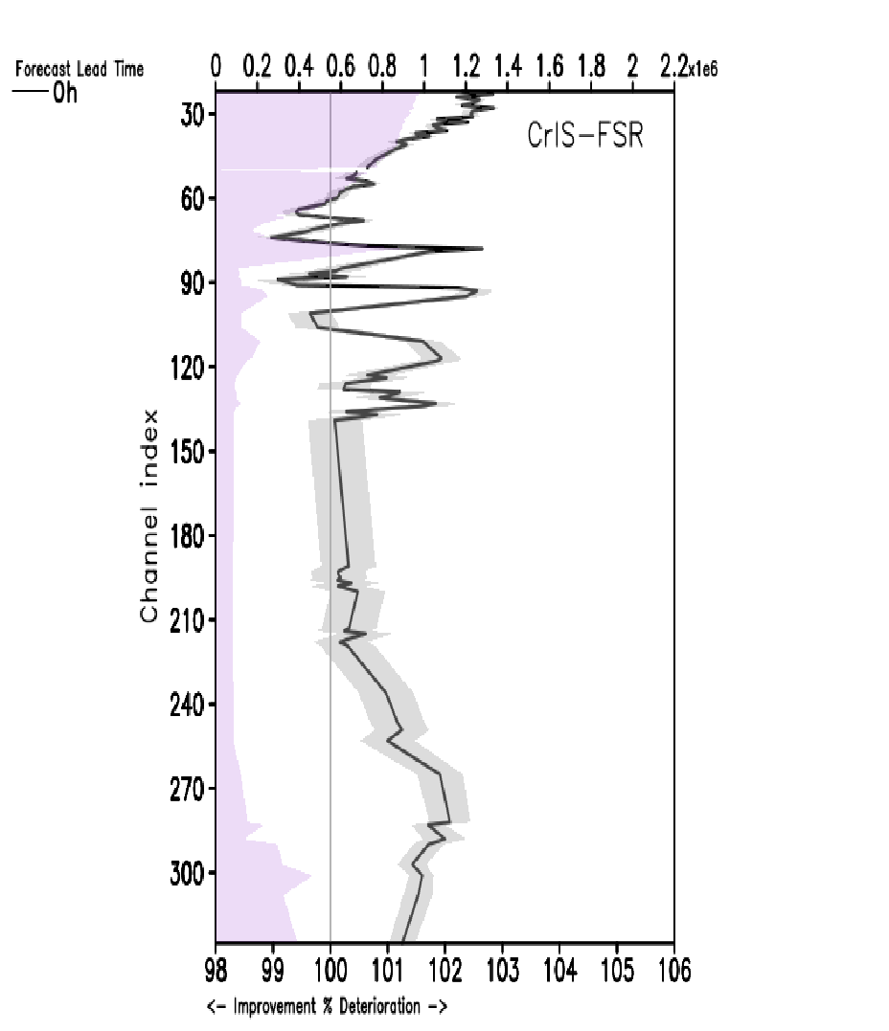
Fits to radiance
ATMS
GPSRO
Below: Data denial experiment seems to result
in significant deterioration in assimilation of
hyperspectral IASI and CrIS instruments.
IASI
CrIS-FSR
Above: All ATMS channels show significant
deterioration in data denial experiment in all
used channels. GPSRO give mixed results;
hardly significant.

Slide 24
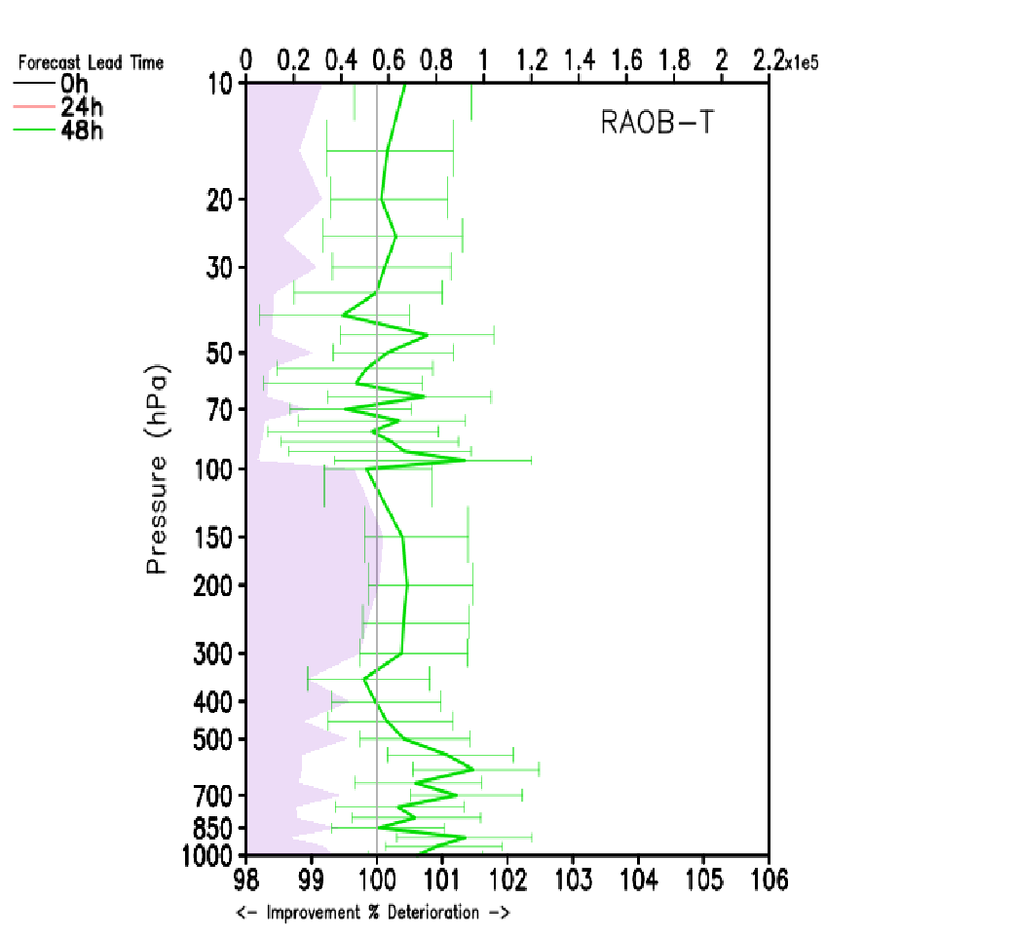
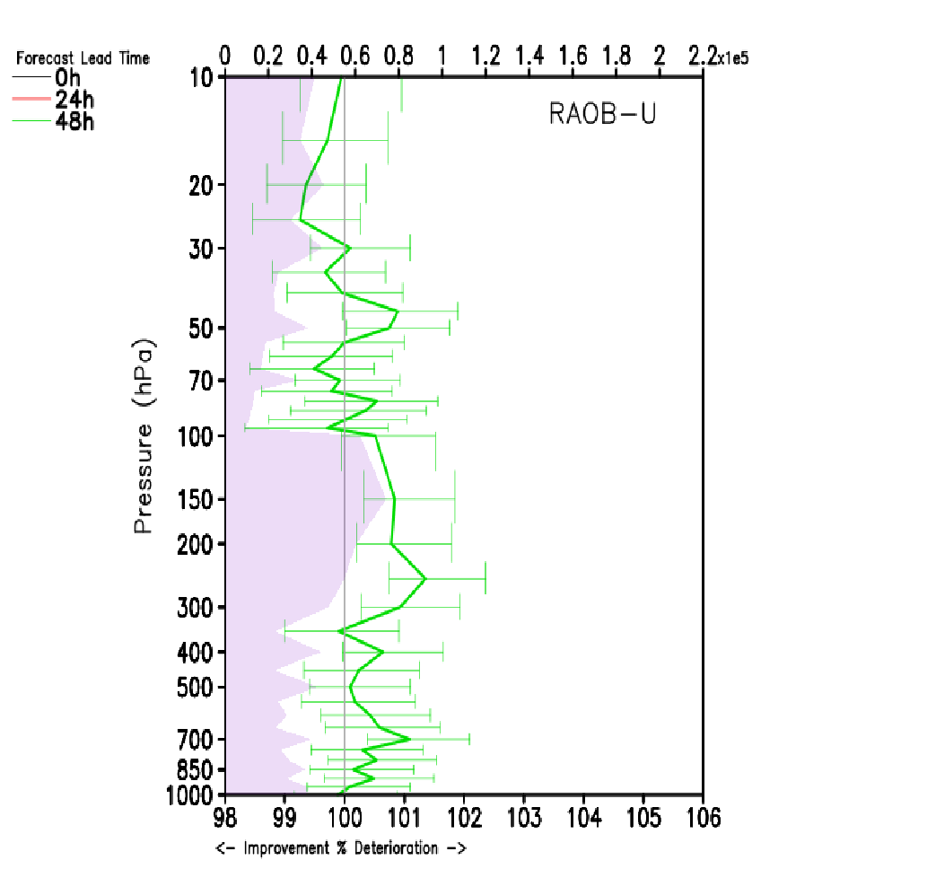
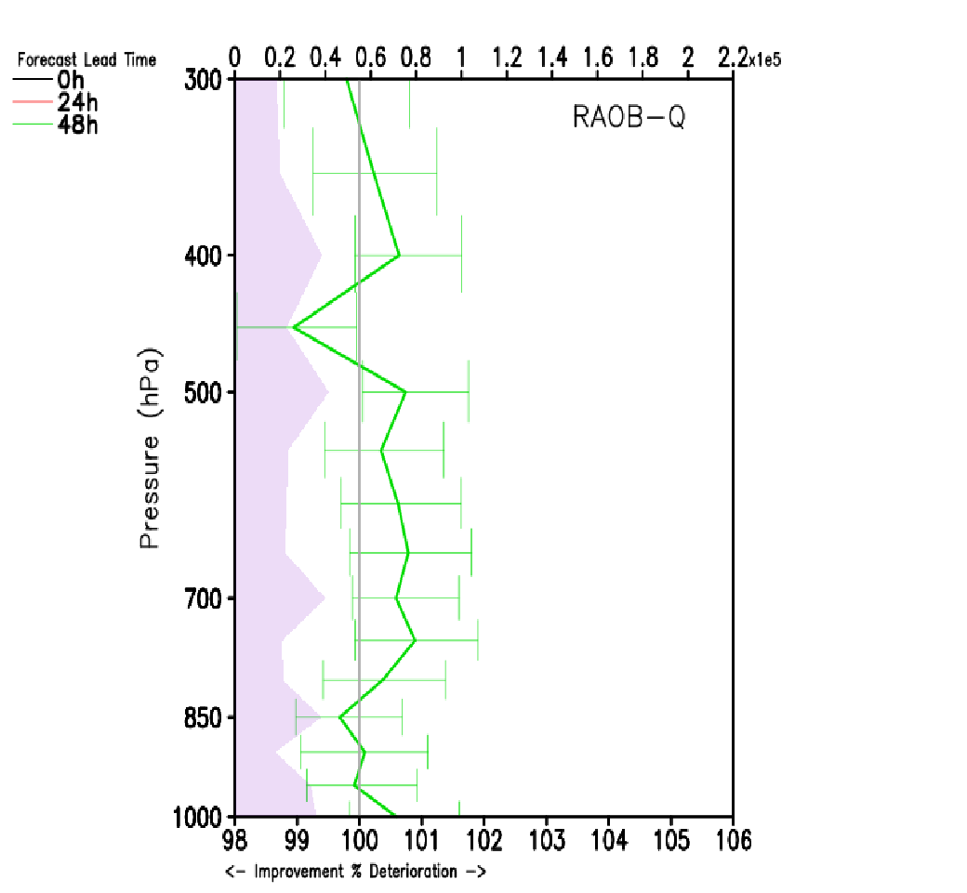
48-h fits to radiosonde
Temperature
U-Wind
Water Vapor
Forecast fit to radiosonde observations shows deterioration up to 48 hours forecast

Slide 25
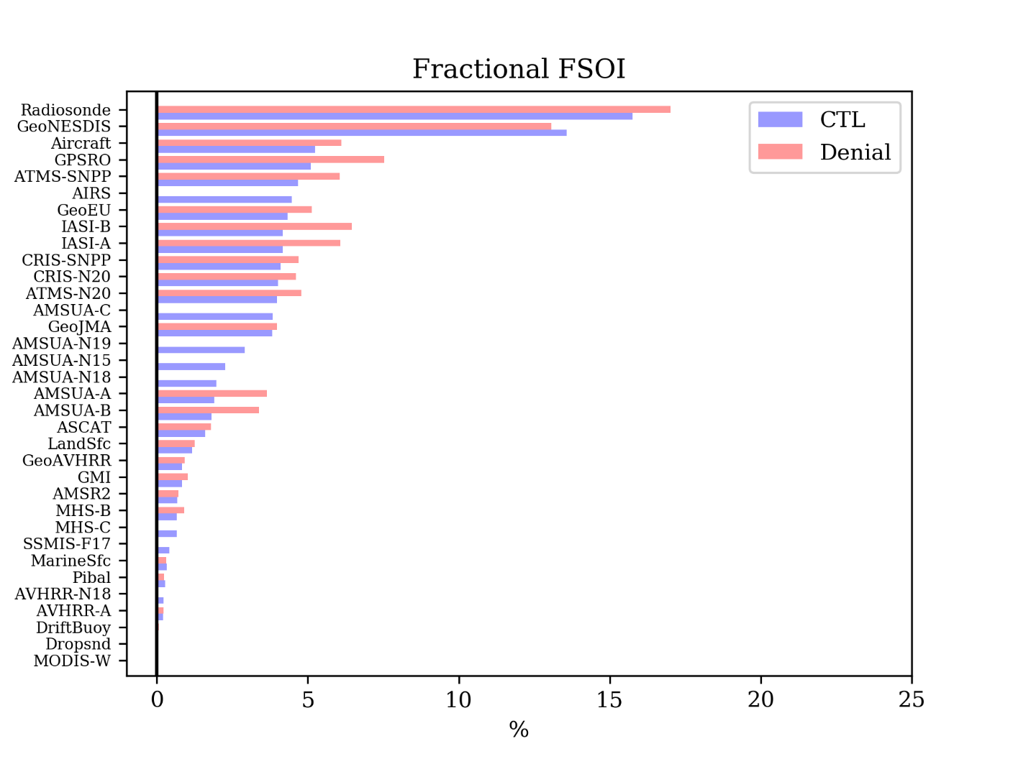
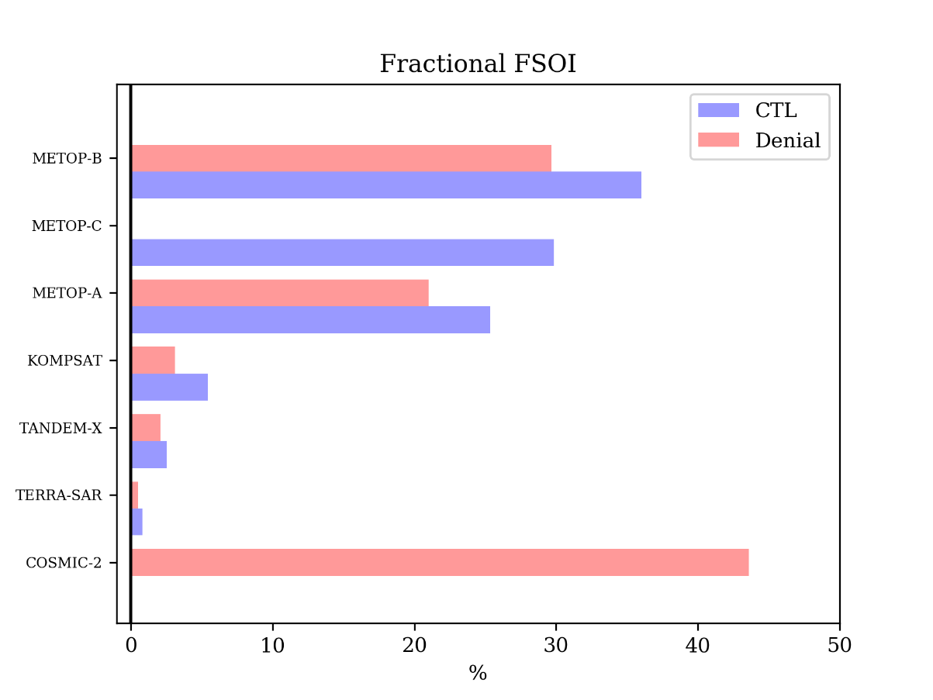
FSOI

Slide 26
GMAO Summary
Forecast skill score shows:
CTL evaluation suggests dramatic deterioration in predictive skills
Evaluation against independent analyses suggest data denial EXP to have significant drop in early to mid-period of 5-day forecast
Deterioration of fits to observations significant up to 48-h forecast
O-B deterioration in range of 0.5% - 2% for most instruments

Slide 27
Overall Summary
All regional and global data denials show significant degradation in various forecast parameters verified against several referenes
In some cases it is demonstrated that other components of the satellite GOS can partially compensate for loss of legacy POES, but significant negative impacts remain
Addition of COSMIC-2 may help compensate for loss of POES data in some regions
Continued efforts are ongoing (diurnal variation, TC impacts)

Slide 28
BACKUP

Slide 29
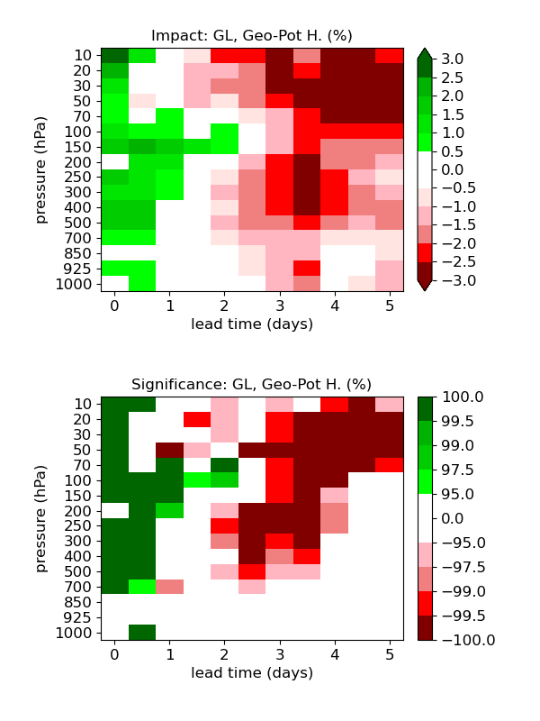
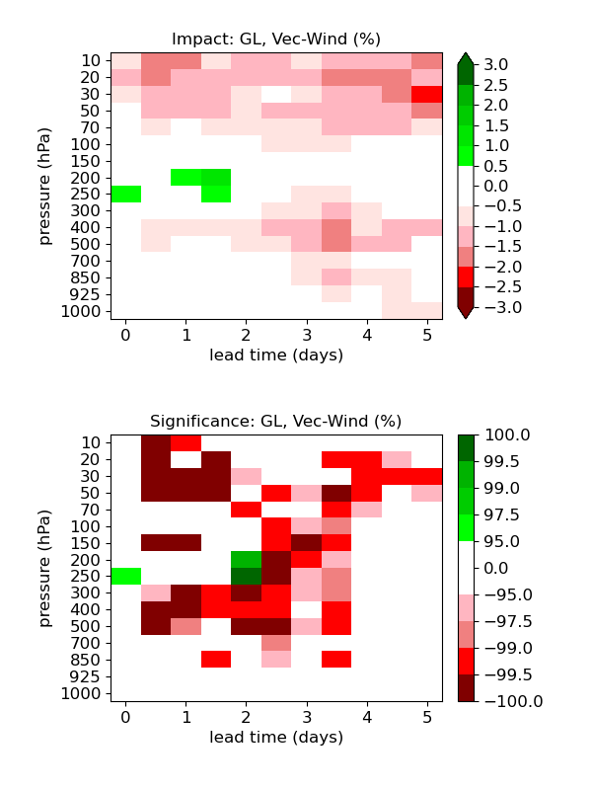
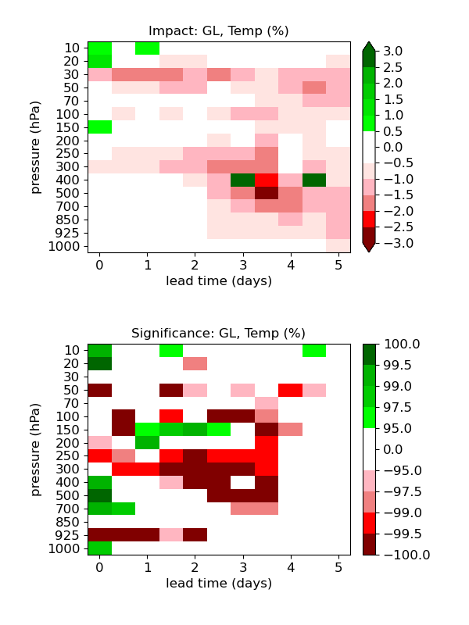
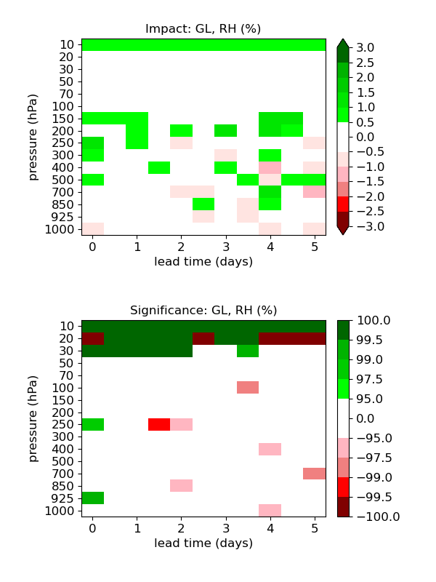
Verification against Global Radiosonde
Verification period: 04/01/2020 – 05/27/2020
Geopotential height
Vector winds
Temperature
RH

Slide 30
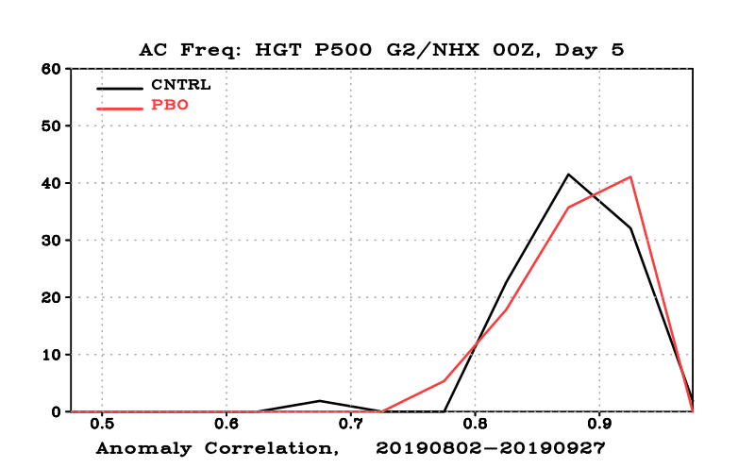
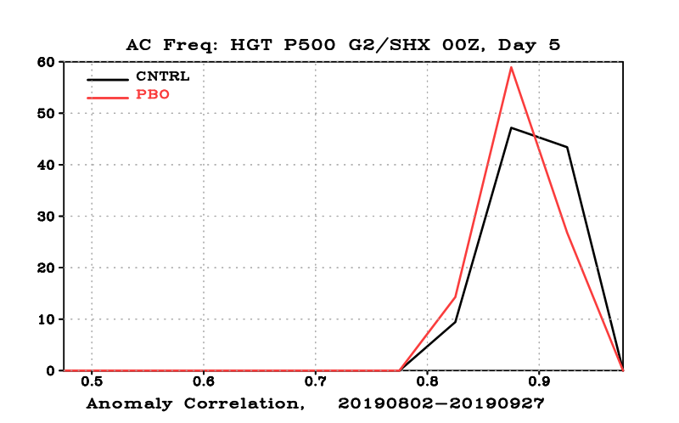
Dieoff curve Anomaly Correlation for HGT 500 hPa for NH and SH and their histograms for forecast day 5
PBO with respect to Control verified against ECMWF analysis

Slide 31
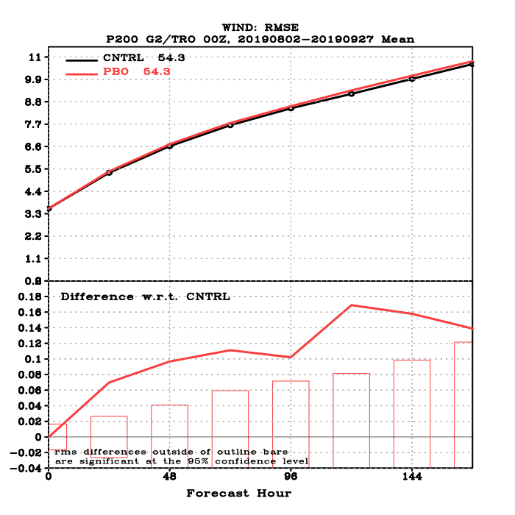
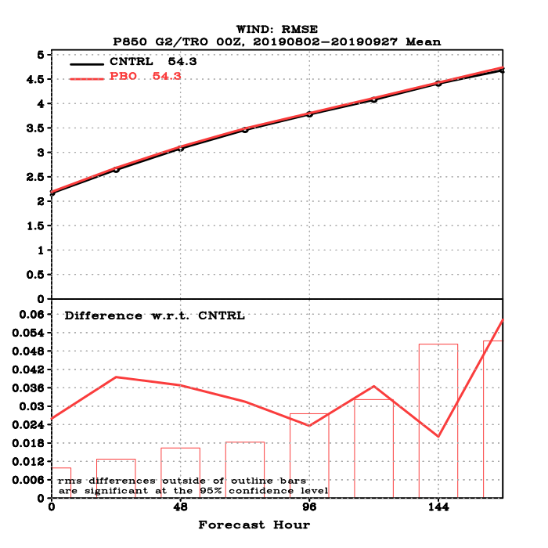
Dieoff Curve: RMS for Wind at 200 and 850 hPa for Tropics
PBO with respect to Control verified against ECMWF analysis

Slide 32
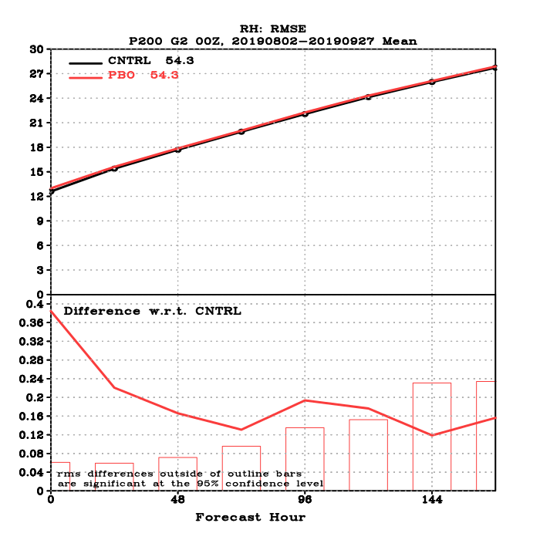
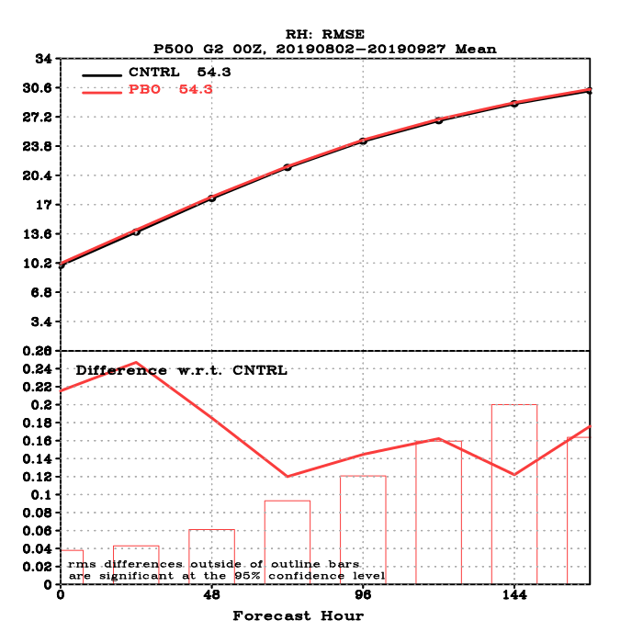
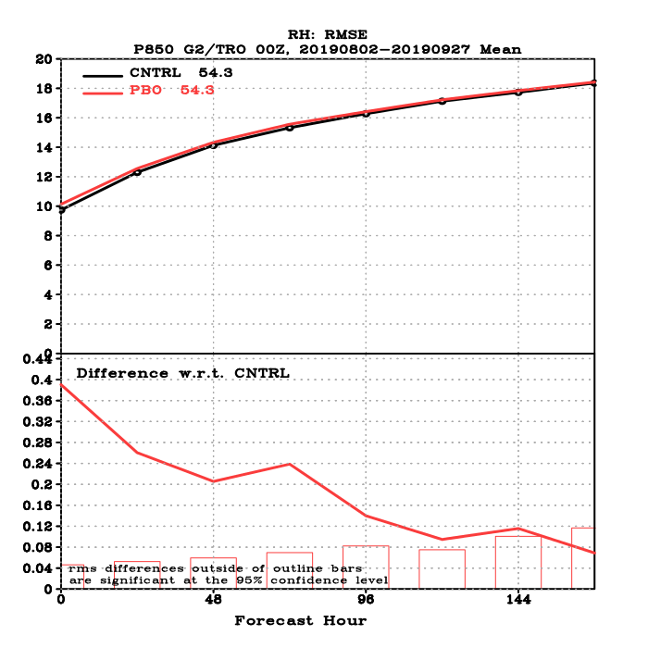
Dieoff Curves: RMS for RH at 200, 500, and 850 hPa Global
PBO with respect to Control verified against ECMWF analysis

Slide 33
Normalized (MinMax) for the two experiments
over one month for:
AC,RMSE,MAE
0h,24h,48h,72h,96h,120h,144h,168h
NHX,SHX,Tropics
HGT,T,Wind,RH
Levels: 250,500,700,850,1000

Slide 34
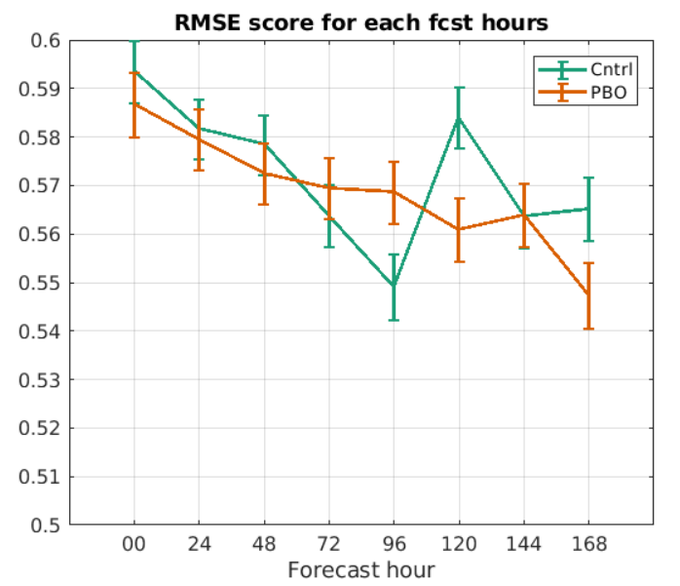
RMSE score:
Averaged HGT, T, RH, Wind at 250, 500, 850 for NH, TRO, and SH
Normalized (MinMax) at each forecast lead time separately for each experiment

Slide 35
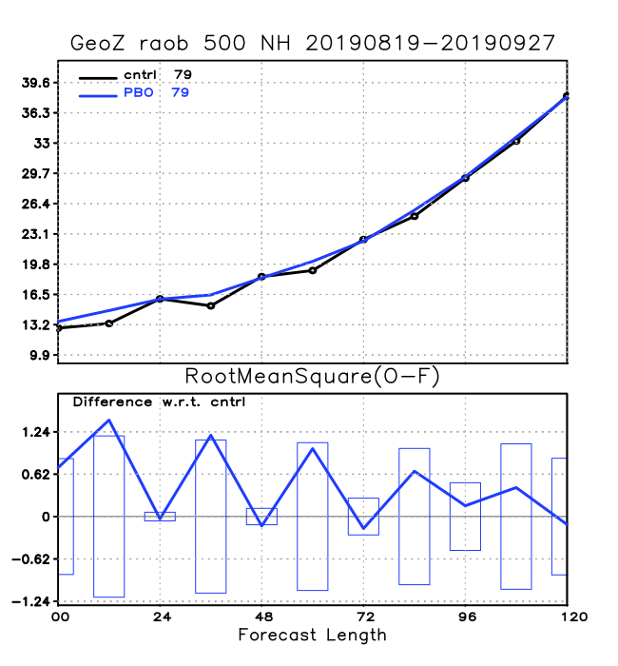
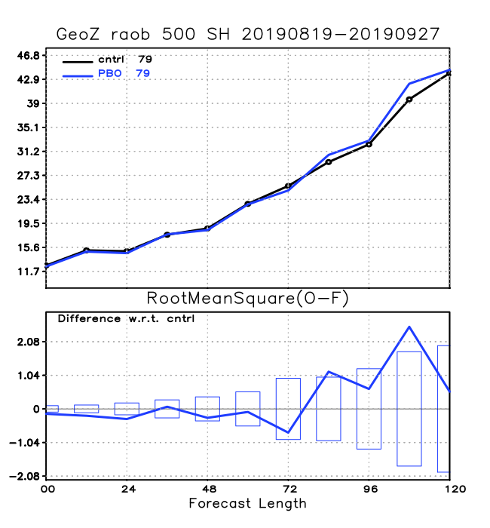
RMS Dieoff curves verified against Radiosonde obs.
HGT at 500 hPa for NH and SH

Slide 36
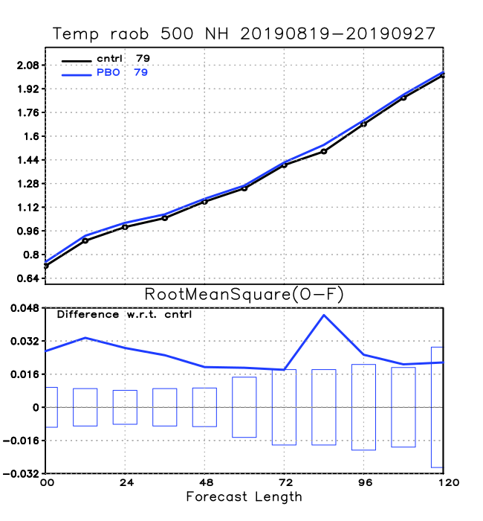
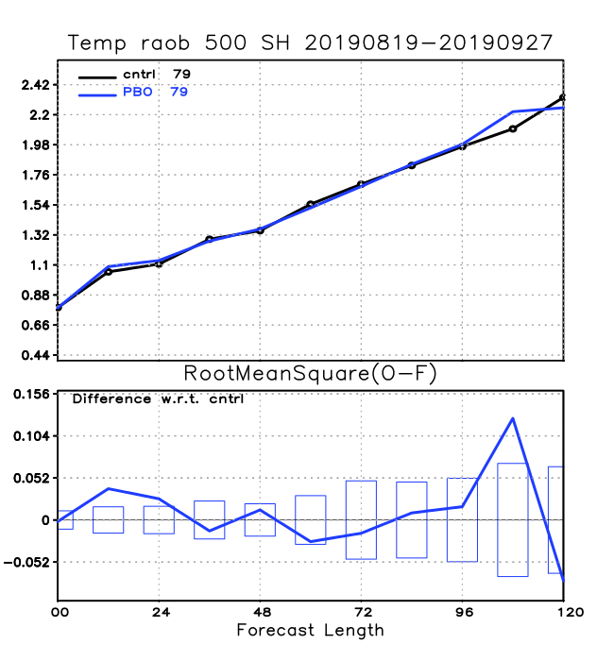
RMS Dieoff curves verified against Radiosonde obs.
Temperature at 500 hPa for NH and SH

Slide 37
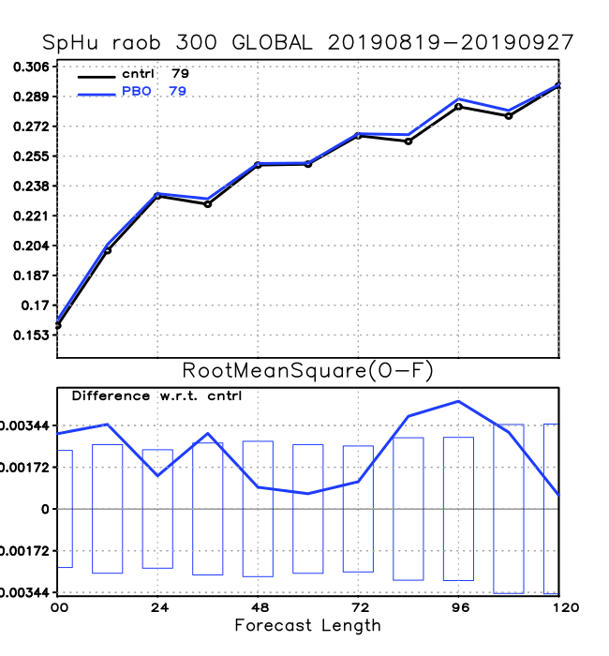
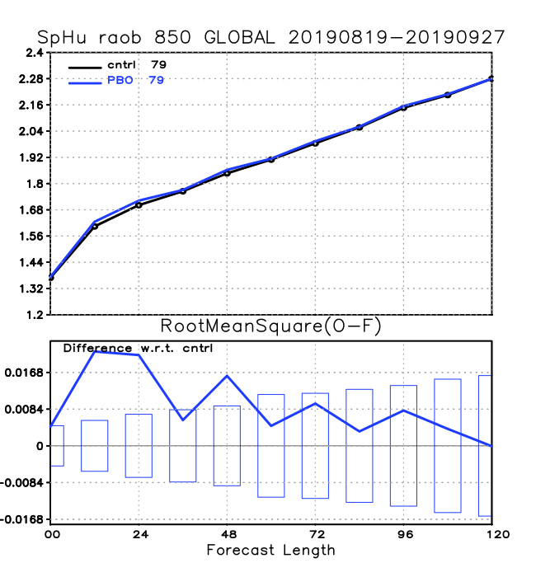
RMS Dieoff curves verified against Radiosonde obs.
Specific Humidity at 300 and 850 hPa global

Slide 38
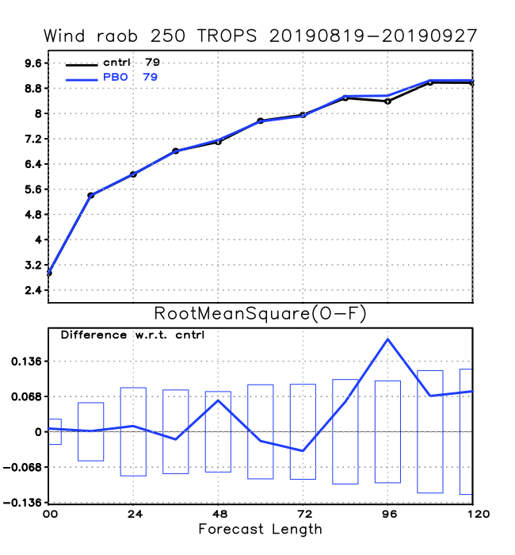
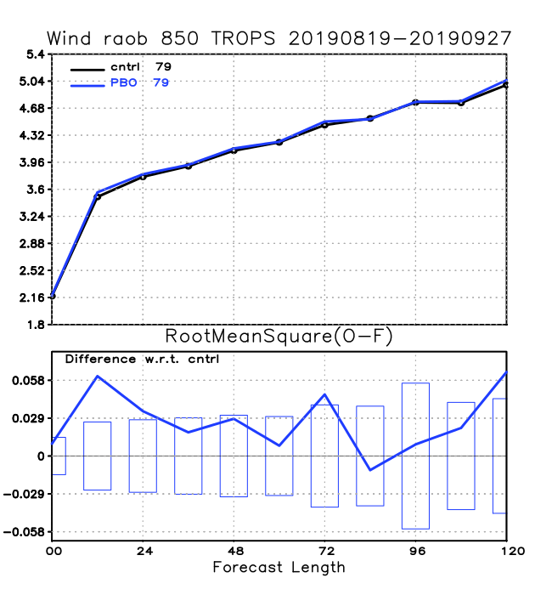
RMS Dieoff curves verified against Radiosonde obs.
Wind at 200 and 850 hPa for Tropics

Slide 39
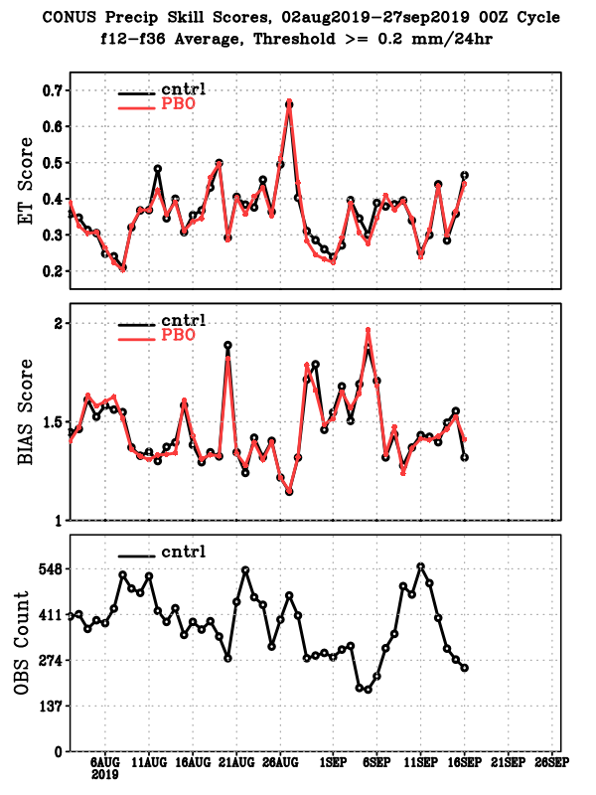
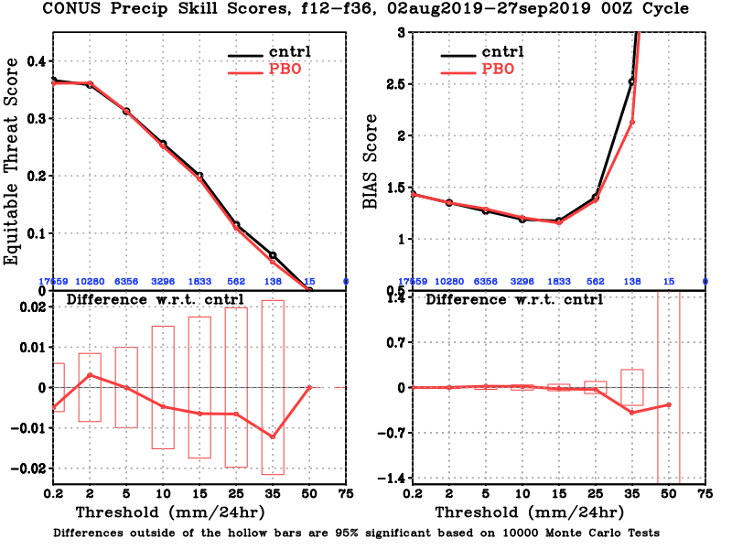
CONUS precip skill score for forecast hours: 12-36

Slide 40
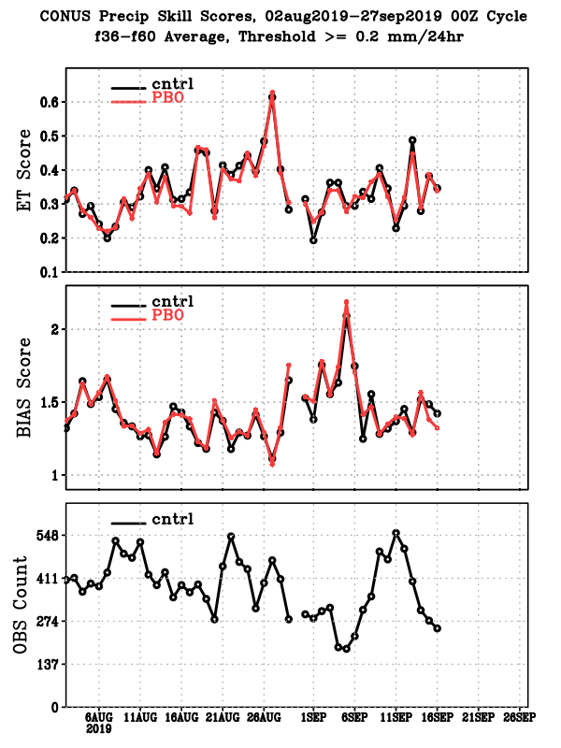
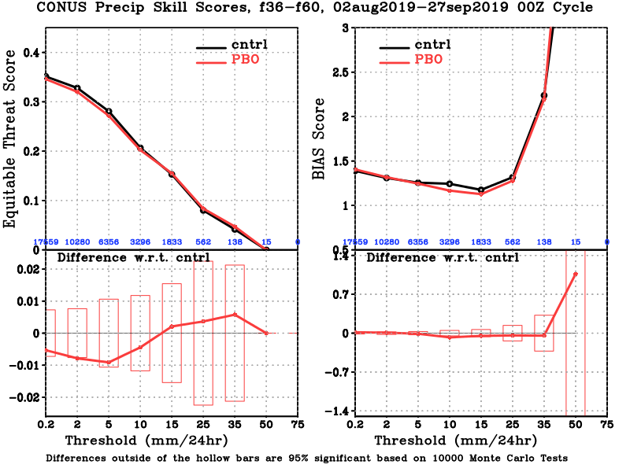
CONUS precip skill score for forecast hours: 36-60

Slide 41
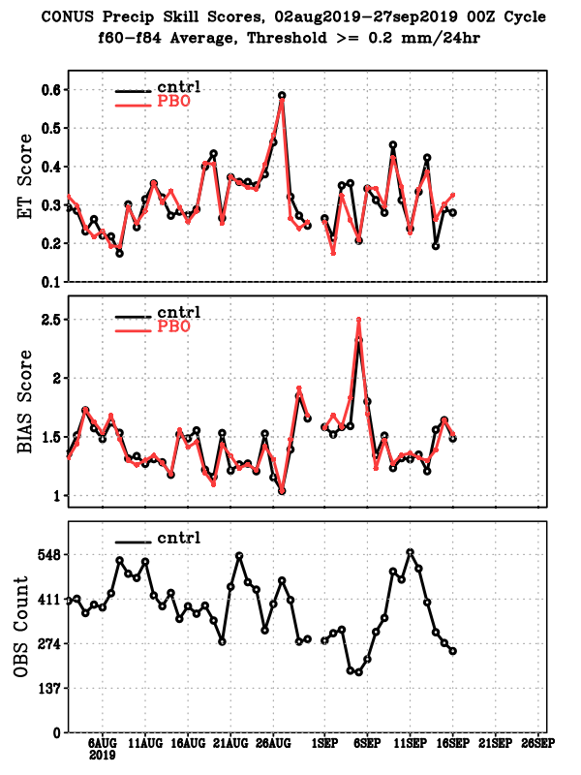
CONUS precip skill score for forecast hours: 60-84

Slide 42
Dorian 2019
Forecasted on August 29th
Assessing impact on hurricane forecast

Slide 43
Dorian 2019
Forecasted on August 30th
Assessing impact on hurricane forecast

